Slide 1
A practice testimony on the implementation of information security and data protection at the Crossroads Bank for Social Security and the eHealth platform

Slide 2
Outline
Context
  Crossroads Bank for Social Security
  eHealth platform
Holistic vision on information security and data protection
Some concrete measures
  structural and institutional measures
    overview
    Information Security Committee
  organizational measures
    Information Security Department and DPO
    minimal information security standards
    Data Protection Impact Assessment (DPIA)
    unique file
  technical measures
    integrated user and access management (UAM)
    circles of trust
Conclusion

Slide 3
Context – CBSS
Stakeholders of the Belgian social sector
  > 11,370,00 citizens
  > 220,000 employers
  about 3,000 public and private institutions (actors) at several levels (federal, regional, local) dealing with
    collection of social security contributions
    delivery of social security benefits
      child benefits
      unemployment benefits
      benefits in case of incapacity for work
      benefits for the disabled
      re-imbursement of health care costs
      holiday pay
      old age pensions
      guaranteed minimum income
    delivery of supplementary social benefits
    delivery of supplementary benefits based on the social security status of a person

Slide 4
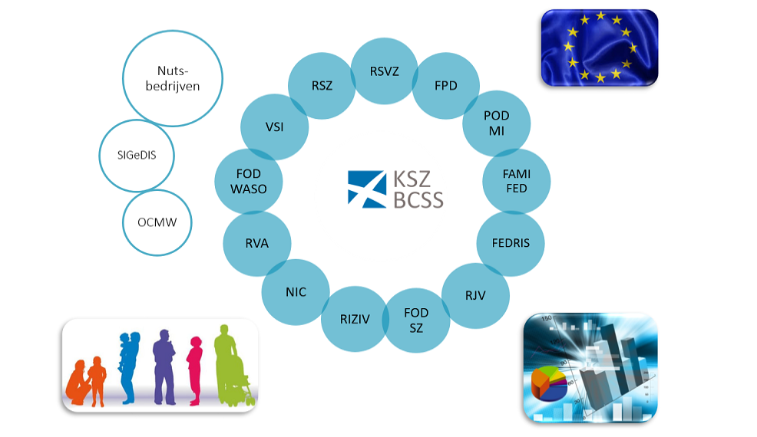
Context – CBSS
Enterprises of public interest

Slide 5
Context – CBSS
A network between all 3,000 social sector actors with a secure connection to the internet, the federal MAN, regional extranets, extranets between local authorities and the Belgian interbanking network
A unique identification key
  for every citizen
  for every company
  for every establishment of a company
An agreed division of tasks between the actors within and outside the social sector with regard to unique collection, validation and management of information and with regard to electronic storage of information in authentic sources

Slide 6
Context – CBSS
220 electronic services for mutual information exchange amongst actors in the social sector, defined after process optimization
  nearly all direct or indirect (via citizens or companies) paper-based information exchange between actors in the social sector has been abolished
  in 2016, > 1,2 billion electronic messages were exchanged amongst actors in the social sector, which saved as many paper exchanges
Electronic services for citizens
  maximal automatic granting of benefits based on electronic information exchange between actors in the social sector
  22 electronic services via an integrated portal
  about 30 new electronic services are foreseen

Slide 7
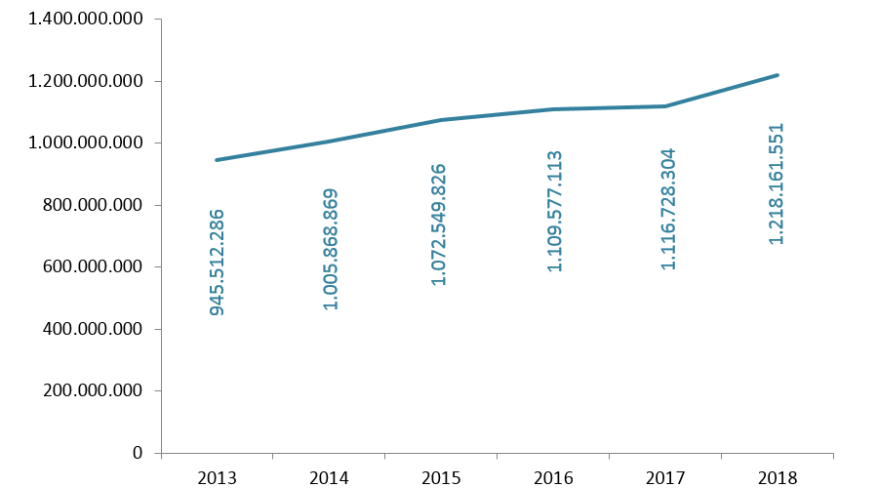
Context – CBSS
1.218.161.551 electronic messages were exchanged in 2018

Slide 8
Context – CBSS
More than 50 electronic services for employers, either based on the electronic exchange of structured messages or via an integrated portal site
  50 social security declaration forms for employers have been abolished
  in the remaining 30 (electronic) declaration forms the number of headings has on average been reduced to a third of the previous number
  declarations are limited to 3 events
    immediate declaration of recruitment and discharge (only electronically)
    quarterly declaration of salary and working time (only electronically)
    occurrence of a social risk (electronically or on paper)
  in 2018, more than 25 million electronic declarations were made by all 220,000 employers, 98 % of which from application to application

Slide 9
Context – CBSS
An integrated portal site containing
  electronic transactions for citizens, employers and professionals
  simulation environments
  information about the entire social security system
  harmonized instructions and information model relating to all electronic transactions
  a personal page for each citizen, each company and each professional
An integrated, multimodal contact centre supported by a customer relationship management tool
A data warehouse containing statistical information with regard to the labour market and all branches of social security

Slide 10
Context – CBSS
Reference directory
  directory of available services/information
    which information/services are available at any actor depending on the capacity in which a person/company is registered at each actor
  directory of authorized users and applications
    list of users and applications
    definition of authentication means and rules
    definition of authorization profiles: which kind of information/service can be accessed, in what situation and for what period of time depending on in which capacity the person/company is registered with the actor that accesses the information/service
  directory of data subjects
    which persons/companies have personal files at which actors for which periods of time, and in which capacity they are registered
  subscription table
    which users/applications want to automatically receive what information/services in which situations for which persons/companies in which capacity

Slide 11
Context – CBSS – advantages
Gains in efficiency
  in terms of cost: services are delivered at a lower total cost
    according to a study of the Belgian Planning Bureau, rationalization of the information exchange processes between the employers and the social sector implies an annual saving of administrative costs of about 1,7 billion € a year for the companies
  in terms of quantity: more services are delivered
    services are available at any time, from anywhere and from several devices
    services are delivered in an integrated way according to the logic of the customer
  in terms of speed: the services are delivered in less time
Gains in effectiveness: better social protection
  in terms of quality: same services at same total cost in same time, but to a higher quality standard
  in terms of type of services: new types of services, e.g.
    push system: automated granting of benefits
    active search of non-take-up using data warehousing techniques
    personalized simulation environments
Better support of social policy
More efficient combating of fraud

Slide 12
Context – eHealth platform
Stakeholders of the Belgian health sector
  > 11,370,000 citizens
  > 100.000 healthcare providers (physicians, dentists, clinical labs, pharmacists, physiotherapists, home nurses, …)
  > 300 health care institutions (hospitals, rest and care homes, …)
  sickness funds
  public institutions
    federal level (Ministry of Public Health, National Institute for Health and Disability Insurance (RIZIV - INAMI), Federal Agency for Medicines and Health Products, …)
    regional level

Slide 13
Context – eHealth platform
eHealth platform is a public institution whose mission is
  to promote and support a well-organised, electronic information exchange among all actors in the (health) care sector
  with necessary guarantees related to
    information security
    protection of the personal data of the patients and the health care providers
    professional secrecy
By doing this, the eHealth platform
  optimises the quality and continuity of health care provision
  optimises patient safety
  simplifies the administrative formalities for all (health) care actors
  (pro-)actively supports health care policy making and evaluation

Slide 14
Context – eHealth platform: 10 tasks
Developing a vision and of a strategy regarding eHealth
Being the motor of the necessary changes for the implementation of the vision and the strategy regarding eHealth
Organizing the cooperation between all governmental institutions charged with the coordination of electronic service provision
Determining functional and technical norms, standards, specifications and basic architecture with regard to eHealth
Registering software for the management of electronic patient files

Slide 15
Context – eHealth platform: 10 tasks
Managing and coordinating the ICT aspects of information exchange with regard to electronic patient files and electronic care prescriptions
Conceiving, designing and managing a cooperation platform for secure information exchange with relevant basic services
Reaching agreements about division of tasks and about quality standards, and checking that the quality standards are being fulfilled
Acting as an independent trusted third party (TTP) for the encoding and anonymization of personal information regarding health
Promoting and coordinating programmes and projects

Slide 16








Context – eHealth platform: architecture
Patients, health care providers
and health care institutions
Site Ministry
Software health care professional
Software health care institution
VAS
Site RIZIV
VAS
eHealth-portal
MyCareNet
VAS
VAS
VAS
users
Basic services
eHealth-platform
Network
AS
AS
AS
AS
AS
AS
Suppliers
Notes:
16
16

Slide 17
Context – eHealth platform: basic services
Coordination of the electronic processes
Portal
Integrated user and access management system
Management of loggings
System for end-to-end encryption
eHealthBox
Timestamping
Coding and anonymising
Consultation of National register and CBSS registers
Reference directories (hub-metahub system)

Slide 18
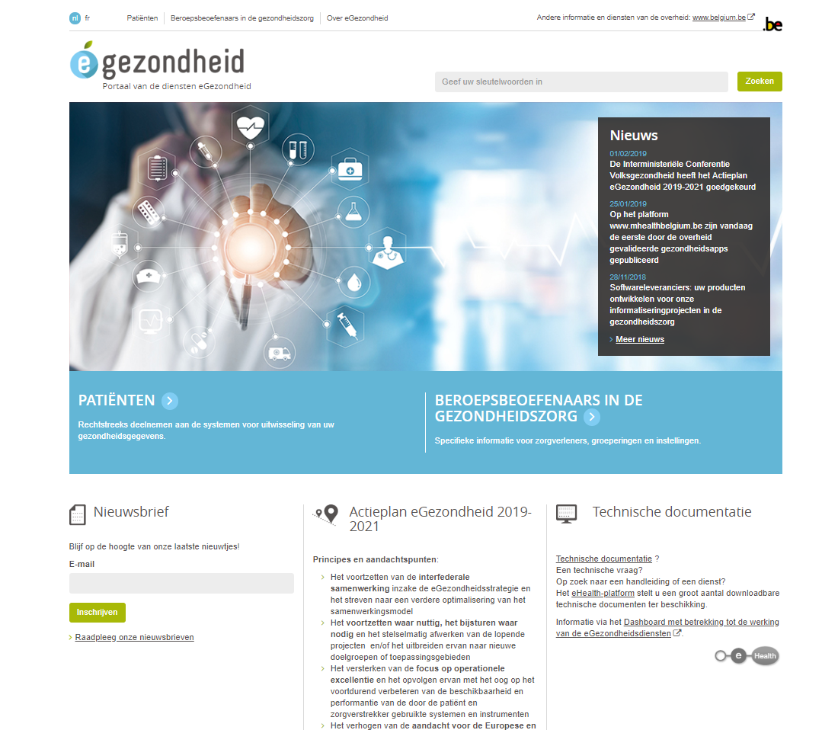
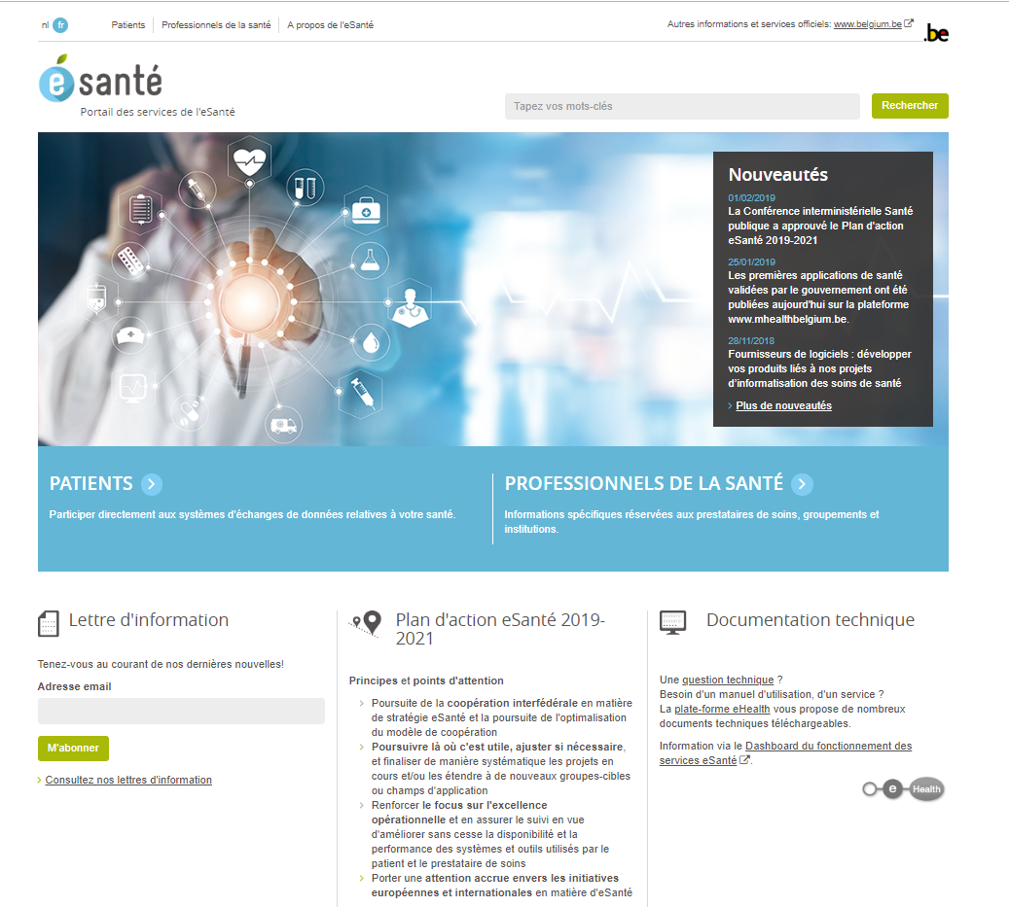

Slide 19
Context – eHealth platform
The sharing of data between healthcare providers / institutions via the hub-meta-hub system, the health safes and the eHealthBox reaches cruising speed: > 13,3 billion transactions in 2018
> 75% of the Belgian population has now given their informed consent to electronically exchange information
The opening up of health information for the patient has started
Experience is gained with mobile eHealth applications

Slide 20
Vision on information security
Security, availability, integrity and confidentiality of information is ensured by integrated structural, institutional, organizational, HR, technical and other security measures, according to agreed policies
Personal information is only used for purposes compatible with the purposes of the collection of the information
Personal information is only accessible to authorized actors and users according to business needs, legislative or policy requirements
The access authorization to personal information is granted by an Information Security Committee, designated by Parliament, after having checked whether the access conditions are met
The access authorizations are public

Slide 21
Vision on information security
Within the social sector, every actual electronic exchange of personal information has to pass an independent trusted third party (CBSS) and is preventively checked on compliance with the existing access authorizations by that trusted third party
Every actual electronic exchange of personal information is logged, to be able to trace possible abuse afterwards
Within the social sector, every time information is used to take a decision, the information used is communicated to the person concerned together with the decision
Every person has the right to access and correct his/her own personal data
Every actor in the social sector and every health institution disposes of an data protection officer with an advisory, stimulating, documentary and control task

Slide 22
Structural and institutional measures
No central data storage
Availability of free of charge, basic information security services
  user- & access management
  encryption
  logging
  reference directories
  …
Independent Information Security Committee designated by the Parliament
Within the social sector, a preventive control of the legitimacy of personal data exchange by CBSS according to the authorizations of the independent Information Security Committee

Slide 23
Information Security Committee (ISC)
Not a supervisory authority as defined by GDPR
Set up by law of September 5th 2018
Composition
  Chamber Social Security and Health
  Chamber Federal Government
  independent members designated by Parliament
Tasks
  delivering deliberations with normative value (=> legal certainty for the data controllers) regarding
    the exchange of personal data
    the processing of pseudonymized and anonymous data
  retaining and publishing of deliberations
  defining good practices
  supporting DPOs
  publishing a yearly activity report

Slide 24
Considerations in the deliberations
Lawfullness and purpose limitation
  is the processing serving a legitimate purpose?
  are the purposes of the processing well defined ?
Data minimization
  is the processing using the minimal dataset to achieve the purposes ?
  storage limitation
Integrity and confidentiality
  measures on how to guarantee both parameters
Transparency for the data subjects

Slide 25
Organizational measures
Information security department headed by DPO with each actor in the social sector and each health care institution
Specialized information security service providers
Need for compliance with minimal information security and data protection standards (Minimale normen / Normes minimales)
Information security working parties developing information security policies
Data Protection Impact Assessments (DPIA)
Unique file (dossier unique / uniek dossier)

Slide 26
Organizational measures
Yearly assessment of compliance with minimal security standards
  questionnaire sent out to all institutions connected to the CBSS
  checked by the security service of the CBSS
  reviewed in the Information Security work group
Security requirements reviewed on regular basis
Internal audits with continuous improvement plans => independent auditor reporting on findings

Slide 27
Information Security Department
Legal obligation since 1990 !
  assignment of a DPO
  advices controller on privacy and security
  can be assigned additional tasks as long as this does not conflict with the mission of a DPO
Role of the information security department
  each institution has to set up a security department
    stimulates information security
    documents the information security related topics
    checks on compliance
    reports on information security and privacy
  the DPO the is head of the security department

Slide 28
Role of the DPO of CBSS/eHealth platform
Leads the security department of both CBSS and eHealth platform
All tasks as specified in article 39 of GDPR
Stimulates the elaboration of minimal security standards
Advises on GDPR compliance
  informs management and co-workers on compliance needs
  supports in setting up the record of processing
  participates in running the DPIA
  plans for regular review of the DPIA
Supports in information security incident and threat management
Plans internal audits

Slide 29
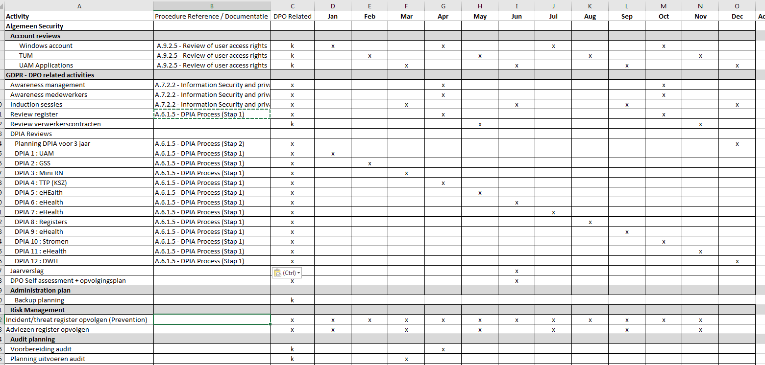
Role of the DPO
It is about ad hoc tasks…
  advice upon request
  incident management
… and planned works
  DPIA review planning
  check on registers
  …

Slide 30
Minimal standards
Developed by information security working parties => buy in !
Approved by the independent Information Security Committee
Based on ISO 27000 standards, adapted for social security and health care
Defines 15 areas of security
Enforced for all actors connected to the network of CBSS and, gradually, all health care institutions
Extended with policy guidelines
  minimal standards refer to policy guidelines for more detail
  policy guidelines provide support for concrete implementation

Slide 31
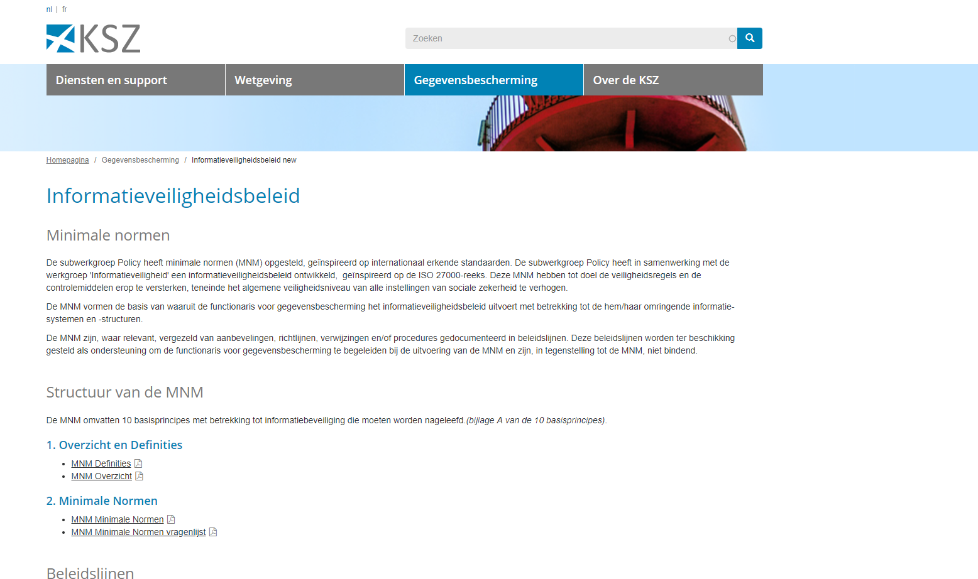
https://ksz.fgov.be/nl/gegevensbescherming/informatieveiligheidsbeleid

Slide 32
Topics covered by minimal information security standards
Basic principles
Information security policies
Organisation of information security
  internal organisation
  mobile equipment and remote working
Security measures for employees and co-workers
Management of company assets
Access control (logical)
Encryption
Physical security

Slide 33
Topics covered by minimal information security standards
Operations management
Protecting communications
Procurement, design, development and maintenance of systems
Supplier management
Incident management
Business continuity
Compliance

Slide 34
Minimal standards: data classification
5 levels of data sensitivity classification
  4 -> top secret
  3 -> secret, high classified
  2 -> confidential, classified
  1 -> unclassified, sensitive
  0 -> unclassified, public
Each type of data is linked to a sensitivity classification
  see next slide
Each type of classification has the data handling guidelines
  how to transport,
  use in test, development, acceptance,
  authentication level for access,
  ….

Slide 35
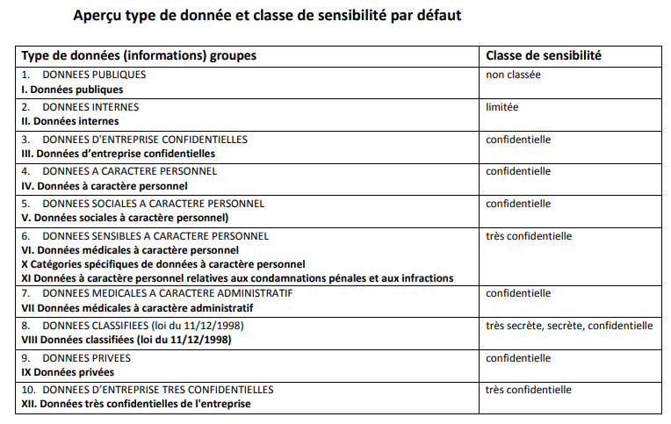
Minimal standards: data classification

Slide 36
Data Protection Impact Assessment (DPIA)
A Data Protection Impact Assessment (DPIA) is a process to help you identify and minimize the data protection risks
A DPIA must be completed for processing that is likely to result in a high risk to individuals; this includes some specified types of processing
It is also good practice to do a DPIA for any other major project which requires the processing of personal data
The DPIA must
  describe the nature, scope, context and purposes of the processing
  assess necessity, proportionality and compliance measures
  identify and assess risks to individuals
  identify measures to mitigate those risks

Slide 37
Data Protection Impact Assessment (DPIA)
To assess the level of risk, one must consider both the likelihood and the severity of any impact on individuals. High risk could result from
  a high probability of some harm
  a lower probability of serious harm
The DPIA should implicate the DPO and, where appropriate, individuals and relevant experts; any processors may also need to assist
If a high risk is identified, the supervisory authority must be implicated before starting the processing

Slide 38
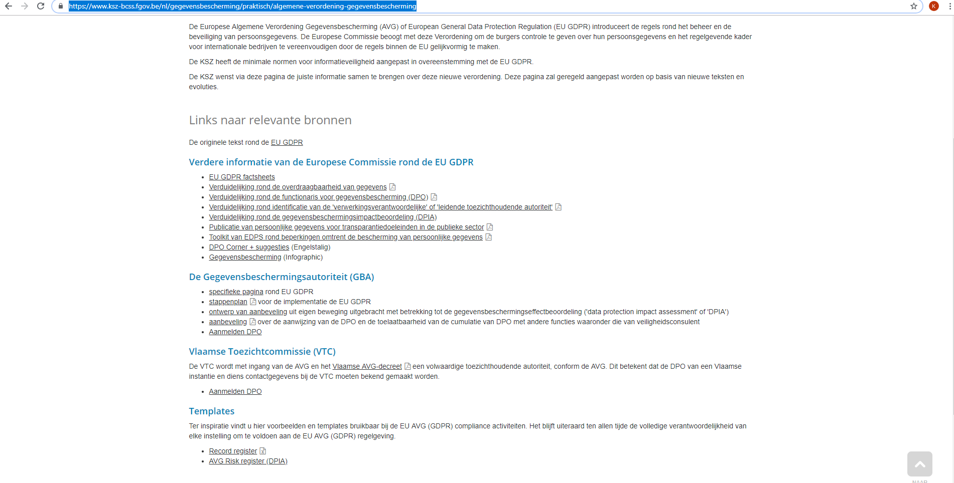
Executing the DPIA
CBSS has developed a template for executing the DPIA
https://www.ksz-bcss.fgov.be/nl/gegevensbescherming/praktisch/
algemene-verordening-gegevensbescherming

Slide 39
First sheet: basic screening
Basic screening determines whether a DPIA is required
Developed based on following criteria
  article 35 GDPR
  consideration 75 GDPR
  recommendation of the Belgian Data Protection Authority
  Working Party 29 – guidelines for DPIA
As soon as 2 risks are present, the DPIA is required

Slide 40
Second sheet: risk assessment & management
If a DPIA is required, perform a risk assessment of the processing
  check what risks in the tool are relevant for the processing
  the controller participates in this part of the exercise
Next, describe the existing information security and data protection measures in the DPIA
Consider the residual risks
If the residual risks are above the acceptable level, try to apply additional information security and data protection measures in order to get the residual risk under the acceptable level of risk
In case residual risks above acceptable level cannot be remediated, the controller has to consult the Data Protection Authority before starting the processing

Slide 41
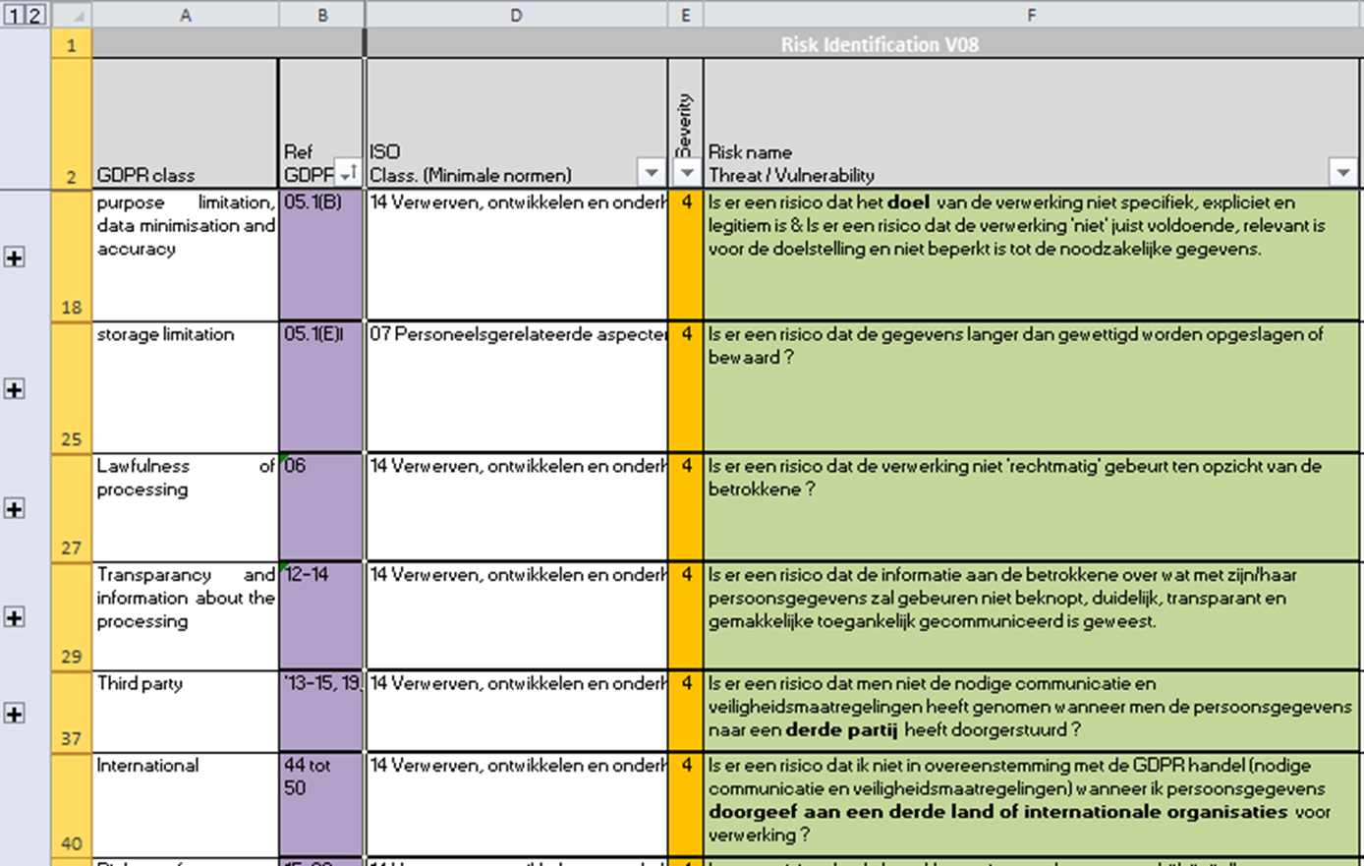
Template: list of risks based on GDPR

Slide 42
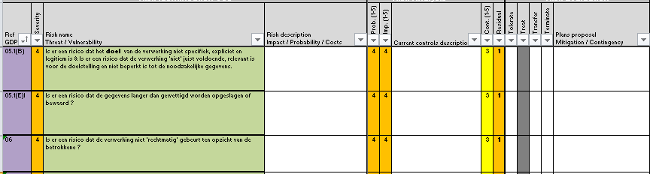
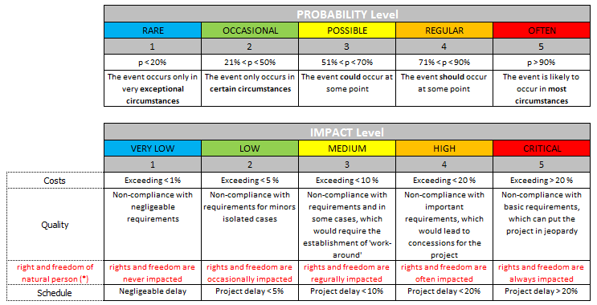
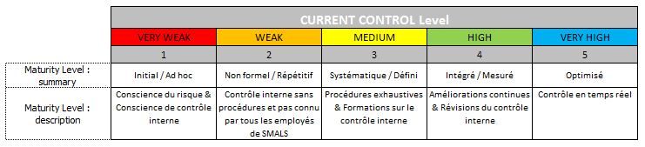
Template: risk evaluation
Initial risks and risk mitigation
(security controls)
Remaining risks

Slide 43
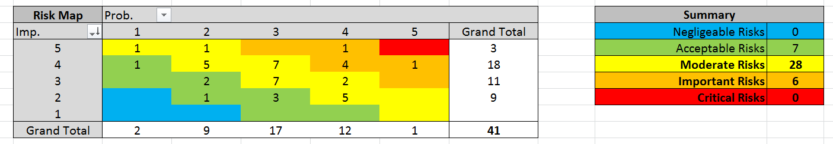
Template: heat maps initial risk

Slide 44
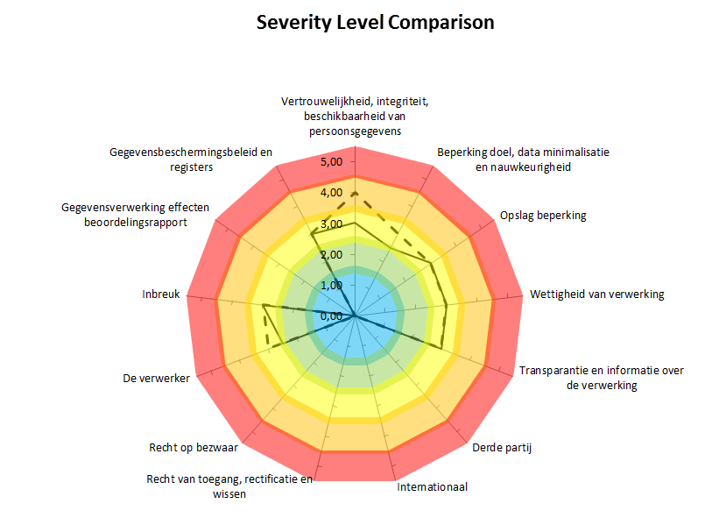
Template: intermediate result

Slide 45
Template: end result

Slide 46
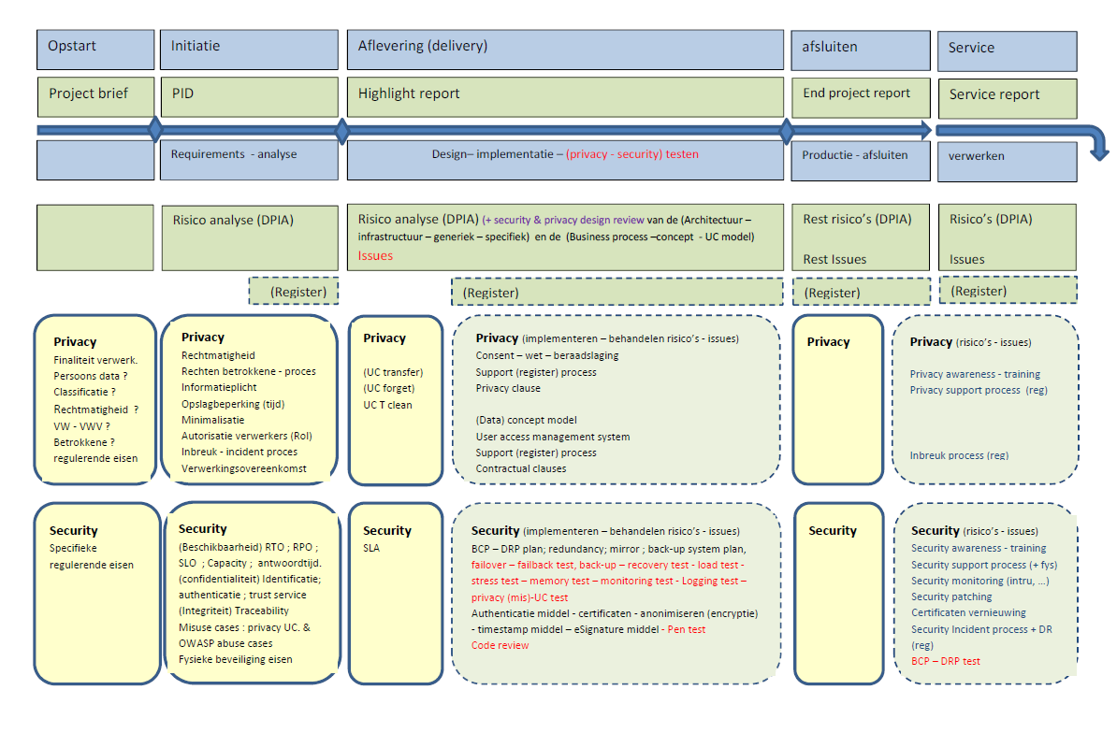
DPIA: as from start up of project to delivery

Slide 47
DPIA and production services
During the lifecycle of a service, it is advised to regularly review the DPIA
  changing conditions
  major changes to technology
  changing risks on the market
CBSS and eHealth platform plan to review the DPIA every 3 years

Slide 48
Unique file
Goals
  centralizing all information required to approve the service prior to commissioning the service in line with guidelines regarding information security and data protection
  meeting the documentation requirement of GDPR
Content
  purposes of the processing
  high level technical design
  categories of data subjects and data
  types of users
  security measures, ao
    user authentication level
    user authorization system
    user activity logging
  DPIA if available
Elaborated for every new service
Updated and approved for major changes to existing services

Slide 49
UAM: objectives
Be able to (electronically)
  identify all relevant entities (physical persons, companies, applications, machines, …)
  know the relevant characteristics of the entities
  know the relevant relationships between entities
  know that an entity has been mandated by another entity to perform a legal action
  know the authorizations of the entities
In a sufficiently certain and secure way
In as much relations as possible (C2C, C2B, C2G, B2B, B2G, …)
Using open interoperability standards

Slide 50
UAM: user expectations
One-time registration of identity, characteristics, relationships and mandates
Single sign on for as many public and private sector applications as possible
  authentication of the identity
  verification of relevant characteristics, relationships and mandates
Electronic means for authentication of identity that can be used on as much devices as possible
Minimal cost of
  registration procedures
  electronic means for authentication of identity
  use of electronic means for authentication of identity

Slide 51
Division of tasks
Registration of the identity of
  citizens: municipalities
  companies: company counters
Official identification document for citizens
  delivered by the municipalities (eID)
Means for the electronic authentication of identity
  free choice for user between means offered
    by the government or
    by the private sector, recognized by the government
  free of charge for user

Slide 52
Division of tasks
Registration of characteristics, relationships and mandates relevant for eGovernment or eHealth
  by public or private bodies designated by government
  with quality assurance
Authentic sources containing characteristics, relationships and mandates relevant for eGovernment or eHealth
  managed by public or private bodies designated by government
  with SLA’s
  according to a federated model
  accessible by UAM
    for eGovernment and eHealth applications
    for private sector applications
Authorization is the responsibility of each service provider

Slide 53
UAM: Policy Enforcement Model
Action on application
DENIED
Policy
Enforcement
(PEP)
Action on application
PERMITTED
User
Application
Action on application
Decision
request
Decision
reply
Policy
Decision
(PDP)
Information
request/reply
Policy
retrieval
Information
request/reply
Policy management
Policy
Administration
(PAP)
Policy
Information
(PIP)
Policy
Information
(PIP)
Manager
Policy repository
Authentic source
Authentic source

Slide 54
Policy Enforcement Point (PEP)
Intercepts the request for authorization with all available information about the user, the requested action, the resources and the environment
Passes on the request for authorization to the Policy Decision Point (PDP) and extracts a decision regarding authorization
Grants access to the application and provides relevant credentials
Action on application
DENIED
Policy
Enforcement
(PEP)
Action on application
PERMITTED
User
Application
Action on application
Decision
request
Decision
reply
Policy
Decision
(PDP)

Slide 55
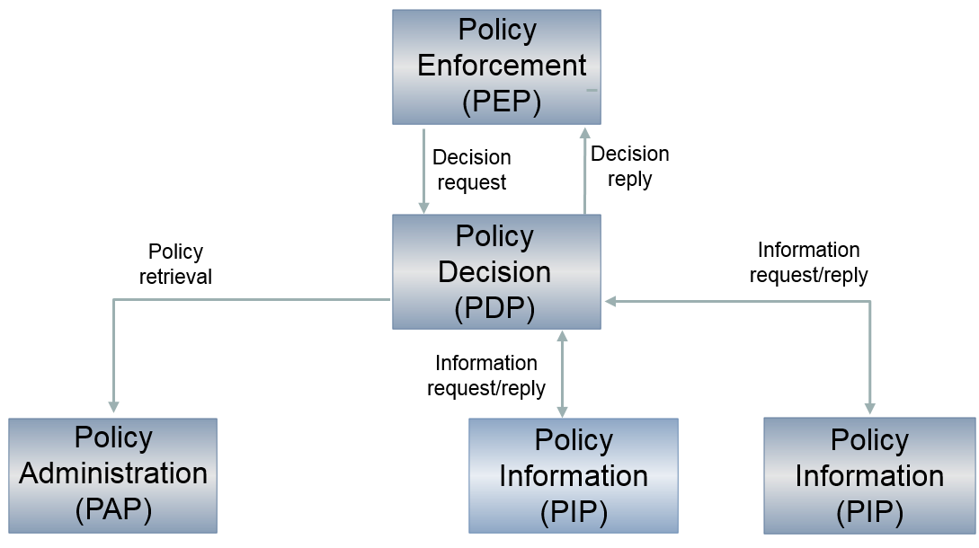
Policy Decision Point (PDP)
Based on the request for authorization received, retrieves the appropriate authorization policy from the Policy Administration Point(s) (PAP)
Evaluates the policy and, if necessary, retrieves the relevant information from the Policy Information Point(s) (PIP)
Takes the authorization decision (permit/deny/not applicable) and sends it to the PEP

Slide 56
Policy Administration Point (PAP)
Environment to store and manage authorization policies by authorized person(s) appointed by the application managers
Puts authorization policies at the disposal of the PDP
Policy
Decision
(PDP)
Policy
retrieval
Policy management
Policy
Administration
(PAP)
Manager
Policy repository

Slide 57
Policy Information Point (PIP)
Puts information at the disposal of the PDP in order to evaluate authorization policies (authentic sources with characteristics, relationships, mandates, etc.)
Policy
Decision
(PDP)
Information
request/reply
Information
request/reply
Policy
Information
(PIP)
Policy
Information
(PIP)
Authentic source
Authentic source

Slide 58
Federated architecture
Sector/country A
Sector/country B
Sector/country C
USER
USER
USER
APPLICATIONS
APPLICATIONS
APPLICATIONS
Authen
-
Authorisation
Authen
-
Authorisation
Authen
-
Authorisation
tication
PEP
WebApp
tication
PEP
WebApp
tication
PEP
WebApp
Role
XYZ
Role
XYZ
Role
XYZ
Mapper
Mapper
Mapper
Role
Role
Role
Mapper
Mapper
Mapper
DB
DB
DB
PDP
Role
PAP
PDP
Role
PAP
PDP
Role
PAP
Role
Provider
‘’Kephas’’
Role
Provider
‘’Kephas’’
Role
Provider
‘’Kephas’’
Provider
DB
Provider
DB
Provider
DB
PIP
PIP
PIP
PIP
PIP
PIP
PIP
PIP
PIP
Attribute
Attribute
Attribute
Attribute
Attribute
Attribute
Attribute
Attribute
Attribute
Provider
Provider
Provider
Provider
Provider
Provider
Provider
Provider
Provider
Management
Management
DB
DB
Management
DB
RIZIV
DB
DB
UMAF
DB
Judicial
exut-
ers
XYZ
DB
Mandates
XYZ
VAS
Mandates
XYZ
VAS
XYZ
VAS

Slide 59
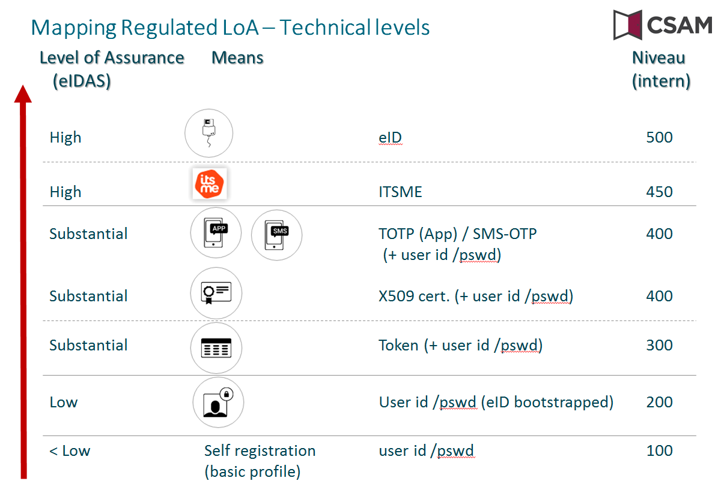
Authentication of identity: different levels

Slide 60
Circles of trust
Agreements between actors about
  who is responsible of carrying out which authentications and verifications on the basis of which means
  how the results of the authentications and verifications are securely stored and exchanged electronically between the actors involved
  who is responsible of logging access (attemps) to the services and applications
  how it is ensured that a complete reconstruction of loggings can take place to determine which natural person has used which service in relation to which person , when and for what purposes
  the retention period of the loggings, as well as the way in which these can be consulted by those who are entitled to do so

Slide 61
How does this all fit together?
Plan
  delivering deliberations by the Information Security Committee
  setting up information security departments
  elaborating minimal information security standards
  performing Data Protection Impact Assessments (DPIA)
  composing ‘unique files’
Do
  implementing information security measures according to minimal information security standards, DPIA, unique file and deliberations of the Information Security Committee
  using user & access management system
  logging access to services and applications
Check
  reactualizing DPIA regularly
  checking on compliance with minimal information security standards
  checking correct implementation of information security measures
  analyzing loggings
Act
  implementing additional measures where compliance level is not reached or where risks are not acceptable

Slide 62
Conclusion
Focus has to be put on a good balance between
  effectiveness and efficiency of information systems
  information security and data protection
  => based on risk analysis
Information security and data protection need a holistic approach and are translated into a number of measures
  structural measures
  organizational measures
  technical measures
  legal measures
Promoting information security and data protection by design

