Slide 1



Bilateral Meeting EU Commission DG EMPL – Belgian Delegation
21.03.2019

Slide 2

Agenda
Introduction (EC)
Status of different workstreams in Belgium
Issues raised by BE delegation and ways to move forward:
  Blocking issues
  Calendar of production
  Hosting/financing RINA
Next Steps

Slide 3
Introduction

Slide 4
Status of Workstreams in Belgium

Slide 5
Status of different workstreams in Belgium
Transition Planning & Organization/Coordination
    Governance and nationally agreed plan in place
    National legislation alignment almost finalized
      Linked to 6th State Reform
    Business Analysis to be finalized by end April:
      Legislation Applicable; Unemployment Benefits; Family Benefits finalized
      Sickness; Pensions; Horizontal almost completed
      Recovery & Miscellaneous still pending
    Nationally agreed training plan in place

Slide 6
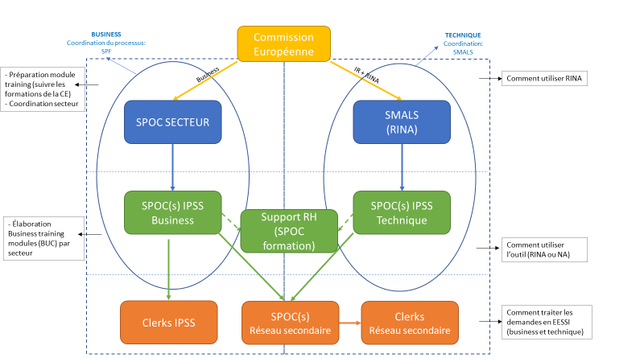
National training plan

Slide 7
Service Desk
No L1 and L2 Service Desk in place yet
plan and cost evaluation is ongoing
  Hot topic in Belgium
  Issue with financing

Slide 8
Institution Repository (IR)
95% uploaded in IR in acceptance
  100% for institutions working in EESSI
  Regional institutions pending (non-EESSI ready)
Validation process of current data ongoing
No access yet to IR in production
  Technical procedures/checks still ongoing

Slide 9
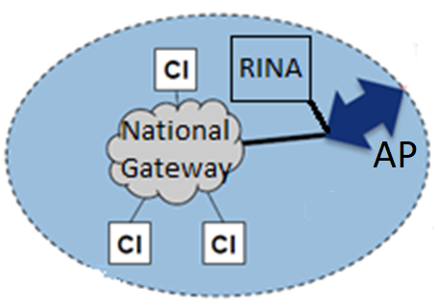
Access Point/National Gateway/National Application/RINA
Acces Point (AP) - Package (delivered by EU):
  Archiving system & Statistics
  Intelligent routing
National Gateway (NG) - Based on Business Messaging Interface (BMI) web services (delivered by EU):
  Transport layer between the EESSI’s network and the Competent Institutions (CI)
  Respect existing communication standards between CI / CBSS
National Application (NA) - Custom development :
  implementation of CI’s business
RINA - Case management software (delivered by EU):
  Implementation in multi-tenant & multi-server
  Integration with RMA for a strong authentication
AP : Access Point
CI: Competent Institutions

Slide 10
Issues raised by BE delegation & ways to move forward

Slide 11
Blocking Issues
Mentioned in Roadmap
AP:
  In Archiving, no possibility for differentiating ingoing and outgoing messages (JIRA : EESSI-4296)
NG:
  2 blocking issues:
    Update the BMIWS retry mechanism to include notifications and to systematically retry sending unhandled messages without having to restart the BMIWS service (JIRA : EESSI-4645)
    Add related set id information on the ApListener interface of the BMIWS (JIRA : EESSI-4646)
  Uncertainty for managing large size messages (Ex.: international claims)
RINA:
  Complexity of configuration for achieving required performance and stability
  Distribution of tenants among instance can’t be reviewed

Slide 12
Calendar of Production
Vast majority of the BUCs will go in production by July 2nd
All BUCs will go into production in 2019
LOT01BE : 28-Jun-2019 : RINA + LA_BUC_04 (66 BUCs)
LOT02BE : 31-Jul-2019 : LA _BUC_02 & 03 (2)
LOT03BE : 27- Sep-2019 : LA_BUC_01, 5 & 6 (3)
LOT04BE : 31-dec-2019 : P_BUCs (10)
LOT05BE: 31-dec-2019 : AW (BUC 05, 15 & 23); FB (7)

Slide 13
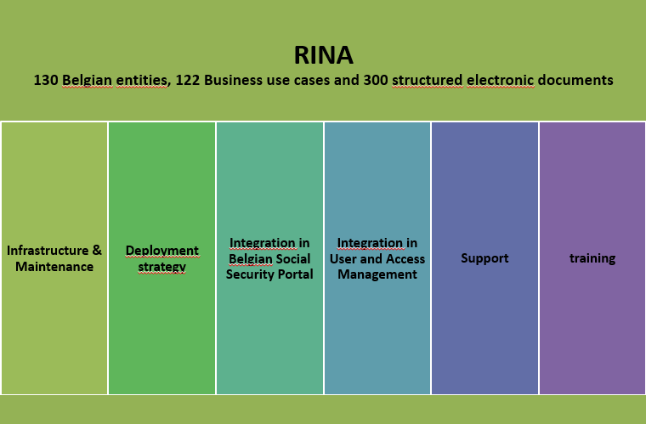
Hosting/financing RINA

Slide 14
Intended usage of NA versus RINA
NA
  4 institutions
  18 Business Use Cases
  Up to 2 million Structured Electronic Documents annually
RINA
  129 institutions
  +/- 110 Business Use Cases
  +/- 500,000 Structured Electronic Documents annually
  Estimated + 5,000 institution/Business Use Case combination averaging less than 100 Structured Electronic documents per institution/Business Use Case annually

Slide 15
Work to be done before July 2019 (summary)
Integration with Role Management Application and the Federal Authentication Service
System configuration (application and infrastructure)
Hotfix on november 2018 release to be tested, validated and deployed (waiting for hotfix to be delivered by EC)
End user training
Privacy training
Conformance testing

Slide 16
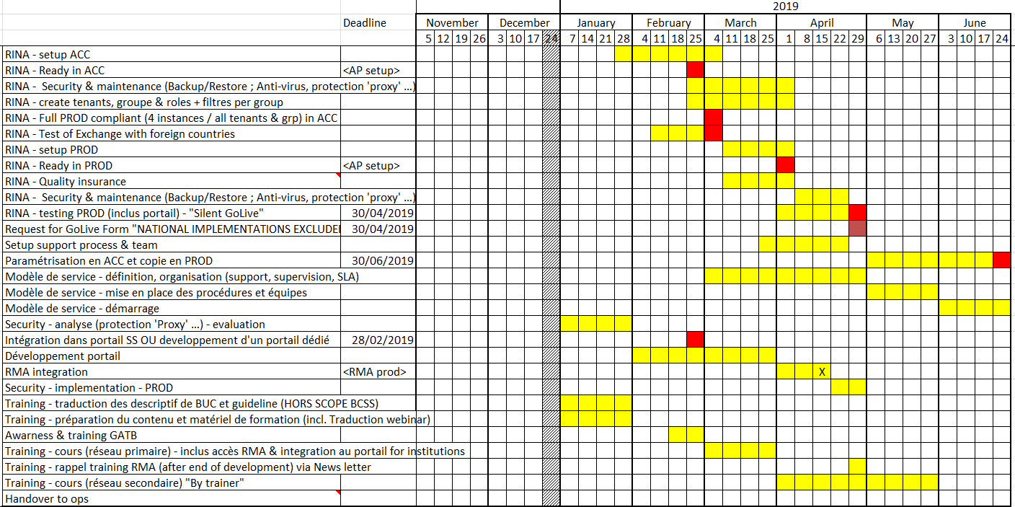
Planning Overview

Slide 17
Issues (1)
Delivery planning not respected by EC due to quality issues
  Many quality issues with initial version of RINA
  Necessity to apply major changes
  Still some blocking issues to be delivered
Deployments are not cost effective
Necessity to implement twice
  Planning in Belgian teams was disrupted
  Budgets became insufficient
  Grant Agreement not adapted
  Project at risk
RINA lacks adequate support for integration with national identification and authentication systems

Slide 18
Issues (2)
Complexity of the solution
  Number of Business Use Cases
  Exotic technologies used (e.g. holodeck)
  User Management
Lacking features
  Tenants are not entirely isolated
  Audit log
Weak documentation
  e.g. holodeck
Robustness and performance of the solution
  e.g. back-up restore not working
  Too much (machine) resources required in function of the kind of application
  The solution is still unstable (e.g. it occurs that messages cannot be sent, ack is not received, defect in case assignment)

Slide 19
Needed solution
Central hosting of the solution by the EC
« RINA as a Service » respecting (private or community-) cloud principles
Allowing integration of eidas and national identification and authentication
RINA must allow configuration of its SAML calls for easy integration with national systems
Rina must handle SAML responses completely
  to achieve automatic creation of users and user sessions
  in order to know the roles and authorisations managed by the national systems
  In order to avoid value less technical subsystems
Privacy must be guaranteed by adequate measures (e.g. multitenancy)

Slide 20
Pending implementation of the needed solution: what is required for RINA in service mode
Enhanced support offered to national teams:
  By EC
  By experts in the RINA application
  Adequately staffed
Enhanced usability in order to reduce support costs for the national teams
Enhanced documentation

Slide 21
Next steps

