Slide 1
Meeting with DG DIGIT

Slide 2
Outline
Experience gained
  Crossroads Bank for Social Security (°1991)
  eHealth platform (°2008)
  G-Cloud (°2014)
  Smals (°1939)
Some topics to be addressed
  re-use of components and services
  data & process modelling, architecture
  paneuropean services
  beyond eIDAS
  European hybrid cloud
  open method of coordination
  large vendors

Slide 3
Crossroads Bank
for Social Security

Slide 4
Mission
CBSS is the motor of digital transformation in the Belgian social sector, i.e.
  to stimulate and to support the actors in the Belgian social sector to grant more effective and efficient services with a minimum of administrative formalities and costs for all the involved; based on a common and concerted vision, the actors in the Belgian social sector benefit from the new technologies to improve and re-organize radically their mutual relationships and processes
  to promote the information security and the privacy protection by the actors in the Belgian social sector so that all the involved institutions and people can have justified confidence in the system
  to deliver integrated statistical information to the politicians and the researchers in order to support the social policy

Slide 5
Concrete tasks
Definition of the vision and the strategy on eGovernment in the social sector
Definition of the common principles related to information management, information security and privacy protection
Definition, implementation and management of an interoperability framework
  technical: secure messaging of several types of information (structured data, documents, images, metadata, …)
  semantic: harmonization of concepts and co-ordination of necessary legal changes
  business logic and orchestration support
Coordination of business process reengineering
Stimulation of service oriented applications
Driving force of the necessary innovation and change
Consultancy and coaching

Slide 6
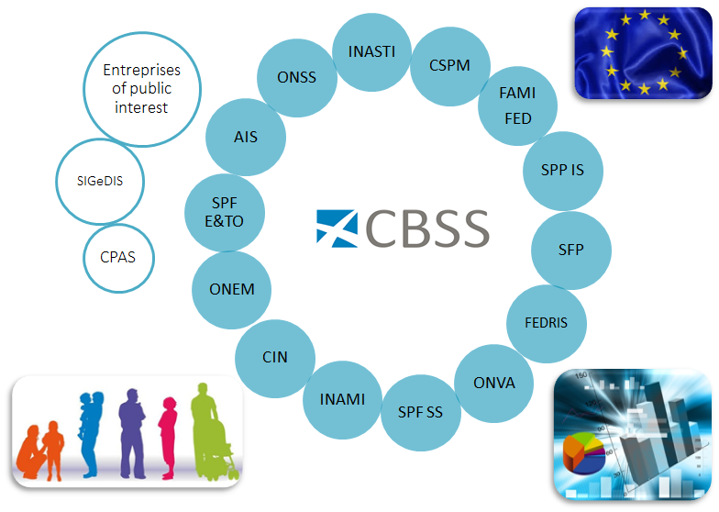
Overall architecture – logical view

Slide 7
Overall architecture – physical view
Internet
R
FedMAN
Users
R
Isabel
FW
R
…
R
Backbone
FW
FW
FW
FW
FW
R
R
R
R
R
ONEM
CBSS
ONSS
R
R
CIN
…

Slide 8
Distributed information servers
Information servers
  reference directory at the Crossroads Bank
  basic identification data of citizens at the National Register and the complementary Crossroads Bank Register
  basic identification data of companies at the Company Register
  employers directory (WGR) at the ONSS
  work force register at the ONSS
  salary and working time database at the ONSS and the ONSSAPL
  database of contribution certificates
Services offered
  interactive consultation
  batch consultation
  automatic communication of updates

Slide 9
Pre-processed messages
Pre-processed messages
  beginning/end of labour contract, beginning/end of self-employed activity
  contribution certificates medical care (employees, self-employed, beneficiaries of social security allowances)
  unemployment benefits
  benefits in case of career break
  benefits in case of incapacity for work ((labour) accident, (occupational) disease)
  reimbursement of health care costs
  child benefits
  old age pensions
  holiday pay
  benefits for the disabled
  guaranteed minimum income – social welfare
  derived rights (e.g. tax reduction/exemption, free public transport, ...)
  migrant workers
  …
Services offered
  interactive consultation
  batch consultation
  automatic communication of messages

Slide 10
Achievements
A network between all 3,000 social sector actors, employers and citizens
A unique identification key
  for every citizen
  for every company
  for every establishment of a company
An agreed division of tasks between the actors within and outside the social sector with regard to collection, validation and management of information and with regard to electronic storage of information in authentic sources

Slide 11
Achievements
220 electronic services for mutual information exchange amongst actors in the social sector, defined after process optimization
  nearly all direct or indirect (via citizens or companies) paper-based information exchange between actors in the social sector has been abolished
  in 2018 > 1,2 billion electronic messages were exchanged amongst actors in the social sector, which saved as many paper exchanges
Electronic services for citizens
  maximal automatic granting of benefits based on electronic information exchange between actors in the social sector
  21 electronic services via an integrated portal and/or mobile applications

Slide 12
Achievements
1.218.161.551 electronic messages were exchanged in 2018

Slide 13
Achievements
More than 50 electronic services for employers, either based on the electronic exchange of structured messages or via an integrated portal site
  50 social security declaration forms for employers have been abolished
  in the remaining 30 (electronic) declaration forms the number of headings has on average been reduced to a third of the previous number
  declarations are limited to 3 events
    immediate declaration of recruitment and discharge (only electronically)
    quarterly declaration of salary and working time (only electronically)
    occurrence of a social risk (electronically or on paper)
  in 2018, more than 25 million electronic declarations were made by all 220,000 employers, 98 % of which from application to application

Slide 14
Achievements
An integrated portal site and mobile applications containing
  electronic transactions for citizens, employers and professionals
  simulation environments
  information about the entire social security system
  harmonized instructions and information model relating to all electronic transactions
  a personal page for each citizen, each company and each professional
  see www.socialsecurity.be
An integrated multimodal contact centre supported by a customer relationship management tool
A data warehouse containing statistical information with regard to the labour market and all branches of social security

Slide 15
eHealth platform

Slide 16
Mission
As a public institution, the eHealth platform has the mission to
to promote and support well-organised mutual electronic services and information exchange between all actors in the health care sector
while providing the necessary guarantees with regard to information security, the protection of the privacy of the patient and the healthcare provider and the observance of medical confidentiality
and thereby
to optimize the quality and continuity of health care delivery
to optimize patient safety
to simplify administrative formalities for all actors in the health care sector
to provide effective support for health policy

Slide 17
Concrete tasks
Development of a vision and of a strategy for eHealth
Organization of the cooperation between all governmental institutions which are charged with the coordination of the electronic service provision
The motor of the necessary changes for the implementation of the vision and the strategy with regard to eHealth
Promoting and coordinating programmes and projects
Determination of functional and technical norms, standards, specifications and basic architecture with regard to ICT
Registration of software for the management of electronic patient files

Slide 18
Concrete tasks
Managing and coordinating the ICT aspects of data exchange within the framework of the electronic patient files and of the electronic medical prescriptions
Conceptualization, design and management of a cooperation platform for secure electronic data exchange with the relevant basic service
Reaching an agreement about division of tasks and about the quality standards and checking that the quality standards are being fulfilled
Acting as an independent trusted third party (TTP) for the encoding and anonymisation of personal information regarding health for certain institutions summarized in the law for the support of scientific research and the policymaking

Slide 19








Overall architecture
Patients, health care providers,
health facilities
Health portal
Software
HC provider
Software health facility
VAS
Site NIHDI
VAS
eHealth
portal
MyCareNet
VAS
VAS
VAS
Users
Basic services eHealth platform
Network
VAD
VAD
VAD
VAD
VAD
VAD
Suppliers

Slide 20
Basic services eHealth platform
Coordination of digital subprocesses
Portal
Integrated user and access management
Management of logs
System for end-to-end encryption
eHealthBox
Timestamping
Encryption and anonymization
Consultation of the National Register and the CBSS Registers
Reference directory (metahub)

Slide 21
Achievements
The sharing of data between healthcare providers / institutions via the hub-meta-hub system, the health safes and the eHealthBox reaches cruising speed (>13.3 billion transactions in 2018)
About 75% of the Belgian population has now given their informed consent to share health data between healthcare providers/institutions having a therapeutic relationship with them
The opening up of health data for the patient starts => attention for integrated access
Experience is gained with mobile eHealth applications

Slide 22
G-Cloud

Slide 23





What is G-Cloud ?
A program including synergy projects
Synergy for existing as well as new services
For public services
Managed by public services
In cooperation with the private sector

Slide 24








Cloud deployment types
Hybrid
Public Cloud
Shared
Access/Control
Outsourced Community Cloud (= off-premise)
Community Cloud on-premise
Private Cloud on-premise
Outsourced Private Cloud (= off-premise)
Dedicated
Location
Customer
Service Provider

Slide 25




G-Cloud ‘products’
Procurement
Cooperationá
Efficiencyá
Projects
Synergy
Services
Costsâ
Qualityá
Know-how & Expertise

Slide 26



Why G-Cloud?
Creation of economies of scale: efficiency and high quality/availability
Respect of confidentiality and data protection
Bigger focus on business applications and flexibility in order to realize them

Slide 27

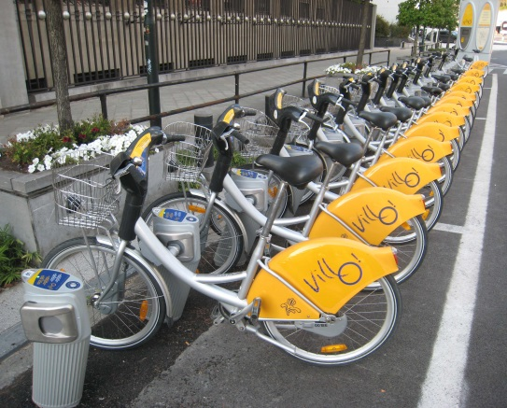

Why G-Cloud?
Greater weight
during negotiations with suppliers
Pooling of knowledge and resources
Technological evolution faster available for everyone

Slide 28
G-Cloud organization
Government
G-Cloud Operations & Programme Board
G-Cloud Strategic Board
FPS/PPS
(Horizontal FPS, SPF FIN, Belnet, …)
PIOSS/IPB
(CBSS, ...)
Association of FPS/PPS/IPB
Private ICT companies directed by FPS/PIOSS/...
3 Colleges
FPS
Public Institutions of Social Security (PIOSS)
Institutions of Public Benefit (IPB)
SIT: ICT managers from
FPS
Public Institutions of Social Security
Institutions of Public Benefit
Service
owners

Slide 29
Actual G-Cloud portfolio

Slide 30



New ways of cooperation
Government ecosystem
Other sectors
Components
parts
Application
1
Application
2
Application
N
Partner
1
Partner
2
Partner
N
Platform
cooperation
DB
DB
Technological cooperation
DB
DB
DB

Slide 31
Sharing best practices
Rise of new technologies => constant innovation & change
Usefulness of common solutions
e.g. API Gateway & REST-style API’s
=> collaborative effort for pragmatic approach to designing RESTful APIs : https://www.gcloud.belgium.be/rest/

Slide 32
Smals
(non for profit association)

Slide 33


Shared ICT services
in Belgian social security & health care since… 1939

Slide 34
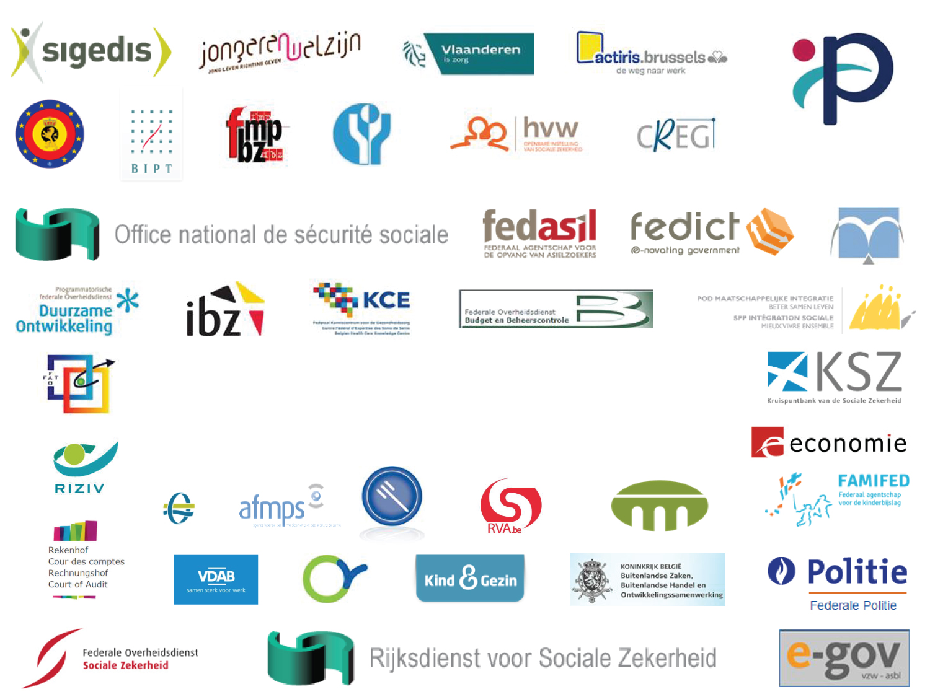

Over 200 Belgian public institutions Federal – Regional – Local

Slide 35
Benefits of the Smals model*
‘In-house’ ICT services for public sector
  managed by public institutions
  only for adhering public institutions
  *Just like its member institutions, Smals is subject to public tender procedures
Operates as a business, rather than a public administration
Knowledge & technical skills retention
Important economies of scale
Belgian social security is one of the oldest, and widely recognized examples of shared ICT services in eGovernment

Slide 36
Smals – Some key figures
>288 million EUR turnover
>1800 collaborators
Core activities:
  development
  ICT services
  staffing
  ‘consultants’
  (sourcing from
  private sector ICT)

Slide 37
Some topics to be addressed

Slide 38
Re-use
Re-use increases interoperability, and reduces cost & time to market
European dimension lesser known
  CEF - building blocks
  Joinup catalogue
Challenges
  connecting global solutions to local needs
  move from software components -> online services
Towards a real fostering a European wide, free re-use of software components and services developed by Member States, at least in sectors of general interest ?

Slide 39
Re-use
Knowledge transfer & communities
  share competences, best practices, collaborate on implementations
  user groups and different fora
Software-components
  don’t re-invent the wheel
  design & adapt for re-use
(Micro)services
  autonomous micro-services
  service assembly
  API economy
Products & Services
  standardized common solutions

Slide 40
Re-use
Value
library
framework
product
service
system
Offered “business” functionality

Slide 41




Re-use – Vision
Processes and tools are put in place to identify, register, implement, monitor and measure reuse throughout the project lifecycle
Every stakeholder can easily find the most common reusable elements in a centralized catalogue
CATALOG
Human networks are maintained and developed on all levels (CEO’s, CIO’s, business owners, business analysts, architects) in order to keep maximum visibility on reuse potential
PROCESSES
A culture develops where reuse is adopted and the creation of reusable products is promoted
NETWORK
MINDSET

Slide 42
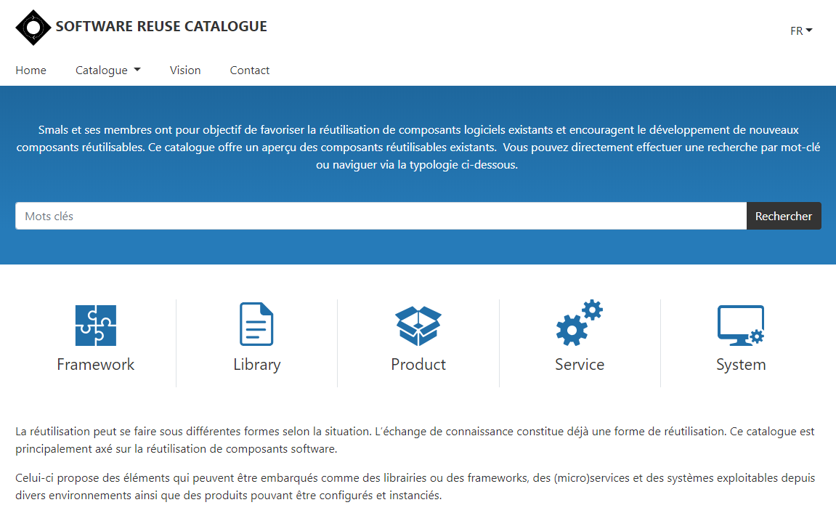
reuse.smals.be
Notes:
NICOLAS

Slide 43
Modelling & architecture
Need for
  data modelling
    factual, multifunctionally re-usable data
    not legally interpreted data
  cross border data catalogue
    modular, re-usable, structured data sets
    with translation into different languages
  process modelling
    standardization
    limited set of use cases
  modular architecture

Slide 44
Paneuropean services
Towards paneuropean services hosted by EC, re-using succesful implementations in Member States ?
  generic basis services, such as
    encryption
    time stamping
    federated user & access management (eg Federal Authentication Service (FAS))
    reference directory
  standardized web applications
    eg RINA
      lack of
        centralized hosting by EC
        federated user & access management
      too many use cases (> 100)
    eg LIMOSA

Slide 45
Paneuropean services – eg LIMOSA
Integrated electronic service delivery based on a single, mandatory declaration in case of temporary or partial professional activities of foreign employees and self-employed persons in Belgium
500.000 declarations per year
Reduction of process time from 7 days to 5 minutes
Integrated service throughout 8 types of institutions (750 concrete institutions)
Gains in effectiveness
  improvement of social protection of migrant workers
  enhancement of free movement of workers and services
Gains in efficiency
  lower cost due to single, multifunctional and electronic information collection and integrated information processing
  shortening of clearance times with immediate return of receipt
  availability of integrated services according to the logic of the user at any time and from anywhere
Gains in transparency
  permanent access for the user to the processing status of its declaration

Slide 46
European hybrid cloud
Main issues with existing public cloud
  longitudinal confidentiality of personal data
    need for comprehensive longitudinal encryption of personal data
    in motion, at rest and in use
  performant continuous availability of application and data
  easy migration of applications and data
  compliance with GDPR
  US-based market leaders: Amazon, Microsoft & Google
    possible risks
    EU-native solutions possible ?
(Public) cloud drives innovation (AI, newSQL, …)

Slide 47
European hybrid cloud
Fostering the creation of a European hybrid cloud would be useful to solve problems with existing public cloud and to drive innovation
Cooperation between Member States, stimulated by the EC ?
Need for overall government positioning
  cloud policy
  based on information classification
  with appropriate technical, organizational & contractual measures
  based on a hybrid approach
Need for broker model
  knowledge & expertise on cloud offerings
  contracts & implementation partners
  tools

Slide 48
Beyond eIDAS
User- & access management (UAM): objectives to be reached
  be able to (electronically)
    identify all relevant entities (physical persons, companies, applications, machines, …)
    know the relevant characteristics of the entities
    know the relevant relationships between entities
    know that an entity has been mandated by another entity to perform a legal action
    know the authorizations of the entities
  in a sufficiently certain and secure way
  in as much relations as possible (C2C, C2B, C2G, B2B, B2G, …)
  using open interoperability standards

Slide 49
Beyond eIDAS
User expectations with regard to UAM
  one-time registration of identity, characteristics, relationships and mandates
  single sign on for as many public and private sector applications as possible
    authentication of the identity
    verification of relevant characteristics, relationships and mandates
  electronic means for authentication of identity that can be used on as much devices as possible
  minimal cost of
    registration procedures
    electronic means for authentication of identity
    use of electronic means for authentication of identity

Slide 50

eIDAS regulation – Overall content
Mandatory recognition of some electronic identification means
Electronic trust services
  scope
    electronic signatures, including validation and preservation services
    electronic seals, including validation and preservation services
    time stamping
    electronic registered service delivery
    website authentication
  horizontal principles: security requirements, trusted lists, EU trust mark, prior authorisation, qualified services, liability, data protection, supervision, international aspects
Non-discrimination of electronic documents vis-à-vis paper documents as evidence in legal proceedings
But proof and verification of relevant characteristics, relationships and mandates is not sufficiently addressed

Slide 51
Beyond eIDAS – Policy Enforcement Model
Action on application
DENIED
Policy
Enforcement
(PEP)
Action on application
PERMITTED
User
Application
Action on application
Decision
request
Decision
reply
Policy
Decision
(PDP)
Information
request/reply
Policy
retrieval
Information
request/reply
Policy management
Policy
Administration
(PAP)
Policy
Information
(PIP)
Policy
Information
(PIP)
Manager
Policy repository
Authentic source
Authentic source

Slide 52
Beyond eIDAS – Federated architecture
Member State A
Member State B
Member State C
USER
USER
USER
APPLICATIONS
APPLICATIONS
APPLICATIONS
Authen
-
Authorisation
Authen
-
Authorisation
Authen
-
Authorisation
tication
PEP
WebApp
tication
PEP
WebApp
tication
PEP
WebApp
Role
XYZ
Role
XYZ
Role
XYZ
Mapper
Mapper
Mapper
Role
Role
Role
Mapper
Mapper
Mapper
DB
DB
DB
PDP
Role
PAP
PDP
Role
PAP
PDP
Role
PAP
Role
Provider
‘’Kephas’’
Role
Provider
‘’Kephas’’
Role
Provider
‘’Kephas’’
Provider
DB
Provider
DB
Provider
DB
PIP
PIP
PIP
PIP
PIP
PIP
PIP
PIP
PIP
Attribute
Attribute
Attribute
Attribute
Attribute
Attribute
Attribute
Attribute
Attribute
Provider
Provider
Provider
Provider
Provider
Provider
Provider
Provider
Provider
Management
Management
DB
DB
Management
DB
RIZIV
DB
DB
UMAF
DB
Judicial
exut-
ers
XYZ
DB
Mandates
XYZ
VAS
Mandates
XYZ
VAS
XYZ
VAS

Slide 53
Open method of coordination
A form of intergovernmental policy-making that does not (necessarily) result in binding EU legislative measures
Working out a common conceptual framework, a common vision and common basic principles
Jointly identifying and defining objectives to be achieved (adopted by the Council)
Jointly established measuring instruments (statistics, indicators, guidelines) (adopted by the Council)
Benchmarking, i.e. comparison of EU Member States' performance and the exchange of best practices (monitored by the Commission)

Slide 54
Large vendors
Complex licensing policies
Vendor always looking for more revenue
Competition not always possible
Shift to subscription based licensing <-> perpetual
EU scale software contracts/license terms with large vendors ?
Cross European price/license terms benchmarks ? (<-> NDA)

