Slide 1
and beyond

Slide 2
Agenda
Context
G-Cloud …
  what & why
  organization and service model
  portfolio
  impact
… and beyond
  expectations of citizens and enterprises
  some ICT-trends rising and their impact on G-Cloud
  innovative means of collaboration with private sector
Wrap up

Slide 3


Slide 4
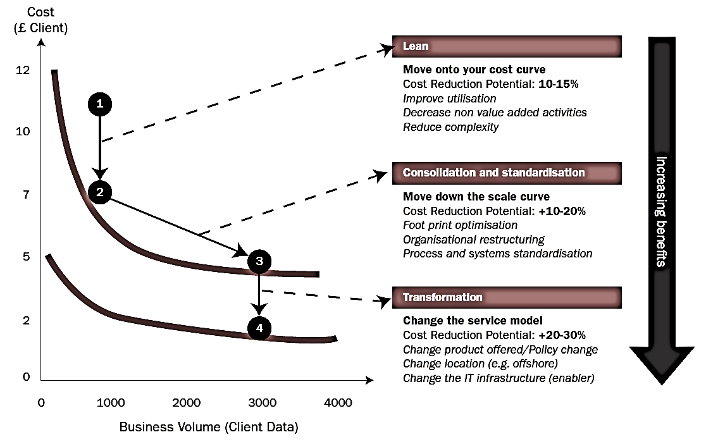
Synergies - transformations
Bron: Booz Allen Hamilton

Slide 5
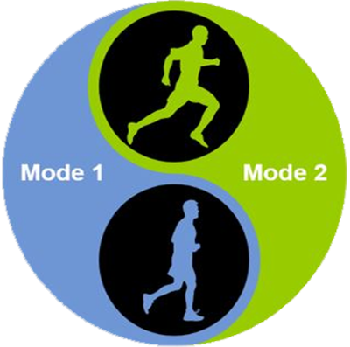
Trends
Sprint
Agility
User centricity
Continuous changes
New / uncertainties
Short cycles
Marathon
Reliability
Price / performance
Planning
Standard processes
Long cycles

Slide 6
Trends
Sprint
Marathon
Need to do both

Slide 7
What is “Cloud” ?
On Demand
Broad network access
Resource pooling
Measured service
Rapid elasiticity
Source: National Institute for Standards and Technology, USA

Slide 8
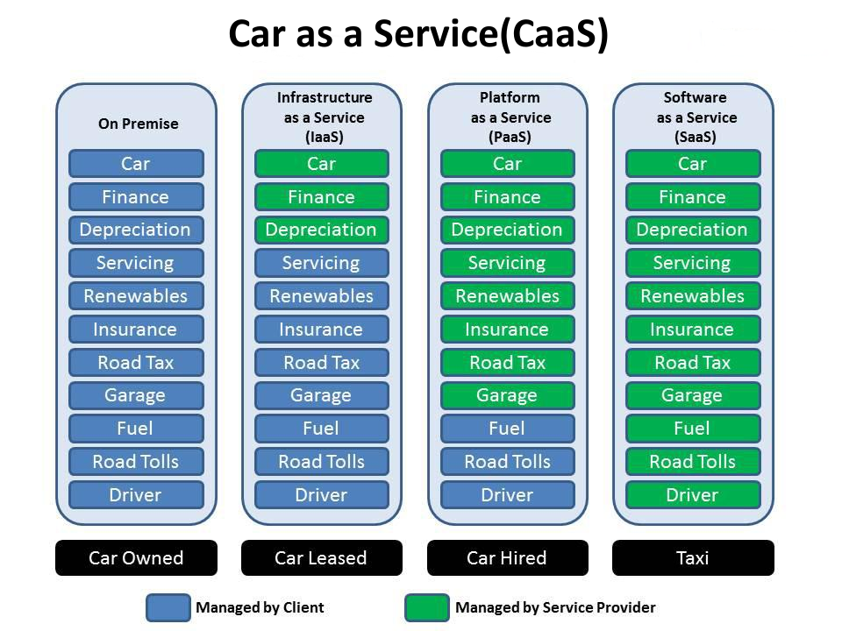

Slide 9
As a service : major characteristics
Self-service : industrialised & automated
Available : immediate availability
Extensible / elastic : scale up or down
Shared : multiple users for scale effects
Use based invoicing : based on real use of resources
Low entry barrier : complexity is hidden for user
Incremental service changes

Slide 10
Cloud Service Models
IaaS
Infrastructure as a Service
PaaS
SaaS
Basic IT infrastructure components (e.g. Amazon virtual machines)
Platform as a Service
Platforms to build applications
Software as a Service
Full applications (e.g. O365, Google Apps, ...)

Slide 11

Virtualisation
Consolidation of physical resources
> 70% “easy consolidation”
First step to Cloud (“dematerialisation”)

Slide 12





What is G-Cloud ?
A program including synergy projects
Synergy for existing as well as new services
For public services
Managed by public services
In cooperation with the private sector

Slide 13
What is G-Cloud ?
Shared public ICT platform
  current target: federal state (FPS, PPS, public institutions of social security, institutions of public benefit)
  can be extended to other interested authorities
Hybrid community cloud model
  use of public cloud if possible
  private community cloud hosted in data centers, managed by the government
  operational implementation with strong involvement of the private sector

Slide 14








Cloud deployment types
Hybrid
Public Cloud
Shared
Access/Control
Outsourced Community Cloud (= off-premise)
Community Cloud on-premise
Private Cloud on-premise
Outsourced Private Cloud (= off-premise)
Dedicated
Location
Customer
Service Provider

Slide 15
Basic principles
Maximum synergy when possible and when generating efficiency gains and/or savings while maintaining or improving the quality of the services provided to the customer
In line with the synergy program: assignment to the one who is the most capable of proposing a form of shared services
Synergy based on result orientation, sense of responsibility and trust

Slide 16




G-Cloud ‘products’
Procurement
Cooperationá
Efficiencyá
Projects
Synergy
Services
Costsâ
Qualityá
Know-how & Expertise

Slide 17
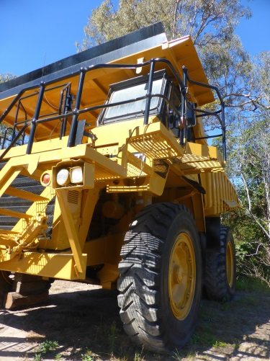


Why G-Cloud?
Creation of economies of scale: efficiency and high quality/availability
Respect of confidentiality and data protection
Bigger focus on business applications and flexibility in order to realize them

Slide 18

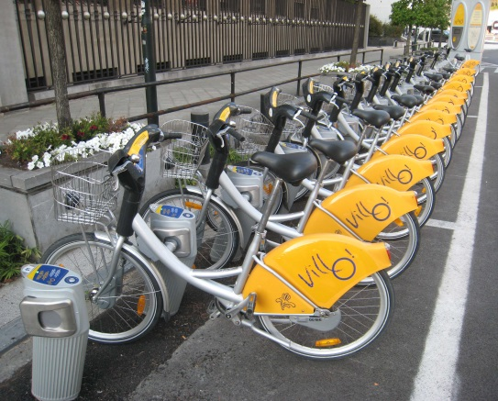

Why G-Cloud?
Greater weight
during negotiations with suppliers
Pooling of knowledge and resources
Technological evolution faster available for everyone

Slide 19
G-Cloud organization
Government
G-Cloud Operations & Programme Board
G-Cloud Strategic Board
FPS/PPS
(Horizontal FPS, SPF FIN, Belnet, …)
PIOSS/IPB
(CBSS, ...)
Association of FPS/PPS/IPB
Private ICT companies directed by FPS/PIOSS/...
3 Colleges
FPS
Public Institutions of Social Security (PIOSS)
Institutions of Public Benefit (IPB)
SIT: ICT managers from
FPS
Public Institutions of Social Security
Institutions of Public Benefit
Service
owners

Slide 20


G-Cloud organization
G-Cloud Strategic Board: strategic direction by senior officials
G-Cloud Operations & Program Board:
CIOs for operational direction

Slide 21
G-Cloud service model
G-Cloud = coalition
G-Cloud ≠ central organization
G-Cloud service
Offered by
Service owner
Delivered by
Service provider
Governance

Slide 22
G-Cloud service model
Service Owner
  organization responsible for the service
  develops the service and its further evolution
  provides SLA, financial model, support model...
  “contract” with clients
Service Provider
  “contract” with Service Owner
  provides the service as agreed upon in the specifications/SLA
Sometimes: Service Owner = Service Provider

Slide 23
G-Cloud P&O
3500 IT professionals in the federal government
War for talent & reversed age pyramid
Cooperation model across institutional boundaries

Slide 24
Opportunities and challenges
Challenges
Security
Confidentiality
Continuity
Strategic management
Opportunities
Cost management
Cooperation
Self-service
Economies of scale
Flexibility
Quality
Know-how

Slide 25

G-Cloud success factors
Efficiency
Adequate security measures (risk↘)
Optimal cooperation and trust between the institutions
Differentiation of the offer: neither ‘one size fits all’ nor tailor-made work
Capacity management
A phased approach, no ‘big bang’
Quality of service: respect of SLAs

Slide 26
G-Cloud portfolio

Slide 27
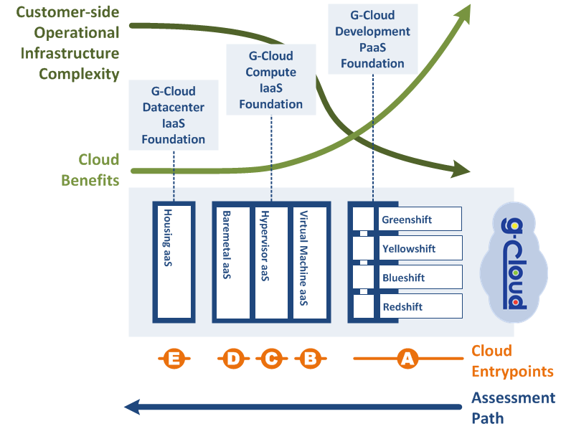
Possible entrypoints

Slide 28
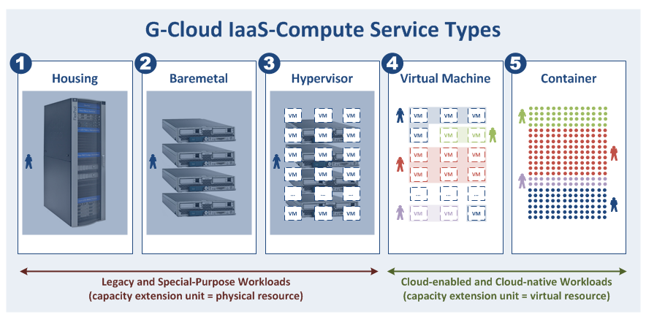
Compute Types versus Workloads
Gebruikers hier willen typisch meer controle over de onderste lagen van de technologiestack (servers, netwerkapparatuur, hypervisor, OS, ...)

Slide 29
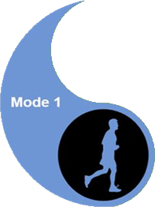
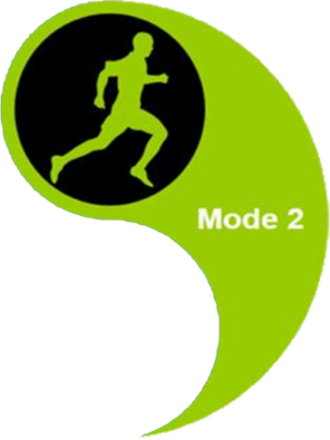
Compute Types versus Workloads

Slide 30
G-Cloud and the private sector
G-Cloud ≠ ICT insourcing
Public procurement
translation tool, converged infrastructure, unified communications, network security, storage, back-up, ...
In consultation with the sector for several specific platforms
IBM, Microsoft, Oracle, RedHat, SAS, ...

Slide 31
G-Cloud impact - examples
Centralized license negotiations with Microsoft & standardization initiative : obtain additional discounts on O365 licenses (~ annual benefit of 3 M€ )
Economies of scale => decreasing cost price G-Cloud services: compute -12%, storage -40% in 9 months’ time
Inventory of “procurement centres” (Dutch: opdrachtencentrales) ➔ large-scale reuse of “procurement centres”

Slide 32
G-Cloud impact - examples
Unified Communications as a Service (UCaaS)
  local examples: NWOW, better/faster communication between employees
  global advantages: standardization, better communication between public services
  much interest: 15+ public services took the step

Slide 33
G-Cloud impact - examples
Communities / knowledge sharing
  knowledge exchange through SIT
  mixed O365 team
  Sharepoint online / BeConnected as supporting platform
  group for the management of work stations / Windows 10 migration
  “user groups” for G-Cloud services
    Sharepoint, Greenshift, VMaaS
  translators community (Babelfed)

Slide 34
G-Cloud impact - shared procurement
Cooperation regarding the public procurements
  juridical: central procurement agency clause
  know-how: specialized in ICT purchases
  simplicity: less administrative work for the private sector and the state
  possibility to accelerate the purchases and to avoid double specifications procedures
  price reductions thanks to the volume
Software licences
  negotiations with the providers
  mutual exchange of unused licences

Slide 35
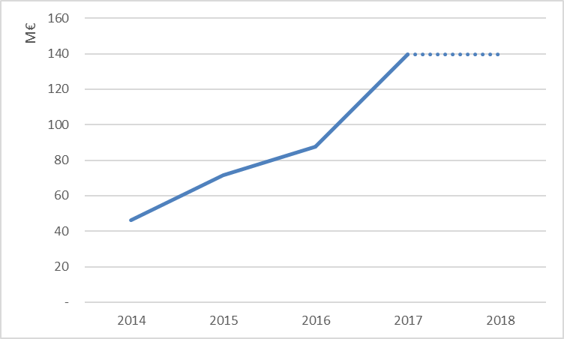
G-Cloud impact - reuse of contracts
Source: Smals

Slide 36
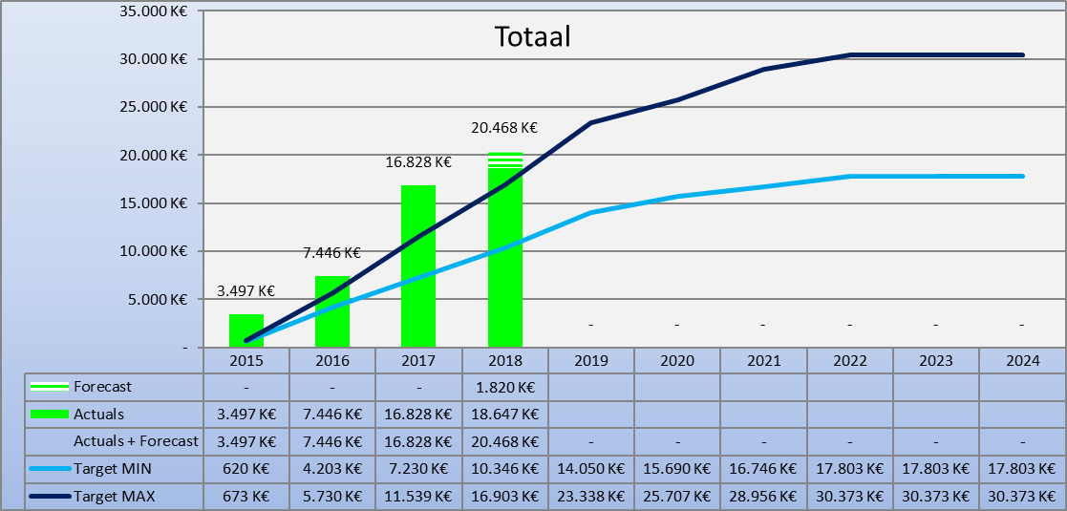
G-Cloud ROI

Slide 37
G-Cloud klanten

Slide 38
G-Cloud klanten

Slide 39
G-Cloud klanten

Slide 40
G-Cloud klanten

Slide 41
and beyond

Slide 42

Digital is the new normal: society needs to evolve
Public & private sector cooperation regarding
  vision
  common components & services
  synergies in order to meet user expectations
  offering according to strengths
Not only about competitive, yet also cooperative strategic advantages

Slide 43
Expectations of citizens & enterprises
Effective services
Integrated services
  adjusted to their specific situation, customized if possible
  life events (birth, school, work, moving, illness, retirement, decease, setting up an enterprise…)
  across government levels, public services and private bodies
Adjusted to their own processes
With a minimum of costs and administrative formalities

Slide 44
Expectations of citizens & enterprises
Provided automatically, if possible
With active user participation ( self-service – self-empowerment – follow-up)
Always up to date
Offered in a performant and user friendly way
Reliable, safe and permanently available
Using the media of their choice (internet, mobile data, telephone, direct contact…)
Respecting their privacy

Slide 45
Cloud-native vs Cloud-enabled ?
Cloud-enabled applications
  traditional applications can benefit of some cloud capabilities
    iso-functional and iso-architectural migrations (cloud-wrapping)
  more modest ‘cloud’ architectures
    use features needed by internet-scale applications
    for augmenting your quality of service
    our workloads are not at the extreme end of the cloud spectrum
  to realize full cloud potential: cloud software architecture needed!
Cloud-native applications
  horizontal scaling for internet-scale applications
  high availability from an application perspective
  single container availability option (restart downtime)
  transportability (move to different clouds)
    worldwide availability zones, multi-cloud strategy, …
  continuous delivery and automated staging
  frequent deployments (e.g. very 5 minutes)
  micro services architectures
  A/B testing and feature toggles
  unpredictable loads, …
What is the maturity level of your organization?
What are the benefits of cloud technology you want to maximize?
What are the characteristics of your (traditional) workloads?
What is your current IT landscape?
...
Why Cloud?
Notes:
Shifting to cloud native features will demand reengineering/modernisation

Slide 46

Focus on business
ICT enables business, effectiveness, efficiency, innovation
Business drives, empowers and
invests in ICT

Slide 47
Shift of focus / Added value
Business components

Slide 48
ICT trends
Public Cloud
API Economy
Artificial Intelligence
Blockchain
…
Re-use
Conver-sational Interfaces
Big data analytics

Slide 49
ICT trends
API Economy

Slide 50
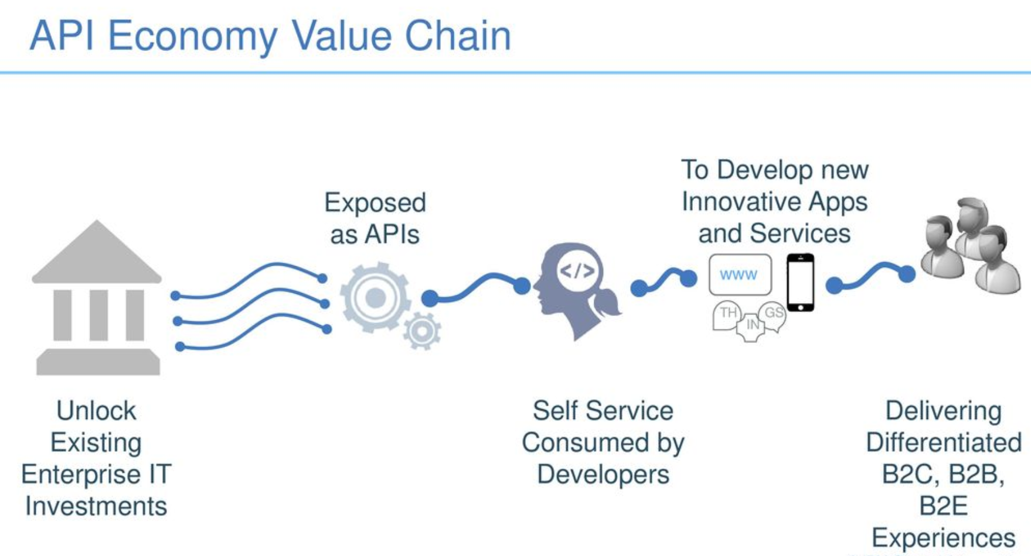
API Economy
Source: IBM

Slide 51
Service architecture (before)

Slide 52
Service architecture (after)
API Management

Slide 53





G-Cloud service platform project
Service Synergy
Product
Financial
Standards
Governance
Business
Service owner, community, supplier contact, financial, organization
Vocabularies, procedures/processes, common services
Technical approach
Multi tenant
Self service
Concept, testing, definition
Enterprise license G-Cloud

Slide 54
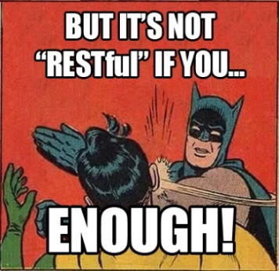
G-Cloud REST style guide
Based on industry standards and best practices
A pragmatic approach to designing RESTful APIs
Collaborative effort organized in several workgroups:
  REST API modelling
  security (OAuth)
  functional/business vocabularies (temporal, location, person, enterprises)
Work in progress
https://www.gcloud.belgium.be/rest/

Slide 55

Platform as a Service (PaaS)
Abstraction of the underlying platform for developers
High automation degree (‘zero touch deployment’)
Higher productivity
DevOps way of working
Micro services

Slide 56
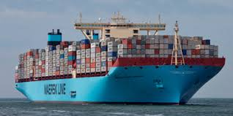
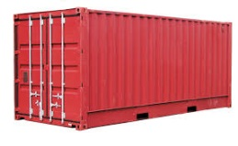
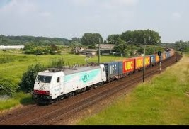
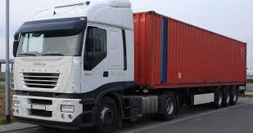






PaaS in G-Cloud - Containers
Introducing container technology
Translated into modern technology such as Platform-as-a-Service
Individuele
inhoud
Easy to move around
Individual content
Isolated storage
Geïsoleerd opgeslagen
En makkelijk verplaatsbaar
Monitoring
Security
Logging
Coming
soon

Slide 57

New ways of cooperation
Government ecosystem
Other sectors
Components
parts
Application
1
Application
2
Application
N
Partner
1
Partner
2
Partner
N
Platform
cooperation
DB
DB
Technological cooperation
DB
DB
DB

Slide 58

Open government services
Building mutual trust
Through specific cooperation
With consistent delivery, results and ROI
Examples
  digital user management
  eBox citizen & eBox enterprise
  eHealth platform

Slide 59








Example: eHealth platform
Patients, health care providers,
health facilities
Health portal
Software
HC provider
Software health facility
VAS
Site NIHDI
VAS
eHealth
portal
MyCareNet
VAS
VAS
VAS
Users
Basic services eHealth platform
Network
VAD
VAD
VAD
VAD
VAD
VAD
Suppliers

Slide 60

Example: eHealth platform
Coordination of digital subprocesses
Portal
Integrated user and access management
Management of logs
System for end-to-end encryption
eHealthBox
Timestamping
Encryption and anonymization
Consultation of the National Register and the CBSS Registers
Reference directory (metahub)

Slide 61
Example: eHealth platform
Government (eHealth platform)
  develop vision & strategy regarding eHealth
  organize cooperation & drive change
  establish functional & technical norms, standards, specifications, IT reference architecture
  certify software for electronic health records management to several health care actors
  design, elaborate and manage a common platform for secure digital data exchange & related basic services
  agree upon governance, quality standards and compliance
  promote and coordinate the creation of programmes & projects
Private sector
  develop & offer electronic health records management software in the health care sector

Slide 62

Example: recognition of electronic identification services
Royal Decree establishing the conditions, procedures and consequences of the recognition of electronic identification services for government applications was signed October 22th, 2017
Some provisions
  conditions and procedures for recognition of private providers of electronic identification services for inclusion in the FAS for access to government applications
  severe criteria: liability of the service provider, security, privacy protection
  recognition for anyone who meets the conditions
  technical integration with FAS standard protocols and European standards
  innovation support and cost control
  identifications means are not determined
  (mobile, biometrics, …)

Slide 63
ICT trends
API Economy
Re-use

Slide 64
Re-use
Knowledge transfer & communities
  share competences, best practices, collaborate on implementations
  user groups and different fora within federal government
Software-components
  don’t re-invent the wheel
  design & adapt for re-use
(Micro)services
  autonomous micro-services
  service assembly
  API economy
Products & Services
  standardized common solutions

Slide 65
Re-use
Value
library
framework
product
service
system
Offered “business” functionality

Slide 66




ReUse – Vision
Processes and tools are put in place to identify, register, implement, monitor and measure reuse throughout the project lifecycle
Every stakeholder can easily find the most common reusable elements in a centralized catalogue
CATALOG
Human networks are maintained and developed on all levels (CEO’s, CIO’s, business owners, business analysts, architects) in order to keep maximum visibility on reuse potential
PROCESSES
A culture develops where reuse is adopted and the creation of reusable products is promoted,
NETWORK
MINDSET

Slide 67
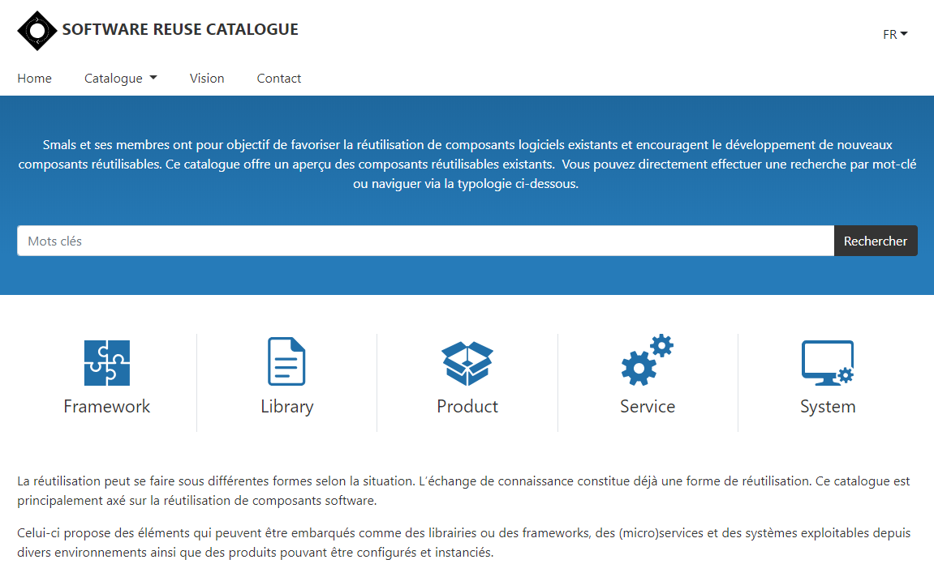
reuse.smals.be
Notes:
NICOLAS

Slide 68
ICT trends
Public Cloud
API Economy
Re-use

Slide 69
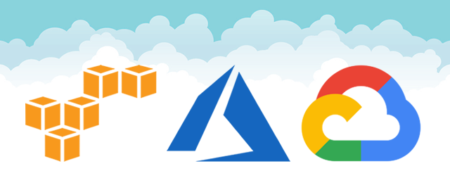

Rise of (public) cloud
Amazon vs Microsoft vs Google
&

Slide 70
Rise of (public) cloud
Need for overall government positioning
  eGov public cloud policy
  based on information classification
  appropriate organizational, technical & contractual measures
  hybrid approach
G-Cloud as broker
  knowledge & expertise on cloud offerings
  contracts & implementation partners
  tools

Slide 71
Public cloud - main issues
Longitudinal confidentiality of personal data
  need for comprehensive longitudinal encryption of personal data
  in motion, at rest and in use
Performant continuous availability of application and data
Easy migration of applications and data
Compliance with GDPR

Slide 72
ICT trends
Public Cloud
API Economy
Blockchain
Re-use

Slide 73



Blockchain is about organizing trust
Blockchain Network
Registration of facts
Transfer of assets
Enforcement of rules

Slide 74











Registration of facts
(Official)
documents
Driving license
Marriage
Diploma
Identity
Will
History/
Overview
Medical
records
Vaccination
Supply chain
Tracking
Taxes
Political
mandates
5f 3b fa 41 9c 63 be 2a 3a 09 ad bd 06 30 c5 1f
64 5e b0 3a ba fc d5 f2 ad 39 63 7a 30 6b 41 77
Will

Slide 75









Transfer of assets
Crypto currencies
(Virtuele assets)
Bitcoin
Monero
Ethereum
.bit
Untangible
assets
Tickets
Domain names
Electricity
Copyright
Tangible
assets
Land registry
Cars
Diamonds

Slide 76











Enforcements of agreements
Permissions
access PII
Flight Delay
Insurance
Auction
Transport
conditions
Processing
medical prescriptions
Elections
Smart locks
Application & Payment
of subsidies / benefits
Blocking
rent guarantee
Crowdfunding
Agreements between parties that do not trust each other,
without trusted intermediary

Slide 77



Integration
Blockchain ≠ a complete business solution, but a component of a larger system
Blockchain ≠ start from scratch (fortunately) => reuse of existing components
“CIOs should view the blockchain portion to be less than 5% of the total project development effort.”

Slide 78
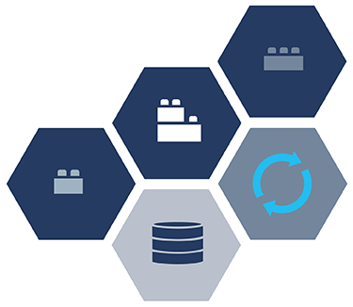






Technological trends
Blockchain isn't the only trend
Multiple technologies combined offer new perspectives and are able to transform the business
Event-driven architecture
API economy
Microservices
Cloud
Containers
(Re)use can lead to fast(er) results

Slide 79




Blockchain as a Service (BaaS)
Setting up a simple blockchain infrastructure can be very complicated
Several cloud providers offer the possibility to set up a blockchain network in their cloud environment
Advantages
The infrastructure’s complexity is hidden
Focus on the applicative part
Faster and cheaper
More security
Disadvantages
Dependence BaaS provider
“We do not trust each other, but we do trust the BaaS provider”
Blockchain technology-specific
Recent development
In the long run government BaaS might be the best option

Slide 80




Future blockchain landscape
Community BaaS
Public BaaS
BaaS
Provider
BaaS
Provider
A
BaaS
Provider
B
BaaS
Provider
C
Own infrastructure
Private
BaaS

Slide 81








Concrete - ideas federal government
Therapeutic relations
Generic traceability service
History cadastre & major works to the home
Identity management
Registration & access management medical data
Tracing food for food safety & sustainability
Government transparency
Cross-border data exchange: who pays social security contributions where?
Prevention/Detection of double or unjustified payments
Tender-calling procedure

Slide 82
ICT trends
Public Cloud
API Economy
Blockchain
Re-use
Big data analytics

Slide 83
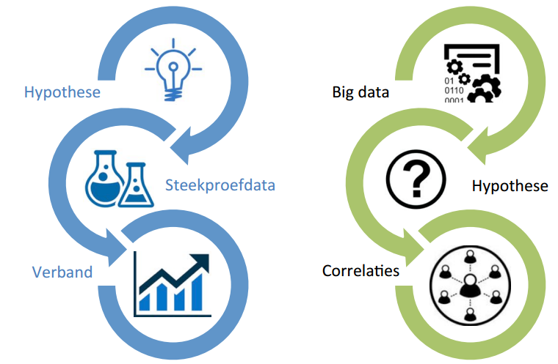
Big data analytics
Variety, velocity, volume, veracity

Slide 84
Big data analytics
Domain | Description
Research | - Phenomenon analysis - (Big) data exploration - Trend analysis
Fraud detection | - Data mining, machine learning, AI - Predictive analytics, predictive modelling
Process support | - Data visualization - Network visualization - Automated searches, calculations, real-time applications of predictive analytics
Policy support | - Reporting, KPI, balanced scorecard - Evaluation of the success measures have - Simulations
Infrastructure management | - Capacity planning - Predictive maintenance
Data protection | - Security Information & Event Management (SIEM)
…

Slide 85
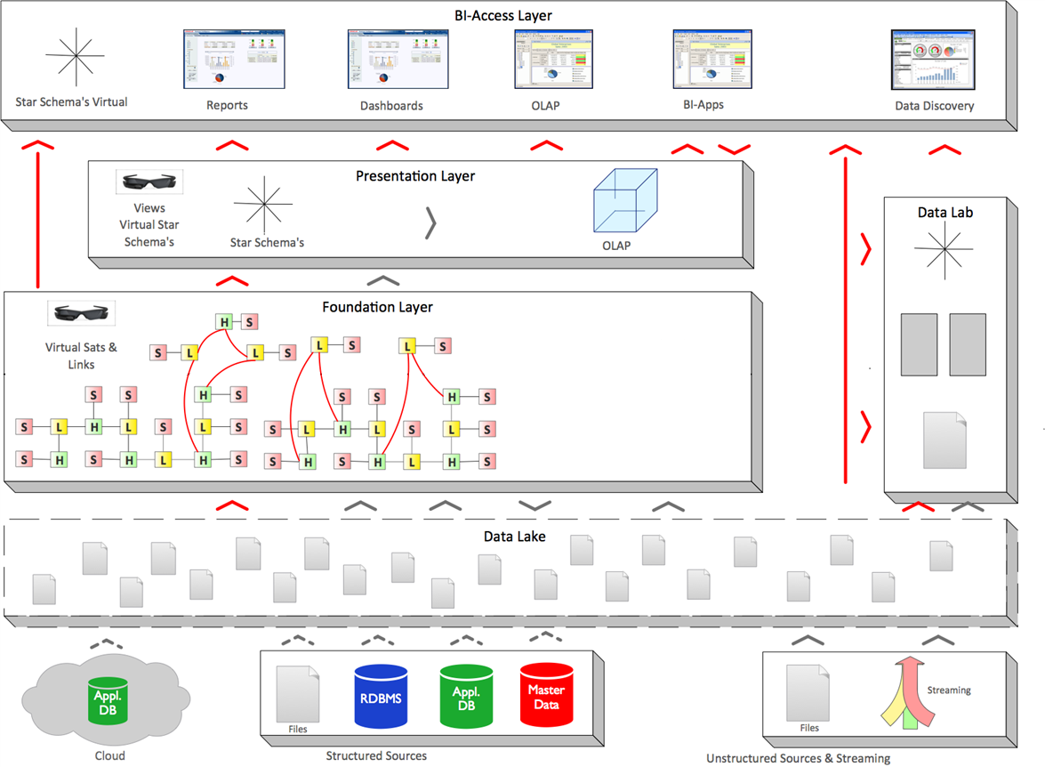

Big data analytics - architecture
BDAP
front-end
All forms of analytical and business value generating re-use of data
BDAP
front-end
Data Mining
AI
Big Data Analytics Platform (Foundation)
Delivers “Bring compute to the data” paradigm:
calculations from front-end tools are pushed to the foundation
Data Integration
Data Warehousing
(ETL—ELT—TEL)
Information Management
Business Glossary
Data Management
Data Quality
Data Governance
Data Protection
Enterprise-ready
Big Data Management solution
(Hadoop, NoSQL)
Relational
Analytical Database
Management System (accelerator)
Computing Power
Connectors
Structured Sources
Unstructured Sources & Streaming
Notes:
BDAP Foundation: sometimes called “Data Lake”, but in this context it’s a Data Lake++ with governance

Slide 86
ICT trends
Public Cloud
API Economy
Artificial Intelligence
Blockchain
Re-use
Big data analytics

Slide 87
What is Artificial Intelligence (AI) ?
An area of computer science concerned with the creation of machines that can reproduce human cognitive functions such as reasoning, planning, learning, language understanding, vision,…
Weak or narrow AI
  simulates intelligence
  is limited to specific areas
  all current implementations of AI are narrow AI
Strong or general AI
  still debated, includes philosophical considerations such as consciousness, intentionality, …
  has real intelligence
  has mental states and beliefs like humans
  holy grail !

Slide 88
Short history
Boom of AI
Rise of Expert Systems
Deep Blue
IBM’s … beats champion chess player Kasparov
Many AI successes
- Personal assistants e.g.Siri, Cortana…
- Semi-autonomous driving assistance systems
- Netflix recommender system
Birth of AI
John McCarthy coined the term Artificial Intelligence
The Dendral Program
Knowledge-based system
1950
1964
1980
1993
2000
1956
1969
1987
1997
The Turing Test
Can we distinguish intelligent behaviour from human behaviour?
First Chatbot (ELIZA)
First attempt to pass the Turing Test
1st AI winter
Less results, less funding
2nd AI winter
Expert systems are expensive to maintain and update
Big Data, Deep Learning and beyond
Availability of huge datasets
Increased computational power
Notes:
1950 - The Turing test: Alan Turing introduces in his article « Computing Machinery ad Intelligence » concepts as machine learning, genetic algorithms and reinforcement learning
1956 – Birth of AI: workshop organised by John McCarthy at Darmouth College around the question how to make machine use language, forms abstraction and concepts to solve problems reserved to humans
Dendral Program: knowledge-based systems use build in domain-specific knowledge to reason and solve problems in narrow areas of expertise

Slide 89
Concepts
Artificial Intelligence
Machine learning
Neuron based
Good Old-Fashioned AI: path finding, constraint satisfaction problems, planning, rule-based systems, expert systems, …
Decision trees, clustering, …
“Hot”
Random forests,
support vector machines, …
Data Mining
Deep learning (CNN, RNN, GAN)
Reinforcement learning
Deep reinforcement learning
Notes:
CNN: Convolution Neural Network (image, text)
RNN: Recurrent Neural Network (sequences, text, language)
GAN: Generative Adversarial Networks (https://deeplearning4j.org/generative-adversarial-network)

Slide 90
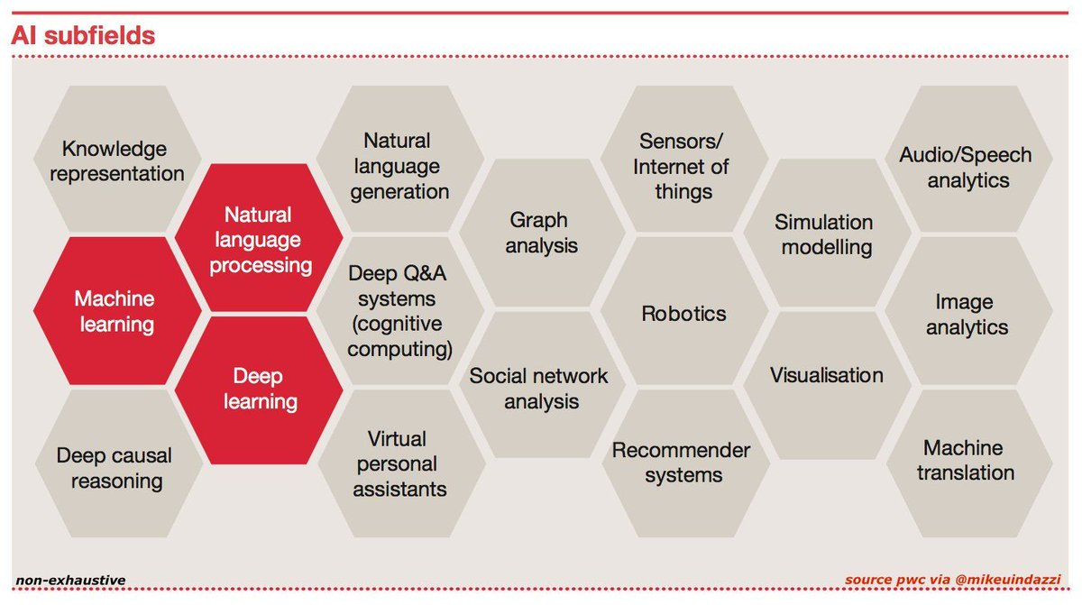
AI domains

Slide 91
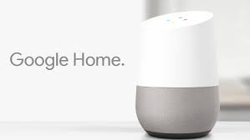
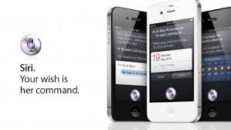
Natural Language Processing (NLP)
Processing of natural language in order to communicate with humans and extract information from written texts
Some applications of NLP are:
  machine translation
  text classification
  information extraction
  speech recognition:
    Google Assistant/Home
    Siri
    Alexa
    Cortana
    ….

Slide 92
Machine learning
Design of algorithms that automatically learn from example data with no or minimal need for human intervention
At the intersection of computer science and statistics
Advantages
  no need to code explicitly all possible situations the machine will have to deal with, the machine adapts to change in conditions or unseen situations
  can learn a solution to a problem by itself where it would be hard for a human to explicitly instruct the machine
Notes:
Machine Learning uses Data Mining techniques and other learning algorithms to build models of what is happening behind some data so that it can predict future outcomes. A computer program is said to learn some task from experience if its performance at the task improves with experience, according to some performance measure. Machine learning involves the study of algorithms that can extract information automatically (i.e., without on-line human guidance). Most tasks that require intelligence require an ability to induce new knowledge from experiences. Thus machine learning is a large area within AI.

Slide 93
Machine learning approaches
Supervised learning
learns from examples of pairs of input-output
feedback from a ‘teacher’ which provides the correct answer for example inputs
Unsupervised learning
no feedback from a ‘teacher’
learns patterns in the input
Reinforcement learning
very efficient for complex problems in unknown environment
no feedback from a ‘teacher’
particularly used in Robotics (film robot)
receives a reward if successful at executing a task or punishment otherwise
most common approach
used mainly for clustering
eg chatbot
Notes:
Source: « Artificial Intelligence: A moder approach » Russel, Norvig

Slide 94
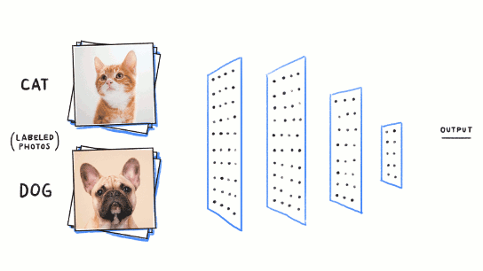
Neuron based machine learning
Initially built to mimic the brain, thousands of interconnected computing units or neurons
Neurons represent patterns
More neurons → richer and deeper insights

Slide 95
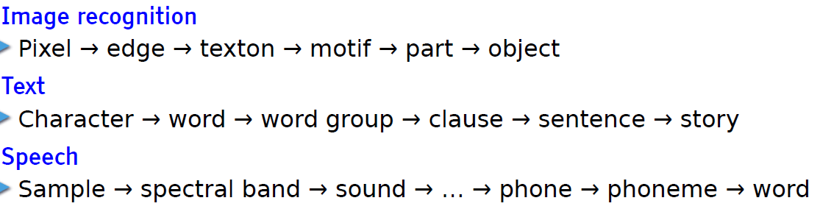
Deep learning
= deep neural network
  neurons or units are organised on more than one layer hence the word « deep»
State of the art: achieves outstanding performance in areas such as speech recognition
Learn hierarchical representations
Leçon inaugurale au Collège de France, Yann LeCun, 04 avril 2016

Slide 96
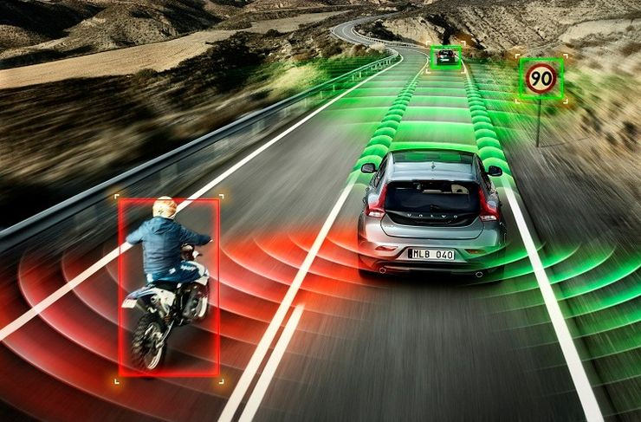
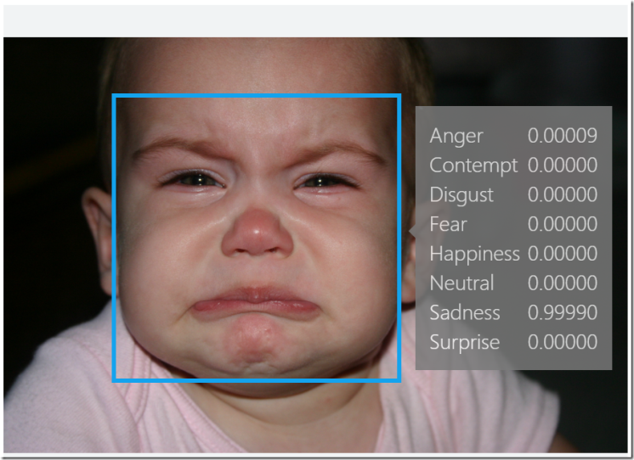
AI applications
Automotive:
  self-driving/-flying robots
Finance and economics:
  automatic trading
  fraud detection
Video games
  non-playable characters
  VR world generation
Communication & social media
  spam filters
  smart email categorization
  face recognition
  speech recognition
Human resources
  resume screening
  recruiting chatbots

Slide 97
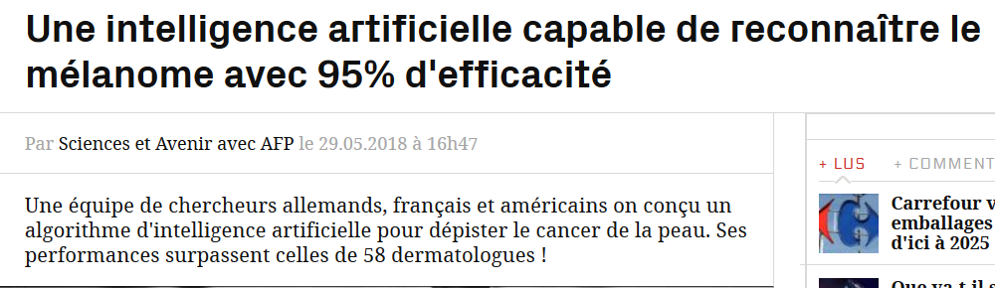
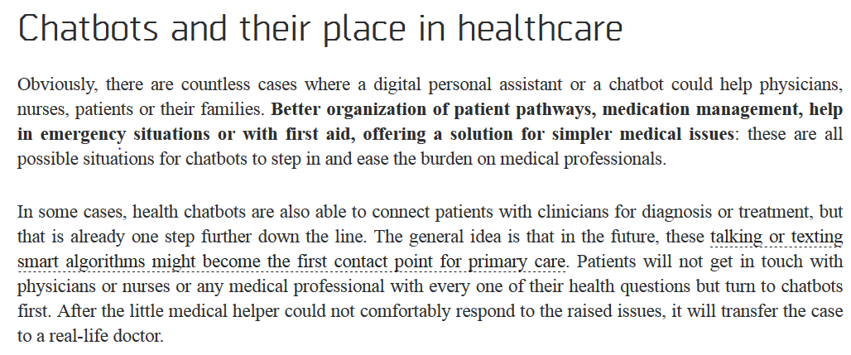
AI applications – healthcare
Notes:
Detection cancer de la peau: Utilisation des réseaux neuronaux convolutifs; 95% d’efficacité pour l’ AI contre 89% pour les dermatologues
Source chatbots and their place in healthcare: http://medicalfuturist.com/top-12-health-chatbots/

Slide 98
AI applications - public sector
Where does it apply?
  when there are lot of administrative and repetitive tasks
  where the workload is too important for the available resources
  for large and complex datasets to analyse
Potential use cases
  understanding and answering citizen questions
  search documents
  document classification
  translation
  legal service: find related case laws
  fraud detection / anomaly detection
  case management / process management
  next best action
  decision support
Notes:
Chatbot: The next wave of AI in citizen services will be more predictive. AI platform will understand what the citizen is doing
or asking, and will prompt to take action on specific issues, asking whether a new driver’s license should be ordered. Artificial Intelligence for Citizen Services and Government, Mehr, Harvard Ash Center

Slide 99
Points of attention
Interpretability in decision making
  whoever undergoes the impact of a decision made by an AI System must be able to understand and challenge it
  black box versus white box
Violation of rights and ethical principles
  autonomous weapons
  profiling & privacy
  discrimination (bias is one of the biggest problem in AI)
Risk of loss of human knowledge
Job losses ?
Notes:
Black box versus white box: humans have no insight in the reasoning and the steps the machine has taken to give a particular output
Bias in AI: Bias is introduced when the data are not enough representative. Ex: In 2015, a google app tagged two black people as gorillas because it wasn’t trained with enough dark skinned people.

Slide 100
Cloud & data confidentiality
Big cloud vendors
  lots of support for AI
  innovative solutions
  easy to get started very quickly
  web based tools
  pre-trained AI models
  even specialized hardware (GPU)
But... in a government context, we must pay attention to
data confidentiality
?
AI-platform

Slide 101
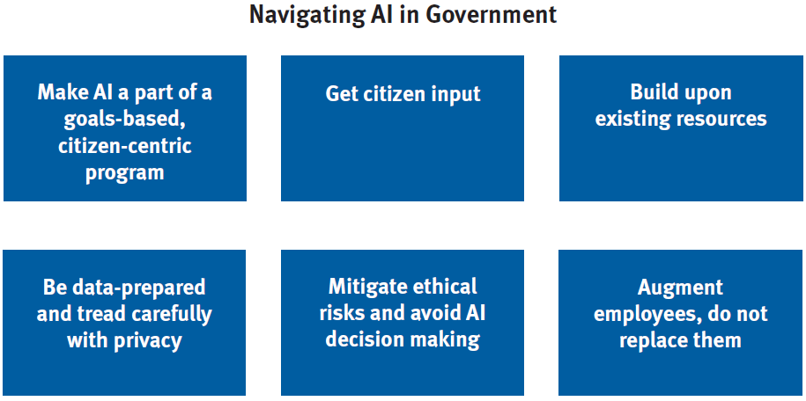
Guidelines for AI in the public sector
Artificial Intelligence for Citizen Services and Government, Ash Center for Democratic Governance and Innovation, Hila Mehr, August 2017
Notes:
Make AI a part of goals-based program: AI should not be implemented just because it is new, it should be the right tool for the problem it solves. citizen’s end-to-end
Journey.
Get citizen input: offer sessions for citizens to create an agenda for AI while addressing any potential concerns, educate everyone from citizens to policymakers so that they truly understand how it works and its tradeoffs.”
Build upon existing resources: do not build the systems from scratch, make use from open-source machine intelligence programs, integrating AI into existing platforms where there is existing data
Be data-prepared, and tread carefully with privacy: significant amount of data avalaible for training, good data management
Mitigate ethical risks and avoid AI decision making: AI is susceptible to bias, AI should only be used for analysis and process improvement
Augment employees, do not replace them: early research has found that AI works best in collaboration with humans

Slide 102

Ethical AI principles
Moral machines
Well-being
Autonomy
Privacy
Knowledge
Democracy
Responsi-bility
Justice
  https://www.montrealdeclaration-responsibleai.com/the-declaration

Slide 103
ICT trends
Public Cloud
API Economy
Artificial Intelligence
Blockchain
Re-use
Conver-sational Interfaces
Big data analytics

Slide 104
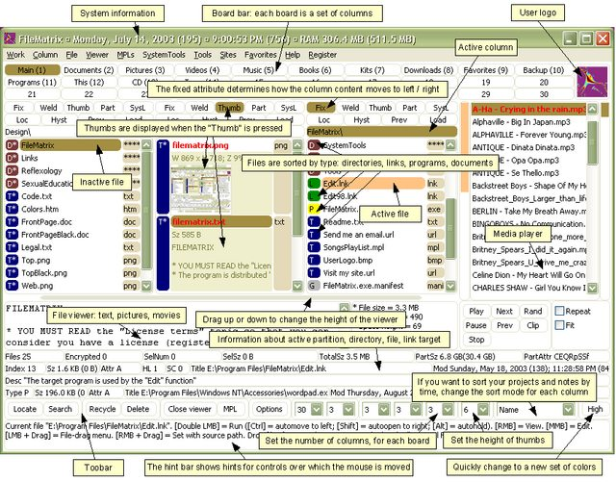
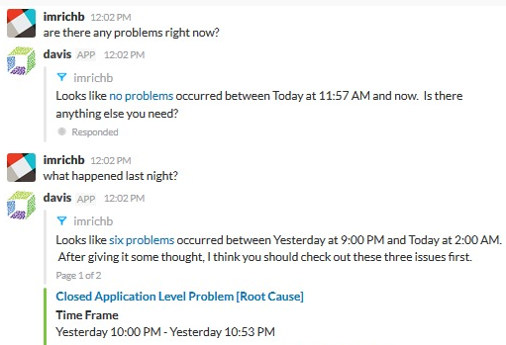
Conversational interfaces
A conversational interface is a user interface which allows interacting with the computer based on conversations in natural language (text or speech)
Lowers the threshold: users do not have to learn how to work with the (graphical) interface
versus

Slide 105
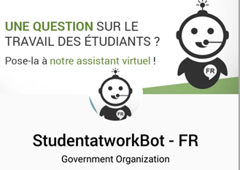
Conversational interfaces
Use of AI – technologies
On-premise <-> cloud
Rapid pace of innovation / improvements

Slide 106
ICT trends
Public Cloud
API economy
Artificial Intelligence
Blockchain
…
Reuse
Conversational interfaces
Big data analytics

Slide 107

G-Cloud = opportunities
Design by public sector with help from private sector
Built in cooperation with private sector
Run
  without heavy investment
  in a safe and familiar environment
  scalable
  easy to adjust
Concepts and components reusable outside the public sector
Drive/support innovation

Slide 108
PPP and concession as intended in ESA
Should the Oosterweel project be included in the national budget or not ? ESA (European System of Accounts) rules apply
Both PPP (government bearing the largest part of the costs through compensations) or concessions (government pays no or only limited compensations) can be used for ICT related project funding
Under correct (utterly strict) conditions, no impact or spread impact on the public budget
Traditionally used for buildings or large infrastructure works, but can also be used for projects using ICT

Slide 109
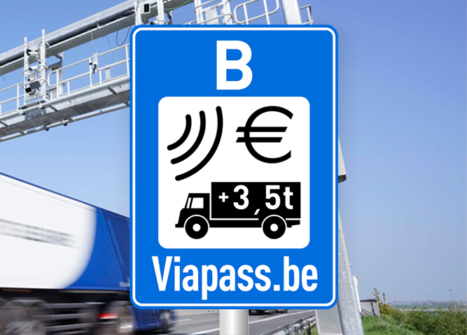
PPP and concession as intended in ESA
Mileage-based charges for lorries is a PPP project
DBFMO (Design, Build, Finance, Maintain and Operate) contract awarded to NV Satellic

Slide 110
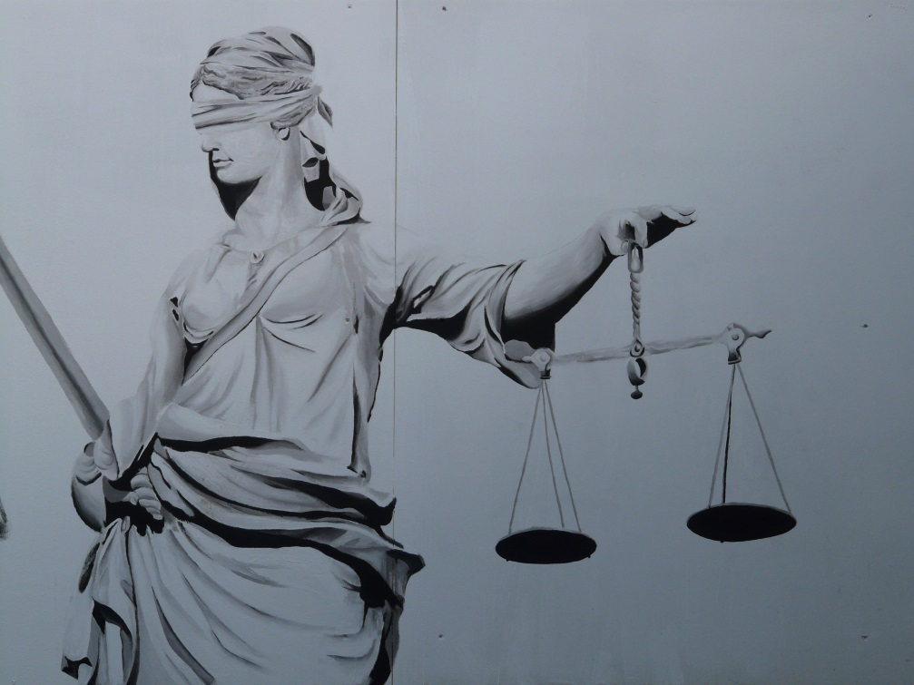
PPP and concession as intended in ESA
Concession: distribution of debt collection missions to bailiffs
Government only creates XML messages
Concessionaire distri-butes to bailiffs and handles feedback about the evolution of the cases
Works for multiple governments
Each bailiff can participate

Slide 111

What about a platform economy ?
We are living in a platform economy:
eBay, Amazon
YouTube
Google, Baidu
Paypal, Alipay
iOS, Android
Airbnb, TripAdvisor
Uber
Linkedin, Glassdoor
Notes:
Glassdoor is a website where employees and former employees anonymously review companies and their management.^{[2]}
The site later also began focusing on CEOs and workplaces, as well as what it is like to work at jobs in general.^{[9]} Employee reviews are averaged for each company.^{[10]} Glassdoor ratings are based on user-generated reviews. Each year Glassdoor ranks overall company ratings to determine its annual Employees’ Choice Awards, also known as the Best Places to Work Awards.^{[11]}
Glassdoor heeft zich hierdoor ontwikkeld als een belangrijke website voor rekruteringen.
=>Baidu, Inc. (Chinese: 百度; pinyin: Bǎidù, anglicized /ˈbaɪduː/ "by-doo"), incorporated on January 18, 2000, is a Chinese web services company headquartered at the Baidu Campus in Beijing's Haidian District.^{[6]} It is one of the largest Internet companies in the world.
Baidu offers many services, including a Chinese search engine for websites, audio files and images. Baidu offers 57 search and community services including Baidu Baike (an online, collaboratively built encyclopedia) and a searchable, keyword-based discussion forum.^{[7]}Baidu was established in 2000 by Robin Li and Eric Xu.
Alipay.com is a third-party online payment platform. It was launched in China in 2004 byAlibaba Group and its founder Jack Ma. According to an analyst research report, Alipay had the biggest market share in China with 400 million users and control of just under half of China's online payment market in October 2016.

Slide 112
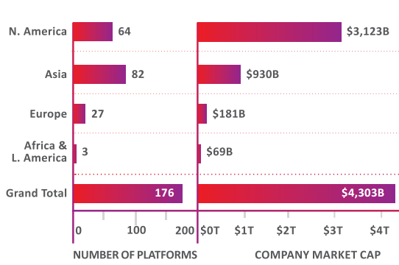
What about a platform economy ?
"A platform is a business that creates value by facilitating direct interactions between two or more distinct types of customers"*
Total value of platform companies >4,000 billion €
Europe < 5%
*
* Andrei Hagiu & Julian Wright – Multi-sided platforms

Slide 113
Creation of a geographic niche ?
Can we set up a platform based on the creation of a geographic niche ?
Combine & integrate elements already present or in preparation:
  eID and strong mobile authentication
  well integrated and innovative digital payments
  eBox citizens and enterprises
  strong authentic sources
  one single gateway to private interactions, purchases and transactions with the government
Trust in local actors & local enforcement
User centricity: focus on what local users prefer
Advantages for citizens, enterprises and authorities
Time for a systematic cooperation or PPP culture ?

Slide 114
Wrap up
Shift from basic ICT services -> value added (business) services
Focus on re-use
Rise of new technologies
  need for common solutions
  platform-approach
Innovative means of collaboration with private sector needed

Slide 115
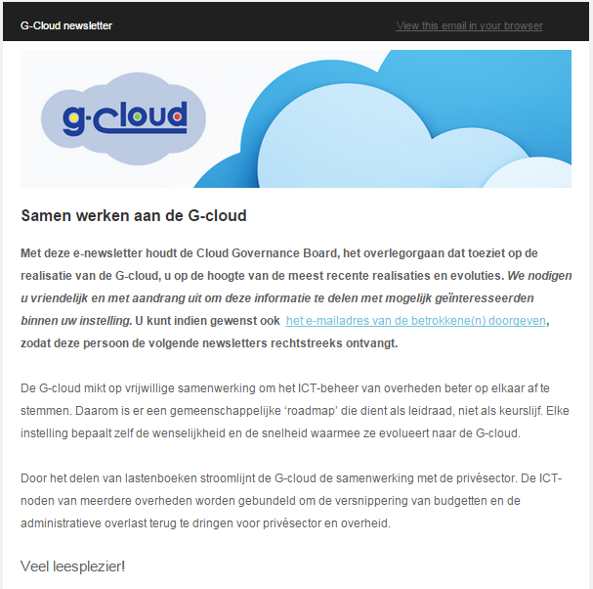
Newsletter
Subcribe via info@gcloud.belgium.be

Slide 116
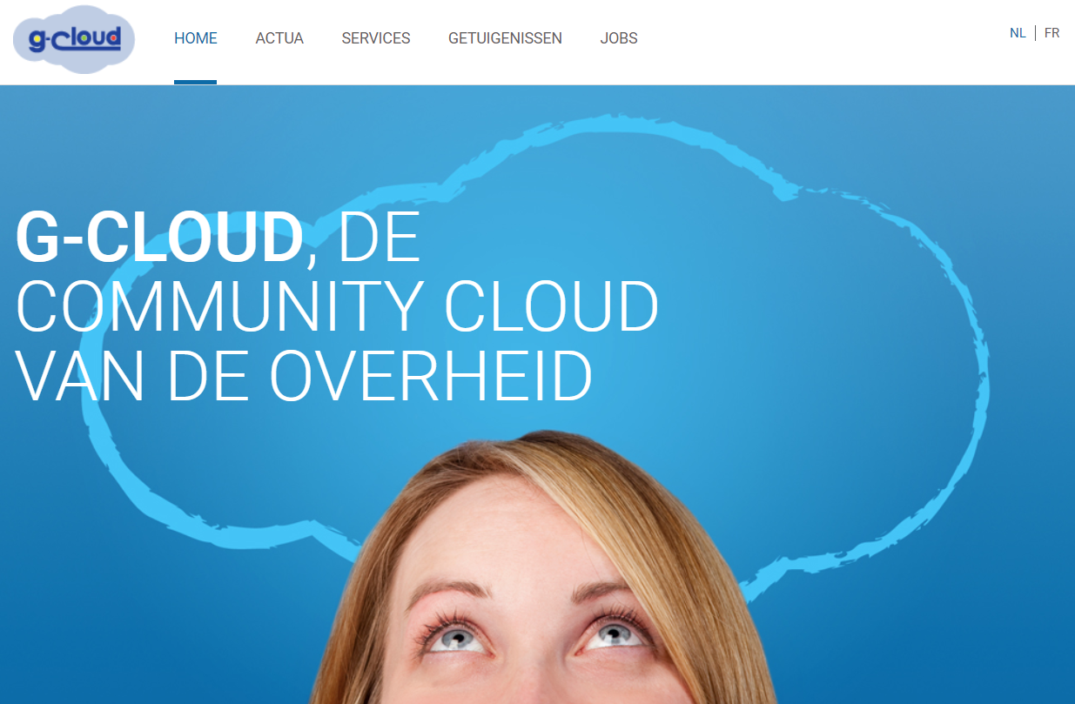
website
www.gcloud.belgium.be
-> service fiches

Slide 117


Want to know more?
http://www.gcloud.belgium.be
info@gcloud.belgium.be

Slide 118



frank.robben@mail.fgov.be
@FrRobben
https://www.frankrobben.be
https://www.gcloud.belgium.be

