Slide 1

Dashboard eHealth services: actual mockup

Slide 2
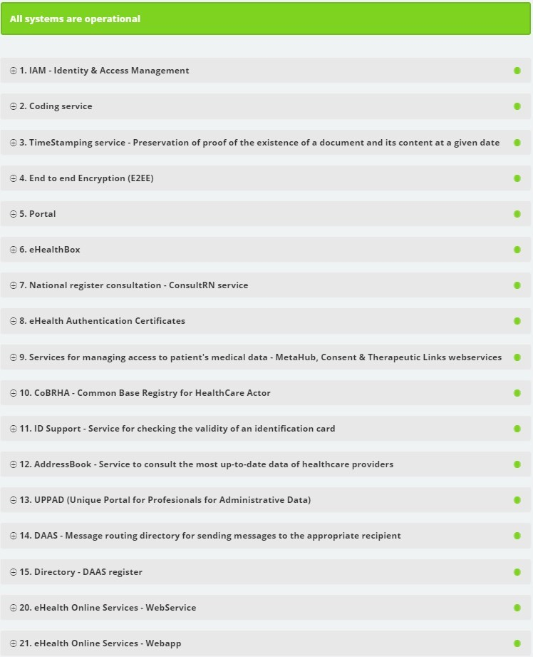

Slide 3
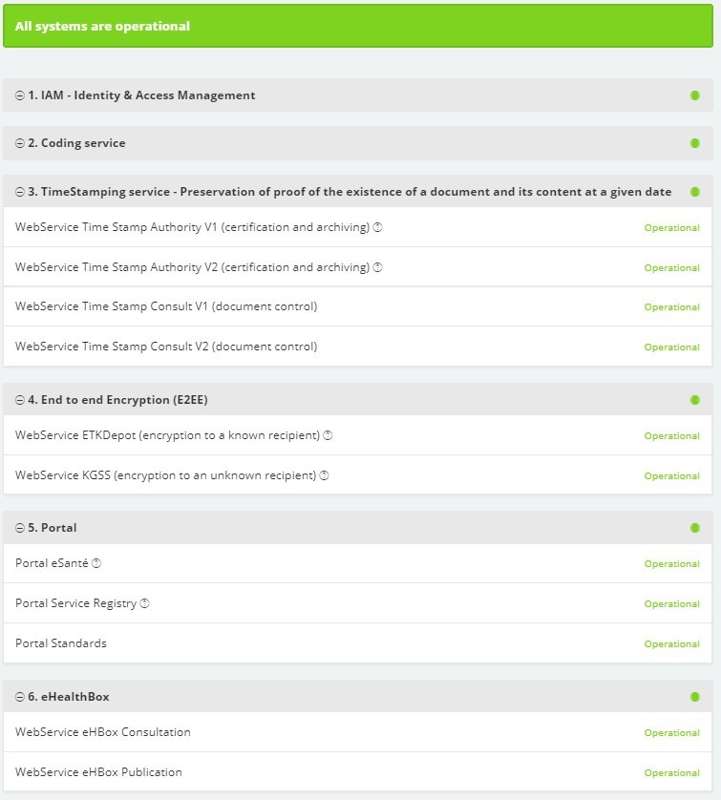

Slide 4
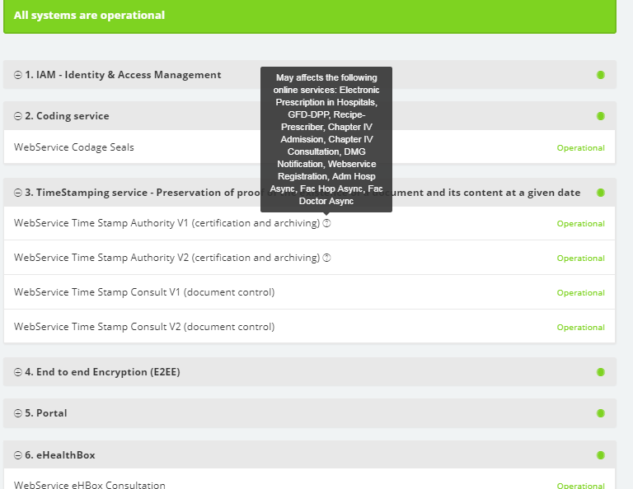


Slide 5
Efficient and secure transborder exchange of patient data

Slide 6











A

Slide 7
Basic requirements
Correct identification of the patient
Correct routing of the information request
Privacy and information security management
  user & access management
  end-to-end encryption
Interoperability
  technical
  semantic

Slide 8
10 Basic services eHealth-platform
Coordination of electronic sub-processes
Portal
Integrated user and access management
Logging management
System for end-to-end encryption
eHealthBox
Timestamping
Encoding and anonymization
Consultation of the National Identification Registers
Reference directory (metahub)

Slide 9
Identification of the patient
Obligatory use of social security identification number (SSIN) in Belgian health sector
Procedures are available in order to guarantee unicity of SSIN
SSIN is available on electronic identity card or ISI+-card
Link register is available in order to link the Belgian SSIN with identification numbers in other countries

Slide 10
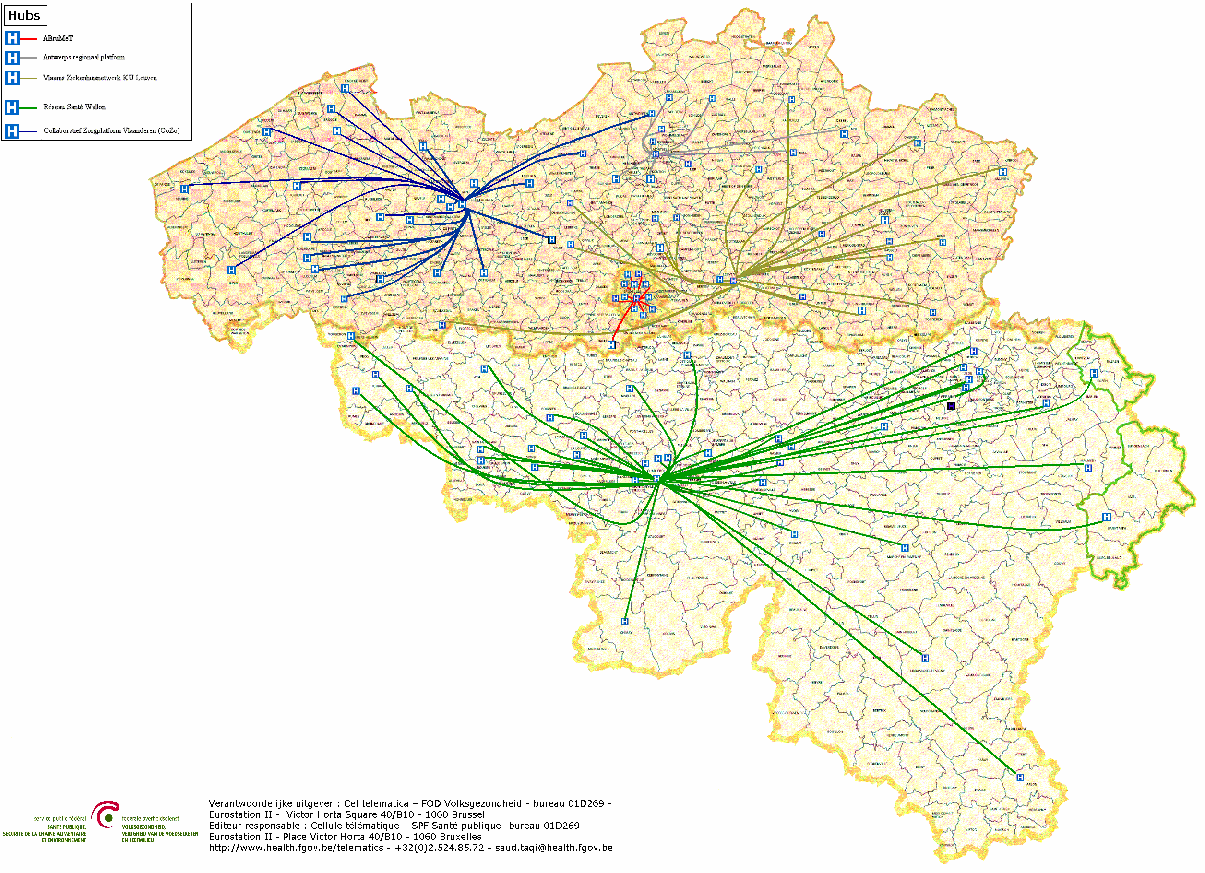
Routing: hubs & metahub system
5 hubs
3 technical implementations
All Belgian hospitals connected

Slide 11



Routing: hubs & metahub system
3. Retrieve data from hub A
A
1: Where can we find data?
2: In hub A and C
4:
All data available
3: Retrieve data from hub C
C
B

Slide 12
Routing: extramural data
A
InterMed
BruSafe
C
B

Slide 13
User & access management (UAM)
reliable exchange of personal data requires sufficient certainty about the identity of the data subjects (cf supra)
adequate access control requires sufficient certainty about
  identity of the users
  authentication of the identity of the users
  verification of relevant characteristics of the users
  verification of relevant relationships between the users and the data subjects
  verification of relevant mandates of the users

Slide 14
UAM: objectives to be reached
be able to (electronically)
  identify all relevant entities (physical persons, companies, applications, machines, …)
  know the relevant characteristics of the entities
  know the relevant relationships between entities
  know that an entity has been mandated by another entity to perform a legal action
  know the authorizations of the entities
in a sufficiently certain and secure way
in as much relations as possible (C2C, C2B, C2G, B2B, B2G, …)
using open interoperability standards

Slide 15
UAM: policy enforcement model

Slide 16

UAM: policy enforcement model

Slide 17
First step: eIDAS regulation
regulation (EU) No 910/2014 of 23 July 2014 on electronic identification and trust services for electronic transactions in the internal market
overall objective: strengthen EU single market by boosting trust and convenience in secure and seamless cross-border electronic transactions
3 means
  increasing the effectiveness of public and private online services, electronic business and electronic commerce in the European Union, by eliminating (legal and technical) obstacles for the functioning of the internal market => choice for a regulation
  enhance trust in electronic transactions , in particular cross-border transactions, by providing a common foundation for secure electronic interaction between citizens, businesses and public authorities => high level of security and better information (EU trust mark)
  enhance legal certainty within the use of electronic identification means and trust services
regulation => direct effect on Belgian law

Slide 18

eIDAS regulation: overall content
mandatory mutual recognition of some electronic identification means
electronic trust services
  scope
    electronic signatures, including validation and preservation services
    electronic seals, including validation and preservation services
    time stamping
    electronic registered service delivery
    website authentication
  horizontal principles: security requirements, trusted lists, EU trust mark, prior authorisation, qualified services, liability, data protection, supervision, international aspects
non-discrimination of electronic documents vis-à-vis paper documents as evidence in legal proceedings
does not regulate mutual recognition of proof of characteristics or relationships !

Slide 19
Belgian law on electronic identification
Belgian law on electronic identification of 18 July 2017 completes the eIDAS Regulation
some provisions:
  each Belgian public sector body determines the required assurance level for access to its services and informs DG DT about this
  DG DT determines the assurance level of the schemes to be notified to the European Commission, after consulting the Colleges of Presidents of the federal public services, the social security institutions and the federal public utility institutions
  DG DT is charged with offering electronic notification services within the federal authentication service (FAS)
  DG DT passes a minimum set of person identification data to the node of another MS (retrieved from by SSIN), when a user wants access to an online service in that other MS

Slide 20
End-to-end encryption
2 methods
  in the case of a known recipient: use of an asymmetric encryption system (2 keys)
  in the case of an unknown recipient: use of symmetric encryption (the information is encrypted and stored outside the eHealth platform; the decryption key can only be obtained through the eHealth platform)
need for agreements in an international context

Slide 21
Asymmetric end-to-end encryption
Healthcare actor
Person or entity
eHealth platform
Internet
1
3
Connector or
other software to
generate key pair
Authenticates sender
2
4
Sends
public key
Identification
certificate
Identificatieoncertificate
Stores
public key
Web service
Register key
2
Public keys
repository
Stores private key
in a secure way

Slide 22
Asymmetric end-to-end encryption
Message originator
eHealth platform
Internet
Identification certificate
Web service
Ask public key
1
Identification
certificate
2
Asks for public key
Authenticates sender
Send message
Any protocol
3
4
Sends
public key
Encrypts
message
Identification
certificate
Message recipient
Public keys
repository
5
Stored
private
key
Decrypts message

Slide 23
Symmetric end-to-end encryption
Key
Management
/ Depot
Encrypted with public key of user 1
Encrypted with public key of user 2
Symmetric key
Symmetric key
2 sends key
5 receives key
User 1
Originator
1 asks for key
User 2
Recipient
4 justifies right to
obtain key
4 justifies right to
obtain message
3 sends encrypted message
Encrypted with public key of Message depot
5 receives message
Encrypted with public key of User 2
Message encrypted with
symmetric key
Messages
Depot
Message encrypted with
symmetric key
Message encrypted with
symmetric key

Slide 24
Interoperability
technical
  preferably structured messages
  use of international standards
semantic
  preferably common coding system
  with embedded translation into different languages

Slide 25
Thank you !
Any questions ?

