Slide 1



What support can the eHealth platform and the Crossroads Bank for Social Security offer to mortality research?
frank.robben@main.fgov.be
@FrRobben
https://www.ehealth.fgov.be
https://www.ksz.fgov.be
https://www.frankrobben.be

Slide 2
Outline
Big data analysis
  some characteristics
  components
  value chain
  some areas in health care
EU General Data Protection Regulation (GDPR)
  principles
  methodology
The main challenge
  how to use the opportunities of big data analysis in health care
  while effectively managing the risks
Implementation in Belgium: possible support by
  the eHealth platform
  the HealtData.be platform
  the Crossroads Bank for Social Security
2

Slide 3
Some characteristics of big data analysis
Data characteristics
  high volume, variety, velocity, veracity
  multiple data sources
  data collection too large and/or too complex to be treated by traditional software
Characteristics of methods/techniques to analyse data
  data driven, looking for patterns and correlations
  rather than hypothesis driven, looking for causalities

Slide 4
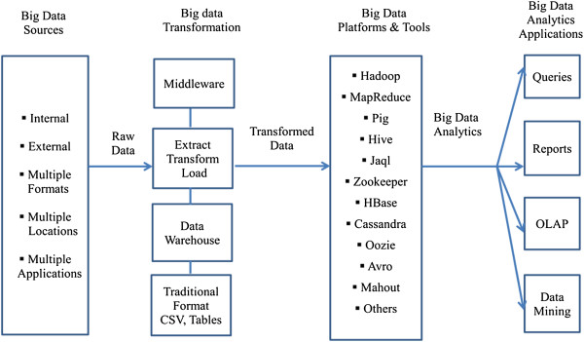
Big data analysis components
Source: https://www.ncbi.nlm.nih.gov/pmc/articles/PMC4341817/

Slide 5
Big data analysis value chain
Data collection
Preparation & storage
Analysis
Use
Iterative, rather than sequential process
Use of data can be
  descriptive
  predictive
  prescriptive
Need for appropriate measures to mitigate risks
  in all phases
  taking into account the type of use

Slide 6
Big data analysis areas in health care
Support of clinical operations
  comparative effectiveness research to determine more clinically relevant and cost-effective ways to diagnose and treat patients
R&D
  predictive modeling to and produce a leaner, faster, more targeted R&D pipeline in drugs and devices
  statistical tools to improve clinical trial design and patient recruitment
  analyzing clinical trials and patient records to identify follow-on indications and discover adverse effects before products reach the market
Source: McKinsey
Notes:
Clinical operations: Comparative effectiveness research to determine more clinically relevant and cost-effective ways to diagnose and treat patients.
Research & development: 1) predictive modeling to lower attrition and produce a leaner, faster, more targeted R & D pipeline in drugs and devices; 2) statistical tools and algorithms to improve clinical trial design and patient recruitment to better match treatments to individual patients, thus reducing trial failures and speeding new treatments to market; and 3) analyzing clinical trials and patient records to identify follow-on indications and discover adverse effects before products reach the market.
Public health: 1) analyzing disease patterns and tracking disease outbreaks and transmission to improve public health surveillance and speed response; 2) faster development of more accurately targeted vaccines, e.g., choosing the annual influenza strains; and, 3) turning large amounts of data into actionable information that can be used to identify needs, provide services, and predict and prevent crises, especially for the benefit of populations [24].
In addition, suggests big data analytics in healthcare can contribute to
Evidence-based medicine: Combine and analyze a variety of structured and unstructured data-EMRs, financial and operational data, clinical data, and genomic data to match treatments with outcomes, predict patients at risk for disease or readmission and provide more efficient care;
Genomic analytics: Execute gene sequencing more efficiently and cost effectively and make genomic analysis a part of the regular medical care decision process and the growing patient medical record;
Pre-adjudication fraud analysis: Rapidly analyze large numbers of claim requests to reduce fraud, waste and abuse;
Device/remote monitoring: Capture and analyze in real-time large volumes of fast-moving data from in-hospital and in-home devices, for safety monitoring and adverse event prediction;
Patient profile analytics: Apply advanced analytics to patient profiles (e.g., segmentation and predictive modeling) to identify individuals who would benefit from proactive care or lifestyle changes, for example, those patients at risk of developing a specific disease (e.g., diabetes) who would benefit from preventive care

Slide 7
Big data analysis areas in health care
Public health
  analyzing disease patterns and tracking disease outbreaks and transmission
  faster development of more accurately targeted vaccines
  turning large amounts of data into actionable information that can be used to
    identify needs
    provide services
    predict and prevent crises
Source: McKinsey

Slide 8
Big data analysis areas in health care
Contribution to
  evidence-based medicine
  genomic analytics
  pre-adjudication fraud analysis
  device/remote monitoring
  patient profile analytics to identify individuals who would benefit from preventive care or lifestyle changes
Source: McKinsey

Slide 9
EU General Data Protection Regulation
Methodology
  risk based approach
  documentation duty
  privacy by design
  privacy by default
  codes of conduct
  certification
  additional measures for sensitive data
Main principles
  purpose limitation
  proportionality
  accuracy and data quality
  security
  transparancy
  accountability

Slide 10
Some risks and how to manage them
Risk of singling out individuals without necessity
  aggregation, anonymisation and pseudonymisation of data
  small cells risk analysis
  legal obligation to not to attempt to re-identify data subjects
Risk of data bias
  careful selection of data used
  reliable analysis methodologies (interative modelling)
  ‘equal opportunity by design’
  appropriate training
  transparancy

Slide 11
Some risks and how to manage them
Risk of violation of purpose limitation principle
  preliminary transparency about purposes of big data analysis
  respecting GDPR, especially in case of big data analysis for public health or scientific research purposes
Risk of huge increase of data storage (quantity and duration)
  limitation of personal data storage to the extent and during the time useful for the foreseen legitimate purposes
  aggregation, anonymisation or pseudonymisation of personal data that are only stored for public health or scientific research purposes

Slide 12
Mission of the eHealth platform
How?
  through a well-organised, mutual electronic service and information exchange between all actors in health care
  by providing the necessary guarantees with regard to information security, privacy protection and professional secrecy
What?
  optimisation of health care quality and continuity
  optimisation of patient safety
  reduction of administrative burden for all actors in health care
  thorough support of health care policy and research

Slide 13
10 Tasks of the eHealth platform
Development of a vision and of a strategy for eHealth
Organization of the cooperation between all governmental institutions which are charged with the coordination of the electronic service provision
The motor of the necessary changes for the implementation of the vision and the strategy with regard to eHealth
Determination of functional and technical norms, standards, specifications and basic architecture with regard to ICT

Slide 14
10 Tasks of the eHealth platform
Registration of software for the management of electronic patient files
Managing and coordinating the ICT aspects of data exchange within the framework of the electronic patient files and of the electronic medical prescriptions
Conceptualization, design and management of a cooperation platform for secure electronic data exchange with the relevant basic service

Slide 15
10 Tasks of the eHealth platform
Reaching an agreement about division of tasks and about the quality standards and checking that the quality standards are being fulfilled
Acting as an independent trusted third party (TTP) for the encoding and anonymization of personal information regarding health for certain institutions summarized in the law for the support of scientific research and the policymaking
Promoting and coordinating programmes and projects

Slide 16
Possible support by eHealth platform
Stakeholder involvement
  Board of Directors
  Users Committee
Organisational and technical support
  proposals for policies and codes of conduct
  trusted third party for anonymisation and pseudonymisation of data (separation of duties)
  organisation of small cells risk analysis
Independent Information Security Committee designated by Parliament
  approval of policies and codes of conduct
  authorisation for data exchange => preventive measures

Slide 17
Governance of the eHealth platform
eHealth platform
Users Committee
Board of Directors
Information Security Committee
(Parliament)
advice
decision
supervision
proposal for
decision
Administration
authorisation

Slide 18








eHealth platform: basic architecture
Patients, health care providers
and health care institutions
Health portal
Health care provider
software
Health care institution software
VAS
Site RIZIV
VAS
portal of the eHealth-platform
MyCareNet
VAS
VAS
VAS
Users
Basic Services
eHealth-platform
Network
AS
AS
AS
AS
AS
AS
Suppliers
Notes:
18
18

Slide 19
eHealth platform: 10 basic services
Coordination of electronic sub-processes
Portal
Integrated user and access management
Logging management
System for end-to-end encryption
eHealthBox
Timestamping
Encoding and anonymization
Consultation of the National Identification Registers
Reference directory (metahub)

Slide 20
What the eHealth platform does NOT do
Collecting personal health data
Storing personal health data
Storing anonymized or pseudonomized health data
Analysing health data
Carrying out studies

Slide 21
Possible support by Healthdata.be platform
Public service by Sciensano (formerly known as WIV-ISP)
Objective: re-use of digitalized information from clinical workflow (real world), and, preferably, from authentic sources or other validated databases (linked data) for research
Approach
  one technical architecture (free & open)
  one information architecture (independent from technical implementation)
  one set of business processes
Notes:
(1) Software application HD4DP (healthdata for data providers) installed in hospital: automatic capture of existing data (using webservices or csv polling) from operational systems (like EHR, LIMS, …) with possibility of manual input and validation in eform. In case of manual input remains available (structured and coded, according to [inter]national standard, based on CBBs) in local database of DP: Import in future upgrade of EPD/LIMS; Re-Use for internal BI & QI
Central digital catalogue with technical description of each data collection (variables, list of values, validation rules, help text). Catalogue communicates this description in real time to HD4DP. For each data collection, the National Registry number (NISS)is used as key ID of the patient.
(2) During transfer from data provider towards researcher, all registrations are encrypted. The ID of the patient (NISS) is pseudonomyzed by a Trused Third Party (the national eHealth platform).
(3) Using the web application HD4RES (healthdata for researchers), the researcher can monitor all registrations in all participating institutions, can view the submitted data, can comment on each submitted value, can return comment to data provider (e.g. a request for correction), …
(4) A generic « Data Quality Tool » facilitates the quality control, by the researcher (NOT by staff HD), of the submitted data.
(6) The researcher accesses his clean data set using a secured VPN connection and his electronic ID Card. Statistical tooling like SAS, STATA, R … are available for statistical analysis by the researcher (NOT by staff HD).
(7) Healthstat.be is the reporting platform of healthdata.be: first public and private reports will be available by March 2017. Researchers provide definition of reports, staff of HD develop the reports.

Slide 22
Healthdata.be platform
Ambition: no administrative burden, higher efficiency, should result in
  more time for patient and thus higher quality of care
  more time for research and thus higher quality of research
  lower overall costs
Guiding scientific principles of the Healthdata.be platform: the FAIR principles (cf Wilkinson et al. 2016): data and metadata should be
  Findable
  Accessible
  Interoperable
  Re-usable

Slide 23






Healthdata.be architecture
One generic technical architecture for collection and management of real world data is in production in all Belgian hospitals and most laboratories
HealthData.be
HD4DP
HD4RES
DATAWAREHOUSE (SAS)
HEALTHSTAT
⓿
❶
❷
❸
Registration
in Primary System
Data Collection
Secure
Data Transfer
& Encoding of ID’s
❸
❹
❺
❻
❼
Data Monitoring
Data Validation
Data Storage
Analysis
BI-Reporting
Annotation & Correction Request
Notes:
(1) Software application HD4DP (healthdata for data providers) installed in hospital: automatic capture of existing data (using webservices or csv polling) from operational systems (like EHR, LIMS, …) with possibility of manual input and validation in eform. In case of manual input remains available (structured and coded, according to [inter]national standard, based on CBBs) in local database of DP: Import in future upgrade of EPD/LIMS; Re-Use for internal BI & QI
Central digital catalogue with technical description of each data collection (variables, list of values, validation rules, help text). Catalogue communicates this description in real time to HD4DP. For each data collection, the National Registry number (NISS)is used as key ID of the patient.
(2) During transfer from data provider towards researcher, all registrations are encrypted. The ID of the patient (NISS) is pseudonomyzed by a Trused Third Party (the national eHealth platform).
(3) Using the web application HD4RES (healthdata for researchers), the researcher can monitor all registrations in all participating institutions, can view the submitted data, can comment on each submitted value, can return comment to data provider (e.g. a request for correction), …
(4) A generic « Data Quality Tool » facilitates the quality control, by the researcher (NOT by staff HD), of the submitted data.
(6) The researcher accesses his clean data set using a secured VPN connection and his electronic ID Card. Statistical tooling like SAS, STATA, R … are available for statistical analysis by the researcher (NOT by staff HD).
(7) Healthstat.be is the reporting platform of healthdata.be: first public and private reports will be available by March 2017. Researchers provide definition of reports, staff of HD develop the reports.

Slide 24
Healthdata.be platform
Architecture of healthdata.be was thoroughly evaluated:
  positive advice from Working Group Architecture of Users Committee
  authorisation from Information Security Committee
  approval from eHealth platform
25 scientific projects are in production; more then 100 projects on to do list
Healthdata.be
  collects very diverse clinical data: vital signs, diagnoses, procedures, but also complex ‘Next Generation Sequence data’, and will also collect Patient Reported Outcomes and Patient Reported Experiences
  collaborates with other data warehouses: e.g. Crossroads Bank for Social Security for research on social impact of diseases and therapies

Slide 25
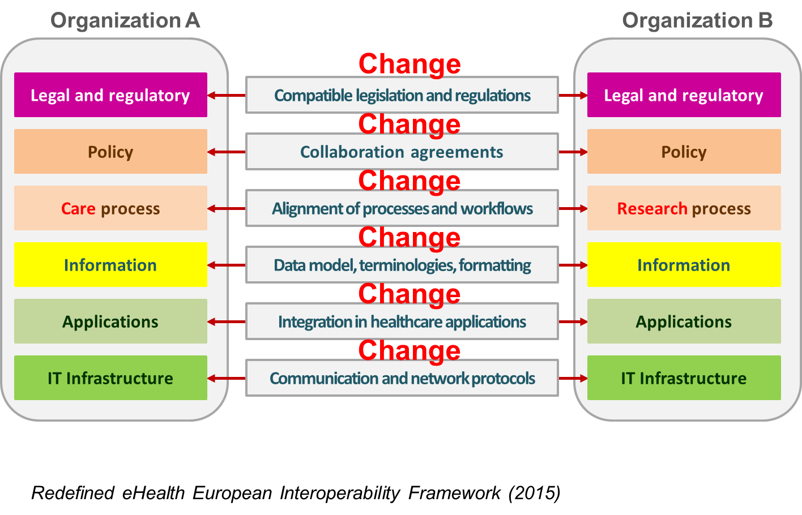

Key determinant: multidimensional interoperability
Being ‘technically’ able to exchange data is not enough !

Slide 26
Key determinant: trust
All scientific projects are - before entering into production - subject to :
  internal evaluation by responsible physician and Data Protection Officer (DPO)
  external evaluation by Steering Committee and Information Security Committee
Collected data becomes available for researchers only after small cell risk analysis by independent specialists, appointed by Information Security Committee

Slide 27
Key determinant: trust
Privacy by design: use of trusted third party (eHealth Platform) for encryption, pseudonymisation, authentication, …
Applications and datacenter are under supervision by key stakeholders (care providers, patients, governments, …) represented in Management Board eHealth platform
Monitoring and auditing: use of software that monitors all activity on infrastructure
Foreseen migration (2019) towards and thus benefit of security measures and services of VAS G-Cloud were other applications with highly sensitive data function

Slide 28
Governance of Healthdata.be platform
Sciensano (WIV-ISP )
Healthdata.be platform
Users Committee eHealth Platform
advice
Steering Committee
Information Security Committee
(Parliament)
ad hoc advice
Belgian Consultative Committee Bioethics
decision
supervision
proposal for
decision
Management Board eHealth Platform
Administration
authorisation
technological
supervision
Notes:
Steering Committee (MD’s, informaticians, patients) decides on eligibility of projects and supervises activities
Belgian Consultative Committee Bioethics is consulted ad hoc by Steering Committee
Sectoral Committee (Parliament) is requested for authorization for each project
Users Committee eHealth Platform supervises / aligns scope and activities of Steering Committee (eg. provides technical advice via Working Group Architecture)
Management Board eHealth Platform supervises all technical solutions, their management and hosting (VAS/G-Cloud)
Healthdata.be:
aligns its activities with the principles and methods adopted by the CIM/IMC Health and published in Action plan eHealth 2013-2018.
is coordinator of Action point 18 on scientific data collections.

Slide 29
CBSS Datawarehouse
Legal assignment of the CBSS: article 5 of the ‘Kruispuntbankwet’
Created to efficiently process data requests from research institutions and the government
Constructed with data from
  the social security institutions
  other government institutions
  the national and CBSS register
  and complemented by self-defined notions
Linkable with other data sources
Documentation
  https://www.bcss.fgov.be/nl/dwh/homepage/index.html
  https://www.bcss.fgov.be/fr/dwh/homepage/index.html

Slide 30
Content
  Data about the labour market
  Data about family allowances
  Data about pensions and pension build-up
  Data about incapacity for work and disabilities
  Data about social assistance (poverty)
  Data about education and certificates
  Personal characteristics
  Data about origin
  Self-defined notions (e.g. socio-economic position)
  Notions on the EU2020 strategy

Slide 31
Functioning and governance
CBSS
  daily monitoring and coordination
  handling custom data requests and developing web applications
University of Leuven and Université libre de Bruxelles
  permanent scientific support
Smals
  hosting of the datawarehouse
Board of users
  council of researchers and government institutions
Board of management:
  council of data suppliers
  Sponsors:
  now: BELSPO / Federal Public Service Social Security / CBSS
  in the future: a group of federal and regional institutions

Slide 32
Use of the datawarehouse
Web applications
  consultation of statistics via the internet
Custom data requests
  scientific and policy supporting research
  only scientific institutions (non-commercial organisations) and government institutions
  encoded personal data or anonymized data
Approval by the Information Security Committee is always mandatory
Prior approval by the institution is possible if desired
At the end of the study, obligation to send a copy of the study report to the CBSS

Slide 33
Conditions for the use of data
In compliance with
  privacy regulation (GDPR, privacy law 30-07-2018,…)
  decision of the Information Security Committee
  contract between data supplier and data recipient
Proportionality
  limitation of the amount of data
  limitation of the amount of data subjects (a sample of the population)
  communication of data in classes (age, nationality, income,…)
No data communication of data to third parties
No re-identification
  implementation of all possible measures to avoid re-identification of the data subject
  no attempts to convert the pseudonymised data into non- pseudonymised data
  publication of the research results exclusively in the form of anonymous data

Slide 34
Conditions for the use of data
Only for the duration of the research
  data must be destroyed afterwards
  a trusted third party can keep the data for a longer period
    for the justification of the research results
    for follow-up
Segregation of duties
  if the data recipient is also (partially) a data supplier
  strict separation between
    the service that processes the non-pseudonymized data for operational purposes (input)
    the service that processes the pseudonymized data for research purposes (output)

Slide 35
Overview of the users
Academic institutions
  commissioned
  own initiative: mostly PhD’s
Government institutions on the federal, regional, provincial and the municipal level, e.g. Statistics Belgium, the Federal Planning Bureau and the National Bank
Political government
Journalists / students
General public

Slide 36
Example of an ongoing use case
Research Institute
  Faculty of Economic and Social Sciences & Solvay Business School / Vrije Universiteit Brussel
Research description
  the general objective is to investigate how (flexible, unstable) employment trajectories (periods of employment, unemployment, inactivity, type of contracts, number of jobs and duration of jobs, number of working hours, forms of non-standard employment, periods of long-term illness, etc.) are related to differences in (cause-specific) disability and general mortality

Slide 37






The future is linked data
Study about labour re-entry after treatment for cancer
NISS, type cancer, stade tumeur au moment diagnostic, type traitement pendant l'année suivant le mois de l'incidence …
NISS, classe d'âge, sexe, position au sein ménage LIPRO, statut relatif droit à l'intervention majorée de l'assurance obligatoire soins santé et indemnités, …
NISS => PseudoNISS
healthdata.be

Slide 38
Thank you !
Any questions ?
frank.robben@main.fgov.be
@FrRobben
https://www.ehealth.fgov.be
https://www.ksz.fgov.be
https://www.frankrobben.be

