Slide 1


Implementing meaningful use of ICT and digital devices in Belgian health care
frank.robben@ehealth.fgov.be
@FrRobben
https://www.ehealth.fgov.be
https://www.ksz.fgov.be
https://www.frankrobben.be

Slide 2
Roadmap eHealth 2.0
End 2012: round table was organized on the further digitization of the health care sector
  about 300 people in the sector participated
  a concrete eHealth action plan was drawn up for 5 years: roadmap 2013-2018
2015 > update: roadmap 2.0 (2015-2018)
  20 action areas with concrete objectives
2018 > roadmap 3.0 (2019-2021) is being prepared with a focus on, amongst others
  operational excellence: availability, performance, quality, chain supervision, usability, training…
  applications for citizens
  support for innovation
  international standards & terminology
  …

Slide 3



Roadmap eHealth 2.0

Slide 4
Roadmap eHealth 2.0
20 areas that can be divided into 5 subcategories
  systems & information flows between health care actors
  optimization of administrative processes
  information for research & policy support
  support & incentives
  basic systems

Slide 5
Roadmap eHealth 2.0
Systems & information flows between health care actors
  AP 3: medication schedule
  AP 4: electronic prescribing
  AP 5: data sharing via the system hubs & metahub by general and university hospitals
  AP 6: sharing data for improved cooperation
  AP 7: psychiatric and other institutions and the system hubs & metahub
  AP 8: implementation of a uniform assessment instrument (BelRAI)
  AP 10: access to the data by the patient
  AP 14: MyCarenet
  AP 19: mobile health

Slide 6
Roadmap eHealth 2.0
Optimization of administrative processes
  AP 1: GMF = EMF => SumEHR
  AP 15: administrative simplification
  AP 16: traceability of implants and medicines
Information for research & policy support
  AP 18: inventory and consolidation of registers

Slide 7
Roadmap eHealth 2.0
Support & Incentives
  AP 2: hospital EPF
  AP 9: incentives for use
  AP 11: communication
  AP 12: training and IT support for health care providers
  AP 20: governance, roll out and monitoring
Basic systems
  AP 13: standards and terminology policy
  AP 17: general use of eHealthBox and data from health care providers available in CoBRHA

Slide 8
Roadmap eHealth 2.0
Focus on
  GMF = EMF => SumEHR
  hospital EPF
  data sharing / hubs & metahubs
  electronic prescribing
  access to the data by the patient
  MyCareNet
  eHealthBox & UPPAD

Slide 9
Action 1: GMF = EMF => SumEHR
In order to guarantee the quality of the care and to inform the patient correctly, the general practitioner (GP) registers the medical data in an EMF (Electronic Medical File)
The EMF is the authentic source for data sharing by GPs
The SumEHR (SUMmarized Electronic Health Record) is a concise summary of the EMF in a structured and coded form that is stored in a well protected health vault with 24/7 availability

Slide 10
Action 1: GMF = EMF => SumEHR
Each patient is entitled to having a SumEHR, if desired
The information in the SumEHR is, with the patient’s consent, accessible to any physician having a therapeutic relation with the patient, and to the patient himself
Use of the SumEHR for out-of-hours GPs and emergency departments is being prioritized

Slide 11
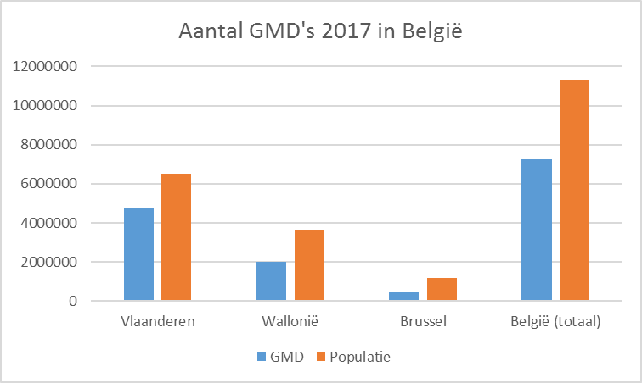
Action 1: GMF = EMF => SumEHR
Number of GMF in 2017

Slide 12
Action 1: GMF = EMF => SumEHR
Objectives 01/01/2020
  GP’s: approval of the legal basis by The National Commission of Representatives of Physicians and Sickness Funds
    every general practitioner has to use a recognized software package with the possibility to register an EMF for each patient
  other health care providers
    definition of the EMF
    publication and update of certain information in the secure ‘health vaults’
Responsible organization: National Institute for Health and Disability Insurance and eHealth platform

Slide 13
Action 2: hospital EPF
EMF = electronic medical file > general practitioners
EPF = electronic patient file > health care providers in general
Integrated EPF is a tool that is necessary for
  better quality / continuity in the health care sector
  administrative simplification (paperless)
  cost reduction (avoiding unnecessary examinations)
  policy support for authorities and hospitals

Slide 14
Action 2: hospital EPF
Integrated EPF has to contain (para-)medically relevant data on a patient (consultation, hospitalization, emergency admission), that is accessible everywhere (intramural and extramural) and at any time
Integrated EPF = interoperable system with
  clinical data on patients
  health care data on patients (medical, nursing)
  data on invoicing, pricing, reimbursement
  administrative data
  management of the planning of consultations, the operation theatre, …
  hotel service
  etc

Slide 15
Action 2: hospital EPF
Simplification of the previous ICT financing method in 3 parts
Phasing but rewarding early adopters
Impossible and imaginary to define the contents/categories of one single EPF for all hospitals at once (size, type of personnel, etc)
Working on the basis of functionalities/goals to be achieved (result commitment)
Use of eHealth value added services
  Belgian Meaningful Use Criteria (BMUC)

Slide 16
Action 2: hospital EPF
BMUC – general hospitals
Functionalities | Step 1 | Step 2 | Step 3 | Step 4
1. Unique patient identification and description | 80% | 90% | 95% | 98%
2 List of (active and passive) problems | 20% | 50% | 80% | 98%
3. List of allergies and intolerances | 30% | 60% | 90% | 98%
4. Electronic prescribing of medicines | 30% | 60% | 90% | 98%
5. Drug interactions | No | No | No | Yes
6. Electronic register of administered medicines | 30% | 60% | 90% | 98%
7. Module for nurse care planning | 0% | 30% | 60% | 98%
8. Management of appointments | >0 | >0 | >0 | >0
9. Electronic input of applications for medical imaging, laboratory or advice | 1 in 3 (X-Ray, labo, consultation) 50% pro rata | 2 in 3 (X-Ray, labo, consultation) 50% pro rata | 3 in 3 (X-Ray, labo, consultation) 50% pro rata | 3 in 3 (X-Ray, labo, consultation) 98% pro rata
10. Electronic discharge letter | 80% | 90% | 95% | 98%
11. Registration of vital parameters | 50% | 65% | 80% | 98%
12. Registration of informed consent | >0 | >0 | >0 | >0
13. Registration of the therapeutic consent | >0 | >0 | >0 | >0
14. Medical results server | 80% | 90% | 95% | 98%
15. Electronic communication with HUBs and interaction with eHealth | 80% | 90% | 95% | 98%

Slide 17
Action 2: hospital EPF
Contract or Action Plan
Step 1 Meaningful Use Model
Start of
Meaningful Use Model
Action Plan
2016/07
2017/06
2018/01
2019/01

Slide 18
Action 2: hospital EPF
  Early Adopters Progressive Budget
  from 0% to 5%
  Accelerator budget:
  = evolutive
  Base per bed = degressive
  from 25% to 10%
  Base per hospital = degressive
  from 20% to 5%

Slide 19
Action 2: hospital EPF
Situation 2018
  77 % strategic ICT plan
  75% multiannual budget
  85% governance structure
Objectives 2019
  most hospitals have an integrated EPF in production and are already using it, other hospitals are implementing an integrated EPF that meets the BMUC criteria
  a multiannual strategic ICT plan an d budget, and an appropriate governance structure exists in each hospital
  immediate publication of important electronic documents via hubs
Responsible organization: FPS Public Health

Slide 20
Action 5 & 6 : Data sharing
Action 5: Data sharing via the system hubs & metahub by general and university hospitals
  responsible organization: eHealth platform
Action 6: Sharing data for improved cooperation
  responsible organization: National Institute for Health and Disability Insurance (+ Vitalink, RSW, Brussels Health Network)

Slide 21
Action 5 & 6 : Data sharing
Hubs-Metahub system = system to make medical data available between health care providers
  consultation and operation reports
  discharge letters
  protocols of medical imaging and results of lab tests
  SumEHRs, medication schedules… in health vaults
  ...
Objective
  linking regional and local exchange systems of medical data (hubs)
  possibility for health care providers to retrieve and consult the available electronic medical files regarding a specific patient, irrespective of
    the location where these documents are stored
    the location where the health care provider logs into the system

Slide 22
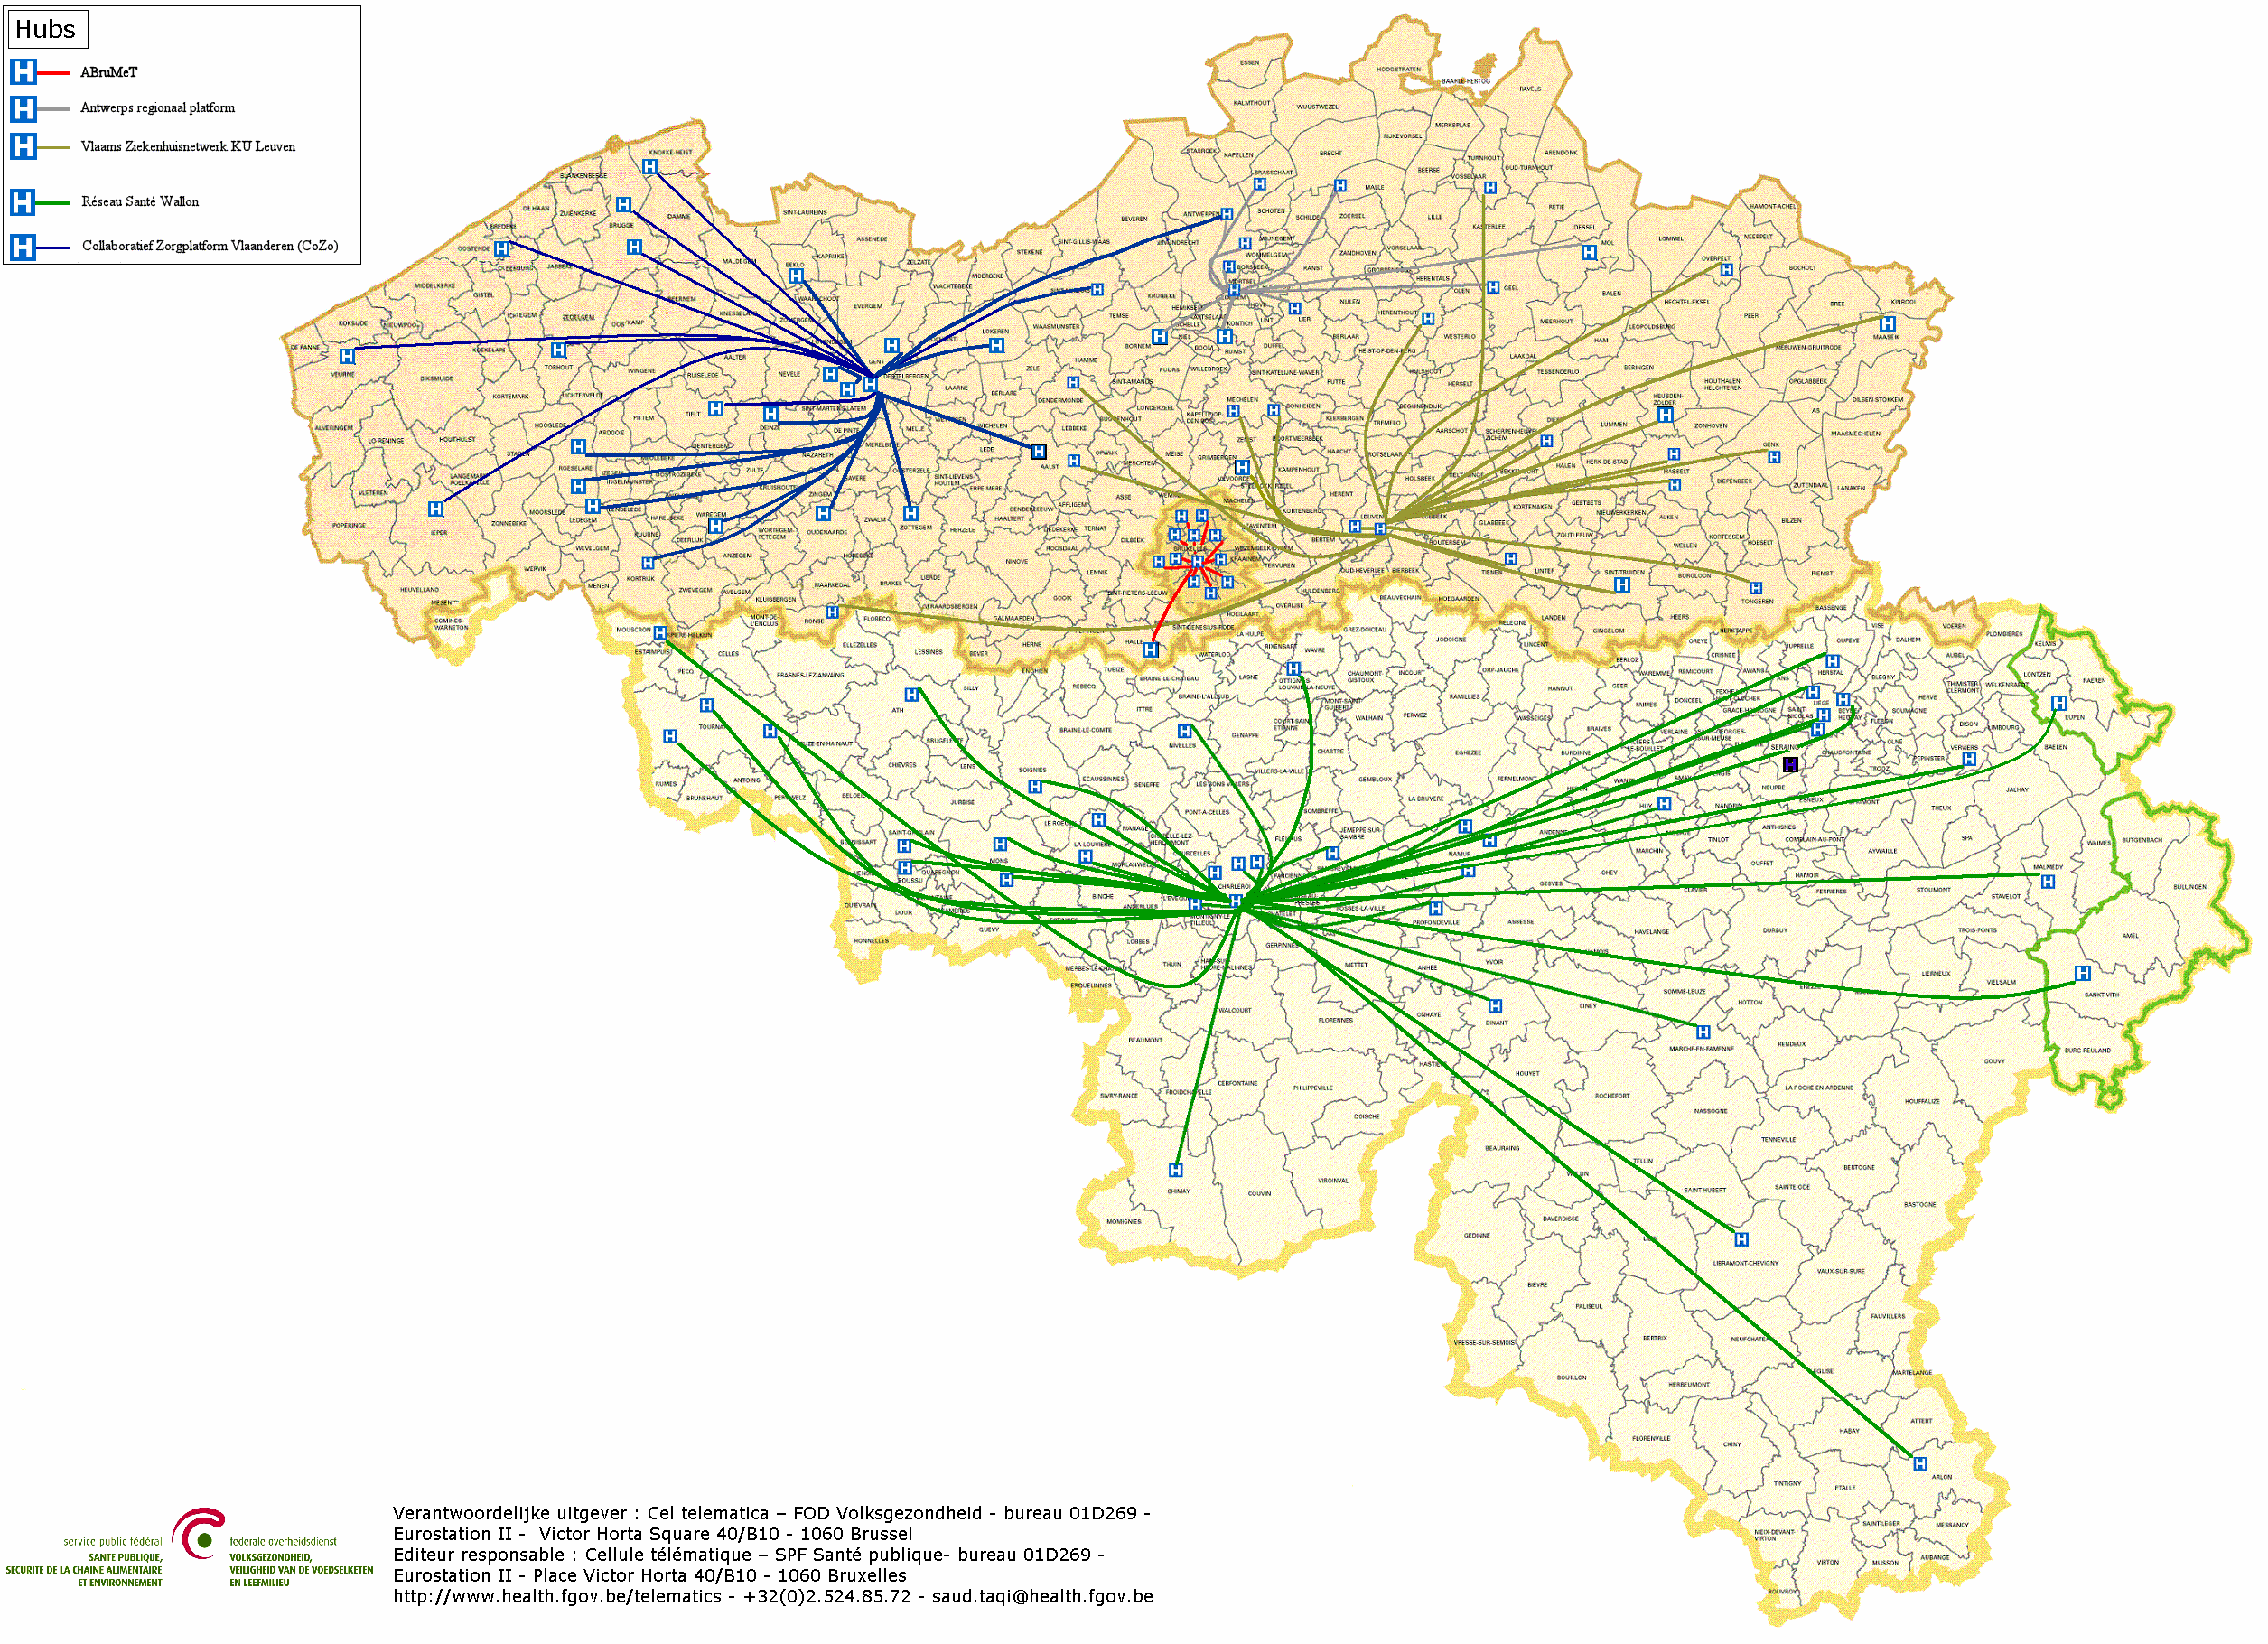

Hubs & Metahub - Scheme
        5 hubs
        The Collaborative Care Platform (in Dutch: Cozo)
        Antwerpian Regional Hub (ARH)
        Flemish Hospital Network KU Leuven (in Dutch: VZN)
        Health Network of Wallonia (in French: RSW)
        Brussels Health Network (in French: RSB)

Slide 23
Action 5 & 6 : Hubs & Metahub
Situation 2018
  system for sharing data and documents by general and psychiatric hospitals via the following 5 hubs
    the Collaborative Care Platform (in Dutch: Cozo)
    Antwerpian Regional Hub (ARH)
    Flemish Hospital Network KU Leuven (in Dutch: VZN)
    Health Network of Wallonia (in French: RSW)
    Brussels Health Network (in French: RSB)
  reference to first-line documents (SumEHR, medication schedules...) via the 3 health vaults/metahub
    Vitalink
    InterMed
    BruSafe

Slide 24
Action 5 & 6 : Data sharing
System is operational and is used intensively
  permanent support to promote the registration of informed consent
    7.850.000 informed consents on 1st December 2018
  rationalization of modalities concerning therapeutic/care relationships
  registration of the therapeutic relationships with GPs in a central database

Slide 25




Hubs & Metahub – Past situation

Slide 26



Hubs & Metahub - Now
3. Retrieve data from hub A
A
1: Where can we find data?
2: In hub A and C
4:
All data available
3: Retrieve data from hub C
C
B

Slide 27




Extramural data: vaults
A
InterMed
BruSafe
C
B

Slide 28
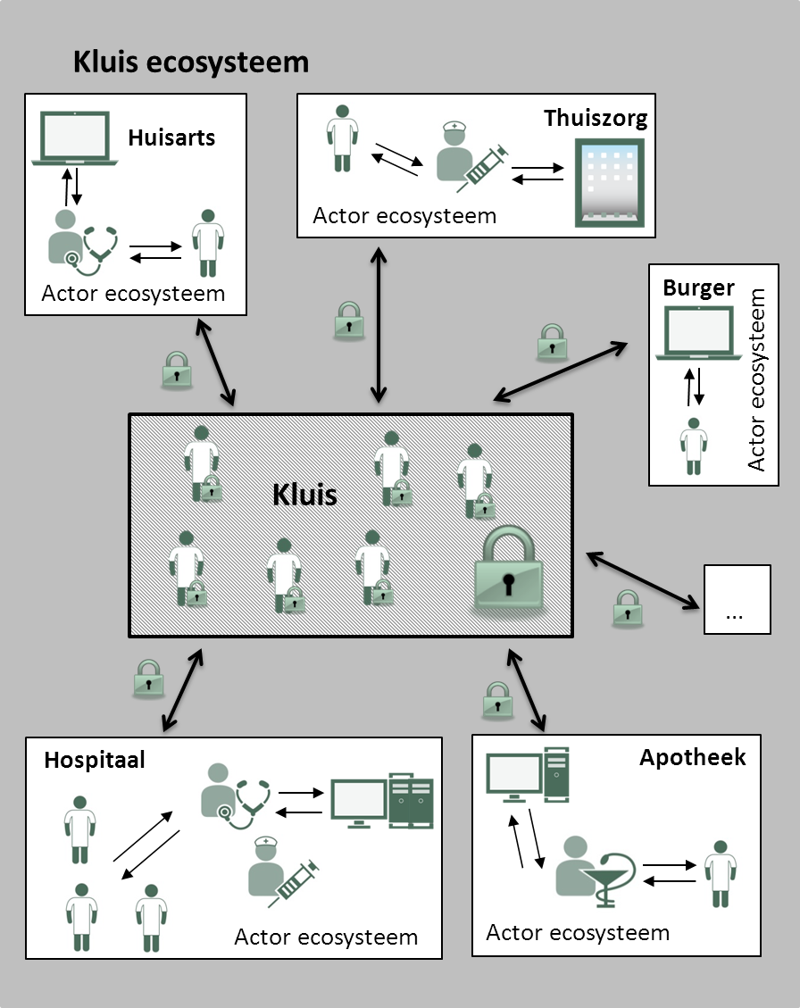

Data sharing
each actor has his own file
but is able to share certain parts with other actors
Examples
  medication schedule
  SumEHR
  parameters
  journal
  …

Slide 29
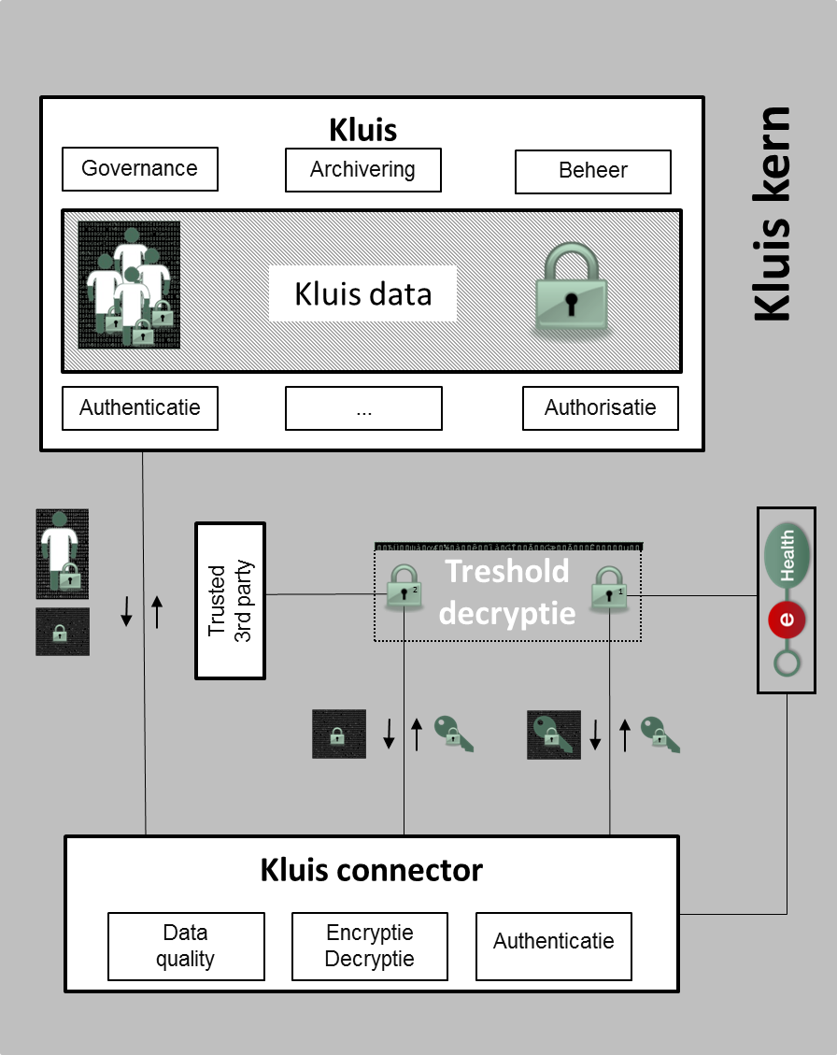
Access for health care providers
with a therapeutic/care relationship
depending on their role
No access for
IT administrators, hoster...
eHealth platform
government
without the active cooperation of the second key holder

Slide 30
Informed consent
Required condition for the exchange of health data: patient has given his informed consent to share his health data electronically
  regulation has been approved by the various management and advisory bodies of the eHealth platform (Consultation Committee with the users, Board of Directors and Information Security Committee)
  only exchange between health care providers/institutions having a therapeutic/care relationship with the patient
  registration of the consent by the patient himself or through his doctor, pharmacist, health fund or hospital

Slide 31
Informed consent
Possibility to exclude a health care provider
Possibility to withdraw the consent
Possibility to modify his permission profile at any time, without any restrictions concerning the modifications
Possibility to see who has entered or modified the informed consent

Slide 32
Therapeutic relationships
Definition of a therapeutic/care relationship: the relationship between a specific patient and one or more health care professionals involved in activities concerning diagnosis, prevention or care for the patient
Examples of evidence of a therapeutic/care relationship
  establishment of a GMF with a GP
  consultation with an individual health care provider
  hospitalization
  supply of a medicinal product in a pharmacy
  …

Slide 33
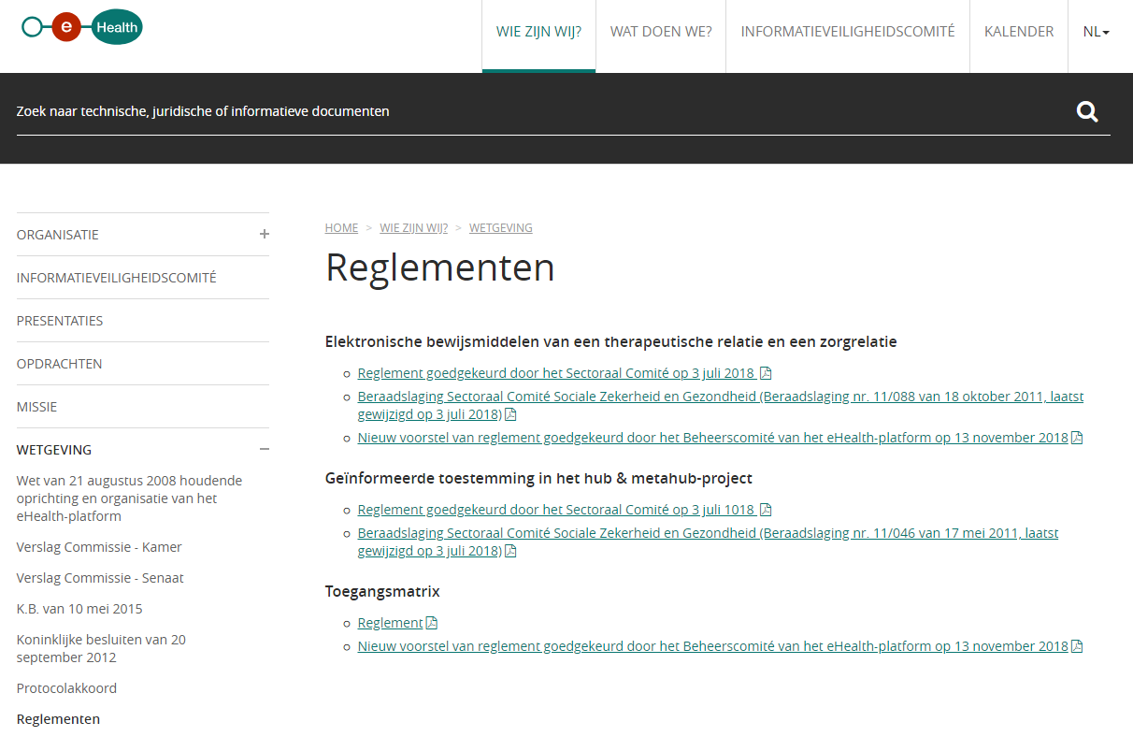
www.ehealth.fgov.be/ehealthplatform/nl/reglementen

Slide 34
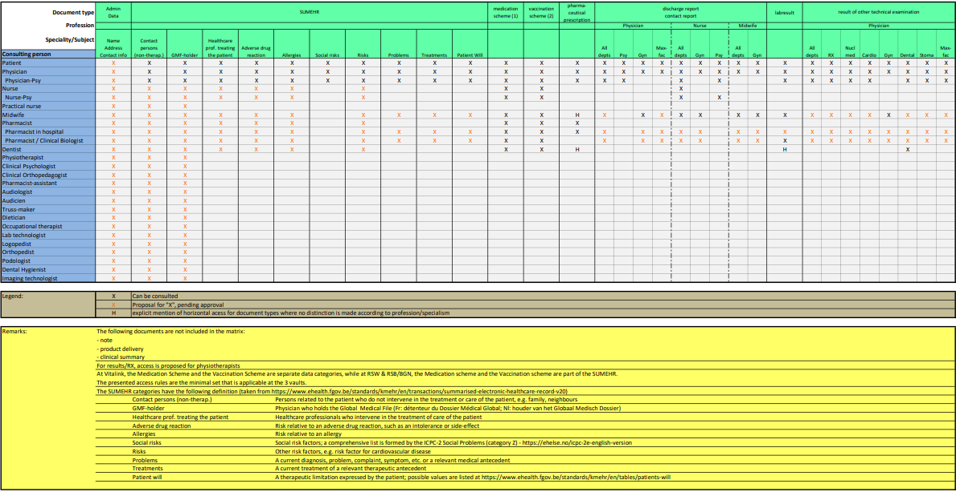
Access matrix

Slide 35
Action 4: electronic prescribing (Recip-e)
Since June 1st 2018, physicians (GPs and specialists), dentists and midwives are obliged to prescribe medication electronically
  this measure does not concern
    patients staying in the hospital
    patients who receive a prescription during a home visit or in an institution (e.g. a nursing home)
    physicians over the age of 62 on this date; they are exempt from this obligation
  the National Institute for Health and Disability Insurance provides prescribers with an app that enables them to establish an electronic prescription outside of the EMF > PARIS (Prescription & Autorisation Requesting Information System) > see further

Slide 36
Action 4: electronic prescribing (Recip-e)
Current situation
  physician, dentist or midwife who prescribes medication electronically (via software package and the Recip-e service) gives his patient a ‘proof of e-prescribing’ containing a barcode
  by scanning the barcode the pharmacist can download the electronic prescription → only the electronic prescription has legal value
Future situation
  no ‘proof of e-prescribing’ anymore
  authentication of the patient at the pharmacy
  pharmacist and patient have electronic access to all pending electronic descriptions of the patient

Slide 37
Action 4: electronic prescribing (Recip-e)
Advantages for pharmacists
  easily download the prescription
  know the reimbursement level of the prescribed medicine
  send feedback to the prescriber
Advantages for prescribers/health care providers
  draw up, consult, send and if needed modify prescriptions that haven’t been provided yet
  delete a prescription that hasn’t been provided yet (if he justifies his decision)
  receive feedback from the health care provider (pharmacist, physiotherapist, nurse)
Advantages for patients
  consult his prescriptions via secure internet access
  delete prescriptions which he finds to be useless

Slide 38
Action 4: electronic prescribing
A ‘protocol for the electronic prescription of drugs to ambulatory patients’ describes the conditions and situations allowing the use of paper prescriptions due to force majeure, e.g.
  the urgent need of medical assistance is indisputable
  the prescriber is a foreign citizen without a NISS (or bis) number
  the patient is a foreign citizen without a NISS (or bis) number
  the patient is a newborn waiting for a NISS number
  etc

Slide 39
Action 4: electronic prescribing (Recip-e)
Some figures (1-30 October 2018)
  13.648 physicians sent 4.623.068 Recip-e prescriptions
  124 hospitals sent 887.905 Recip-e prescriptions
  5.557.381 prescriptions received by Recip-e : 4.859 pharmacists downloaded 4.530.816 Recip-e prescriptions (81.5 % of the prescriptions submitted in the same period)

Slide 40
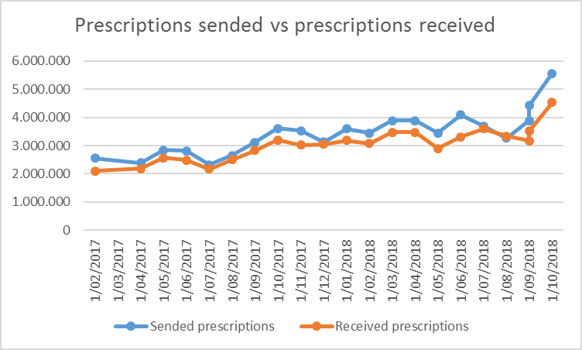
Action 4: electronic prescribing (Recip-e)

Slide 41
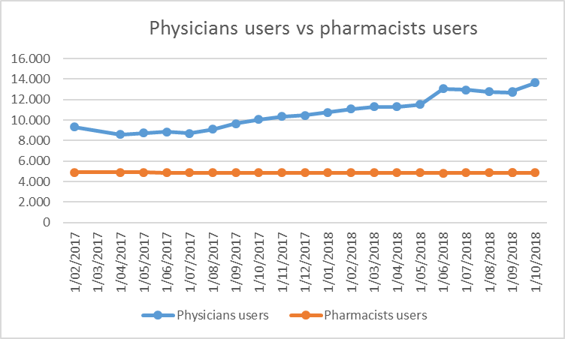
Action 4: electronic prescribing (Recip-e)

Slide 42
Action 4: PARIS
Prescription & Autorisation Requesting Information System
Free web application made available by software providers at INAMI’s request
  offering minimal service to prescribers for delivering electronic prescriptions outside the Electronic Medical File
  as an online service on the eHealth portal, with strong authentication
  no interaction with the electronic medical file or other data sharing systems

Slide 43
Action 4: PARIS
Prescription & Autorisation Requesting Information System
Target groups
  prescribers (temporarily) not having access to the software for managing patient records, or to the hospital’s ICT systems
  prescribers not having any software (yet) for managing electronic medical files
    some specialist categories
    occasional prescribers (limited practice only, or no longer medical practitioner in the classic sense – working for insurance companies, administrations, educational organizations, clinical biologists, anatomist-pathologists…)
    older prescribers at the end of their career

Slide 44
Action 10: Patient data access
Objectives
  creating a framework for access management, consulting and/or adding health data by the patient
  creating a governance structure watching over the execution of the framework
  developing a communication strategy to inform citizens/patients about online health information access and other functions for patients regarding data sharing
  since November 15 citizens can consult their pending drug prescriptions, providing their general practitioner or dentist delivered it electronically
Responsible organization : FPS Public Health

Slide 45

Action 10: Patient data access

Slide 46
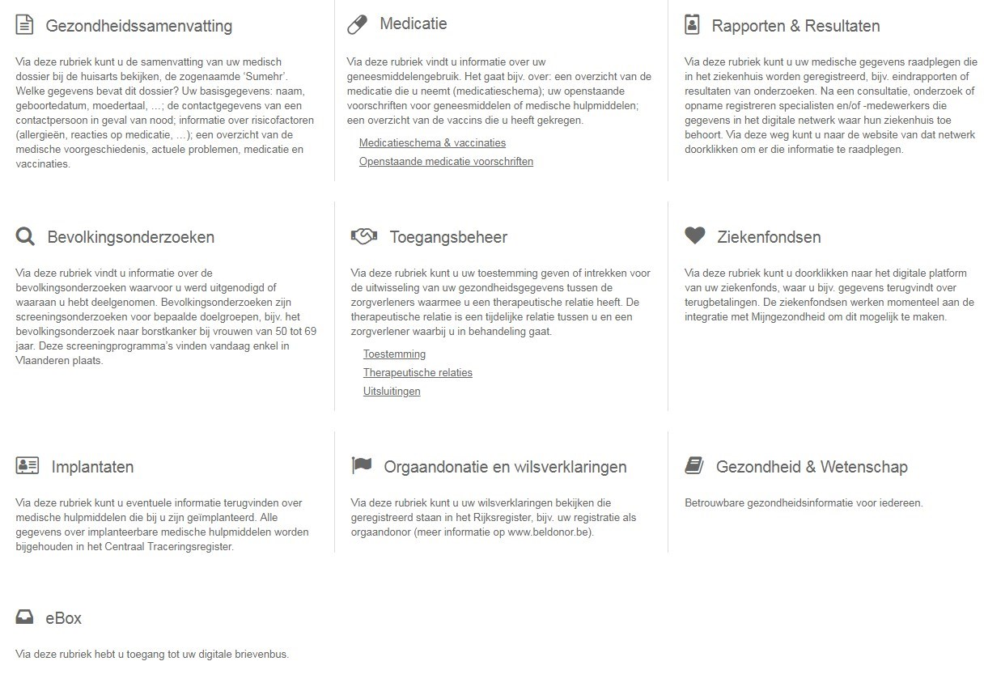
Action 10: Patient data access

Slide 47
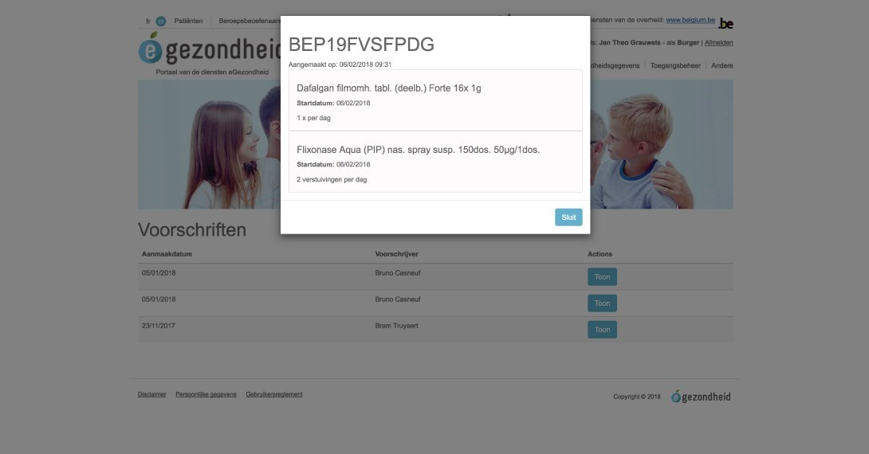
Action 10: Patient data access

Slide 48
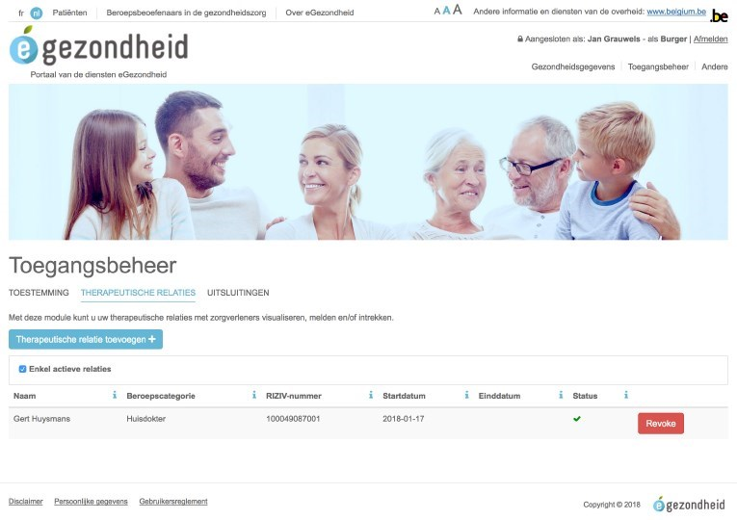
Action 10: Patient data access

Slide 49







Currently approved means of authentication
Strong
 | eID + PIN-code with connected card reader
 | eID + PIN-code with wireless card reader
 | SIM card with PIN-code
 | Security code via mobile app, user-id + password
 | Security code via SMS, user-id + password
 | Security code on paper (paper token), user-id + password
 | User-id + password
Weak

Slide 50
Action 14: MyCareNet
MyCareNet > several applications
  electronic consultation of insurance status by health care providers and institutions
  electronic transfer of third-party invoicing by health care providers and institutions
  medical-administrative flows for the home care sector
  electronic transfer of medical certificates given by health care providers to insurance companies

Slide 51
Action 14: MyCareNet
MyCareNet ‘Insurance status’
  goal
    enable individual providers and institutions to check insurance information about their patients
  features
    request insurance information on a patient
MyCareNet ‘third-party invoicing’
  goal
    enable individual providers and institutions to transfer third-party invoices to health insurance funds
  features
    upload and transfer third-party invoicing files to a specific health insurance fund
    consult the refund decision for an invoice by a specific sickness fund

Slide 52
Action 14: MyCareNet
MyCareNet ‘medical-administrative’ flows
  goal
    transfer of medical-administrative documents between health care providers of the home care sector (or their representatives) and insurance companies (medical advisors) to replace or supplement paper documents
  features
    flows concerning
      flat rate requests
      specific requests for palliative care patients
      requests for specific technical acts

Slide 53
Action 14: MyCareNet
MyCareNet ‘eAttest’
  goal
    enable care providers to electronically send their medical certificates (eASD) to insurance companies for patients not making part of the third-party payment system
  features
    service directly linked with the service to check the insurance status
    concerning patients for whom the health care provider is not allowed / not willing to apply the third-party payment process
    service available via web services only > not available on a portal, health care providers need to use their own software

Slide 54
Action 17: eHealthBox
Objectives 2019
  general use of eHealthBox and of health care provider information available in CoBRHA
  enable secure asynchronic electronic communication of medical and confidential information between health care actors
  development and maintenance of a common database with information about health care providers and care institutions
  enable health care actors to consult / modify / complete specific information themselves
    address book (CoBRHA database)
    unique electronic counter
Responsible organizations: eHealth platform and FPS Public Health

Slide 55
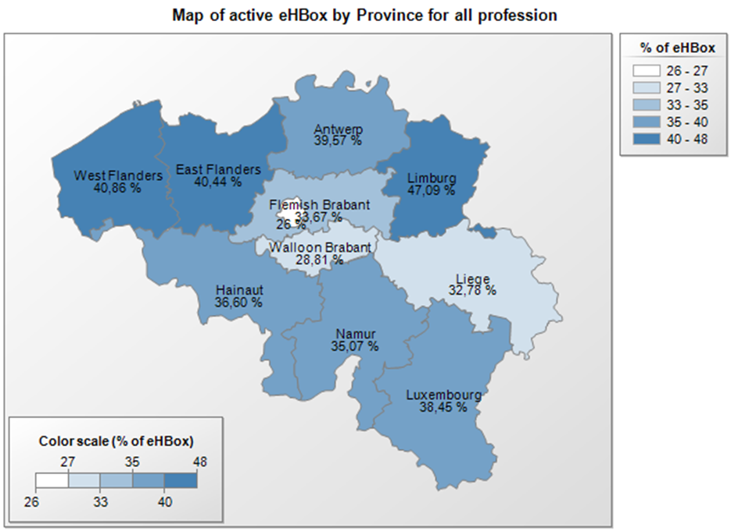
Action 17: eHealthBox
figures on 26/11/2018

Slide 56
Action 17: eHealthBox
Address book
  allows senders of messages to health care providers to decide which channel type and which information are the most appropriate
    for communicating medical data > mandatory use of eHealthBox
    for communicating administrative data (internship, recognition…) > using a regular e-mail address allowed and if no data available > shipment by mail (paper)
    available address book data comes from CoBRHA

Slide 57
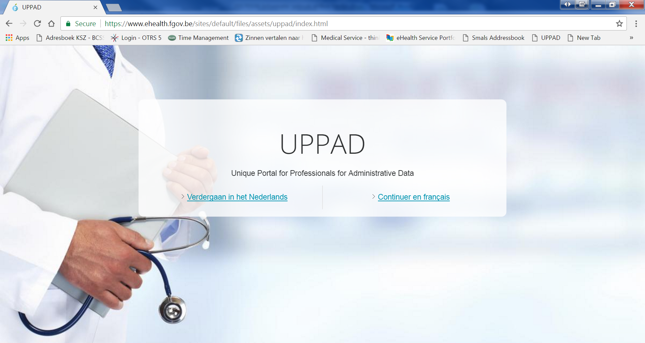
Action 17: UPPAD

Slide 58
Action 17: UPPAD
UPPAD → Unique Portal for Professionals for Administrative Data
Central hub (website) where individual health care providers can consult their administrative data (e.g. visa, recognition…) that are known to government bodies (authentic sources)
Information coming from CoBRHA

Slide 59
Action 17: UPPAD
Possibility to modify specific Authentic Source data yourself (being a health care provider) using underlying applications
Possibility to start up administrative processes electronically (e.g. recognition request) or consult information pages (e.g. procedures on the FPS Public Health website)
UPPAD will not replace applications/procedures that currently exist in various ‘authentic sources’
Health care providers cannot update information directly in UPPAD
  UPPAD merely forwards health care providers to the right application / information available in the authentic sources (= gateway only)

Slide 60
Action 19: Mobile Health
Objectives 2019
  framework for mHealth actions > efficient implementation
  support when using mHealth applications
  Integrate a legal, financial and organizational framework in new and existing care agreements
  integration of the eHealth services in mHealth
  support quality and accessibility of mHealth
  approach based on use cases (diabetes, cardiovascular...)
Institutions responsible
  FAMHP (certification of medical devices)
  INAMI (reimbursement)
  eHealth platform (technical aspects)

Slide 61
Action 19: Mobile Health
Focus on mHealth applications that can be integrated with the actual health care system
5 priority use cases, selected based on their impact (number of patients x severity) and the availability of mHealth technical tools
    stroke
    diabetes
    chronic pain
    mental health
    cardiovascular disease
Working processes and results of the cases are shared publically and applied directly in a specific market situation > they will receive policy guarantees about becoming embedded in the Belgian health care system

Slide 62
Action 19: Mobile Health
Selected pilot projects
  out of the 98 proposals received, a working group selected 24 projects across different health care areas
  the execution requires different health care actors to join forces: health insurance funds, hospitals, home care services, circles of general practitioners

Slide 63
Action 19: Mobile Health
Mid-term review of 24 pilot projects
  both patients and health care providers benefit from using the apps
Some points of concern are:
  the login procedure sometimes being difficult
  the possibility of sharing data with other health care providers

Slide 64
Mobile health applications - validation pyramid
M3
Requires M2
Positioned within Belgian health system
Conditional financing (expert committee)
CostBenefit
Triple Aim
M2
Requires M1
Validated by administrations (or trusted third parties)
Security - Authentication (eHP)
Interoperability (eHP + SPF -FOD)
Scientific evidence (publications)
BE mHealth Validation
CE
Medical device
M1
CE certified as Medical device AFMPS-FAGG)
GDPR compliant
Belgian privacy law compliant

Slide 65








Overall architecture
Patients, health care providers,
health facilities
Health portal
Software
HC provider
Software health facility
VAS
Site NIHDI
VAS
eHealth
portal
MyCareNet
VAS
VAS
VAS
Users
Basic services eHealth platform
Network
VAD
VAD
VAD
VAD
VAD
VAD
Suppliers

Slide 66

Basic services eHealth platform
Coordination of digital subprocesses
Portal
Integrated user and access management
Management of logs
System for end-to-end encryption
eHealthBox
Timestamping
Encryption and anonymization
Consultation of the National Register and the CBSS Registers
Reference directory (metahub)

Slide 67
Operational excellence – stakeholder requirements
Individual end-users & small healthcare institutions without IT knowledge
  high-performance and available end-user applications
  integrated service delivery (single environment, single sign on)
  meeting their needs
  business continuity
  functional support and training
  transparency in case of interventions and problems
  a single functional helpdesk

Slide 68
Operational excellence – stakeholder requirements
Larger healthcare institutions with ICT departments & software providers
  test environments
  high-performance and available web services
  business continuity
  technical support and training
  transparency in case of interventions and problems
  precise division of tasks between the helpdesks

Slide 69
Architecture & partner support
Objective: architecture that takes into account context restrictions and optimally supports stakeholders‘ requirements
Method: choice and progressive implementation
  maintaining the current division into subsystems or more consolidation ?
    data centres and ICT infrastructure
    authentic sources from the authorities (CoBRHA, SAM,...)
    with partners
  secure cloud for healthcare providers and institutions ?
  thin clients vs. heavy clients
  division of labour - software suppliers
  supervision of software suppliers
    free market and tests ?
    specifications ?
    only end-user funding or also direct funding from software providers ?
  catalogue of open, reusable components ?

Slide 70
SLA’s & service management
Objective: high-performance and available end-user applications and web services
Method
  SLA
    related to availability and performance
    difficulty: end-to-end
  remove single points of failures (SPOF) in all environments (eg third backup data center for eHealth platform)
  end-to-end monitoring
  central dashboard & supervision
  incident management
  problem management
  capacity planning
  release & intervention calendar accessible to the public
  importance of completeness !

Slide 71
Documentation, helpdesk & support
Objective: easy-to-use and clear documentation for the various stakeholders and single point of contact for helpdesk and support for each stakeholder
Method
  distinction between end-users on the one hand and software suppliers/computer sections on the other
  clear documentation that can easily be found
    provided by the owner of each service with different levels of detail
    on the basis of a common notional framework
    available in an integrated way on the eHealth portal
  helpdesk & support
  the software providers organize the helpdesk and support for end users
  the service owner organizes helpdesk and support for authentic sources and new value-added services
  the helpdesk and support of the eHealth platform is available to software providers, ICT sections and owners of value-added services

Slide 72
Test environments
Objective: for software providers, ICT sections in healthcare organizations and developers of value-added services, providing integrated test environments
Method
  providing integrated test environments and their documentation by
    eHealth platform for basic Services
    any service provider (e.g. FPS BOSA, national register)
    any supplier of an authentic source
  providing coordinated test data sets and their documentation
  unit tests and end-to-end tests
  minilabs for community support

Slide 73

Business Continuity Procedures
Objective: business continuity procedures (BCP) for every category of end users
  pharmacists
  physicians
  home nurses
  hospitals
Method
  definition of minimal functional requirements by representatives of the end users
  eliminating all single point of failure (SPOF) across environments (for each crucial component there is an alternative in another environment)
  implementation plan with iterations
  communication via website https://www.status.ehealth.fgov.be/
  training via éénlijn, e-Santé Wallonie, eHealth Academy
  integrated dashboard on status of services (availability, performance)
  feedback mechanisms on effective use of BCP

Slide 74
BCP pharmacists
Minimal functional requirements
  authentication when connecting
  having a prescription
  consulting the insurance status of a patient
  consulting the "Chapter IV" agreements
  consulting and updating the Shared Pharmaceutical File (SPF)
  archiving executed electronic prescriptions (RAOTD)
Operational
More information on https://www.status.ehealth.fgov.be/fr/pharmaciens/business-continuity/

Slide 75
BCP general practitioners
Essential functional requirements
  authentication when connecting
  consulting electronic documents available via the hub-metahub system (documents in hospitals, laboratories, medical imaging centers, etc.)
  consulting the vaccination status of a patient
  consulting the SumEHR of a patient
  creating a prescription
  consulting the insurance status of a patient
  electronic transfer of the certificate of care given to the patient to his sickness fund (eAttest)
  electronic billing to the sickness fund for a patient who benefits from the third-party payment system (eFact)
Work in progress
More information on
  https://www.status.ehealth.fgov.be/fr/medecins-generalistes/business-continuity/

Slide 76
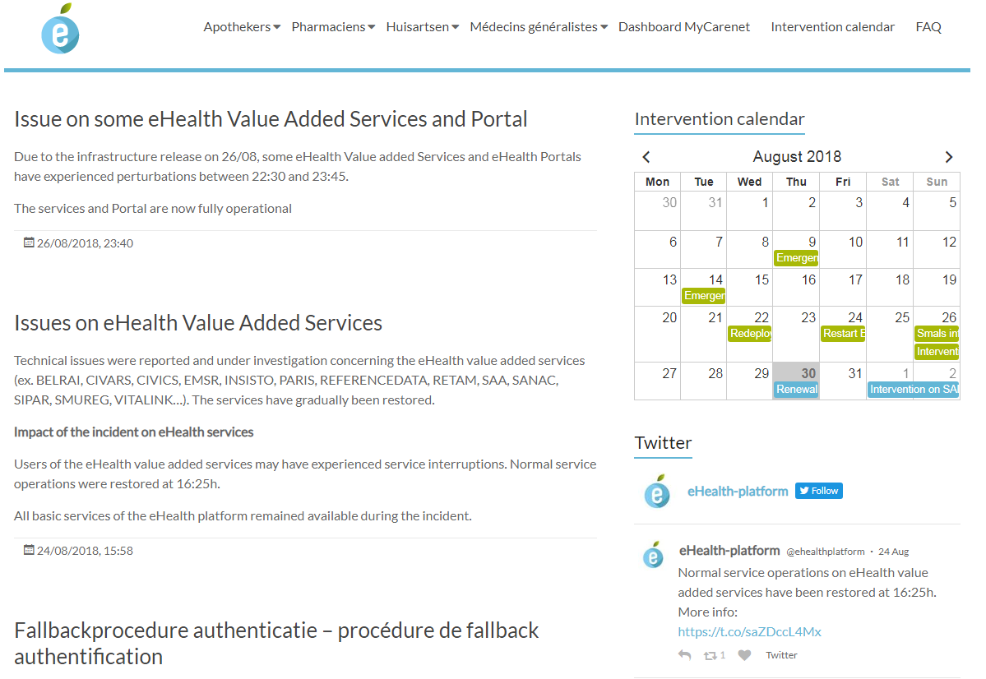
New website
www.status.ehealth.fgov.be

Slide 77
Roadmap 2.0: conclusion
The sharing of data between healthcare providers / institutions via the hub-meta-hub system, the health safes and the eHealthBox reaches cruising speed
> 70% of the Belgian population has now given their informed consent
The opening up of health data for the patient starts => attention for integrated access
Experience is gained with mobile eHealth applications

Slide 78
Thank you
Any questions?
frank.robben@ehealth.fgov.be
@FrRobben
https://www.ehealth.fgov.be
https://www.ksz.fgov.be
https://www.frankrobben.be

