Slide 1








Blockchain
Concept,critical success factors
& possibilities in the food chain
Frank Robben
KSZ/eHealth-platform
frank.robben@ksz.fgov.be
@FrRobben
https://www.ksz.fgov.be
https://www.ehealth.fgov.be
https://www.frankrobben.be

Slide 2
AGENDA
Intro
Bad case,
good case
Experiences
& lessons
Beyond PoC

Slide 3
The bigger picture
Blockchain is not a “disruptive” technology, which can attack a traditional business model with a lower-cost solution and overtake incumbent firms quickly. Blockchain is a foundational technology: it has the potential to create new foundations for our economic and social systems. But while the impact will be enormous, it will take decades for blockchain to seep into our economic and social infrastructure. The process of adoption will be gradual and steady, not sudden, as waves of technological and institutional change gain momentum.
Marco Iansiti & Karim R. Lakhani,
Harvard Business Review 2017

Slide 4



Blockchain is about Trust
The blockchain network can help with
Registration of facts / events
Transfer of assets
Enforcement of rules

Slide 5











Idea
Ok!
Transactions
5,1 BTC →
0,7 BTC →
I transfer 0,4 BTC to .
Dave
0,4 BTC →
Ok!
Transactions
5,1 BTC →
0,7 BTC →
Transactions
5,1 BTC →
0,7 BTC →
Bob
0,4 BTC →
Charlie
0,4 BTC →
Ok!
Transactions
5,1 BTC →
0,7 BTC →
Alice
0,4 BTC →

Slide 6


A chain of blocks
Block 50
Block 51
Block 52
Block 53
Block 54
Header
Header
Header
Header
Header
5,10 BTC →
0,40 BTC →
0,70 BTC →
Concatenation of blocks, which contain transactions
At predetermined frequency, the network appends new block with most recent transactions
Blockchain contains ALL transactions
Transaction in blockchain cannot be removed
Many entities possess same copy of the blockchain

Slide 7
Properties
Robust
Consensus
(same version everywhere)
Integrity
Append-only
(Ledger)
Transparency, verifiability, auditability
Non-repudiability
(existence)
Distributed
(peer 2 peer)
Complies with rules
Authenticity
(≠ identifiability)

Slide 8








Permissionless
Permissioned
Public / open
Enterprise / Consortium
Compare with Internet
Compare with Intranet
Accessible & usable by whole world
Extra layer for access control
Ofter very inefficient
More efficient
Slower
Faster (more tx/s, more blocks/s)
Trust distributed
Trust decentralized
Crypto currency required
No cryptocurrency required

Slide 9
Smart Contracts
Automating rules &
enforcement of agreements
Between parties that do not need to trust each other 100%
Without dependency on a single,
intermediate party

Slide 10


Smart Contracts
Ether (Ξ) is the crypto-
currency on Ethereum
getMoney()
Contract Auction{
function bid()
function getMoney()
HighestBid: Ξ
HighestBidder:
Beneficiary: Charlie
}
20 Ξ
Charlie
bid(), 10 Ξ
0
10
20
10 Ξ
Bob
Alice
Alice
bid(), 20 Ξ
Bob
Can receive, block and spend value
No single entity can influence correct functioning
Reactive
Deaf and blind

Slide 11
Smart Contracts
Publishing a contract, calling its functions & destroying it happens through transactions
Block 50
Block 51
Block 52
Block 53
Block 54
Block 55
Block 56
Header
Header
Header
Header
Header
Header
Header
Publish contr.
Bid Bob
getMoney
Destroy contr.
Bid Alice

Slide 12
AGENDA
Intro
Bad case,
good case
Experiences
& lessons
Beyond PoC

Slide 13
Everything that can be done with a blockchain, can be done with a centralized approach, and even more efficiently
Why blockchain?
A centralized approach might not be desirable
Politics
(E.g. cross-border exchanges, privacy)
Absence of trusted authorities
(E.g. Bitcoin in 2009)
Abuse (quasi-) monopoly positions
Illegal activities
(E.g. Dark Web)
Other blockchain advantages also feasible with other technologies
Process automation
Consistency
Streamlined processes
Real-time updates
Insight in decision proces

Slide 14
Blockchain is about Trust
In case of a centralized approach,
is it an issue that a central entity needs to be trusted?
Blockchain is a bad idea
Blockchain might be an option

Slide 15


Ex. 1: Information flow
If the three central entities in the flow continue existing,
blockchain does not offer an added value over existing technologies

Slide 16
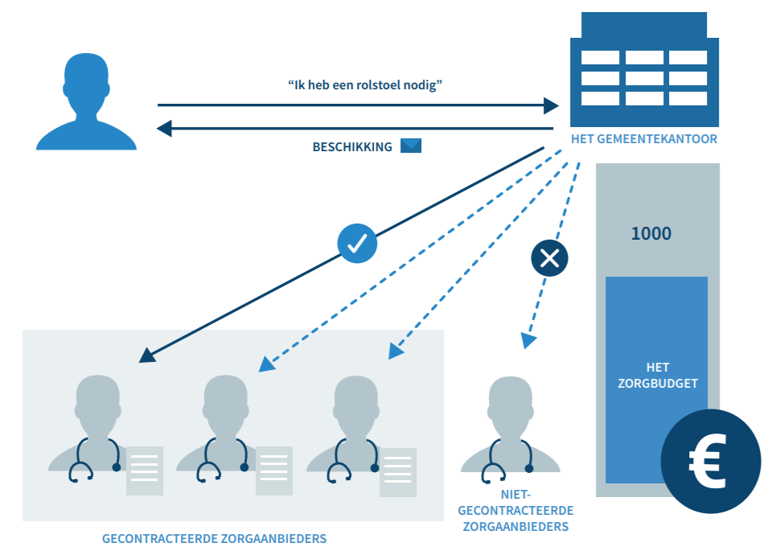
Ex. 2: Application for wheelchair

Slide 17
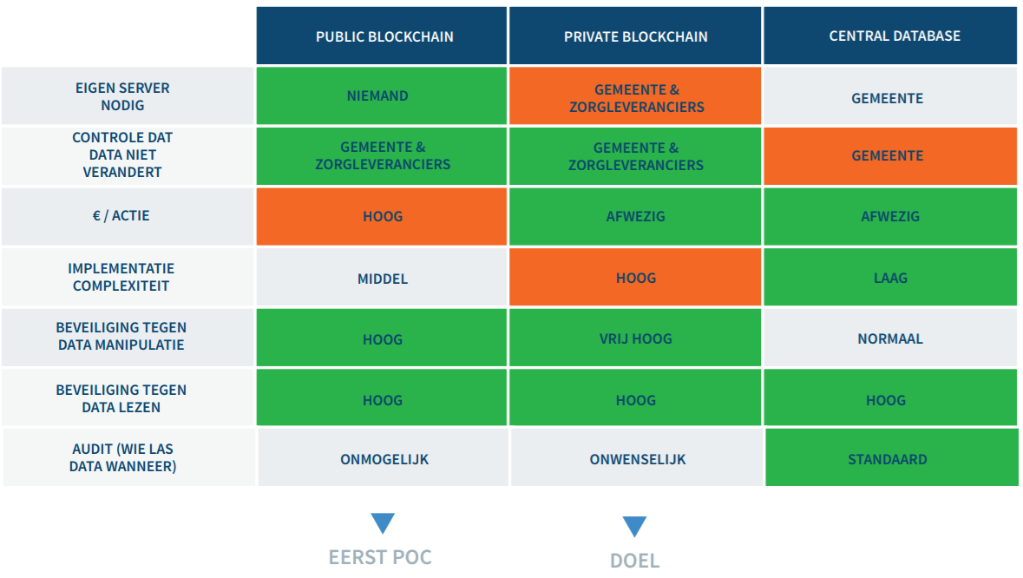
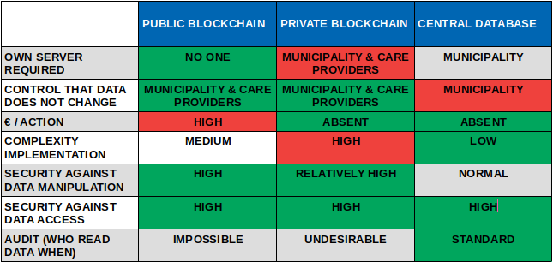
Ex. 2: Application for wheelchair
Does the reduction of dependencies (municipality cannot change data) outweigh the higher level of complexity? Probably, the care providers are not requesting parties
FIRST POC
GOAL

Slide 18
Distribution of trust with blockchain technology
can result in higher complexity and costs
(↔ the blockchain promise)

Slide 19
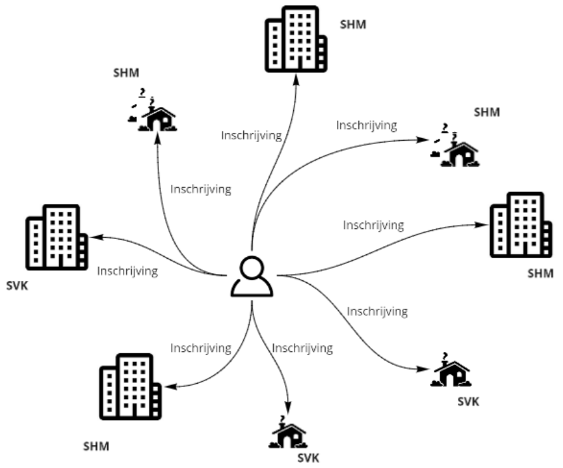
Ex. 3: Social housing
SHC
Situation Today
Citizen subscribes multiple times
Not transparent: “Why it isn’t my turn yet “
SRO
Registration
Registration
SRO
Registration
Registration
Trust issue not so important
Social housing companies no requesting parties for blockchain approach: Increased complexity, costs, maintenance
→ Central approach preferred
Registration
SHC
SHC
Registration
Registration
Registration
SRO
SRO
SHC: Social housing company
SRO: Social renting office
SHC

Slide 20



Ex. 4: Therapeutic relation
Determines if care provider has access to health data of a patient
….
Problem
Fragmentation: information dispersed
No overview for patient
Trust issues
Participants are somehow each other’s competitors
Centralized approach might raise privacy concerns

Slide 21




Ex. 5: Cross-border processes
International
container traffic
Nuclear
waste transport
Food supply chain
Diplomas
Trust issues
What country could be primus inter pares?
Centralized approach organisationally difficult

Slide 22
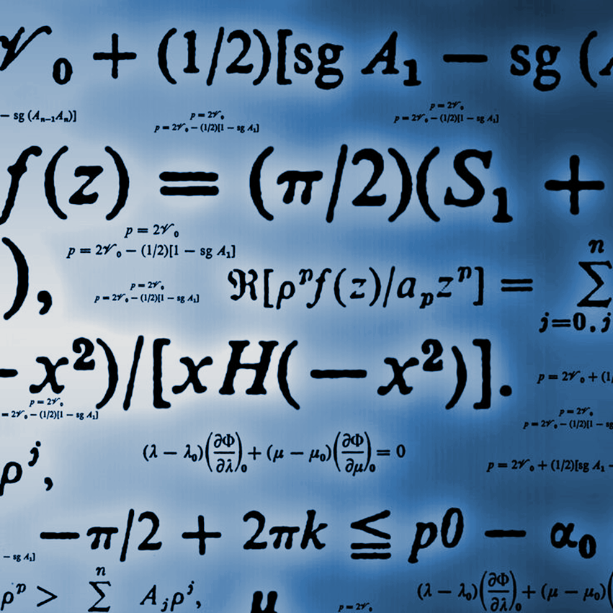









Ex. 6: Demonstrability service
(BeSure)
Creation & storage of proofs becomes collective process
Participants (organisations & eBox) do not need to trust each other (End users do trust their organisation)
eBox
Strong probative value
without central authority
Integrity, non-repudiability, no date tampering, authenticity
Demonstrability
Proof-of-delivery & proof-of-receipt
Storage period: 40-50 years
: Circle of trust

Slide 23
AGENDA
Intro
Bad case,
good case
Experiences
& lessons
Beyond PoC

Slide 24



Financial sector
Inter-bank
transactions
International
payments
Bond
issuance
PoC with 34 banks “went extremely well” but “don't expect a working solution anytime soon.”
Challenges & costs
Re-engineering legacy systems
Operational challenges to preserving confidentiality & privacy
“We haven’t gotten there yet”
Considerable challenges
Scalability
Privacy
Flexibility (support any asset)
Choice ≠ blockchain / DLT
Still unchangeable transactions, instant settlement, more transparency & efficiency
Positive
Settlement time reduced from five days to a few seconds
Challenge
Promise of transparency & reduced transaction cost not yet realised
Considerable challenges. Cost reduction not always easy.
Blockchain will need time to realize its full potential

Slide 25



Provenance & supply chain
Food safety
International trade
Non-blockchain project in 2006
Abandoned due to high investments & complexity at the side of the producers. These expenses are necessary for the registrations, also in a blockchain approach.
Blockchain project Food Trust today Walmart has given all its suppliers of fresh greens a 2019 deadline to join the Food Trust blockchain platform
Negative reactions by sector
Maersk & IBM would keep IP
Money lost due to existence of many similar but separate projects in sector
Challenging to get all stakeholders on board
Need for a common project

Slide 26



Personal data
Alternative to bank account
Tracing expenses
Diplomas in the EU
(PoC)
UK (experiment)
Tracing expenses unemployed & disabled
Finland (live)
Refugees can receive & spend money
Financial transaction history on blockchain
=> Privacy concerns
Purpose
Mobile citizen manages his/her diplomas & decides who can see which ones
GDPR ignored
All diploma data stored unencrypted on the blockchain and, hence, visible by national diploma services and individual schools
=> Unsuited to go further (right to be forgotten, due diligence)
Importance of clear communication if personal data involved
Importance of privacy by design & security by design

Slide 27



Belgian blockchains live
Food safety
Control supply chain of fresh products (they started with eggs from Auvergne region)
Health & Ecology
Incentivise children to go by bike or on foot to school
(started in 3 towns: Bonheiden, Peer, Crisnée)
Fight against fake-news
Check integrity KBC press releases (planning to extend to invoices)
We start seeing blockchain applications in production, also in Belgium
Cases start small, but with the ambition to expand

Slide 28
Blockchain & Transparency
"A large share of blockchain projects is likely incompatible with the GDPR"
Michèle Finck
Max Planck Institute for Innovation
& University of Oxford
Blockchain / DLT
Transparency
TENSION
Confidentiality
Personal & enterprise data

Slide 29
Experiences & lessons
Positive evolutions, but also considerable challenges
Provenance &
supply chain
Financial sector
Personal data
Considerable challenges
Cost reduction not always easy
Blockchain will need time to realize its full potential
Challenging to get all stakeholders on board
Need for a common project
Importance of clear communication if personal data involved
Importance of privacy by design & security by design

Slide 30
AGENDA
Intro
Bad case,
good case
Experiences
& lessons
Beyond PoC

Slide 31
Why a PoC?
Prestige and media attention
Discovering new possibilities of the technology
Acquiring technical knowledge & competences
→ Integrate a learning path
Preparation to go life
→ Requires a profound analysis
Least challenging
Least useful
Most challenging
Most useful

Slide 32
PoC-industry
“We make abstraction of the GDPR”
“Given the limited budget, we do not do a prior analysis”
“The blockchain PoC was not meant to run in a distributed way”
Make clear agreements (on paper) if you are planning to go further than a PoC. This will avoid surprises afterwards.

Slide 33
Going life
Risky today
(Might be doable if you have plenty of resources)
High complexity
of blockchain tech
Therapeutic
relations
Consider it
if clear added value and limited risk
Low complexity
of blockchain tech
BeSure
Application
not critical
Application
critical

Slide 34
Demonstrability service
(BeSure)
Creation & storage of proofs becomes collective process
Participants (organisations & eBox) do not need to trust each other (End users do trust their organisation)
eBox
Strong probative value
without central authority
Integrity, non-repudiability, no date tampering, authenticity
Demonstrability
Proof-of-delivery & proof-of-receipt
Storage period: 40-50 years
: Circle of trust

Slide 35
Demonstrability service (BeSure)
No sensitive data on blockchain
Only (salted) fingerprints
Simplicity
No complex blockchain functionality required
Fork of Bitcoin code
Extensively tested in practice
Secure
Key compromise or blockchain data breach no heavy repercussions
Migration
to other technology possible
Clear added value
Limited risk
Taking into account the limitations of today

Slide 36
Avoid technology lock-in
Leading technologies tomorrow?
Dominant technology today not necessarily dominant in 12 months
No one-tech-suits-all
Choice blockchain technology will depend on business case
No standards
They are working on it
Think about how to migrate away to avoid dependency of single technology

Slide 37





Blockchain as a Service (BaaS)
Observation: setting up & managing blockchain infrastructure can be complicated
Multiple cloud providers offer possibility to set up
a blockchain network in their cloud
Advantages
Infrastructural complexity hidden
Focus on application level
Faster & cheaper
Higher security
Disadvantages
Dependency BaaS provider
“We do not trust each other, but we do trust the BaaS provider“
Blockchain-technology specific
Towards a government-BaaS?

Slide 38






Future blockchain landscape?
Public BaaS
Community BaaS
BaaS
Provider
A
BaaS
Provider
BaaS
Provider
B
BaaS
Provider
C
Private infrastructure
Private
BaaS

Slide 39
It’s good to look at new technologies like blockchain
Just don’t forget that also alternative, less visible
technologies, might be useful (as alternative or in synergy)

Slide 40

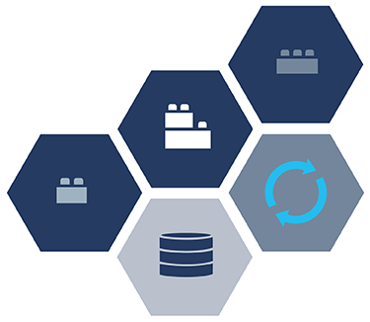





There is more than blockchain
Several technologies together offer new perspectives to transform the business
Event-driven architecture
API economy
Microservices
Cloud
Containers

Slide 41










Potential use cases
Therapeutic relations
Demonstrability service
History land registry & home upgrades
Identity management
Registration & access management medical data
Tracing food for food safety & sustainability
Prevention/detection of double or unjust payments
Cross-country processes & information exchange
E.g. who pays where social security contributions?
Transparency at the government
Public tenders

Slide 42
Frank Robben
Administrator-General
Crossroad Bank Social Security
eHealth-platform
frank.robben@ksz.fgov.be
@FrRobben
https://www.ksz.fgov.be
https://www.ehealth.fgov.be
https://www.frankrobben.be

Slide 43
References
[B17] Gemeente Stichtse Vecht - Rolstoelgebruik in Blockchain, Blockchain pilots Dutch Government, blockchainpilots.nl, Pilotronde 2, 2017. http://hostedby.frogjump.nl/blockchain-magazine#!/stichtse-vecht
[B18a] J. BIESEMANS, De blockchain van de kip en het ei, EOS Magazine, 30 april 2018,
https://www.eoswetenschap.eu/voeding/de-blockchain-van-de-kip-en-het-ei
[B18b] Belfius lanceert via zijn innovatielab The Studio, een mobiliteitsplatform voor scholen en gemeenten dat gebruik maakt van blockchaintechnologie. Belfius, 10 September 2018. https://www.belfius.com/NL/publicaties/nieuwsberichten/2018/Pressrelease20180910.aspx
[D18] K. DANIELS, Certified for Life — International exchange & authentication of diplomas via blockchain, Medium, 31 july 2018, https://medium.com/wearetheledger/certified-for-life-international-exchange-authentication-of-diplomas-via-blockchain-4e947720edd9
[E18] EU Blockchain Observatory and Forum - GDPR Workshop Report - June 8, 2018 https://www.eublockchainforum.eu/sites/default/files/reports/workshop_2_report_-_gdpr.pdf
[F18] Adoption of DLT presents significant operational challenges for Swift member banks, Finextra, 8 March 2018, https://www.finextra.com/newsarticle/31787/adoption-of-dlt-presents-significant-operational-challenges-for-swift-member-banks
[G08] S. GAUDIN, Some Suppliers Gain from Failed Wal-Mart RFID Edict, CIO, 29 april 2008, https://www.cio.com/article/2436434/rfid/some-suppliers-gain-from-failed-wal-mart-rfid-edict.html
[I17] M. IANSITI & K. LAKHANI, The Truth About Blockchain. Harvard Business Review, January-February 2017, https://hbr.org/2017/01/the-truth-about-blockchain

Slide 44
References
[I18] A. IRRERA, Banks unlikely to process payments with distributed ledgers for now, says Ripple, Reuters, 13 June 2018, https://uk.reuters.com/article/us-blockchain-ripple/banks-unlikely-to-process-payments-with-distributed-ledgers-for-now-says-ripple-idUKKBN1J92JG
[J18] R. JUSKALIAN, Inside the Jordan refugee camp that runs on blockchain, MIT Technology Review, 12 april 2018. https://www.technologyreview.com/s/610806/inside-the-jordan-refugee-camp-that-runs-on-blockchain/
[K18] M. KRAMER, Walmart Gives Suppliers Deadline To Join Food Trust Blockchain, ETH News, 25 September 2018,
https://www.ethnews.com/walmart-gives-suppliers-deadline-to-join-food-trust-blockchain
[017] M. ORCUTT, How Blockchain Is Kickstarting the Financial Lives of Refugees, MIT Technology Review, 5 September 2017, https://www.technologyreview.com/s/608764/how-blockchain-is-kickstarting-the-financial-lives-of-refugees/
[P16] G. PLIMMER, Use of bitcoin tech to pay UK benefits sparks privacy concerns, Financial Times, 12 July 2016, https://www.ft.com/content/33d5b3fc-4767-11e6-b387-64ab0a67014c
[R15] K. RANNENBERG, J. CAMENISCH A. SABOURI. Attribute-based Credentials for Trust: Identity in the Information Society, Identity in the Information Society, Springer, 2015.
[R17] P. ROUSSEAU & P. BUYTAERT, Sociale woningen toewijzen via blockchain, Infosessie blockchain, Informatie Vlaanderen, 13 November 2017.
[S18] H. SENDER, World Bank breaks ground with blockchain bond sale, Financial Times, 9 August 2018, https://www.ft.com/content/f99186b2-9bb5-11e8-9702-5946bae86e6d
[V18] K. VERSLYPE, BeSure - A realistic blockchain case for the Belgian government, Medium, 11 September 2018, https://medium.com/@cryptovnet/besure-a-realistic-blockchain-case-for-the-belgian-government-c5b8c62dff38

