Slide 1
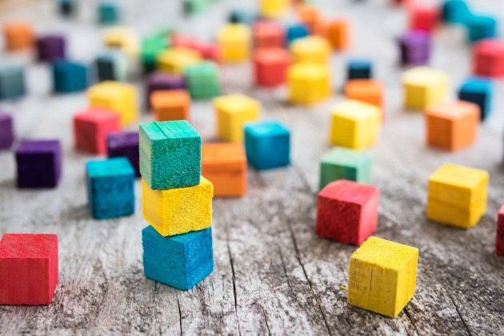

Blockchain & smart contracts under the hood
Kristof Verslype
Smals Research - smalsresearch.be
www.cryptov.net
Overheidscongres – 15 mei 2018 – Brussel
Notes:
Goal: to give a basic understanding of how blockchain & smart contracts functions

Slide 2
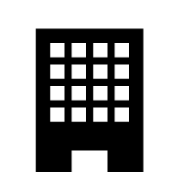

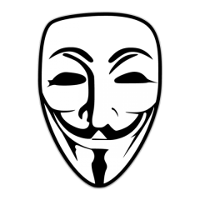
Blockchain is about Trust
Blockchain Network
Registration of facts
Transfer of assets
Enforcement of rules
Notes:
Eerste toepassing van blockchain was Bitcoin
De blauwe cirkel duidt aan waar ons vertrouwen ligt. Links is dat een centrale autoriteit, rechts is dit het netwerk (of, meer correct, vertrouwen we dat de meerderheid van het netwerk eerlijk is)

Slide 3
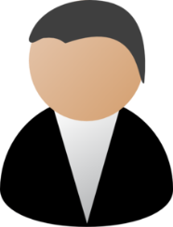





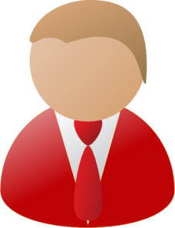


Idea
Ok!
Transactions
5,1 BTC →
0,7 BTC →
I transfer 0,4 BTC to
Dave
0,4 BTC →
Transactions
5,1 BTC →
0,7 BTC →
Ok!
Transactions
5,1 BTC →
0,7 BTC →
0,4 BTC →
Bob
0,4 BTC →
Charlie
Ok!
Transactions
5,1 BTC →
0,7 BTC →
Alice
0,4 BTC →

Slide 4
Idea
Blockchain
Ok!
Transactions
5,1 BTC →
0,7 BTC →
Valid
Only valid transactions accepted by the network
E.g. bob owns the money & did not yet spent it previously
I transfer 0,4 BTC to
Dave
0,4 BTC →
Atomic
Everyone writes transaction in his/her append-only spreadsheet or no one → Consensus mechanism
Transactions
5,1 BTC →
0,7 BTC →
Ok!
Transactions
5,1 BTC →
0,7 BTC →
Relatively fast
0,4 BTC →
Bob
Secure & robust
Systems functions, even if part of members offline or malicious
Charlie
0,4 BTC →
Ok!
Transactions
5,1 BTC →
0,7 BTC →
Distributed
Alice
0,4 BTC →

Slide 5
Blockchain
Block 51
Block 52
Block 53
Block 54
Header
Header
Header
Header
5,10 BTC →
0,40 BTC →
0,70 BTC →
Blockchain = concatenation of blocks, which contain transactions
At predetermined frequency new block appended with most recent transactions
blockchain contains ALL transactions
Transaction in blockchain cannot be removed
Many entities possess the same copy of the blockchain

Slide 6
Idea
Transactions
5,1 BTC →
0,7 BTC →
Dave
0,4 BTC →
Transactions
5,1 BTC →
0,7 BTC →
Transactions
5,1 BTC →
0,7 BTC →
0,4 BTC →
Bob
0,4 BTC →
Charlie
Transactions
5,1 BTC →
0,7 BTC →
Alice
0,4 BTC →

Slide 7

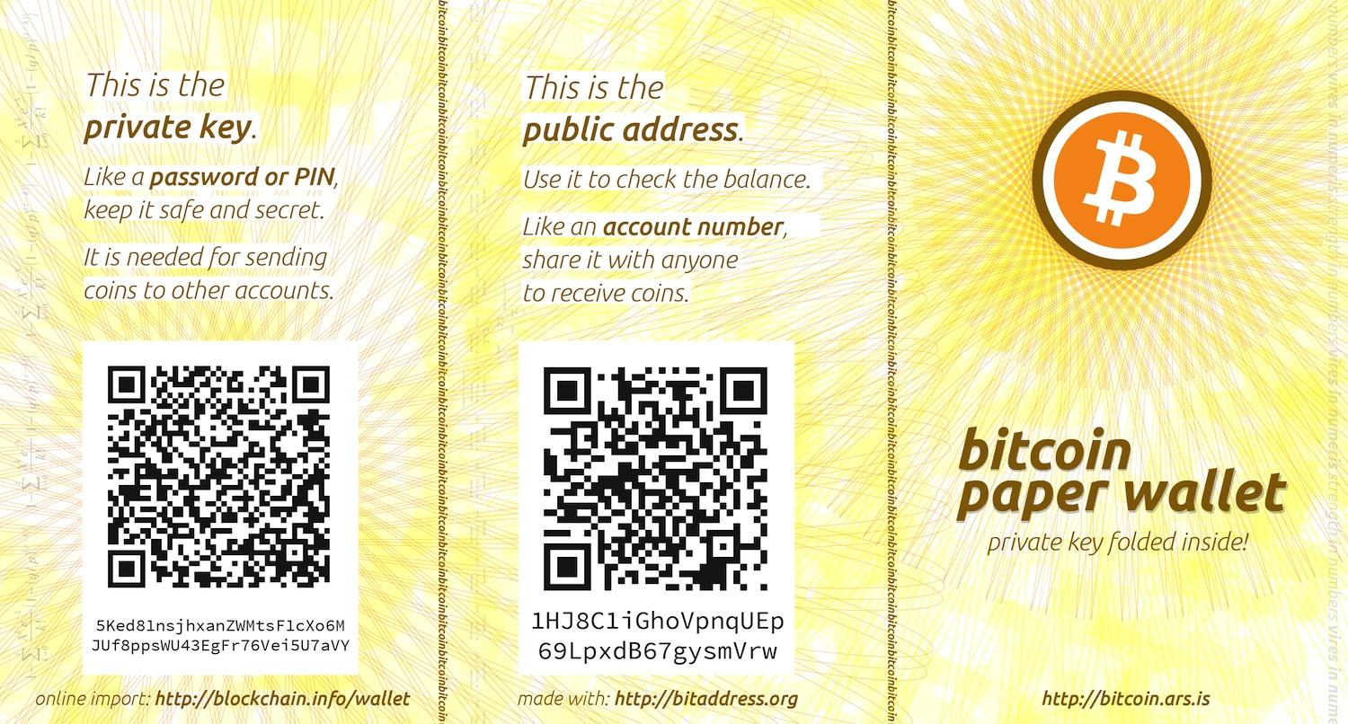

Pseudonyms & Keys
Not
0,40 BTC →
but
0,40 BTC →
Required to digitally sign a transaction in the name of the corresponding pseudonym

Slide 8

Network
Block creator
Full node
Light node
UTXO
UTXO
UTXO
UTXO
UTXO
UTXO
Blockchain
UTXO
UTXO
append-only
Bitcoin history
Relevant info
Most recent state
Notes:
Some people falsely think that the blockchain is very slow because it a serial data structure. To find data, you have to search the whole blockchain sequentially.
Relevant state is put in a fast and efficient NoSQL databae (used by facebook).
Checking if there si a doub le spent can be done quickly

Slide 9


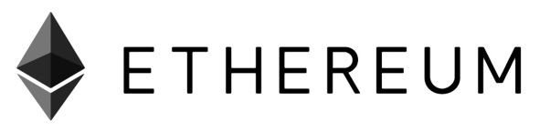
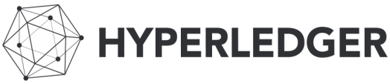
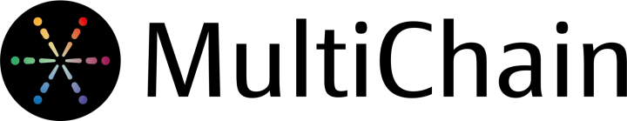
Permissionless
Permissioned
Compare with Internet
Compare with Intranet
Public / open
Enterprise / Consortium
Accessible & usable by whole world
Extra layer for access control
Ofter very inefficient
Much more efficient
Slower
Faster (more tx/s, more blocks/s)
Trust distributed
Trust decentralized
Crypto currency required
No cryptocurrency required
Notes:
Onefficient: much less energy consumption, higher throughput.
Both will coexist and even be used for one application (cfr georgia)
Land register Gerorgie: At a certain frequency, a 32 bytes fingerprint of the land registry is published on blockhchain, and with this, everyone can check if her transaction si still included (FIND LINK). This is posisble with a cryptgraphic concept that was invented in the seventies
E.g. Processing medical prescriptions
Only RIZIV/INAMI can publish smart contracts
Cooperation of 5/7 mutualities for creation valid block
Only accredited doctors can ask the contract to issue a new prescription

Slide 10
Blockchain is about Trust
Blockchain Network
Registration of facts
Transfer of assets
Enforcement of rules
Notes:
Eerste toepassing van blockchain was Bitcoin
De blauwe cirkel duidt aan waar ons vertrouwen ligt. Links is dat een centrale autoriteit, rechts is dit het netwerk (of, meer correct, vertrouwen we dat de meerderheid van het netwerk eerlijk is)

Slide 11








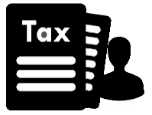
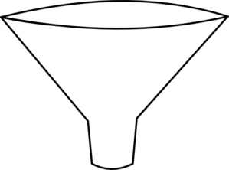

Registration of Facts
(Official)
documents
Driving license
Marriage
Diploma
Identity
Will
History/
Overview
Medical
records
Vaccination
Supply chain
Tracking
Taxes
Political
mandates
5f 3b fa 41 9c 63 be 2a 3a 09 ad bd 06 30 c5 1f
64 5e b0 3a ba fc d5 f2 ad 39 63 7a 30 6b 41 77
Will
Notes:
Political mandates: Transparency is an essential component in a democratic society.
Vaccinatie: verschi!llende mensen plaatsen vaccinaties, verschillende entiteiten toegang nodig
Gegevens die rele
http://www.ad.nl/binnenland/europees-parlement-weigert-controle-van-bureaukosten~a6625673/vant zijn voor het berekenen van uw belastingsaangifte kunnen op de blockchain geregistreerd worden

Slide 12
Registration of Facts
Block 51
Block 52
Block 53
Block 54
Header
Header
Header
Header
Will
Notes:
Political mandates: Transparency is an essential component in a democratic society.
Vaccinatie: verschi!llende mensen plaatsen vaccinaties, verschillende entiteiten toegang nodig
Gegevens die rele
http://www.ad.nl/binnenland/europees-parlement-weigert-controle-van-bureaukosten~a6625673/vant zijn voor het berekenen van uw belastingsaangifte kunnen op de blockchain geregistreerd worden

Slide 13
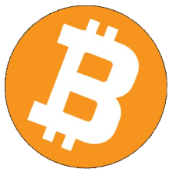

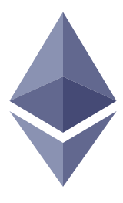


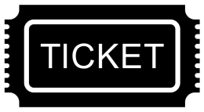
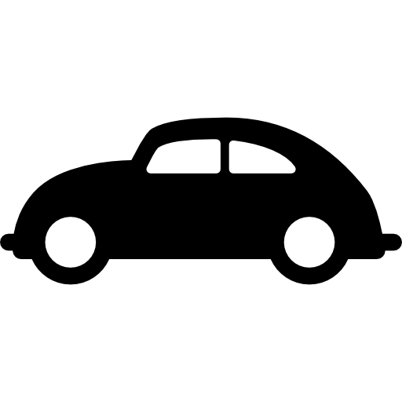


Transfer of Assets
Crypto currencies
(Virtuele assets)
Bitcoin
Monero
Ethereum
.bit
Untangible
assets
Tickets
Domain names
Electricity
Copyright
Tangible
assets
Land registry
Cars
Diamonds
Notes:
Auteursrechten. registering a copyright, of transferring ownerships, of licensing from person A to B, things like consignment or loaning."

Slide 14
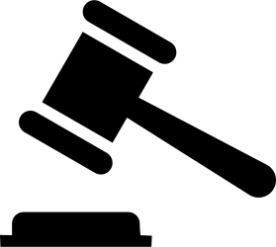


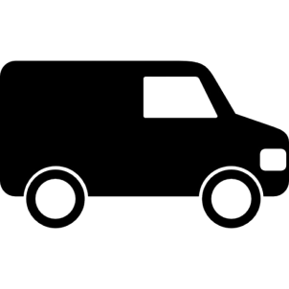
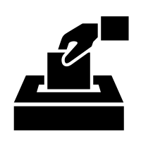



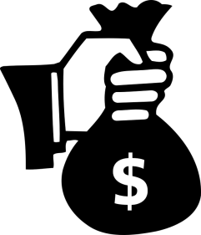
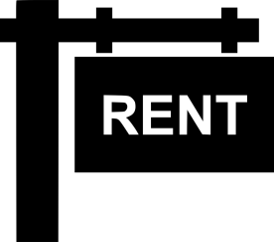

Enforcements of Agreements
Permissions
access PII
Flight Delay
Insurance
Auction
Transport
conditions
Processing
medical prescriptions
Elections
Smart locks
Application & Payment
of subsidies / benefits
Blocking
rent guarantee
Crowdfunding
Agreements between parties that do not trust each other,
without trusted intermediary
Notes:
Each of these applications can have a separate smart contract on the same blockhain

Slide 15
Smart Contracts
Ether (Ξ) is the cryptocurrency
on Ethereum
getMoney()
20 Ξ
Charlie
Contract Auction{
function bid()
function getMoney()
HighestBid: Ξ
HighestBidder:
Beneficiary: Charlie
}
bid(), 10 Ξ
0
10
20
10 Ξ
Bob
Alice
Alice
bid(), 20 Ξ
Bob
Can receive, block and spent value
Reactive
No single entity can influence correct functioning
Deaf and blind
Notes:
If the smart contract needs information from the real world, it is privede by calling a function.
For instance, in the case of flight delay insurance, a kind of authority gives this information to the smart contract by calling a function (eg. registerDelay())
If you need information from the ral world, it should be provided to the smart contract via a function (for instance

Slide 16
Smart Contract Blockchain
Block 51
Block 52
Block 53
Block 54
Contract deploy transaction
Header
Header
Header
Header
Function invoke
transaction
contract c
c.bid(), 20 Ξ
c.bid(), 10 Ξ
c.getMoney()

Slide 17

Network
Block creator
Validating (full) node
Light node
Blockchain
Smart contract
Append-only
History of smart contracts
Changeable by function calls
Actual state of smart contract
Notes:
Smart contract stored in a efficient nosql database.

Slide 18
Smart Contracts - Summarized
Automating rules &
enforcement of agreements
Between parties that do not need to trust each other 100%
Without dependency on a single,
intermediate party

Slide 19



Privacy & Confidentiality
Permissionless
Permissioned
Public / open
Enterprise / Consortium
Everyone can inspect the blockchain
Only participants have access to blockchain
Data in transactions & smart contracts for everyone readable
Encryption can hide data in transactions & smart contracts for part of the network
Trade platforms will be obliged by Europe to strongly link pseudonyms to identity of their customers.
You need crypto currencies to publish a smart contract or to interact with it
Access control layer can identify pseudonyms
Participants only known under pseudonym
One participant can have multiple pseudonyms
Not all data necessarily stored on the blockchain itself
Remark: The participants that collectively secure a smart contract, need access to
this smart contract state & code and to the relevant transactions
Notes:
Blockchain zegt niets over de correctheid van de zaken die erin geregistreerd worden
Bijvoobeelld
Iets over merkle trees

Slide 20
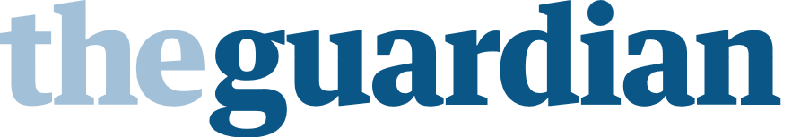

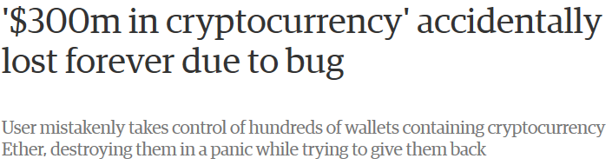
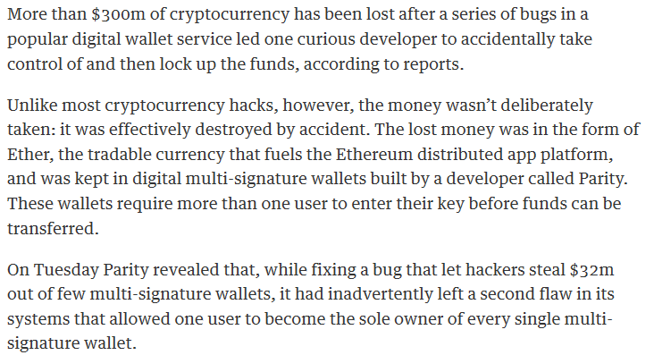
https://www.theguardian.com/technology/2017/nov/08/cryptocurrency-300m-dollars-stolen-bug-ether

Slide 21
Bugs in Smart Contracts
Permissionless
Permissioned
Public / open
Enterprise / Consortium
Hard / impossible to update smart contract
Smart contract more easily updatable
Harder to identify attacker
Attacker can be easily identified
How to reduce risk?
Developers need proper background
Smart contract code looks familiar, but behaves somewhat differently.
Minimize smart contract code
Testing en code verification
Future formal verification

Slide 22

Future Functionality
Blockchain interaction
“Hyperledger still requires an addressing system that allows transactions on one ledger to discover and utilize appropriate transactions and smart contracts (chaincode) on other ledgers.”
FABRIC
Blockchain truncation
After a voting round, the oldest part of the blockchain that has become dead weight, can be collectively forgotten. This feature will help to keep the blockchain manageable.
Two examples of useful features that do not yet exist in current blockchain platforms. However, the blockchain community is working on it.
http://www.the-blockchain.com/docs/Hyperledger%20Whitepaper.pdf
Notes:
Interledger.org: only payments

Slide 23


Slide 24
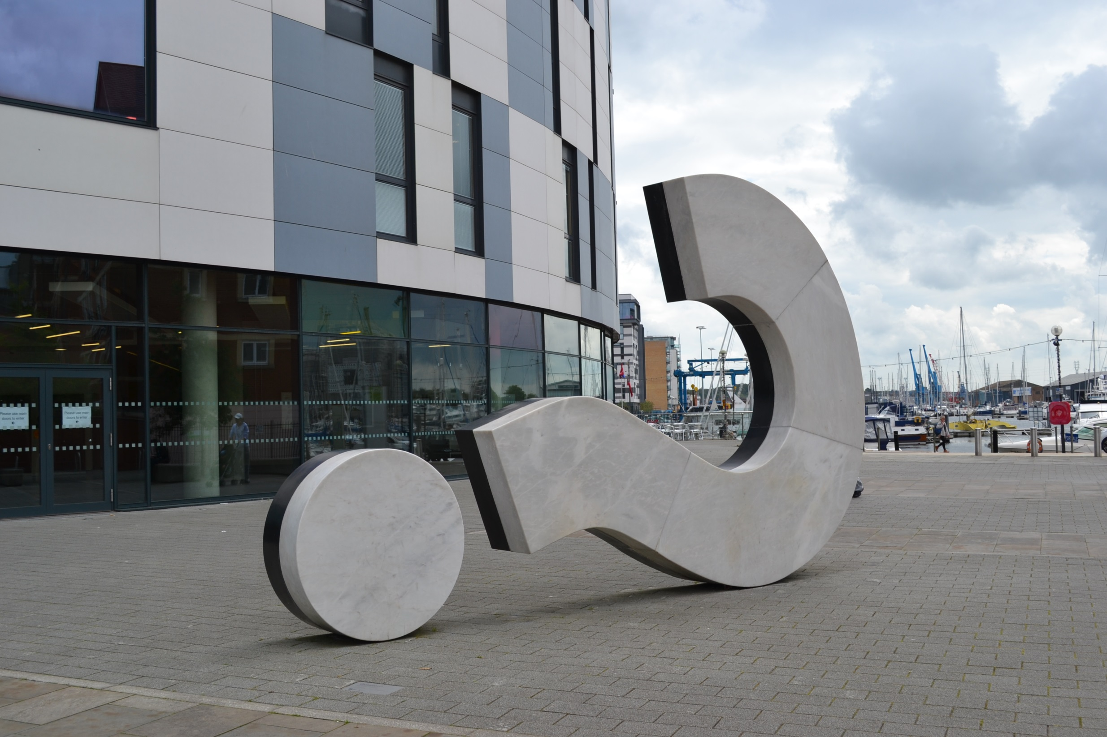
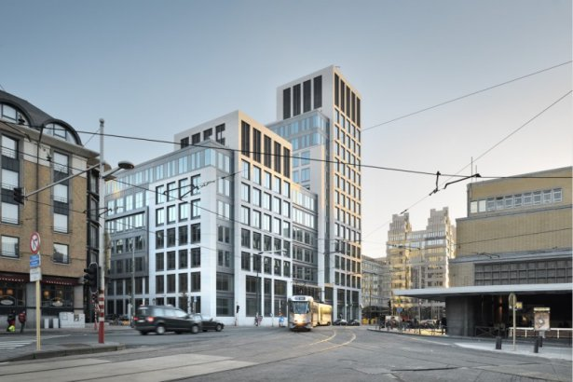
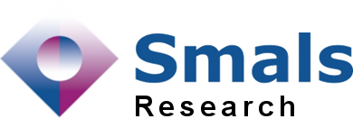



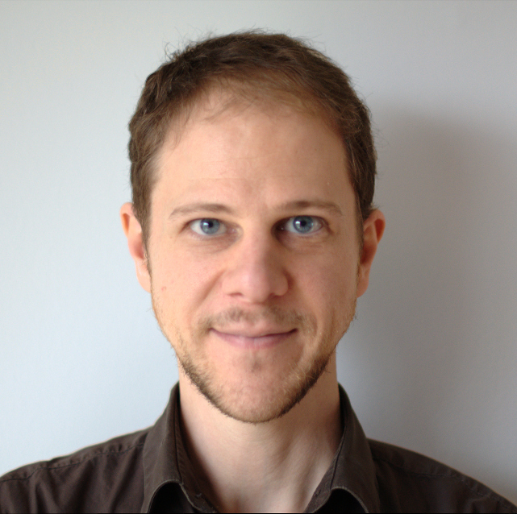


Questions & Contact
Dr. Kristof Verslype
Researcher, advisor & speaker
in crypto, privacy & blockchain tech
www.smalsresearch.be
@SmalsResearch
www.smals.be
@Smals_ICT
Personal
www.cryptov.net
kristof.verslype@smals.be
@KristofVerslype
be.linkedin.com/in/verslype
© Benjamin Reay

