Slide 1
01/09/17
Architecture

Slide 2
Electronic Exchange of Social Security Information (EESSI) - Perspective
EESSI will connect over 10.000 social security institutions across Europe and support the international data exchanges between these institutions in a secure and reliable manner.
The data exchange will be performed by using predefined messages (SEDs) and in accordance with the business rules agreed by Member States (MS).
This will facilitate the social security coordination effort of national institutions and hundreds of thousands of clerks allowing Member States to fulfil their obligations under Regulations (EC) Nos. 883/2004 and 987/2009.

Slide 3
EESSI & BelEESSI
International Domain that hosts components which are common to all Member States.
The EESSI Central Service Node (CSN) – designating the components that will be hosted centrally (e.g. hosted by European Commission). As a component, CSN is transparent for a National Application Integration project.
CSN is seen as a central repository and from a National Application Integration, it will be important because information stored there would be the first layer of routing info, when document exchange is taking place

Slide 4
EESSI & BelEESSI
The National Domain that hosts national specific elements of the network (i.e. the so-called National Systems)
The Access Point (AP) – a domain that holds components common to all countries, developed centrally, but deployed and hosted in the participant countries. Access Points establish the border between the national and international domains of the EESSI end-to-end network
A Reference Implementation for a National Application (RINA) is developed by the EESSI central project team, based on open source software and using a modular design (reusable components for national systems)
National Gateway (NG) –The component is handling other activities to interconnect existing systems
SOAP webservice or FTP file exchanges instead of more complex ebMS protocol
EESSI conformance testing at NG level; EESSI requirements satisfied at NG level (validation rules, antimalware)
Existing network connections and certificates instead of new connections and EU certificates
The National Application (NA) is the National Institution Application

Slide 5
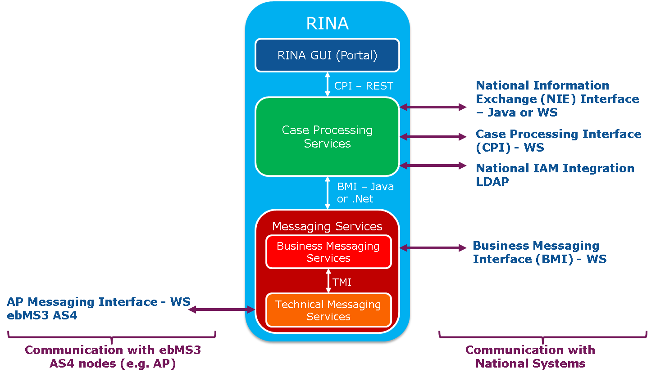
RINA
RINA is based on 3 layers which are built one on top of the other
Portal – provides an UI build on top of the Case Management Services having administration consoles and case management modules
Case Management Services – provides a stateful component built on top of the Business Messaging Services that manages cases in a structured manner taking care of all the issues regarding case flow, documents, notifications, user management and provides several interfaces for external access
Business Messaging Services & Technical Messaging Services - provides a reusable component for sending business messages to the Access Point using the technical protocol (ebMS/AS4). These services provide the translation (business message to technical message and vice versa), validation and signing of the business messages for correct exchange with the EESSI environment, and the correct reception of messages from other institutions

Slide 6
Belgian architecture for EESSI
EU
BCSS
SMALS
BCSS
Institution
CLERCKS
UAM
CSN
NA
NG
AP
Access Points of other member states
BMI
History
Database
Services: identification of a person, of Belgian institution, …
2

Slide 7
Belgian architecture for EESSI
Clerks
UI
National application (CI)
RINA (Portaal SocSec –
Smals)
Clerks
NIE/CPI
History
Database (Smals)
UAM
(Smals)
UI
IAM
National application
(CI)
RINA
Link register Phonetic identification (CBSS)
Reference Repository for routing
(CBSS)
ebMS AS4
National Gateway (CBSS)
Access Point
(CBSS)
ebMS AS4
RINA BMIWS
CBSS protocols (SOAP web service / FTP LDM)
CSN
(EU)
Access Points of other member states
2

Slide 8
Consequences
A single business case can not be partially treated in both RINA and National Application (NA)
Low message volumes
Cloud RINA
High message volumes
National Application interacting with National Gateway
Limited possibilities for NA to integrate with existing systems or applications (cloud RINA, extension with CPI/NIE)

Slide 9
Consequences
To be studied: central archive « history database » for all institutions (G-cloud)
Subprocesses not implemented by NA will:
If started by Belgian CI, created in RINA by a clerk as a separate horizontal process instead
If started by foreign CI, refused. Foreign CI should start them as separate horizontal process.
Link register (mapping between foreign id and national id) functionality will be made separately available as a webservice
Forwarding between institutions: connection between AP and the BCSS service ‘reference repository’ (identification of Belgian Institution)
Enrichments:
CBSS won’t add new business data from other sources to messages sent to foreign CI outgoing from Belgian institutions in NG.
Message metadata can be mapped in NG to CBSS format (e.g. identification of Belgian institution).
Identification matches will be added to messages from foreign CI without SSIN

