Slide 1



Digital transformation: a marriage between public and private sector
frank.robben@mail.fgov.be
@FrRobben
https://www.ksz.fgov.be
https://www.ehealth.fgov.be
https://www.smals.be
https://www.frankrobben.be

Slide 2

Agenda
Evolution
Expectations
Trends
Government ICT strategy as a means
Conclusion

Slide 3

Digital is the new normal: society needs to evolve
Public & private sector cooperation regarding
  vision
  common components & services
  synergies in order to meet user expectations
  ask sharing according to strengths
Not only about competitive, yet also cooperative strategic advantages

Slide 4
Expectations of citizens & enterprises
Effective services
Integrated services
  adjusted to their specific situation, customized if possible
  life events (birth, school, work, moving, illness, retirement, decease, setting up an enterprise…)
  across government levels, public services and private bodies
Adjusted to their own processes
With a minimum of costs and administrative formalities
Provided automatically, if possible
With active user participation ( self-service – self-empowerment – follow-up)
Always up to date

Slide 5
Expectations of citizens & enterprises
Offered in a performant and user friendly way
Reliable, safe and permanently available
Using the media of their choice (internet, mobile data, telephone, direct contact…)
Respecting their privacy

Slide 6
Trends
Interconnec-tivity
Service architecture
Mobile devices & wearables
3D printing
Internet of things platforms
…
Autonomous agents and things
Adaptive security architecture
Big data
6

Slide 7

Trends
Marathon
Reliable
Price / performance
Planning
Standard processes
Long cycles
Sprint
Agility
User focused
Continuous changes
New / level of uncertainty
Short cycles
Mode 1
Mode 2

Slide 8
Trends
Marathon
Sprint
We need to do both

Slide 9
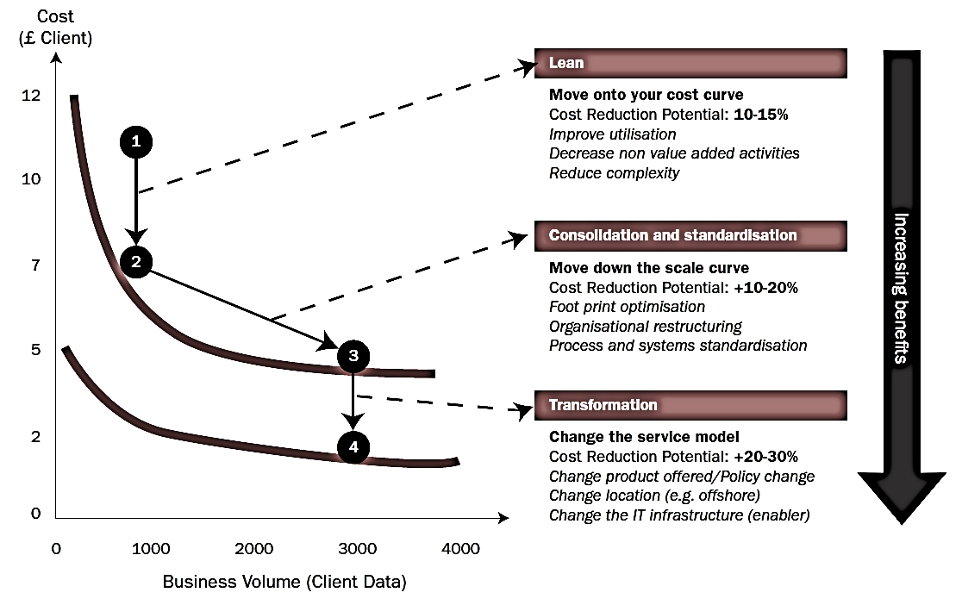
Synergies and transformation
Source: Booz Allen Hamilton

Slide 10

How can the government’s ICT policy contribute ?
Government as instigator
Open government services
G-Cloud
PPP and concession as intended in ESA
Platform economy

Slide 11

Government as instigator: setting the example, facilitating & stimulating
1998 Dimona: first mandatory online transaction for many companies
2003 DmfA: first use of XML for online communications with the government
2008 eHealth platform: secure exchange of health data (E2EE, timestamping, Vitalink health vault, …)
2017 Blockchain ?

Slide 12
Blockchain
Blockchain is not a “disruptive” technology, which can attack a traditional business model with a lower-cost solution and overtake incumbent firms quickly. Blockchain is a foundational technology: it has the potential to create new foundations for our economic and social systems. But while the impact will be enormous, it will take decades for blockchain to seep into our economic and social infrastructure. The process of adoption will be gradual and steady, not sudden, as waves of technological and institutional change gain momentum.
Marco Iansiti & Karim R. Lakhani, Harvard Business Review 2017

Slide 13


Blockchain: distributed trust
Blockchain network
Storage
Integrity, timestamping, non-repudiation
Rules / Binding agreements
through smart contracts (= chaincode)

Slide 14
Why blockchain?
Blockchain is ideal for the simplification of processes
  including several parties
  who (still) do not (fully) trust each other
  No trusted third party (process integrator)
  Additional transparency / audit possibilities
Involved parties obtain most recent data (almost) in real time
allowing faster and more streamlined processes
from a pure sequential approach to a more parallel one

Slide 15
The essence of blockchain
Distributed ledger on the internet
Each action is & stays visible for everyone; only adding lines is possible
“Peer to peer”: no third party is required in order to carry out transactions
Secured by uncrackable cryptography
Useful for everything having value in the broadest sense

Slide 16
What can a blockchain register?
Birth: registration of birth, identity and attributes
Property: registration of ownership
Integrity: registration of unique files (“hash codes”)
Process: registration of a chain of events or documents
Transfer: registration of transfer of property, data or value
…

Slide 17






Improved governance through blockchain
Simplification
Streamlined processes
Transparency
?
?
?
?
?
?
?
?
OK
Life cycle
Debt mediation
Food safety
Blockchain promising technology

Slide 18

Blockchain & government
Silo 2.0
Danger of data being spread in several isolated blockchains
Coordinated approach for cross institutional blockchain ecosystems
Common platform
Common vision

Slide 19
Business & blockchain
Unique opportunities to reach process optimization across different government levels/institutions/citizens & enterprises
Optimized processes only in broader ecosystems
Coordinated approach required
Applying existing principles & preparing for new ones: distributed trust

Slide 20

Open government services
Building mutual trust
Through specific cooperation
With consistent delivery, results and ROI
Examples
  digital user management
  eBox citizen & eBox enterprise
  eHealth platform

Slide 21








Example: eHealth platform
Patients, health care providers,
health facilities
Health portal
Software
HC provider
Software health facility
VAS
Site NIHDI
VAS
eHealth
portal
MyCareNet
VAS
VAS
VAS
Users
Basic services eHealth platform
Network
VAD
VAD
VAD
VAD
VAD
VAD
Suppliers

Slide 22

Example: eHealth platform
Coordination of digital subprocesses
Portal
Integrated user and access management
Management of logs
System for end-to-end encryption
eHealthBox
Timestamping
Encryption and anonymization
Consultation of the National Register and the CBSS Registers
Reference directory (metahub)

Slide 23
Example: eHealth platform
Government (eHealth platform)
  develop vision & strategy regarding eHealth
  organize cooperation & drive change
  establish functional & technical norms, standards, specifications, IT reference architecture
  certify software for electronic health records management to several health care actors
  design, elaborate and manage a common platform for secure digital data exchange & related basic services
  agree upon governance, quality standards and compliance
  promote and coordinate the creation of programmes & projects
Private sector
  develop & offer electronic health records management software in the health care sector

Slide 24

G-Cloud
Shared public ICT platform
  current target: federal state (FPS, PPP, Public Institutions of Social Security, Institutions of Public Benefit)
  can be extended to other interested authorities
Hybrid community cloud model
  use of public cloud if possible
  private community cloud hosted in government managed data centers
  operational implementation with strong involvement of the private sector

Slide 25






Types of cloud deployments
Public Cloud
Shared
Access/Control
Outsourced Community Cloud (= off-premise)
Community Cloud on-premise
Hybrid
Private Cloud on-premise
Outsourced Private Cloud (= off-premise)
Dedicated
Customer
Location
Service Provider

Slide 26
Basic principles
Maximize synergy where possible, generate efficiency gains and/or savings, while maintaining or improving service quality to citizens / enterprises / public institutions
In line with overall synergy programme: assign services to the most capable one or propose shared services
Synergy based on result orientation, sense of responsibility and mutual trust

Slide 27




G-Cloud ‘products’
Procurement
Cooperationá
Efficiencyá
Projects
Synergy
Services
Costsâ
Qualityá
Know-how & Expertise

Slide 28

The role of the private sector
G-Cloud ≠ ICT insourcing
Public procurement
  translation tool
  converged infrastructure
  unified communications
  IAP (network security)
  ITSM (Service Now)
  storage
  back-up...
Consultation with the sector regarding vendor-specific platforms: IBM, Microsoft, Oracle, Red Hat, SAS...

Slide 29
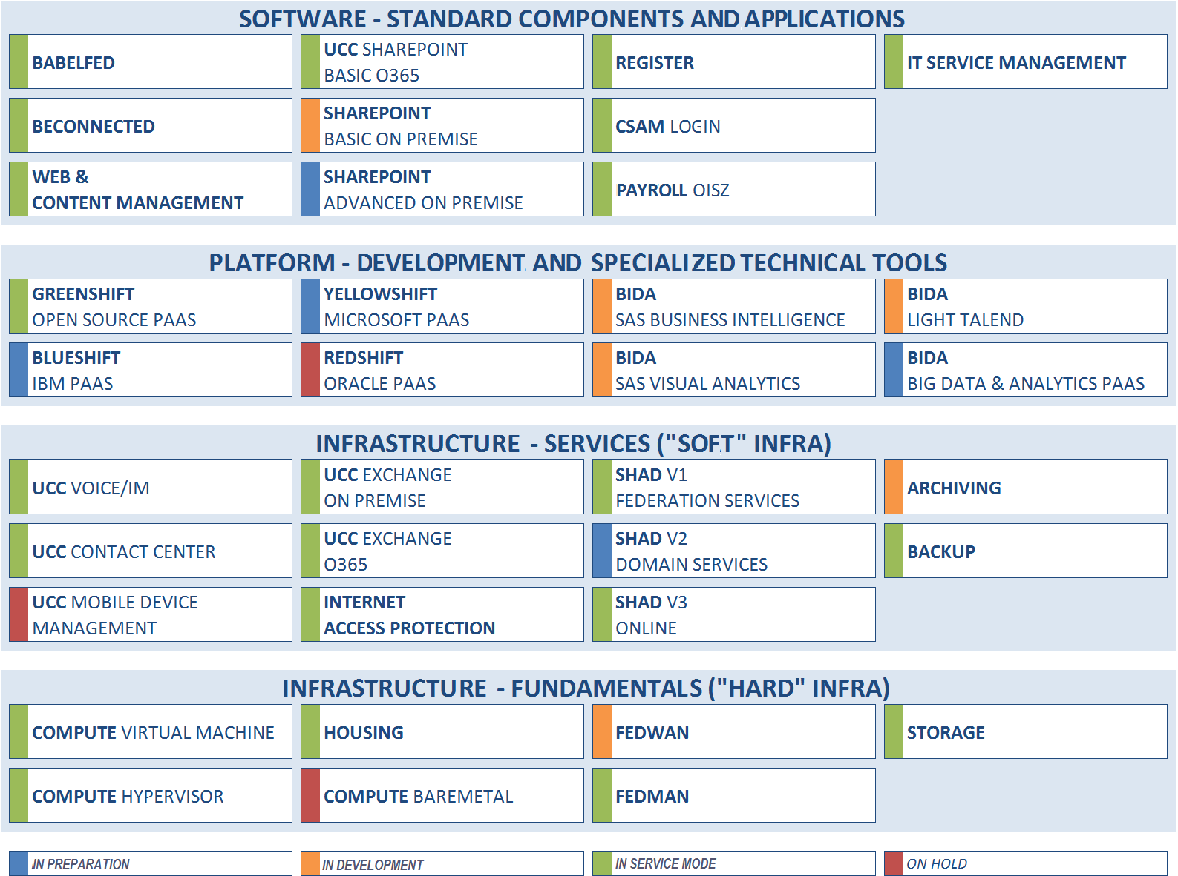

Slide 30

Role of open source
Extensive use of open source technologies
Native to system administrators & developers
Examples
  Red Hat OpenStack in VMaaS
  Red Hat OpenShift & containers in Greenshift PaaS
  Developer pipelines
  Automation toolchain
Importance of vendor-supported open source technologies

Slide 31

Platform as a Service (PaaS) in G-Cloud
Abstraction of the underlying platform for developers
High automation degree (‘zero touch deployment’)
Higher productivity
DevOps way of working
‘Shifts’: Green (Red Hat open source), Blue (IBM), Yellow (Microsoft), Red (Oracle)

Slide 32
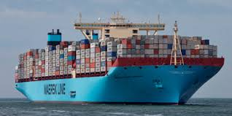
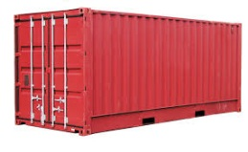

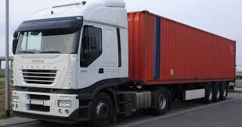






PaaS in G-Cloud - Containers
Introducing container technology
Translated into modern technology such as Platform-as-a-Service
Individuele
inhoud
Easy to move around
Individual content
Isolated storage
Geïsoleerd opgeslagen
En makkelijk verplaatsbaar
Monitoring
Security
Logging
Coming
soon

Slide 33

PaaS in G-Cloud
New ways of cooperation
Government ecosystem
Other sectors
Components
parts
Application
1
Application
2
Application
N
Partner
1
Partner
2
Partner
N
Platform
cooperation
DB
DB
Technological cooperation
DB
DB
DB

Slide 34

G-Cloud = opportunities
Design by public sector with help from private sector
Built by private sector
Run
  without heavy investment
  in a safe and familiar environment
  scalable
  easy to adjust
Concepts and components reusable outside the public sector

Slide 35
PPP and concession as intended in ESA
(European System of Accounts)
Should the Oosterweel project be included in the national budget or not? « European System of Accounts » rules apply
Both PPP (government bearing the largest part of the costs through compensations) or concessions (government pays no or only limited compensations) can be used for IT related project funding
Under correct (utterly strict) conditions, no impact or spread impact on the public budget
Traditionally used for buildings or large infrastructure works, but can also be used for projects using IT

Slide 36

PPP and concession as intended in ESA
Mileage-based charges for lorries is a PPP project
DBFMO (Design, Build, Finance, Maintain and Operate) contract awarded to NV Satellic

Slide 37

PPP and concession as intended in ESA
Concession: distribution of debt collection missions to bailiffs
Government only creates XML messages
Concessionaire distributes to bailiffs and handles feedback about the evolution of the cases
Works for multiple governments
Each bailiff can participate

Slide 38

What about a platform economy ?
We are living in a platform economy:
eBay, Amazon
YouTube
Google, Baidu
Paypal, Alipay
iOS, Android
Airbnb, TripAdvisor
Uber
Linkedin, Glassdoor
Notes:
Glassdoor is a website where employees and former employees anonymously review companies and their management.^{[2]}
The site later also began focusing on CEOs and workplaces, as well as what it is like to work at jobs in general.^{[9]} Employee reviews are averaged for each company.^{[10]} Glassdoor ratings are based on user-generated reviews. Each year Glassdoor ranks overall company ratings to determine its annual Employees’ Choice Awards, also known as the Best Places to Work Awards.^{[11]}
Glassdoor heeft zich hierdoor ontwikkeld als een belangrijke website voor rekruteringen.
=>Baidu, Inc. (Chinese: 百度; pinyin: Bǎidù, anglicized /ˈbaɪduː/ "by-doo"), incorporated on January 18, 2000, is a Chinese web services company headquartered at the Baidu Campus in Beijing's Haidian District.^{[6]} It is one of the largest Internet companies in the world.
Baidu offers many services, including a Chinese search engine for websites, audio files and images. Baidu offers 57 search and community services including Baidu Baike (an online, collaboratively built encyclopedia) and a searchable, keyword-based discussion forum.^{[7]}Baidu was established in 2000 by Robin Li and Eric Xu.
Alipay.com is a third-party online payment platform. It was launched in China in 2004 byAlibaba Group and its founder Jack Ma. According to an analyst research report, Alipay had the biggest market share in China with 400 million users and control of just under half of China's online payment market in October 2016.

Slide 39
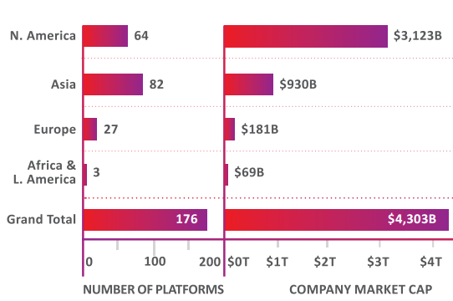
What about a platform economy ?
"A platform is a business that creates value by facilitating direct interactions between two or more distinct types of customers"*
Total value of platform companies >4,000 billion €
Europe < 5%
*
* Andrei Hagiu & Julian Wright – Multi-sided platforms

Slide 40
The idea behind a platform economy: creation of a geographic niche
Can we set up a platform based on the creation of a geographic niche ?
Combine & integrate elements already present or in preparation:
  eID and strong mobile authentication
  well integrated and innovative digital payments
  eBox citizens and enterprises
  Strong authentic sources
  One single gateway to private interactions, purchases and transactions with the government
Trust in local actors & local enforcement
User centricity: focus on what local users prefer
Advantages for citizens, enterprises and authorities
Time for a systematic cooperation or PPP culture?

Slide 41
Conclusion
Innovations expected to come from the private sector, yet sometimes the government is acting as an instigator
(Also smaller) software companies can develop software and use containers helping public institutions put their applications in the G-Cloud
DBFMO (Design, Build, Finance, Maintain and Operate) approaches do not only apply to building tunnels or schools, but also to IT projects
Enterprise open source is offering new ways of collaboration in ICT; independence of key vendors like Red Hat should be preserved.
Odds are low that Belgium will get platforms such as Amazon, Google or eBay – yet if we gather the strengths of the public and private sector in function of our user preferences, then we can reach a geographic niche platform

Slide 42

Frank Robben
General Manager
Crossroads Bank for Social Security eHealth platform
frank.robben@ksz.fgov.be
@FrRobben
www.ksz.fgov.be
www.ehealth.fgov.be
www.socialsecurity.be
www.frankrobben.be

