Slide 1

Efficient and secure transborder exchange of patient data

Slide 2












A

Slide 3
Basic requirements
Correct identification of the patient
Correct routing of information request
Privacy and information security management
  user and access management
  end-to-end encryption
Interoperability
  technical
  semantic

Slide 4
Mission of the Belgian eHealth platform
How?
  through a well-organised, mutual electronic service and information exchange between all actors in health care
  by providing the necessary guarantees with regard to information security, privacy protection and professional secrecy
What?
  optimisation of health care quality and continuity
  optimisation of patient safety
  reduction of administrative burden for all actors in health care
  thorough support of health care policy and research

Slide 5
10 Tasks
Development of a vision and of a strategy for eHealth
Organization of the cooperation between all governmental institutions which are charged with the coordination of the electronic service provision
The motor of the necessary changes for the implementation of the vision and the strategy with regard to eHealth
Promoting and coordinating programmes and projects

Slide 6
10 Tasks
Determination of functional and technical norms, standards, specifications and basic architecture with regard to ICT
Registration of software for the management of electronic patient files
Managing and coordinating the ICT aspects of data exchange within the framework of the electronic patient files and of the electronic medical prescriptions

Slide 7
10 Tasks
Conceptualization, design and management of a cooperation platform for secure electronic data exchange with the relevant basic services
Reaching an agreement about division of tasks and about the quality standards and checking that the quality standards are being fulfilled
Acting as an independent trusted third party (TTP) for the encoding and anonymisation of personal information regarding health for certain institutions summarized in the law for the support of scientific research and policymaking

Slide 8








Basic Architecture
Patients, health care providers
and health care institutions
Health portal
Health care provider
software
Health care institution software
VAS
Site RIZIV
VAS
eHealth-
portal
MyCareNet
VAS
VAS
VAS
Users
Basic Services
eHealth-platform
Network
AS
AS
AS
AS
AS
AS
Suppliers
Notes:
8
8

Slide 9
10 Basic services
Coordination of electronic sub-processes
Portal
Integrated user and access management
Logging management
System for end-to-end encryption
eHealthBox
Timestamping
Encoding and anonymization
Consultation of the National Identification Registers
Reference directory (metahub)

Slide 10
Identification of the patient
Obligatory use of social security identification number (SSIN) in health sector
Procedures are available in order to guarantee unicity of SSIN
SSIN is available on electronic identity card or ISI+-card
Link register is available in order to link the Belgian SSIN with identification numbers in other countries

Slide 11
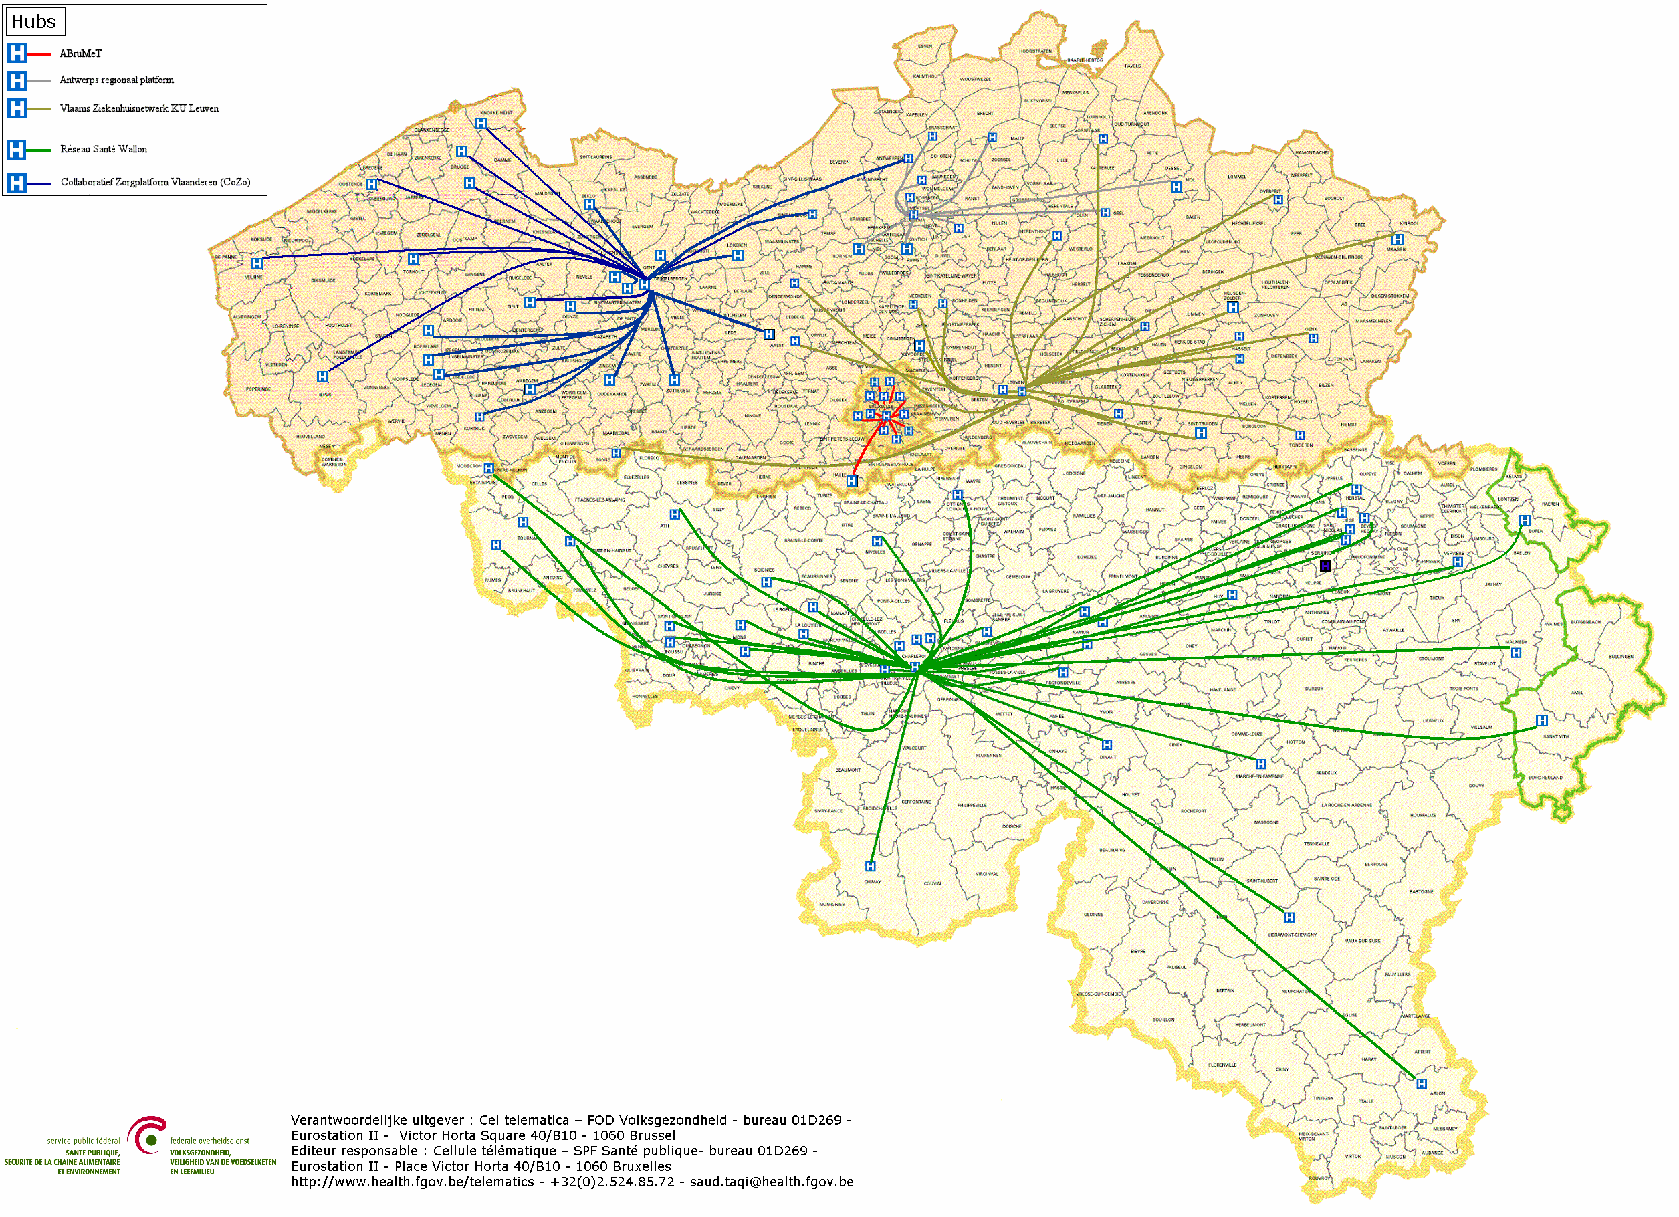
Routing: hubs & metahub system
5 hubs
3 technical implementations
All Belgian hospitals connected

Slide 12


Hubs & metahub system before

Slide 13


Hubs & metahub system today
3. Retrieve data from hub A
A
1: Where can we find data?
2: In hub A and C
4:
All data available
3: Retrieve data from hub C
C
B

Slide 14
Extramural data
A
InterMed
BruSafe
C
B

Slide 15
User and access management

Slide 16
User and access management

Slide 17
End-to-end encryption
2 methods:
    In the case of a known recipient: use of an asymmetric encryption system (2 keys)
    In the case of an unknown recipient: use of symmetric encryption (the information is encrypted and stored outside the eHealth platform; the decryption key can only be obtained through the eHealth platform)

Slide 18
Asymmetric end-to-end encryption
Healthcare actor
Person or entity
eHealth platform
Internet
1
3
Connector or
other software to
generate key pair
Authenticates sender
2
4
Sends
public key
Identification
certificate
Identificatieoncertificate
Stores
public key
Web service
Register key
2
Public keys
repository
Stores private key
in a secure way

Slide 19
Asymmetric end-to-end encryption
Message originator
eHealth platform
Internet
Identification certificate
Web service
Ask public key
1
Identification
certificate
2
Asks for public key
Authenticates sender
Send message
Any protocol
3
4
Sends
public key
Encrypts
message
Identification
certificate
Message recipient
Public keys
repository
5
Stored
private
key
Decrypts message

Slide 20
Symmetric end-to-end encryption
Key
Management
/ Depot
Encrypted with public key of user 1
Encrypted with public key of user 2
Symmetric key
Symmetric key
2 sends key
5 receives key
User 1
Originator
1 asks for key
User 2
Recipient
4 justifies right to
obtain key
4 justifies right to
obtain message
3 sends encrypted message
Encrypted with public key of Message depot
5 receives message
Encrypted with public key of User 2
Message encrypted with
symmetric key
Messages
Depot
Message encrypted with
symmetric key
Message encrypted with
symmetric key

Slide 21


Slide 22
Thank you !
Any questions ?

