Slide 1

Mobile health: follow-up

Slide 2
Roadmap 2.0 2015-2019
End of 2012: Round table conference about the priorities for informatisation of the Belgian Healthcare sector
300 stakeholders representing the healthcare sector
Result: Roadmap eGezondheid / Plan d’Action eSanté with concrete objectives for the next 5 years.
2015: actualisation Roadmap eGezondheid/Plan d’Action eSanté : Roadmap 2.0

Slide 3
Roadmap 2.0 2015-2019
Principles
  collaboration: coalition of the willing
  involvement of all stakeholders
  empowerment of all stakeholders
  dependable basic services and business continuity actions
  simplification whenever possible
  emphasis on concrete results rather than everlasting discussions
  steady progress through SMART objectives and action points
  multidisciplinary approach
  basis for synergies necessary for high quality and affordable health care

Slide 4
Action point 19: mobile health (mHealth)
Objectives 2019
  improving health in the Belgian population
  creating better health and comfort in the Belgian healthcare system by facilitating effective and efficient care support using mHealth applications
  creating a framework in the healthcare sector to integrate mHealth applications into existing and future health care (legal, financial and organizational aspects)
  making services of the eHealth platform available for mobile use
  supporting healthcare that uses mHealth applications
  supporting quality and accessibility of mHealth

Slide 5

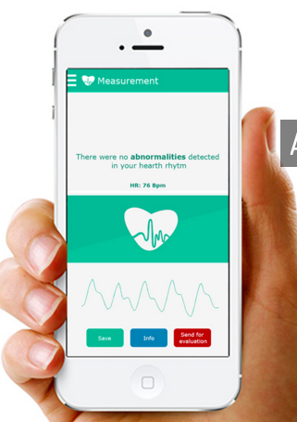
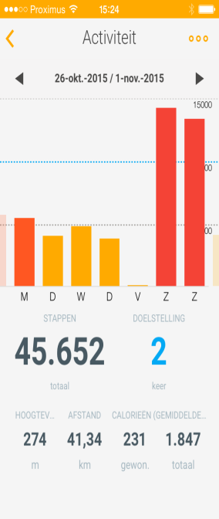
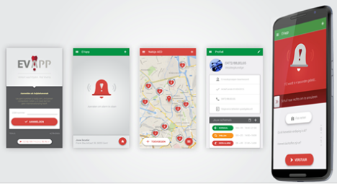
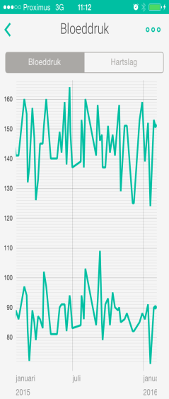

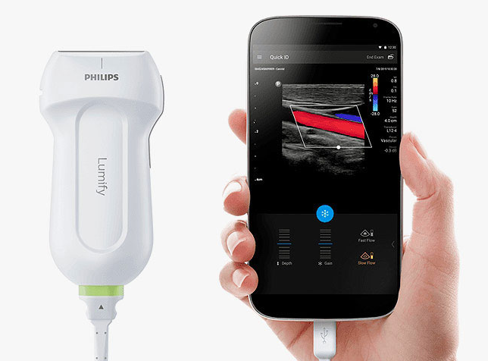

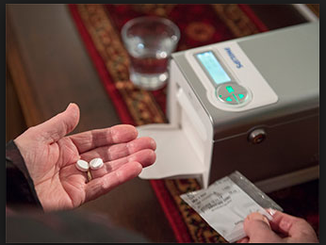
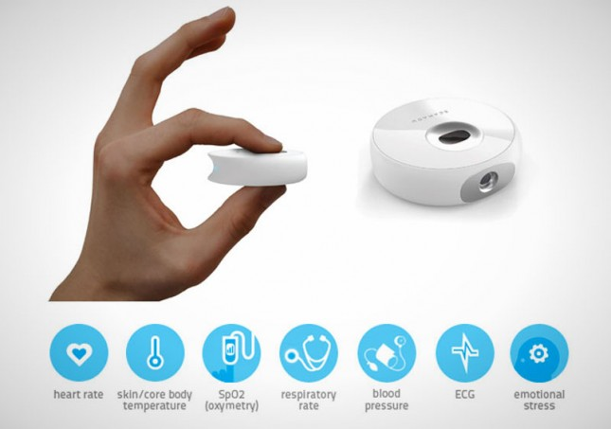
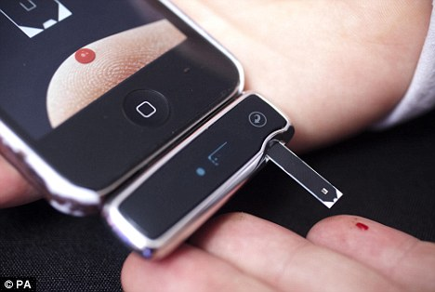
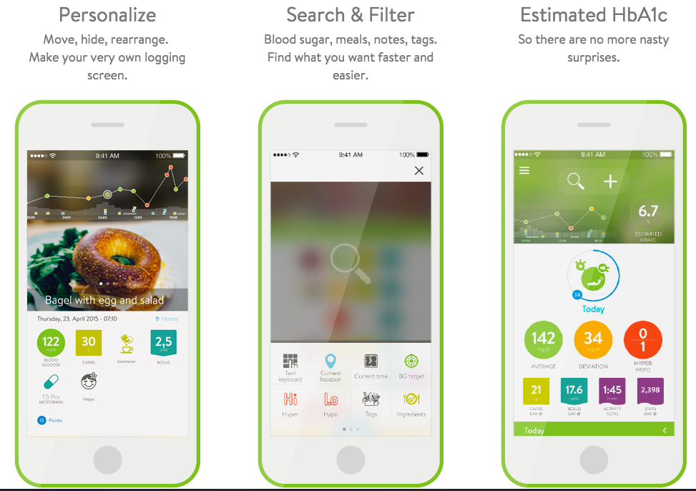


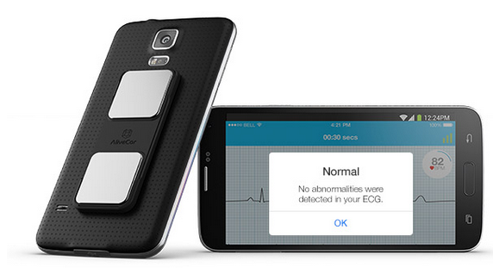
Notes:
Withings, EVApp, Qompium, Scanadu, Clinic, MySugr, Zembro, Philips Medido, Mercy Virtual

Slide 6
Roadmap 2.0 – 5 Prioritary use cases
Stroke: mhealth apps for acute stroke care with ultra fast and specialized treatment, home rehabilitation, reintegration-mobile access, selfmanagement and empowerment of the patient and his environment
Cardiovascular disorders: risk management and care (lipids, weight, blood pressure, etc.)
Diabetes: telemonitoring, point-of-care testing and digital support of integrated care
Mental health: telecare and tele-psychotherapy, treatment compliance, working with mobile teams, ...
Chronic pain: multidisciplinary approach to chronic pain in specialized pain centre with monitoring of patient: effort, quality of sleep, pain intensity and therapy adherence

Slide 7
AP 19 - Means
Creating a framework for mHealth applications in Belgium
Adapting the legal, financial and organizational framework to allow the use of mHealth applications
Setting up a validation process for mHealth applications
Facilitating the use of eHealth services on Mobile devices
Guaranteeing privacy, security and quality of mHealth applications
Stimulating patient (and family) empowerment
Preparing for a flexible rollout of mHealth applications within the health system in Belgium

Slide 8
AP19 - Timeline
2016 Q1 2016 Q2 2016 Q3 2016 Q4 2017 Q1 2017 Q2 …
Focus / Scope / Stakeholders / Experts
Legal framework
Law
Use cases
Process
Call
Selection
Pilot
Eval
Mobile authentication
Mobile EPR
Mobile PHR

Slide 9
AP19 - Scope
9
Mobile
Health
Outside Care
System
Tele
Monitoring
Tele
Health
Tele
Consult
Tele
Care
Mobile authentication
Mobile EHR
for professionals
Mobile PHR
for citizens
Inside Care
System
Self Management
Supervised
Apps
Wellness
Quantified Self
Prevention
Wearables
Apps
Wearables
Red = Short term, Orange = Medium term, Blue = Out of scope roadmap 2015-2018
Notes:
----- Meeting Notes (19/05/16 10:11) -----
Telecare voorbeeld Schotland CATS
Voorbeeld van telefoon naar huisarts.
Voorbeeld thuisverpleging fraxiparine.

Slide 10
Call for projects - Procedure
Scope
RFI Suppliers
Call for projects
1st Selection
Confirm
Pilot
Evaluation
Baseline
Pitches
2nd Selection
Negociation
Contract Art 56 + Projectplan
Notes:
Pitches november

Slide 11
Call for projects - Evaluation criteria
Privacy
Security
  authentication
  secure storage
Semantic interoperability
  interfaces
Regulation medical devices
(Scientific) Evidence
  levels of evidence
Financial model
Budget

Slide 12
Call for projects – 1st round
98 valid projects
Written evaluation by
  RIZIV/INAMI
  FOD/SPF
  FAGG/AFMPS
  eHealth platform

Slide 13
Call for projects - Pitches
36 projects
Presentation
Oral evaluation by
  RIZIV/INAMI
  FOD/SPF
  FAGG/AFMPS
  eHealth platform

Slide 14
Call for projects – 24 selected projects

Slide 15
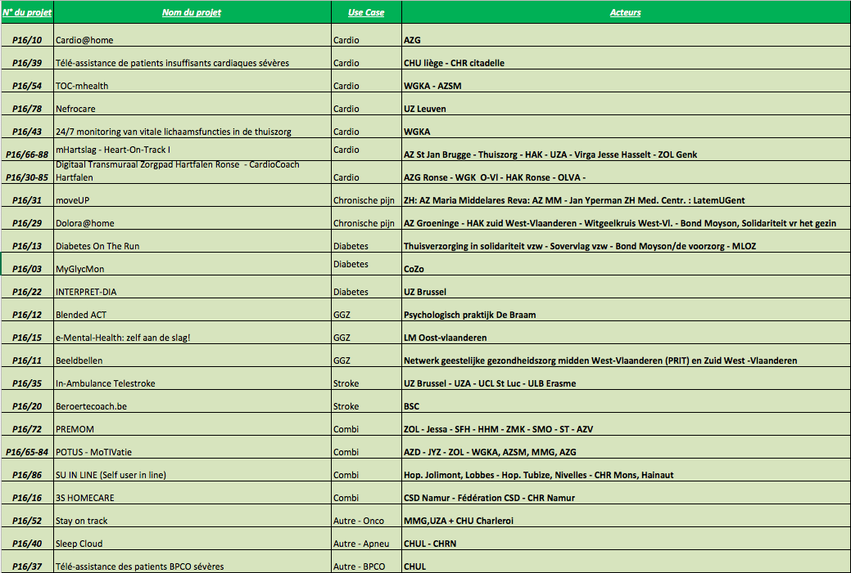

Slide 16
AP19 – Lessons learned so far
Enthusiastic projects have been entered
Many projects really tried to make a financial model
Nobody is 100% ready
More devices and platforms, less apps
Mental health apps > difficult evidence
Avoid overhead and configuration
Iterative mHealth validation framework
6 months is short
Indirect gain
Security and interoperability are poor

Slide 17
AP19 – Next steps
Information session 25/1/2017
Finalising contracts
Starting projects
In parallel
  working on technical criteria
    interoperability
    security
  evaluating results on quality of health(care)
  legal framework
  evaluation of health-economical aspects
Evaluation > decisions towards 2018
This is only the beginning !
Notes:
Verzekeringscomité

Slide 18
Thank you !
Any questions ?

