Slide 1
eHealth for quality & continuity of care and patient safety
frank.robben@ehealth.fgov.be
@FrRobben
https://www.ehealth.fgov.be
http://www.ksz.fgov.be
http://www.frankrobben.be

Slide 2
Some evolutions in health care
More chronic care instead of merely acute care
Remote care (monitoring, assistance, consultation, diagnosis, operation, ...), and home care
Multidisciplinary, transmural and integrated care
Patient-centric care and patient empowerment
Rapidly evolving knowledge => need for reliable and coordinated management and access to knowledge
Threat of excessively time-consuming administrative processes
Thorough support of health care policy and research requires thorough, integrated and anonymized information
Cross-border mobility
Need for cost control

Slide 3
The reported evolutions require...
Cooperation between all actors in health care
Efficient and secure electronic communication amongst all actors in health care
High quality, multidisciplinary electronic health records
Care pathways
Optimized administrative processes
Technical and semantic interoperability
Guarantees with regard to
information security
privacy protection
respect for the professional secrecy of health care providers

Slide 4
Electronic communication also stimulates …
Quality of care and patient safety
avoidance of wrong care and medication
incompatibility between medicines
contra-indications against certain medicines or treatments for a specific patient (eg allergies, diseases, …)
avoidance of errors in concrete care provision and administration of medicines
availability of reliable databases on good treatment practices and decision support scripts
more opportunity for multidisciplinary consultations and second opinions
Avoidance of unnecessary multiple examinations => less stress for the patient and avoidance of unnecessary additional costs

Slide 5
Objectives of the eHealth-platform
How?
through a well organized, mutual electronic service provision and information exchange amongst all actors in health care
with the necessary guarantees on the level of information security, privacy protection and professional secrecy
What?
optimization of the quality and continuity of the provision of health care
optimization of the patient safety
simplification of the administrative formalities for all actors in health care
proper support of health care policy and research
Priorities: eHealth road map 2013-2018 (see www.rtreh.be)

Slide 6
10 Tasks
Development of a vision and of a strategy for eHealth
Organization of the cooperation between all governmental institutions which are charged with the coordination of the electronic service provision
The motor of the necessary changes for the implementation of the vision and the strategy with regard to eHealth
Determination of functional and technical norms, standards, specifications and basic architecture with regard to ICT
Registration of software for the management of electronic health records

Slide 7
10 Tasks
Conceptualization, design and management of a cooperation platform for secure electronic data exchange with the relevant basic services
Reaching an agreement about division of tasks and about the quality standards and checking that the quality standards are being fulfilled
Acting as an independent trusted third party (TTP) for the encoding and anonymisation of personal information regarding health for certain institutions summarized in the law for the support of scientific research and the policymaking
Promoting and coordinating programmes and projects
Managing and coordinating the ICT aspects of data exchange within the framework of the electronic health records and of the electronic prescriptions

Slide 8
Basic Architecture
Patients, health care providers
and health care institutions
Health portal
Health care provider software
Health care institution software
VAS
Site RIZIV
VAS
portal of the eHealth-platform
MyCareNet
VAS
VAS
VAS
Users
Basic Services
eHealth-platform
Network
AS
AS
AS
AS
AS
AS
Suppliers
Notes:
8
8

Slide 9
Some authentic sources
Electronic health records (EHR)
hospitals
physicians (Global Medical File (GMF))
pharmacists
nurses
physiotherapists
shared EHR for certain pathologies, eg cancer register and arthritis register (SAFE)
Result servers
hospitals
extramural clinical labs and medical imaging centres
Health vaults (Vitalink, Intermed)
SumEHR (summarized EHR (current medical problems and treatments, relevant medical history, risk factors (allergies, reactions to medication, …), vaccination status, …)
medication schedule

Slide 10
Some authentic sources
Electronic prescriptions (Recip-e)
Shared pharmaceutical file: medication delivered
Insurance status
sickness funds (legal insurance status, chapter IV agreements, …)
insurance companies
CoBRHA (Common Base Register of Health care Actors)
common initiative of RIZIV, FPS Public Health, FAGG, Communities
Implant registers
Orthopride (hip and knee prosthesis)
Qermid (pacemakers and coronary stents)
traceability register (eg breast implants)

Slide 11
10 Basic services
Coordination of electronic sub-processes
Portal
Integrated user and access management
Logging management
System for end-to-end encryption
eHealthBox
Timestamping
Encoding and anonymization
Consultation of the National Identification Registers
Reference directory (metahub)

Slide 12
>65 Value added services are using basic services
Hospital networks (hubs-metahub system)
Electronic health vaults (Vitalink/Intermed)
Electronic prescription
intramural
ambulatory
Entry and consultation of records within registers
Support of care pathways
Third party invoicing
Registration of emergency services, MUG interventions, births, …
Referrals
…

Slide 13
Multidisciplinary data exchange
Data transmission
snapshot of the data
sender chooses recipient
sender is responsible for sending the data only to recipients who are entitled to have access to these data
eHealthBox
Data sharing
evolutive data
the source does not know in advance who will consult the data (eg on-call doctor)
necessity of clarifying which people are entitled to have access to the data: only health care providers having a therapeutic relationship with the patient
hub-metahub system and electronic health vaults – informed consent

Slide 14
eHealthBox
Standard functions of a mail system with a high security level => access to the system via the eID (web application) or the eHealth certificate
Available for all health care providers
Each message is encrypted end-to-end
Presence of metadata, which can be configured individually and which can be used eg to route the message within organizations such as hospitals
Current use of the eHealthBox by 40 hospitals and laboratories and approximately 4500 general practitioners
ROI Agoria Award 2014
47,310,520 messages sent in 2014

Slide 15
Hubs-metahub system
5 hubs
3 technical implementations
Almost all Belgian hospitals connected

Slide 16
Hubs-metahub system: before

Slide 17
Hubs-metahub system: today
3. Retrieve data from hub A
A
1: Where can we find data?
2: In hub A and C
4: All data available
3: Retrieve data from hub C
C
B

Slide 18
Extramural data
A
Inter-Med
C
B

Slide 19
The patient consults his/her physician
Administrative advantages
Via eID of the patient (at least at the first consultation)
Authentication of identity of the patient
Verification of insurance status
GMF?
Possibility of registering informed consent and therapeutic relationships

Slide 20
History via the SumEHR and hubs/metahub
Online advice and guidelines
Medical
Electronic prescriptions
Medication schedule
Lab results and results of medical imaging
Electronic referrals

Slide 21
Rate setting
& invoicing
SumEHR,
medication schedule,
... updates
Adminis-trative
Create and send certificates
Registrations
Send report to GMF holder

Slide 22
www.patientconsent.be

Slide 23
Information folder

Slide 24
Information folder

Slide 25
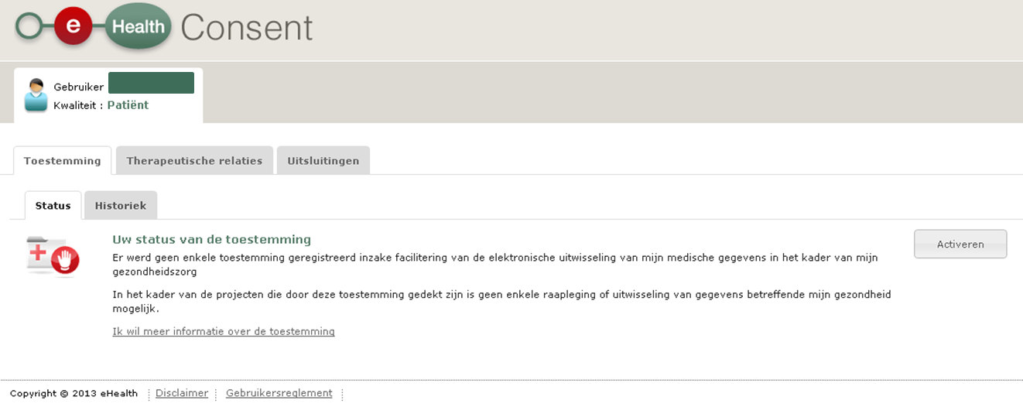
eHealthConsent

Slide 26
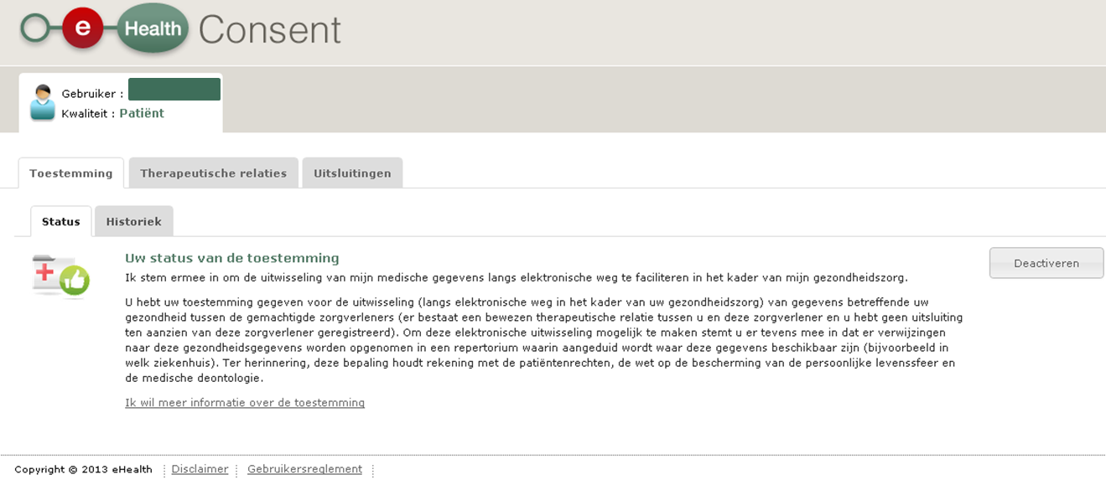
eHealthConsent

Slide 27
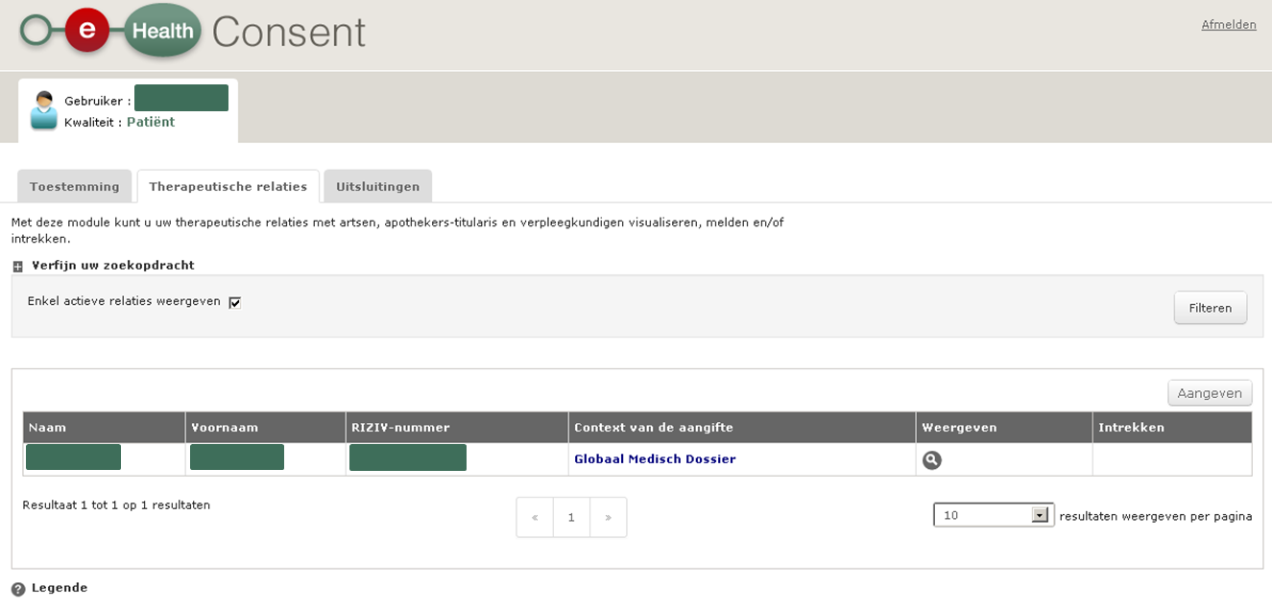
eHealthConsent

Slide 28
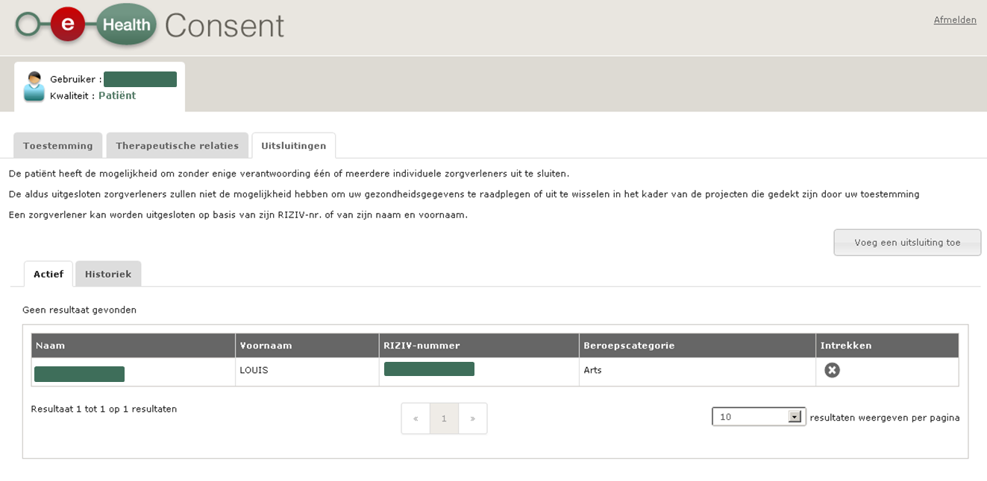
eHealthConsent

Slide 29
Importance of unique identification
Need to guarantee that information exchange concerns the same entity => need for unique identification of
patients (social security identification number mentioned on eID or ISI+ card)
health care providers and health care institutions (CoBRHA)
medicines
medical devices such as implants
Characteristics
unique (1 to 1 relation between number and entity to be identified)
in an international context
stable over time => identification number without content
systematically available
generally used

Slide 30
What is the role of the health care providers?

Slide 31
What is the role of the health care providers?
Use of registered software
list available
Systematic computerization of patient files
Good structuring of the information
use of standard terminology
option to create/query a SumEHR
Participating, supplying, querying of the available tools
65 added value services available
Promotion of registration of the informed consent of the patient
Individual health care providers

Slide 32
What is the role of the health care providers?
Systematic computerization of the patient files amongst disciplines
Good structuring of the information
use of standard terminology
option to create/query a SumEHR
Mutual approval of working methods of the hospitals
Participating, supplying, querying of the available tools (including hubs/metahub system)
> 65 added value services available
Information security
Promotion of registration of the informed consent of the patient
Health care and insurance
institutions

Slide 33
Critical success factors
Adequate ICT architecture
Governance by stakeholders
Agile delivery
End-to-end process optimization

Slide 35
THANK YOU! ANY Questions?
frank.robben@ehealth.fgov.be
@FrRobben
https://www.ehealth.fgov.be
http://www.ksz.fgov.be
http://www.frankrobben.be

