Slide 1


eHealth-platform: state of affairs and perspectives
frank.robben@ehealth.fgov.be
@FrRobben
https://www.ehealth.fgov.be
http://www.ksz.fgov.be
http://www.frankrobben.be

Slide 2
A few evolutions in health care
More chronic care instead of merely acute care
Remote care (monitoring, assistance, consultation, diagnosis, operation, ...), and home care
Multidisciplinary, transmural and integrated care
Patient-centric care and patient empowerment
Rapidly evolving knowledge => need for reliable and coordinated management and access to knowledge
Threat of excessively time-consuming administrative processes
Thorough support of health care policy and research requires thorough, integrated and anonymized information
Cross-border mobility
Need for cost control

Slide 3
The reported evolutions require...
Cooperation between all actors in health care
Efficient and secure electronic communication amongst all actors in health care
High quality, multidisciplinary electronic patient files
Care pathways
Optimized administrative processes
Technical and semantic interoperability
Guarantees with regard to
  information security
  privacy protection
  respect for the professional secrecy of health care providers

Slide 4
Overview
e-Health Roadmap - the primary realizations
Role and responsibility of the eHealth platform
Role of the health care providers

Slide 5
eHealth Roadmap 2013-2018
At the end of 2012 organization of a round table conference with regard to further computerization of health care
Participation of approximately 300 persons from the sector
Set-up of a concrete action plan for eHealth for 5 years: Roadmap 2013-2018
5 Pillars
  development of the exchange of information by health care providers based on a common architecture
  increasing involvement of the patient and his/her knowledge of eHealth
  creation of a reference terminology
  realization of administrative simplification and efficiency
  introduction of a flexible and transparent governance structure in which all competent authorities and stakeholders are involved
20 concrete, measurable objectives

Slide 6
eHealth Roadmap 2013-2018
  Each holder of a global medical file (GMF) manages an electronic patient file (EPF) and adds the SumEHR to the electronic health vault Vitalink/Intermed; the SumEHR is available there
    Changes to registration criteria of the general practitioner software
    Support in software use
    Determination of the reference architecture for the electronic health information
    Realization and schedule for the creation of the link between the hubs and Vitalink
GMF = EPF & and sharing of the relevant health information

Slide 7
eHealth Roadmap 2013-2018
Shared pharmaceutical file (SPF) is authentic source of medication delivered
  history regarding medications delivered
  better control of contraindications
  reinforcement of the advisory role of the pharmacist
  Medication schedules originating from (first line) actors in health care are saved in the electronic health vaults Vitalink/InterMed
Shared pharmaceutical file & Medication schedule

Slide 8

eHealth Roadmap 2013-2018
Sectors
  general practitioners
  physiotherapists
  nurses
Determination of registration criteria
  with the cooperation of representatives of the general practitioners, physiotherapists and nurses and from the competent public institutions (RIZIV and FPS Public Health)
  approval by ad hoc committees (National Committee of Physicians - Health Insurance Companies or the Policy Committee)
Check of registration criteria (testing)
Intensive support
  mini-labs
Planned: replacement of premiums for the possession of software by premiums for effective use of software
Registration of software packages

Slide 9
eHealth Roadmap 2013-2018
Generalisation of electronic prescriptions for drugs in the outpatient sector and expansion to other types of prescriptions (physiotherapy, nursing care, lab tests, medical imaging)
How does it work?
    the doctor creates the electronic prescription, encrypts it and sends it to the Recip-e server
    the pharmacist picks up the prescription from the Recip-e server and decrypts it
    the pharmacist has electronic access to the insurance status with the sickness fund
    Recip-e safes the electronic prescriptions in encrypted form only temporarily until the patient's chosen health care provider picks up and executes the prescription
Advantages:
    legibility of prescriptions
    automatic checks to prevent contraindications
    prevention of fraud and falsification
    better management of expired prescriptions
Electronic prescriptions -
Recip-e

Slide 10
eHealth Roadmap 2013-2018
  Access to hospital documents via the hubs/metahub system
  Health care providers who have a therapeutic relationship with the patient have access via their software package to the electronic documents saved by the hospitals and to which there is a reference available in the hubs/metahub system
  For the extramural environment: support for integration of services in the software packages for general practitioners (linking libraries, minilabs, ...)
Access to hospital documents via hubs/metahub system

Slide 11
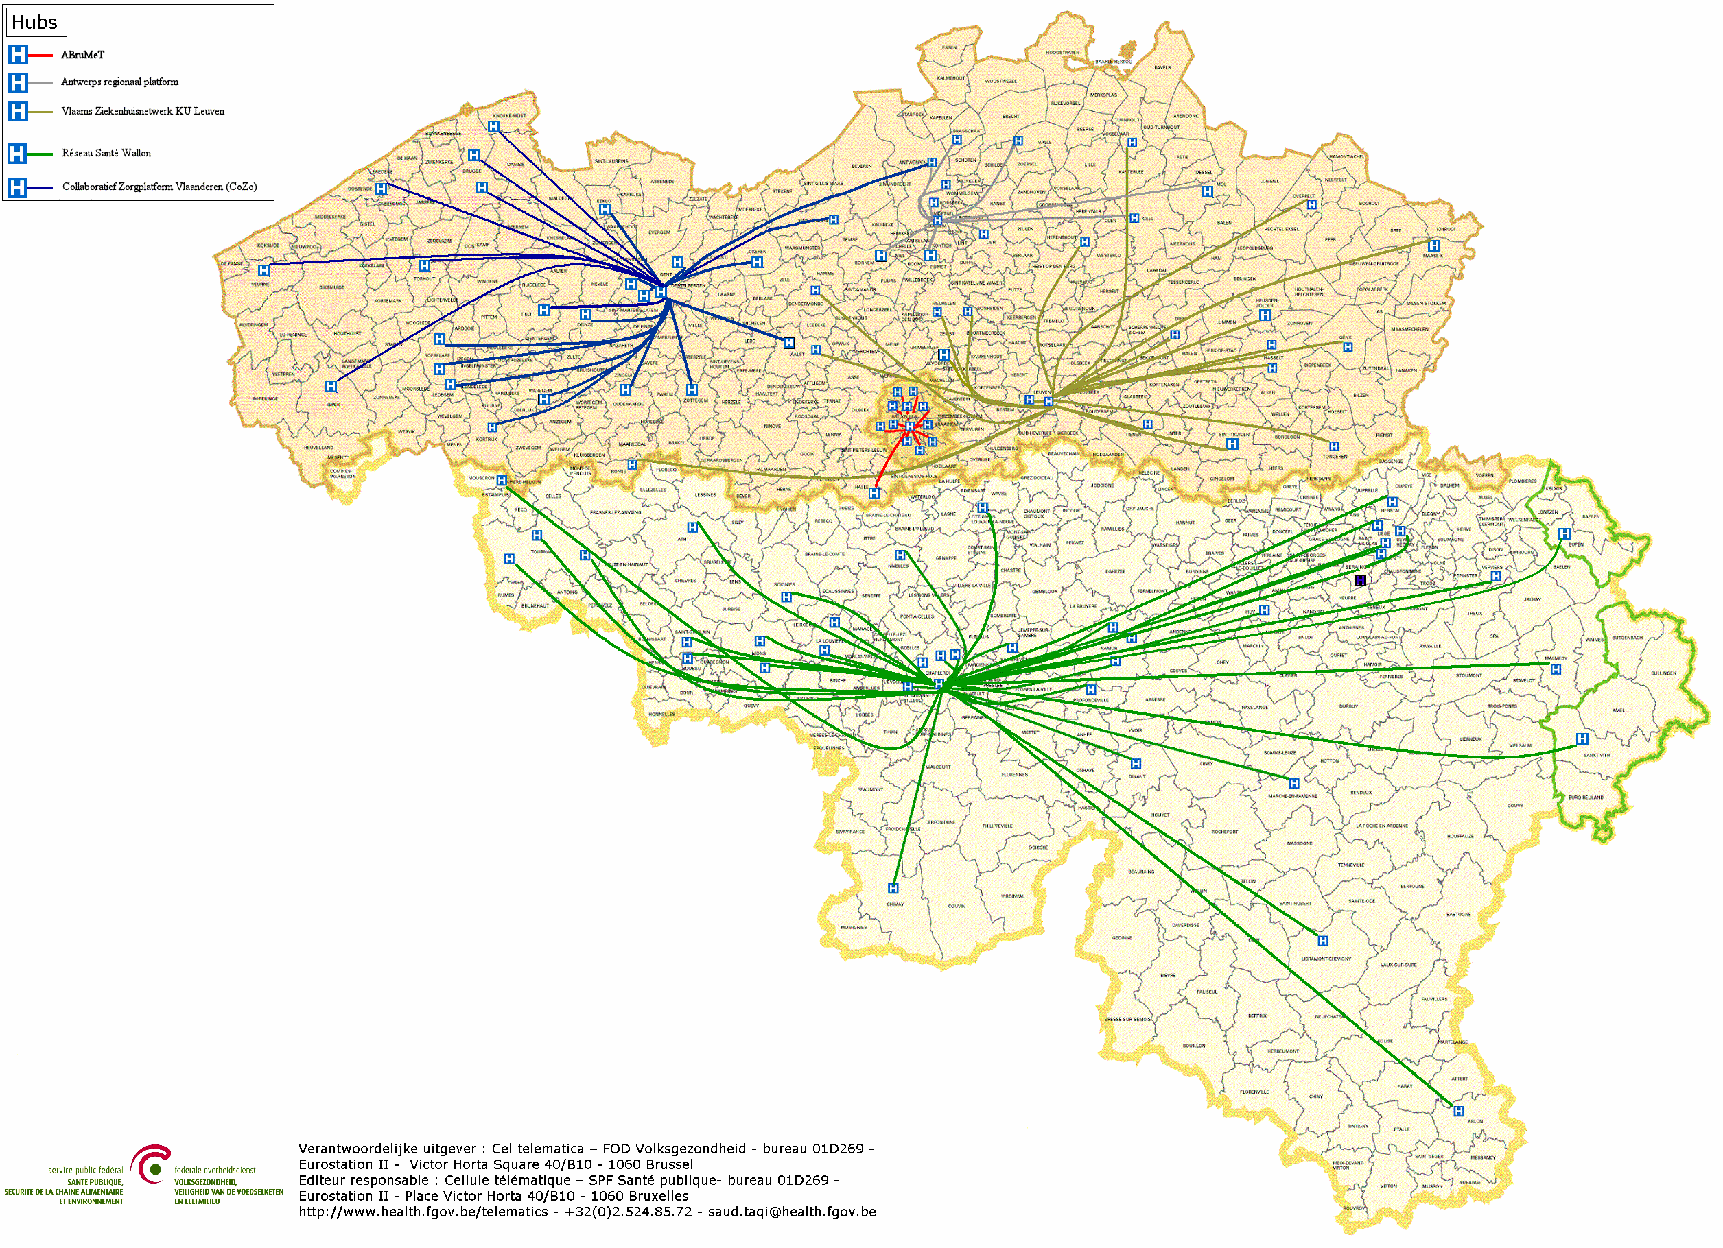
Hubs-metahub system
5 hubs
3 technical implementations
98 % of Belgian hospitals have signed the 2012 protocol

Slide 12




Hubs-metahub system: before

Slide 13



Hubs-metahub system: today
3. Retrieve data from hub A
A
1: Where can we find data?
2: In hub A and C
4:
All data available
3: Retrieve data from hub C
C
B

Slide 14



Extramural data
A
Inter-Med
C
B

Slide 15
eHealth Roadmap 2013-2018
Electronic invoicing of third payer
Rate setting
Electronic consultation of insurance status
Electronic exchange between the hospital and the sickness fund if there is an admission
Requests for agreement to repay Chapter IV drugs
Connection with the GMF
Available at this time (via software and/or MyCareNet portal) for:
  hospitals
  rehabilitation centres
  outpatient clinics
  medical institutions (via physician or nurse access)
  physicians
  nurses
  laboratories
  pharmacists
  dentists
MyCareNet
Notes:
RCH = Rest and Care Home
RH = Retirement Home
DCF = Day Care Facility

Slide 16
eHealth Roadmap 2013-2018
Standard functions of a mail system with a high security level => access to the system via the eID (web application) or the eHealth certificate
  available for all health care providers
Each message is encrypted end-to-end
Presence of metadata, that can be configured individually, which can be sent for example to be able to route the message within organizations such as hospitals
  Current use of the eHealthBox by 40 hospitals and laboratories and approximately 4000 general practitioners
  ROI Agoria Award 2014
  47,310,520 messages sent in 2014
Generalized use of the eHealthBox

Slide 17
eHealth Roadmap 2013-2018
  Recognition of persons with a handicap
electronic exchange of multi-functional medical documents regarding the person with a handicap
document availability for the physicians from the government and the sickness funds
secured communication via the eHealthBox
a potential for 296,000 request/year
Agreements for Chapter IV drugs
  via MyCareNet
  secure and rapid transfer of the information necessary for the provision and repayment of these types of drugs (prior agreement from the sickness fund required)
  acceleration of the procedure and doing away with a number of administrative formalities
Administrative simplification

Slide 18
eHealth Roadmap 2013-2018
Central traceability register
central storage of basic information about some types of implants (eg breast implants)
integration of the "Orthopride" (hip and knee replacements) and "Qermid" applications (pacemakers and coronary stents)
pilot project in April 2014 in 2 hospitals (Charleroi and Leuven)
advantages
  better traceability of the implanted units
  creation of an implant card for the patient with all useful information
Traceability of implants

Slide 19

Role and responsibility of the eHealth platform

Slide 20





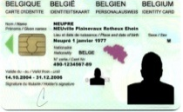



The patient consults his/her physician
Administrative advantages
Via eID of the patient (at least at the first consultation)
Authentication of identity of the patient
Verification of insurance status
GMF?
Possibility of registering informed consent and therapeutic relationships

Slide 21














History via the SumEHR and hubs/metahub
Online advice and guidelines
Medical
Electronic prescriptions
Medication schedule
Lab results and results of medical imaging
Electronic referrals

Slide 22





Rate setting
& invoicing
SumEHR,
medication schedule,
... updates
Adminis-trative
Create and send certificates
Registrations
Send report to GMF holder

Slide 23
Objectives of the eHealth-platform
How?
  through a well organized, mutual electronic service provision and information exchange amongst all actors in health care
  with the necessary guarantees on the level of information security, privacy protection and professional secrecy
What?
  optimization of the quality and continuity of the provision of health care
  optimization of the patient safety
  simplification of the administrative formalities for all actors in health care
  proper support of health care policy and research

Slide 24
10 Tasks
Development of a vision and of a strategy for eHealth
Organization of the cooperation between all governmental institutions which are charged with the coordination of the electronic service provision
The motor of the necessary changes for the implementation of the vision and the strategy with regard to eHealth
Determination of functional and technical norms, standards, specifications and basic architecture with regard to ICT
Registration of software for the management of electronic patient files

Slide 25
10 Tasks
Conceptualization, design and management of a cooperation platform for secure electronic data exchange with the relevant basic services
Reaching an agreement about division of tasks and about the quality standards and checking that the quality standards are being fulfilled
Acting as an independent trusted third party (TTP) for the encoding and anonymisation of personal information regarding health for certain institutions summarized in the law for the support of scientific research and the policymaking
Promoting and coordinating programmes and projects
Managing and coordinating the ICT aspects of data exchange within the framework of the electronic patient files and of the electronic medical prescriptions

Slide 26








Basic Architecture
Patients, health care providers
and health care institutions
Health portal
Health care provider
software
Health care institution software
VAS
Site RIZIV
VAS
portal of the eHealth-platform
MyCareNet
VAS
VAS
VAS
Users
Basic Services
eHealth-platform
Network
AS
AS
AS
AS
AS
AS
Suppliers
Notes:
26
26

Slide 27
10 Basic services
Coordination of electronic sub-processes
Portal
Integrated user and access management
Logging management
System for end-to-end encryption
eHealthBox
Timestamping
Encoding and anonymization
Consultation of the National Identification Registers
Reference directory (metahub)

Slide 28

10 Basic Services
  Guaranteed and easy and harmonious integration of various sub-processes and basic services, including the business logic, to an on-call service (web service)
Coordination of electronic sub-processes

Slide 29

10 Basic Services
  Window on the web which offers various online services and actors in health care to support their health practices
  provides all useful information with regard to the services offered by the eHealth-platform, its standards, etc.
  the portal environment includes the documents the users need to create the correct configurations and get access to the available online services
Portal

Slide 30


Slide 31

10 Basic Services
Ensures that only the authorized health care providers/institutions have access to the personal information to which they are entitled
  the access rules are set up by law or by the authorizations from the Health Department of the Sectoral Committee (set up within the Privacy Commission)
  specific access rules for each application
  when a user consents the generic verification model of the tool is started: the model queries the rules set for the application, checks whether the user fulfils these requirements and then will grant or deny access
Integrated user and access management

Slide 32
Integrated user and access management
How does it work ?

Slide 33

10 Basic Services
  Saves all access to applications, their author, the time and the patient it relates to, for audit and substantiation purposes
Logging management

Slide 34

10 Basic Services
Encryption of sent data between the sender and the recipient so that these data are illegible to and uneditable for third parties
2 methods:
  if the recipient is known at dispatch: use of asymmetric encryption (2 keys)
  if the recipient is not known at dispatch: symmetric encryption (the information is encrypted and stored outside of the eHealth- platform; the decryption key can only be acquired from the eHealth- platform)
System for end-to-end encryption

Slide 35
Asymmetric encryption
Healthcare actor
Person or entity
eHealth-platform
1
Internet
3
Connector or
other software to
generate key pair
Authenticates sender
2
Identification
certificate
4
Sends
public key
Identification
certificate
Stores
public key
Web service
Register key
2
Public keys
repository
Stores private key
in a secure way

Slide 36
Asymmetric encryption
Message originator
Internet
eHealth-platform
1
Identification
certificate
Web service
Ask public key
Identification
certificate
2
Asks for public key
Authenticates sender
Send message
Any protocol
3
4
Sends
public key
Encrypts
message
Identification
certificate
Message recipient
Public keys
repository
5
Stored
private
key
Decrypts message

Slide 37
Symmetric encryption
Key
Management
/ Depot
Encrypted with public key of user 1
Encrypted with public key of user 2
Symmetric key
Symmetric key
2 sends key
User 1
Originator
1 asks for key
5 receives key
User 2
Recipient
4 justifies right to
obtain key
4 justifies right to
obtain message
3 sends encrypted message
Encrypted with public key of Message depot
5 receives message
Encrypted with public key of User 2
Message encrypted with
symmetric key
Messages
Depot
Message encrypted with
symmetric key
Message encrypted with
symmetric key

Slide 38

10 Basic Services
Option of dating and guaranteeing the validity of the content the second after each document created in health care by adding an eHealthsignature
Timestamping

Slide 39


Example: electronic prescription in hospitals
1
Prescription A
Prescription B
Electronic
signature
5
2
Hashcode A
Hashcode B
3
6
Timestamp bag
4
Archive
Electronic
timestamping
6
Archive

Slide 40

10 Basic Services
Option of hiding the identity of persons behind a code so that the useful information for this person can be used without their privacy being compromised and option to make data anonymous by converting the detailed information by general information; once encoded or anonymized, the data retain their usefulness, but it is no longer possible to trace them directly or indirectly back to the person's identity
Encoding and & anonymizing

Slide 41

10 Basic Services
Access to the national register and to the enterprise registers by the authorized actors in health care, under strict provisions
Consultation of the National Identification Registers

Slide 42

10 Basic Services
Secure electronic mailbox for the exchange of health information
eHealthBox

Slide 43
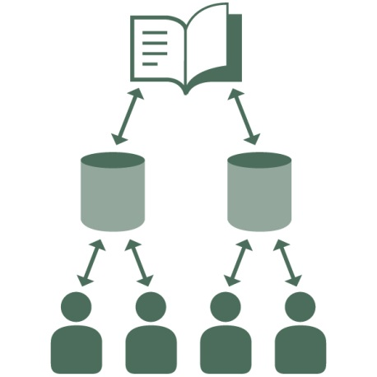
10 Basic Services
Indicates, with consent of the patients involved, which electronic documents are stored with which actor for which patients
Reference directory

Slide 44
Support
1 Chairperson
  32 members, of which
      11 health care providers
      7 representatives of the sickness funds
      4 representatives of the patients
      4 representatives of the federal government
      6 representatives of the regions & communities
Role
  introduction of initiatives to promote and perpetuate electronic service provision for the benefit of the actors in the health care sector
  introduction of measures for safe and confidential processing of personal information
  introduction of measures for administrative simplification for the benefit of the actors in the health care sector
Consultation Committee with the Users

Slide 45
Support
eHealth-certificates
basis for the creation of the double encryption key (ETK) used by the encryption service
the system can be identified and authenticated using the eHealth-certificate while the end user (the person) can be identified and authenticated using the eID or the citizen token
this applies both to the use of basic services as well as to the use of added value services offered in the form of web services
the software integrators (not the health care provider) can also request test certificates, which enables the testing of the integration of our basic services
certificates can be ordered via the portal of the eHealth-platform (https://www.ehealth.fgov.be/nl/application/applications/beheer_ehealth_certificaten.html)
eHealth-certificates

Slide 46
Support
Connectors
tools to help software developers in the integration of the basic services of the eHealth-platform
Supports the connection with the applications available via the eHealth-platform or using the ICT standards set out by the eHealth-platform (such as the hubs)
Connectors

Slide 47
Support
Training for the security consultants
each hospital must set up an internal information security service which is put under the management of an information security consultant
the information security consultant has to be designated in accordance with the sectoral committee, which checks whether the candidate has the necessary knowledge and sufficient time to be able to perform the job and that he/she is not performing activities which are incompatible with the position
the eHealth-platform offers training for information security consultants
Security training

Slide 48
Support
eHealthConsent
allows for the registration or withdrawal of "informed consent" by the patient for electronic exchange of health information within the framework of the care of this patient
with this the citizen can also exclude a number of specific health care providers from access to his/her health information
contains a number of functions to manage the "therapeutic relationships" which form a necessary basic condition for the querying of health information electronically
Informed consent

Slide 49

www.patientconsent.be

Slide 50

Information folder

Slide 51

Information folder

Slide 52
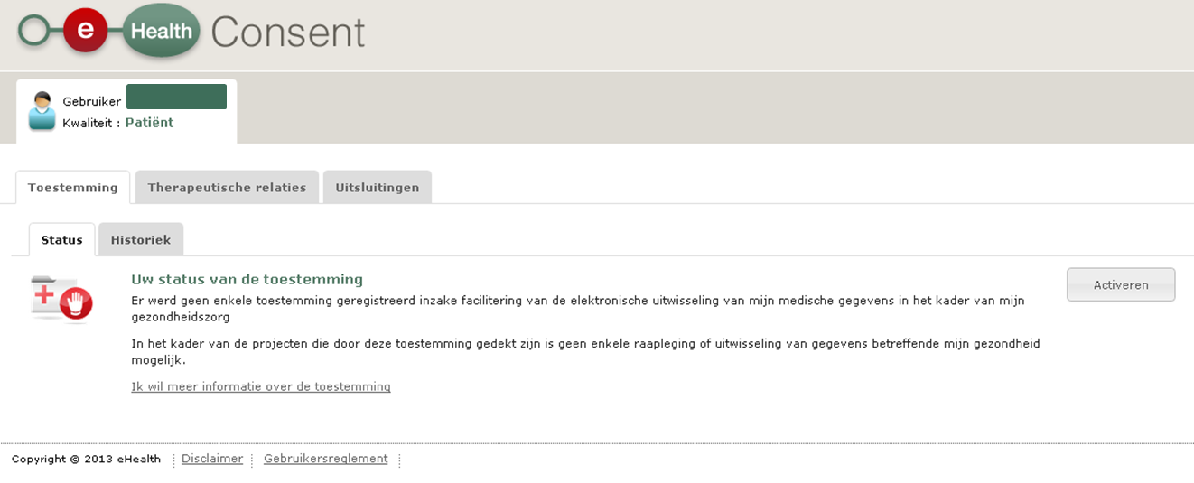
eHealthConsent

Slide 53
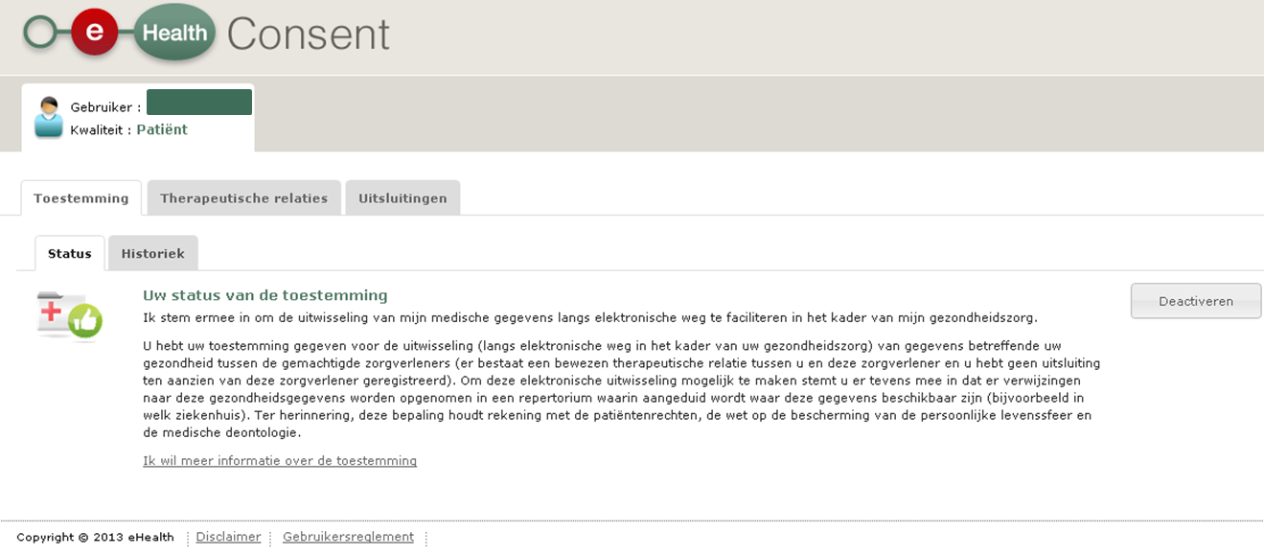
eHealthConsent

Slide 54
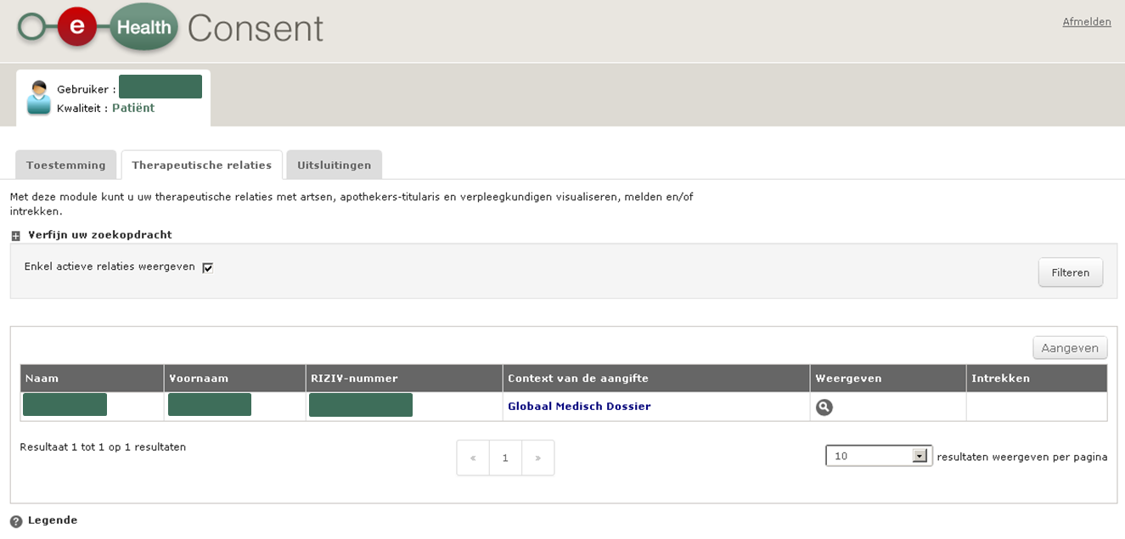
eHealthConsent

Slide 55
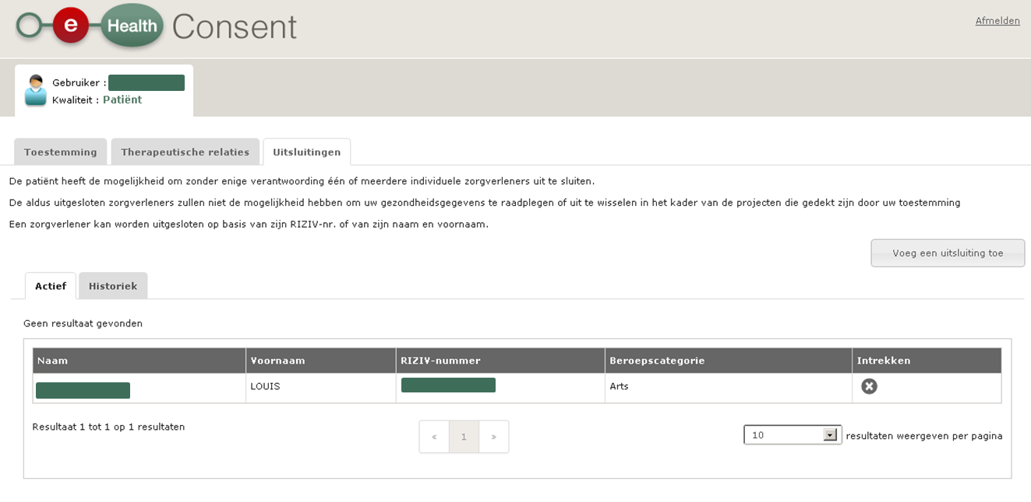
eHealthConsent

Slide 56

What is the role of the health care providers?

Slide 57





What is the role of the health care providers?
Use of registered software
  list available
Systematic computerization of patient files
Good structuring of the information
  use of standard terminology
  option to create/query a SumEHR
Participating, supplying, querying of the available tools
  65 added value services available
Promotion of registration of the informed consent of the patient
Individual health care providers

Slide 58






What is the role of the health care providers?
Systematic computerization of the patient files among disciplines
Good structuring of the information
  use of standard terminology
  option to create/query a SumEHR
Mutual approval of working methods of the hospitals
Participating, supplying, querying of the available tools (including hubs/metahub system)
  65 added value services available
      Information security
Promotion of registration of the informed consent of the patient
Care and Insurance
Institutions

Slide 59


Slide 60
THANK YOU!
ANY Questions?
frank.robben@ehealth.fgov.be
@FrRobben
https://www.ehealth.fgov.be
http://www.ksz.fgov.be
http://www.frankrobben.be

