Slide 1




eHealth: state of affairs and perspectives
frank.robben@ehealth.fgov.be
@FrRobben
https://www.ehealth.fgov.be
http://www.ksz.fgov.be
http://www.frankrobben.be

Slide 2
Outline
Context
eHealth roadmap 2015-2019
  health care providers
  patients
Some focus points
Role and responsabilities of the eHealth-platform

Slide 3
Some evolutions in health care
More chronic care instead of merely acute care
Remote care (monitoring, assistance, consultation, diagnosis, operation...), and mobile care
Multidisciplinary, transmural and integrated care
Patient-centric care and patient empowerment
Rapidly evolving knowledge => need for reliable and coordinated management and access to knowledge
Threat of excessively time-consuming administrative processes
Thorough support of health care policy and research requires thorough, integrated and anonymised information
Cross-border mobility
Need for cost control

Slide 4
The reported evolutions require...
Cooperation between all actors in health care
Efficient and secure electronic communication amongst all actors in health care
High-quality, multidisciplinary electronic health records
Care pathways
Optimised administrative processes
Technical and semantic interoperability
Guarantees with regard to
  information security
  privacy protection
  respect for the professional secrecy of health care providers

Slide 5
Electronic communication also stimulates…
Quality of care and patient safety
  avoidance of wrong care and medication
    incompatibility between medicines
    contra-indications against certain medicines or treatments for a specific patient (eg allergies, diseases…)
  avoidance of errors in concrete care provision and administration of medicines
  availability of reliable databases on good treatment practices and decision support scripts
  more opportunity for multidisciplinary consultations and second opinions
Avoidance of unnecessary multiple examinations => less stress for the patient and avoidance of unnecessary additional costs

Slide 6









The patient consults his/her physician
Administrative advantages
Via eID of the patient (at least at the first consultation)
Authentication of identity of the patient
Verification of insurance status
GMF?
Possibility of registering informed consent and therapeutic relationships

Slide 7














History via the SumEHR and hubs/metahub
Online advice and guidelines
Medical
Electronic prescriptions
Medication schedule
Lab results and results of medical imaging
Electronic referrals

Slide 8





Rate setting
& invoicing
SumEHR,
medication schedule,
... updates
Adminis-trative
Create and send certificates
Registrations
Send report to GMF holder

Slide 9
eHealth Roadmap 2015-2019
End of 2012: organisation of a Round table conference on the priorities for computerising the health sector
Participation of about 300 people involved in the sector
Result: eHealth Roadmap providing concrete targets for the next 5 years
2015: update of the eHealth Roadmap 2.0

Slide 10
eHealth Roadmap 2015-2019
Principles
  cooperation: coalition of the willing
  involvement of all stakeholders
  empowerment of all stakeholders
  reliable basic services and business continuity actions
  simplification where possible
  emphasis on concrete results rather than on everlasting discussions
  steady progress because of SMART goals and action points
  multidisciplinary approach, including training and financial aspects
  basis for synergies necessary for high-quality and affordable health care

Slide 11
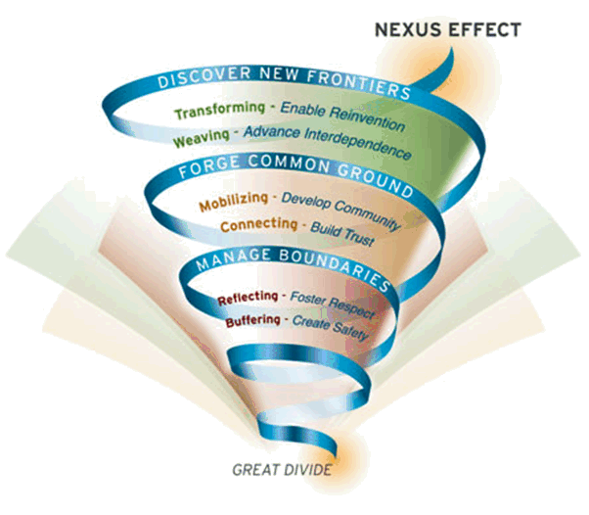
Nexus effect
Bron: MIT Sloan

Slide 12
Roadmap 2.0: health care providers
All GPs will have digitised medical records for all their patients and will publish and keep updated a SumEHR in a secure 'health vault’ (Vitalink, Intermed or BruSafe)
For all other health care professionals, a digitised patient file (DPF) will be set up and they will also be able to publish and keep (certain) information from their DPF up to date in secure ‘vaults'
Hospitals, psychiatric institutions and laboratories will publish their documents via hubs with which they are affiliated and will consult data in secure vaults (Vitalink, Intermed, BruSafe) using this method

Slide 13
Roadmap 2.0: health care providers
Pharmacists will publish a shared pharmaceutical file (SPF), which will feed into the medication schedule
The medication schedule will also be available in secure vaults and will be shared between doctors, pharmacists, home nurses and hospitals
GPs, through the EHR (electronic health record for GP’s), will have access to all the medical information published about their patients

Slide 14
Roadmap 2.0: health care providers
All health care providers will have access to all health data published about their patients, insofar as they are relevant to them
  filters will be set up for this purpose
  the information may also be added to on a multidisciplinary basis
Thus, maximum support will also be given to multidisciplinary care
Health information and documents collected and published will be structured and coded to the greatest extent possible
    ! this will not be fully in place until 2019

Slide 15
Roadmap 2.0: health care providers
All health care providers will be able to communicate through the eHealthBox
  certain standard forms will be provided for this purpose
Health care providers will be able to make use of remote health care through 'mobile health' applications which must be officially registered
  registration will be subject to controls as regards respect for private life, interoperability, the CE label for medical devices and evidence-based medicine (EBM)
Registers will be optimised and standardised and registration will be automated insofar as possible
Traceability of implants and medicines must comply with international standards

Slide 16
Roadmap 2.0: health care providers
Health care providers will receive incentives for adequate use and usage of eHealth
  financial incentives may include a federal element, as well as an element in relation to the various communities and regions
They will be trained on eHealth, both as part of their basic training and continuing professional education
A single point of contact will be in place for all information for the INAMI, SPF Santé Publique, AFMPS and the federal authorities (the 'only once' principle)

Slide 17
Roadmap 2.0: patients
Patients will have access to all ‘objective’ health information concerning them that is available via the secure vaults and the hubs
The possibility of setting up a consolidated platform is being looked into > this platform would allow patients to consult all their information in an integrated way and to use analysis tools as well as 'translation' tools for a better understanding of the information
    contribution to 'health literacy' among patients (preventive health care)

Slide 18
Roadmap 2.0: patients
  Patients can themselves add information, either via the consolidated platform, or in the secure vaults or the hubs
All the information present on the hubs and the secure vaults on the consolidated platform or in the cloud makes up the patient's PHR (Personal Health Record)
Via the consolidated platform, other information may also be added by sickness funds, the Crossroads Bank for Social Security and other relevant sources such as the patient's declarations of their wishes as regards organ donation and euthanasia

Slide 19
Roadmap 2.0: patients
The patient will have access to his/her PHR through various channels
  e.g. a preinstalled application on their smartphone
  strengthening the role of the patient in their treatment
In principle, the patient should no longer receive papers from their doctor (unless by special request)
  the statement of health care provided will be sent to the sickness funds electronically
  the medication prescription will be available in the medication schedule
  proof of unfitness for work will be sent in electronic format to the employer/schhol
  the patient will receive the acknowledgement of receipt (transparency act) in their inbox

Slide 20
Roadmap 2.0: patients
Prerequisite to the above: the patient must have given his informed consent

Slide 21

www.plan-egezondheid.be

Slide 22
Focus: GMF* = EMF => SumEHR
In order to assure the quality of care and to provide patients with correct information, the GP has to register the medical data in an EMF (Electronic Medical File)
The EMF is the authentic source for data sharing by the GP
The SumEHR (SUMmarized Electronic Health Record) is a brief summary of the EMF in a structured and encrypted form
Each patient is, if desired, entitled to a SumEHR
Subject to consent of the patient, the information provided in the SumEHR is accessible for each doctor having a therapeutic relationship with the patient and for the patient himself
Priority for the use of SumEHR for out-of-hours GP services and emergency services
* Global Medical File

Slide 23

Focus: GMF = EMF => Sumehr
Targets 2019
  For 100 % of the GPs
    an EMF for each patient
    publication and update of the SumEHR in a secured “health vault”
  For all the other health care providers
    definition of the EMF
    publication and update of certain information in the secured “health vaults”
Responsible organisation: RIZIV (the Belgian National institute for Health and Disability Insurance) and eHealth platform

Slide 24

Focus: Hubs & Metahub
Hubs-Metahub system = system for the provision of health data between health care providers
    consultation reports
    surgery reports
    discharge letters
    protocols of medical imaging
    ...
Target
  linking of regional and local exchange systems of medical data (hubs);
  possibility for the health care provider to find and consult the available electronic medical documents on a certain patient regardless of
    the place where the documents are stored
    the place where the health care provider logs in to the system

Slide 25
Focus: Hubs & Metahub
Situation 2016
  system for sharing data and documents for the general and psychiatric hospitals via 5 hubs
      Collaboratief Zorgplatform (Cozo)
      Antwerpse Regionale Hub (ARH)
      Vlaams Ziekenhuisnetwerk KU Leuven (VZN)
      Réseau Santé Wallon (RSW)
      Réseau Santé Bruxellois (RSB)
  reference to the first-line documents (SumEHR, medication schedule...)
    via the 3 secure vaults/hubs-metahub
      Vitalink
      InterMed
      BruSafe
  May 2016: 13.283.824 Hubs patients relationships registered in the Metahub (total volume)

Slide 26
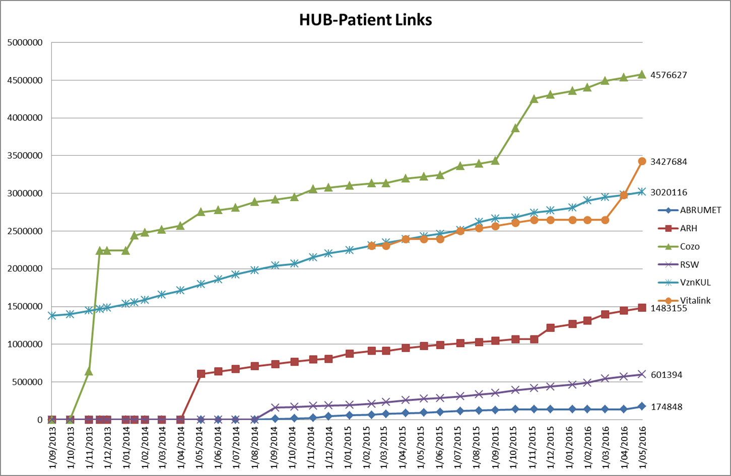
Hubs & Metahub

Slide 27
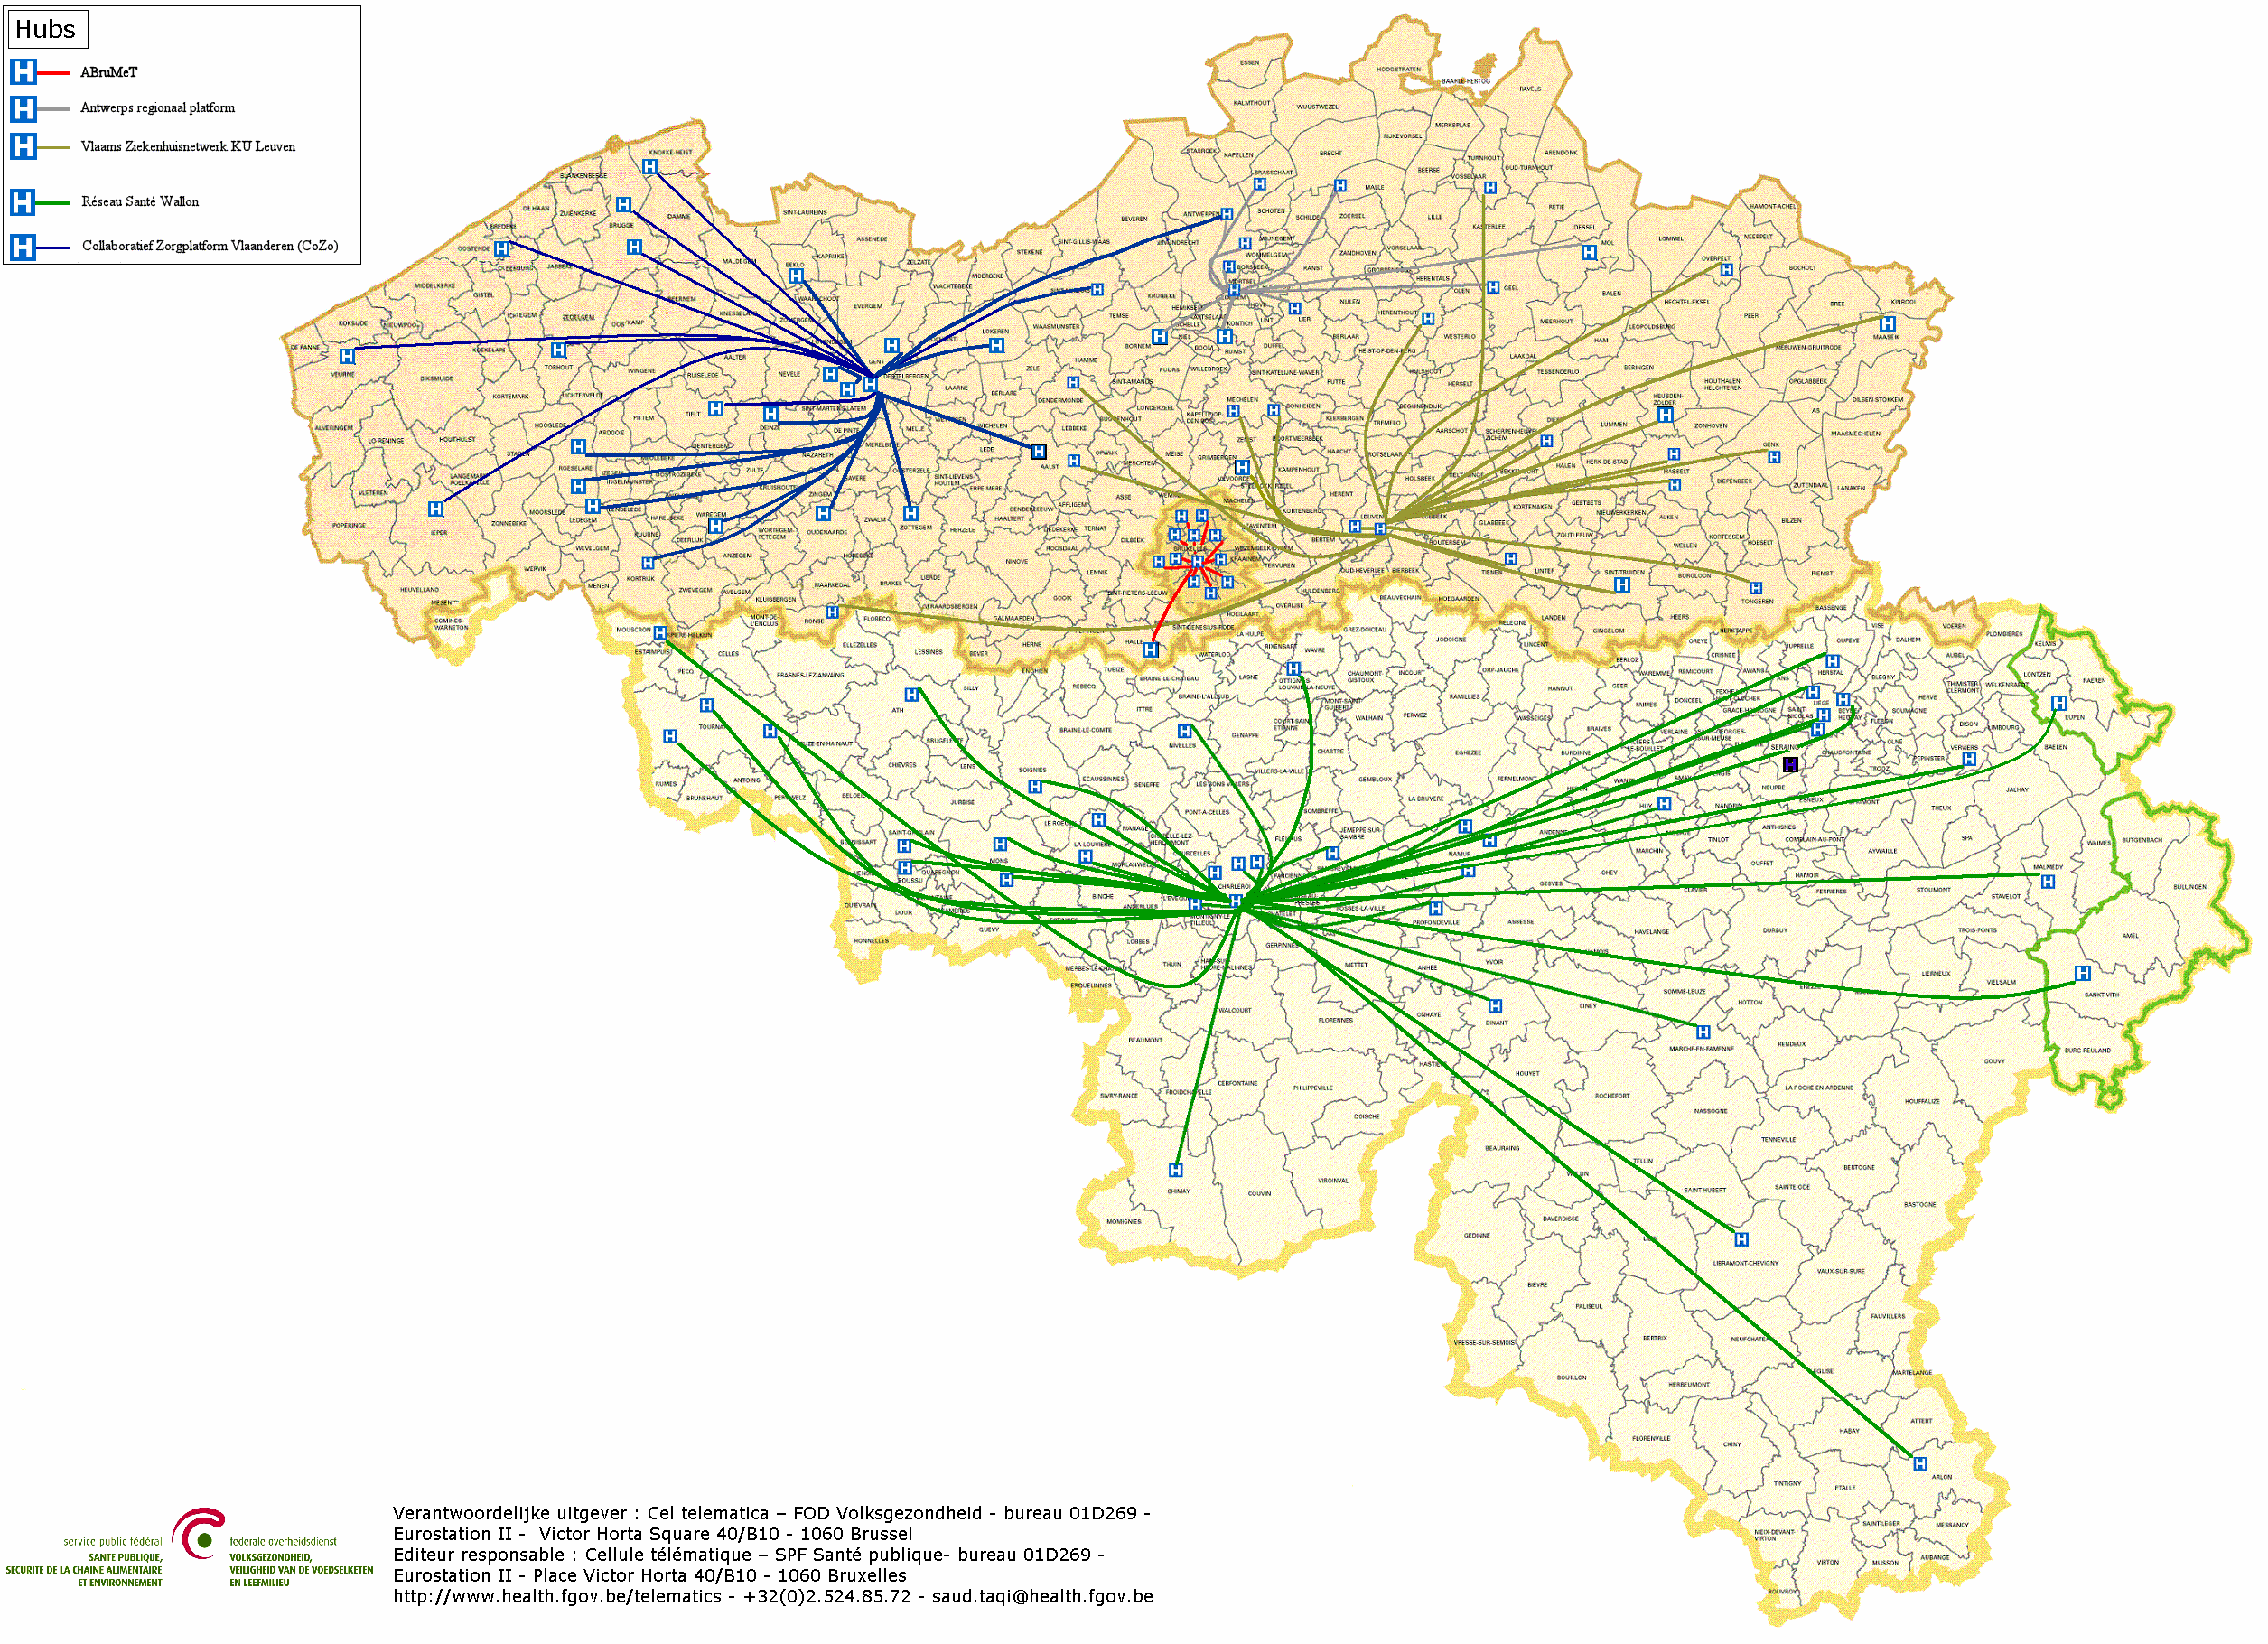
Hubs & Metahub system
5 hubs
3 technical implementations
Almost all Belgian hospitals connected

Slide 28




Hubs & Metahub system before

Slide 29



Hubs & Metahub system today
3. Retrieve data from hub A
A
1: Where can we find data?
2: In hub A and C
4:
All data available
3: Retrieve data from hub C
C
B

Slide 30



Extramural data
A
InterMed
BruSafe
C
B

Slide 31
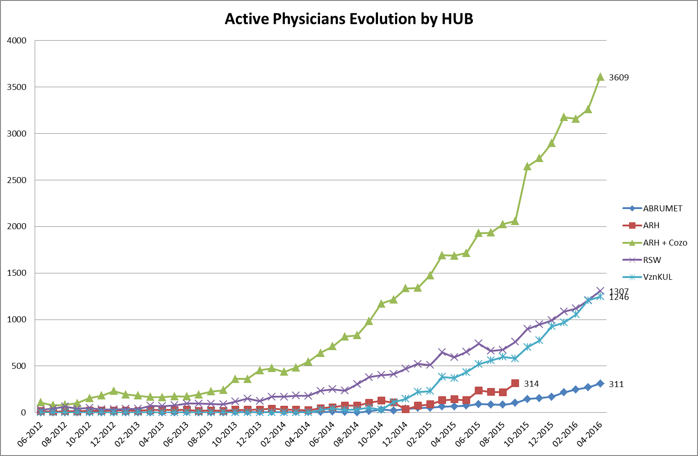
Hubs & Metahub

Slide 32
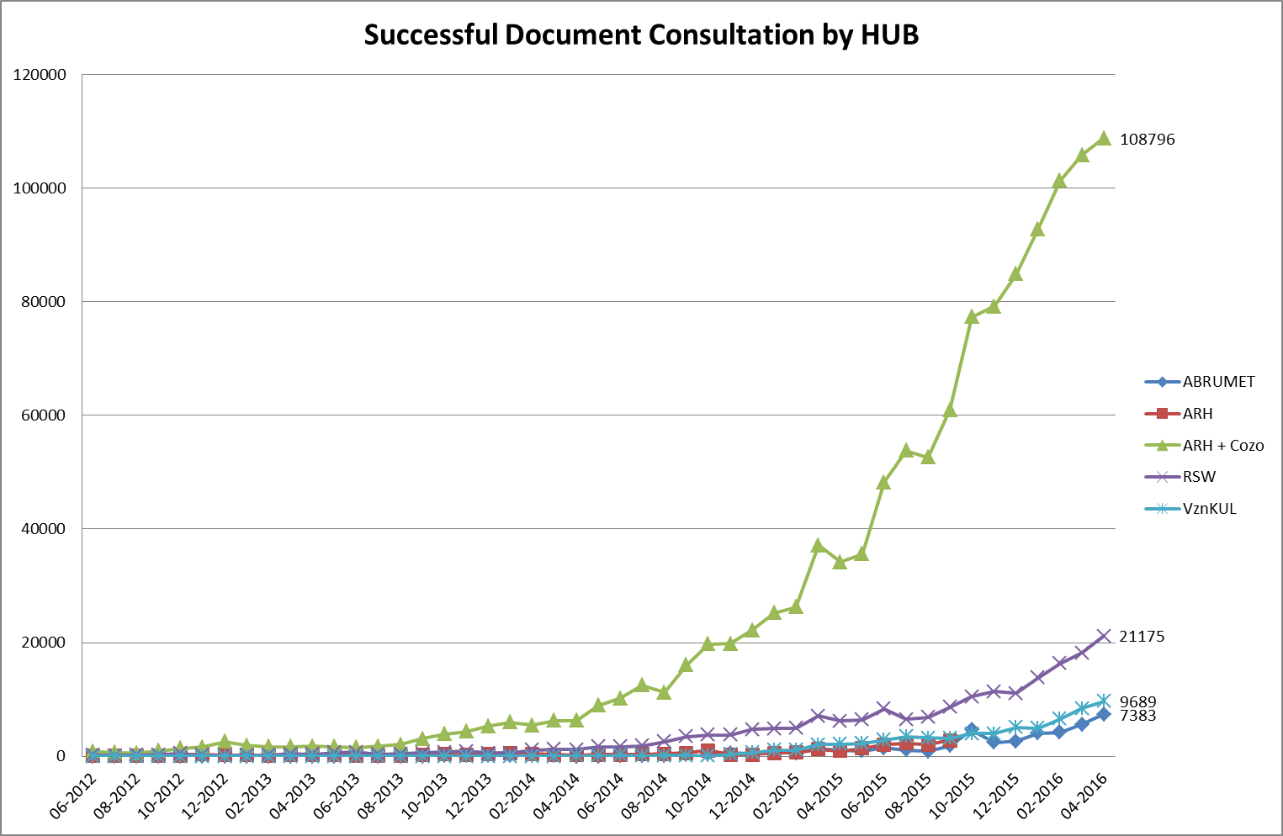
Hubs & Metahub

Slide 33
Focus: informed consent
Necessary condition for the exchange of health information: consent of the patient for the electronic sharing of his health information
  regulations approved by the different management and advisory bodies of the eHealth platform (Conciliation Committee with the users, Management Committee and Health Sector Committee)
  only between health care providers/institutions having a therapeutic/health care relationship with the patient (ex. no access for the labour doctor)
  registration of the consent by the patient himself or via his doctor, pharmacist, mutual insurance company or hospital

Slide 34
Focus: informed consent
Possibility to exclude a health care provider
Possibility to withdraw the consent
Possibility to modify the consent profile at any time, without any restriction regarding the modifications
Possibility to see who has entered/modified the informed consent

Slide 35
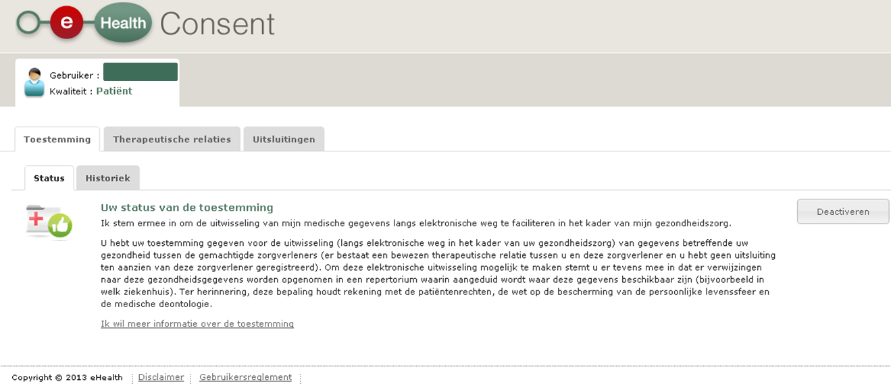
eHealthConsent

Slide 36
Focus: informed consent
Target 31/12/2015: 2.75 million registered consents
26/05/2016: 3,424,043 registered consents
www.patientconsent.be
  information folders
  advertising spot spread in hospitals, mutual insurance companies, pharmacies
  call centre

Slide 37

www.patientconsent.be

Slide 38

www.patientconsent.be/folder

Slide 39
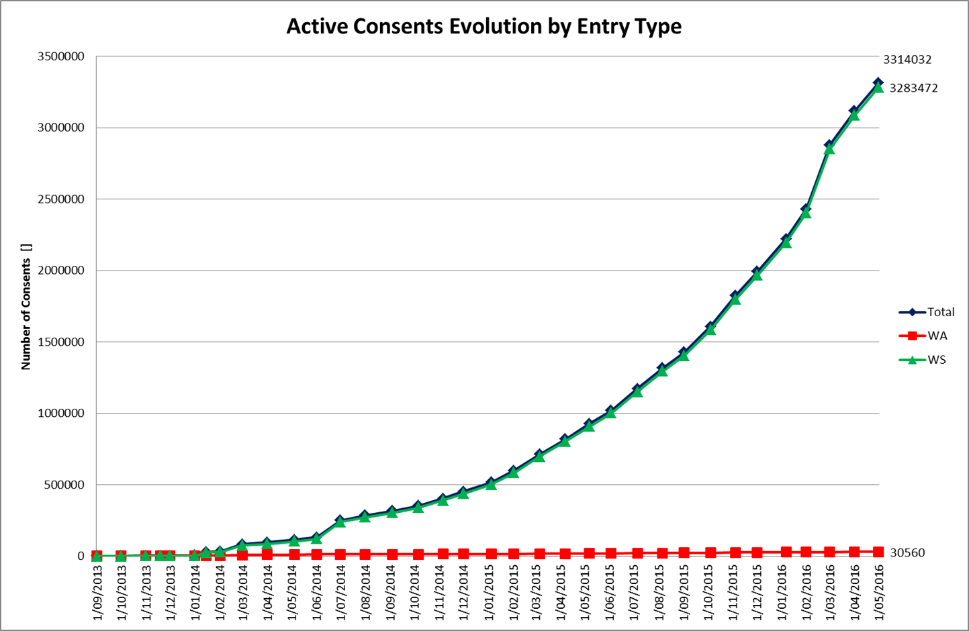
Focus: Informed consent

Slide 40
Focus: eHealthBox
eHealthBox - Status 2015
  standard functionalities of an electronic mailbox system with a high-level security for the exchange of medical information
  each message is fully encrypted > the health information can be securely exchanged between the different health care actors
  2015: 44,753,486 messages sent
  2015: +/- 4 million messages sent per month
  April 2016: 4.104.056 messages sent
  April 2016: 34.301 active health care providers including 18.085 GPs

Slide 41
Focus: eHealthBox
Targets 2019
  generalized use of the eHealthBox and of the health care providers’ information available in CoBRHA
  allowing a safe electronic communication of health and confidential information between the health care actors
  developing and maintaining a common database with information of the health care actors and institutions
  allowing the health care actors to consult and modify/complete specific information themselves
    address book (database CoBRHA)
    unique desk of the care provider
Responsible organisation: eHealth platform and FPS Health, Food Chain Safety & Environment

Slide 42
Focus: mobile Health (mHealth)
Objectives 2019
  framework for mHealth actions > efficient implementation
  support of health care using mHealth applications
  integration of legal, financial and organizational framework into existing and new care agreements
  integration of basic services of the eHealth platform in mHealth
  to support the quality and accessibility of mHealth
Responsible organization : FAMHP, RIZIV and eHealth platform

Slide 43
Focus: mHealth - types of apps
Apps aimed towards communication, e.g.
  apps allowing patients to ask questions online to health care professionals (tele-coaching)
  apps allowing patients to answer questions of researchers
  apps allowing patients to access their electronic patient file
Apps used as a reference source for health information (for health care professionals and/or patients)
Training apps : apps used for (permanent) training of health care professionals and/or patients

Slide 44
Focus: mHealth - types of apps
Monitoring apps : apps that measure, register and/or transfer health parameters
Apps for health self-management
Medical devices : apps used for diagnostic or therapeutic purposes

Slide 45
Focus: mHealth - examples
iHealth – MyVitals
  measures and registers into the app several basic health values; the actual values are registered in the app; the patient can take a look at them and examine how he evolves comparing to his goal values

Slide 46

Focus: mHealth - examples
MyDiagnostick
  tool allowing to measure heart rhythm disorders
MYDIAGNOSTICK

Slide 47
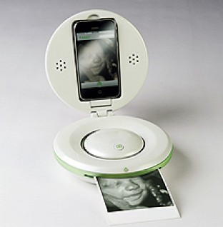
Focus: mHealth - examples
iBaby: DIY echography

Slide 48
Focus: mHealth – social utility
Improvement of health care quality by focussing on prevention
Health care support at any time and in any place, both for health care providers and patients
Reinforcement of patients' autonomy
Stimulation of technical innovation and entrepreneurship

Slide 49
Focus: mHealth - apps and data
The data are
  either registered locally and processed in the mobile device
  either transferred by the mobile device to a central platform that is administered by the organization in charge of the aggregation, the processing and the exchange of the data
Need for clarity regarding the objectives of the data processing : the apps and platforms are often developed and administered by the pharmaceutical industry or by companies that sell monitoring data to third parties

Slide 50
Focus: mHealth – objectives of mHealth
To achieve improved health and comfort for citizens (patients and users) in the Belgian health care by facilitating effective and efficient health care support using mHealth applications
To create a framework in the health care sector for the legal, financial and organizational integration of mHealth applications into the existing and new care agreements
To make the eHealth platform services available on mobile devices
To support the quality and availability of mHealth
To empower the health care user through mHealth applications
To realize an organized mHealth policy in Belgium with a flexible and administratively simple application in all regions

Slide 51
Focus: mHealth – mHealth objectives
Focus on mHealth applications that can be integrated into the health care system
Responsible public institutions
  FAMHP (certification of medical devices)
  RIZIV (reimbursement)
  eHealth platform (technical aspects)

Slide 52
Focus: mHealth – division of tasks
The social care entrepreneurship and the industry examine the added value of mHealth applications
The authorities, in synergy with the umbrella governance model, using international examples and best practices as much as possible, are in charge of
  determining the general principals to which the mHealth applications have to comply in a context of integrated care and reimbursed remote care
  organizing the mobile access of all health care providers and patients to relevant information within the scope of health care continuity
  supporting the quality, the deontological use, the safety and accessibility of mHealth applications
  verifying the respect of privacy when using mHealth applications
  clarifying when it comes to liability of users and industry when using mHealth applications

Slide 53
Focus: mHealth - action items
The authorities realize this by
  determining standards and specifications regarding
    interoperability
    information security and privacy protection (e.g. user and access management, encryption, ...)
    user-friendliness
    reliability
  verifying the compliance with standards
  independent review and user review
  organizing training
  directives on the use of mHealth applications
  promoting useful adjustments for target groups

Slide 54
Focus: mHealth
5 priority use cases
Chosen for their impact (number of patients x gravity) and the available technical tools of mHealth
The functioning and the results of these cases are shared with the public and are immediately applied in a concrete market situation > they obtain the political guarantee of embedding in the Belgian health care system

Slide 55
Focus: mHealth – priority use cases
Stroke: mHealth apps for acute stroke care with ultra-fast and specialized treatment, physiotherapy at home, rehabilitation – mobile access, self-management and empowerment of the patient and his environment
Cardiovascular diseases: risk management and care (lipids, weight, blood pressure, …)
Diabetes : tele-monitoring, point-of-care tests and digital support of integrated care
Mental health care : tele-care and tele-psychotherapy, compliance, combination with mobile teams, …
Chronic pain : multidisciplinary approach of chronic pain in specialized pain center, including monitoring of the patient : effort, sleep quality, pain intensity and compliance

Slide 56

Role and responsibility of the eHealth platform

Slide 57
Mission of the eHealth platform
How?
  through a well-organised, mutual electronic service and information exchange between all actors in health care
  by providing the necessary guarantees with regard to information security, privacy protection and professional secrecy
What?
  optimisation of health care quality and continuity
  optimisation of patient safety
  reduction of administrative burden for all actors in health care
  thorough support of health care policy and research

Slide 58
10 Tasks
Development of a vision and of a strategy for eHealth
Organization of the cooperation between all governmental institutions which are charged with the coordination of the electronic service provision
The motor of the necessary changes for the implementation of the vision and the strategy with regard to eHealth
Determination of functional and technical norms, standards, specifications and basic architecture with regard to ICT

Slide 59
10 Tasks
Registration of software for the management of electronic patient files
Managing and coordinating the ICT aspects of data exchange within the framework of the electronic patient files and of the electronic medical prescriptions
Conceptualization, design and management of a cooperation platform for secure electronic data exchange with the relevant basic service

Slide 60
10 Tasks
Reaching an agreement about division of tasks and about the quality standards and checking that the quality standards are being fulfilled
Acting as an independent trusted third party (TTP) for the encoding and anonymisation of personal information regarding health for certain institutions summarized in the law for the support of scientific research and the policymaking
Promoting and coordinating programmes and projects

Slide 61








Basic Architecture
Patients, health care providers
and health care institutions
Health portal
Health care provider
software
Health care institution software
VAS
Site RIZIV
VAS
portal of the eHealth-platform
MyCareNet
VAS
VAS
VAS
Users
Basic Services
eHealth-platform
Network
AS
AS
AS
AS
AS
AS
Suppliers
Notes:
61
61

Slide 62
10 Basic services
Coordination of electronic sub-processes
Portal
Integrated user and access management
Logging management
System for end-to-end encryption
eHealthBox
Timestamping
Encoding and anonymization
Consultation of the National Identification Registers
Reference directory (metahub)

Slide 63

www.ehealth.fgov.be

Slide 64
Critical success factors
ICT architecture
Governance by stakeholders
Agile delivery
End-to-end process optimisation

Slide 65


Slide 66
THANK YOU!
ANY Questions?
frank.robben@ehealth.fgov.be
@FrRobben
https://www.ehealth.fgov.be
http://www.ksz.fgov.be
http://www.frankrobben.be

