Slide 1
A solid, sector-wide enterprise architecture as an important asset for an adequate use of ICT in the fight against the COVID-19 pandemic
Webinar SAI
15/02/2022

Slide 2
Abstract
In the development of information systems in the social and health sector, the emphasis has been placed for years on a solid, sector-wide enterprise architecture
  sharing of infrastructure and platforms
  reuse of data, services and components described in a publicly accessible catalogue
  an integrated service to end users, supported by APIs
  participatory governance in the development of the systems, up to the level of policy makers.
Through this approach, the information systems and apps set up in the fight against the COVID-19 pandemic (contact tracing, organization of tests, organization of vaccination, teleconsultation, policy support, ...) can be developed very quickly and agile, and can be adjusted very flexibly and at low cost in function of the changing situation and evolving scientific insights.

Slide 3
Short history
2008: basic services eHealth-platform
2016: G-Cloud as a sound synergy program
2018: shifting focus towards synergies in the area of business components: ReUse initiative
2020: COVID-19 pandemic

Slide 4





eHealth-platform
Public Federal institution founded in 2008
for facilitating well-organized, mutual
electronic service and information
exchange between all actors in health care
The e-Health platform provides
necessary guarantees with regard to
information security, privacy protection
and professional secrecy
API
Connectors Standards
Online Authentic
services sources
4

Slide 5















eHealth-platform actors
Authentic sources

Slide 6
eHealth-platform: basic services & API’s
Coordination of the electronic processes & API gateway
Portal
Integrated user and access management system (IUAM)
Management of loggings
System for end-to-end encryption (ETEE)
eHealthBox
Timestamping
Coding and anonymising
Consultation of National register and CBSS registers (ConsultRN)
Reference directories (hub-metahub system)
6

Slide 7










Some results
> 88,5 %
of Belgian citizens have given
an informed consent for data sharing
+97%
of GPs make use
of eHealth services
193 millions
messages/year
via eHealthBox
Electronic prescriptions
2021
13,4 millions/month
19.600.000.000
digital transactions
4.346.796
Belgian patients with
Summary Electronic Health Records in health vaults
> 29.000
> 4000
  215 millions
  electronic documents available
  at hospitals and clinical labs
7

Slide 8





What is G-Cloud ?
A program including synergy projects
For existing as well as for new services
For public services
Managed by public services
In cooperation with the private sector

Slide 9
What is G-Cloud ?
Shared public ICT platform
  current target: federal state (FPS, PPS, public institutions of social security, institutions of public benefit)
  can be extended to other interested authorities
Hybrid community cloud model
  use of public cloud if possible
  private community cloud hosted in data centers, managed by the government
  operational implementation with strong involvement of the private sector

Slide 10






Cloud deployment types
Hybrid
Public Cloud
Shared
Access/Control
Outsourced Community Cloud (= off-premise)
Community Cloud on-premise
Private Cloud on-premise
Outsourced Private Cloud (= off-premise)
Dedicated
Location
Customer
Service Provider

Slide 11
Basic principles
Maximum synergy when possible and when generating efficiency gains and/or savings while maintaining or improving the quality of the services provided to the customer
In line with the synergy program: assignment to the one who is the most capable of proposing a form of shared services
Synergy based on result orientation, sense of responsibility and trust

Slide 12




G-Cloud ‘products’
Procurement
Cooperationá
Efficiencyá
Projects
Synergy
Services
Costsâ
Qualityá
Know-how & Expertise

Slide 13



Why G-Cloud?
Creation of economies of scale: efficiency and high quality/availability
Respect of confidentiality and data protection
Bigger focus on business applications and flexibility in order to realize them

Slide 14

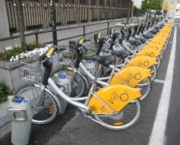

Why G-Cloud?
Greater weight
during negotiations with suppliers
Pooling of knowledge and resources
Technological evolution faster available for everyone

Slide 15
G-Cloud organization
Government
G-Cloud Operations & Programme Board
G-Cloud Strategic Board
FPS/PPS
(Horizontal FPS, FPS FIN, Belnet, …)
PSSI/IPB
(CBSS, ...)
Association of FPS/PPSI/IPB
Private ICT companies directed by FPS/PSSI/...
3 Colleges
FPS
Public Institutions of Social Security (PIOSS)
Institutions of Public Benefit (IPB)
SIT: ICT managers from
FPS
Public Institutions of Social Security
Institutions of Public Benefit
Service
owners

Slide 16


G-Cloud organization
G-Cloud Strategic Board: strategic direction by senior officials
G-Cloud Operations & Program Board:
CIOs for operational direction

Slide 17
G-Cloud service model
G-Cloud = coalition
G-Cloud ≠ central organization
G-Cloud service
Offered by
Service owner
Delivered by
Service provider
Governance

Slide 18
G-Cloud portfolio (www.gcloud.belgium.be)

Slide 19





Data classification
Information classifification model drafted within « Federal Information Security Policy » (FISP)
  https://dt.bosa.be/nl/federaal beleid_voor_informatiebeveiliging_fisp
Definition of levels
Classification based on the impact of the loss or dissemination of information
  impact for government (agencies)
  impact on privacy rights
Practical classification explained in privacy vademecum
  https://dt.bosa.be/sites/default/files/fisp_-_privacy_vademecum_nl.pdf

Slide 20
G-Cloud and the private sector
G-Cloud ≠ ICT insourcing
Public procurement
translation tool, converged infrastructure, unified communications, network security, storage, back-up, ...
In consultation with the sector for several specific platforms
IBM, Microsoft, Oracle, RedHat, SAS, ...

Slide 21
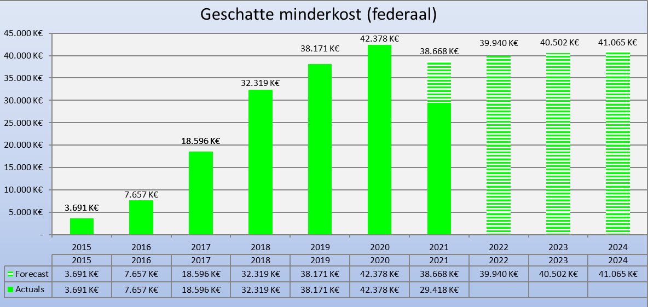
G-Cloud ROI

Slide 22


Shifting focus
towards synergies in the area of business components
Business components
Stronger centrally coordinated approach to offering platforms
22

Slide 23
activiteitenrapporten
beheer van comités
Besturingprocessen
parlementaire vragen
sealing
timestamping
verwijzings-
repertoria
logging
GDPR
2. Dossierbeheer
beheer bronnen
3. Beveiligings-
componenten
dossierbeheer
contactbeheer
4. Authentieke
Bronnen
rapportering
processturing
procesopvolging
handtekening
documentopslag
archivering
ontsluiting bronnen
OCR
codelijsten &
glossaria
encryptie
documenttransformatie
Primaire
Processen
Intake & Inform
Verwerking
Leveren van dienst
portaal
aangiftes verrichten
onderzoeken beheren
factureren
attesten leveren
frontoffice
invorderen
gegevens distribueren
activiteiten traceren
dossiers beheren
gestuctureerd
Chatbot
1. Gebruikers- en toegangsbeheer
eBox
niet-gestuctureerd
Interactieve
formulieren
5. Interfaces
6. Communicatie
mandaatbeheer
identificatie personen
ondernemingen/buitenlanders
CMS
burger, onderneming,
overheden, interationaal
styleguides
devices
gebruikersbeheer
toegangsbeheer
rollenbeheer
personeel
vertaling
23
boekhouding
Ondersteunende Processen
intranet
e-learning
software factory
logistiek
kadercontracten

Slide 24
About the ReUse initiative
Initiative within the public social security & health institutions & Smals
Purpose
  synergy around (technical) business components
  and thus save costs by avoiding multiple development of components
Regardless of whether development takes place by
  the institution's own ICT department
  SMALS
  subcontractors
A competence center within Smals aims to maximally integrate and support the ReUse of business components within Smals, its members, partners and domains in which Smals is active
24

Slide 25

ReUse – Vision
Every stakeholder
can easily find the most common reusable elements in a centralized catalogue
Processes
and tools are put in place to identify, register, implement, monitor and measure ReUse throughout the project lifecycle
Human
networks are maintained and developed on all levels (CEO’s, CIO’s, business owners, business analysts, architects) in order to keep maximum visibility on ReUse potential
A culture
develops where
ReUse is adopted and the creation of reusable products is promoted
25

Slide 26

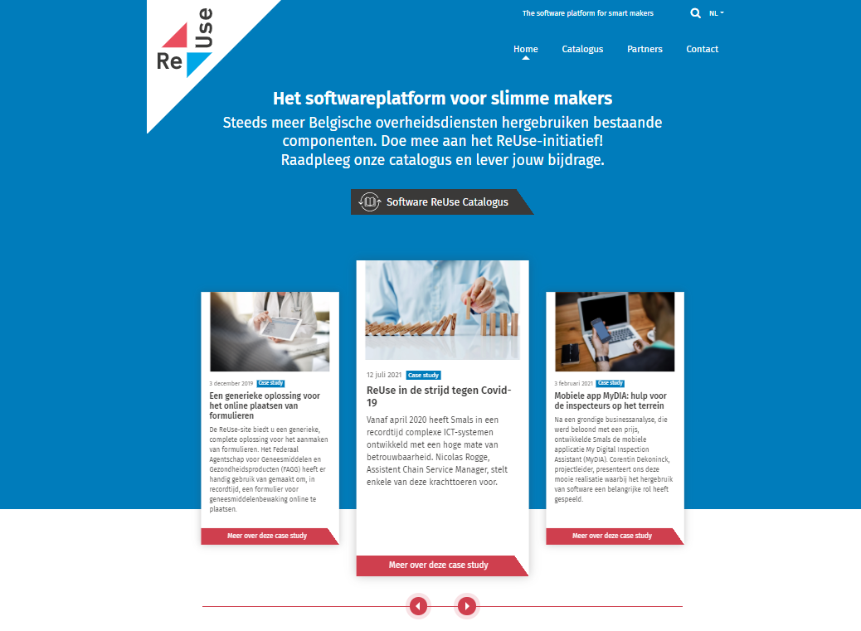
How? With Software ReUse Platform! https://www.ict-reuse.be
26

Slide 27
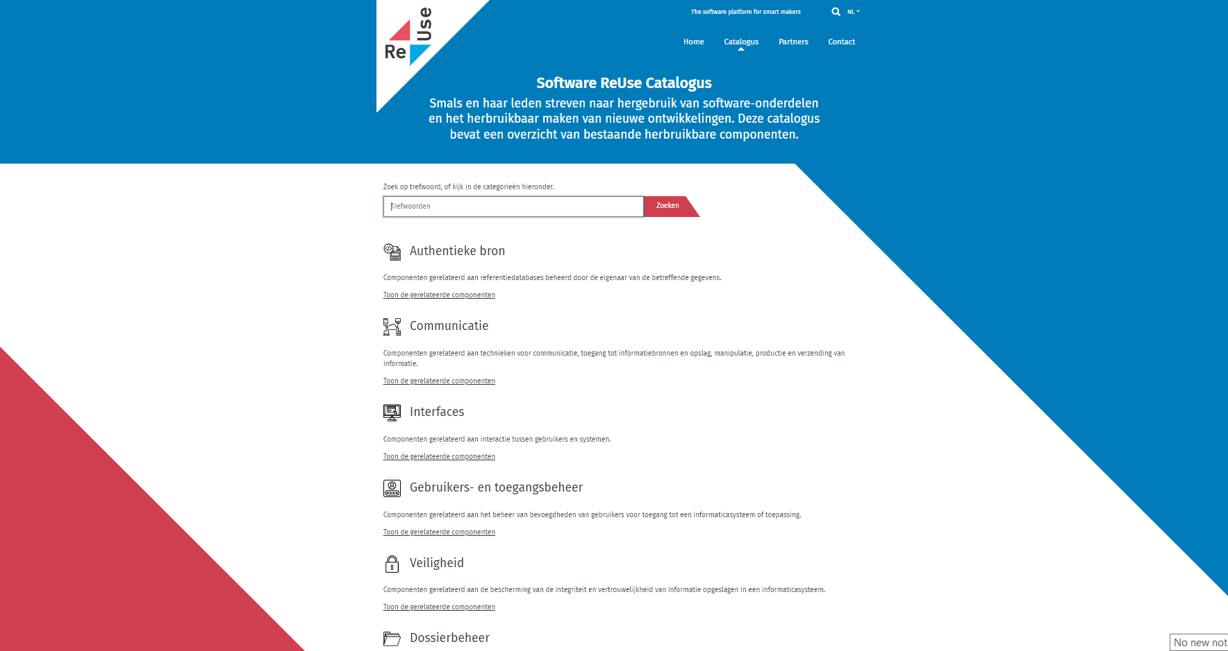
New project?
Consult the
Software ReUse
Catalogue
27

Slide 28
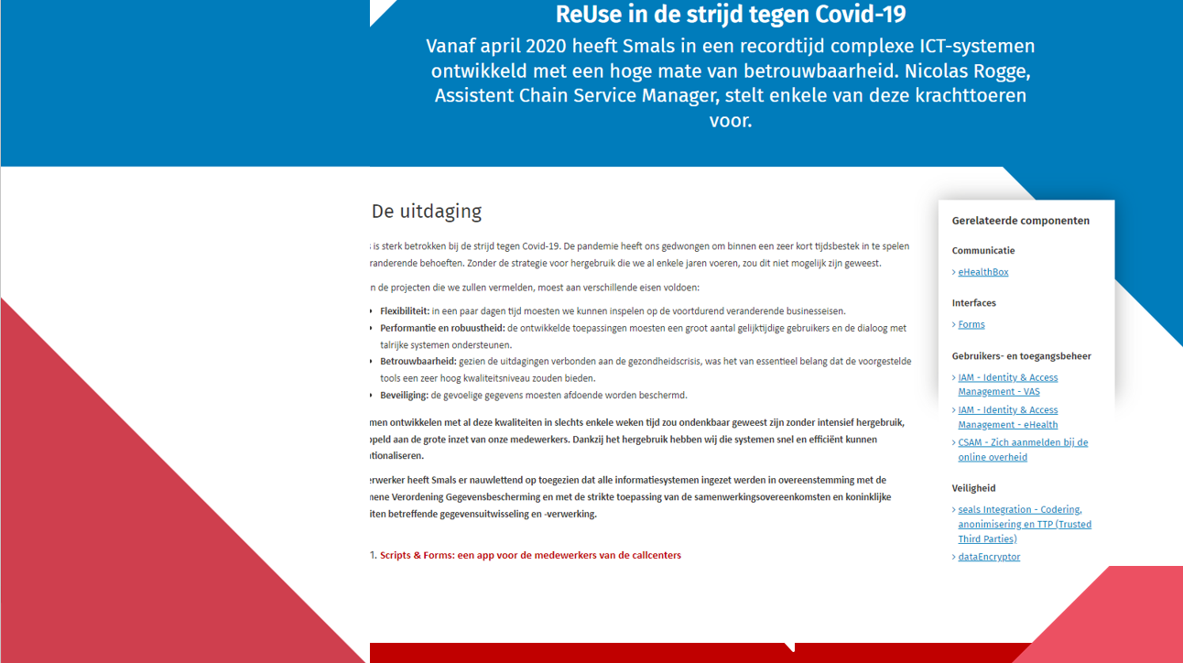
Publish
Your Success Stories !
28

Slide 29
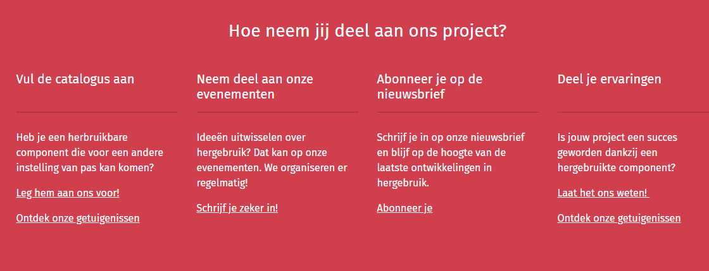
Share your success stories...and become an ambassador for ReUse! https://www.ict-reuse.be
29

Slide 30

























Dare to share!
Framework
Library
Product
Service
System
30

Slide 31
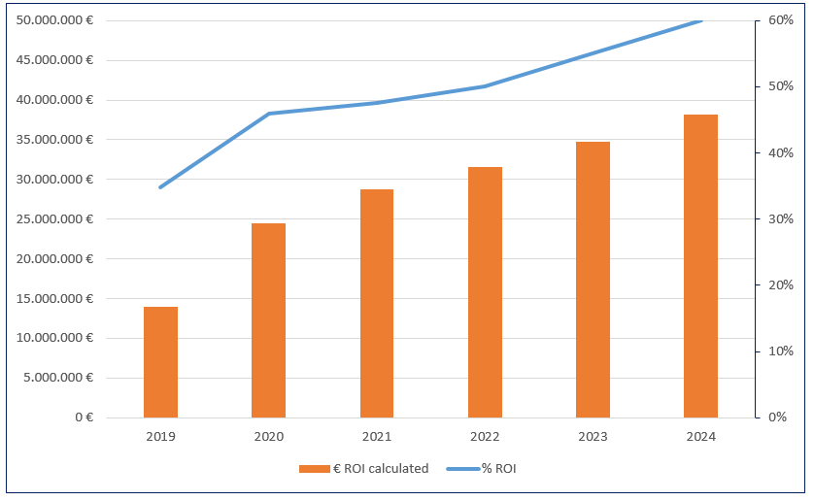
Reuse ROI
31

Slide 32

Good API ReUse = business ReUse
(and also ideal from a technical perspective)
Potential
Value
Technical
Ease
Amount of “business” functionality
Library
Framework
Program
32

Slide 33
Why are API’s important?
Cost reduction by reusability: consumers don’t need to rewrite what already exists!
Complexity reduction: no more big, monolithic systems
Decoupling: consumers and providers can continue to connect as long as the technical contract is followed → ex. less impact in case of migrations
Driver of innovation: new products raise, based on existing API capability
Stimulation of partnerships
Stimulation of standardization
33

Slide 34
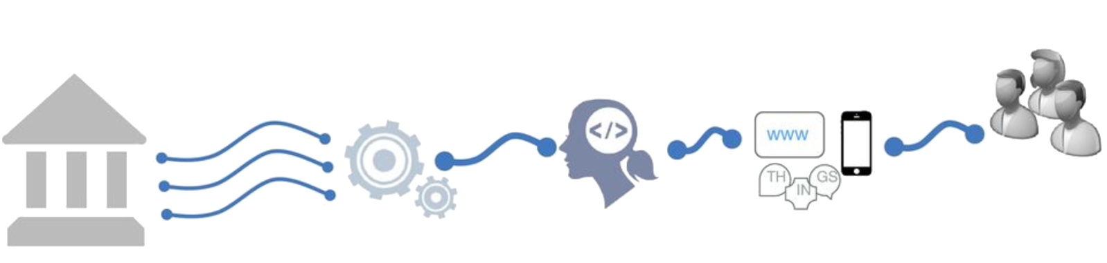
Shifting to an API economy: the value chain
APIs drive today's business processes in e-Government
APIs are key in real-time information exchange between public - private sector & citizens
Differentiated
services
Made available as APIs
Self service
used by developers
To create new innovative apps and services
Existing
Systems
34

Slide 35





API Management Solution
From ESB-technology to API Gateway
  parallel platform
  zero-impact migration
Ready for today's technology, but supports our legacy as well
Flexible to extend and customize
Accelerates time-to-market
API Manager
API Portal
API
API Registration & Lifecycle
Application Developers
API Catalog
Partner & Policy Administration
REST
API
API Gateway
SOAP
Policy Enforcement
35

Slide 36



Beyond tooling: API management throughout the organization’s soul
API Ecosystem eHealth
API Ecosystem Soc Sec
100+ APIs
1.200M transactions / month
250+ APIs
600M transactions / month
API Consumers
Client& Partners Applications
API Communication
reUse Catalogue
various Presentations
API Consumption
API Portal
API Gateway
API Management
API Manager
API Gateway
tool API Gateway
API Catalogue
API Governance
API Architecture
REST Board
Integration Competency Center
(ICC)
G-Cloud Platform is the reference
Smals Governance
Smals API’s Application & Tools
API Reporting
API Development
API Metrics
REST
SOAP
development Guidelines
API Trainings
API Operations
Help Center
API Providers

Slide 37
API Challenges
More Top Management Involvement, across Government
  establish A Shared Vision, followed by a Strategy to achieve it
Don’t just ask yourself “What services and data do I need in my project / agency”, also consider “What can I offer the Governmental API Economy for the benefit of all (i.e., both institutions and citizens)”?
Use the power of the network of institutions
Deal with interdependencies
Focus on the essence, not on "bells and whistles"
Deal with the (un)availability of (critical) services
Strive for uniformity of technological solutions / use of site licenses
37

Slide 38
Fighting the COVID-19 pandemic
Some basic concepts
Testing
Contact tracing & cluster detection
Passenger locator form (PLF)
Vaccination
Big data analysis

Slide 39
Some basic concepts
Incubation period
  the time between the exposure to the virus and the onset of symptoms
  COVID-19: on average 5-6 days, but can be as long as 10-14 days
  thus, quarantine should be in place for 10-14 days from the last exposure to an infected person
Contagiousness
  the period during which an infected person can transmit the virus to other persons
  COVID-19: on average 2 days before the onset of symptoms and up to 7-10 days after the onset of symptoms
  thus, isolation should be respected for 7-10 days from the onset of symptoms

Slide 40
Some basic concepts
High risk contact
  cumulative contact with a COVID-19 patient for at least 15 minutes within a distance of <1.5 m without the correct use of a mouth mask (covering mouth and nose completely) by at least one of the persons and without complete separation by a wall of plexiglass
  direct physical contact with a COVID-19 patient
  direct contact with excretions or bodily fluids of a COVID-19 patient
  travel with a COVID-19 patient for more than 15 minutes, in any mode of transport, sitting within two seats (in either direction) of the patient, even if everyone involved was correctly wearing a mask

Slide 41
Some basic concepts
Low risk contact
  cumulative contact with a confirmed COVID-19 case for at least 15 minutes within a distance of <1.5 m, but where both have adequately used a mouth mask (covering mouth and nose completely) or with complete separation by a wall of plexiglass
  cumulative contact for less than 15 minutes contact with a COVID-19 patient within a distance of <1.5 m, without the correct use of a mouth mask (covering mouth and nose completely) by at least one of the persons and without complete separation by a wall of plexiglass
  being in the same room/closed environment with a COVID-19 patient for more than 15 minutes, but respecting a distance of > 1.5 m (eg people working in the same room or sitting together in a waiting room)

Slide 42
Testing
Ever changing testing strategy in function of
  evolving scientific insights
  available types of tests
  capacity
    sampling material
    test material
    personnel
Many actors involved
  GPs, collectivity doctors, company doctors
  sample collection points
  hospitals
  labs
  …

Slide 43
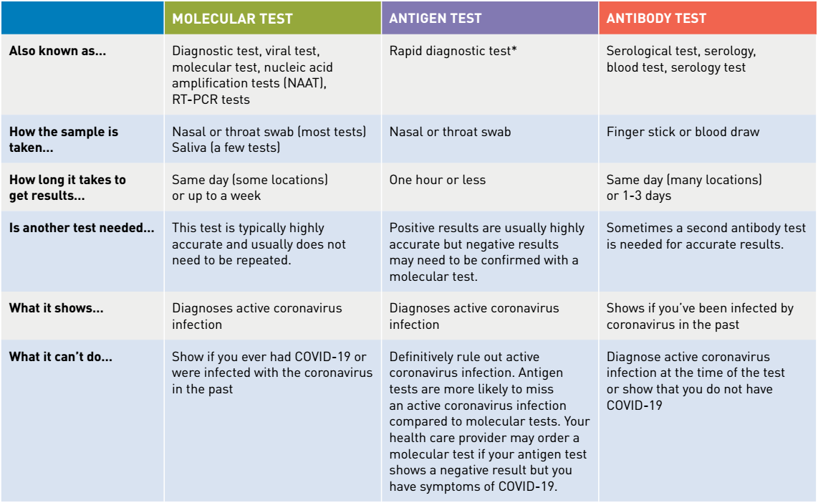
Testing: types of tests

Slide 44
Testing: happy flow
5 phases
  determination of a cause for performing a COVID-19 test on a patient and delivery of a corona test prescription code (CTPC) from a central database CTPC
  reservation of a sampling moment
  sampling
  execution of the test and analysis of the test result
  making the test results available
Very modular, event driven and rule based information system

Slide 45









Testing: main building blocks
CTPC Code
EMF software
Doctors
Nurses
CTPC
Test location
Collectivities
eHealth Box
Laboratories
Tracing business process engine

Slide 46




Testing: reuse
CTPC Code
Integrated software
IUAM
API gateway
IUAM
API gateway
eHealthBox
ETEE
Doctors
Nurses
CTPC
Test centers
DataEncryptor
Seals
Entities prescriptions
Addressbook
ConsultRN
DossierNumberGeneration
CentralPersonnelFile
DmfA
Laboratories
Mandate

Slide 47
Testing: some numbers
Since 06/2021
  15,4 M Corona Test Prescription Codes requested
    12,5 M requested by tracing or health professionals
    2,9 M requested by citizens
      950 k after a self assessment tool
      130 k after a positive auto test
      1.250 k vacation free tests
      630 k paid tests
API Calls : ~600k per day on working days

Slide 48
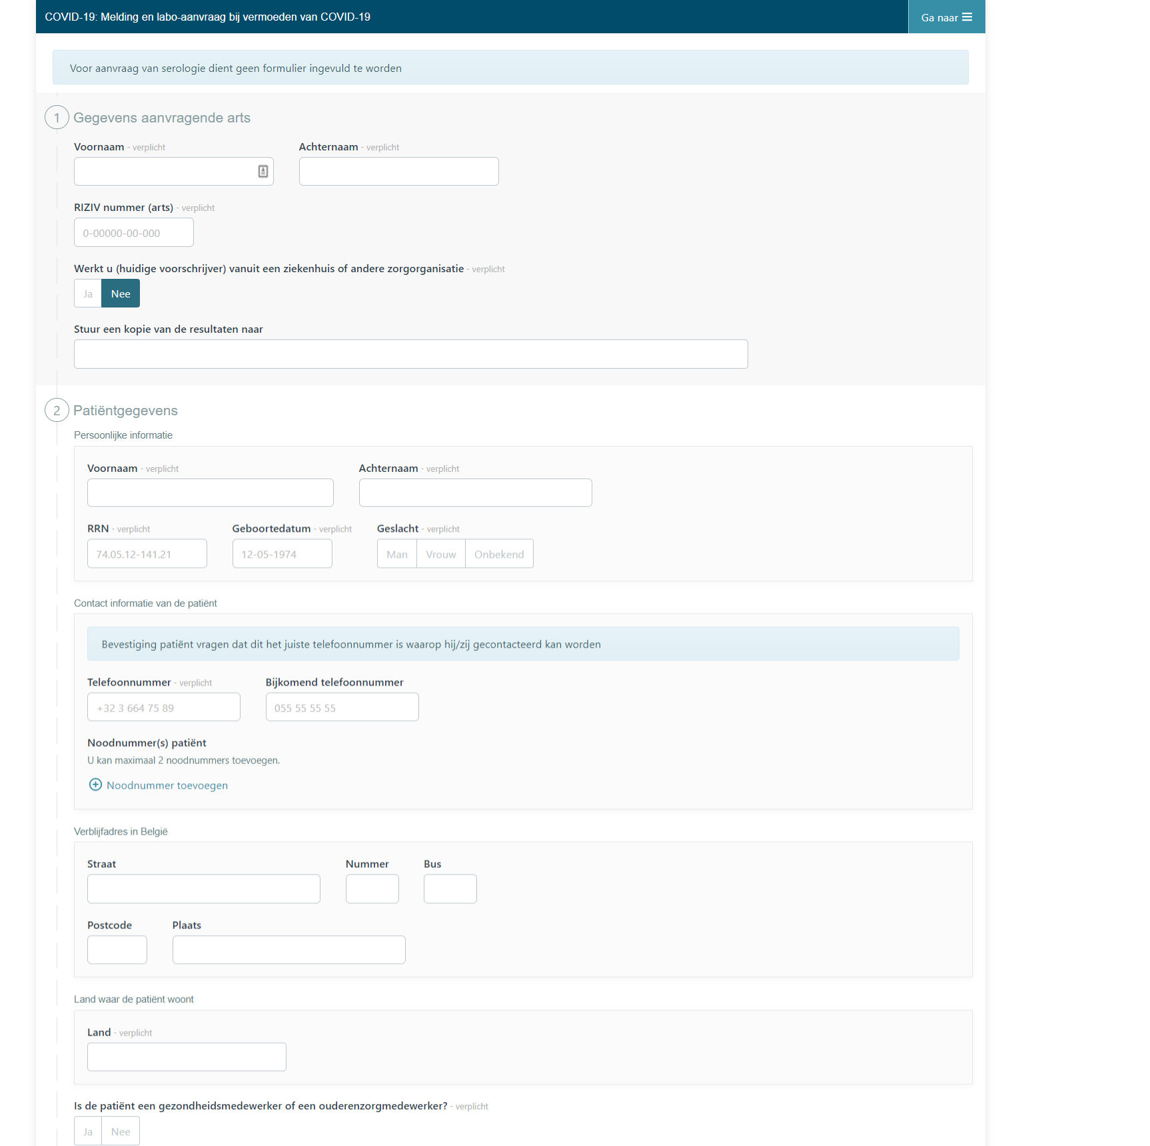
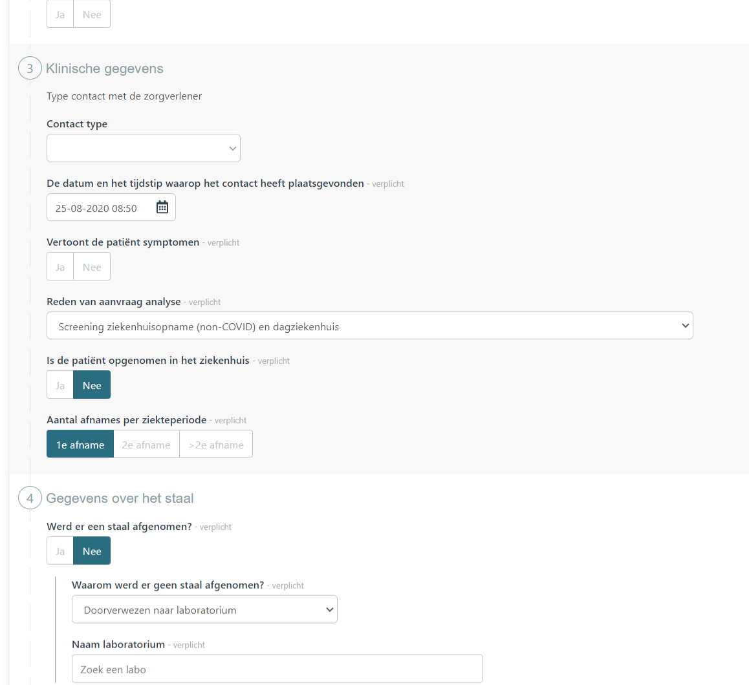
eForm COVID-19 lab request (1/2)

Slide 49
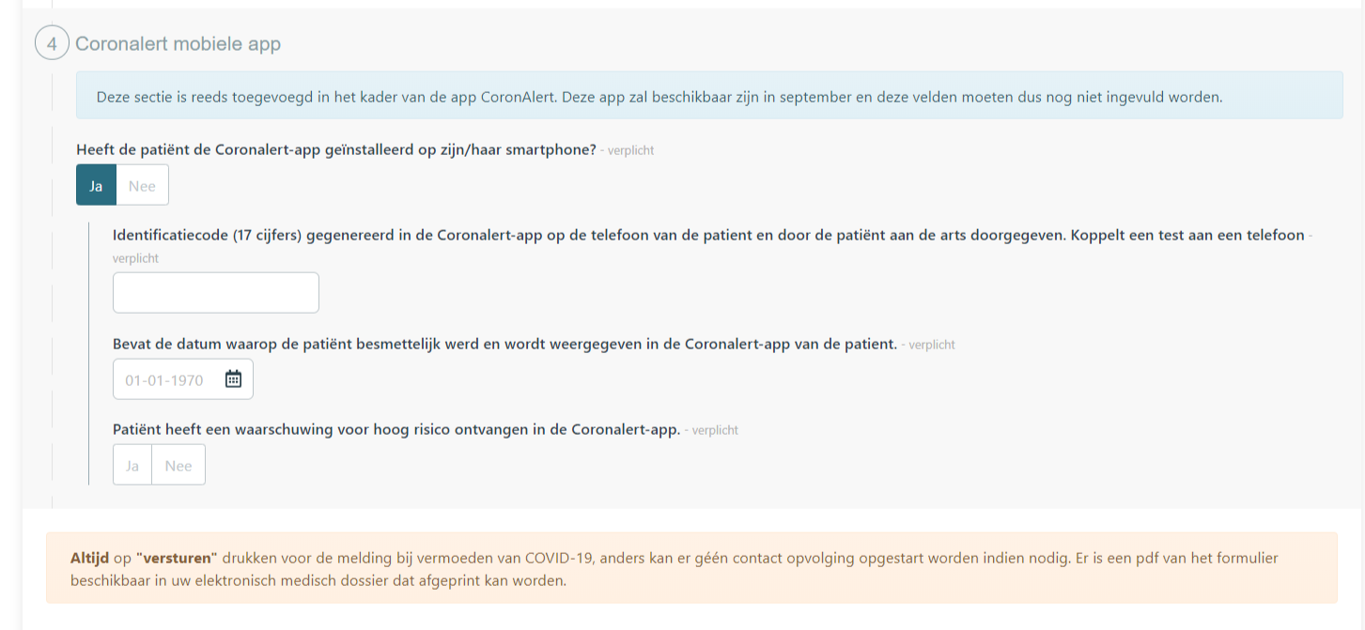
eForm COVID-19 lab request (2/2)

Slide 50
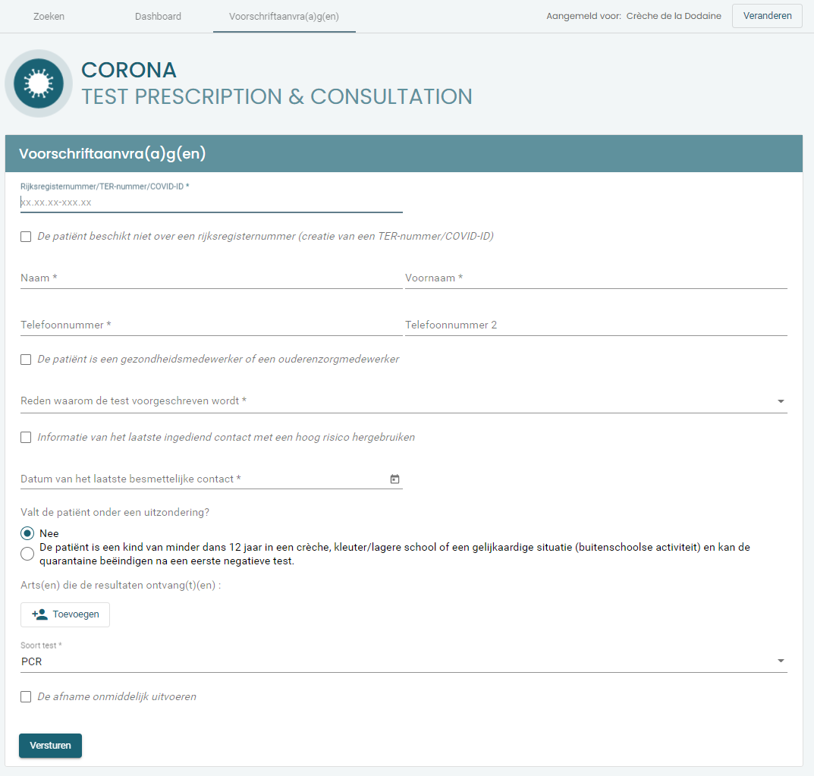
Entities prescriptions

Slide 51
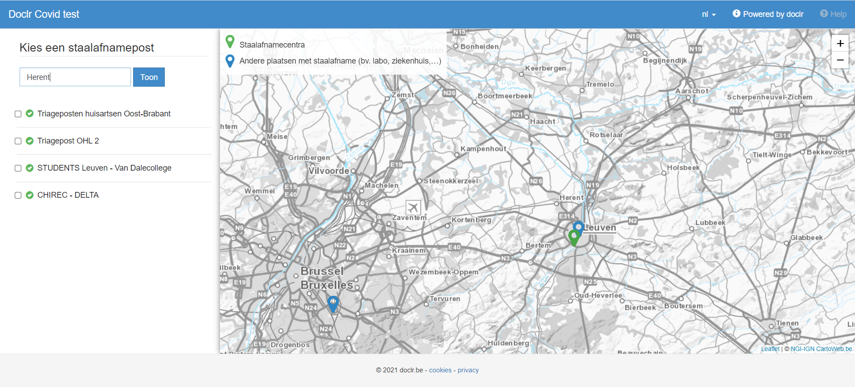
Testing: reservation of a sampling location and moment

Slide 52
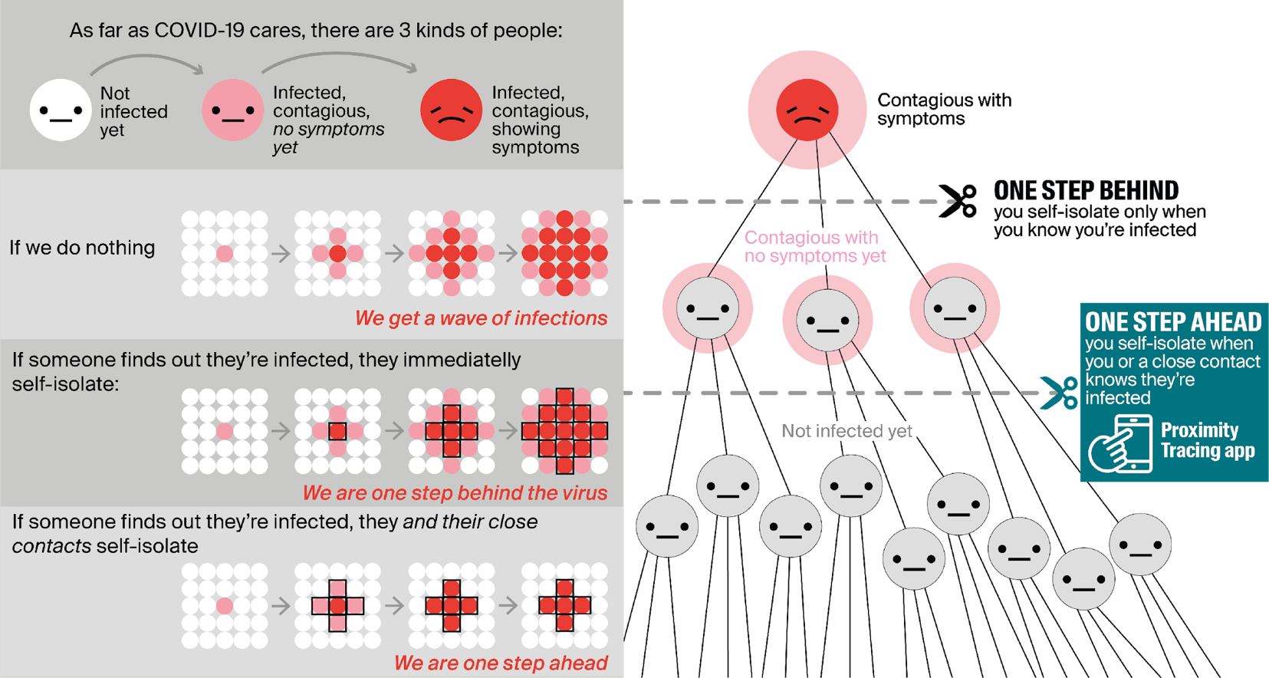
Contact tracing: why ?

Slide 53
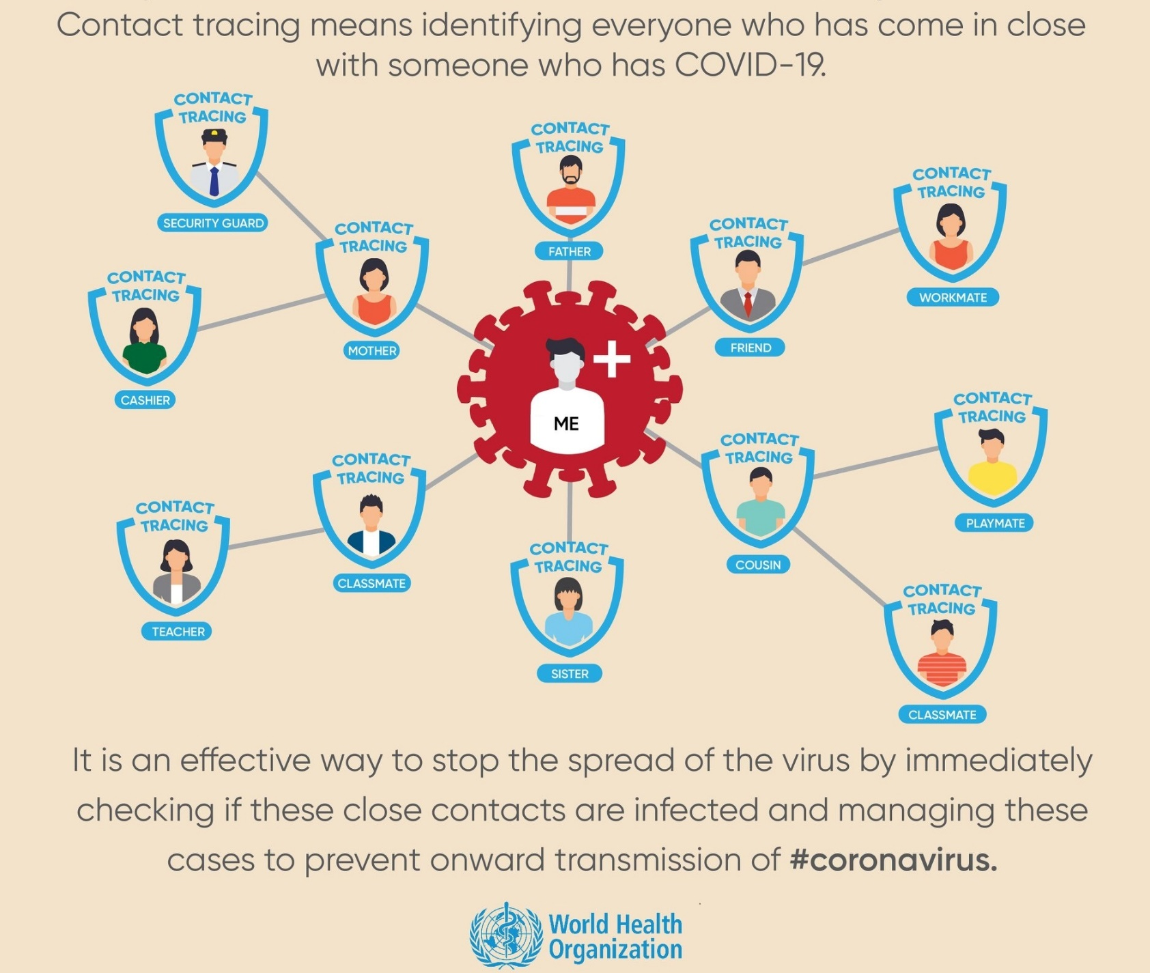
Contact tracing: what ?

Slide 54
How contact tracing is put in place ?
Contact tracing by health care providers
Contact tracing by contact centers
  see https://www.corona-tracking.info/
Contact tracing within companies and collectivities
  see https://co-prev.be/nl/covid-19-informatie/ or https://co-prev.be/fr/covid-19-information/
Contact tracing via app Coronalert
  see https://coronalert.be/

Slide 55


Tracing: enterprise architectural view
  Tracing is a very reactive customer relationship management process in a campaign management context
A simple yet powerful CRM process
I want to reach a specific target group
Filter the target group in the CRM
Select the communication channels depending on profession, age, place of living, …
The platform simulates the effect of the choices on reachability, call center capacity, …
The platform optimizes the different channels
CRM for contact tracing
I want to reach infected persons (index persons)
I receive a list of index persons from Sciensano
I communicate via SMS, email, telephone and field agents depending on the country of origin
The platform uses historic data to simulate the effect on reachability, call center capacity, …
Regions optimize the communication channels to prevent call center meltdown

Slide 56






Tracing: main building blocks and reuse
elasticms
Passenger Locator Form
Coronalert Form
FORMS
Tracing business process engine
Script&Forms
IUAM
eHealthBox
ETEE

Slide 57
Tracing: service mode
Quick modification of decision tables to reflect business changes
Self documenting and high transparency of the operational BPMN processes
Business decision points in the process are clearly identified and unique
Same scripts serve for tracing as well as websites (citizen form)
Challenges for the (near) future
  support of the more fine grained tracing approaches (e.g. demographic zones in large cities).
  feedback loop to enable simulation of campaign management decisions.

Slide 58
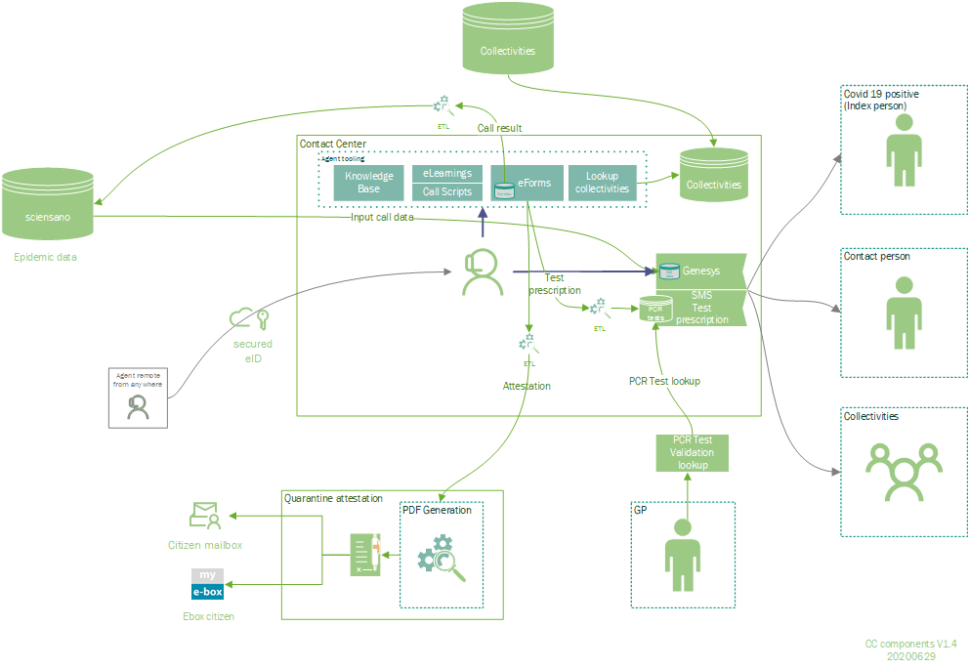
Contact tracing by contact centers

Slide 59
Contact tracing within companies and collectivities
Call by contact center
Identification of infected person (index case)
Risk analysis
Identification and triage of contacts (high risk – low risk)
Contacting contacts
Measures for contacts
  high risk: quarantine – telework/unemployment – vigilance for symptoms
  low risk: social distancing – vigilance for symptoms
Resumption of work

Slide 60
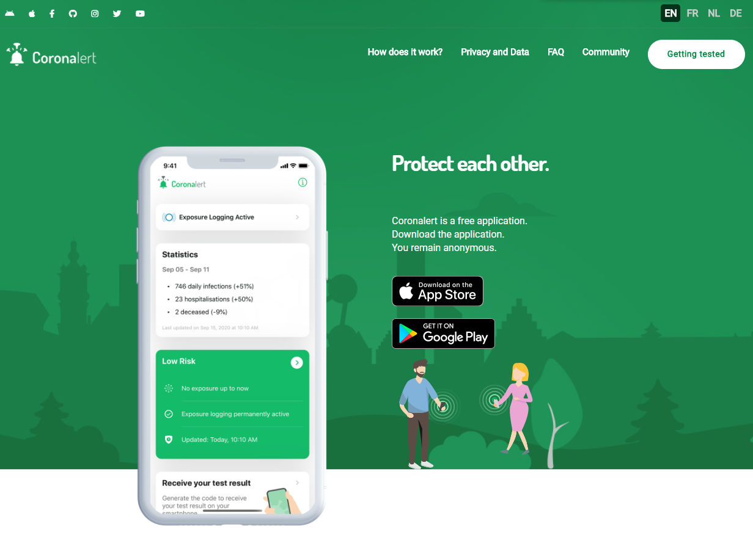
App Coronalert

Slide 61



App Coronalert
installation
operation
RPIA3
RPIB4
RPIA1
RPIA2
RPIA3
RPIA4
RPIB1
RPIB2
RPIB3
RPIB4
Store
RPID1
RPIC2
TEKA
TEKB
TEKA
TEKB
RPID1
RPIC2
RPIC1
RPIC2
RPIC3
RPIC4
RPID1
RPID2
RPID3
RPID4
store
RPIA3
RPIC2
TEKD
Store
RPIA3
RPID1
TEKD
TEKC
TEKC

Slide 62



App Coronalert
test
proximity tracing
TEKD
TEKD
TEKD
TEKD
TEKD
Store
RPID1
RPIC2
TEKA
TEKB
test result
TEKD
TEKD
Store
RPIA3
RPIC2
TEKD
Store
RPIA3
RPID1
TEK*
TEKC

Slide 63






App Coronalert
Details: GP visit
RAG: Date patient became infectious
= two days before onset of symptoms
or = two days before day of test (if asymptomatic)
Do you have symptoms?
If yes: day of onset of symptoms?
test result
test result
Date (infectious)
Test number (15+2)
INSZ
Date (infectious)
Test number (15+2)
specimen
TEKD
2 check digits to detect typos

Slide 64
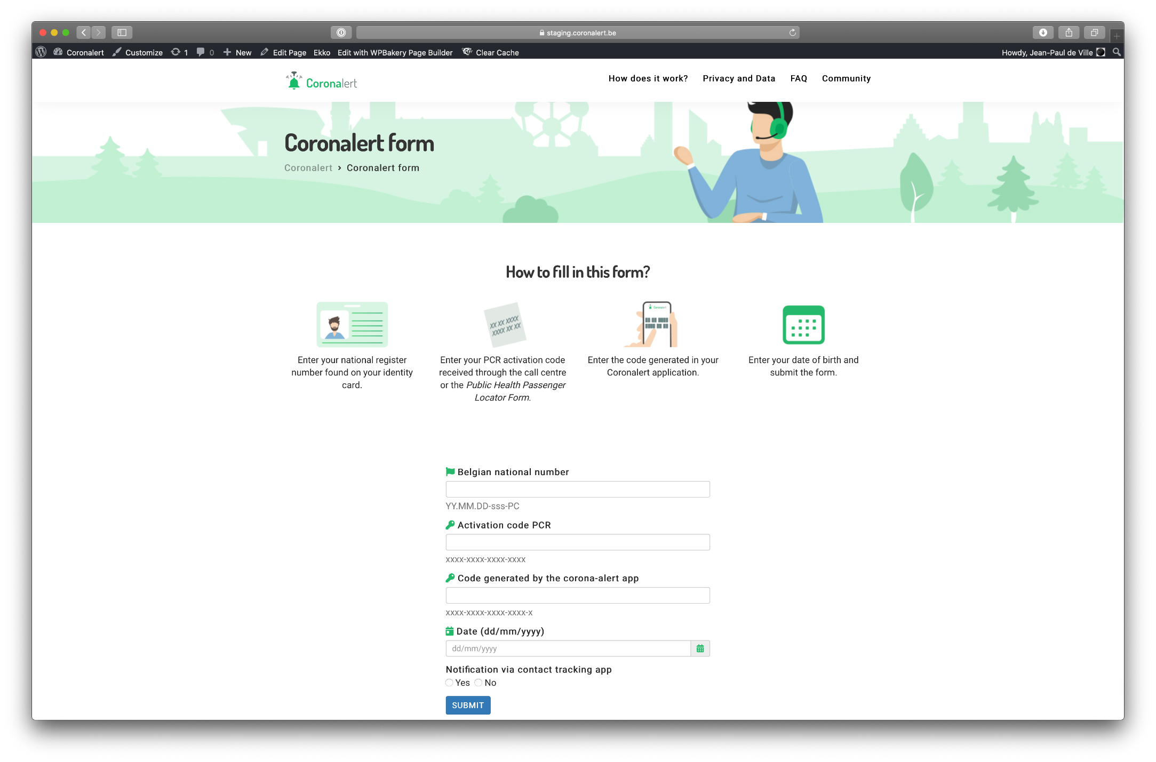
App Coronalert
Details: webform for user

Slide 65
App Coronalert
Recommend the use of the app
Exchange of anonymous codes by the app can be deactivated and reactivated
Generate a test code with the app if you are tested and ensure that it ends up at Sciensano together with your social security identification number => you will receive your test result on the app as soon as it is available
  general practitioner via eForm LaboratoryTestPrescription
  person to be tested via webform (see https://coronalert.be/nl/coronalert-formulier/)
Publish the transmitted anonymous codes if you test positively

Slide 66
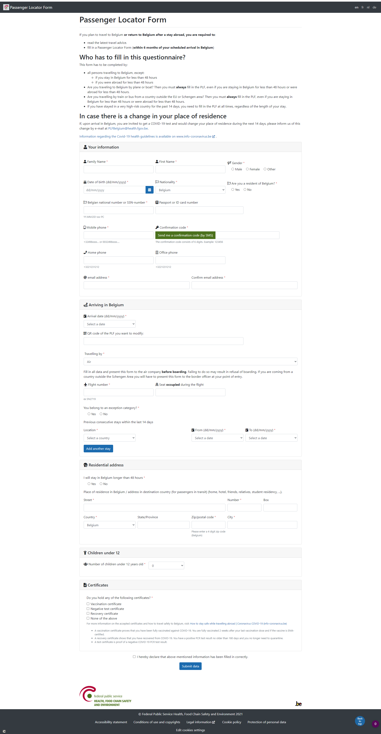
Passenger Locator Form

Slide 67
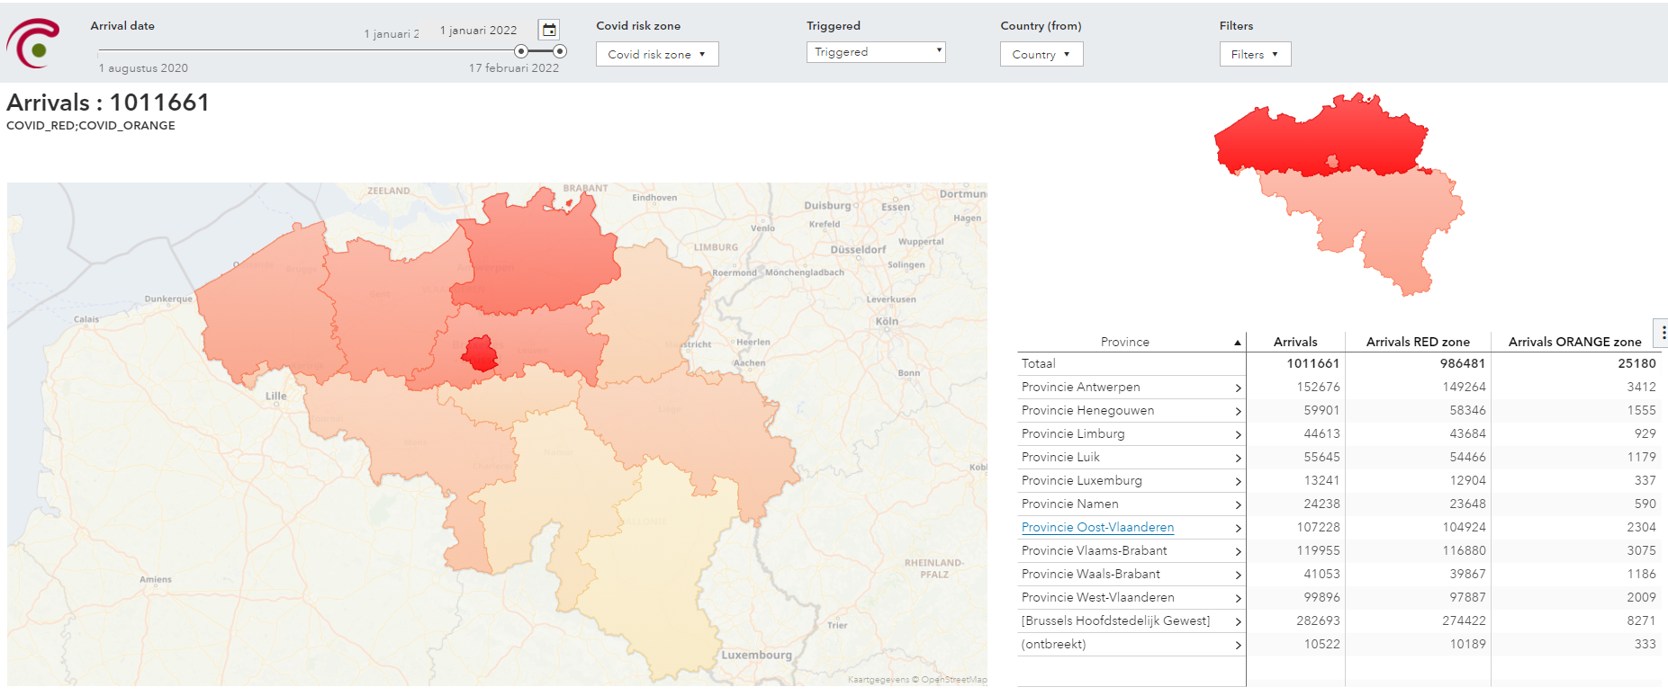
Paloma

Slide 68
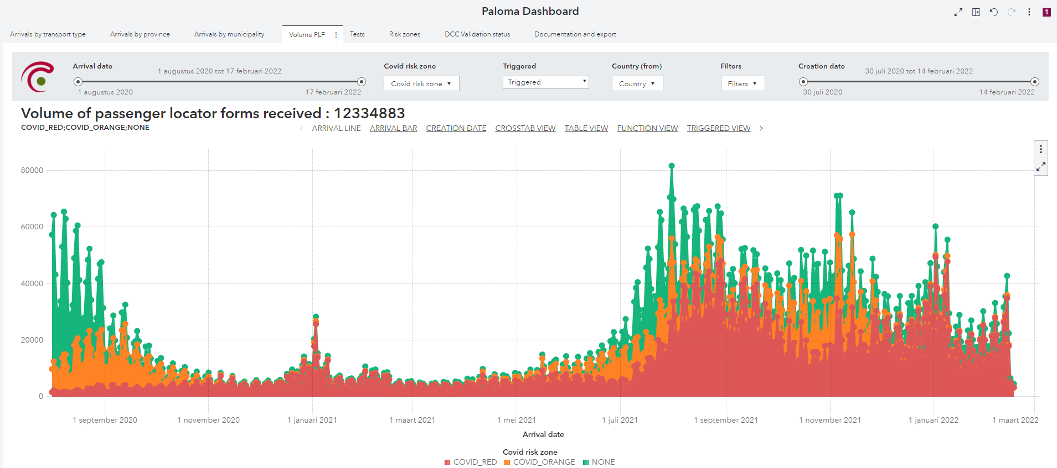
Paloma

Slide 69
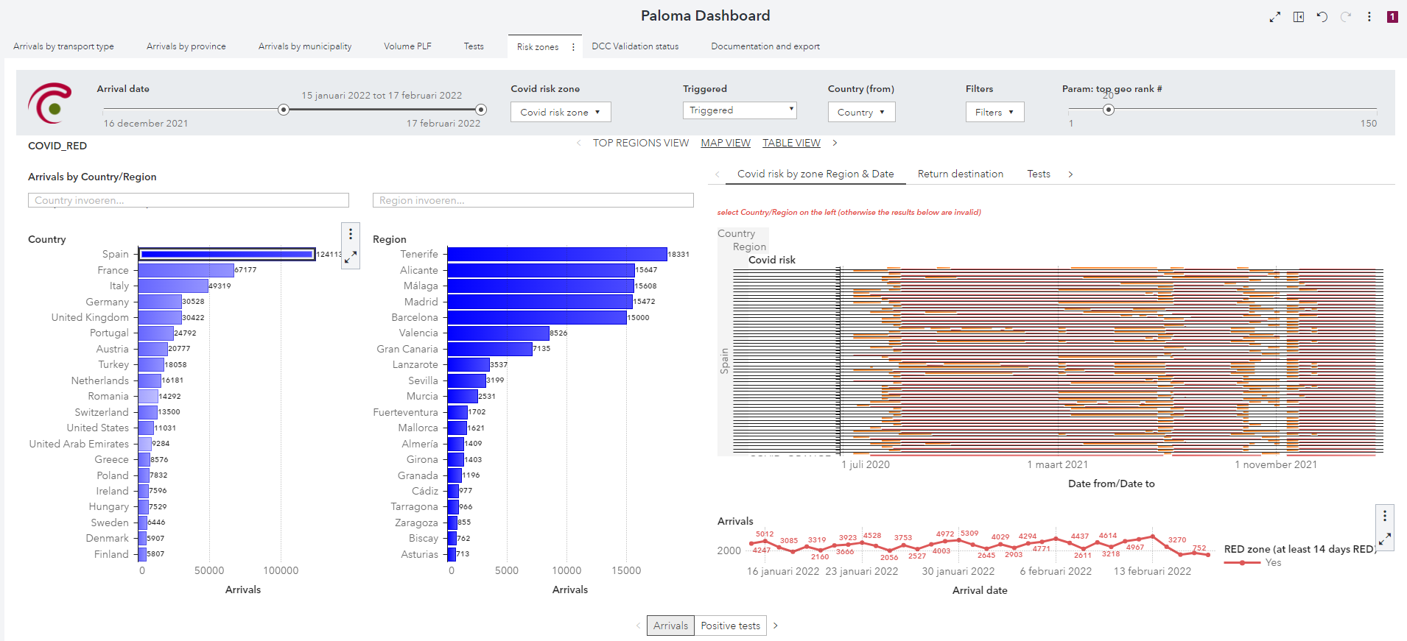
Paloma

Slide 70

Integrated citizen portal

Slide 71
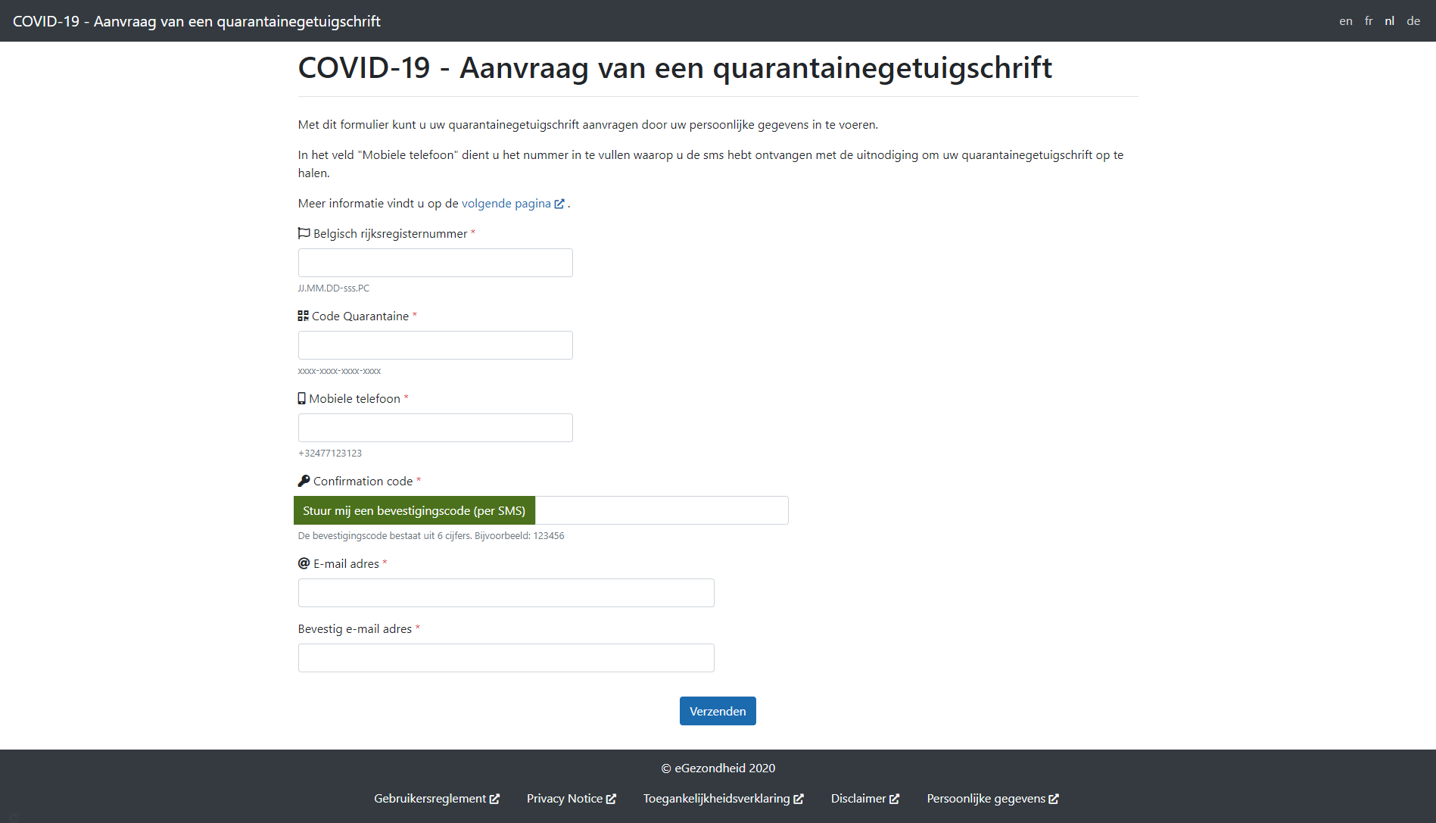
Integrated citizen portal

Slide 72
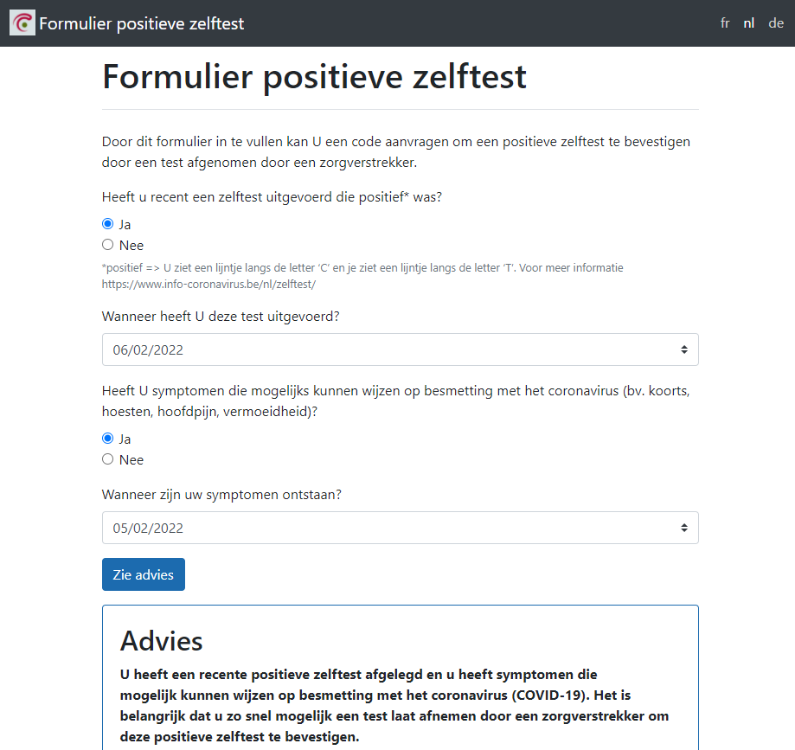
Integrated citizen portal

Slide 73
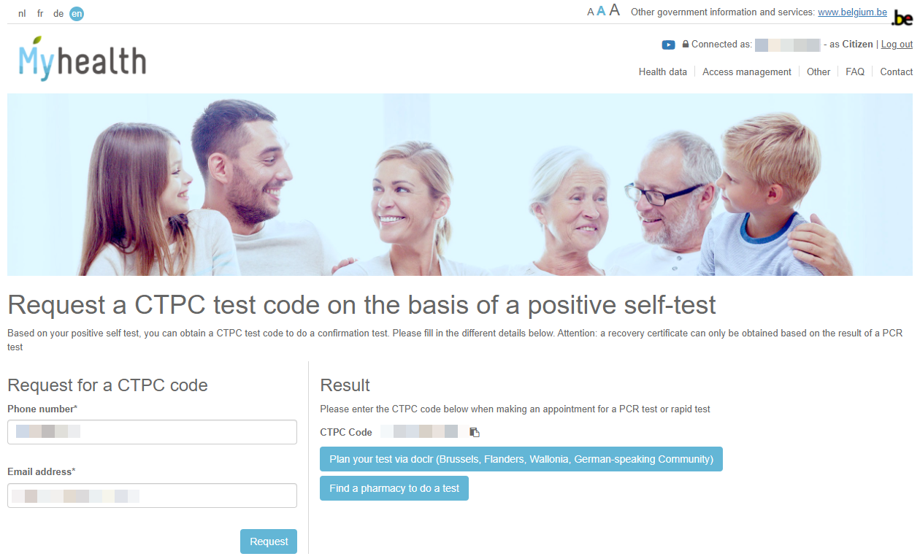
Integrated citizen portal

Slide 74
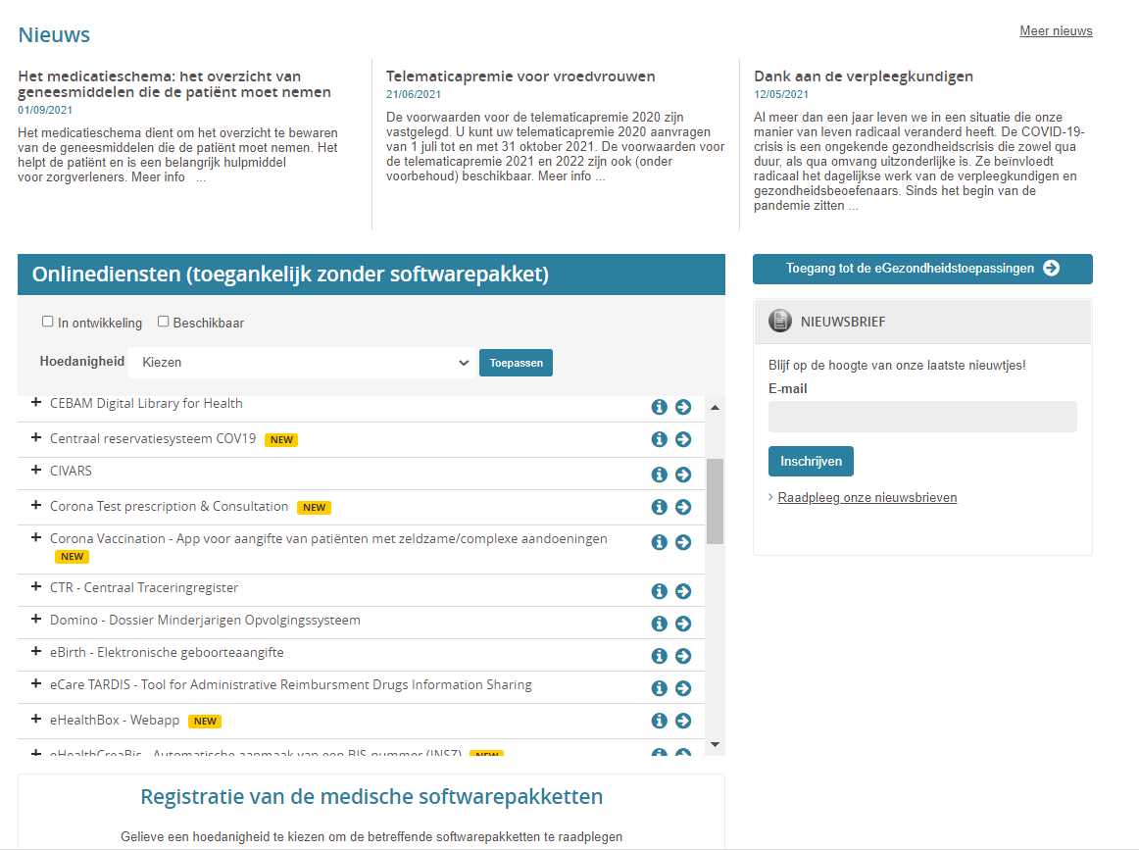
Integrated portal for health care providers

Slide 75
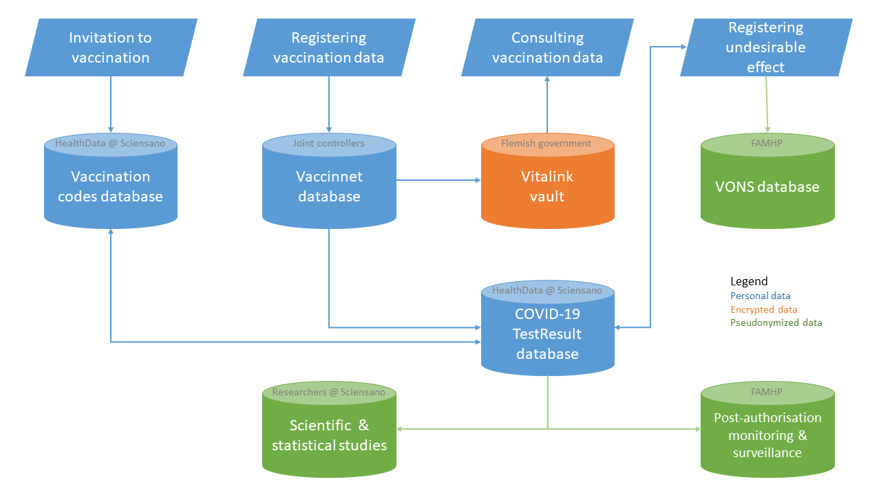
Vaccination

Slide 76
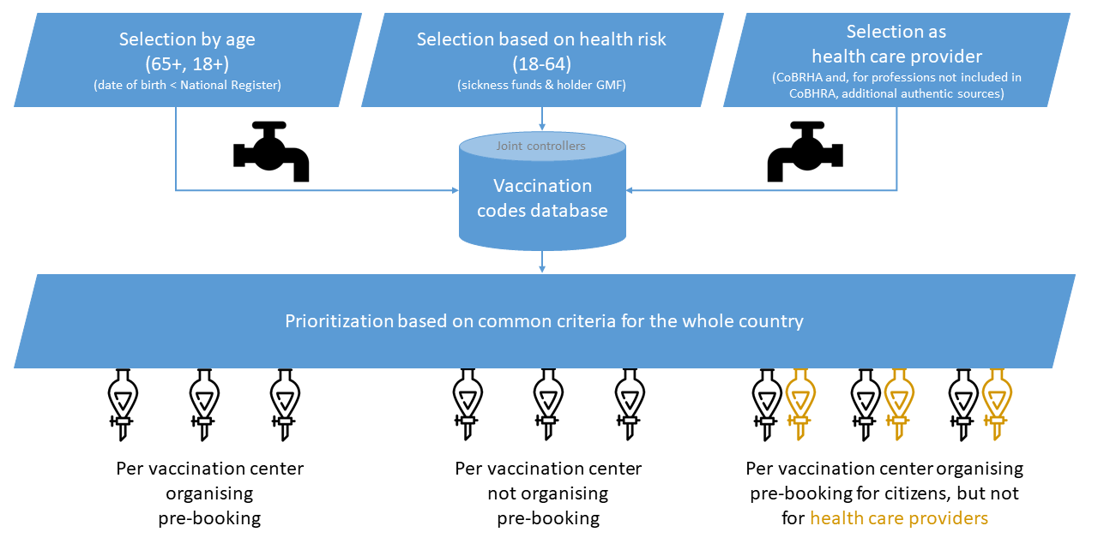
Vaccination

Slide 77
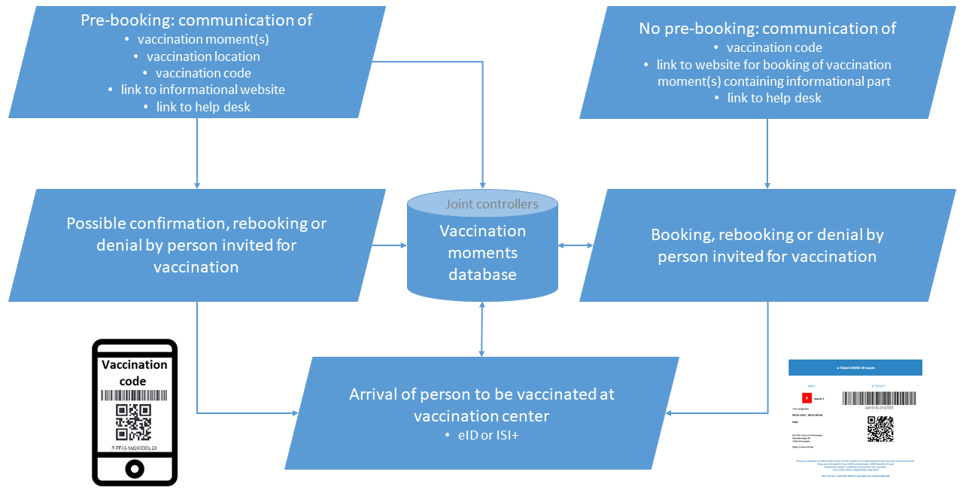
Vaccination

Slide 78


Vaccination: (Simplified) Integration
Sciensano
Vaccinnet
National Register
IUAM
API gateway
ConsultRN
CoBRHA
Regions
National Intermutual College
Doctors
Vaccination Codes Database
Inivitation & booking
system
Vaccination centers
Hospitals
Pharmacies
Last minute
invitation system

Slide 79
Vaccination: some numbers
Vaccination Codes Database
  primary vaccination
    10,1 M citizens invited
    8,9 M citizens vaccinated
      of whom 6,7 M were invited
  38,3 M notifications sent in total
    multiple canals : Letters, e-mails, SMS
    first invitation & reminder
    multiple campaigns : Primary vaccination, Extra dose & Booster
API Calls : ~1.1M per day on working days

Slide 80
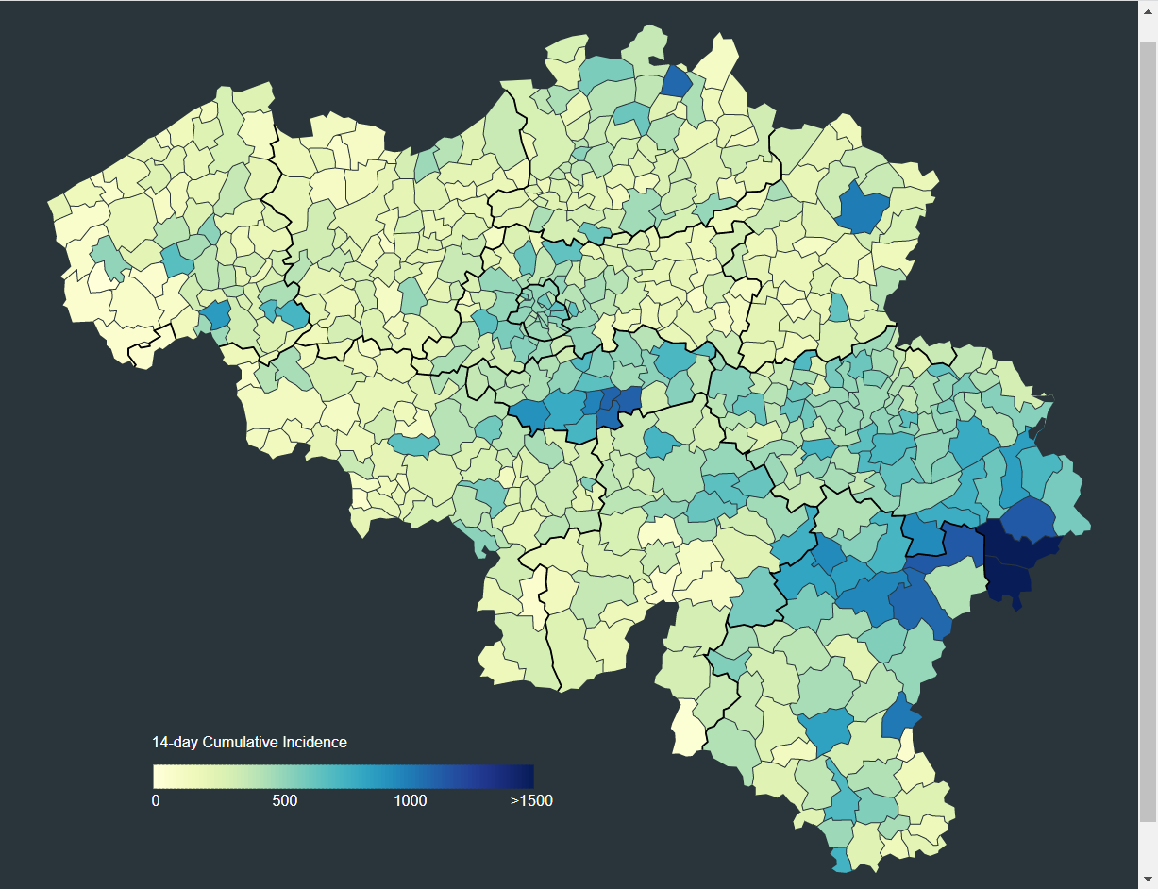
Dashboards
COVID-19 Epidemiological Situation per municipality

Slide 81
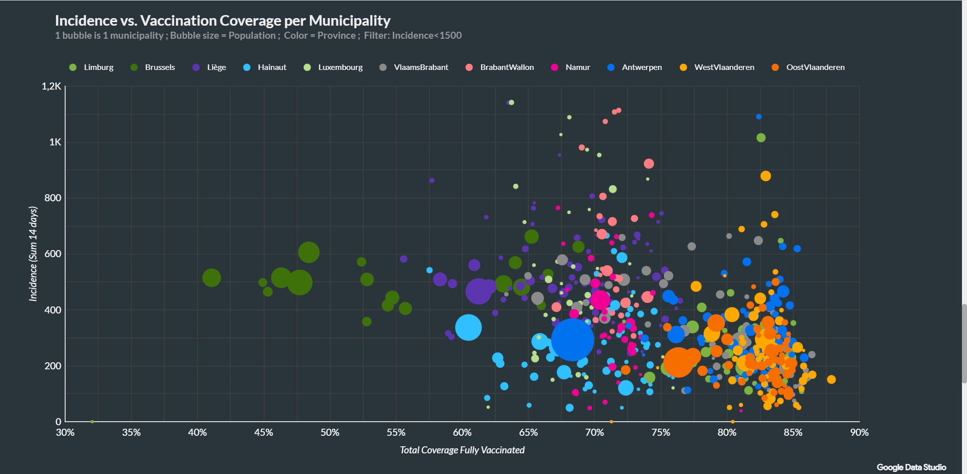
Dashboards

Slide 82

Big data analysis
https://fair.healthdata.be/

Slide 83
Abstract
In the development of information systems in the social and health sector, the emphasis has been placed for years on a solid, sector-wide enterprise architecture
  sharing of infrastructure and platforms
  reuse of data, services and components described in a publicly accessible catalogue
  an integrated service to end users, supported by APIs
  participatory governance in the development of the systems, up to the level of policy makers.
Through this approach, the information systems and apps set up in the fight against the COVID-19 pandemic (contact tracing, organization of tests, organization of vaccination, teleconsultation, policy support, ...) can be developed very quickly and agile, and can be adjusted very flexibly and at low cost in function of the changing situation and evolving scientific insights.

