Slide 1
Importance of location information in the fight against COVID-19
Title of your amazing presentation
Speaker, organisation
Frank Robben, eHealth platform

Slide 2
Abstract of the presentation
some basic concepts
use of location information
testing
contact tracing
cluster detection
passenger locator form (PLF)
vaccination
big data analysis

Slide 3
Some basic concepts
incubation period
the time between the exposure to the virus and the onset of symptoms
Covid-19: on average 5-6 days, but can be as long as 10-14 days
thus, quarantine should be in place for 10-14 days from the last exposure to an infected person
contagiousness
the period during which an infected person can transmit the virus to other persons
Covid-19: on average 2 days before the onset of symptoms and up to 7-10 days after the onset of symptoms
thus, isolation should be respected for 7-10 days from the onset of symptoms

Slide 4
Some basic concepts
high risk contact
cumulative contact with a COVID-19 patient for at least 15 minutes within a distance of <1.5 m without the correct use of a mouth mask (covering mouth and nose completely) by at least one of the persons and without complete separation by a wall of plexiglass
direct physical contact with a COVID-19 patient
direct contact with excretions or bodily fluids of a COVID-19 patient
travel with a COVID-19 patient for more than 15 minutes, in any mode of transport, sitting within two seats (in either direction) of the patient, even if everyone involved was correctly wearing a mask

Slide 5
Some basic concepts
low risk contact
cumulative contact with a confirmed COVID-19 case for at least 15 minutes within a distance of <1.5 m, but where both have adequately used a mouth mask (covering mouth and nose completely) or with complete separation by a wall of plexiglass
cumulative contact for less than 15 minutes contact with a COVID-19 patient within a distance of <1.5 m, without the correct use of a mouth mask (covering mouth and nose completely) by at least one of the persons and without complete separation by a wall of plexiglass
being in the same room/closed environment with a COVID-19 patient for more than 15 minutes, but respecting a distance of > 1.5 m (eg people working in the same room or sitting together in a waiting room)

Slide 6
Use of location information
shortest path determination
citizen – sampling location
sampling location – laboratory
citizen – vaccination center
distribution of material for
protection
sampling
executing tests
vaccination
determination of required capacity in function of residence and/or work location

Slide 7
Use of location information
determination of high or low risk contacts
identification of clusters of infections
passenger locator form (PLF)
dashboards
not used: identification of places of high concentration of people at certain times

Slide 8
Testing
ever changing testing strategy in function of
evolving scientific insights
available types of tests
capacity
sampling material
test material
personnel
many actors involved
GPs, collectivity doctors, company doctors
sample collection points
hospitals
labs
…

Slide 9
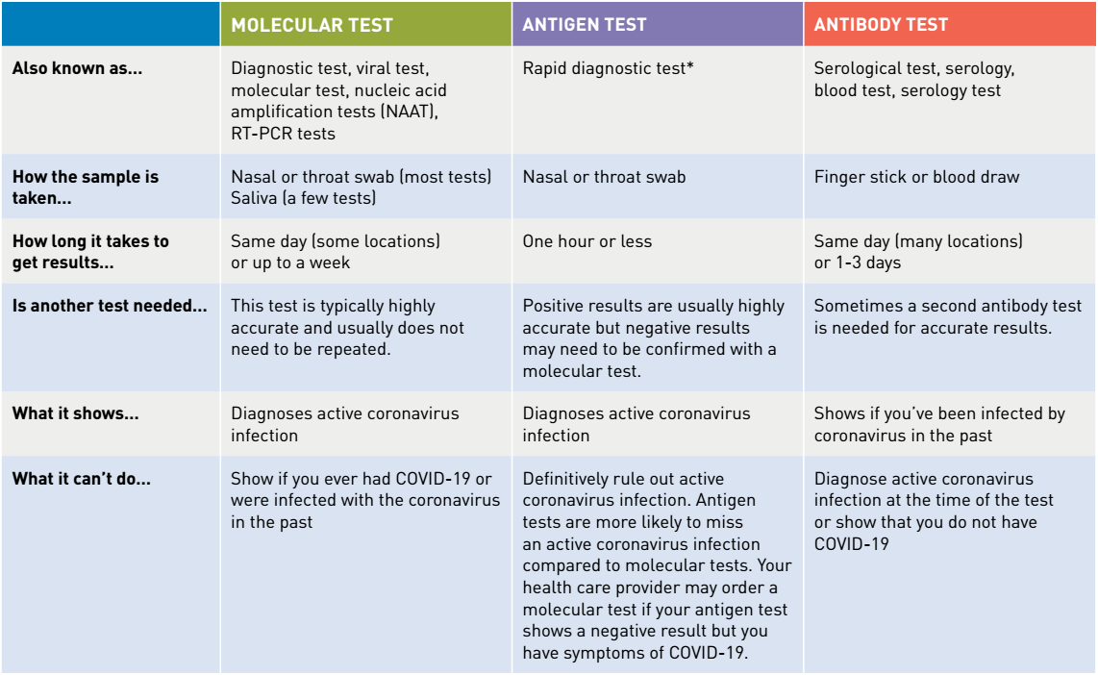
Testing: types of tests

Slide 10
Testing: happy flow
5 phases
determination of a cause for performing a Covid-19 test on a patient and delivery of a corona test prescription code (CTPC) from a central database CTPC
reservation of a sampling moment
sampling
execution of the test and analysis of the test result
making the test results available
very modular, event driven and rule based information system

Slide 11
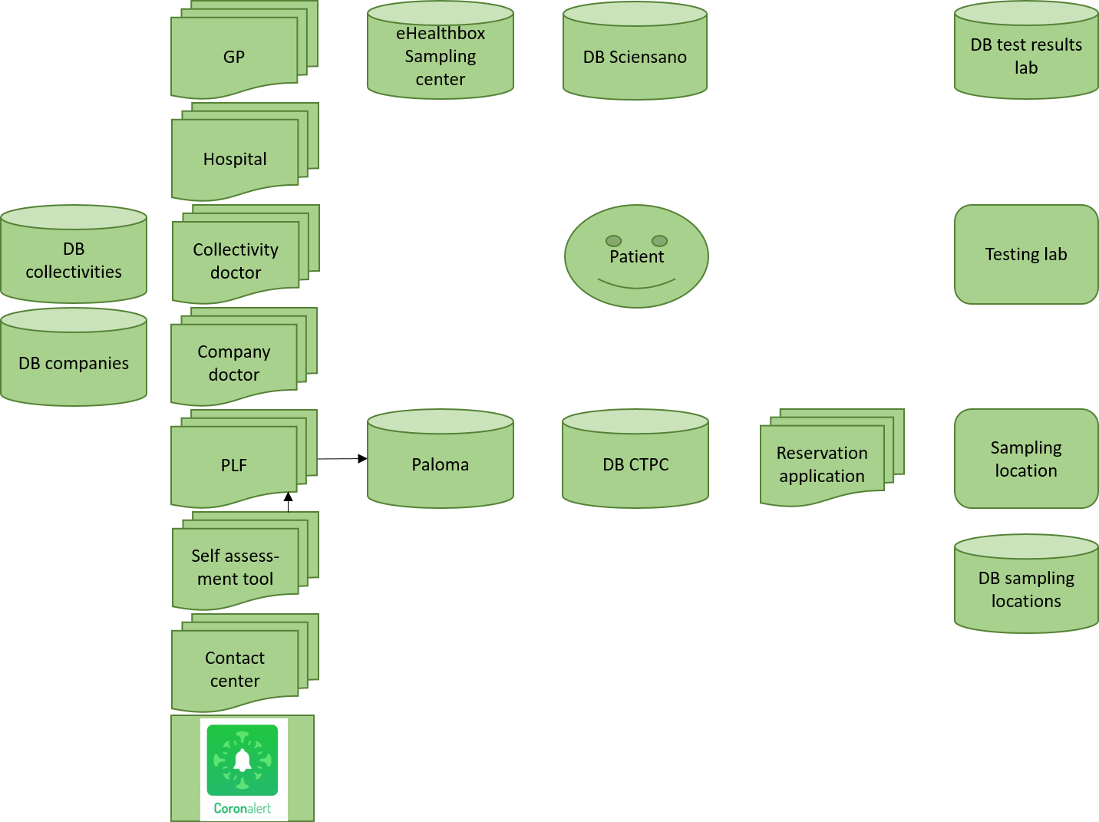
Testing: context diagram

Slide 12
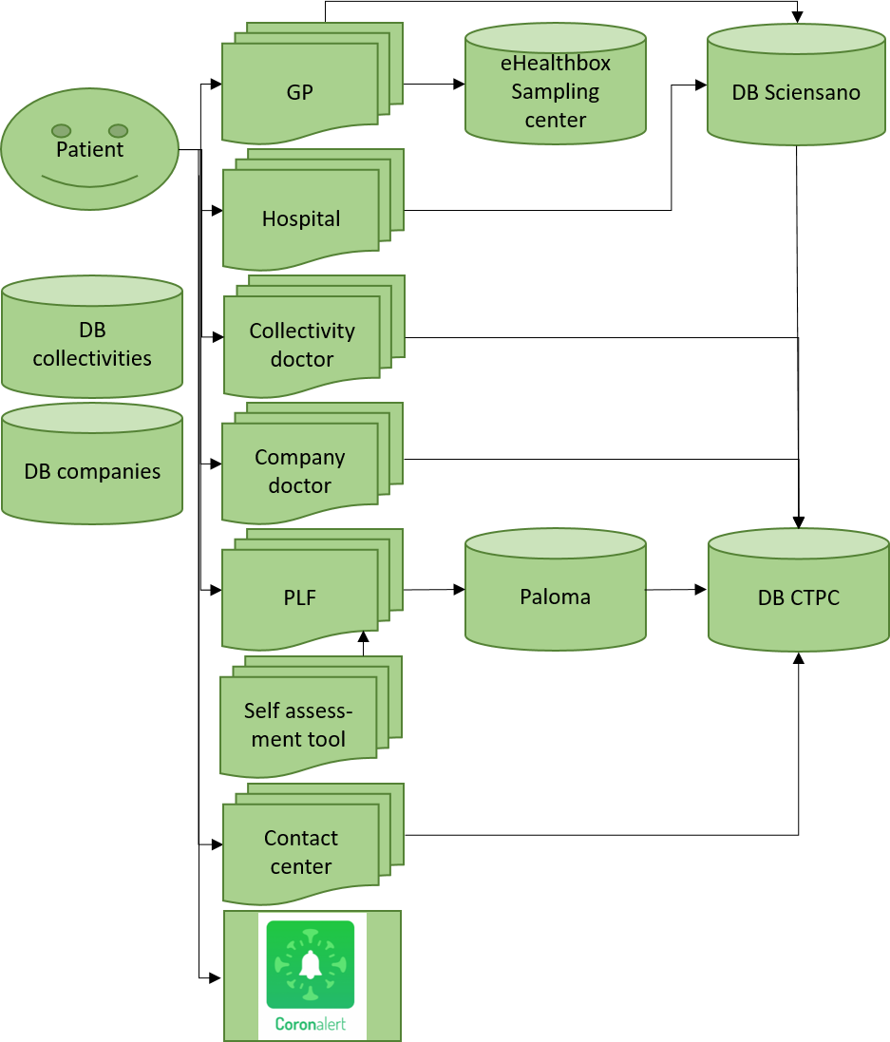
Testing: determination of a cause for performing a Covid-19 test

Slide 13
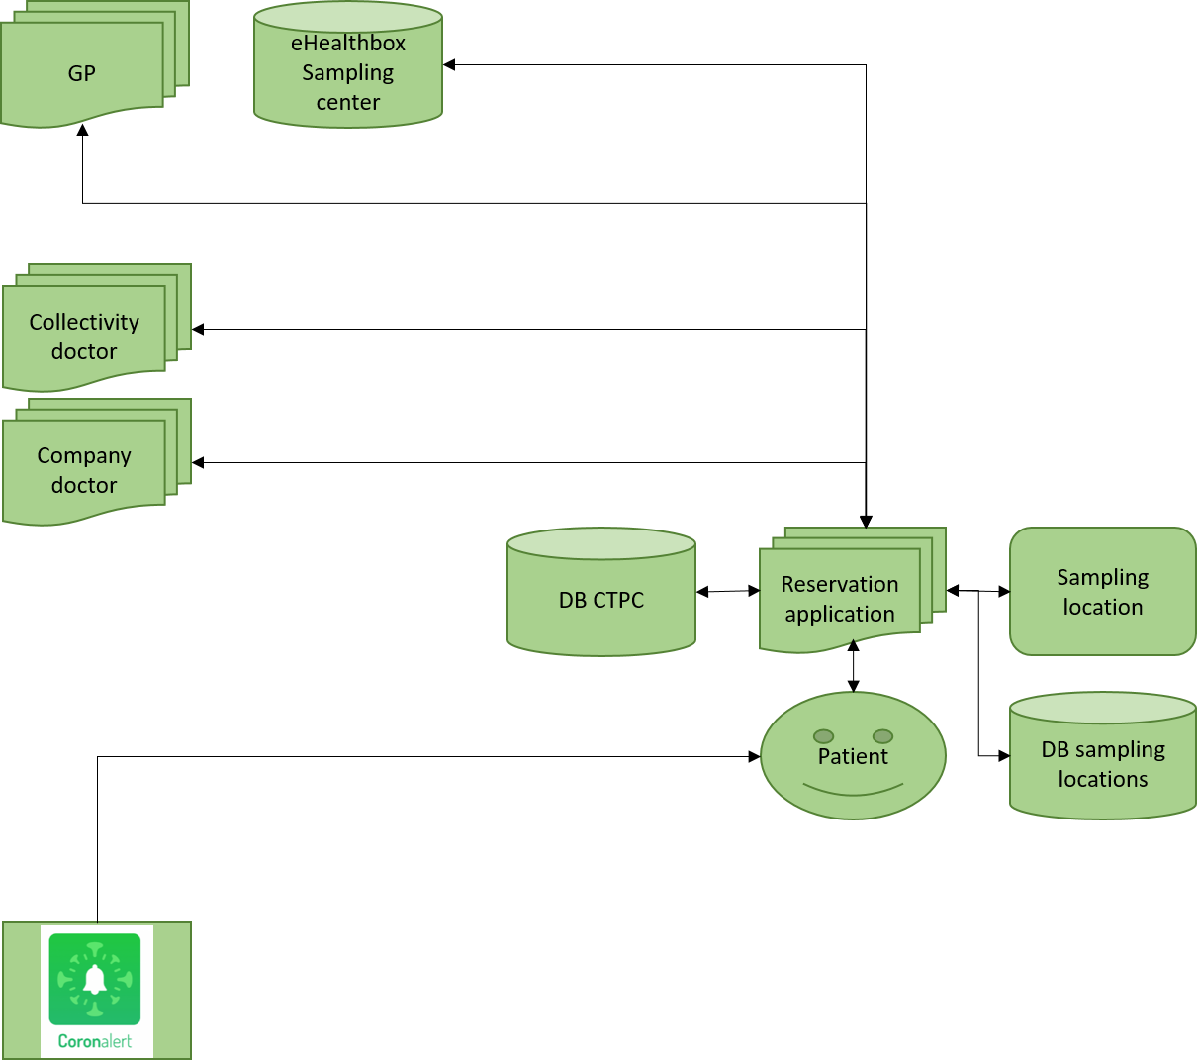
Testing: reservation of a sampling location and moment

Slide 14
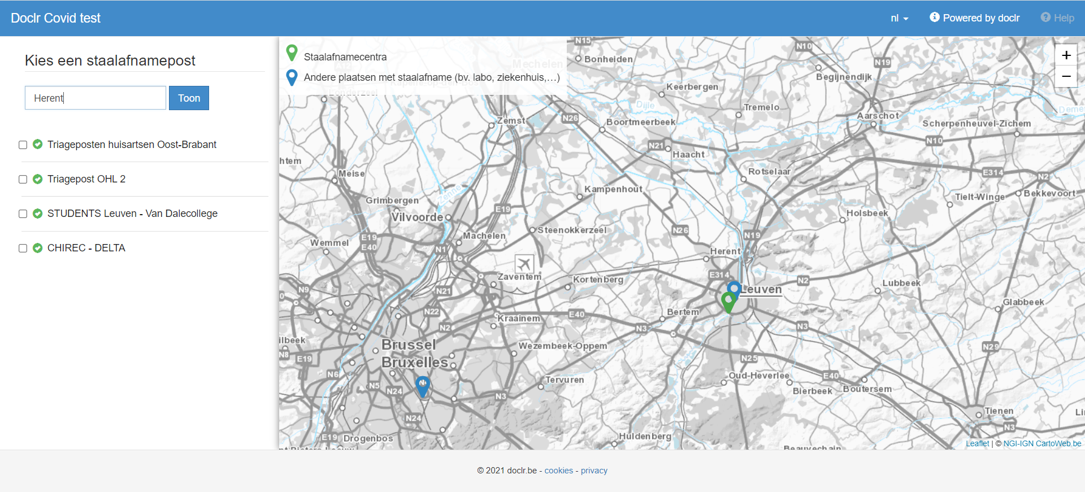
Testing: reservation of a sampling location and moment

Slide 15
Testing: sampling and execution of the test
Testing lab
DB CTPC
Sampling location
Patient

Slide 16
Testing: making the test results available
GP
DB Sciensano
DB test results lab
Patient
Testing lab
Collectivity doctor
Company doctor

Slide 17
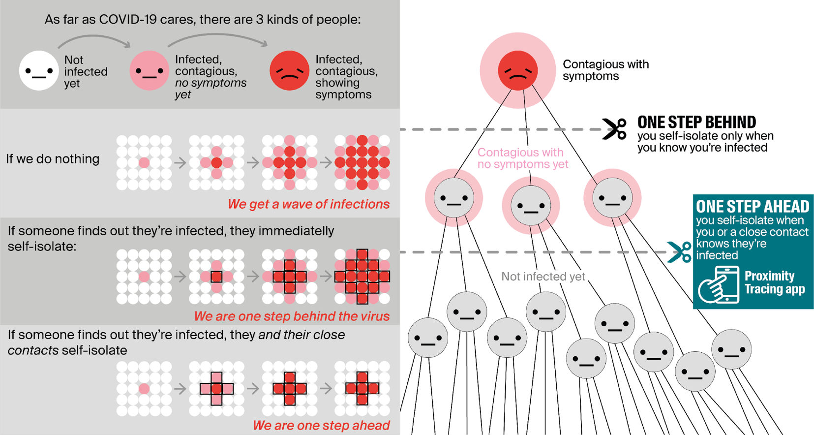
Contact tracing: why ?

Slide 18
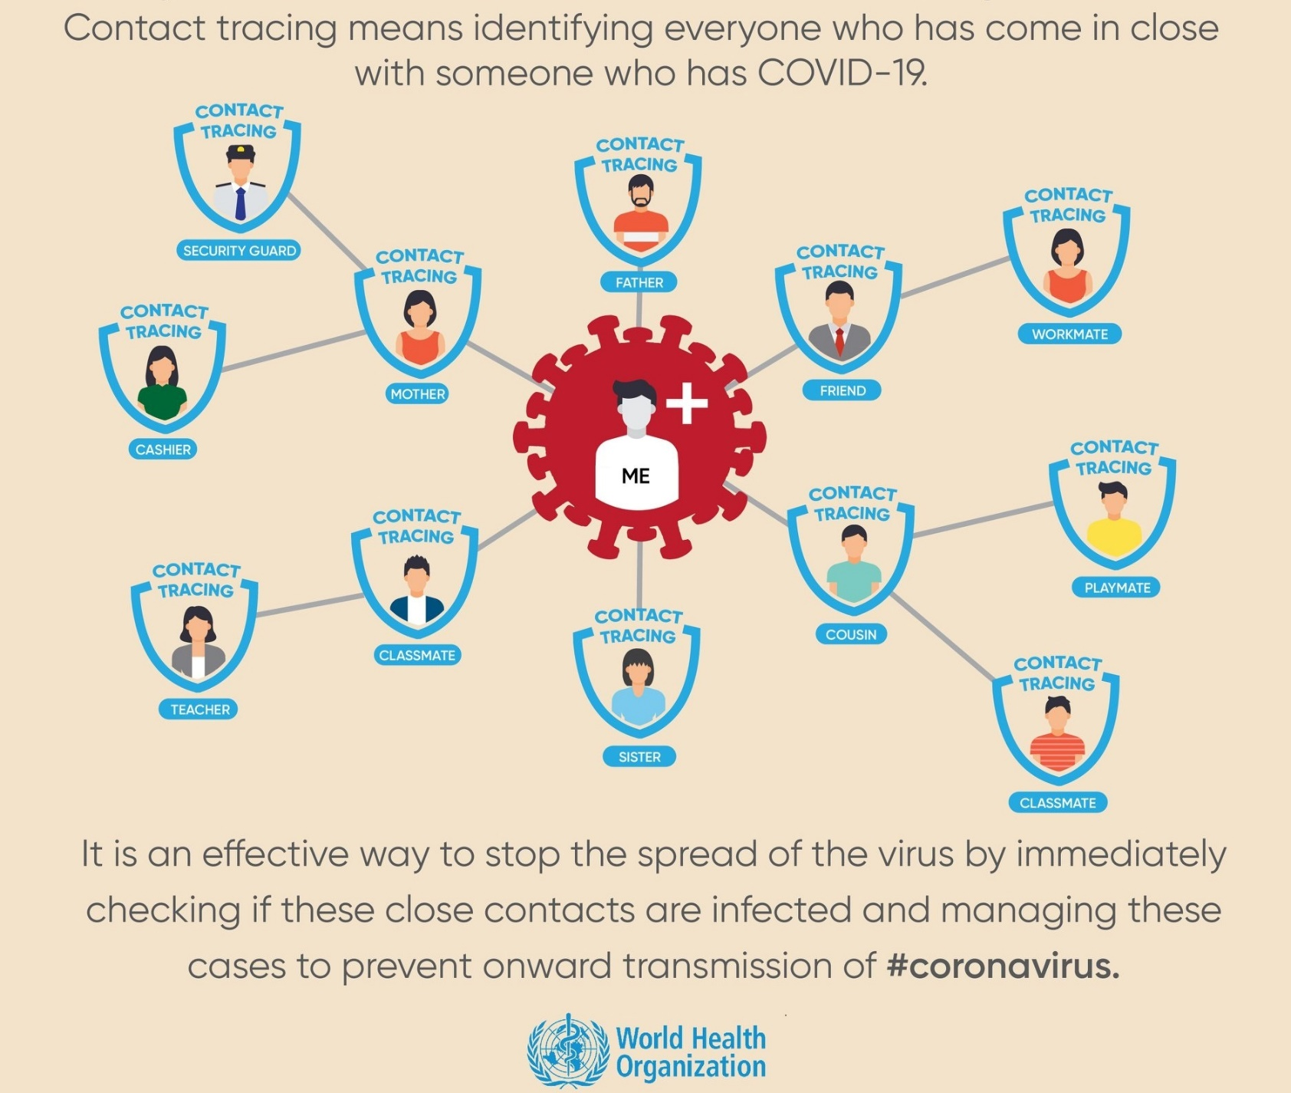
Contact tracing: what ?

Slide 19
How contact tracing is put in place ?
contact tracing by health care providers
contact tracing by contact centers
see https://www.corona-tracking.info/
contact tracing within companies and collectivities
see https://co-prev.be/nl/covid-19-informatie/ or https://co-prev.be/fr/covid-19-information/
contact tracing via app Coronalert
see https://coronalert.be/

Slide 20
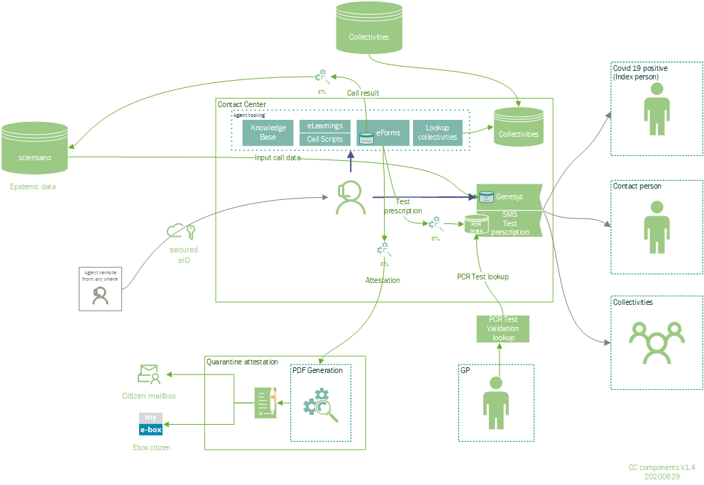
Contact tracing by contact centers

Slide 21
Contact tracing within companies and collectivities
call by contact center
identification of infected person (index case)
risk analysis
identification and triage of contacts (high risk – low risk)
contacting contacts
measures for contacts
high risk: quarantine – telework/unemployment – vigilance for symptoms
low risk: social distancing – vigilance for symptoms
resumption of work

Slide 22
App Coronalert

Slide 23
App Coronalert
installation
operation
RPIA3
RPIB4
RPIA1
RPIA2
RPIA3
RPIA4
RPIB1
RPIB2
RPIB3
RPIB4
Store
RPID1
RPIC2
TEKA
TEKB
TEKA
TEKB
RPID1
RPIC2
RPIC1
RPIC2
RPIC3
RPIC4
RPID1
RPID2
RPID3
RPID4
store
RPIA3
RPIC2
TEKD
Store
RPIA3
RPID1
TEKD
TEKC
TEKC

Slide 24
App Coronalert
test
proximity tracing
TEKD
TEKD
TEKD
TEKD
TEKD
Store
RPID1
RPIC2
TEKA
TEKB
test result
TEKD
TEKD
Store
RPIA3
RPIC2
TEKD
Store
RPIA3
RPID1
TEK*
TEKC

Slide 25
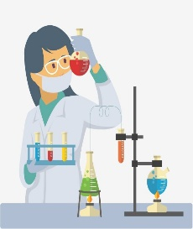
App Coronalert
Details: GP visit
RAG: Date patient became infectious
= two days before onset of symptoms
or = two days before day of test (if asymptomatic)
Do you have symptoms?
If yes: day of onset of symptoms?
test result
test result
Date (infectious)
Test number (15+2)
INSZ
Date (infectious)
Test number (15+2)
specimen
TEKD
2 check digits to detect typos

Slide 26
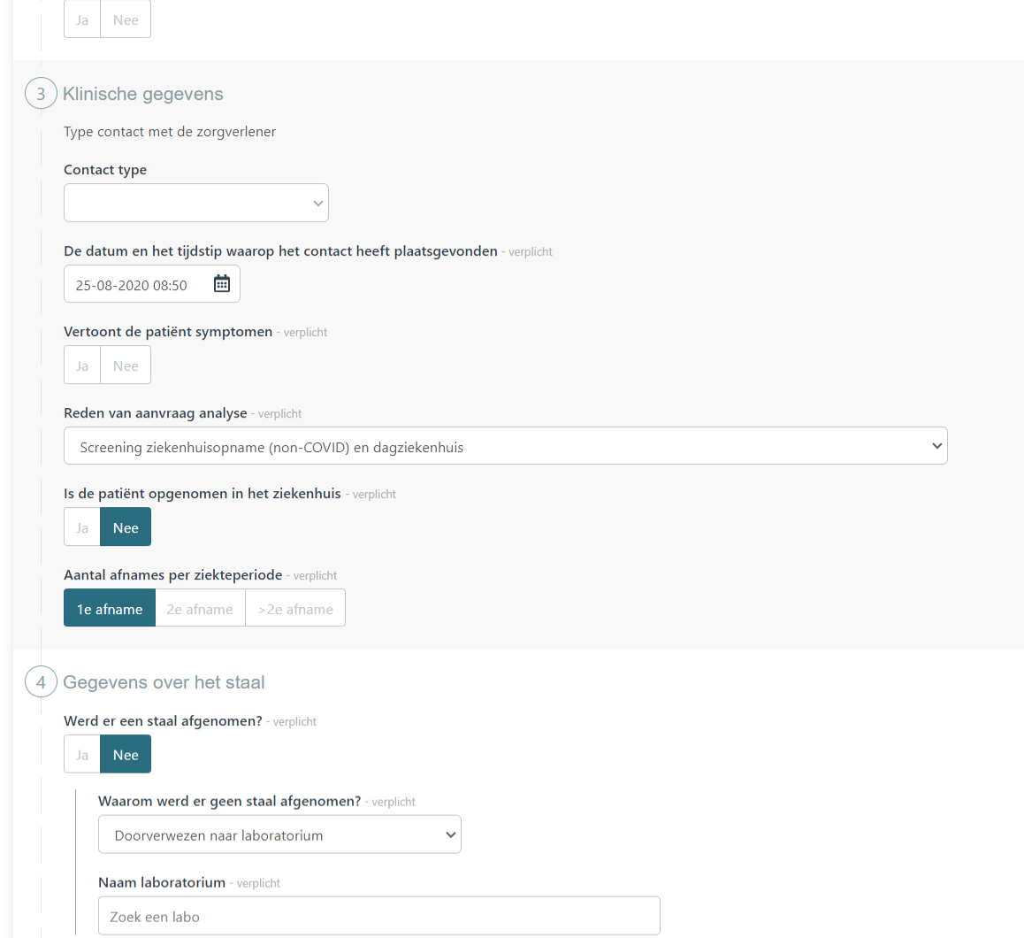
eForm COVID-19 lab request (1/2)

Slide 27
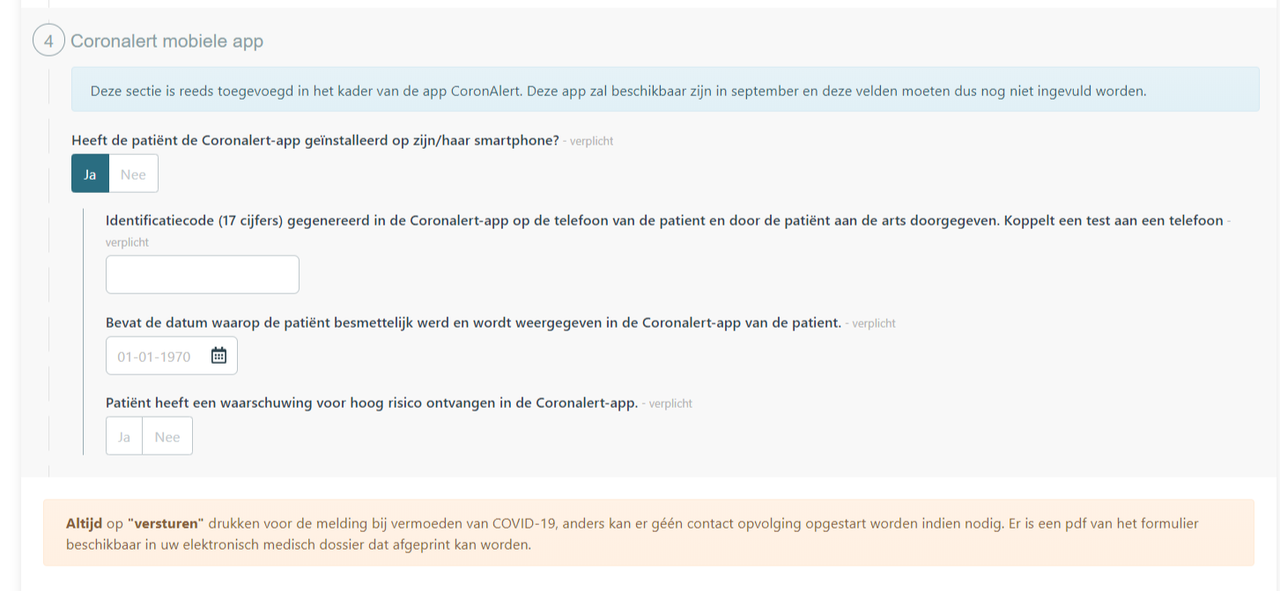
eForm COVID-19 lab request (2/2)

Slide 28
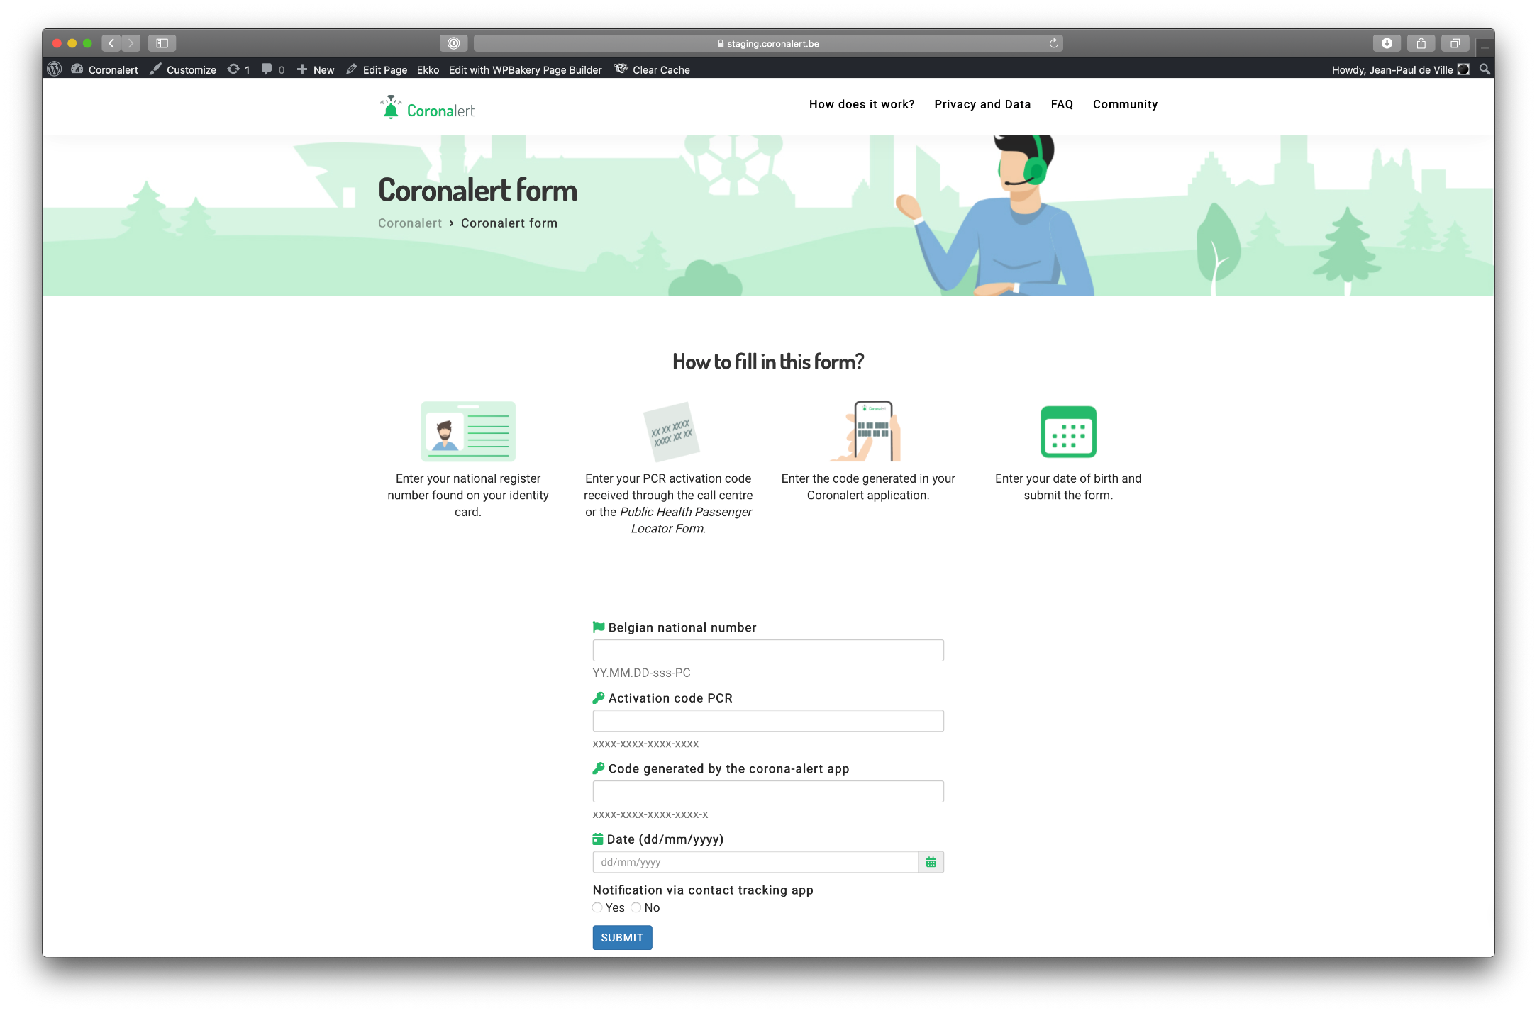
App Coronalert
Details: webform for user

Slide 29
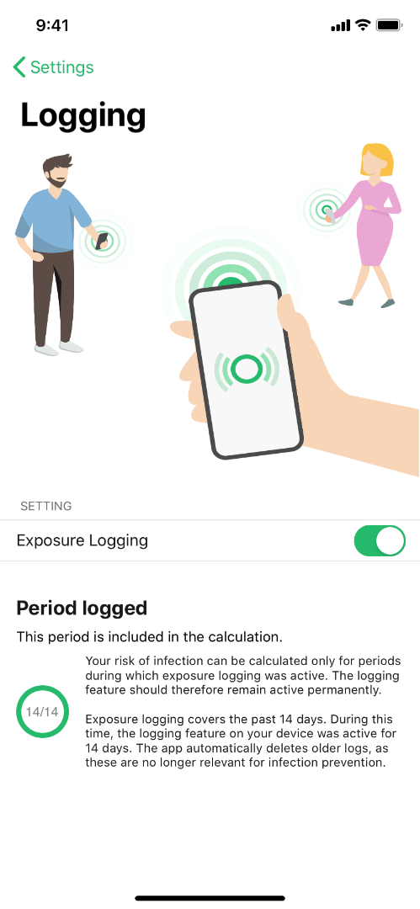
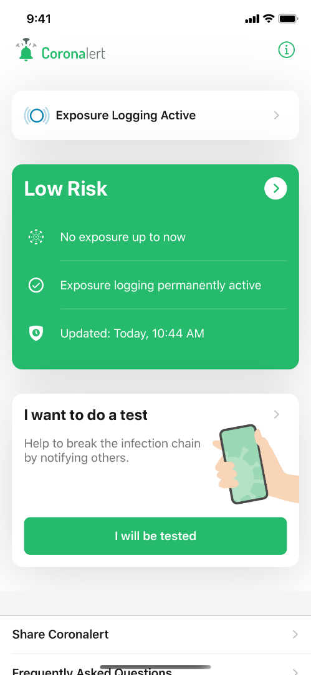
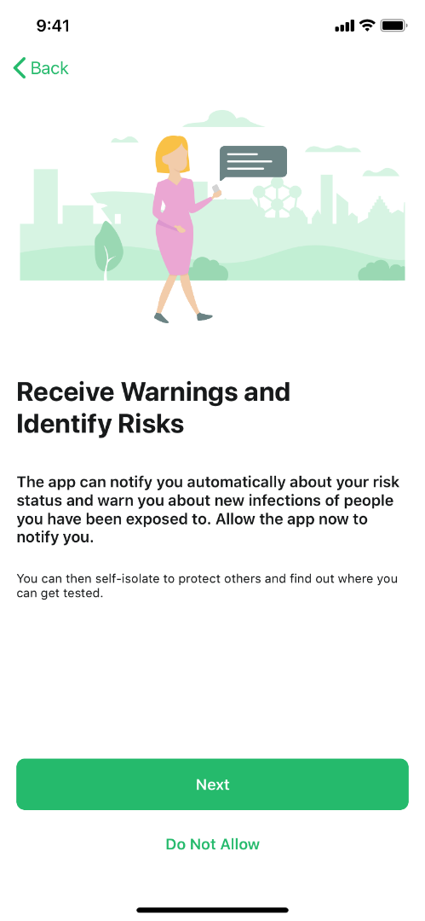
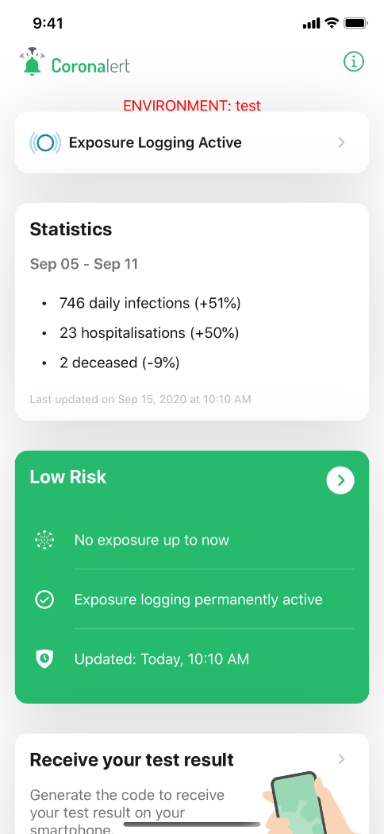
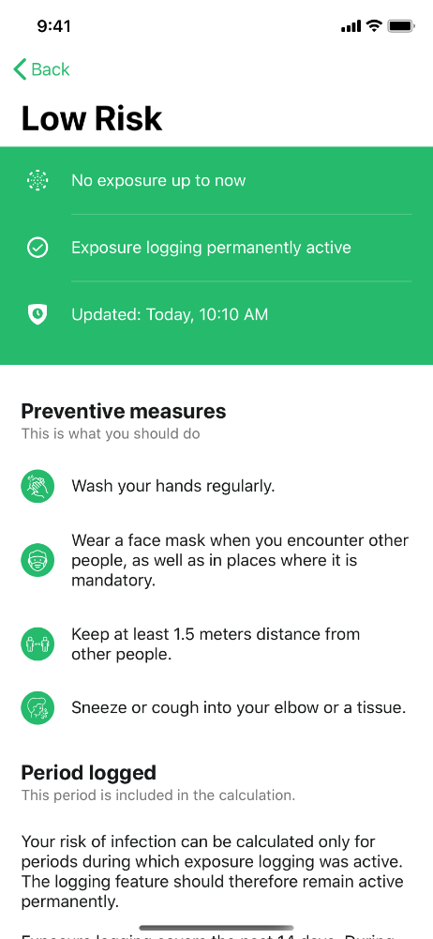
App Coronalert: put your phone to work

Slide 30
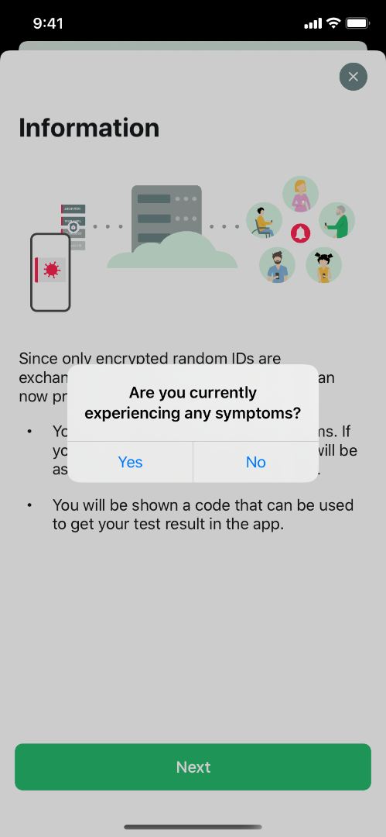
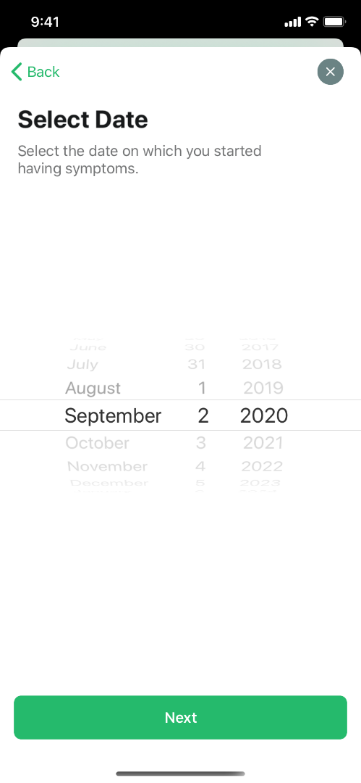
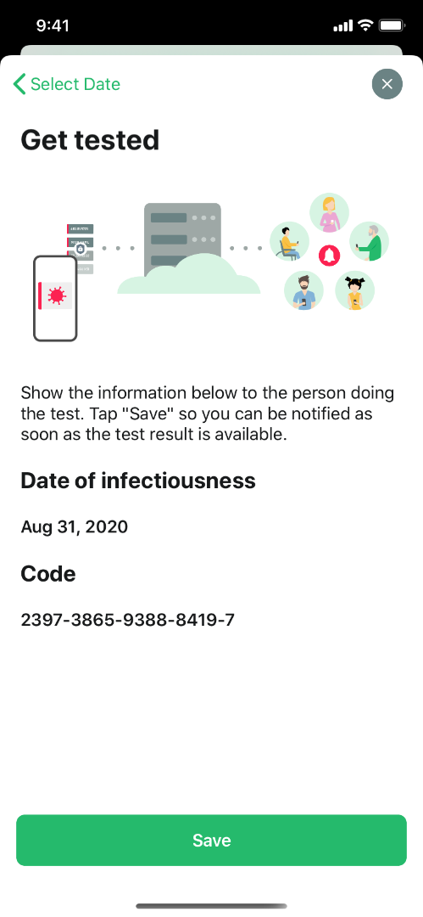
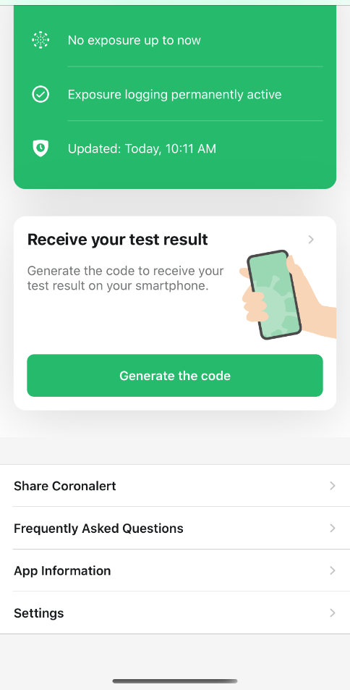
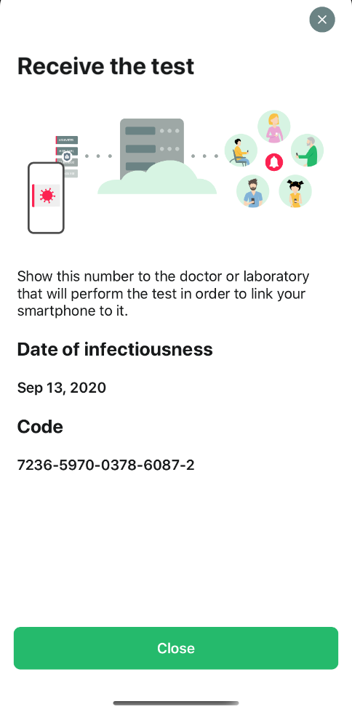
App Coronalert: get tested

Slide 31
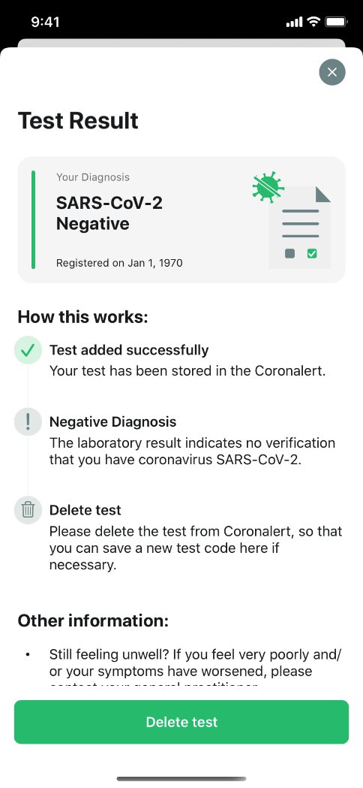
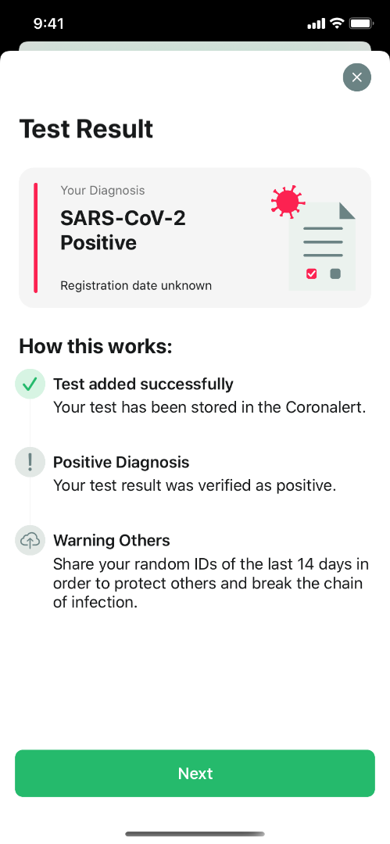
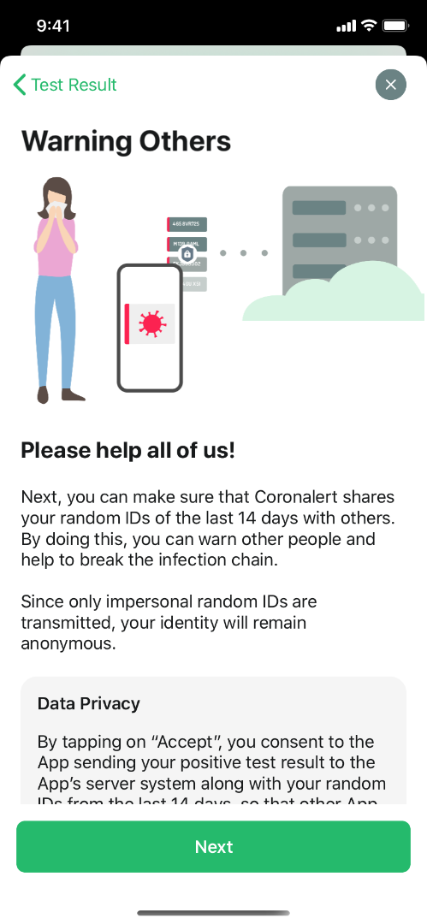
App Coronalert: test result

Slide 32
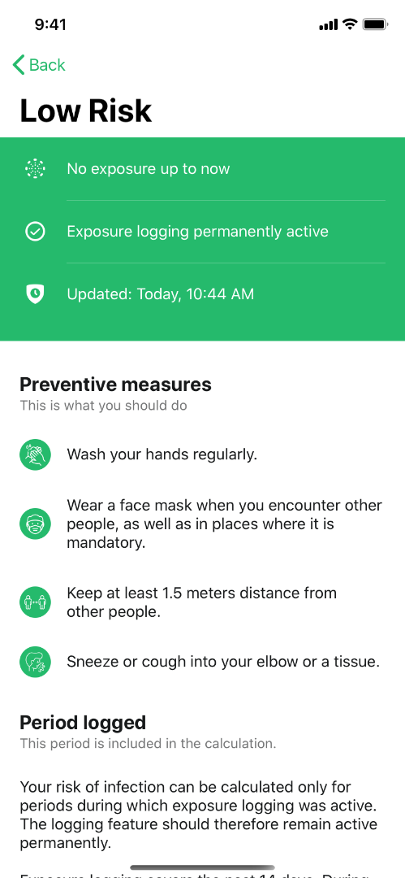
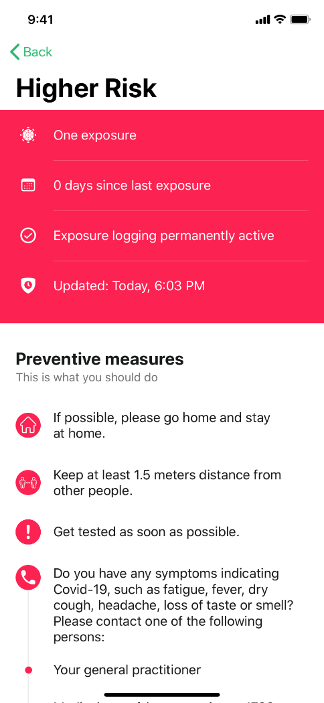
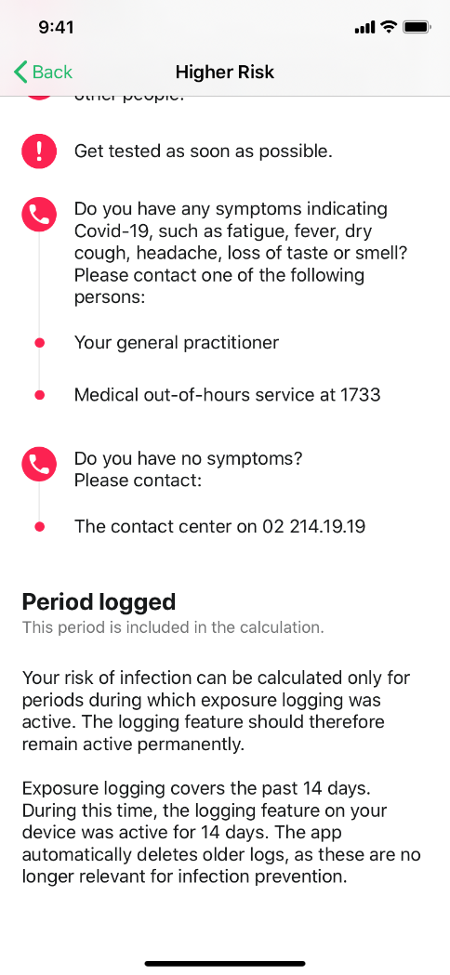
App Coronalert: be notified

Slide 33
App Coronalert
recommend the use of the app
exchange of anonymous codes by the app can be deactivated and reactivated
generate a test code with the app if you are tested and ensure that it ends up at Sciensano together with your social security identification number => you will receive your test result on the app as soon as it is available
general practitioner via eForm LaboratoryTestPrescription
person to be tested via webform (see https://coronalert.be/nl/coronalert-formulier/)
publish the transmitted anonymous codes if you test positively

Slide 34
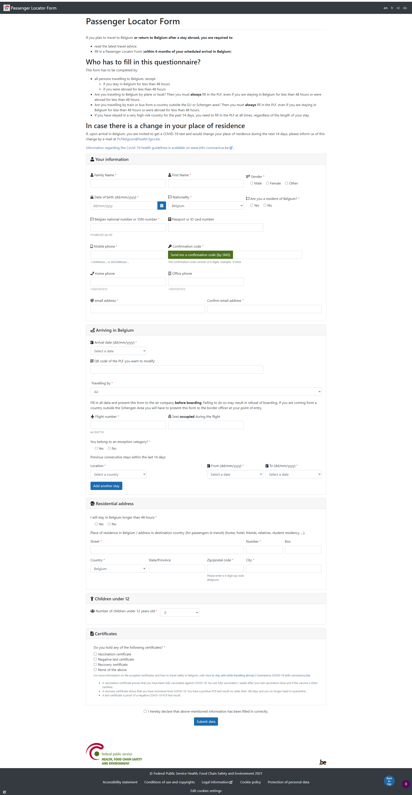
Passenger Locator Form

Slide 35
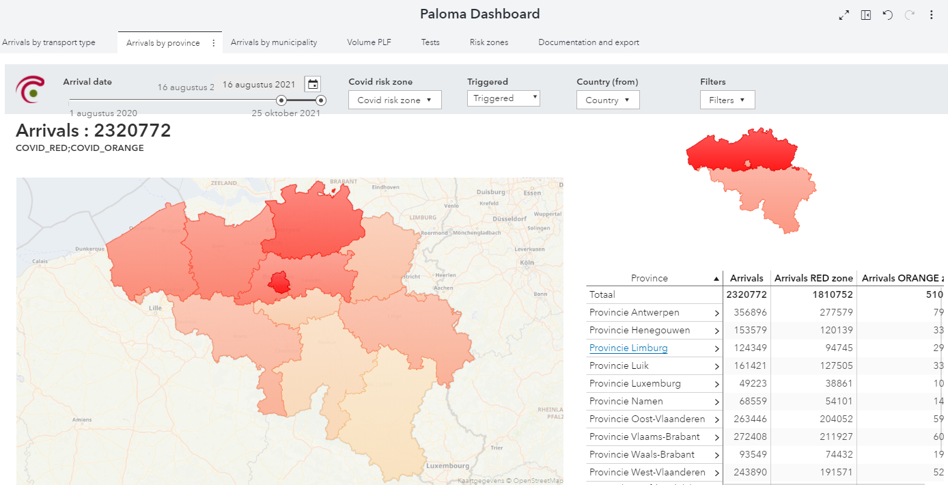
Paloma

Slide 36
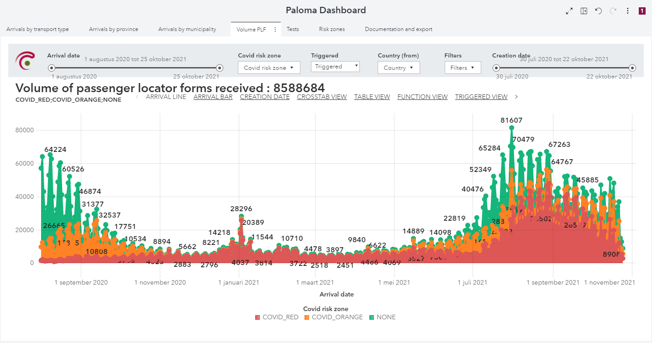
Paloma

Slide 37
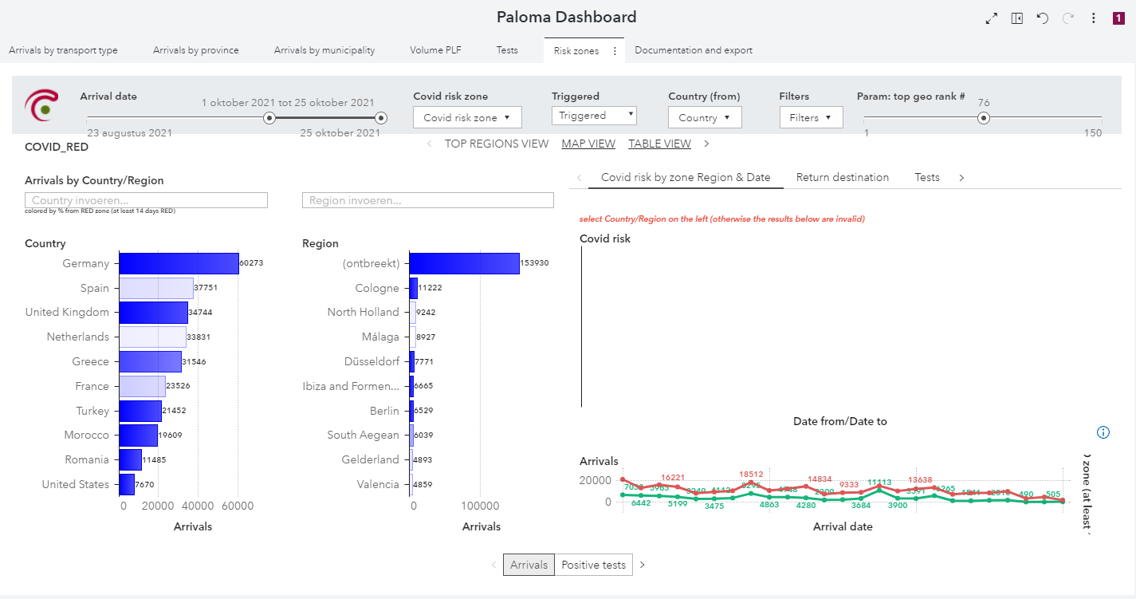
Paloma

Slide 38
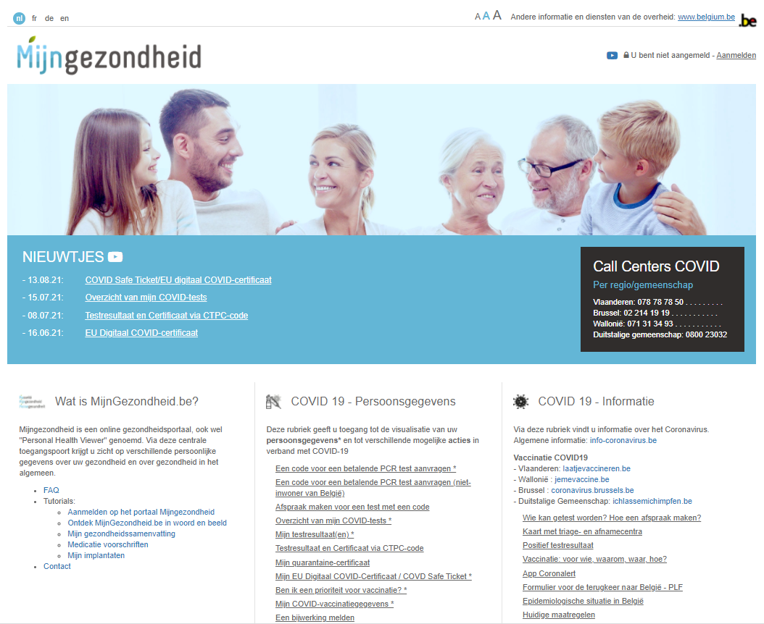
Integrated citizen portal

Slide 39
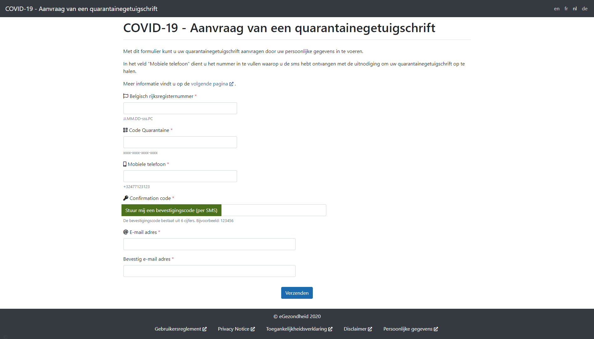
Integrated citizen portal

Slide 40
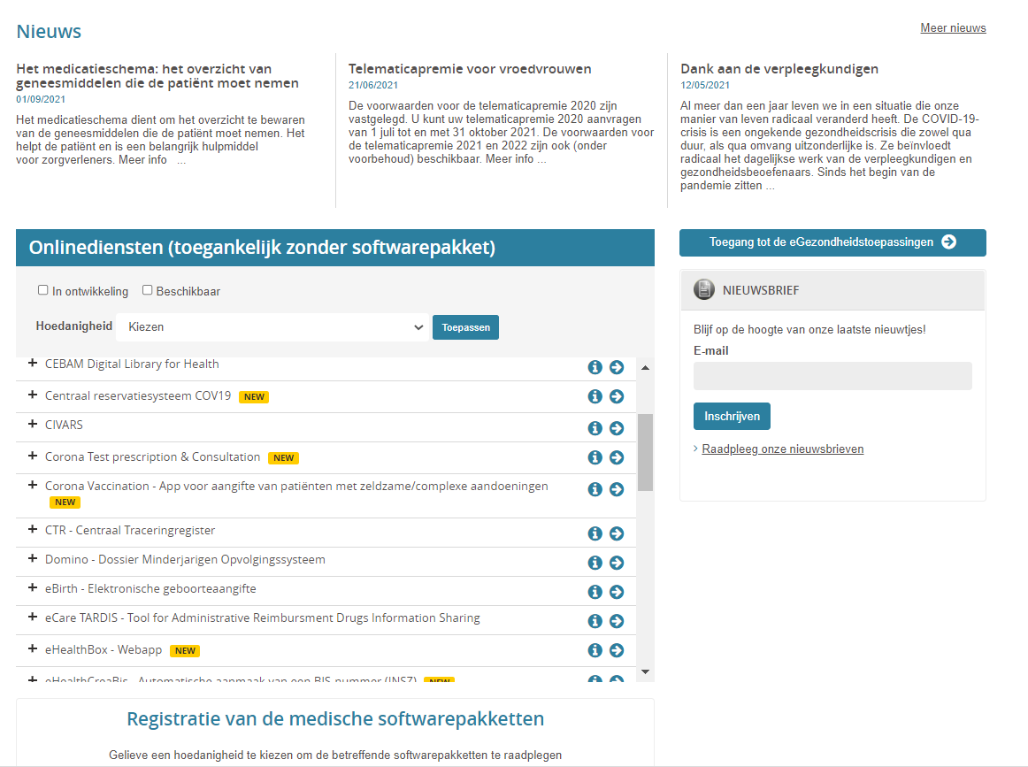
Integrated portal for health care providers

Slide 41
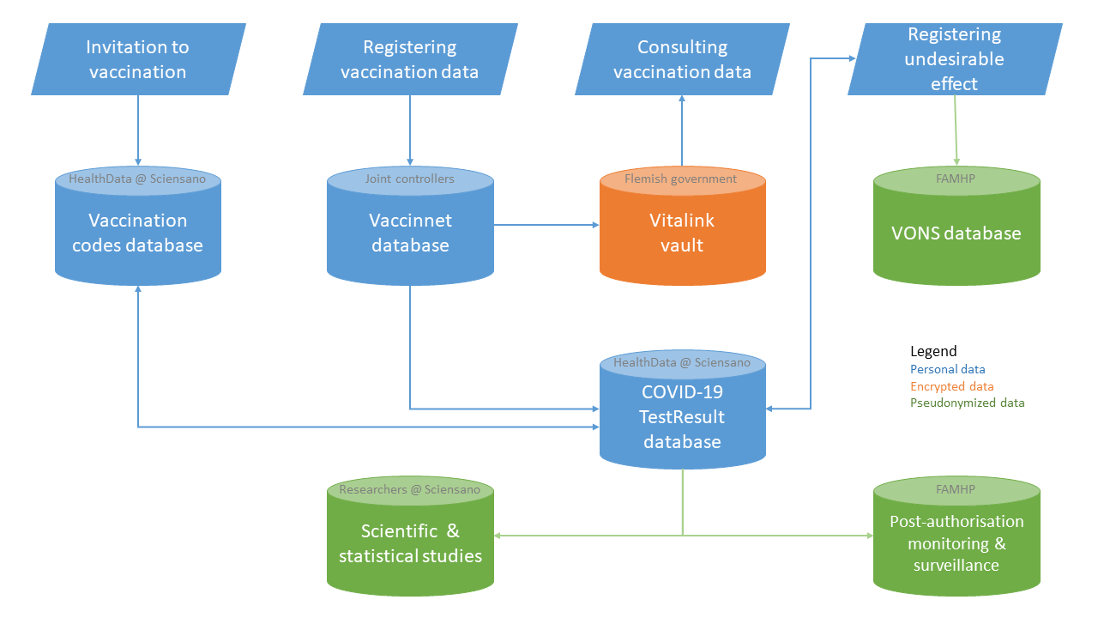
Vaccination

Slide 42
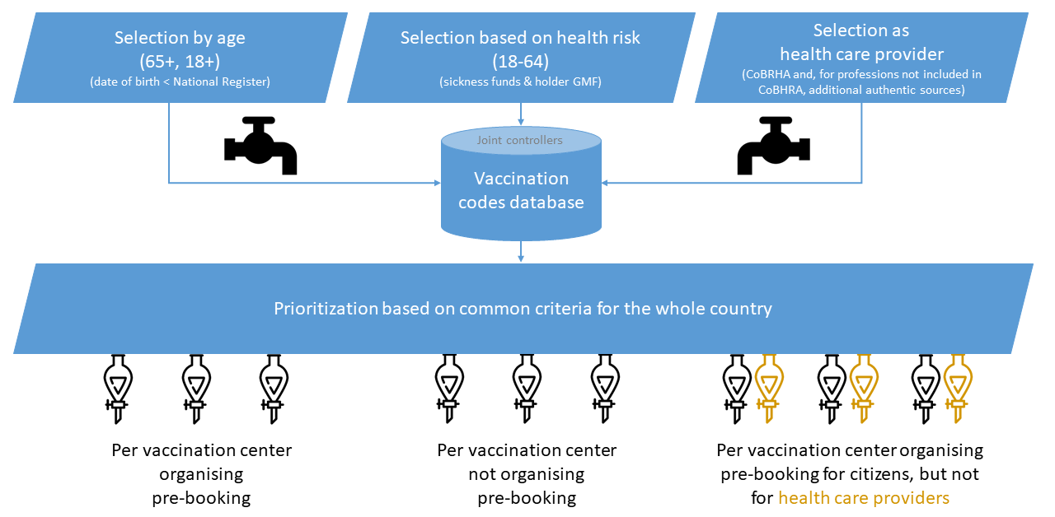
Vaccination

Slide 43
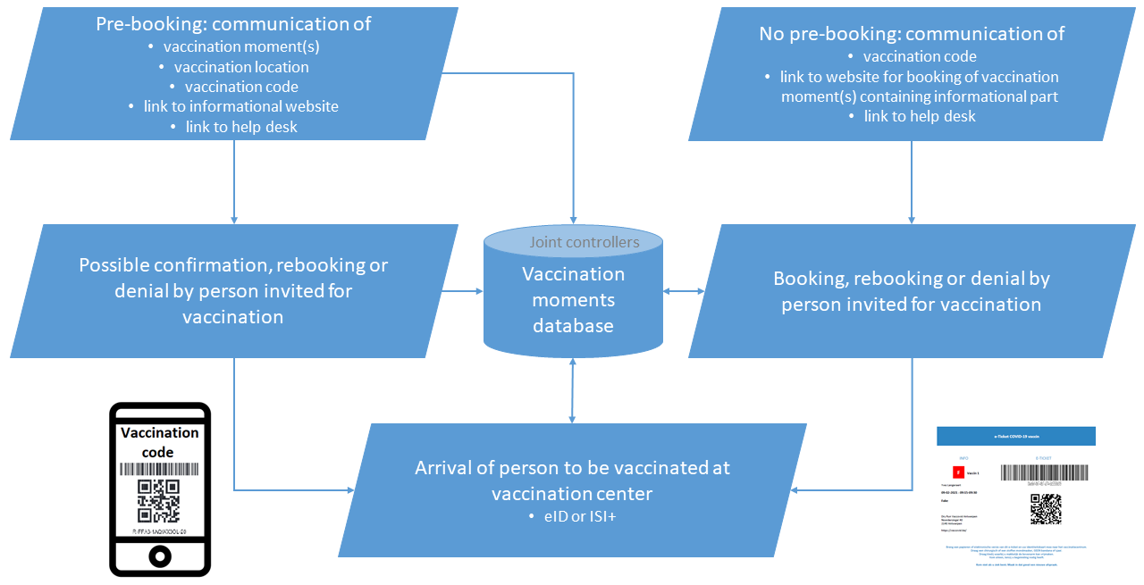
Vaccination

Slide 44
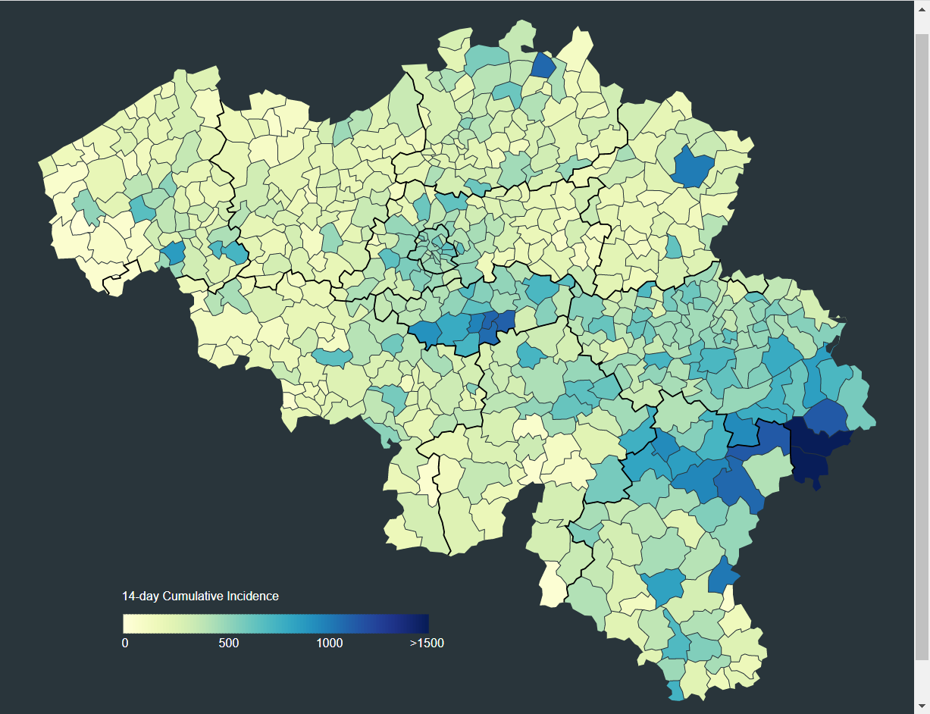
Dashboards
COVID-19 Epidemiological Situation per municipality

Slide 45
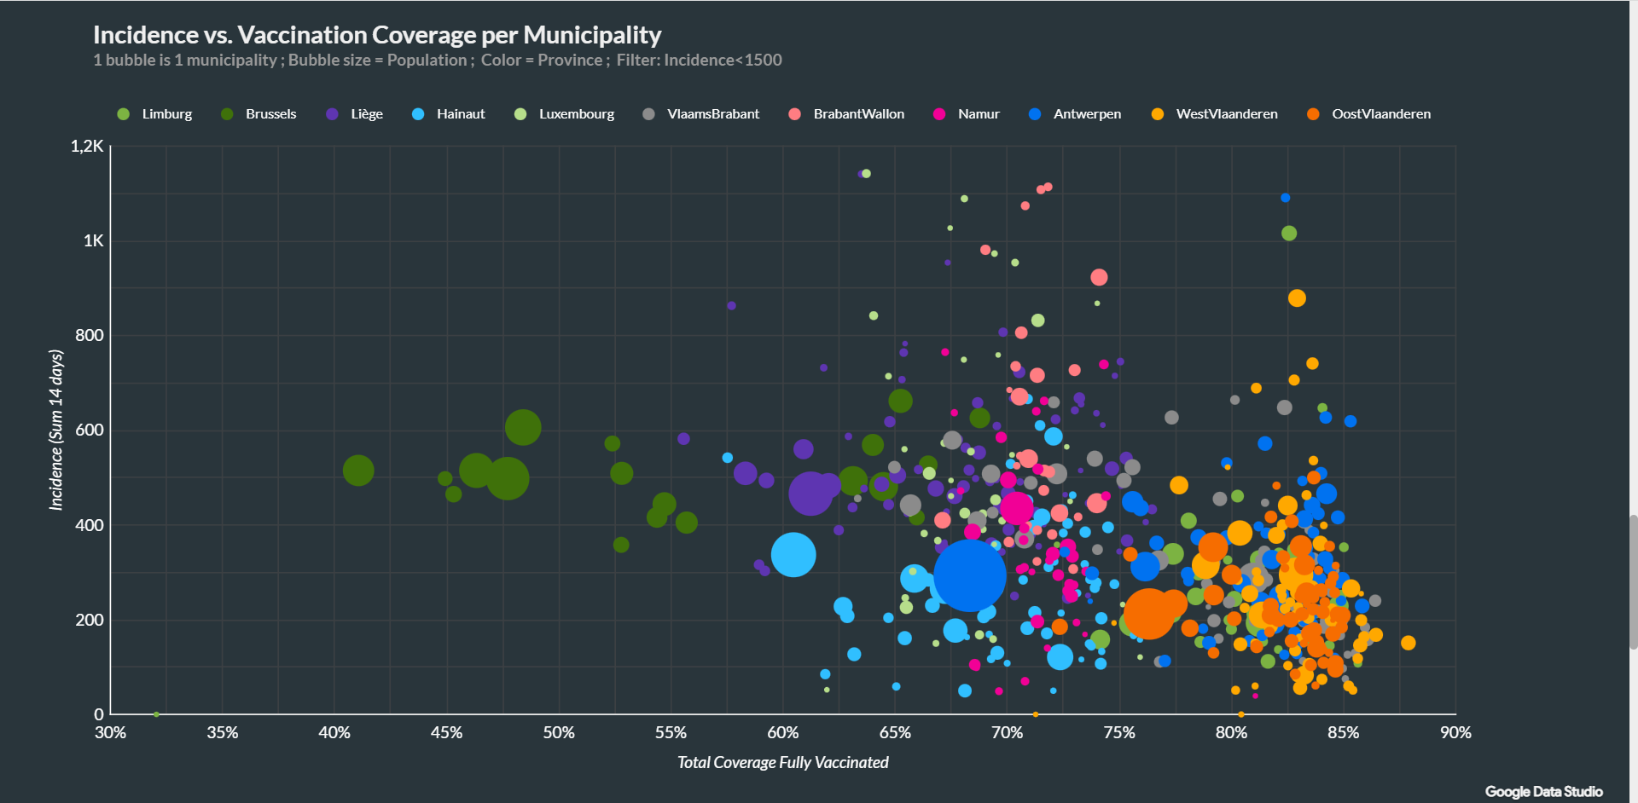
Dashboards

Slide 46
Big data analysis
https://fair.healthdata.be/

