Slide 1

ICT als enabler en als utility

Slide 2
Plan van de uiteenzetting
ICT als enabler
  enkele focusgebieden
    sharing a reuse
    API (Application Programming Interface)
    end-to-end automation
    artificial intelligence
ICT als utility
  enkele focusgebieden
besluit

Slide 3
ICT als enabler

Slide 4
Mogelijke strategische voordelen
informatie is, naast menselijk kapitaal, infrastructuur en financiële middelen, zowat de belangrijkste productiefactor voor de overheidsdiensten
  => aandacht voor effectief en efficiënt informatiebeheer is kritische succesfactor
klanten wensen geïntegreerde dienstverlening aangepast aan hun persoonlijke behoeften met minimale kosten en lasten
  aandacht vooral voor coöperatieve strategische voordelen door effectief en efficiënt informatiebeheer
    competitief: behalen of behouden van langdurige onderscheidende voordelen tov concurrerende organisaties
    coöperatief: betere langdurige verwezenlijking van de doelstellingen van de eigen organisatie en/of de sector door samenwerking met andere organisaties

Slide 5
Mogelijke strategische voordelen
grotere effectiviteit van strategie
hogere return on investment
  lagere kosten
  hogere opbrengsten
efficiëntere processen
hogere kwaliteit
hogere klantentevredenheid
grotere aanpasbaarheid van de diensten
grotere reikwijdte en penetratiegraad van de dienstverlening
meer innovatie
…

Slide 6
Soms zelfs erg disruptief
voorbeelden
  muziek- en fotoindustrie (digitale distributie)
  media
  hotelsector (bv. Airbnb)
  vervoer (bv. zelfrijdende auto’s, Uber)
  banken (bv. bitcoin)
  gezondheid
sectoren vervagen: Google, Tesla, …
vaak ook impact op tal van aspecten, bv. zelfrijdende wagen
  wat is verzekeringspremie ?
  wie is aansprakelijk bij een ongeval ?

Slide 7

Wisselwerking
ICT enables business, effectiveness, efficiency, innovation
Business drives, empowers and
invests in ICT

Slide 8


Hou in het achterhoofd
Op school mocht ik niet afkijken of afschrijven, en moest ik minstens 50% halen
In het echte leven mag ik afkijken en afschrijven zoveel ik wil, en probeer ik 100% te halen

Slide 9


Focus area: sharing & reuse

Slide 10


Different types of sharing & reuse
infrastructure
  hard infrastructure
  soft infrastructure
  platforms
common vendor contracts
federal ICT community
business
  knowledge & experiences
  business functionality
  business data
  complete business services
Important to know what already exists
→ catalogues!

Slide 11
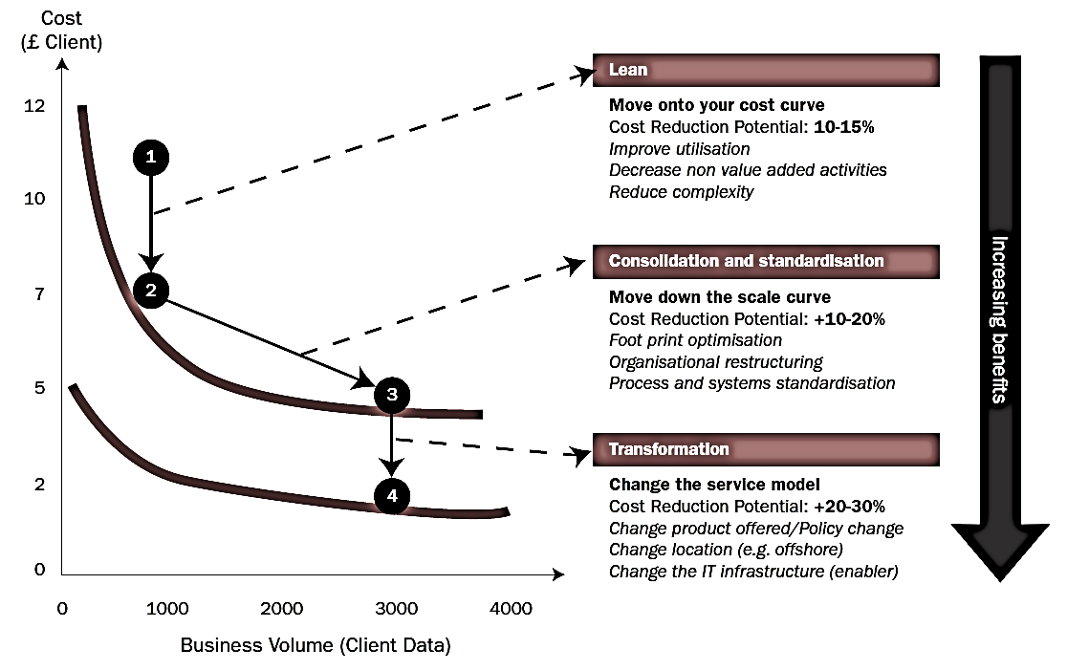
Synergies - transformations

Slide 12








Cloud deployment types
Hybrid
Public Cloud
Shared
Access/Control
Outsourced Community Cloud (= off-premise)
Community Cloud on-premise
Private Cloud on-premise
Outsourced Private Cloud (= off-premise)
Dedicated
Customer
Location
Service Provider

Slide 13
G-Cloud portfolio

Slide 14




G-Cloud
Procurement
Cooperationá
Efficiencyá
Projects
Synergy
Services
Costsâ
Qualityá
Know-how & Expertise
Notes:
Maximum synergy when possible and when generating efficiency gains and/or savings while maintaining or improving the quality of the services provided to the customer
In line with the synergy program: assignment to the one who is the most capable of proposing a form of shared services
Synergy based on result orientation, sense of responsibility and trust

Slide 15
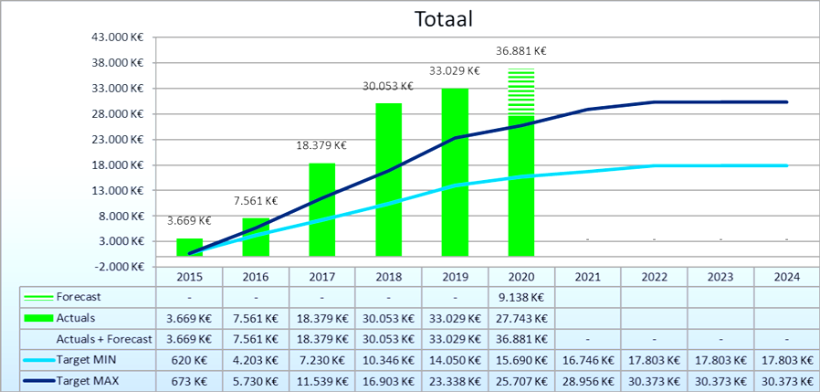
G-Cloud ROI

Slide 16

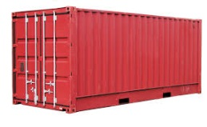
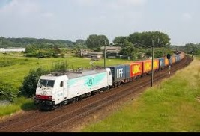
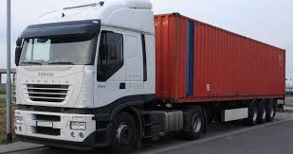






PaaS in G-Cloud - containers
introducing container technology
translated into modern technology such as Platform-as-a-Service
Individuele
inhoud
Easy to move around
Individual content
Isolated storage
Geïsoleerd opgeslagen
En makkelijk verplaatsbaar
Monitoring
Security
Logging
Coming
soon

Slide 17

New ways of cooperation
Government ecosystem
Other sectors
Components
parts
Application
1
Application
2
Application
N
Partner
1
Partner
2
Partner
N
Platform
cooperation
DB
DB
Technological cooperation
DB
DB
DB

Slide 18
Rise of (public) cloud
need for overall positioning
  public cloud policy
  based on information classification
  appropriate organizational, technical & contractual measures
  hybrid approach
G-Cloud as broker
  knowledge & expertise on cloud offerings
  contracts & implementation partners
  tools

Slide 19
Public cloud - main issues
longitudinal confidentiality of personal data
  need for comprehensive longitudinal encryption of personal data
  in motion, at rest and in use
performant continuous availability of application and data
easy migration of applications and data
compliance with GDPR

Slide 20

Shifting focus
towards synergies in the area of business components
Business components
Stronger centrally coordinated approach to offering platforms

Slide 21
About the initiative
initiative within the public social security institutions & Smals
purpose
  synergy around (technical) business components
  and thus save costs by avoiding multiple development of components
regardless of whether development takes place by
  the institution's own ICT department
  Smals
  subcontractors
creation of a competence center within Smals in order to maximally integrate and support the reuse of business components within Smals, its members, partners and domains in which Smals is active
21

Slide 22

Reuse: vision
Every stakeholder
can easily find the most common reusable elements in a centralized catalogue
Processes
and tools are put in place to identify, register, implement, monitor and measure reuse throughout the project lifecycle
Human
networks are maintained and developed on all levels (CEO’s, CIO’s, business owners, business analysts, architects) in order to keep maximum visibility on reuse potential
A culture
develops where
reuse is adopted and the creation of reusable products is promoted,
22

Slide 23

Value
Value
library
framework
product
system
Offered “business” functionality
23

Slide 24


























So… dare to share! ☺
Framework
Library
Product
Service
System
24

Slide 25

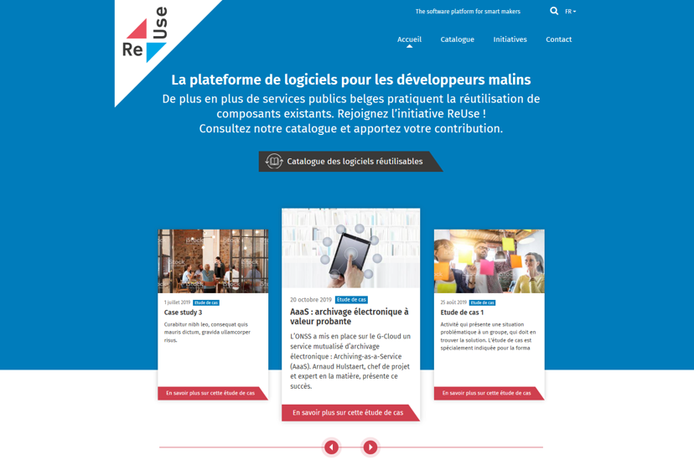
How ? with the new Software Reuse Platform !
https://www.ict-reuse.be
25

Slide 26
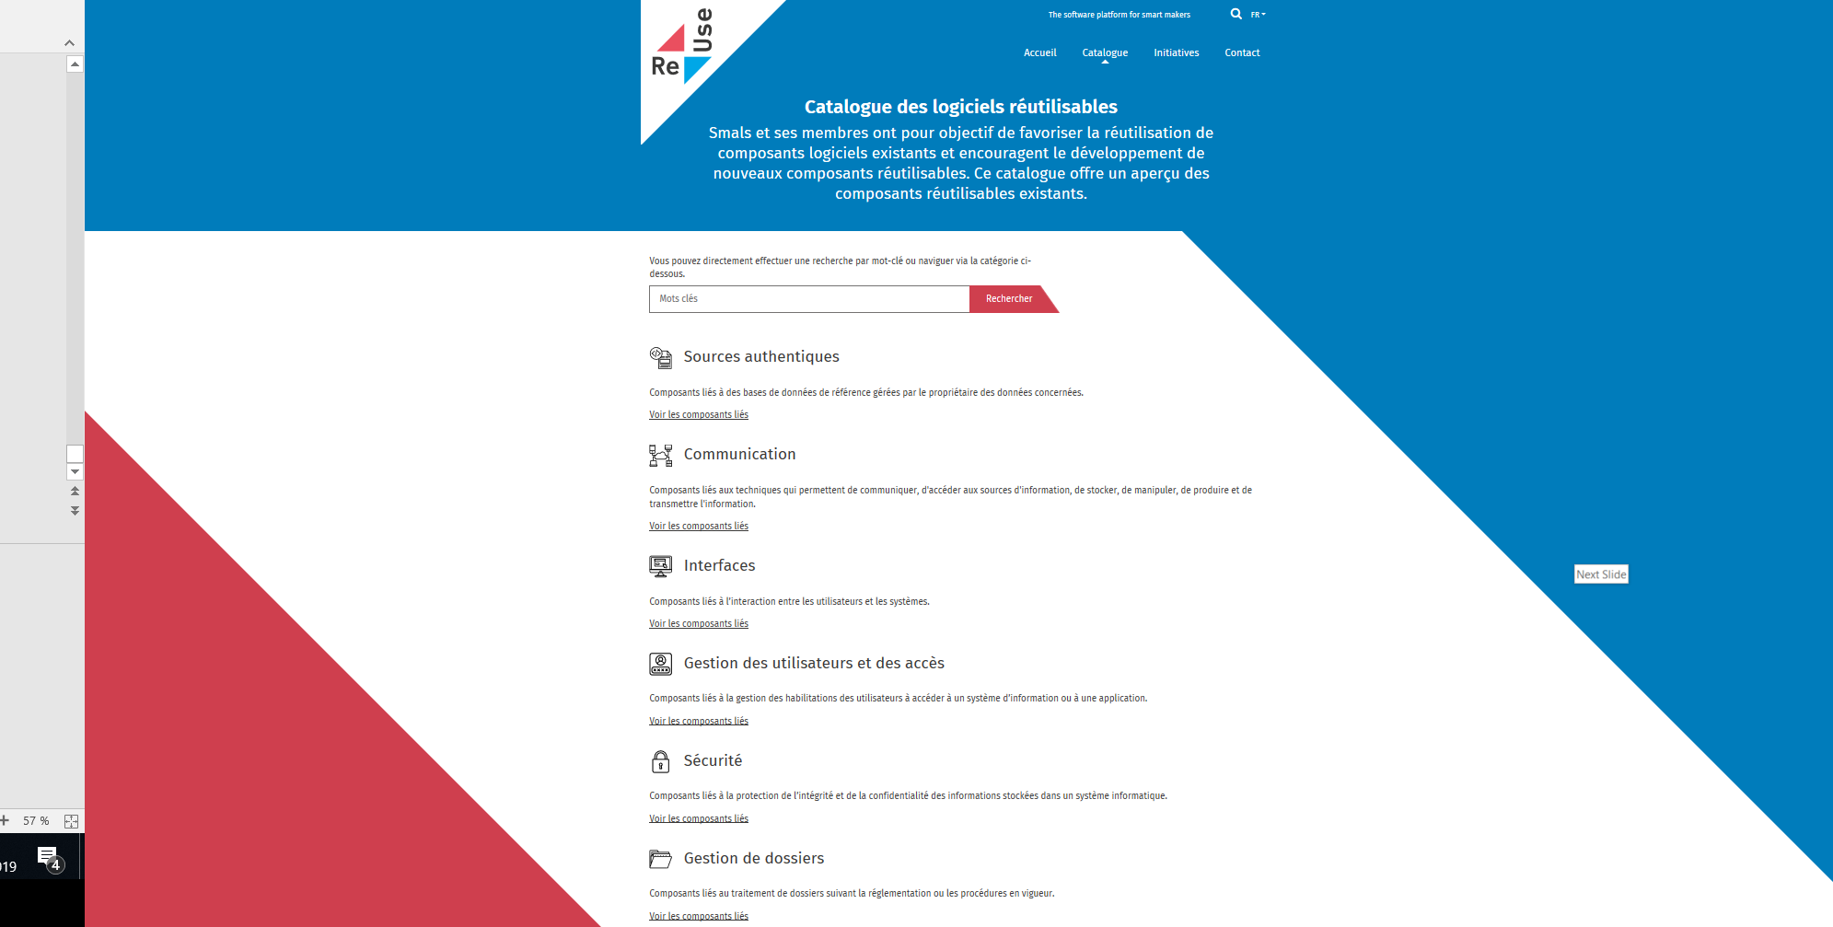
New project?
consult the
Software Reuse
Catalogue

Slide 27
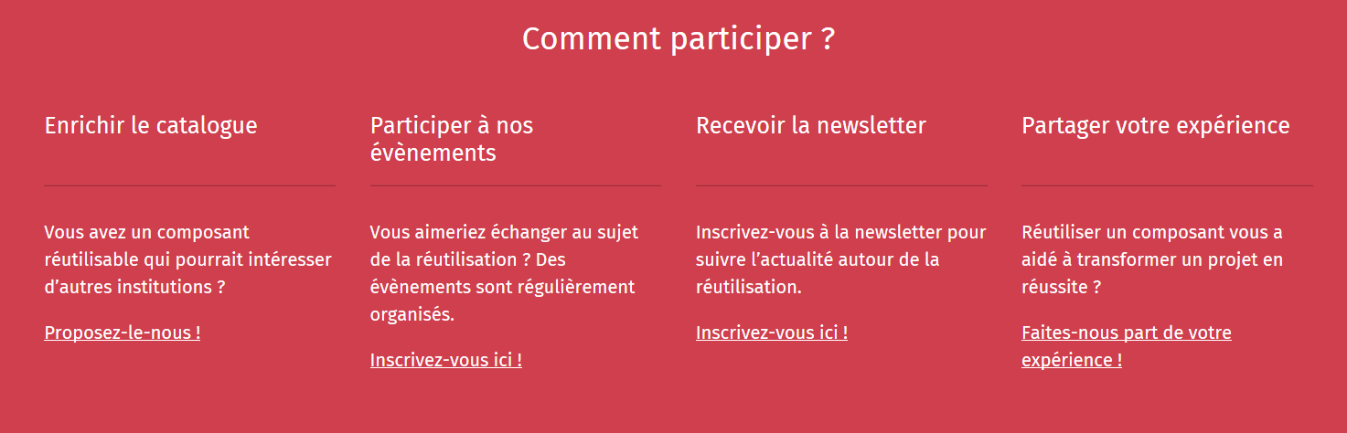
Share your success stories...and become an ambassador for reuse!
https://www.ict-reuse.be
27

Slide 28
ROI of reuse
you can only improve what you measure
reuse is embedded in the "project life cycle" of projects carried out by Smals
this makes it possible to compare the project cost without reuse and with reuse and to calculate the ROI
28

Slide 29
ROI 2019 for projects carried out by Smals
23%
54%
35%
reusable
Reused
ROI
10.000.000 €
29

Slide 30
Focus area: API

Slide 31

API - Application Programming Interface
an API is a programmatic interface to data or some set of functionality
thanks to API’s it is possible to use the data or functionality behind it and continue to build on it
API = a software building block

Slide 32
About API - Application Programming Interface
providers vs consumers
  when an API is offered over a network, the service that offers the API is called the “provider”
  the “consumer” of the API is often a software application
the consumer may outsource the requirement for data or functionality by “calling” API’s
  billing
  identity
  storing
  image processing
  all sort of (authentic) data sources
  …

Slide 33
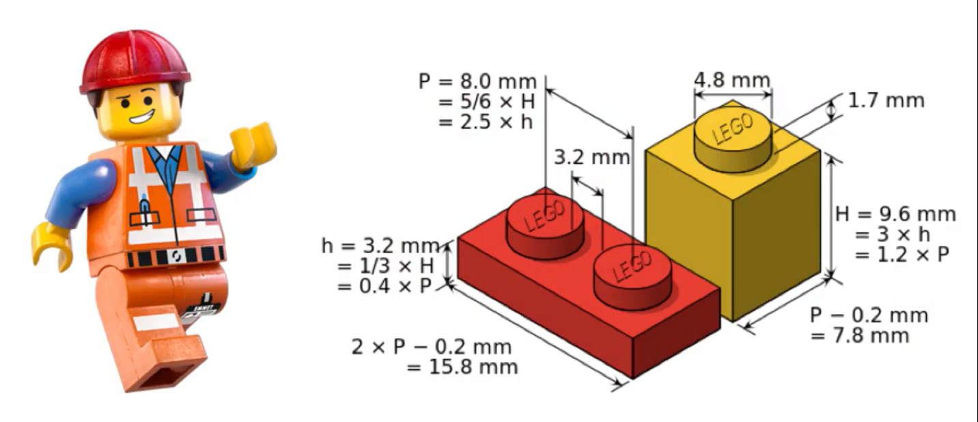
About API - Application Programming Interface
consumers can connect to an API of a provider and use its data or functionality as long as the “technical contract” has been respected
consumers don’t need to know the technical details behind the functionality
API’s can be written in any possible programming language

Slide 34
Why are API’s important ?
cost reduction by reusability: consumers don’t need to rewrite what already exists!
complexity reduction: no more big, monolithic systems
decoupling: consumers and providers can continue to connect as long as the technical contract is followed → ex. less impact in case of migrations
driver of innovation: new products arise, based on existing API capability
stimulation of partnerships
stimulation of standardization

Slide 35
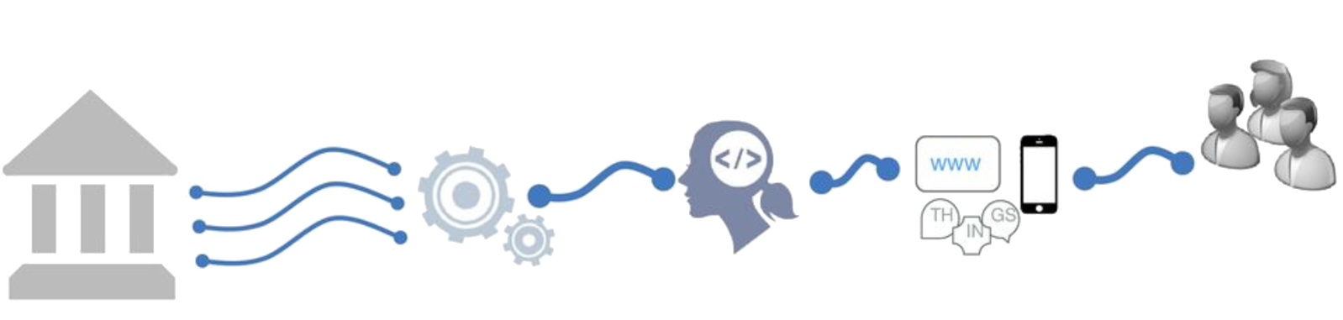
Shifting to an API economy: the value chain
To create new innovative apps and services
Made available as API
Differentiated
services
Self service
use by developers
Existing
Systems

Slide 36
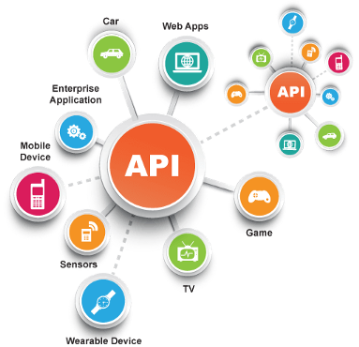
Today the API economy is a becoming a reality
Everything connects to everything

Slide 37



Example: realtime presence registration for construction workers
API
WEB
Notes:
Backend checks of the employment declaration, constructions sites, Limosa, (temporal work permits),
> 500.000 euro
Checkinatwork is de onlinedienst voor de aanwezigheidsregistratie bij werken in onroerende staat en activiteiten die behoren tot de vleessector. Het gaat om de registratie van:
iedereen die werken in onroerende staat uitvoert op een werkplaats waarvan de totale kost gelijk is aan of hoger is dan een specifiek drempelbedrag, en
iedereen die activiteiten uitvoert in verband met vleesbereidingen of vleesproducten en het slachten of uitsnijden van hoefdieren, gevogelte en konijnen in inrichtingen onderworpen aan de erkenning (erkenningen, toelatingen en voorafgaande registraties) van het Federaal Agentschap voor de Veiligheid van de Voedselketen (FAVV).
Via Checkinatwork registreren werkgevers en aannemers de aanwezigheid van hun eigen werknemers, van hun onderaannemers en van hun zelfstandige onderaannemers. De werknemers of zelfstandige onderaannemers kunnen zich ook zelf in het systeem aanmelden.
De registratie moet dagelijks gebeuren, en wel vóór de persoon die de werken uitvoert aan het werk gaat.
De werkplaatsen die vallen onder de verplichte aanwezigheidsregistratie via Checkinatwork moeten aangegeven zijn in de Aangifte van werken.

Slide 38


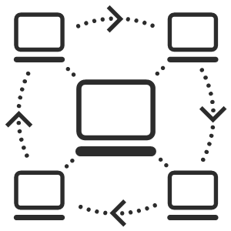


Example: eHealth-platform
Public Federal institution founded in 2008 for facilitating well-organized, mutual electronic service and information exchange between all actors in health care
The e-Health platform provides necessary guarantees with regard to information security, privacy protection and professional secrecy
API
WEB
Connectors Standards
Online Authentic
services sources

Slide 39














eHealth: landscape
Authentic sources

Slide 40
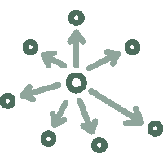



eHealth: technical choices
Decentralization
API
Security
Standardization
Integration
ReUse

Slide 41







eHealth: architecture
Patients, health care providers
and health care institutions
Site Ministry
Software health care professional
Software health care institution
VAS
Site RIZIV
VAS
eHealth-portal
MyCareNet
VAS
VAS
VAS
Users
Basic services
eHealth-platform
Network
AS
AS
AS
AS
AS
AS
Suppliers

Slide 42
eHealth-platform : basic services & API’s
Coordination of the electronic processes
Portal
Integrated user and access management system
Management of loggings
System for end-to-end encryption
eHealthBox
Timestamping
Coding and anonymising
Consultation of National register and CBSS registers
Reference directories (hub-metahub system)

Slide 43







Electronic information sharing: some figures
>86,4%
Belgian citizens’
informed consent to share data
+97%
went digital
620 million
messages / year
via secure eHealthBox
API
WEB
Electronic Prescriptions
> 18.000.000.000
digital transactions annually
19 million / month
7,7 million
Belgian patients with
Summary Electronic Health Records in health vaults
  215 million
  electronic documents available
  at hospitals and clinical labs
29.000
4.800

Slide 44


API in health and social sector: some statistics and evolution
social security
100+ APIs
Most consumers are external (# 20,000-24,000)
Peak load 2000-3000 req / s
1.200M transactions / month
200+ APIs
Consumers mostly internal applications/services (# 200-300)
Peak load 1000-1500 req / s
300M transactions / month
Disclaimer: metrics listed since 2016 are for all ESB + gateway platforms. Migration to Axway APIM in progress since Q3 2018.
(eHealth currently 30% APIs migrated, Social Security gradually does onboarding on APIM for all new APIs and API evolutions)
Notes:
Need for a rock-solid service platform that meets our SLA requirements and can scale easily, while keeping costs under control

Slide 45
API standards
API standards in eGovernment are based on industry standards and best practices
a pragmatic approach to designing RESTful APIs
collaborative effort organized in several workgroups
  REST API modelling
  security (OAuth)
  functional/business vocabularies (temporal, location, person, enterprises)
REST style guide
  https://www.gcloud.belgium.be/rest/

Slide 46





API management
importance of good API management
  transparent migration of legacy services
  ready for today's standards, but supports our legacy as well
  from ESB-technology to API gateway
  parallel platform
  zero-impact migration
faster implementation of new services
  flexible to extend and customize
  accelerates time-to-market
API Manager
API Portal
API
API Registration & Lifecycle
Application Developers
API Catalog
Partner & Policy Administration
REST
API
API Gateway
SOAP
Policy Enforcement
Notes:
https://unsplash.com/photos/vE3ZFtIhA4c?utm_source=unsplash&utm_medium=referral&utm_content=creditCopyText
Parallel platforms
Controlled migration growth
In service mode: close monitoring
Inevitable surprises: challenge
Defaults adapt to our volumes: lots of tweaking / DRP tests
Challenge rebuild existing standards to new Axway
SOAP-REST
New services on new platform

Slide 47
Challenges
use the power of the network of institutions
deal with interdependencies
focus on the essence, not on "bells and whistles"
deal with the (un)availability of (critical) services
strive for uniformity of technological solutions / use of site licenses

Slide 48
Focus area: end-to-end automation

Slide 49
What is end to end automation ?
combination of
  (technical) mapping of business processes
  use of data from authentic and local sources
  API economy
  reusing available (business) components
  systems that orchestrate the whole
only contact with citizen / company when needed
automatic allocation of rights & handling of file (happy flow)
focus on exceptions, specific situations
tooling to facilitate automation (eg Robotic Process Automation (RPA))

Slide 50


Consequences
employees become "architects"
  which data / services are available ?
  which APIs offer this?
  give a plan to ICT
based on a global view of the processes
ICT serves to provide layered support for all types of customers
reusability requires a form of "generic thinking" (no "bells and whistles")
need for
  catalog of data and services
  use of the cross-institutional network (between managers, between ICT managers, between (business) analysts, etc)
  intelligence to assess the impact of changes on situations where it matters (social policy)

Slide 51
Consequences
Business App 1
Business App 2
Business App 3
Focus on product/service delivery
"DevOps" way of working
Product teams with end-end responsibility
Use of platform & tools
Maximum automation
Development platform
“Cloud & Container Services”
Infrastructure
Joint management of the platform

Slide 52

Present and future interfaces
growth of mobile user interfaces
mobile applications with added value, not "mobile for mobile"
how do we ensure user-friendly, maintainable and secure applications ?
what is acceptable to the target audience?

Slide 53

Importance of means of authentication
correct registration procedure to establish identity, qualities and
relationships
as simple as possible for end users
tiered levels of authentication
  according to level of registration: how certain are we of identity?
  according to application needs: what are the risks in case of abuse?
protection of data / functionality according to entitlements
take into account technological evolution
  eg eID -> security code (mobile / SMS) -> Itsme
cooperation initiative between government and private sector

Slide 54

Robotic Process Automation (RPA)
automation technology based on software robots
mimicking the work of humans across applications
using the app’s UI, and not requiring deeper (more costly) integration
Designed by Freepik

Slide 55
Difference with “normal” automation
software robots simulate manual clicks and keystrokes, performing actions and business logic
normal automation requires new systems to be built and integrated => normal automation is usually costly and time consuming
Automation Options
process requiring intelligence
AI based solutions
BPM based
solutions
Traditional
Applications
or Services
RPA
deterministic process
cheap
expensive

Slide 56
Kind of processes automated using RPA
repeatable, rules-driven software interactions by human users are low hanging fruits for RPA
especially high-volume / long-running
until the time a process can be automated within a more robust development effort, it can be automated with RPA
most RPA tools support recording actions on these applications, which can then be replayed many times:
  Web based
  Desktop
  Citrix
  SAP
  Excel

Slide 57
Better than humans ?
RPA is not meant to replace humans but to help human workers
software robots are good for tasks which are mundane, repetitive and disliked by most employees
for some kinds of applications, bots are better
  robots can run 24/7
  robot is not error-prone (completely deterministic behaviour, doesn’t “forget” a step in the process)
  robot actions can be logged in the background

Slide 58
RPA examples
search for certain files in an online document management system, extract relevant information, input this data in a desktop program, then move the original file to a different folder
perform an entire procedure to prepare, print, send and archive a document, requiring only 2 inputs at the start
login to twitter analytics to get statistics, download and clean them, analyze them in Excel
perform a check in several systems consecutively to see if a certain user’s credentials have been added / removed

Slide 59
Evaluation
Advantages
easier, faster than other options
usable by non-IT (power users)
quick ROI
can be used with legacy or otherwise difficult or inconvenient to integrate systems (eg no API available)
quick, temporary solution
Disadvantages
more work to accomodate branching / complex processes (easiest for “happy path” only)
sensitive to UI change in automated systems
less robust in general (greater stability requires more testing and exception handling, reducing ROI speed)
existence of RPA script may discourage building more robust/permanent solution
quick, temporary solution

Slide 60
Focus area: artificial intelligence

Slide 61
What is Artificial Intelligence (AI) ?
an area of computer science concerned with the creation of machines that can reproduce human cognitive functions such as reasoning, planning, learning, language understanding, vision,…
weak AI vs strong AI
  weak or narrow AI
    simulates intelligence
    is limited to specific areas
    all current implementations of AI are narrow AI
  strong or general AI
    still debated, includes philosophical considerations such as consciousness, intentionality, …
    has real intelligence,
    has mental states and beliefs like humans
    Holy grail !
Notes:
Weak AI: Weak AI simply acts upon and is bound by the rules imposed on it and it could not go beyond those rules
General or strong AI is still debated as it is hard to give a good definition of what intelligence is. Should the machine have consciousness (be aware of its mental states) ? Does it have intentionality?

Slide 62
AI subfields (non-exhaustive)
Knowledge representa-tion
Natural language generation
Sensors/
internet of things
Audio/
speech analytics
Machine learning
Graph analysis
Simulation modelling
Natural language processing
Deep Q&A systems
(cognitive computing)
Robotics
Image analytics
Deep learning
Social network analysis
Visualisa-tion
Deep causal reasoning
Virtual personal assistants
Recommen-der systems
Machine translation
Source: PWC via @mikeuindazzi

Slide 63

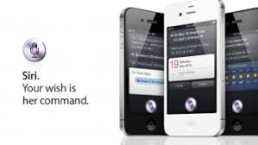
Natural Language Processing (NLP)
processing of natural language in order to communicate with humans and extract information from written texts
some applications of NLP are:
  machine translation
  text classification
  Information extraction (Named Entity Recognition (NER))
  information retrieval
  speech recognition:
    Google Assistant/Home
    Siri
    Alexa
    Cortana
    ….
Notes:
Information extraction . explain

Slide 64
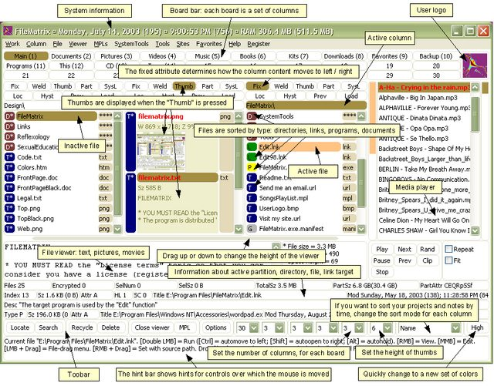
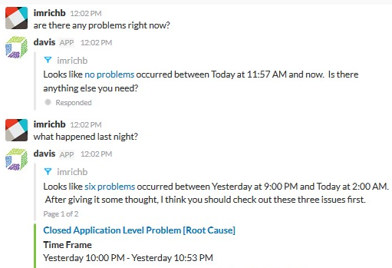
Conversational interfaces
A conversational interface is a user interface where the interaction is based on conversations in natural language (text or speech)
Threshold lowering: the user does not have to learn to work with the (graphical) interface
versus
Notes:
Een (extreem) voorbeeld van het verschil tussen de klassieke grafische interface (veel menu's, knoppen, invoervelden, etc.) en het voeren van een natuurlijke conversatie in eigen bewoordingen.
Je hoeft als gebruiker de interface niet meer te leren.
Rechtervoorbeeld is "davis", de virtuele assistent van Dynatrace voor performance management (wat is de status van de systemen).

Slide 65
Chatbot Student@Work
automatic answer to general questions about student labor
substantive questions
technical questions (access, error messages)
available via Student@work contact webpage
available 24/7 (students are often active outside office hours)
immediate reply
scalable
status: operational

Slide 66
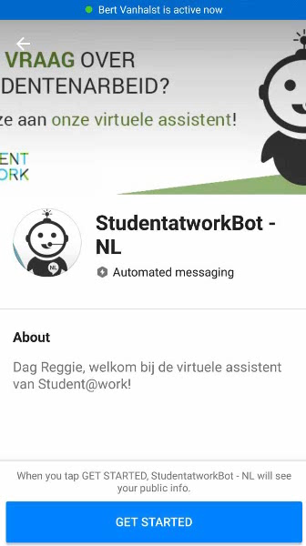
Chatbot Student@Work
DEMO

Slide 67
Dimona via Google Assistant
simplified employment declaration:
  employer number
  employee number
  date of employment
integration with Google Assistant, Google's virtual assistant
  via Google Home (smart speaker)
  via smartphone
voice interface
English (and Dutch prototype)
status: experiment

Slide 68
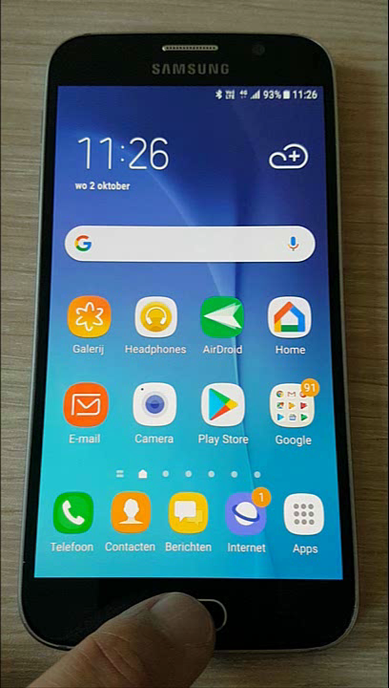

Dimona via Google Assistant

Slide 69
Machine learning
design of algorithms that automatically learn from example data with no or minimal need for human intervention
at the intersection of computer science and statistics
advantages
  no need to code explicitly all possible situations the machine will have to deal with, the machine adapts to change in conditions or unseen situations
  can learn a solution to a problem by itself where it would be hard for a human to explicitly instruct the machine
Notes:
Machine Learning uses Data Mining techniques and other learning algorithms to build models of what is happening behind some data so that it can predict future outcomes. A computer program is said to learn some task from experience if its performance at the task improves with experience, according to some performance measure. Machine learning involves the study of algorithms that can extract information automatically (i.e., without on-line human guidance). Most tasks that require intelligence require an ability to induce new knowledge from experiences. Thus machine learning is a large area within AI.

Slide 70
Machine learning approaches
Supervised learning
learns from examples of pairs of input-output
feedback from a « teacher » which provides the correct answer for example inputs
Unsupervised learning
no feedback from a « teacher »
learns patterns in the input
Reinforcement learning
suitable for complex problems in unknown environment
no feedback from a « teacher »
particularly used in robotics (film robot)
receives a reward if successful at executing a task or punishment otherwise
most common approach
used mainly for clustering
eg chatbot
Notes:
Source: « Artificial Intelligence: A moder approach » Russel, Norvig
Example chatbot: training data are pairs of texts and related intentions

Slide 71

Applied to fraud detection
Database X
Database Y
Database Z
Data-preprocessing
Sudden Change in Behaviour
(type 1 fraud) network
t
Fraud type 2 symptoms
& profit
Start of
Lifecycle
Parameter
Change
Consecutive or Complex Events
Network
Info
Predictive model

Slide 72
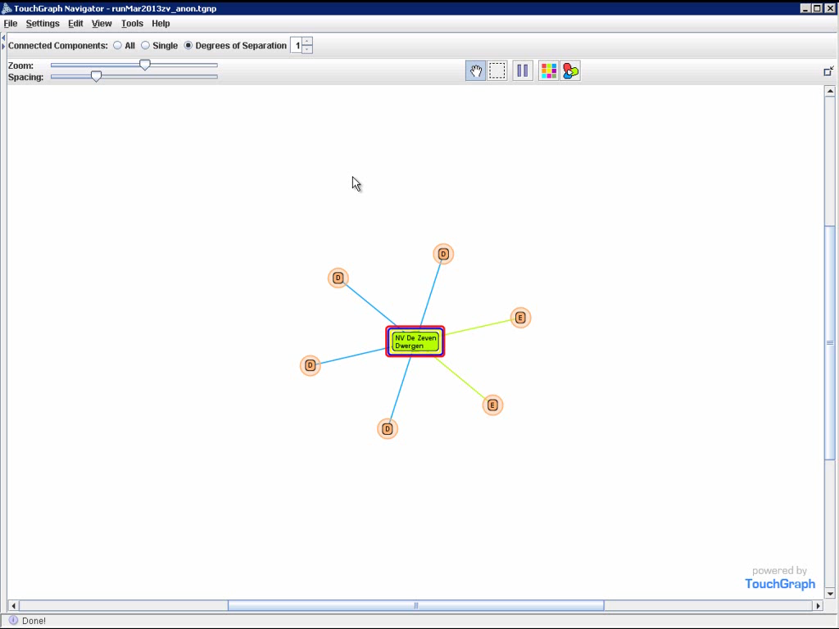
Example: spider constructions

Slide 73
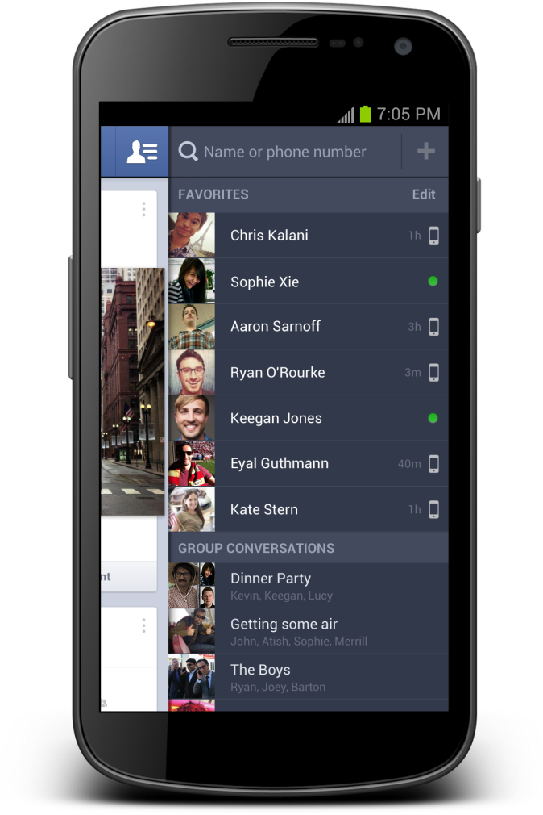
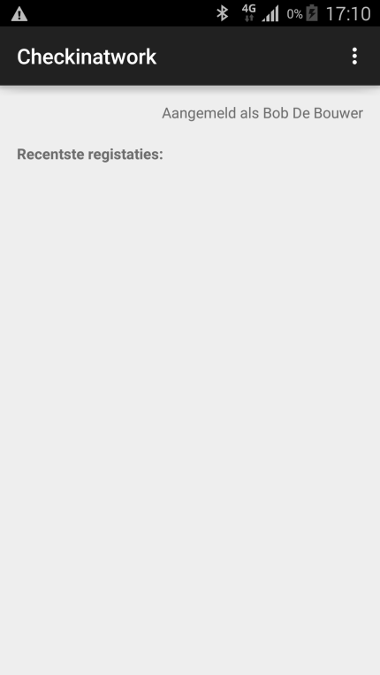
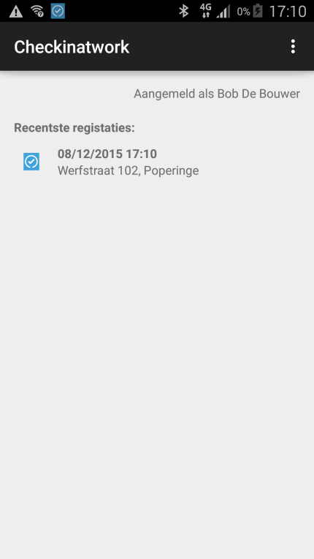



Internet of things: experiment with beacons
Notificatie:
Beacon present at the workplace
Beacons are easy, inexpensive and quick to integrate with mobile applications and can help to provide context-specific information to the application
Notes:
In dit experiment werd een scenario uitgebouwd op basis van eenvoudige beacons (zendertjes die een uniek identificatienummer hebben).
Het scenario veronderstelt dat de betrokken ondernemer de beacon aangemeld heeft met de relevante informatie: voor welk bedrijf? Voor welke werf?
Een werknemer of een onderaannemer die de werf bezoekt beschikt over een app op zijn mobiel device die de activiteit van de beacon kan oppikken, de identiteit kan uitlezen en dan vervolgens ia zijn app een melding doet dat hij op die bouwwerf aanwezig is. Op die manier krijg je een low-cost, snel te implementeren mogelijkheid om aanwezigheidsmeldingen te doen.
Dit scenario is nuttig voor veiligheid op het werk (accurate registratie van aanwezigheden in seveso bedrijven bvb) of voor fraudebestrijding.

Slide 74
ICT als utility

Slide 75
ICT als utility: enkele aandachtspunten
Project manage-ment
Procure-ment
Sourcing strategie
Agile develop-ment
…
Architec-tuur
Personeels-planning
ICT gover-nance
Service manage-ment
Open stan-daarden

Slide 76
ICT als utility: enkele aandachtspunten
Sourcing strategie

Slide 77
Sourcing strategie
waarvoor wordt beroep gedaan op IaaS, PaaS of SaaS ?
wat doen we nog zelf ?
grote impact op ICT-afdeling
  reductie van
    technisch infrastructuur- en platformbeheer
    eigen ontwikkeling, die waar mogelijk wordt vervangen door standaardpakketten en SaaS-oplossingen (te gebruiken as such, geen customisatie ! – good is good enough – enkel relevante modules)
  ontwikkeling van
    architectuurfunctie
    informatieveiligheids- en compliancefunctie
    proces- en informatie-analyse
    businesskennis
    kennis van ICT-markt en haar ontwikkeling

Slide 78
ICT als utility: enkele aandachtspunten
Sourcing strategie
ICT gover-nance

Slide 79












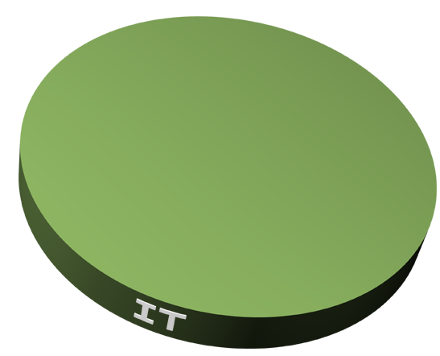
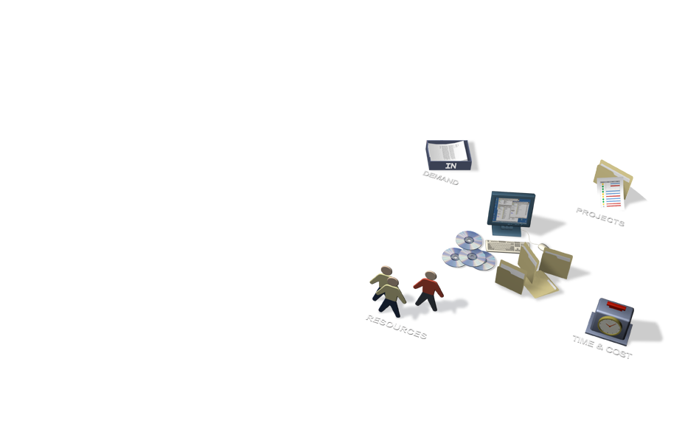


Business-ICT relationship
Demand
Tasks
Resources
Time & Cost
Notes:
Application portfolio
Infrastructure portfolio
Project Portfolio
Peut marcher si petite organisation
Client : Flexibilité mais pas de garantie ni de contrôle

Slide 80















Internal communication
Demand
Tasks
Resources
Time & Cost

Slide 81

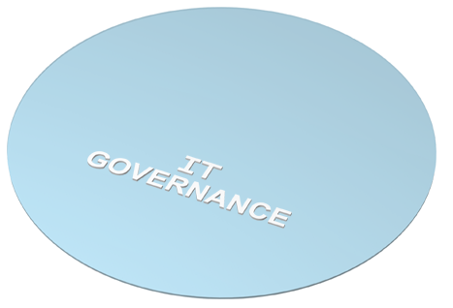







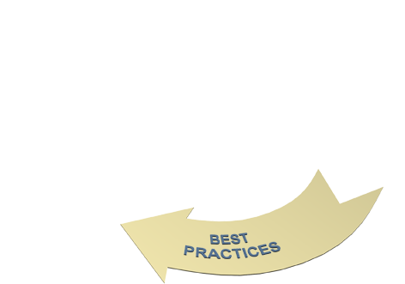
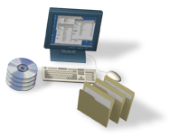








ICT governance
Demand Mgt
Tasks Execution
Resources Mgt
Time & Cost Mgt
Notes:
Client : perte de flexibilité mais niveau de service (garantie) + contrôle possible
Ownership des demandes/changes …
Rôles doivent être clairs : Demandeur et gestionnaire en même temps

Slide 82
ICT governance
duidelijkheid over nagestreefde strategische doelstellingen
degelijk ICT-portfoliomanagement met evaluatie van de programma’s en projecten op basis van toegevoegde waarde voor het bereiken van de strategische doelstellingen
voldoende sponsorship van het management en draagvlak bij de businessverantwoordelijken voor de mogelijkheden tot inzet van ICT voor het bereiken van de strategische voordelen, en inzicht in hunnen hoofde in de randvoorwaarden en beperkingen
  marketing door ICT-verantwoordelijken
    inzichtelijk maken van aanbod, toegevoegde waarde, risico’ s en kosten van ICT
    begrijpbaar voor managers en businessverantwoordelijken – geen klemtoon op technologie !
  vorming van managers en businessverantwoordelijken
Notes:
Bestuurders en businessverantwoordelijken moeten zicht krijgen op de toegevoegde waarde van ICT voor het onderscheidend vermogen, en ICT niet louter zien als een oplossing voor problemen. Zoniet blijft ICT voor hen de verantwoordelijkheid van de ICT-manager en niet van zichzelf.
Wereldwijde enquête 2004: 60% van de CEO’s zien ICT vandaag als een beperking voor hun groei (veranderingen zijn te moeilijk).
Meer ambitie van ICT-managers om door te groeien tot CEO ?

Slide 83
ICT governance
voldoende aandacht van ICT-verantwoordelijken voor de inzet van ICT voor het bereiken van de strategische doelstellingen
  ICT-verantwoordelijke als onderdeel van de bedrijfsvoering, niet als louter technische specialiteit
  meedenken over strategische doelstellingen
  meedenken over bedrijfsmodel en –processen
  “fusie” tussen business en ICT
netwerking
  goed inzicht in de kritische succesfactoren en de stakeholders
  buy in van de stakeholders
  actieve deelname aan informele besluitvorming
  feedback
Notes:
ICT-verantwoordelijken moeten klemtoon leggen op waardetoevoeging voor kernactiviteiten van de business en onderscheid maken tussen strategische en niet-strategische uitgaven.

Slide 84
ICT als utility: enkele aandachtspunten
Project & program manage-ment
Sourcing strategie
Gover-nance

Slide 85
Project management
een project
  induceert verandering
  is tijdelijk (heeft een begin en een einde)
  is functie-overschrijdend (verschillende profielen, klanten, leveranciers, …)
  is uniek
  kent onzekerheden
methodologische aanpak nodig, bvb PRINCE2, met 6 te beheren dimensies
Time
Risk
Cost/effort
=> tijdens uitvoering regelmatig SQERT-analyse
(scope, quality, effort, risk, time)
Benefits
Quality
Scope

Slide 86
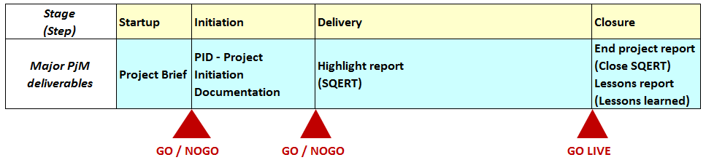
Project management
principes
  continued business justification
  learn from experience
  defined roles and responsibilities
  delivery by stages
  manage by exception
  focus on products
  tailor to suit the project environment

Slide 87
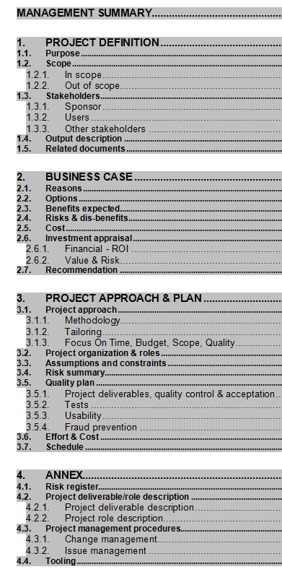
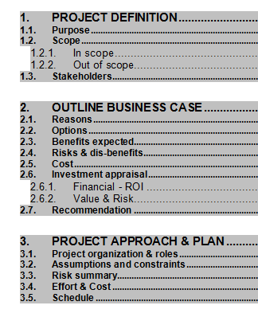
Project brief - project initiation document
PjB
PID

Slide 88
Program management
geïntegreerd beheer van meerdere, onderling gerelateerde projecten
  prioriteitenstelling
  onderlinge afhankelijkheden
  alignment
  governance
  accountability
  architectuur
  financiële coherentie

Slide 89
ICT als utility: enkele aandachtspunten
Project & program manage-ment
Sourcing strategie
Architec-tuur
Gover-nance

Slide 90
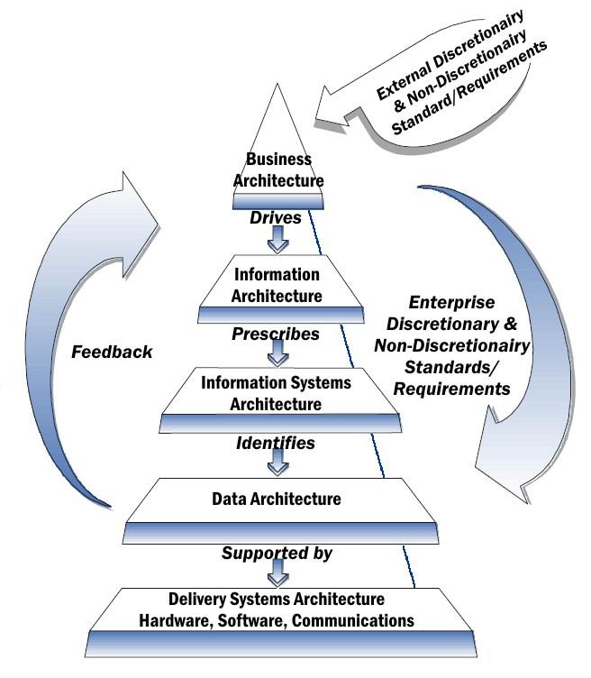
Architectuur
manier om
  te begrijpen hoe de informatie-voorziening en ICT is opgebouwd en waarom
  te beschrijven hoe de verschillende onderdelen zijn opgebouwd en met elkaar samenhangen
  te besturen hoe dat zich doorheen de tijd ontwikkelt
doel
  kostenbeheersing: slechte architectuur en veel wijzigingen verhoogt kosten exponentieel
  snellere time to market
  betere onderhoudbaarheid
  grotere flexibiliteit
  grotere mobiliteit
  grotere veiligheid
  hogere beschikbaarheid van resources

Slide 91
Service Oriented Architecture (SOA)
wat ?
“Service Oriented Architecture (SOA) is a paradigm for organizing and utilizing distributed capabilities that may be under the control of different ownership domains. It provides a uniform means to offer, discover, interact with and use capabilities to produce desired effects consistent with measurable preconditions and expectations. This style of architecture promotes reuse at the macro (service) level rather than micro levels (eg. objects). It also makes interconnection of existing IT assets trivial.” (OASIS Reference Group)
kenmerken
  dienstgeörienteerd
  modulair
  interoperabel (gebaseerd op open standaarden of open specificaties)
  uitbreidbaar
  gelaagd
  gebaseerd op hergebruik van componenten en gegevens

Slide 92
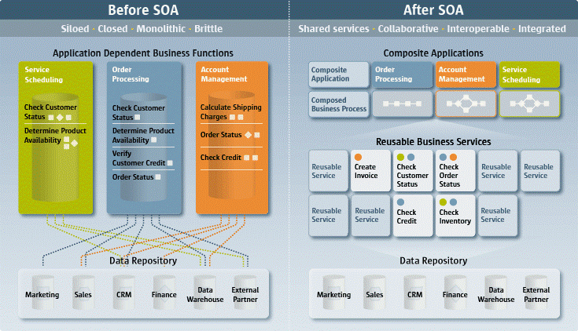
Service Oriented Architecture (SOA)

Slide 93
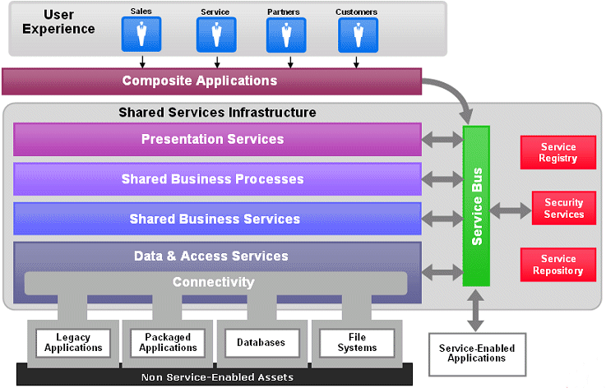
Service Oriented Architecture (SOA)

Slide 94
ICT als utility: enkele aandachtspunten
Project & program manage-ment
Sourcing strategie
Architec-tuur
Gover-nance
Open stan-daarden

Slide 95
Open standaarden
kenmerken
  publiek beschikbaar
  specificaties mogen vrij van licentierechten worden toegepast, gebruikt en gehanteerd
voordelen
  verhoging van uitwisselbaarheid van informatie tussen informatiesystemen
  verhoging van vervangbaarheid van componenten van informatiesystemen
  waarborgen van toekomstvastheid
  meer keuzevrijheid in (en daarmee minder afhankelijkheden van) de leveranciers
verschillende domeinen en verschillende standaardisatie-instellingen

Slide 96
ICT als utility: enkele aandachtspunten
Project & program manage-ment
Sourcing strategie
Agile develop-ment
Architec-tuur
Gover-nance
Open stan-daarden

Slide 97
Traditioneel: watervalmethode
analyse & plan
design
build
test
correct
test
deploy

Slide 98
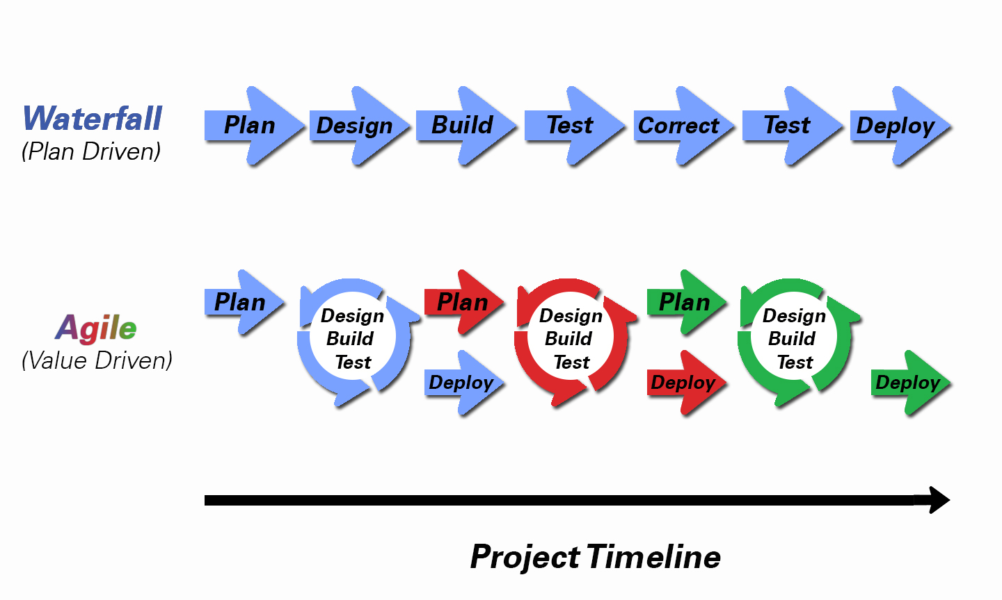
Vaak te verkiezen: agile development

Slide 99
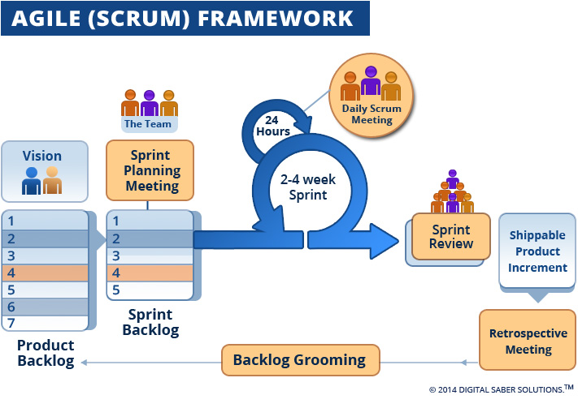
Vaak te verkiezen: agile development

Slide 100
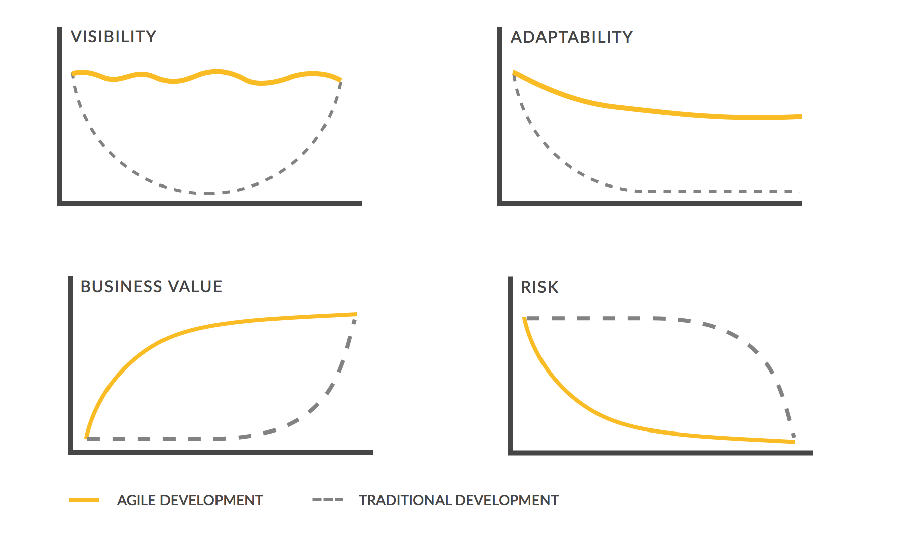
Traditional vs agile development

Slide 101
ICT als utility: enkele aandachtspunten
Project & program manage-ment
Sourcing strategie
Agile develop-ment
Architec-tuur
Gover-nance
Service manage-ment
Open stan-daarden

Slide 102
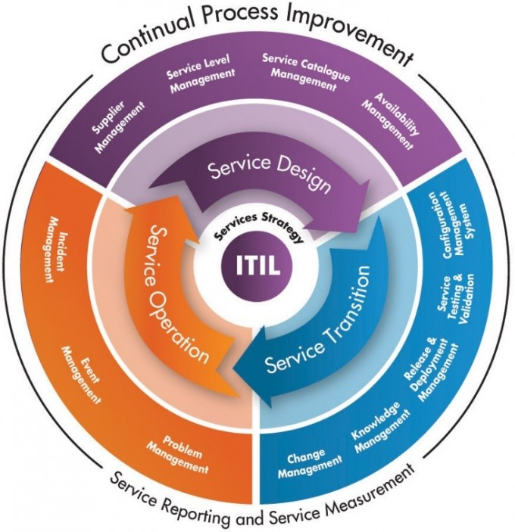
Service management: ITIL

Slide 103
ICT als utility: enkele aandachtspunten
Project & program manage-ment
Procure-ment
Sourcing strategie
Agile develop-ment
Architec-tuur
Gover-nance
Service manage-ment
Open stan-daarden

Slide 104
Wetgeving overheidsopdrachten
overheid is onderworpen aan de wetgeving overheidsopdrachten
uitdaging: hoe naleving van deze wetgeving verzoenen met efficiënt en flexibel ICT-beheer ?
  synergieën met andere organisaties inzake plaatsingsprocedures
  gebruik van mogelijkheden geboden om kosten te vermijden en flexibiliteit te verzekeren
    opdrachtencentrales
    raamovereenkomsten
    toepassing van cascadesysteem
  in elk geval steeds onderhandelingsprocedure

Slide 105
Opdrachtencentrale
opdrachtencentrales gunnen opdrachten van leveringen, diensten of werken voor rekening van meerdere, juridisch onderscheiden entiteiten
de diensten die beroep doen op een opdrachtencentrale zijn vrijgesteld van het zelf voeren van een procedure overheidsopdrachten – de budgettaire en toezicht procedures blijven wel van toepassing
de diensten die beroep doen op een opdrachtencentrale bestellen rechtstreeks
flexibiliteit verhoogt bij combinatie met raamovereenkomst
niet alle toezichtsorganen voelen zich comfortabel bij het model door gebrek aan rechtstreeks toezicht op de gevoerde procedure

Slide 106
Raamovereenkomst
concrete invulling van de opdracht wordt bepaald door latere bestellingen
situatie waarin de aanbestedende overheid wel haar type behoefte afdoende kan definiëren, maar niet de omvang of de benodigde hoeveelheden ervan
raamovereenkomst bepaalt voorwaarden van erop gesteunde opdrachten oa inzake prijzen en beoogde hoeveelheden
voorbeeld: raamovereenkomst voor ICT-medewerkers
  profiel en competenties zijn bepaald
  uur- of dagprijzen zijn bepaald in functie van ervaringsniveau
  bij behoefte wordt aanvraag gedaan voor specifieke periode en bedrijf stelt een concrete consultant voor
  indien de consultant wordt aanvaard, volgt bestelling

Slide 107
Cascadesysteem
contractueel van aard, opgenomen en in detail uitgewerkt in het lastenboek
opdracht wordt gegund aan de inschrijver die eerst gerangschikt is als meest voordelig
opdracht wordt eveneens gegund aan een tweede en een derde gerangschikte
bij behoefte gaat aanvraag naar eerste gerangschikte die volgens een vaste procedure en strikte timing antwoordt
bij afwijzing van de aanvraag, niet conform aanbod of bij uitblijven van antwoord wordt de aanvraag gericht aan tweede gerangschikte en zo nodig naar derde gerangschikte
vooral nuttig voor ICT-medewerkers
  cyclische markt met periodes van schaarste
  verhoogt substantieel de kans om steeds over de nodige ICT-medewerkers te kunnen beschikken

Slide 108
ICT als utility: enkele aandachtspunten
Project & program manage-ment
Procure-ment
Sourcing strategie
Agile develop-ment
…
Architec-tuur
Personeels-planning
Gover-nance
Service manage-ment
Open stan-daarden

Slide 109
Strategische personeelsplanning (SPP)
nuttige methodiek
  eenvoudig te hanteren
  gemakkelijk in onderhoud
  geen kunstje van HR: business is eigenaar
stappenplan
  beïnvloedende externe en interne factoren in kaart brengen: strategische evoluties, budget, operationele ondersteuning 24/7, …
  huidige situatie in kaart brengen: samenstelling, kwaliteit, dynamiek
  toekomstige gewenste bezetting in kaart brengen
  toekomstig verwachte bezetting in kaart brengen
  beleidsdiscussie over gap
  cocktail van beleid, instrumenten en actieplannen
niet het plan op zich maar wel de bewustwording en de actiebereidheid bepalen het succes

Slide 110
Actieplan SPP
Straks nodig
Nu nodig
Nu aanwezig
7. Prospects :
recrutering
(om)scholing
synergie
Key players :
retentie
opleiden
belonen
7.
6. Most wanted :
recrutering
(om)scholing
synergie
2. Onbenut potentieel :
tijdelijk uitlenen
tijdelijk flexibiliseren
2.
6.
1.
5. Tijdelijke krachten :
consultants
collegiale inleen
3 . Zorgenkindjes :
ontwikkelplan
mobiliteitsplan
outplacement
4.
4. Huidige kern :
potentieel beoordeling
ontwikkelingsplan
mobiliteitsplan
outplacement
flexibiliseren
3.
5.

Slide 111
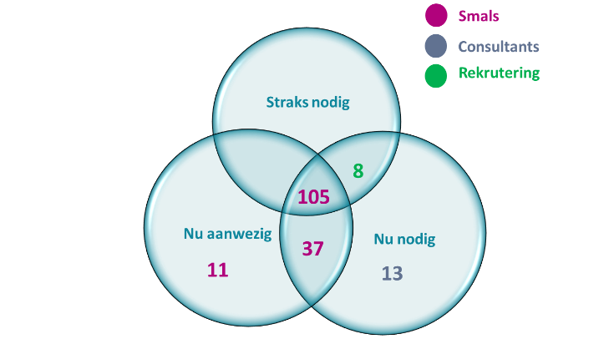
Voorbeeld: Smals
één werkgroep per teamleader/domein (directeur, teamleader en HR) :
  jobarchitecturen overlopen
    welke verantwoordelijkheidsgebieden veranderen ?
    welke competenties veranderen ?
  identificatie van de functietitularis
  in kaart brengen actuele, toekomstige en verwachte bezetting
start actieplan voor de medewerkers "nu aanwezig"
uitwerken mogelijke pistes voor de medewerkers "nu aanwezig maar straks niet meer nodig in de huidige functie"
permanente actualisatie SPP

Slide 112
Samenvattend
gepast inspelen op technologische mogelijkheden kunnen bijdragen tot strategische voordelen voor de organisatie
  georganiseerde technology watch
  strategische keuzes
de ICT-kosten dreigen te hoog te zijn indien
  er niet voortdurend wordt gezorgd voor business aligment
  schaaleffecten op het niveau van infrastructuur, platformen, basisdiensten en procurement niet worden uitgebuit
  de architectuur niet dienstgeoriënteerd en modulair is
  verkeerde sourcingskeuzes worden gemaakt
  toepassingen via verouderde methodes ontwikkeld worden
  er geen degelijk program, project en service beheer is
een proactief HR-beleid is nodig

