Slide 1
Contact tracing: why, what and how?

Slide 2
Some basic concepts
incubation period
the time between the exposure to the virus and the onset of symptoms
Covid-19: on average 5-6 days, but can be as long as 10-14 days
thus, quarantine should be in place for 10-14 days from the last exposure to an infected person
contagiousness
the period during which an infected person can transmit the virus to other persons
Covid-19: on average 2 days before the onset of symptoms and up to 7-10 days after the onset of symptoms
thus, isolation should be respected for 7-10 days from the onset of symptoms

Slide 3
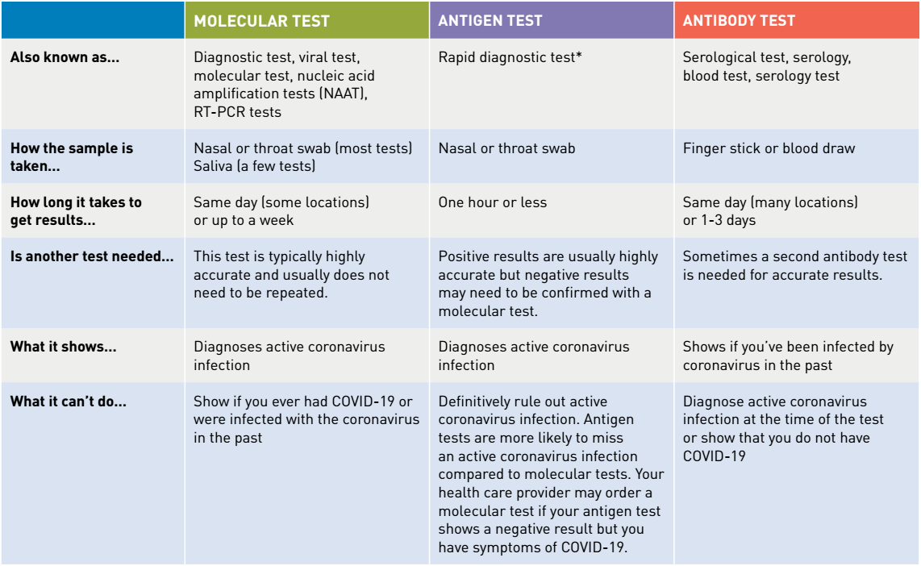
Some basic concepts: types of tests

Slide 4
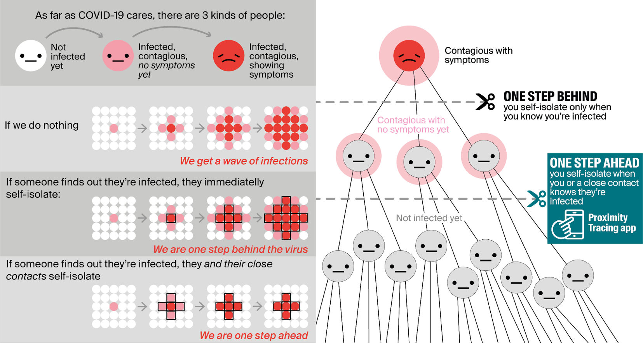
Why contact tracing ?

Slide 5
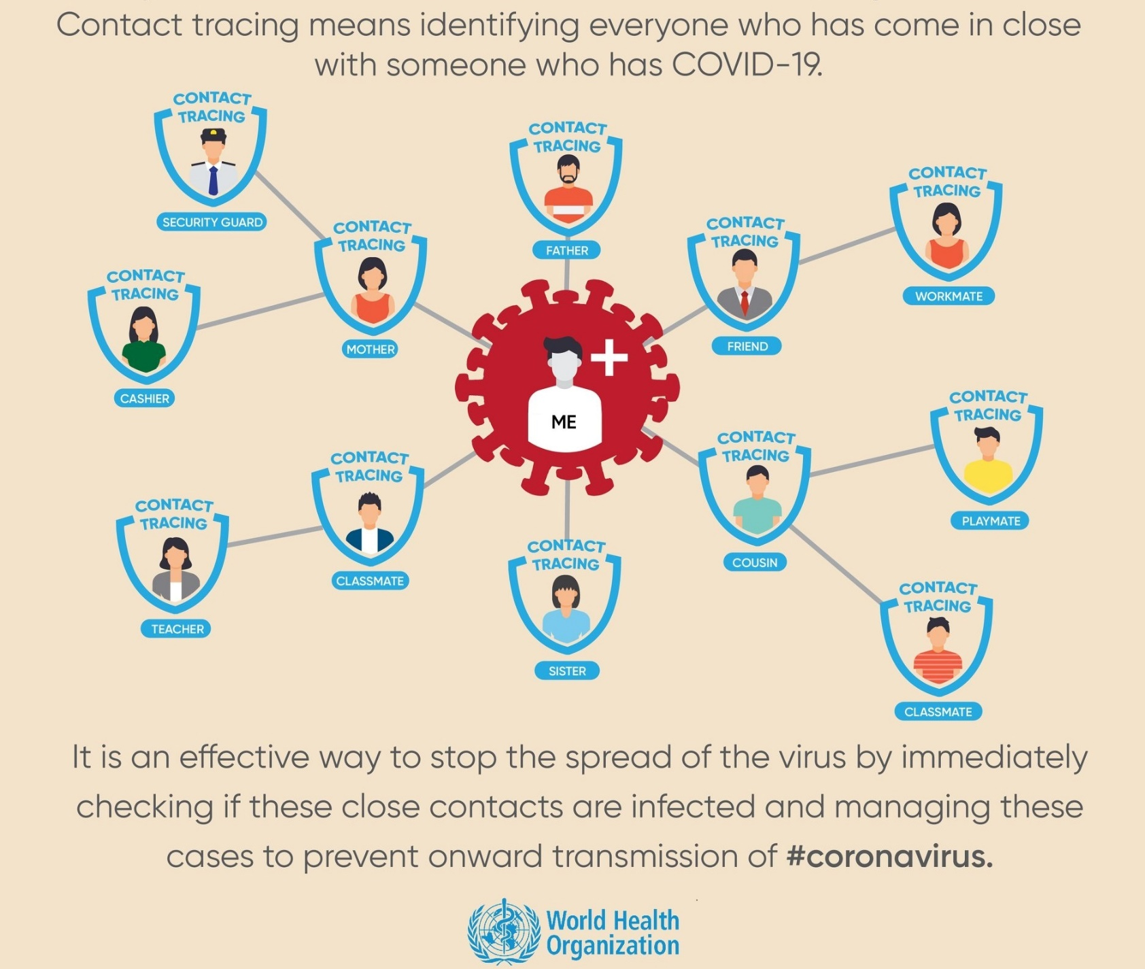
What is contact tracing ?

Slide 6
How contact tracing is put in place ?
contact tracing by health care providers
contact tracing by contact centers
see https://www.corona-tracking.info/
contact tracing within companies and collectivities
see https://co-prev.be/nl/covid-19-informatie/ or https://co-prev.be/fr/covid-19-information/
contact tracing via app Coronalert
see https://coronalert.be/

Slide 7
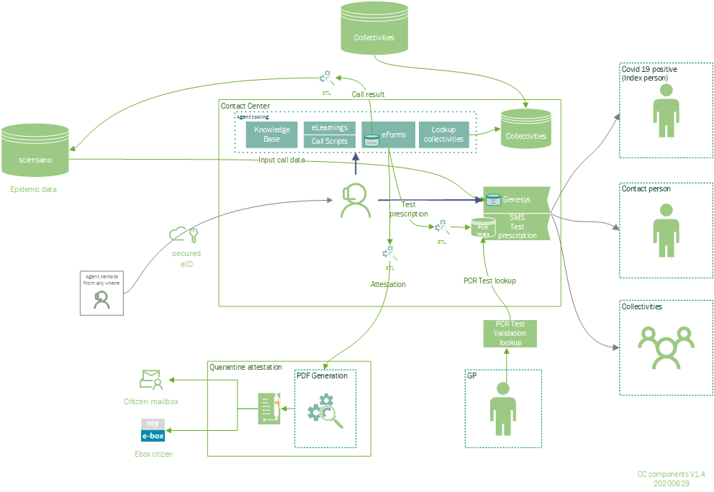
Contact tracing by contact centers

Slide 8
Contact tracing within companies and collectivities
call by contact center
identification of infected person (index case)
risk analysis
identification and triage of contacts (high risk – low risk)
contacting contacts
measures for contacts
high risk: quarantine – telework/unemployment – vigilance for symptoms
low risk: social distancing – vigilance for symptoms
resumption of work

Slide 9
App Coronalert

Slide 10
App Coronalert
installation
operation
RPIA3
RPIB4
RPIA1
RPIA2
RPIA3
RPIA4
RPIB1
RPIB2
RPIB3
RPIB4
Store
RPID1
RPIC2
TEKA
TEKB
TEKA
TEKB
RPID1
RPID2
RPIC1
RPIC2
RPIC3
RPIC4
RPID1
RPID2
RPID3
RPID4
store
RPIA3
RPIC2
TEKD
Store
RPIA3
RPID1
TEKD
TEKC
TEKC

Slide 11
App Coronalert
test
proximity tracing
TEKD
TEKD
TEKD
TEKD
TEKD
Store
RPID1
RPIC2
TEKA
TEKB
test result
TEKD
TEKD
Store
RPIA3
RPIC2
TEKD
Store
RPIA3
RPID1
TEK*
TEKC

Slide 12
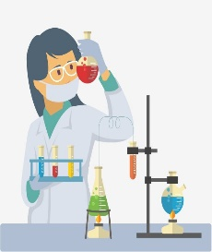
App Coronalert
overview
TEKD
RPIA3
TEKD
TEKD
TEKD
RPID1
RPIB5
RPID1
test result
test result
TEKA
RPIB5
RPIA3
RPIB5
TEKD
RPIA3RPID1
RPIA1
sample
TEKB

Slide 13
App Coronalert
Details: GP visit
RAG: Date patient became infectious
= two days before onset of symptoms
or = two days before day of test (if asymptomatic)
Do you have symptoms?
If yes: day of onset of symptoms?
test result
test result
Date (infectious)
Test number (15+2)
INSZ
Date (infectious)
Test number (15+2)
SPECIMEN
TEKD
2 check digits to detect typos

Slide 14
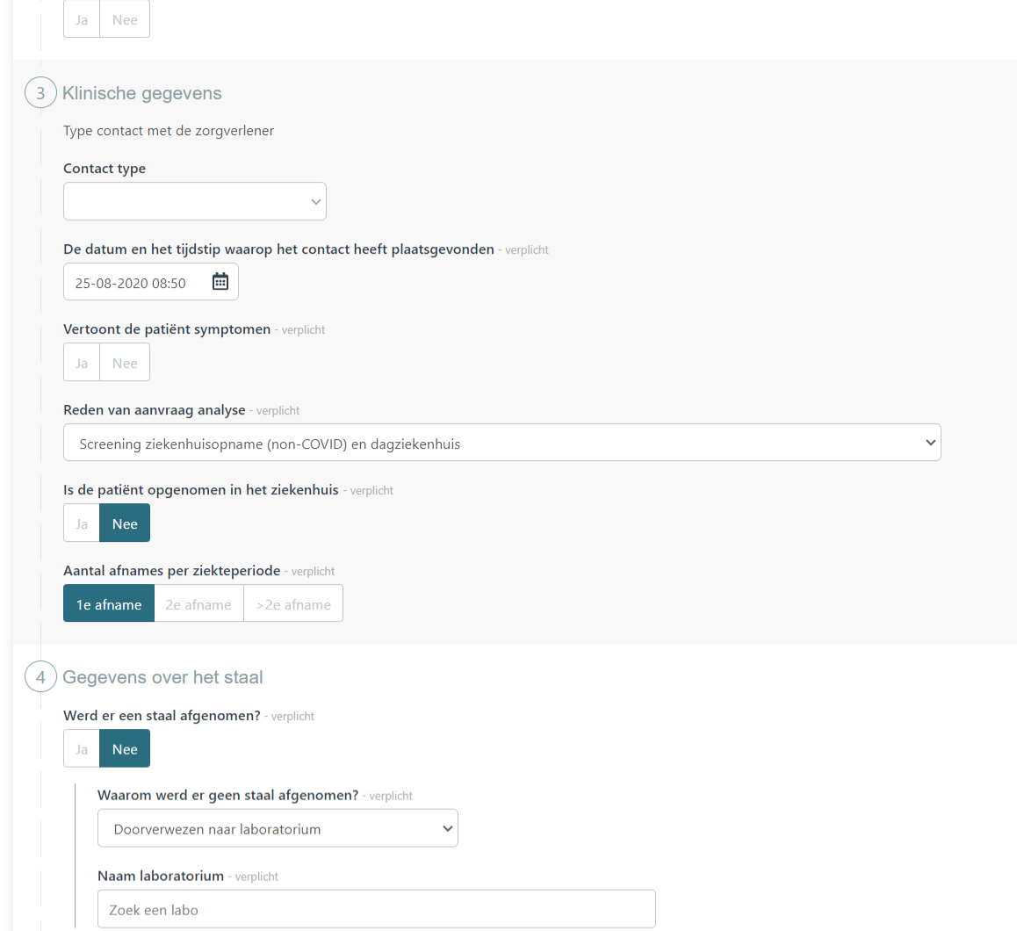
eForm COVID-19 lab request (1/2)

Slide 15
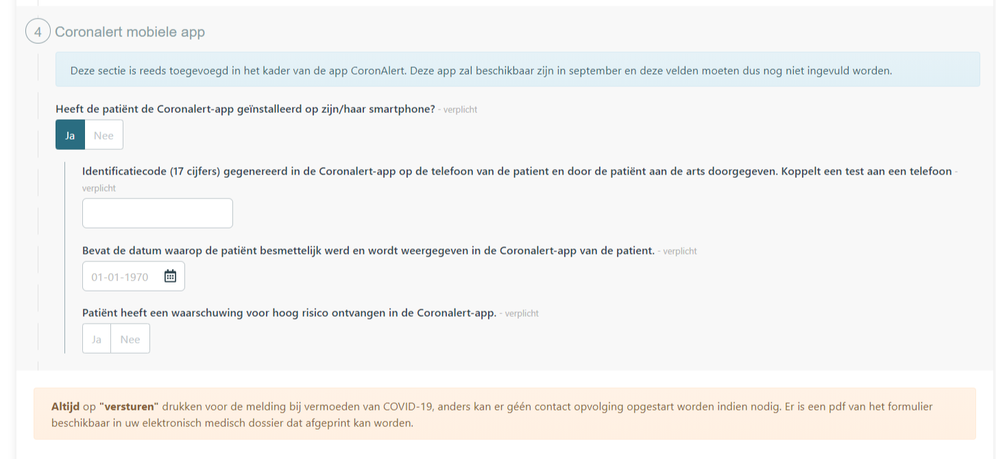
eForm COVID-19 lab request (2/2)

Slide 16
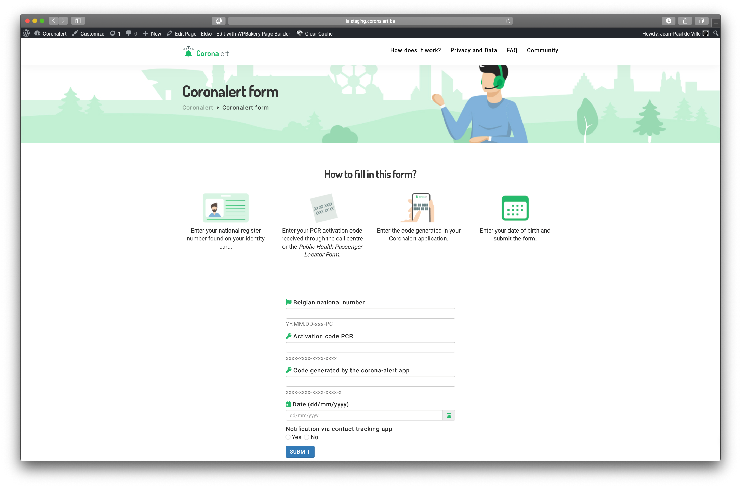
App Coronalert
Details: webform for user

Slide 17
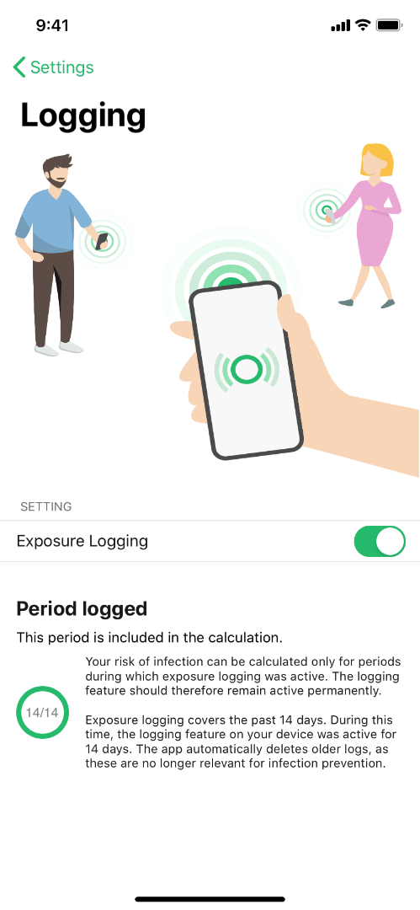
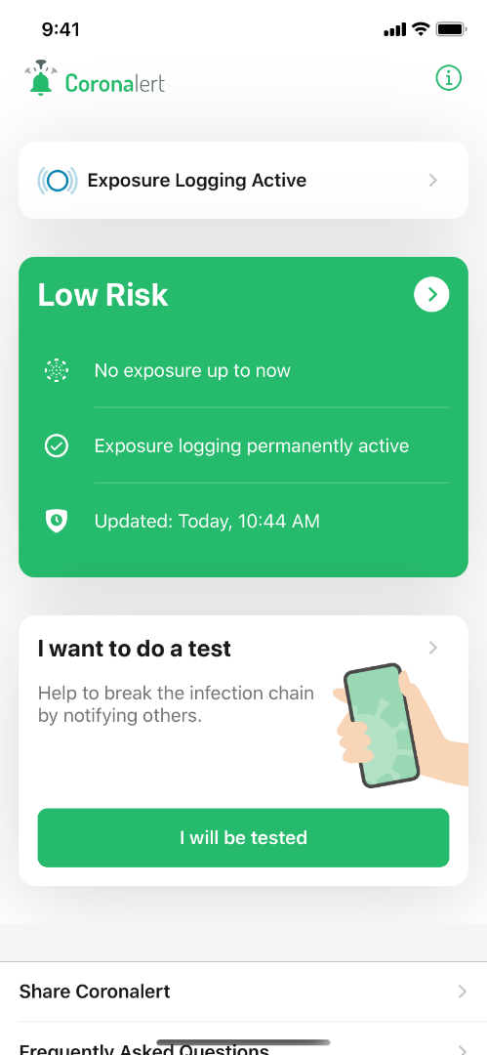
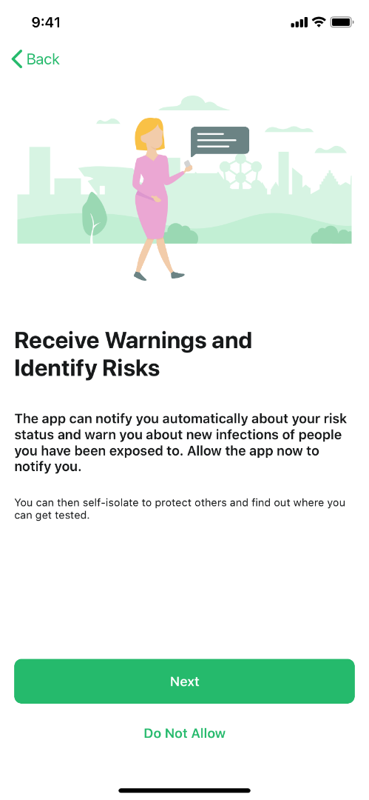
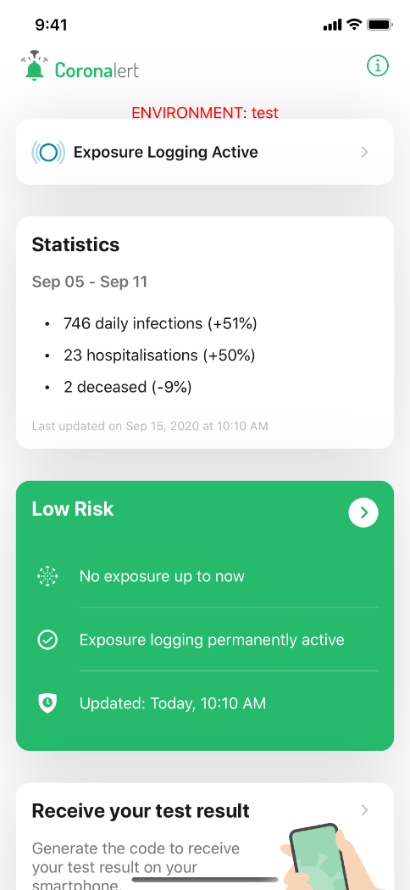
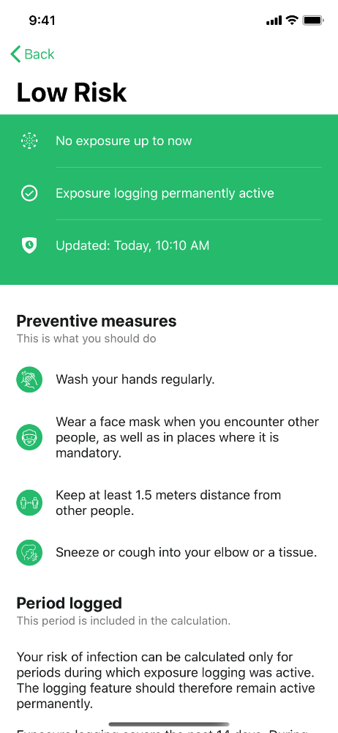
App Coronalert: put your phone to work

Slide 18
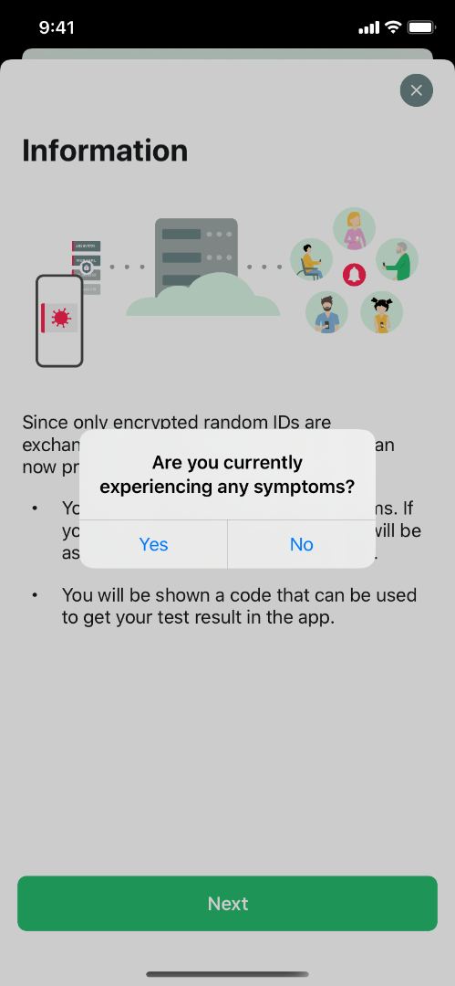
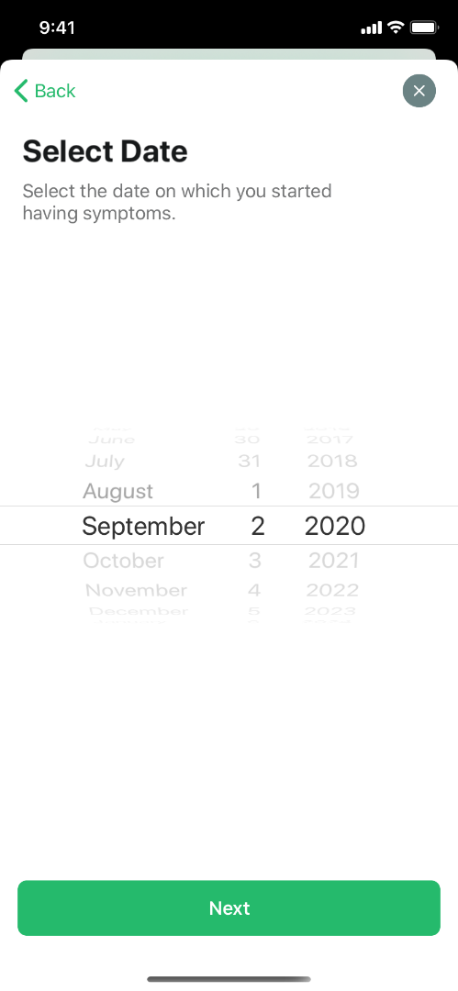
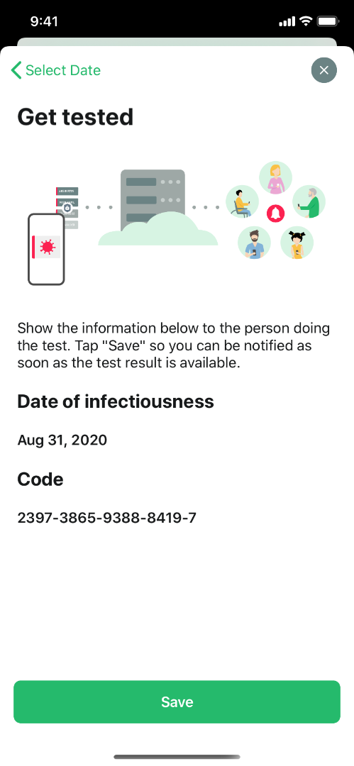
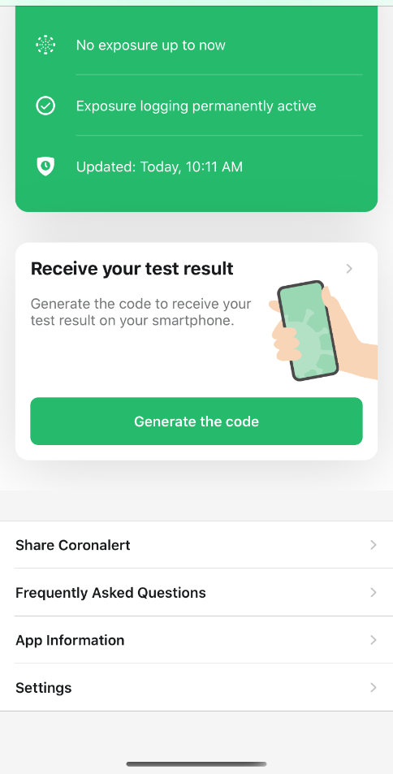
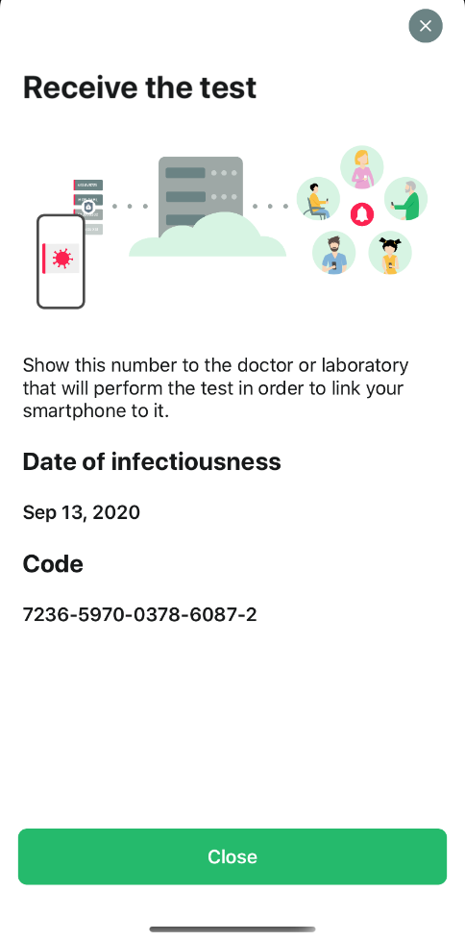
App Coronalert: get tested

Slide 19
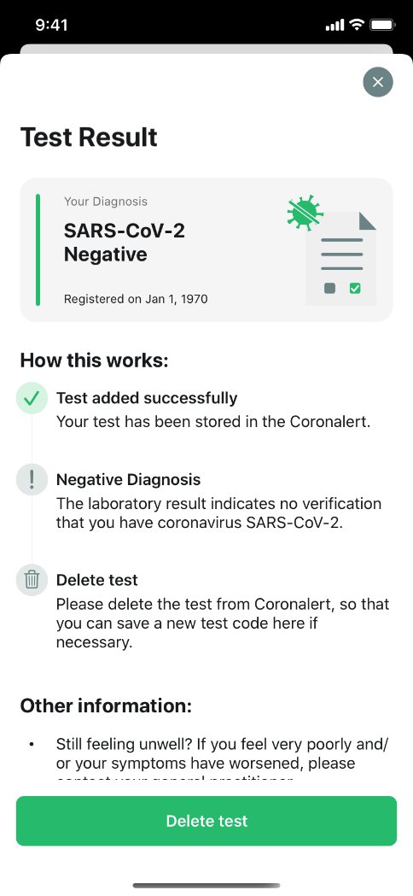
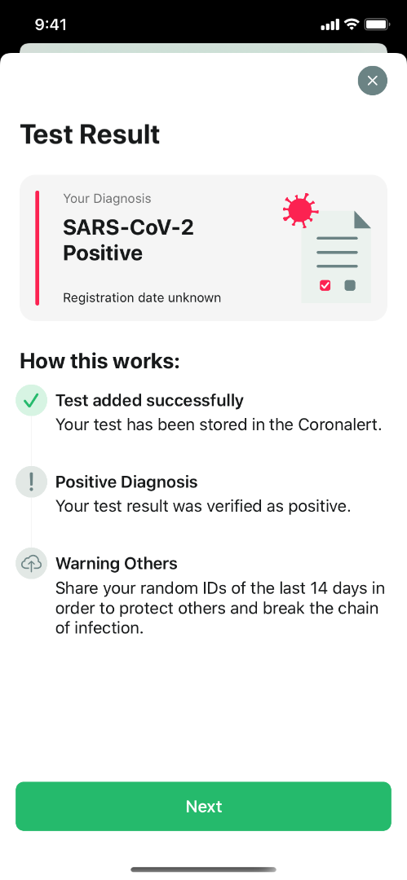
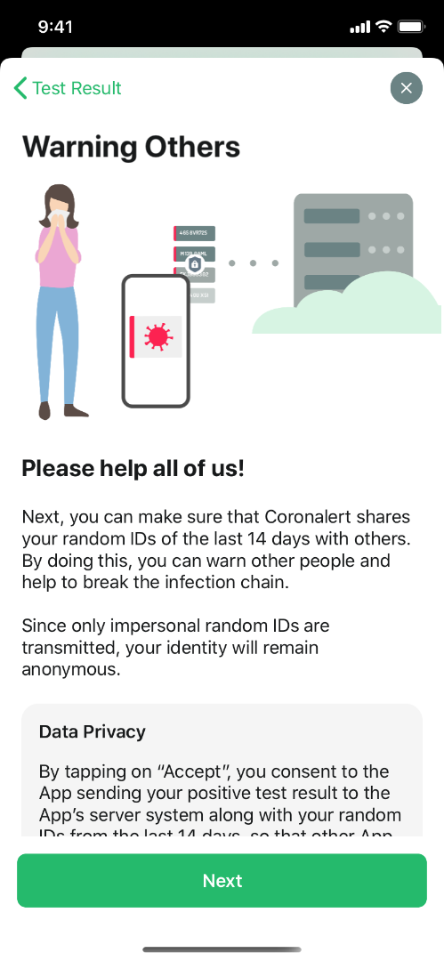
App Coronalert: test result

Slide 20
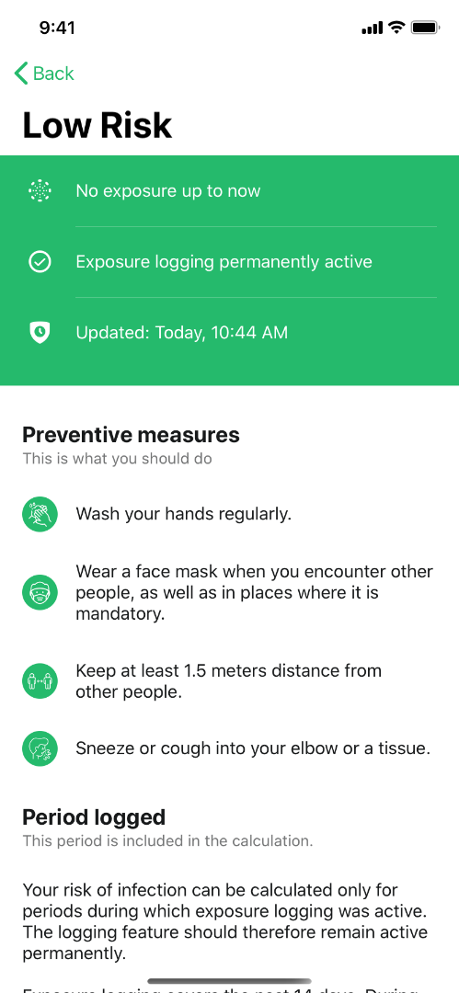
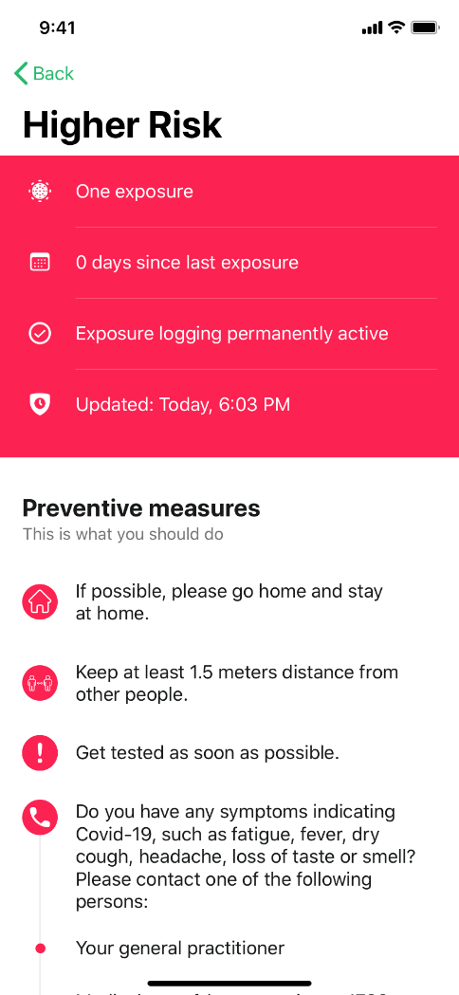
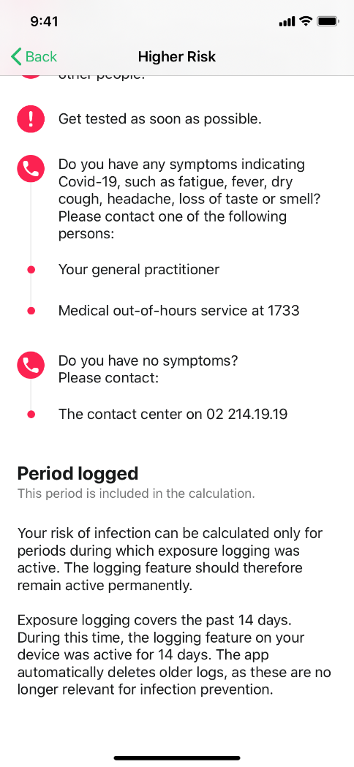
App Coronalert: be notified

Slide 21
App Coronalert
recommend the use of the app
exchange of anonymous codes by the app can be deactivated and reactivated
generate a test code with the app if you are tested and ensure that it ends up at Sciensano together with your social security identification number => you will receive your test result on the app as soon as it is available
general practitioner via eForm LaboratoryTestPrescription
person to be tested via webform (see https://coronalert.be/nl/coronalert-formulier/)
publish the transmitted anonymous codes if you test positively

Slide 22
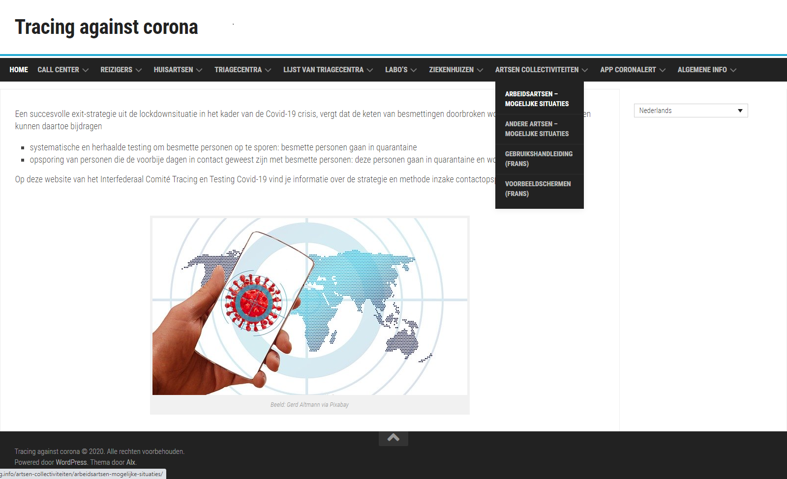
Prescription tool for company and collectivity doctors
See www.corona-tracking.info

Slide 23
frank.robben@ehealth.fgov.be
@FrRobben
https://www.ehealth.fgov.be
https://www.ksz-bcss.fgov.be
https://www.frankrobben.be

