Slide 1
eHealth and its hazards
frank.robben@ehealth.fgov.be
@FrRobben
https://www.ehealth.fgov.be
https://www.frankrobben.be

Slide 2
Summary
eHealth – basic principles & achievements
eHealth platform - overview
eHealth roadmap 3.0 (2019-2021)
Conclusion

Slide 3
eHealth Basic principles & achievements

Slide 4
Roadmaps on eHealth
2012: round table was organized on the further digitization of the health care sector
about 300 people in the sector participated
a concrete eHealth action plan was drawn up for 5 years: roadmap 2013-2018
2015 > update: roadmap 2.0 (2015-2018)
20 action areas with concrete objectives
2019 > roadmap 3.0 (2019-2021) has been elaborated with a focus on, amongst others
operational excellence: availability, performance, quality, chain supervision, usability, training…
applications for citizens
support for innovation
international standards & terminology
…

Slide 5
Roadmap eHealth 2.0

Slide 6
Roadmap eHealth 2.0
Systems & information flows between health care actors
AP 1: GMF = EMF => SumEHR
AP 3: medication schedule
AP 4: electronic prescribing
AP 5: data sharing via the system hubs & metahub by general and university hospitals
AP 6: sharing data for improved cooperation
AP 7: psychiatric and other institutions and the system hubs & metahub
AP 8: implementation of a uniform assessment instrument (BelRAI)
AP 14: MyCarenet

Slide 7
Roadmap eHealth 2.0
Optimization of processes
AP 10: access to the data by the patient
AP 15: administrative simplification
AP 16: traceability of implants and medicines
AP 19: mobile health
Information for research & policy support
AP 18: inventory and consolidation of registers

Slide 8
Roadmap eHealth 2.0
Support & Incentives
AP 2: hospital EPF
AP 9: incentives for use
AP 11: communication
AP 12: training and IT support for health care providers
AP 20: governance, roll out and monitoring
Basic systems
AP 13: standards and terminology policy
AP 17: general use of eHealthBox and data from health care providers available in CoBRHA

Slide 9
Roadmap eHealth 2.0
Focus on
GMF = EMF => SumEHR
hospital EPF
data sharing / hubs & metahubs
eHealthBox & UPPAD
electronic prescribing
MyCareNet
access to the data by the patient
mobile health

Slide 10
GMF = EMF => SumEHR
In order to guarantee the quality of the care and to inform the patient correctly, the general practitioner (GP) registers the medical data in an EMF (Electronic Medical File)
The EMF is the authentic source for data sharing by GPs
The SumEHR (SUMmarized Electronic Health Record) is a concise summary of the EMF in a structured and coded form that is stored in a well protected health vault with 24/7 availability

Slide 11
GMF = EMF => SumEHR
Each patient is entitled to having a SumEHR, if desired
The information in the SumEHR is, with the patient’s consent, accessible to any physician having a therapeutic relation with the patient, and to the patient himself
Use of the SumEHR for out-of-hours GPs and emergency departments is being prioritized

Slide 12
GMF = EMF => SumEHR
Objectives 01/01/2020
GP’s: approval of the legal basis by The National Commission of Representatives of Physicians and Sickness Funds
every general practitioner has to use a recognized software package with the possibility to register an EMF for each patient
other health care providers
definition of the EMF
publication and update of certain information in the secure ‘health vaults’

Slide 13
Hospital EPF
EMF = electronic medical file > general practitioners
EPF = electronic patient file > health care providers in general
Integrated EPF is a tool that is necessary for
better quality / continuity in the health care sector
administrative simplification (paperless)
cost reduction (avoiding unnecessary examinations)
policy support for authorities and hospitals

Slide 14
Hospital EPF
Integrated EPF has to contain (para)medically relevant data on a patient (consultation, hospitalization, emergency admission), that is accessible everywhere (intramural and extramural) and at any time
Integrated EPF = interoperable system with
clinical data on patients
health care data on patients (medical, nursing)
data on invoicing, pricing, reimbursement
administrative data
management of the planning of consultations, the operation theatre, …
hotel service
etc

Slide 15
Hospital EPF
Simplification of the previous ICT financing method in 3 parts
Phasing but rewarding early adopters
Impossible and imaginary to define the contents/categories of one single EPF for all hospitals at once (size, type of personnel, etc)
Working on the basis of functionalities/goals to be achieved (result commitment)
Use of eHealth value added services
Belgian Meaningful Use Criteria (BMUC)

Slide 16
Hospital EPF
BMUC – general hospitals
Functionalities | Step 1 | Step 2 | Step 3 | Step 4
1. Unique patient identification and description | 80% | 90% | 95% | 98%
2 List of (active and passive) problems | 20% | 50% | 80% | 98%
3. List of allergies and intolerances | 30% | 60% | 90% | 98%
4. Electronic prescribing of medicines | 30% | 60% | 90% | 98%
5. Drug interactions | No | No | No | Yes
6. Electronic register of administered medicines | 30% | 60% | 90% | 98%
7. Module for nurse care planning | 0% | 30% | 60% | 98%
8. Management of appointments | >0 | >0 | >0 | >0
9. Electronic input of applications for medical imaging, laboratory or advice | 1 in 3 (X-Ray, labo, consultation) 50% pro rata | 2 in 3 (X-Ray, labo, consultation) 50% pro rata | 3 in 3 (X-Ray, labo, consultation) 50% pro rata | 3 in 3 (X-Ray, labo, consultation) 98% pro rata
10. Electronic discharge letter | 80% | 90% | 95% | 98%
11. Registration of vital parameters | 50% | 65% | 80% | 98%
12. Registration of informed consent | >0 | >0 | >0 | >0
13. Registration of the therapeutic consent | >0 | >0 | >0 | >0
14. Medical results server | 80% | 90% | 95% | 98%
15. Electronic communication with HUBs and interaction with eHealth | 80% | 90% | 95% | 98%

Slide 17
Hospital EPF
Contract or Action Plan
Step 1 Meaningful Use Model
Start of
Meaningful Use Model
Action Plan
2016/07
2017/06
2018/01
2019/01

Slide 18
Hospital EPF
Early Adopters Progressive Budget
from 0% to 5%
Accelerator budget:
= evolutive
Base per bed = degressive
from 25% to 10%
Base per hospital = degressive
from 20% to 5%

Slide 19
Hospital EPF
Situation 2018
77 % strategic ICT plan
75% multiannual budget
85% governance structure
Objectives 2019
most hospitals have an integrated EPF in production and are already using it, other hospitals are implementing an integrated EPF that meets the BMUC criteria
a multiannual strategic ICT plan and budget, and an appropriate governance structure exists in each hospital
immediate publication of important electronic documents via hubs

Slide 20
Hubs & Metahub
System to make medical data available between health care providers
consultation and operation reports
discharge letters
protocols of medical imaging and results of lab tests
SumEHRs, medication schedules, … in health vaults
...
Objective
linking regional and local exchange systems of medical data (hubs)
possibility for health care providers to retrieve and consult the available electronic medical files regarding a specific patient, irrespective of
the location where these documents are stored
the location where the health care provider logs into the system

Slide 21
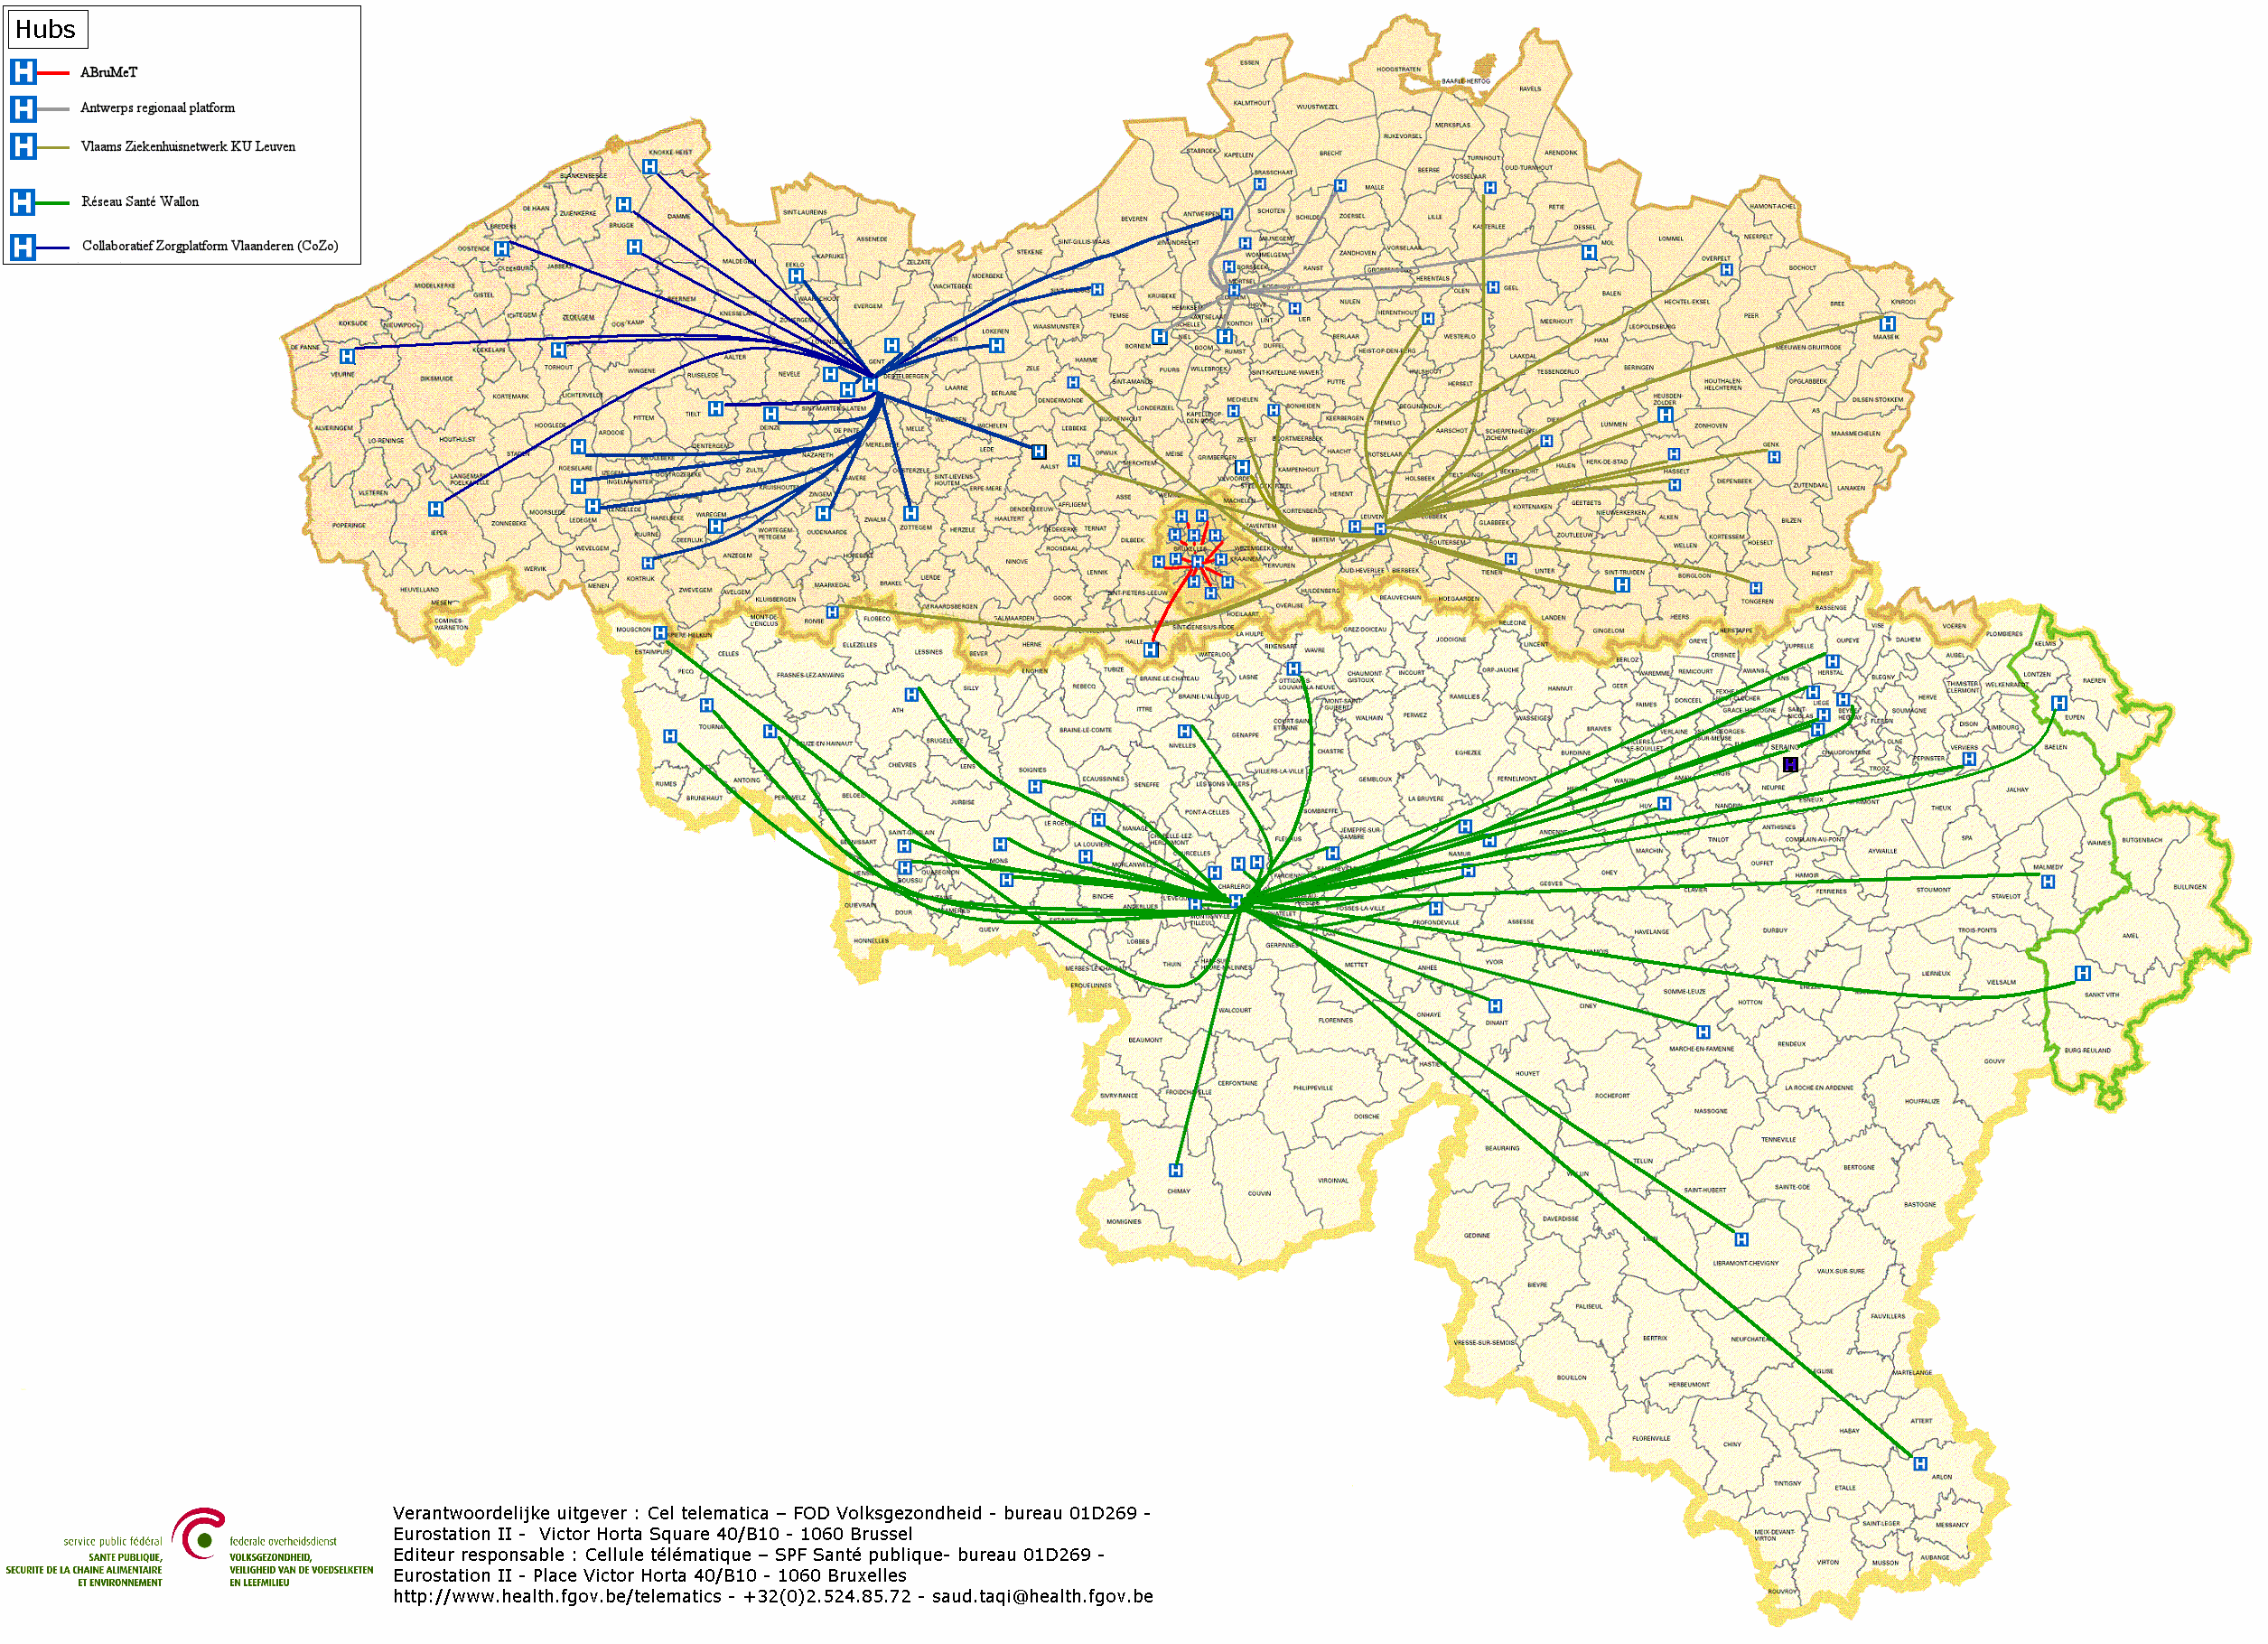
Hubs & Metahub - Scheme
5 hubs
The Collaborative Care Platform (in Dutch: Cozo)
Antwerpian Regional Hub (ARH)
Flemish Hospital Network KU Leuven (in Dutch: VZN)
Health Network of Wallonia (in French: RSW)
Brussels Health Network (in French: RSB)

Slide 22
Hubs & Metahub
Situation 2018
system for sharing data and documents by general and psychiatric hospitals via the following 5 hubs
the Collaborative Care Platform (in Dutch: Cozo)
Antwerpian Regional Hub (ARH)
Flemish Hospital Network KU Leuven (in Dutch: VZN)
Health Network of Wallonia (in French: RSW)
Brussels Health Network (in French: RSB)
reference to first-line documents (SumEHR, medication schedules...) via the 3 health vaults/metahub
Vitalink
InterMed
BruSafe

Slide 23
Hubs & Metahub – Past situation

Slide 24
Hubs & Metahub - Now
3. Retrieve data from hub A
A
1: Where can we find data?
2: In hub A and C
4: All data available
3: Retrieve data from hub C
C
B

Slide 25
Extramural data: vaults
A
InterMed
BruSafe
C
B

Slide 26
Hubs & Metahub

Slide 27
Hubs & Metahub

Slide 28
Hubs & Metahub

Slide 29
Hubs & Metahub

Slide 30
Informed consent
Required condition for the exchange of health data: patient has given his informed consent to share his health data electronically
regulation has been approved by the various management and advisory bodies of the eHealth platform (Consultation Committee with the users, Board of Directors and Information Security Committee)
only exchange between health care providers/institutions having a therapeutic/care relationship with the patient
registration of the consent by the patient himself or through his doctor, pharmacist, health fund or hospital

Slide 31
Informed consent
Possibility to exclude a health care provider
Possibility to withdraw the consent
Possibility to modify his permission profile at any time, without any restrictions concerning the modifications
Possibility to see who has entered or modified the informed consent
Permanent support to encourage the registration of consents
8.106.227 consents on 11/02/2019

Slide 32
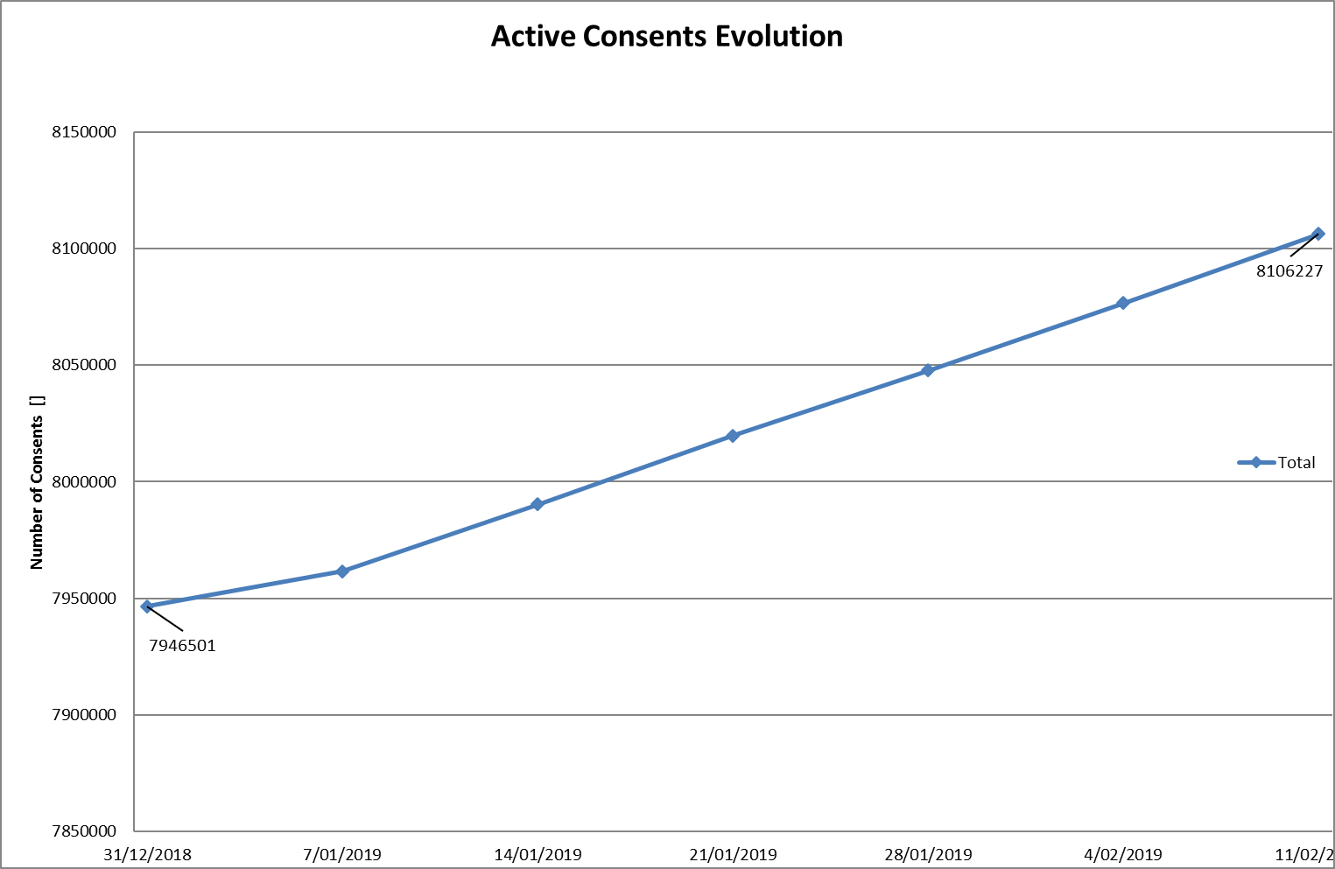
Informed consent
Notes:
NL

Slide 33
Informed consent

Slide 34
Therapeutic/care relationships
Definition: the relationship between a specific patient and one or more health care professionals involved in activities concerning diagnosis, prevention or care for the patient
Examples of evidence of a therapeutic/care relationship
establishment of a GMF with a GP
consultation with an individual health care provider
hospitalization
supply of a medicinal product in a pharmacy
…

Slide 35
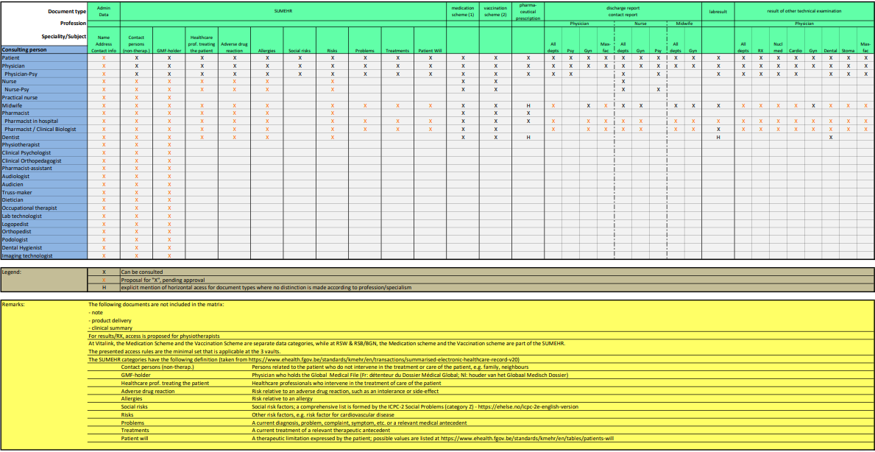
Access matrix

Slide 36
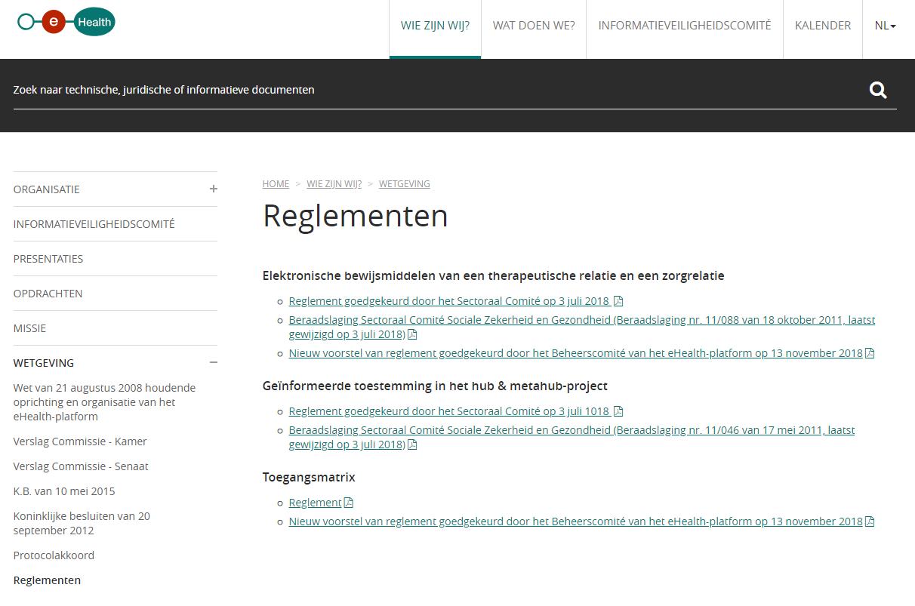
www.ehealth.fgov.be/ehealthplatform/nl/reglementen

Slide 37
eHealthBox, CoBRHA and UPPAD
eHealthBox
enables secure asynchronic electronic communication of medical and confidential information between health care actors
generally used by health care actors registered in CoBRHA
CoBHRA
common database with information about health care providers and care institutions
UPPAD
enables health care actors to consult / modify / complete specific information themselves
unique electronic counter (UPPAD)
address book (CoBRHA database)

Slide 38
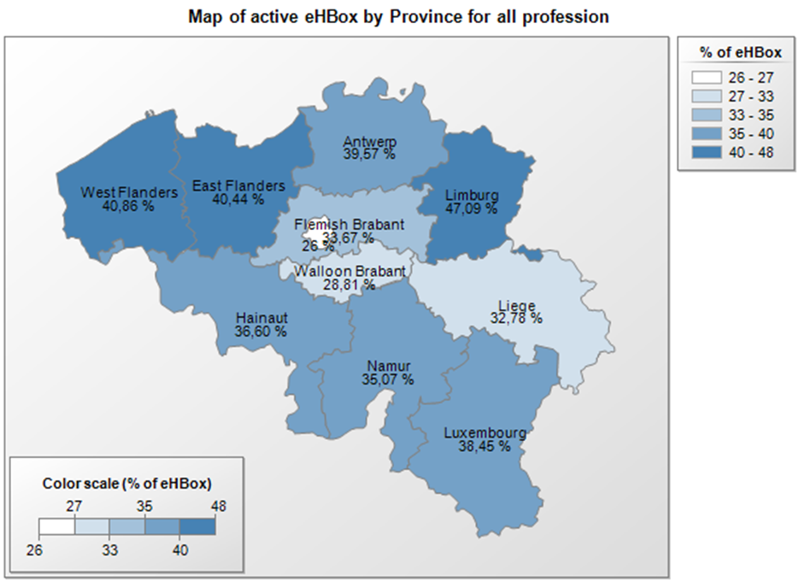
eHealthBox
figures on 26/11/2018

Slide 39
eHealthBox
Address book
allows senders of messages to health care providers to decide which channel type and which information are the most appropriate
for communicating medical data > mandatory use of eHealthBox
for communicating administrative data (internship, recognition…) > using a regular e-mail address allowed and if no data available > shipment by mail (paper)
available address book data comes from CoBRHA

Slide 40
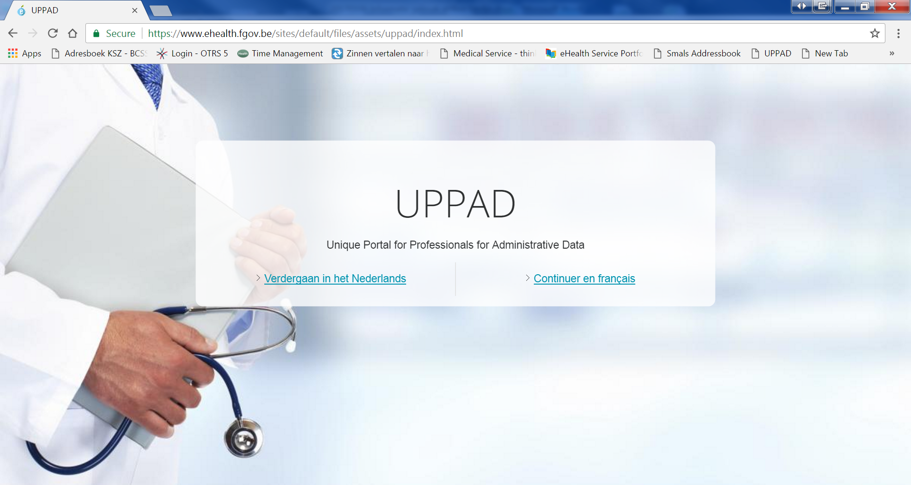
UPPAD

Slide 41
UPPAD
UPPAD → Unique Portal for Professionals for Administrative Data
Central hub (website) where individual health care providers can consult their administrative data (e.g. visa, recognition…) that are known to government bodies (authentic sources)
Information coming from CoBRHA

Slide 42
UPPAD
Possibility to modify specific Authentic Source data yourself (being a health care provider) using underlying applications
Possibility to start up administrative processes electronically (e.g. recognition request) or consult information pages (e.g. procedures on the FPS Public Health website)
UPPAD will not replace applications/procedures that currently exist in various ‘authentic sources’
Health care providers cannot update information directly in UPPAD
UPPAD merely forwards health care providers to the right application / information available in the authentic sources (= gateway only)

Slide 43
Electronic prescribing (Recip-e)
Current situation
physician, dentist or midwife who prescribes medication electronically (via software package and the Recip-e service) gives his patient a ‘proof of e-prescribing’ containing a barcode
by scanning the barcode the pharmacist can download the electronic prescription → only the electronic prescription has legal value
Future situation
no ‘proof of e-prescribing’ anymore
authentication of the patient at the pharmacy
pharmacist and patient have electronic access to all pending electronic descriptions of the patient

Slide 44
Electronic prescribing (Recip-e)
Advantages for pharmacists
easily download the prescription
know the reimbursement level of the prescribed medicine
send feedback to the prescriber
Advantages for prescribers/health care providers
draw up, consult, send and if needed modify prescriptions that haven’t been provided yet
delete a prescription that hasn’t been provided yet (if he justifies his decision)
receive feedback from the health care provider (pharmacist, physiotherapist, nurse)
Advantages for patients
consult his prescriptions via secure internet access
delete prescriptions which he finds to be useless

Slide 45
Electronic prescribing
A ‘protocol for the electronic prescription of drugs to ambulatory patients’ describes the conditions and situations allowing the use of paper prescriptions due to force majeure, e.g.
the urgent need of medical assistance is indisputable
the prescriber is a foreign citizen without a NISS (or bis) number
the patient is a foreign citizen without a NISS (or bis) number
the patient is a newborn waiting for a NISS number
etc

Slide 46
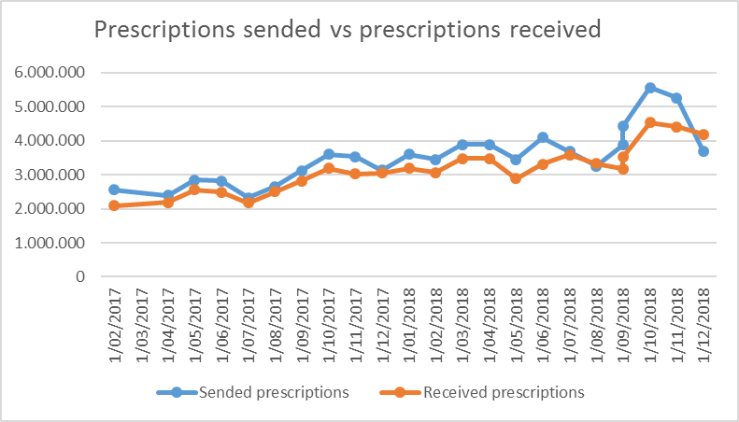
Electronic prescribing
Notes:
NL

Slide 47
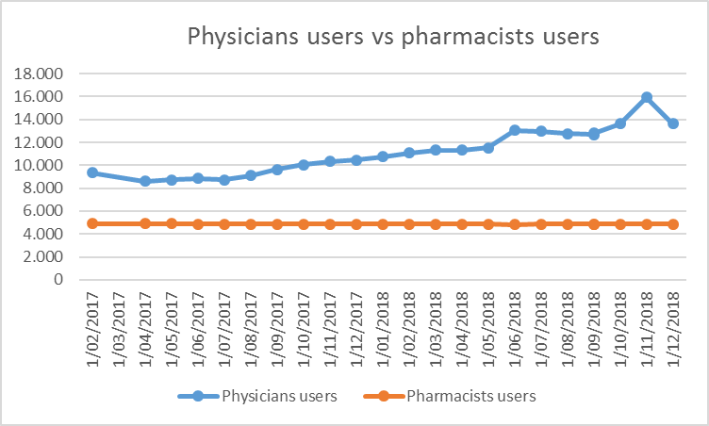
Electronic prescribing
Notes:
NL

Slide 48
PARIS Prescription & Autorisation Requesting Information System
Free web application made available by software providers at INAMI’s request
offering minimal service to prescribers for delivering electronic prescriptions outside the Electronic Medical File
as an online service on the eHealth portal, with strong authentication
no interaction with the electronic medical file or other data sharing systems

Slide 49
PARIS Prescription & Autorisation Requesting Information System
Target groups
prescribers (temporarily) not having access to the software for managing patient records, or to the hospital’s ICT systems
prescribers not having any software (yet) for managing electronic medical files
some specialist categories
occasional prescribers (limited practice only, or no longer medical practitioner in the classic sense – working for insurance companies, administrations, educational organizations, clinical biologists, anatomist-pathologists…)
older prescribers at the end of their career

Slide 50
MyCareNet
MyCareNet > several applications
electronic consultation of insurance status by health care providers and institutions
electronic transfer of third-party invoicing by health care providers and institutions
medical-administrative flows for the home care sector
electronic transfer of medical certificates given by health care providers to insurance companies

Slide 51
MyCareNet
MyCareNet ‘Insurance status’
goal
enable individual providers and institutions to check insurance information about their patients
features
request insurance information on a patient
MyCareNet ‘third-party invoicing’
goal
enable individual providers and institutions to transfer third-party invoices to health insurance funds
features
upload and transfer third-party invoicing files to a specific health insurance fund
consult the refund decision for an invoice by a specific sickness fund

Slide 52
MyCareNet
MyCareNet ‘medical-administrative’ flows
goal
transfer of medical-administrative documents between health care providers of the home care sector (or their representatives) and insurance companies (medical advisors) to replace or supplement paper documents
features
flows concerning
flat rate requests
specific requests for palliative care patients
requests for specific technical acts

Slide 53
MyCareNet
MyCareNet ‘eAttest’
goal
enable care providers to electronically send their medical certificates (eASD) to insurance companies for patients not making part of the third-party payment system
features
service directly linked with the service to check the insurance status
concerning patients for whom the health care provider is not allowed / not willing to apply the third-party payment process
service available via web services only > not available on a portal, health care providers need to use their own software

Slide 54
Access to data by patient
Objectives
creating a framework for access management, consulting and/or adding health data by the patient
creating a governance structure watching over the execution of the framework
developing a communication strategy to inform citizens/patients about online health information access and other functions for patients regarding data sharing
since November 15 citizens can consult their pending drug prescriptions, providing their general practitioner or dentist delivered it electronically

Slide 55
Access to data by patient

Slide 56
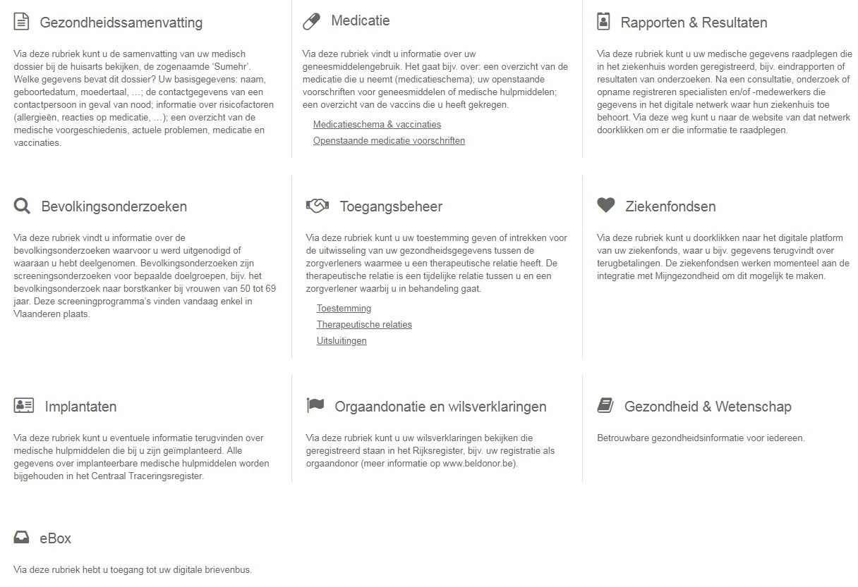
Access to data by patient

Slide 57
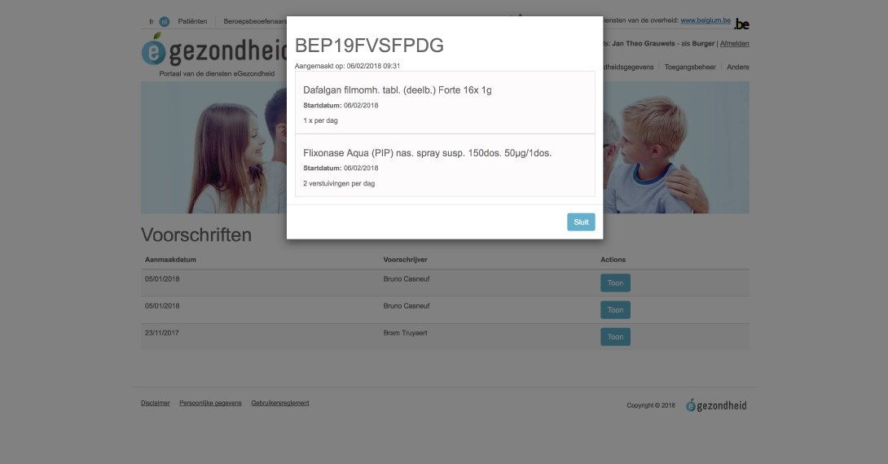
Access to data by patient

Slide 58
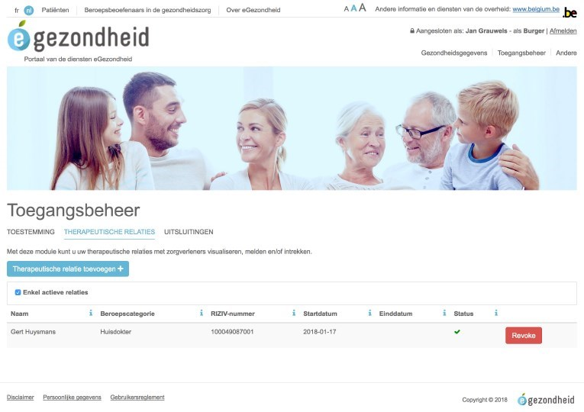
Access to data by patient

Slide 59
Currently approved means of authentication
Strong
 | eID + PIN-code with connected card reader
 | eID + PIN-code with wireless card reader
 | SIM card with PIN-code
 | Security code via mobile app, user-id + password
 | Security code via SMS, user-id + password
 | Security code on paper (paper token), user-id + password
 | User-id + password
Weak

Slide 60
Mobile Health
Objectives 2019
framework for mHealth actions > efficient implementation
support when using mHealth applications
integrate a legal, financial and organizational framework in new and existing care agreements
integration of the eHealth services in mHealth
support quality and accessibility of mHealth
approach based on use cases (diabetes, cardiovascular...)

Slide 61
Mobile Health
5 priority use cases, selected based on their impact (number of patients x severity) and the availability of mHealth technical tools
stroke
diabetes
chronic pain
mental health
cardiovascular disease

Slide 62
Mobile health applications - validation pyramid
M3 Requires M2 Positioned within Belgian health system Conditional financing (expert committee)
CostBenefit Triple Aim
M2 Requires M1 Validated by administrations (or trusted third parties) Security - Authentication (eHP) Interoperability (eHP + SPF -FOD) Scientific evidence (publications)
BE mHealth Validation
CE
Medical device
M1 CE certified as Medical device AFMPS-FAGG) GDPR compliant Belgian privacy law compliant

Slide 63
Mobile health

Slide 64
Mobile health
Applications meeting the required criteria are published at www.mhealthbelgium.be for each level
Today people can already visit the website for more information about the policy on mobile health in Belgium
presentations of the 24 pilot projects can be found here
the first validated health applications have recently been published
an application to detect cardiac dysrhythmias
a rehabilitation application for patients who have undergone knee or hip surgery
an application to improve follow-up of cancer patients during chemo and
an application for people with respiratory or sleep disorders

Slide 65
eHealth platform Overview

Slide 66
Overall architecture
Patients, health care providers, health facilities
Health portal
Software HC provider
Software health facility
VAS
Site NIHDI
VAS
eHealth portal
MyCareNet
VAS
VAS
VAS
Users
Basic services eHealth platform
Network
VAD
VAD
VAD
VAD
VAD
VAD
Suppliers

Slide 67
Basic services eHealth platform
Coordination of digital subprocesses
Portal
Integrated user and access management
Management of logs
System for end-to-end encryption
eHealthBox
Timestamping
Encryption and anonymization
Consultation of the National Register and the CBSS Registers
Reference directory (metahub)

Slide 68
10 Tasks
Development of a vision and of a strategy for eHealth
Organization of the cooperation between all governmental institutions which are charged with the coordination of the electronic service provision
The motor of the necessary changes for the implementation of the vision and the strategy with regard to eHealth
Determination of functional and technical norms, standards, specifications and basic architecture with regard to ICT

Slide 69
10 Tasks
Registration of software for the management of electronic patient files
Managing and coordinating the ICT aspects of data exchange within the framework of the electronic patient files and of the electronic medical prescriptions
Conceptualization, design and management of a cooperation platform for secure electronic data exchange with the relevant basic service

Slide 70
10 Tasks
Reaching an agreement about division of tasks and about the quality standards and checking that the quality standards are being fulfilled
Acting as an independent trusted third party (TTP) for the encoding and anonymisation of personal information regarding health for certain institutions summarized in the law for the support of scientific research and the policymaking
Promoting and coordinating programmes and projects

Slide 71
eHealth Roadmap 3.0 (2019-2021)

Slide 72
Roadmap 3.0 (2019-2021)
Cluster 0 Basics
Cluster 1 Transversal
Cluster 2 Support
Cluster 3 Operational Excellence
Cluster 4
Care providers and care institutions
Cluster 5 Patient as co-pilot
Cluster 6 eHealth & health insurance

Slide 73
Main principles
Adapting current projects, with extra focus on the real use
Stopping no longer relevant projects
Starting new projects limited to projects that can consolidate, harmonize and stabilize current projects
Extension of existing concepts to other target groups or other application areas
Focus on 'operational excellence‘
Development of a framework and management model for using existing systems that have been built by the government and / or the private sector
Connection with Europe and international initiatives and programs

Slide 74
Cluster 0 - Basics
0.1 Informed Consent
0.2 Access matrix, therapeutic, care and other relationships
0.3 User and access management
0.4 Rules for 'eHealth cloud' and distribution of tasks between authentic sources
0.5 Technical standards
0.6 Terminology
0.7 CoBRHA Next Generation & UPPAD
0.8 Strategic research into efficient models of cooperation with external stakeholders

Slide 75
Clusters 1 & 2 – Transversal – Support
1.1 Communication
1.2 Program monitoring
2.1 Incentives
2.2 Legally supported code of conduct & guidelines on sharing personal health information

Slide 76
Cluster 3 - Operational Excellence
3.1 Basic architecture
3.2 SLAs & Service Management
3.3 Business continuity
3.4 Documentation, helpdesk & support
3.5 Test environments : environments, flows, processes, data
3.6 Quality of health software
3.7 Delivery of information to public administrations

Slide 77
Operational excellence – stakeholder requirements
Individual end-users & small healthcare institutions without IT knowledge
high-performance and available end-user applications
integrated service delivery (single environment, single sign on)
meeting their needs
business continuity
functional support and training
transparency in case of interventions and problems
a single functional helpdesk

Slide 78
Operational excellence – stakeholder requirements
Larger healthcare institutions with ICT departments & software providers
test environments
high-performance and available web services
business continuity
technical support and training
transparency in case of interventions and problems
precise division of tasks between the helpdesks

Slide 79
Cluster 3.1 – Basic architecture
Objective: architecture that takes into account context restrictions and optimally supports stakeholders‘ requirements
Method: choice and progressive implementation
maintaining the current division into subsystems or more consolidation ?
data centres and ICT infrastructure
authentic sources from the authorities (CoBRHA, SAM,...)
with partners
secure cloud for healthcare providers and institutions ?
thin clients vs heavy clients ?
division of labour - software suppliers
supervision of software suppliers
free market and tests ?
specifications ?
only end-user funding or also direct funding from software providers ?
catalogue of open, reusable components ?

Slide 80
Cluster 3.2 - SLA’s & Service Management
Objective: high-performance and available end-user applications and web services
Method
SLA
related to availability and performance
difficulty: end-to-end
remove single points of failures (SPOF) in all environments (eg third backup data centre for eHealth platform)
end-to-end monitoring
central dashboard & supervision
incident management
problem management
capacity planning
release & intervention calendar accessible to the public
importance of completeness !

Slide 81
Cluster 3.3 - Business continuity
Objective: business continuity procedures (BCP) for every category of end users
pharmacists
physicians
home nurses
hospitals
Method
definition of minimal functional requirements by representatives of the end users
eliminating all single point of failure (SPOF) across environments (for each crucial component there is an alternative in another environment)
implementation plan with iterations
communication via website https://www.status.ehealth.fgov.be/
training via éénlijn, e-Santé Wallonie, eHealth Academy
integrated dashboard on status of services (availability, performance)
feedback mechanisms on effective use of BCP

Slide 82
Cluster 3.3 - Business continuity
BCP pharmacists
minimal functional requirements
authentication when connecting
having a prescription
consulting the insurance status of a patient
consulting the "Chapter IV" agreements
consulting and updating the Shared Pharmaceutical File (SPF)
archiving executed electronic prescriptions (RAOTD)
operational
more information on https://www.status.ehealth.fgov.be/fr/pharmaciens/business-continuity/

Slide 83
Cluster 3.3 - Business continuity
BCP general practitioners
essential functional requirements
authentication when connecting
consulting electronic documents available via the hub-metahub system (documents in hospitals, laboratories, medical imaging centres, etc.)
consulting the vaccination status of a patient
consulting the SumEHR of a patient
creating a prescription
consulting the insurance status of a patient
electronic transfer of the certificate of care given to the patient to his sickness fund (eAttest)
electronic billing to the sickness fund for a patient who benefits from the third-party payment system (eFact)
work in progress
more information on
https://www.status.ehealth.fgov.be/fr/medecins-generalistes/business-continuity/

Slide 84
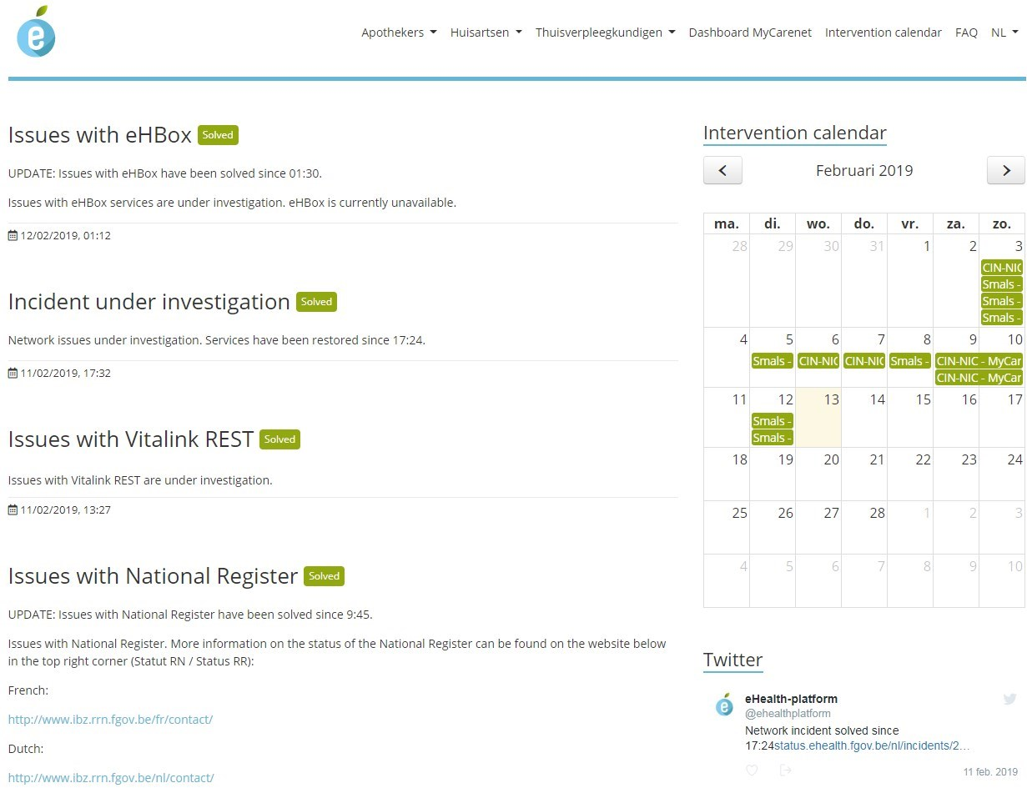
Cluster 3.3 - Business continuity
www.status.ehealth.fgov.be

Slide 85
Cluster 3.4 - Documentation, helpdesk & support
Objective: easy-to-use and clear documentation for the various stakeholders and single point of contact for helpdesk and support for each stakeholder
Method
distinction between end-users on the one hand and software suppliers/computer sections on the other
clear documentation that can easily be found
provided by the owner of each service with different levels of detail
on the basis of a common notional framework
available in an integrated way on the eHealth portal
helpdesk & support
the software providers organize the helpdesk and support for end users
the service owner organizes helpdesk and support for authentic sources and new value-added services
the helpdesk and support of the eHealth platform is available to software providers, ICT sections and owners of value-added services

Slide 86
Cluster 3.5 – Test environments
Objective: for software providers, ICT sections in healthcare organizations and developers of value-added services, providing integrated test environments
Method
providing integrated test environments and their documentation by
eHealth platform for basic Services
any service provider (e.g. FPS BOSA, national register)
any supplier of an authentic source
providing coordinated test data sets and their documentation
unit tests and end-to-end tests
minilabs for community support

Slide 87
Cluster 3.6 - Quality of health software
Providing a qualification tool
needed to support ICT suppliers in the process of integrating and checking quality
is a website that guides ICT suppliers step by step towards obtaining a formal validation/homologation/registration
Providing and periodically updating a self-evaluation
the aim is to incorporate this into the federal concept of the validation pyramid
the qualification tool supports this process
the starting point of the evaluation process is a self-evaluation, to be carried out by the ICT suppliers themselves

Slide 88
Cluster 4 – Care providers and care institutions
4.1 Multidisciplinary exchange of information
4.2 Multidisciplinary features
4.3 Electronic prescription
4.4 VIDIS
4.5 Decision support platform
4.6 BelRAI
4.7 Mult-eMediatt
4.8 MEDEX in the field of eHealth
4.9 EPF in all hospitals

Slide 89
Cluster 4 – Care providers and care institutions
4.10 Publication of structured information
4.11 Registers
4.12 Communication about care planning
4.13 European Connecting Europe Facility (CEF) Project "Patient Summary

Slide 90
Cluster 5 – Patient as co-pilot
5.1 Patient Health Portal
5.2 Digital reference platform
5.3 Orgadon

Slide 91
Cluster 6 – eHealth & health insurance
6.1 eAttest for dentists, specialists, physiotherapists and logopedists
6.2 Third-party billing for Medical Homes, Physiotherapists and logopedists
6.3 Data consultation
6.4 Digitisation of revalidation agreements
6.5 Digitisation of Chapter IV agreements
6.6 Subscriptions in Medical Homes
6.7 Digitisation of physiotherapy agreements

Slide 92
Conclusion
The sharing of data between healthcare providers / institutions via the hub-meta-hub system, the health safes and the eHealthBox reaches cruising speed
> 70% of the Belgian population has now given their informed consent
The opening up of health data for the patient starts => attention for integrated access
Experience is gained with mobile eHealth applications

Slide 93
Thank you Any questions?
frank.robben@ehealth.fgov.be
@FrRobben
https://www.ehealth.fgov.be
https://www.frankrobben.be

