Slide 1
Public private partnership concerning user and access management (UAM): the vision of the federal administration
frank.robben@ksz.fgov.be
@FrRobben
https://www.ksz.fgov.be
https://www.ehealth.fgov.be
https://www.frankrobben.be

Slide 2
Outline of the presentation
UAM: strategic importance and objectives to be reached
conceptual framework
user expectations and critical success factors
vision of the federal administration
main vision
identification number for every entity
division of tasks related to UAM
architecture: policy enforcement model
concrete implementation authentication of identity for eGovernment and eHealth-applications
eIDAS and Belgian regulation
short appendix: legally valid electronic signature

Slide 3
1. Strategic importance of UAM
reliable exchange of personal data requires sufficient certainty about the identity of the data subjects
adequate access control requires sufficient certainty about
identity of the users
authentication of the identity of the users
verification of relevant characteristics of the users
verification of relevant relationships between the users and the data subjects
verification of relevant mandates of the users

Slide 4
1. UAM: objectives to be reached
be able to (electronically)
identify all relevant entities (physical persons, companies, applications, machines, …)
know the relevant characteristics of the entities
know the relevant relationships between entities
know that an entity has been mandated by another entity to perform a legal action
know the authorizations of the entities
in a sufficiently certain and secure way
in as much relations as possible (C2C, C2B, C2G, B2B, B2G, …)
using open interoperability standards

Slide 5
2. Conceptual framework
entity
someone or something that has to be identified
e.g. a physical person, a company, a computer application, …
attribute
a piece of information about an entity
identity
a number or a set of attributes of an entity that allows to know precisely who or what the entity is
an entity has only one identity, but this identity can be determined by several numbers or sets of attributes

Slide 6
2. Conceptual framework
characteristic
an attribute of an entity, other than an attribute determining its identity
an entity can have several characteristics
e.g. a capacity, a function, a professional qualification, ...
relationship
a link between two or more entities
an entity can have several relationships
e.g. a therapeutic relationship between a health care provider and a patient

Slide 7
2. Conceptual framework
mandate
a right granted by an identified entity to another identified entity to perform well-defined legal actions in her name and for her account
an entity can have several mandates
registration
the process of determining the identity, a characteristic, a relationship or a mandate of an entity with sufficient certainty
before putting at the disposal means by which the identity can be authenticated, or the characteristic, the relationship or the mandate can be verified

Slide 8
2. Conceptual framework
authentication of the identity
the process of checking whether the identity that an entity pretends to have, corresponds to the real identity
authentication of the identity can be done based on the verification of
knowledge (e.g. a password)
possession (e.g. an electronic card)
biometric characteristics
a combination of those (multifactor authentication)

Slide 9
2. Conceptual framework
verification of a characteristic, a relationship or a mandate
the process of checking whether a characteristic, a relationship or a mandate that an entity pretends to have, corresponds to a real characteristic, relationship or mandate of that entity
the verification of a characteristic, a relationship or a mandate can be done by
the same kind of means as those used for the authentication of the identity
or, after the authentication of the identity, by consulting reliable databases (‘authentic sources’) that contain information about characteristics, relationships or mandates related to identified entities

Slide 10
2. Conceptual framework
authorization
a permission to an entity to perform a defined action or to use a defined service
authorization group
a group of authorizations
role
a group of authorizations or authorization groups related to a specific service
role based access
a method of assigning authorizations to entities by means of authorization groups and roles, in order to simplify the management of authorizations and their assignment to entities

Slide 11
3. User expectations
one-time registration of identity, characteristics, relationships and mandates
single sign on for as many public and private sector applications as possible
authentication of the identity
verification of relevant characteristics, relationships and mandates
electronic means for authentication of identity that can be used on as much devices as possible
minimal cost of
registration procedures
electronic means for authentication of identity
use of electronic means for authentication of identity

Slide 12
3. Critical success factors
meeting user expectations
simplicity in use
taking advantage of opportunities of technological evolution => evolutionary, future proof solutions
accordance with the European regulatory framework
sufficient applications for which electronic user management can be used

Slide 13
4 a. Main vision
evolution of the society to 'digital is the new normal' requires
collaboration between the government and the private sector with respect to
common vision
multifunctional components and services
synergies to meet user expectations
division of tasks based on strengths of each one
not only thinking in terms of competitive, but also in terms of cooperative strategic benefits

Slide 14
4 b. Identification number
identification number for every citizen and every company, having following characteristics
unicity
one entity – one identification number
same identification number is not assigned to several entities
exhaustivity
every entity to be identified has an identification number
stability through time
identification number should not contain variable characteristics of the identified entity
identification number should not contain references to the identification number or characteristics of other entities
identification number should not change when a quality or characteristic of the identified entity changes

Slide 15
4 c. Division of tasks
registration of the identity of
citizens: municipalities
companies: company counters
official identification document for citizens
delivered by the municipalities (eID)
means for the electronic authentication of identity
free choice for user between means offered
by the government or
by the private sector, recognized by the government
free of charge for user

Slide 16
4 c. Division of tasks
registration of characteristics, relationships and mandates relevant for eGovernment or eHealth
by public or private bodies designated by government
with quality assurance
authentic sources containing characteristics, relationships and mandates relevant for eGovernment or eHealth
managed by public or private bodies designated by government
with SLA’s
according to a federated model
accessible by UAM
for eGovernment and eHealth applications
for private sector applications
authorization is the responsibility of each service provider

Slide 17
4 d. Policy Enforcement Model
Action on application
DENIED
Policy Enforcement (PEP)
Action on application
PERMITTED
User
Application
Action on application
Decision request
Decision reply
Policy Decision (PDP)
Information request/reply
Policy
retrieval
Information request/reply
Policy management
Policy Administration (PAP)
Policy Information (PIP)
Policy Information (PIP)
Manager
Policy repository
Authentic source
Authentic source

Slide 18
4 d. Policy Enforcement Point (PEP)
intercepts the request for authorization with all available information about the user, the requested action, the resources and the environment
passes on the request for authorization to the Policy Decision Point (PDP) and extracts a decision regarding authorization
grants access to the application and provides relevant credentials
Action on application
DENIED
Policy Enforcement (PEP)
Action on application
PERMITTED
User
Application
Action on application
Decision request
Decision reply
Policy Decision (PDP)

Slide 19
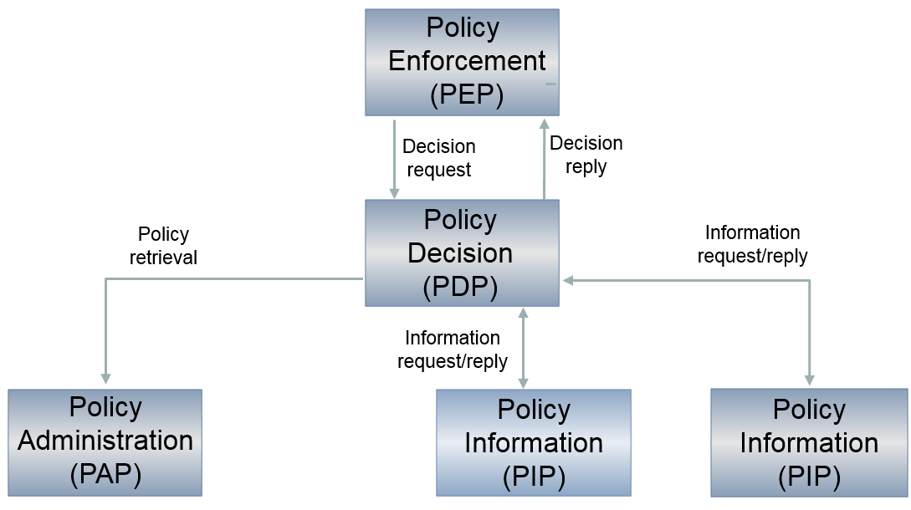
4 d. Policy Decision Point (PDP)
based on the request for authorization received, retrieves the appropriate authorization policy from the Policy Administration Point(s) (PAP)
evaluates the policy and, if necessary, retrieves the relevant information from the Policy Information Point(s) (PIP)
takes the authorization decision (permit/deny/not applicable) and sends it to the PEP

Slide 20
4 d. Policy Administration Point (PAP)
environment to store and manage authorization policies by authorized person(s) appointed by the application managers
puts authorization policies at the disposal of the PDP
Policy Decision (PDP)
Policy
retrieval
Policy management
Policy Administration (PAP)
Manager
Policy repository

Slide 21
4 d. Policy Information Point (PIP)
puts information at the disposal of the PDP in order to evaluate authorization policies (authentic sources with characteristics, relationships, mandates, etc.)
Policy Decision (PDP)
Information request/reply
Information request/reply
Policy Information (PIP)
Policy Information (PIP)
Authentic source
Authentic source

Slide 22
4 d. Federated architecture
eHealth platform
Social sector
(CBSS)
Non social FPS
(BOSA)
USER
USER
USER
APPLICATIONS
APPLICATIONS
APPLICATIONS
Authen
-
Authorisation
Authen
-
Authorisation
Authen
-
Authorisation
tication
PEP
WebApp
tication
PEP
WebApp
tication
PEP
WebApp
Role
XYZ
Role
XYZ
Role
XYZ
Mapper
Mapper
Mapper
Role
Role
Role
Mapper
Mapper
Mapper
DB
DB
DB
PDP
Role
PAP
PDP
Role
PAP
PDP
Role
PAP
Role
Provider
‘’Kephas’’
Role
Provider
‘’Kephas’’
Role
Provider
‘’Kephas’’
Provider
DB
Provider
DB
Provider
DB
PIP
PIP
PIP
PIP
PIP
PIP
PIP
PIP
PIP
Attribute
Attribute
Attribute
Attribute
Attribute
Attribute
Attribute
Attribute
Attribute
Provider
Provider
Provider
Provider
Provider
Provider
Provider
Provider
Provider
Management
Management
DB
DB
Management
DB
RIZIV
DB
DB
UMAF
DB
Judicial
exut-
ers
XYZ
DB
Mandates
XYZ
VAS
Mandates
XYZ
VAS
XYZ
VAS

Slide 23
4 e. Concrete implementation authentication of the identity
Strong
 | eID + PIN-code with connected card reader
 | eID + PIN-code with wireless card reader
 | Recognized solutions delivered by the private sector
 | Security code via mobile app (TOTP), user-id + password
 | Security code via SMS, user-id + password
 | Recognized solutions delivered by the private sector
 | Security code on paper (paper token), user-id + password
 | User-id + password
Weak

Slide 24
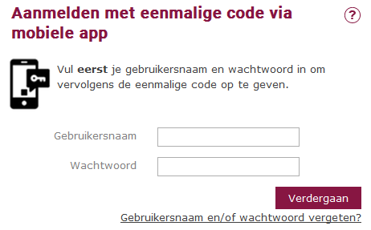
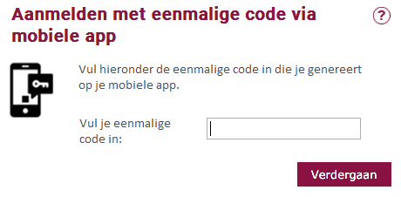
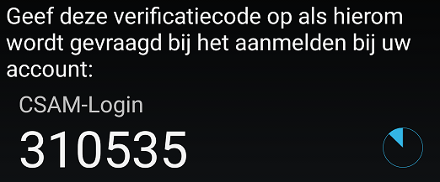
4 e. Concrete implementation: TOTP
Examples: Google Authenticator, Duo Mobile, Amazon AWS MFA en Authenticator, freely available

Slide 25
5. eIDAS regulation: objectives
regulation (EU) No 910/2014 of 23 July 2014 on electronic identification and trust services for electronic transactions in the internal market (“eIDAS regulation” - electronic identification, authentication and trust services)
strengthen EU single market by boosting trust and convenience in secure and seamless cross-border electronic transactions
three important objectives
increasing the effectiveness of public and private online services, electronic business and electronic commerce in the European Union, by eliminating (legal and technical) obstacles for the functioning of the internal market => choice for a regulation
enhance trust in electronic transactions , in particular cross-border transactions, by providing a common foundation for secure electronic interaction between citizens, businesses and public authorities => high level of security and better information (EU trust mark)
enhance legal certainty within the use of electronic identification means and trust services
regulation => direct effect on Belgian law

Slide 26
5. eIDAS regulation: overall content
mandatory recognition of some electronic identification means
electronic trust services
scope
electronic signatures, including validation and preservation services
electronic seals, including validation and preservation services
time stamping
electronic registered service delivery
website authentication
horizontal principles: security requirements, trusted lists, EU trust mark, prior authorisation, qualified services, liability, data protection, supervision, international aspects
non-discrimination of electronic documents vis-à-vis paper documents as evidence in legal proceedings

Slide 27
5. eIDAS: electronic identification
possibility for MS’s to notify electronic identification schemes, provided that some conditions are met, e.g.
issued by, under a mandate from or recognized by the notifying MS
can be used to access at least one government service which requires electronic identification in the notifying MS
meets the requirements of at least one of the assurance levels set out by the eIDAS regulation
high
substantial
low
notifying MS ensures that the person identification data uniquely representing a person is attributed in accordance with the requirements of the chosen assurance level
party issuing electronic identification means ensures that electronic identification means is attributed according to the requirements of the chosen assurance level

Slide 28
5. eIDAS: electronic identification
when an electronic identification and authentication is required under national law or by administrative practice to access an online government service in a MS, the electronic identification means issued in another MS shall be recognized, provided that
the electronic identification means has been notified by a MS and is included in the list of the European Commission AND
the assurance level of the electronic identifications means is equal or higher than the assurance level required for online access to the online government service, provided that the assurance level is substantial or high AND (no obligatory recognition for electronic identification means of level low)
the government service uses the assurance level substantial or high for access to its online service (no obligatory recognition of electronic identification means of another MS if the online government service can be accessed by electronic identification means of level low)

Slide 29
5. eIDAS: electronic identification
no obligation to implement or use a device for electronic identification on a national level, and no obligatory European notification for cross-border use
obligation for the notifying MS to provide free online authentication service in case of a government service (not obligatory in case of a private service or may be paying)
obligation to designate ‘points of single contact’ for cooperation with other MS’s
obligation to designate a node operator for interoperability with other MS’s
if security is compromised, the notifying MS has to suspend or recall the cross-border identification means and to inform other MS’s and the European Commission

Slide 30
5. eIDAS: electronic identification
liability of the notifying MS
the notifying MS ensures that the person identification data uniquely representing the person in question is attributed, in accordance with the requirements of the chosen assurance level
the notifying MS ensures the availability of authentication online, so that any relying party established in the territory of another MS is able to confirm the person identification data received in electronic form
the notifying Member State has to organise supervision to the notified electronic identification schemes
possibility to set conditions to the private sector to use the notified electronic identification schemes

Slide 31
5. Belgian law on electronic identification
Belgian law on electronic identification of 18 July 2017 completes the eIDAS Regulation
some provisions:
each Belgian public sector body determines the required assurance level for access to its services and informs DG DT about this
DG DT determines the assurance level of the schemes to be notified to the European Commission, after consulting the Colleges of Presidents of the federal public services, the social security institutions and the federal public utility institutions
DG DT is charged with offering electronic notification services within the federal authentication service (FAS)
DG DT passes a minimum set of person identification data to the node of another MS (retrieved from by SSIN), when a user wants access to an online service in that other MS

Slide 32
5. Belgian law on electronic identification
some provisions
the supervisory body consists of representatives of at least 3 government services and is responsible for monitoring the notified schemes and taking measures
the ‘points of single contact’ and an operator of the Belgian node are designated by Royal Decree in accordance with the European Implementing Regulations
private parties can provide electronic identification services recognized by DG DT after consulting Colleges of Presidents for access to Belgian government applications within the FAS (conditions for recognition are determined by Royal Decree)

Slide 33
5. Royal decree regulating conditions for recognition of electronic identification services
Royal Decree establishing the conditions, procedures and consequences of the recognition of electronic identification services for government applications was signed October 22th, 2017
some provisions
conditions and procedures for recognition of private providers of electronic identification services for inclusion in the FAS for access to government applications
severe criteria: liability of the service provider, security, privacy protection
recognition for anyone who meets the conditions
technical integration with FAS standard protocols and European standards
innovation support and cost control
identifications means are not determined (mobile, biometrics, …)

Slide 34
Thank you ! Any questions ?
frank.robben@ksz.fgov.be
@FrRobben
https://www.ehealth.fgov.be
https://www.ksz.fgov.be
https://www.frankrobben.be

