Slide 1

mHealth
25/01/2017
Frank Robben
frank.robben@ehealth.fgov.be
Wolfgang Wauters
wolfgang.wauters@ehealth.fgov.be
https://www.ehealth.fgov.be

Slide 2
Agenda
Modularity and standards
Authentication
Cloud and security aspects of the cloud

Slide 3
Modularity & Standards

Slide 4
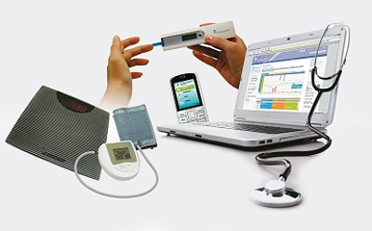
Modularity

Slide 5
Modularity
Modularity is the degree to which a system's components may be separated and recombined (Wikipedia)
No proprietary link between mobile device/app and platform/EHR
Every device/app (approved) has to be able to communicate
  by using open standards
  in a transparent way
  without lock-in

Slide 6
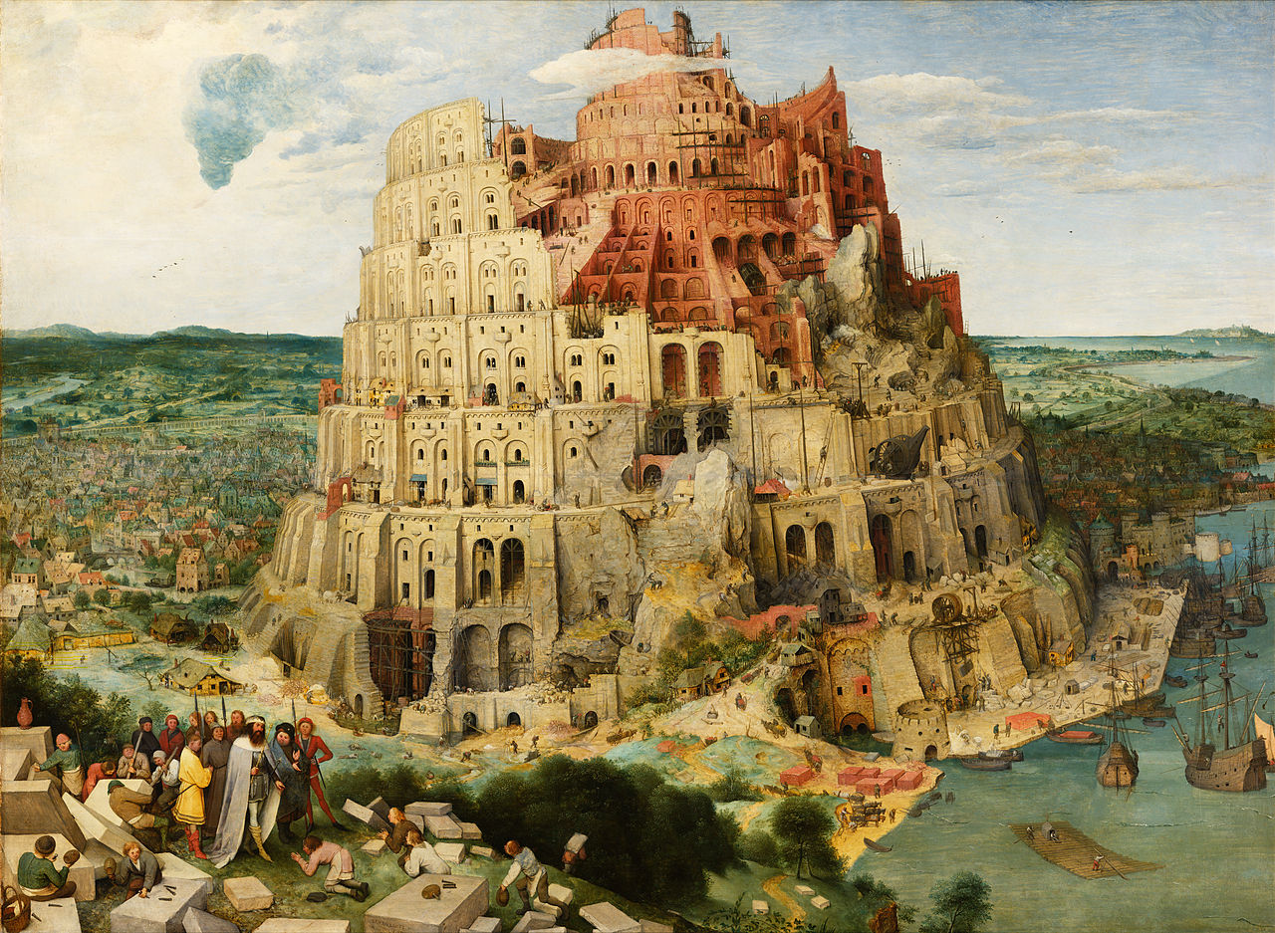
Standards

Slide 7
Standards
Use of structured standard messages
  communication using structured messages
  based on (international) standards (KMEHR, HL7 V3 CDA R2 )
  to enable modular connections
  to enable communication with back-end systems/EMR (EPD/DPI)
  standard has to be open

Slide 8


App to EHR communication
APP EHR

Slide 9

App to EHR communication
APP EHR

Slide 10
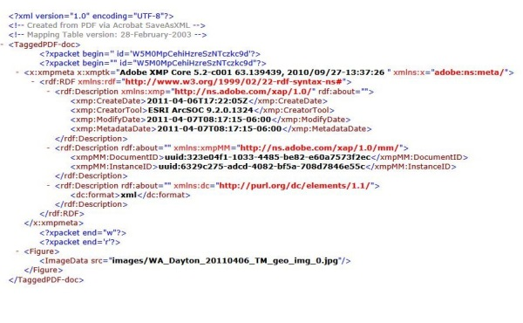
App to EHR communication
APP EHR
Standard
Message
Structure

Slide 11
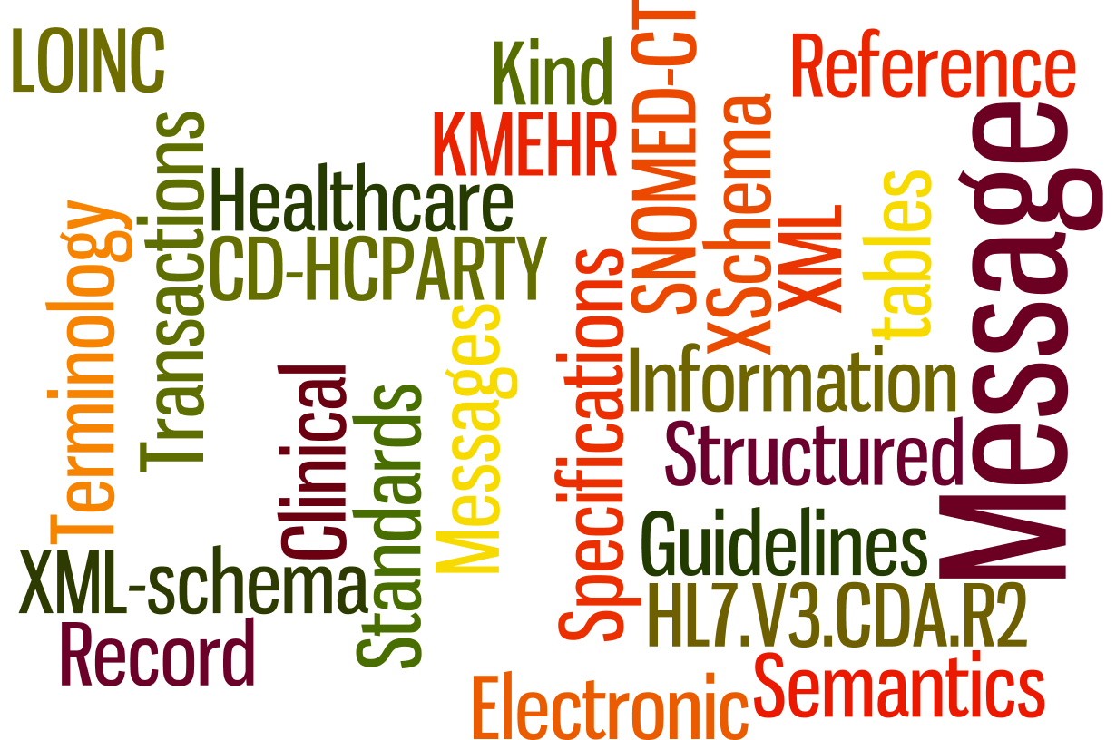
What standards ?

Slide 12
Standards - an introduction
Preliminary concepts
  exchanging data
High level concepts
  XML
  XSD
  KMEHR & HL7 V3 CDA R2
Content concepts
  business context
  business rules
  codifications
  initiating a new message

Slide 13
Preliminary concepts

Slide 14
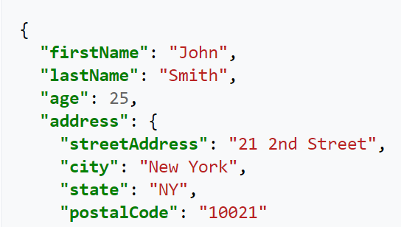
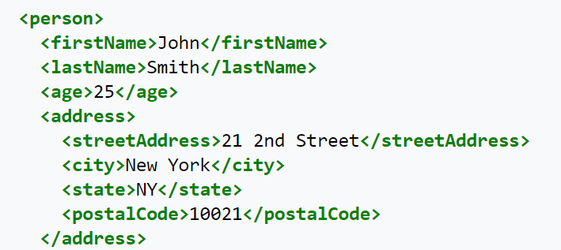
Exchanging data..
IN SCOPE
in this presentation
  WHAT we exchange
    .doc?
    .mp3?
    .txt?
    JSON?
    XML?
OUT OF SCOPE
in this presentation
  HOW we TRANSPORT what we exchange
    Send a USB key in the mail?
    E-mail?
    Fax?

Slide 15

What we exchange?
All recently defined definitions to exchange data between actors in our Belgian eHealth landscape chose to exchange XML (see next slide)
  This is only the format!
But how do we USE this format to pass STRUCTURED information that other parties can UNDERSTAND?
=> HUGE amount of choices to make!
  <person> or <pers>?
  <firstname> or <fname>?
  How many times <fname>?
  <country>Belgium</country>?
  <country>BE</country>?

Slide 16
High level concepts

Slide 17
XML – what?
XML is a structured markup language
EXtensible Markup Language
  Human-readable
  Machine-readable
  Heavily used to represent data structures

Slide 18
XSD – what? (1/3)
XML Schema Definition
  Formal description of the elements of an XML message.
  e.g. what elements are optional, how many elements, datatype of elements…

Slide 19
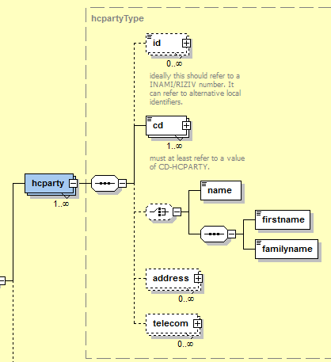
XSD – what? (2/3)
The limit of machines…
  Actual quality of the content of data in an XML?
  XSD validation does not equal ‘business’ validation!

Slide 20
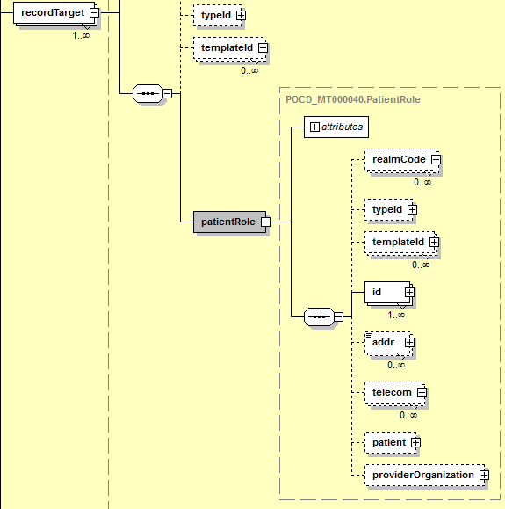
XSD – what? (3/3)
So… the XSD defines some sort of TEMPLATE
Machines know what to expect where and how many times
Only some very limited rules on the content
  e.g. text or numbers

Slide 21
Existing XSD's
KMEHR XSD (Belgian standard –inspired by HL7)
HL7 V3 CDA R2 XSD (International standard)
Both are published and free to use
But…. the use of a schema says nothing about the actual CONTENT!
  Content is defined in…
    KMEHR 'transaction definitions' use the KMEHR schema.
    HL7 V3 CDA R2 'profiles' use the CDA schema.

Slide 22
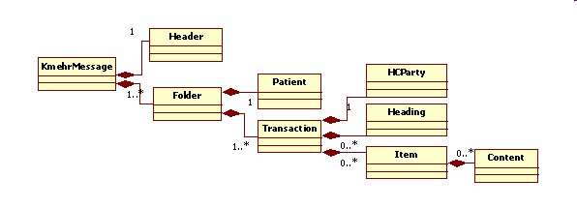
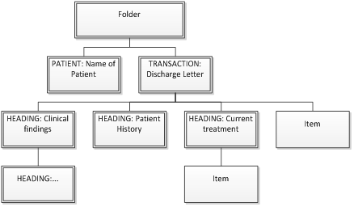
Example: the KMEHR XSD

Slide 23
KMEHR (1/2)
Kind Message for Electronic Health Record
Formalized in 2002, it implements the fourth recommendation of the Belgian Healthcare Telematics Commission
Specifically aimed at structuring the exchange of clinical information. Created at a time when no clear XML standard for clinical info was available.

Slide 24

KMEHR(2/2)
Defined as
  XML & XSD Schema (eHealth platform)
  Generic transaction templates (eHealth platform)
  Implementation-specific conventions (partners)
KMEHR use in Belgian Healthcare projects:
  Hub/Metahub
  Vitalink
  SumEHR exchange
  Recip-e
  myCareNet
  …

Slide 25
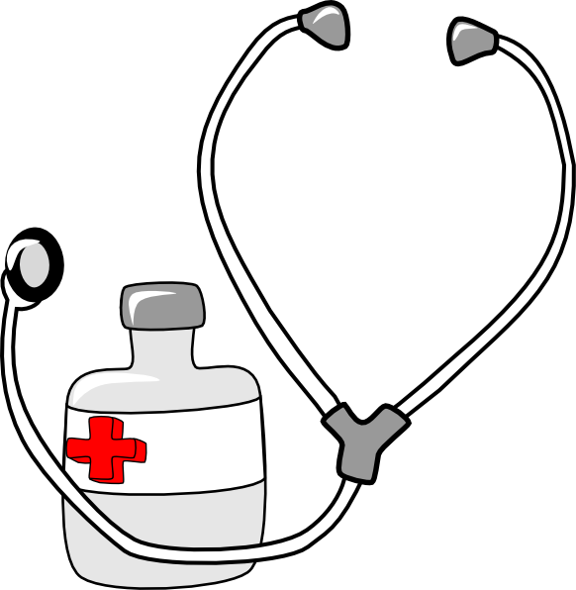
HL7 V3 CDA R2 (1/2)
Health Level-7 or HL7 refers to a set of international standards for transfer of clinical and administrative data between software applications used by various healthcare providers.
CDA Release 2:
the XML schema
to support this
standard

Slide 26
HL7 V3 CDA R2 (2/2)
'Profiles' exist how to use this schema.
We will align foremost on the IHE profiles.
IHE is an initiative by healthcare professionals and industry to improve the way computer systems in healthcare share information. IHE promotes the coordinated use of established standards such as DICOM and HL7 to address specific clinical needs in support of optimal patient care.

Slide 27
KMEHR & CDA - future
Recently, we evolve to choose HL7 V3 CDA R2 schema combined with a maximum use of existing HL7 profiles
  Better alignment possibilities towards international level
  Easier mapping/exchange across borders
  International alignment is sometimes heavy process and a long road but with huge potential benefits
Advantages of KMEHR:
  Already heavily used… in Belgium
  Schema is relatively light
  Managed by Belgian eHealth platform => quick path for change requests
  If a totally custom XML message is considered => use KMEHR instead!
Future choice?
  Preference for CDA in new data flow… if feasible time/quality/budget!
  e.g. laboratory results

Slide 28
Content concepts

Slide 29
Profiles (IHE) / Transaction definitions (KMEHR)
Describes when to send a message in a “business”context
Also describes the 'business rules': the actual administrative and medical content & the logic to construct that content
Also describes how to EXPRESS certain information

Slide 30
Business context
An IHE CDA profile or a KMEHR transaction definition describes:
  WHEN to send these messages in a 'business' context:
    What is the trigger to send them?
      Every day?
      When something changes?
      …
    Who will send and who will receive?
    What is the high level content?
  This needs to be described in detail without any ambiguity when defining a message

Slide 31
Business content & rules
An IHE CDA profile or a KMEHR transaction definition also describes the 'business rules': the actual administrative and medical content & the logic to construct that content
What medical and administrative information we want to send & the internal logic of the message
    e.g. we always send the address of the patient and his weight, length and current medications,…
    Certain parameters need to be send IF…
      The patient is male/female
      The patient is certain age
      …
    Certain combinations may be only send IF…
    Certain infomation must be send IF the patient has…. THEN….
This needs to be described in detail without any ambiguity when defining a message

Slide 32
Business codifications
An IHE CDA profile or a KMEHR transaction definition also describes how to EXPRESS certain information
'Simple' information:
  e.g. how to express the height of a person?
    179 cm, 1,79 m?
    UCUM (Unified Code for Units of Measure)
More complex infomation:
  e.g. how to express 'unspecified migraine'
    ICD-10: 'G43.9'
    SNOMED-CT : '37796009'
    …
  -e.g. how to express ‘blood type test’
    LOINC
    …
This needs to be described in detail without any ambiguity when defining a message

Slide 33
When defining a new message (1/2)
Content is king!
  Define your business context
    Work with your business project level stakeholders (YOU).
    Reach out to eHealth Platform Standards
  Define your business content and logic
    Work with your subject matter experts (SME's) on sending and receiving sides (YOU)
  Choose your business codifications
    Work with your SME's (YOU)
    Work with the terminology center (SPF/FOD)

Slide 34

When defining a new message (2/2)
  Follow procedure initiating a new message…
  ttps://www.ehealth.fgov.be/standards/kmehr/content/page/866/new-message-guidelines
  Contact eHealth Platfom Standards cell early in the process (message-structure@ehealth.fgov.be)
    There to help and advise
  Contact Terminology Center (terminologie@health.belgium.be ) for advise on codifications, to help you codify your content
    Know what you want to send so they can advise

Slide 35
Open Standards

Slide 36
Open Standards
To guarantee that :
Electronic exchange of medical data between different healthcare actors
  Is done as much as possible through structured messages
  With a standardised structure
  Preferably based on international standards
  Meeting the needs of users (content of the message)
Every healthcare actor, using such standard structured messages
  Is able to freely send and receive medical data to and from every other healthcare actor
  Using his/her own software environment (choice should always be free)
Every stakeholder can initiate the definition of a new standard message structure
Every stakeholder has (at any given time) a global view of
  Which standard message structures are under development (by whom)
  Which standard message structures have already been defined and validated
  Which standard message structures are already in use
  https://www.ehealth.fgov.be/standards/kmehr/
  https://www.ehealth.fgov.be/standards/kmehr/content/page/866/new-message-guidelines

Slide 37
Open Standards (2)
Healthcare actors are using standard message structures to exchange medical data with other healthcare actors “as much as possible” and …
If they are not using standard message structures, they publish their message structures
  To enable any other healthcare actor, using this non standard message structure
    To freely send and receive medical data to and from every other healthcare actor
    Using his/her own software environment (choice should always be free)
  These message structures can be an inspiration for defining new standard message structures

Slide 38
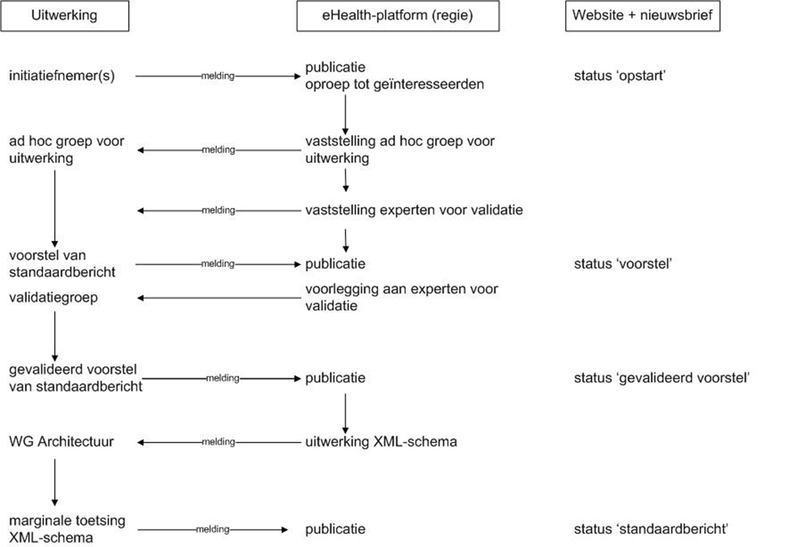
Open Standards (3)
To realise new standard messages a procedure has been defined

Slide 39
At the end of the trial period
Proposition of standard message structures
  For each Use Case
  Enabling future developments
  Coming from You, the stakeholders

Slide 40
Authentication

Slide 41
Authentication
Using an authentication method that
  is independent of the app used
    not proprietary for one specific app
    generally applicable/usable
  allows single sign on (SSO)

Slide 42
Authentication: concerns
Avoid to be forced to use one specific device (smartphone/tablet/…) to be able to use a specific app
At least two factor authentication
Use of the eHealth basic services
Use of federal authentication service (FAS)
  every method supported by FAS (meeting the minimal criteria = at least TOTP) is accepted, including the future methods
Authentication based on social security identification number (SSIN)
Future proof

Slide 43





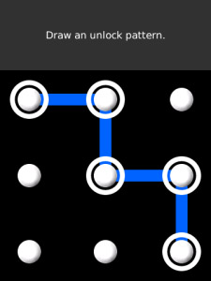
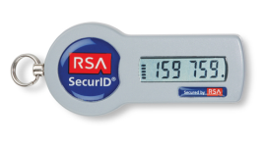
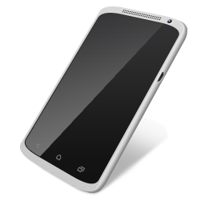
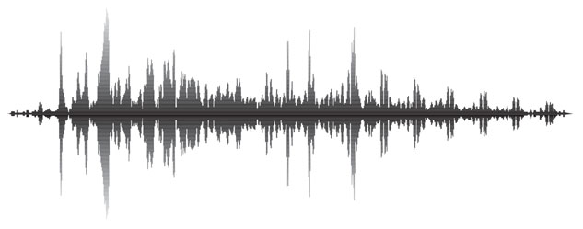
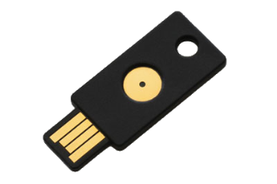
Mobile authentication: authentication factors
Knowledge
Something You know
Possession
Something You own
Biometrics
Something You are

Slide 44
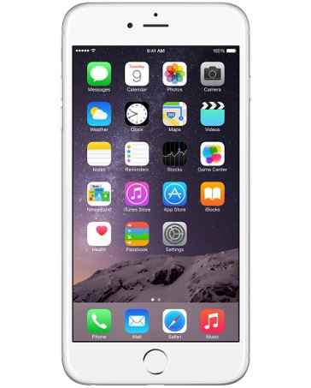

Multi-factor authentication
Multi-factor authentication: combining at least 2 factors
Knowledge
+
+
Possession
Biometrics
+

Slide 45
Mobile authentication
Mobile authentication: provide evidence of identity to access applications on a mobile device
Mobile device: smartphone or tablet with mobile OS (Android, iOS, etc.)
Mobile web applications: web applications adapted to be used on small (touch)screens
Native apps: platform-specific apps (Android, iOS, etc.)

Slide 46





Currently available authentication methods (CSAM/FAS)
Strong
 | eID + PIN-code with connected card reader
 | eID + PIN-code with wireless card reader
 | Security code via mobile app, user-id + password
 | Security code via SMS, user-id + password
 | Security code on paper (paper token), user-id + password
 | User-id + password
Weak

Slide 47

Currently approved authentication methods (CSAM/FAS) for confidential/medical data
Strong
 | eID + PIN-code with connected card reader
 | eID + PIN-code with wireless card reader
 | Security code via mobile app, user-id + password
 | Security code via SMS, user-id + password
 | Security code on paper (paper token), user-id + password
 | User-id + password
Weak

Slide 48
eID bootstrap
Authentication without registration = eID only
Activation of other authentication methods based on demand with eID + Card reader
Goal: high degree of certainty about the identity of the user when authenticating without eID
Management of these methods through the self-management application van "Mijn eGov Profiel"
www.csam.be/myprofile

Slide 49

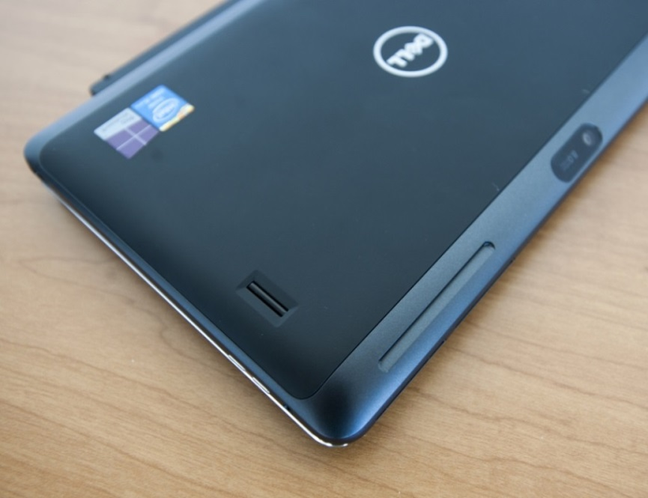

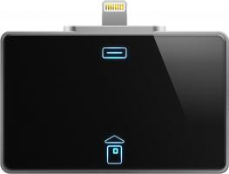
eID + card reader
Compatibility with mobile apps = limited
Tablets with built in reader
"Add-on" card reader
Notes:
Figuren:
1/ Tablet met ingebouwde kaartlezer (zie rood omcirkeld).
2/ Specifieke eID kaartlezer die kan ingeplugd worden in iPhone of iPad. Te gebruiken met specifieke browser-app die de drivers bevat voor de kaartlezer en de eID-kaart zelf.
3/ iPad casing (cover) met ingebouwde kaartlezer (zie rood omcirkeld). Eveneens te gebruiken met specifieke browser-app.

Slide 50
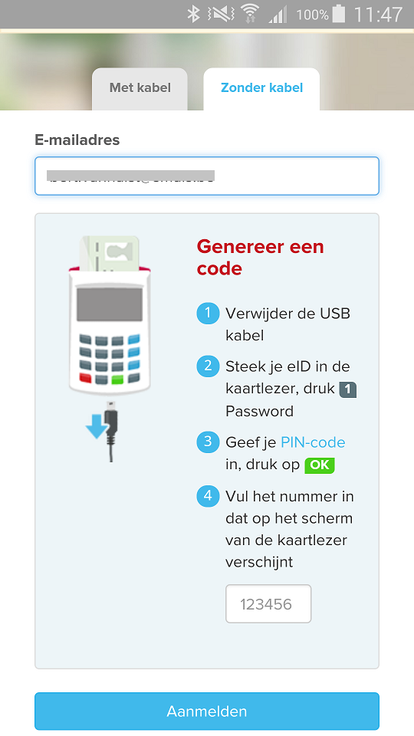
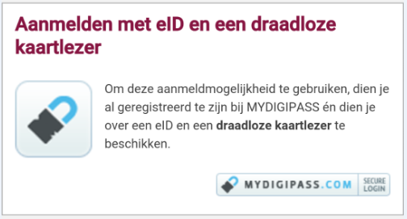
eID + unconnected card reader
Authenticate through external partner (Mydigipass)
Compatible with mobile Webapps
Less user friendly in a mobile context

Slide 51
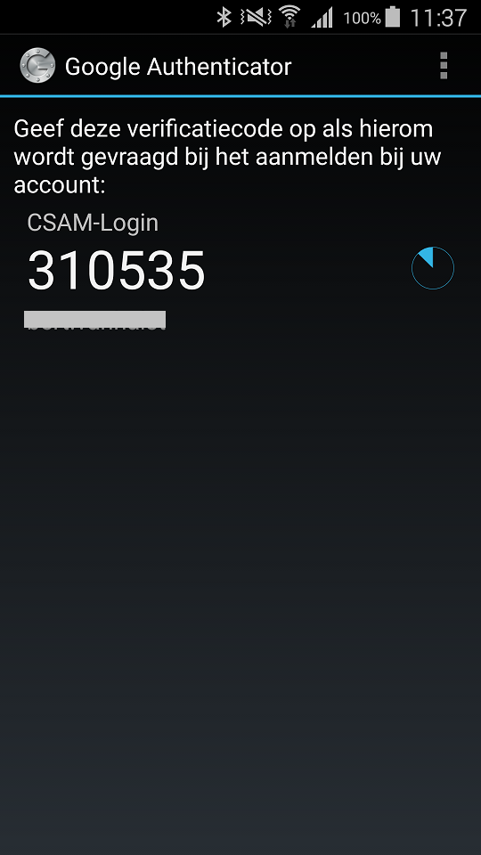
Security token generated by mobile app (1/5)
How does it work? (one time registration)
One time registration of mobile app through eID bootstrap
User can choose his own mobile app to generate access codes
Condition: app has to be compatible with TOTP protocol (Time-based One Time Password)
Examples: Google Authenticator, Duo Mobile, Amazon AWS MFA en Authenticator
Most apps are freely available in app stores
Notes:
Activatie van een app:
https://www.youtube.com/watch?v=5Gh0onNP0fI

Slide 52
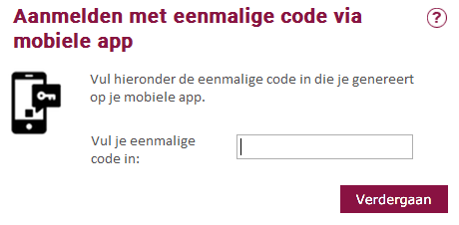
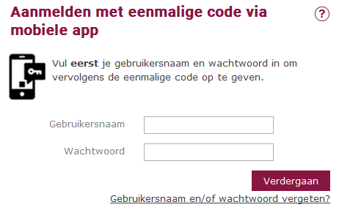
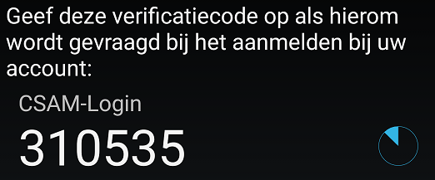
Security token generated by mobile app (2/5)
How does it work? (Authentication)
Step 1: Enter Username and password
Step 2: Enter TOTP code generated through Mobile App / App generates new code every 30 seconds
Notes:
Aanmelden op smartphone of tablet:
https://www.youtube.com/watch?v=Lw0UjKMbb5I

Slide 53
Security token generated by mobile app (3/5)
Compatible with mobile webapps
Safer than use of password only
  knowledge factor = password
  possession factor = device with registered mobile app
Somewhat less user-friendly than password only
  re-enter or copy/paste code generated by the mobile app

Slide 54
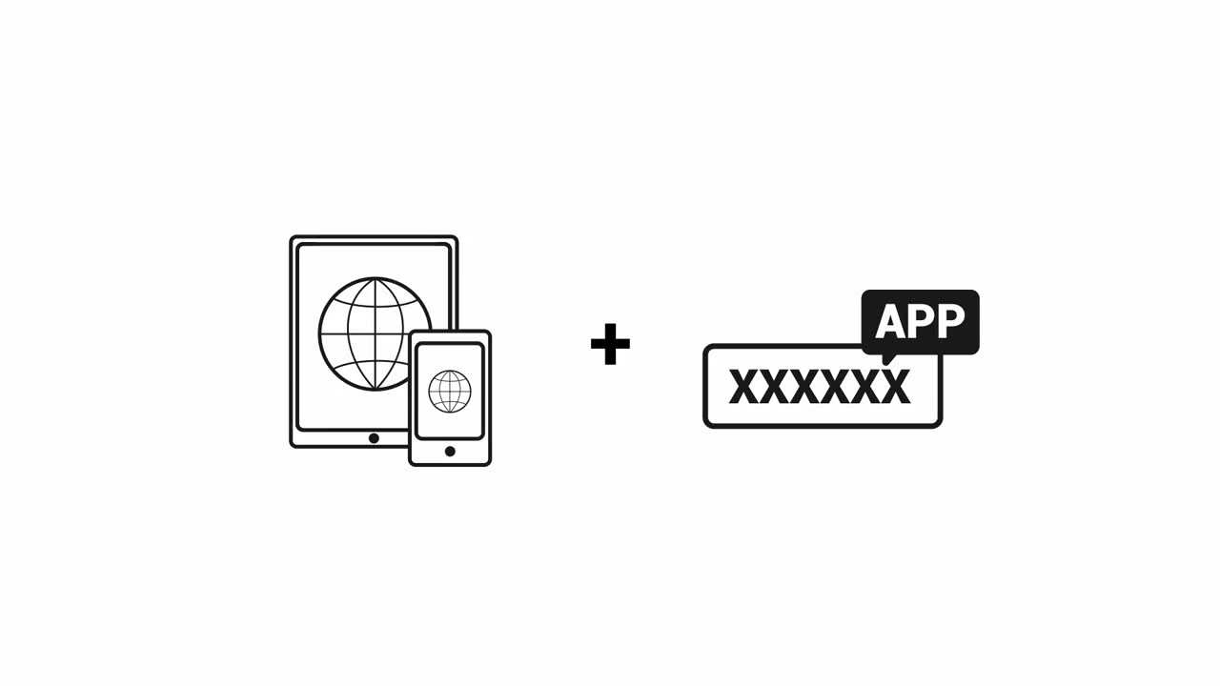
Security token generated by mobile app (4/5)
Notes:
https://www.youtube.com/watch?v=0EwGBbgPv0I

Slide 55
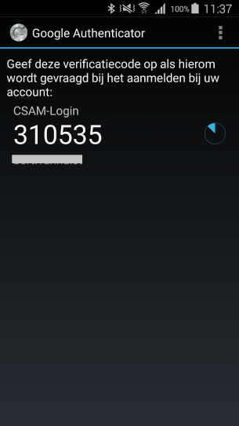

Security token generated by mobile app (5/5)
For security reasons (paper token is easy to copy) paper tokens should be replaced by more secure digital tokens
TOTP-app as "digital token"
Changing to digital has no impact on existing applications

Slide 56
TOTP for Native Apps
New Development : TOTP for Native apps
  native Android/iOS apps authentication method
  available: Authorisation server v1
  available in the near future: v1 enhanced
  v2 (more functionality) under construction (june 2017)
  development of native apps by app developers
  cookbook under construction

Slide 57
Evolution
Towards even more user friendly methods
  without external Card readers or tokens
  no code copying/re-entering
  mobile device as possession factor, in combination with knowledge factor (pincode or other) or biometrics factor (Fingerprint or other))
Sufficient security guarantees when accessing confidential information
  securing key information in hardware (cf. eID-card)
  in stead of software
  registration process: high degree of certainty about the identity of the user when authenticating without eID (eID Bootstrap)
Use of FAS (Federal Authentication Service)
  every method supported by FAS (meeting the minimal criteria = at least TOTP) is accepted, including the future methods

Slide 58
Cloud and Security Aspects of the Cloud

Slide 59
What is “Cloud” ?
On Demand
Broad network access
Resource pooling
Measured service
Rapid elasiticity
Source: National Institute for Standards and Technology, USA

Slide 60
As a service : major characteristics
Self-service : industrialised & automated
Available : immediate availability
Extensible / elastic : scale up or down
Shared : multiple users for scale effects
Use based invoicing : based on real use of resources
Low entry barrier : complexity is hidden for user
Incremental service changes

Slide 61
Cloud Service Models
IaaS
Infrastructure as a Service
PaaS
SaaS
Basic IT infrastructure components (e.g. Amazon virtual machines)
Platform as a Service
Platforms to build applications
Software as a Service
Full applications (e.g. O365, Google Apps, ...)

Slide 62
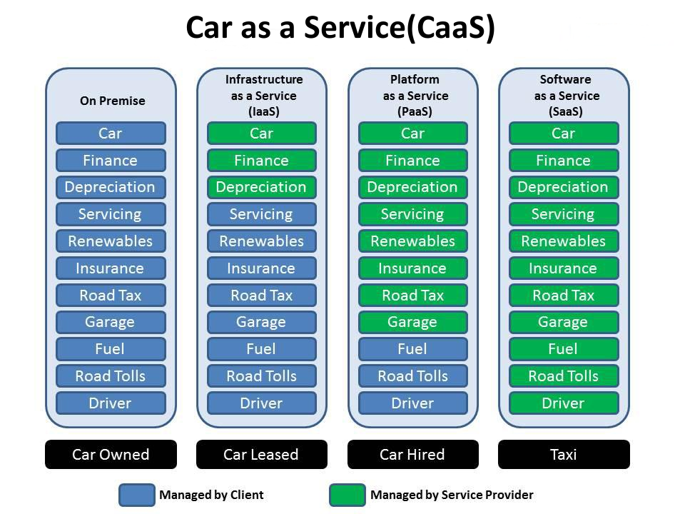

Slide 63

Virtualisation
Consolidation of physical resources
> 70% « easy consolidation »
First step to Cloud (“dematerialisation”)

Slide 64
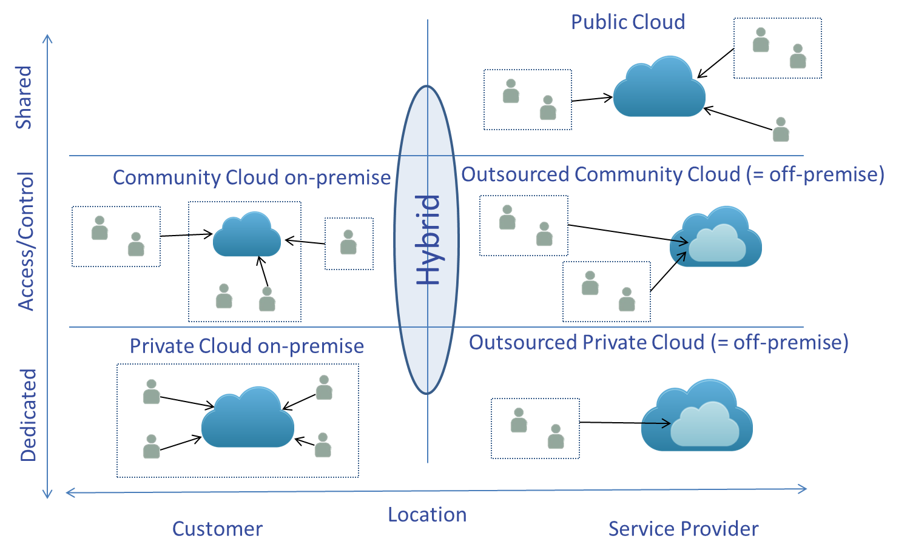
Cloud deployment models

Slide 65
Cloud advantages
Any place, any time, anywhere : mobile
Safeguarded with backups
High level of security if well implemented
Lower Total Cost of Ownership (TCO)
Stability & incremental updates
Collaboration
Should provide portability
Community cloud solutions
  can be open for integration with other services
  trust relationship / data protection (e.g. Vitalink)

Slide 66
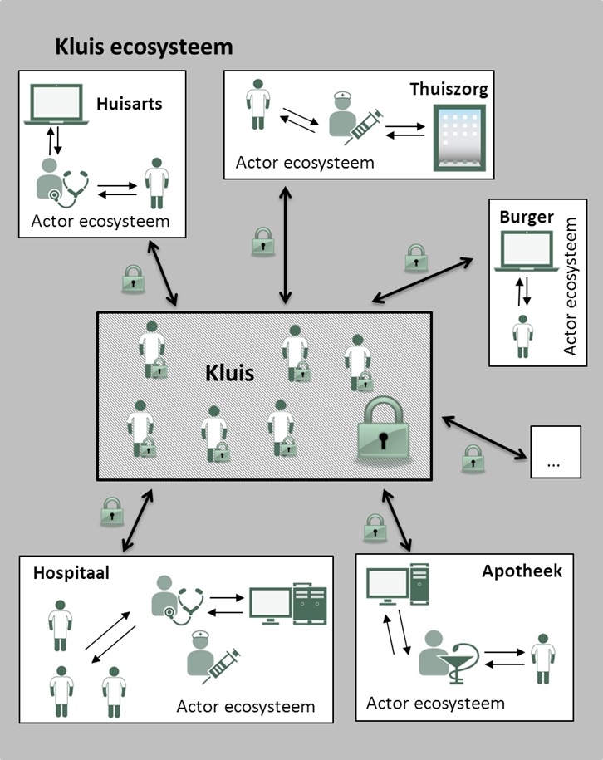
Vitalink
Share data
every actor keeps his records,
but can share specific parts with other actors
examples :
  medication scheme
  SUMEHR
  parameters
  journal
  …

Slide 67
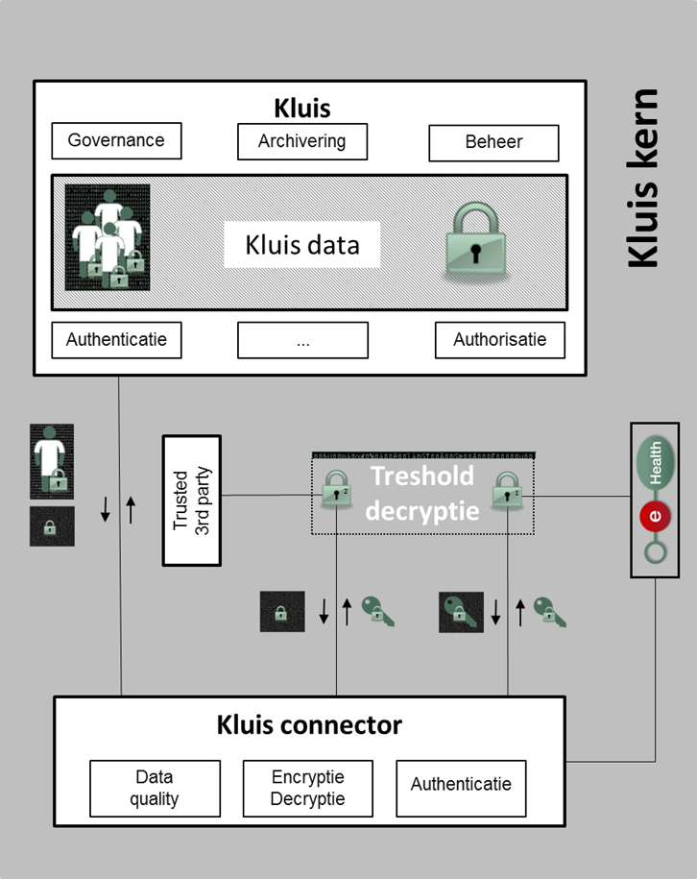
Vitalink
Access for care givers
with therapeutic relation
dependent of their role
No access for
IT-administrators, hoster,…
eHealth-platform
government
… without the active cooperation of the holder of the second key

Slide 68



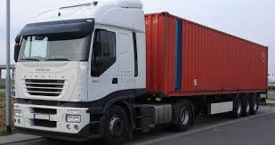






Platform as a Service - containers
Introduction to container technology
Translated into modern technology as Platform-as-a-Service
Individual
content
Stored in an isolated way
And easily removable
Monitoring
Security
Logging
Coming
soon

Slide 69



PaaS – Cooperation modes
Public sector ecosystem
Other sectors
Sharing components
Application
1
Application
2
Application
N
Partner 1
Partner 2
Partner N
Platform cooperation
DB
DB
Technological
cooperation
DB
DB
DB

Slide 70

Can we go to the public cloud?

Slide 71

No known countries with large amounts of sensitive data in the public cloud
Private ⬄ national interest
Cost
Confidentiality
Continuity
Vendor lock-in

Slide 72

If data of a single individual is lost or made public, private interests are violated
If data of a large population of citizens/companies gets lost or made public, the essential economic or economic interests are at stake

Slide 73
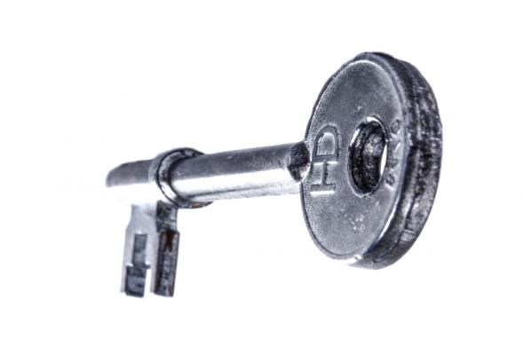
Confidentiality
Almost every nation has equivalent of ‘patriot act’
MLAT’s: Mutual Legal Assistance Treaty
Keeps evolving
  US judges issue warrants on computers in any jurisdiction (april 2016)
  Privacy Shield

Slide 74

Confidentiality: encryption as a solution ?
Homomorphic encryption not sufficiently performant
Current algorithms can be broken in 10 – 15 years (MD-5 designed 1991, weaknesses in 1996, broken in 2010)
Quantum computing 15 to 30 years? Current encryption technology (RSA) extremely vulnerable
Encrypted today ≠ safe forever

Slide 75

Continuity
Acquisitions & mergers (Appfog)
Bankruptcy (Nirvanix)

Slide 76

Vendor lock-in
Extremely difficult negotiations
Immediate suspension of services

Slide 77

Intermediate conclusion
Pure public cloud not suited for sensitive use cases
Secure private cloud on-premise for secret and top secret
Hybrid (community on-premise and public) cloud for other levels
Example:

Slide 78





What is G-Cloud ?
A program
including synergy projects
Synergy for existing as well as new services
For public services
Managed by public services
In cooperation with the private sector

Slide 79
What is G-Cloud ?
Shared public ICT platform
  current target: federal state (FPS, PPS, Public Institutions of Social Security, Institutions of Public Benefit)
  can be extended to other interested authorities
Hybrid community cloud model
  use of public cloud if possible
  private community cloud hosted in data centers, managed by the government
  operational implementation with strong involvement of the private sector

Slide 80




G-Cloud: products
Procurement
Cooperationá
Efficiencyá
Projects
Synergy
Services
Costsâ
Qualityá
Know-how & Expertise

Slide 81
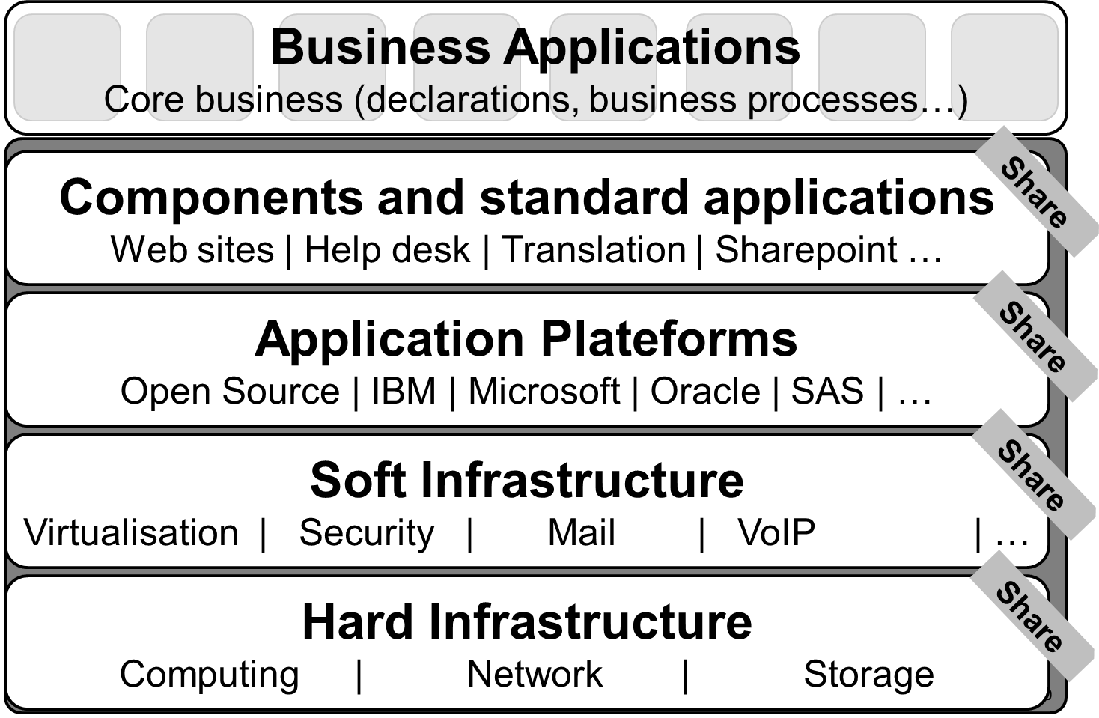
G-Cloud: focus

Slide 82
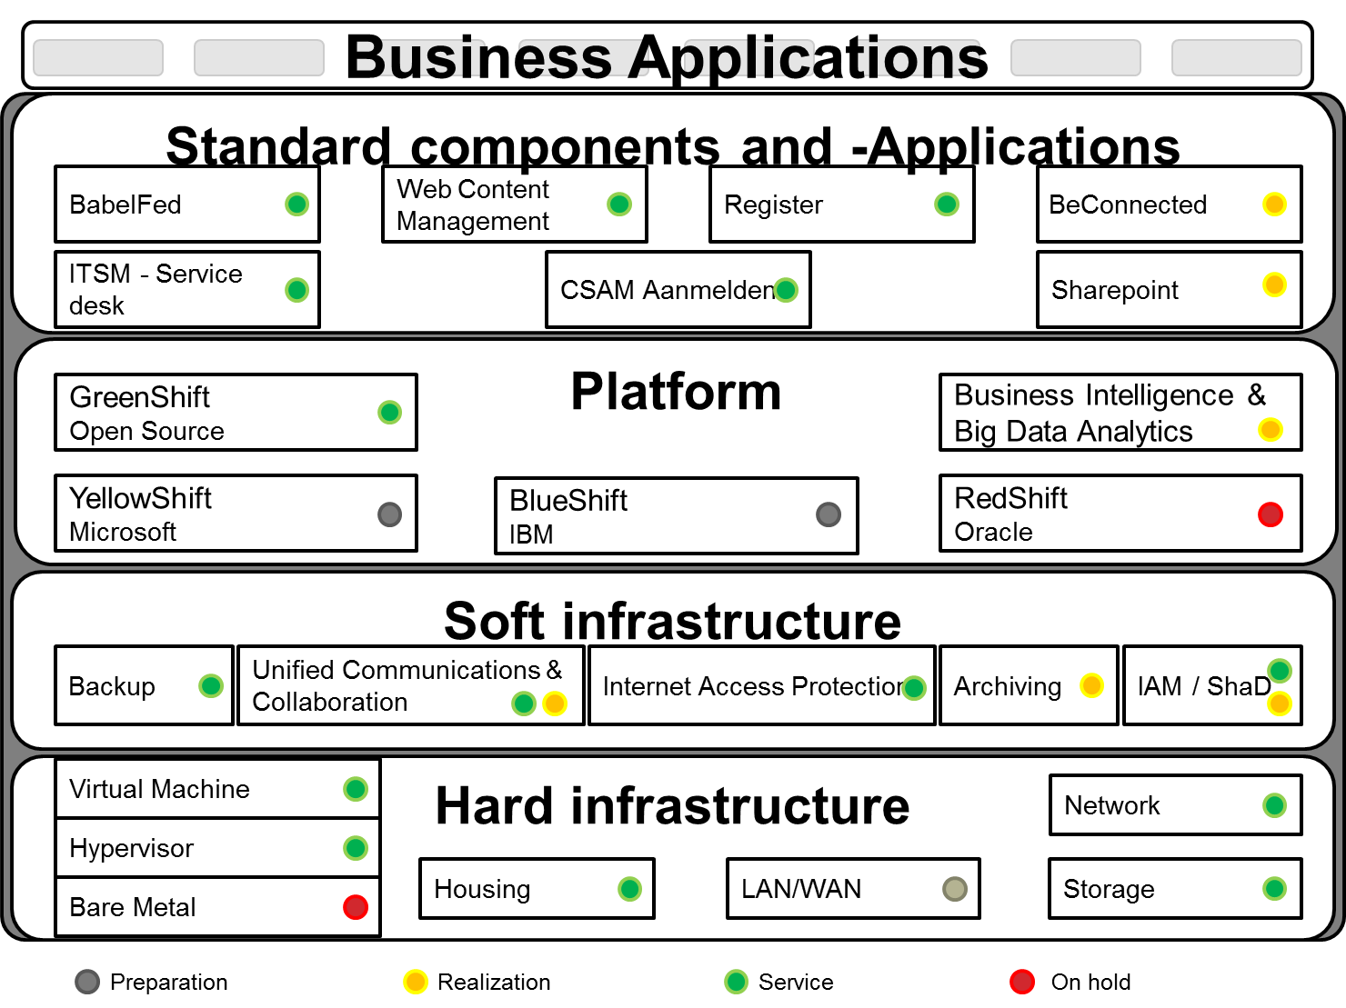
G-Cloud: projects

Slide 83
Data & cloud
Privacy Commission / Advice nr 04/2015 (25/02/2015)
... risicoanalyse nagaan welke de weerslag zal zijn op de beveiliging en de vertrouwelijkheid als er persoonsgegevens van de betrokken personen in de cloud worden gezet
operationeel bruikbare evaluatietool die ... toelaat om op eigen verantwoordelijkheid de beveiliging van cloud diensten te evalueren

Slide 84
Cloud security evaluation model
What ?
Security evaluation of Cloud-provider/service
How ?
Detailed questionnaire with ratings
4 main criteria: IAM, IT-security, operational security, governance
Excel sheet
Free & publicly available
Based on nature and sensitivity of treated data
Visualisation of results

Slide 85
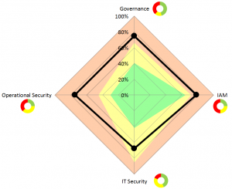
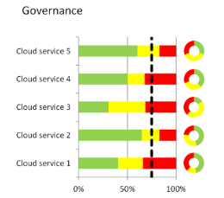
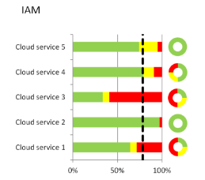
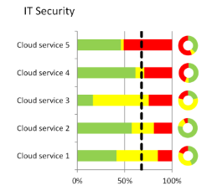
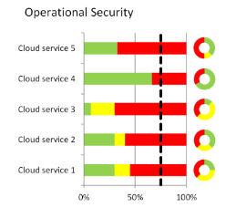
Cloud security evaluatiemodel
https://www.privacycommission.be/nl/evaluatiemodel-voor-de-beveiliging-van-de-clouddiensten
https://www.privacycommission.be/fr/le-modele-devaluation-de-securite-des-services-cloud

Slide 86
Data & Cloud ?
Privacy Commission / Advice nr. 10/2016 (24/02/2016)
“... voorzichtig te zijn met buitenlandse cloudproviders, .... afgeraden om hen gevoelige gegevens toe te vertrouwen die raken aan de nationale economie. ... gebruik van state of the art encryptietechnieken gecombineerd met het feit dat de encryptiesleutel zich enkel bij de klant bevindt. ... periodiek gedecrypteerd en opnieuw geëncrypteerd met de nieuwste technieken...”

Slide 87
Data & Cloud ?
General Data Protection Regulation (EU)
“Personal data concerning health should include all data pertaining to the health status of a data subject which reveal information relating to the past, current or future physical or mental health status of the data subject.”
Risk-based approach
  Nature
  Size
  Context
  Purpose
  Impact
“Appropriate technical and organisational measures”

Slide 88
Conclusion
“As-a-Service” has become common good
Hybrid models provide flexibility (but raise complexity)
Use of (Public) Cloud : case by case
  Type of data
  Impact analysis
  Organisational & technical measures
Multiple advantages to cloud use (from individual -> community)
Community model combines advantages but has to reach scale

Slide 89

Questions ?
Would you like to know more?
Business SPOC: Wolf Wauters (for mHealth projects)
wolfgang.wauters@ehealth.fgov.be
eHealth Platfom Standards cell
  message-structure@ehealth.fgov.be
  eHealth Platform:
  https://www.ehealth.fgov.be/
  https://www.ehealth.fgov.be/standards/kmehr/
  Terminology Center (FPS Health)
  www.terminology-center.be
  HL7 & IHE:
  http://www.hl7.org/implement/standards/product_brief.cfm?product_id=7
  https://ihe.net/Profiles/

Slide 90
Thank You!
Questions?

