Slide 1
Introduction to Cloud

Slide 2
Agenda
What is “Cloud” ?
Cloud advantages
Public cloud issues
G-Cloud
Data & Cloud
Conclusion

Slide 3
What is “Cloud” ?
On Demand
Broad network access
Resource pooling
Measured service
Rapid elasiticity
Source: National Institute for Standards and Technology, USA

Slide 4
As a service : major characteristics
Self-service : industrialised & automated
Available : immediate availability
Extensible / elastic : scale up or down
Shared : multiple users for scale effects
Use based invoicing : based on real use of resources
Low entry barrier : complexity is hidden for user
Incremental service changes

Slide 5
Cloud Service Models
IaaS
Infrastructure as a Service
PaaS
SaaS
Basic IT infrastructure components (e.g. Amazon virtual machines)
Platform as a Service
Platforms to build applications
Software as a Service
Full applications (e.g. O365, Google Apps, ...)

Slide 7
Virtualisation
Consolidation of physical resources
> 70% « easy consolidation »
First step to Cloud (“dematerialisation”)

Slide 8
Cloud deployment models

Slide 9
Agenda
What is “Cloud”?
Cloud advantages
Public cloud issues
G-Cloud
Data & Cloud
Conclusion

Slide 10
Cloud advantages
Any place, any time, anywhere : mobile
Safeguarded with backups
High level of security if well implemented
Lower Total Cost of Ownership (TCO)
Stability & incremental updates
Collaboration
Should provide portability
Community cloud solutions
can be open for integration with other services
trust relationship / data protection (e.g. Vitalink)

Slide 11
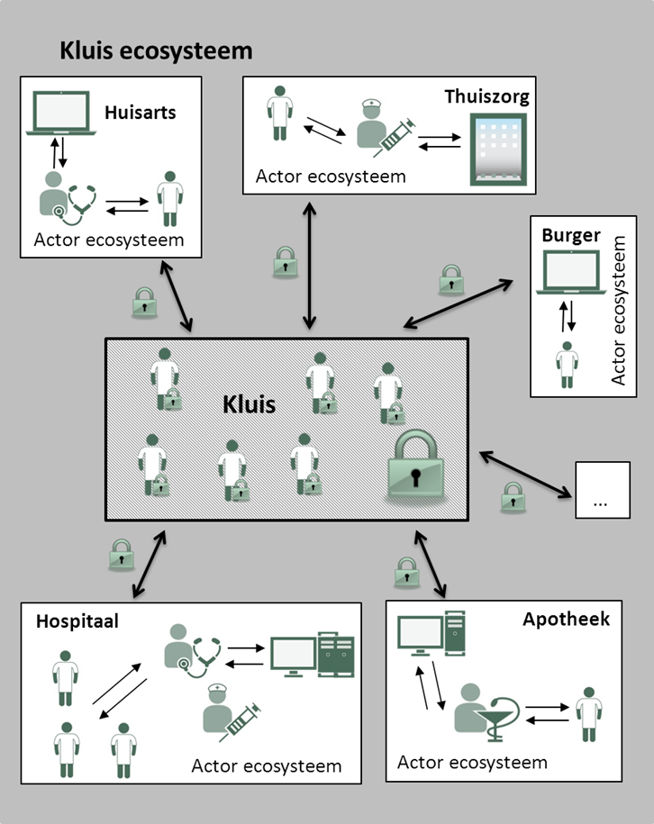
Vitalink
Share data
every actor keeps his records,
but can share specific parts with other actors
examples :
medication scheme
SUMEHR
parameters
journal
…

Slide 12
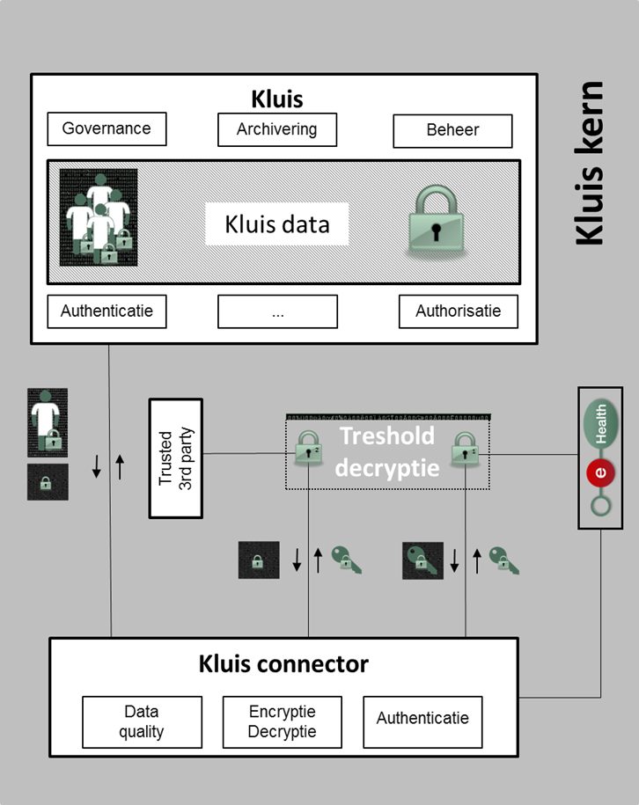
Vitalink
Access for care givers
with therapeutic relation
dependent of their role
No access for
IT-administrators, hoster,…
eHealth-platform
government
… without the active cooperation of the holder of the second key

Slide 13
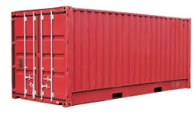
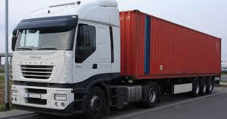
Platform as a Service - containers
Introduction to container technology
Translated into modern technology as Platform-as-a-Service
Individual
content
Stored in an isolated way
And easily removable
Monitoring
Security
Logging
Coming
soon

Slide 14
PaaS – Cooperation modes
Public sector ecosystem
Other sectors
Sharing components
Application
1
Application
2
Application
N
Partner 1
Partner 2
Partner N
Platform cooperation
DB
DB
Technological
cooperation
DB
DB
DB

Slide 15
Agenda
What is “Cloud”?
Cloud advantages
Public cloud issues
G-Cloud
Data & Cloud
Conclusion

Slide 16
Can we go to the public cloud?

Slide 17
No known countries with large amounts of sensitive data in the public cloud
Private ⬄ national interest
Cost
Confidentiality
Continuity
Vendor lock-in

Slide 18
If data of a single individual is lost or made public, private interests are violated
If data of a large population of citizens/companies gets lost or made public, the essential economic or economic interests are at stake

Slide 19
Confidentiality
Almost every nation has equivalent of ‘patriot act’
MLAT’s: Mutual Legal Assistance Treaty
Keeps evolving
US judges issue warrants on computers in any jurisdiction (april 2016)
Privacy Shield

Slide 20
Confidentiality: encryption as a solution ?
Homomorphic encryption not sufficiently performant
Current algorithms can be broken in 10 – 15 years (MD-5 designed 1991, weaknesses in 1996, broken in 2010)
Quantum computing 15 to 30 years? Current encryption technology (RSA) extremely vulnerable
Encrypted today ≠ safe forever

Slide 21
Continuity
Acquisitions & mergers (Appfog)
Bankruptcy (Nirvanix)

Slide 22
Vendor lock-in
Extremely difficult negotiations
Immediate suspension of services

Slide 23
Intermediate conclusion
Pure public cloud not suited for sensitive use cases
Secure private cloud on-premise for secret and top secret
Hybride (community on-premise and public) cloud for other levels
Example:

Slide 24
Agenda
What is “Cloud” ?
Cloud advantages
Public cloud issues
G-Cloud
Data & Cloud
Conclusion

Slide 25
What is G-Cloud ?
A program
including synergy projects
Synergy for existing as well as new services
For public services
Managed by public services
In cooperation with the private sector

Slide 26
What is G-Cloud ?
Shared public ICT platform
current target: federal state (FPS, PPS, Public Institutions of Social Security, Institutions of Public Benefit)
can be extended to other interested authorities
Hybrid community cloud model
use of public cloud if possible
private community cloud cloud hosted in data centers, managed by the government
operational implementation with strong involvement of the private sector

Slide 27
G-Cloud: products
Procurement
Cooperationá
Efficiencyá
Projects
Synergy
Services
Costsâ
Qualityá
Know-how & Expertise

Slide 28
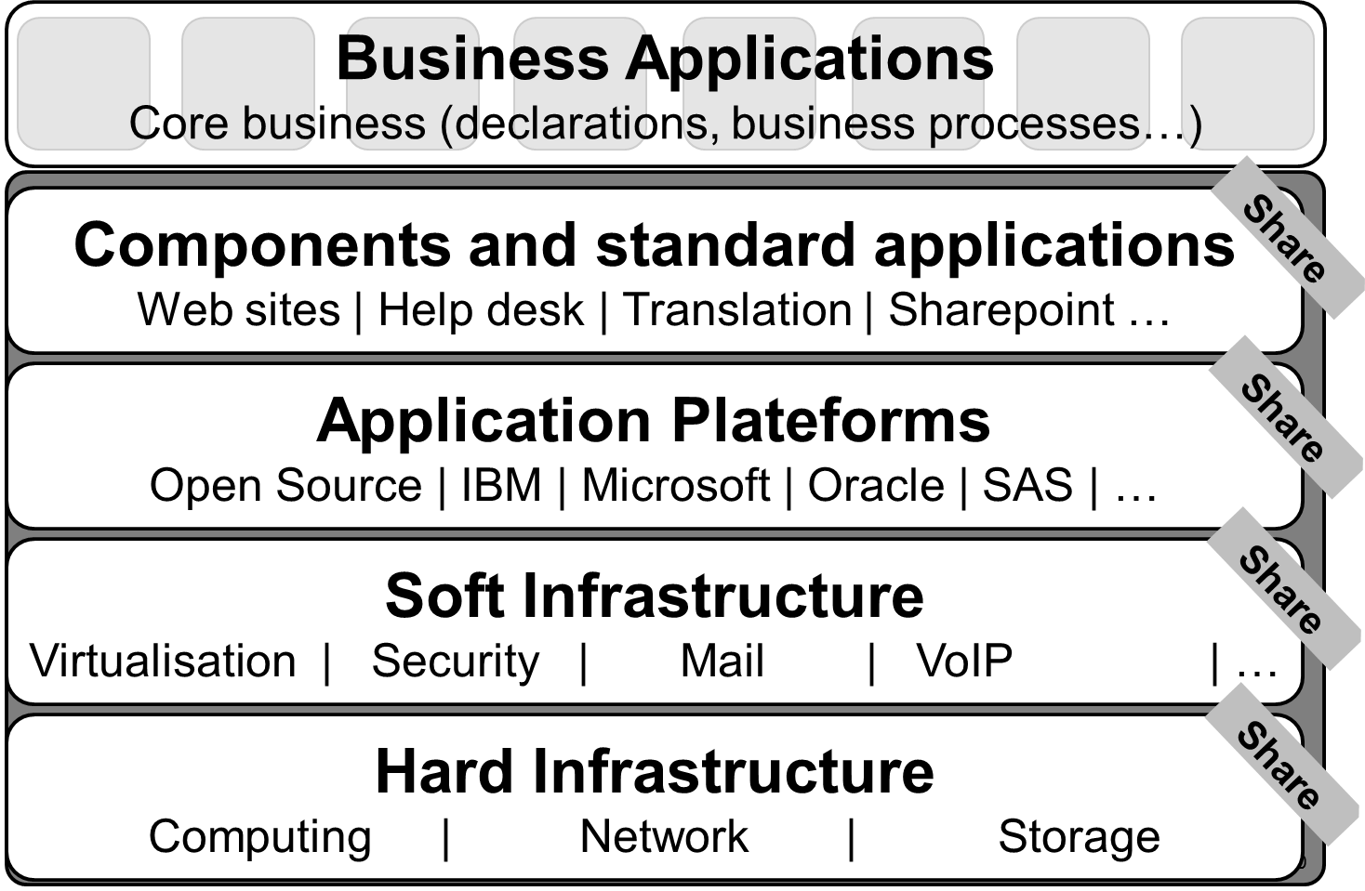
G-Cloud: focus

Slide 29
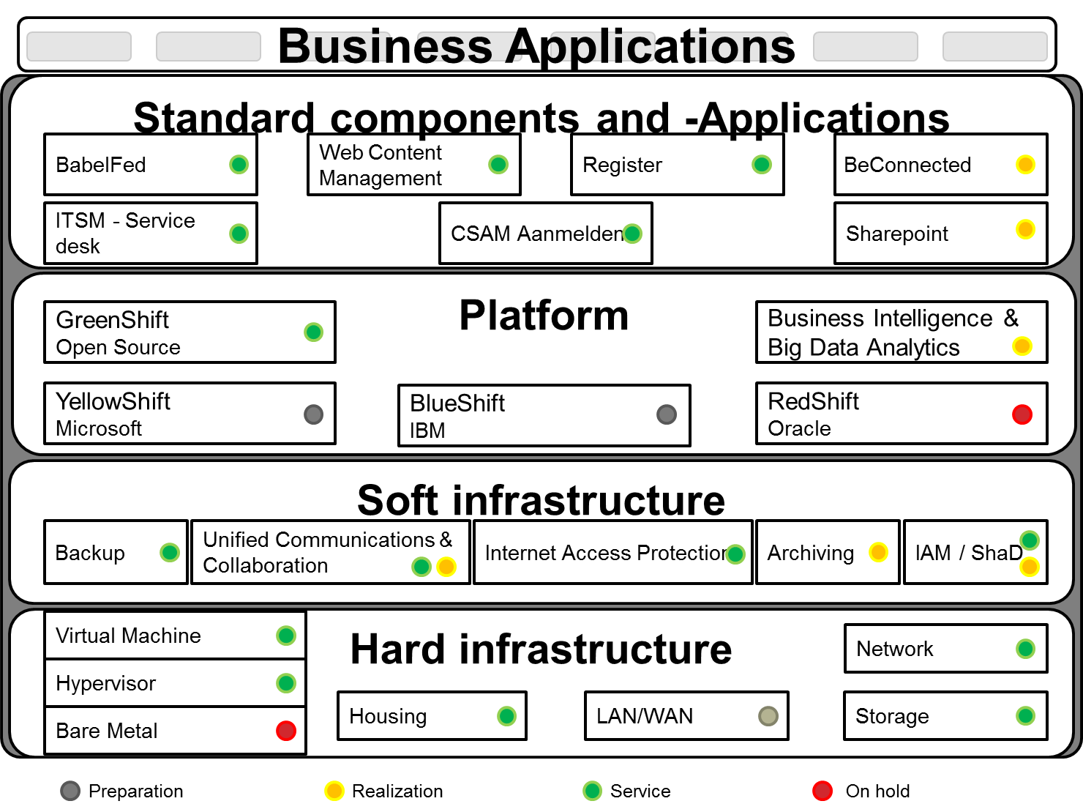
G-Cloud: projects

Slide 30
Agenda
What is “Cloud” ?
Cloud advantages
Public cloud issues
G-Cloud
Data & Cloud
Conclusion

Slide 31
Data & cloud
Privacy Commission / Advice nr 04/2015 (25/02/2015)
... risicoanalyse nagaan welke de weerslag zal zijn op de beveiliging en de vertrouwelijkheid als er persoonsgegevens van de betrokken personen in de cloud worden gezet
operationeel bruikbare evaluatietool die ... toelaat om op eigen verantwoordelijkheid de beveiliging van cloud diensten te evalueren

Slide 32
Cloud security evaluation model
What ?
Security evaluation of Cloud-provider/service
How ?
Detailed questionnaire with ratings
4 main criteria: IAM, IT-security, operational security, governance
Excel sheet
Free & publicly available
Based on nature and sensitivity of treated data
Visualisation of results

Slide 33
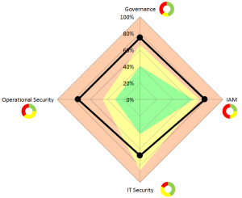
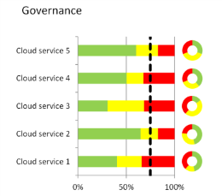
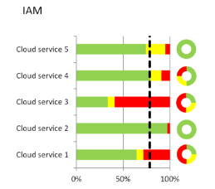
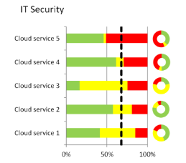
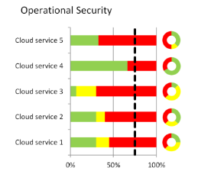
Cloud security evaluatiemodel
https://www.privacycommission.be/nl/evaluatiemodel-voor-de-beveiliging-van-de-clouddiensten
https://www.privacycommission.be/fr/le-modele-devaluation-de-securite-des-services-cloud

Slide 34
Data & Cloud ?
Privacy Commission / Advice nr. 10/2016 (24/02/2016)
“... voorzichtig te zijn met buitenlandse cloudproviders, .... afgeraden om hen gevoelige gegevens toe te vertrouwen die raken aan de nationale economie. ... gebruik van state of the art encryptietechnieken gecombineerd met het feit dat de encryptiesleutel zich enkel bij de klant bevindt. ... periodiek gedecrypteerd en opnieuw geëncrypteerd met de nieuwste technieken...”

Slide 35
Data & Cloud ?
General Data Protection Regulation (EU)
“Personal data concerning health should include all data pertaining to the health status of a data subject which reveal information relating to the past, current or future physical or mental health status of the data subject.”
Risk-based approach
Nature
Size
Context
Purpose
Impact
“Appropriate technical and organisational measures”

Slide 36
Agenda
What is “Cloud” ?
Cloud advantages
Public cloud issues
G-Cloud
Data & Cloud
Conclusion

Slide 37
Conclusion
“as-a-Service” has become common good
Hybrid models provide flexibility (but raise complexity)
Use of (Public) Cloud : case by case
Type of data
Impact analysis
Organisational & technical measures
Multiple advantages to cloud use (from individual -> community)
Community model combines advantages but has to reach scale

Slide 38
Thank You! Questions?

