Slide 1
The Crossroads Bank for Social Security: information security and privacy protection by design without unnecessary impediments of effective and efficient electronic information management

Slide 2
Plan of the presentation
the Crossroads Bank for Social Security
  context & creation of CBSS
  actual results and impact
  institutional structure & financing
  critical success factors, obstacles and advantages
common vision on information management
information security
  common vision
  usefull tools
  concrete measures
G-Cloud

Slide 3
Crossroads Bank for Social security

Slide 4
Origins of the CBSS initiative
stakeholders of the Belgian social sector
  > 10,000,000 citizens
  > 220,000 employers
  about 3,000 public and private institutions (actors) at several levels (federal, regional, local) dealing with
    collection of social security contributions
    delivery of social security benefits
      child benefits
      unemployment benefits
      benefits in case of incapacity for work
      benefits for the disabled
      re-imbursement of health care costs
      holiday pay
      old age pensions
      guaranteed minimum income
    delivery of supplementary social benefits
    delivery of supplementary benefits based on the social security status of a person

Slide 5
Origins of the CBSS initiative
a lack of well coordinated service delivery processes and of a lack of well coordinated information management led to
  a huge avoidable administrative burden and related costs for
    the citizens
    the employers/companies
    the actors in the social sector
  service delivery that didn’t meet the expectations of the citizens and the companies
  suboptimal effectiveness of social protection
  insufficient social inclusion
  too high possibilities of fraud
  suboptimal support of social policy
at the same moment there were
  a clear political will to solve those problems
  a scientifically well-founded solution based on the creation of a Crossroads Bank stimulating and coordinating business process re-engineering and electronic co-operation

Slide 6
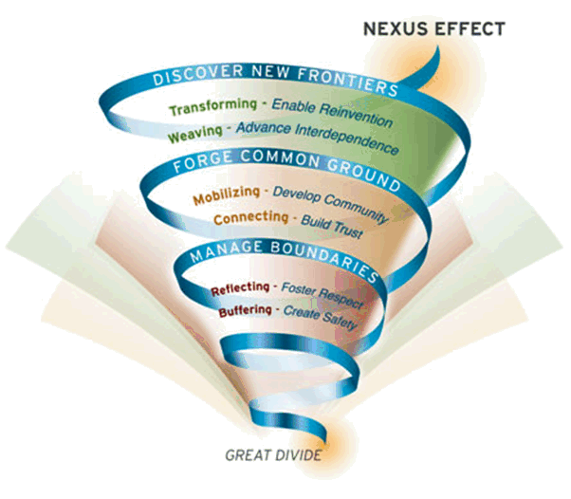
Change management

Slide 7
Expectations of citizens and companies
effective social protection
integrated services
  attuned to their concrete situation, and personalized when possible
  delivered at the occasion of events that occur during their life cycle (birth, going to school, starting to work, move, illness, retirement, starting up a company, …)
  across government levels, public services and private bodies
attuned to their own processes
with minimal costs and minimal administrative burden
if possible, granted automatically
with active participation of the user (self service)
well performing and user-friendly
reliable, secure and permanently available
accessible via a channel chosen by the user (direct contact, phone, PC, …)
sufficient privacy protection

Slide 8
Creation of CBSS (°1990)
a clear long term vision combined with quick wins
federal Minister of Social Affairs as a political sponsor
demonstration of organisational and technical feasibility
gradual implication of
  the general managers of all public social security institutions
  the social partners managing the public social security institutions
  the general managers of the private social security institutions
successive formal approval of the vision and the initiative by
  all federal Ministers dealing with aspects of social security
  the federal Council of Ministers
  the National Labour Council (highest consultative body between the government and the social partners)
  the federal Parliament

Slide 9
Creation of CBSS (°1990)
small team in direct support of the federal Minister of Social Affairs
  consisting of
    experienced civil servants with a sound human network within all levels of the social sector
    scientific experts
    political advisors
  with multidisciplinary skills
    business process re-engineering
    change management
    legal
    ICT
    information security and privacy protection
    communication
    program and project management
gradually, co-operation agreements with other government levels (regions, local authorities, …)

Slide 10
Actual situation
a network between all 3,000 social sector actors with a secure connection to the internet, the federal MAN, regional extranets, extranets between local authorities and the Belgian interbanking network
a unique identification key
  for every citizen
  for every company
  for every establishment of a company
an agreed division of tasks between the actors within and outside the social sector with regard to collection, validation and management of information and with regard to electronic storage of information in authentic sources

Slide 11




Actual situation
Entreprises
of public interest
ORPSS
INASTI
CSPM
ONSS
FAMI
FED
AIS
SPP IS
SIGeDIS
SFP
SPF E&TO
CPAS
FAT
ONEM
FMP
CIN
INAMI
ONVA
SPF SS

Slide 12
Actual situation
Internet
R
FedMAN
Users
R
Isabel
FW
R
…
R
Backbone
FW
FW
FW
FW
FW
R
R
R
R
R
ONEM
CBSS
ONSS
R
R
CIN
…

Slide 13
Actual situation
220 electronic services for mutual information exchange amongst actors in the social sector, defined after process optimization
  nearly all direct or indirect (via citizens or companies) paper-based information exchange between actors in the social sector has been abolished
  in 2015, > 1 billion electronic messages were exchanged amongst actors in the social sector, which saved as many paper exchanges
electronic services for citizens
  maximal automatic granting of benefits based on electronic information exchange between actors in the social sector
  19 electronic services via an integrated portal
  about 30 new electronic services are foreseen

Slide 14
Actual situation

Slide 15
Actual situation
more than 50 electronic services for employers, either based on the electronic exchange of structured messages or via an integrated portal site
  50 social security declaration forms for employers have been abolished
  in the remaining 30 (electronic) declaration forms the number of headings has on average been reduced to a third of the previous number
  declarations are limited to 3 events
    immediate declaration of recruitment and discharge (only electronically)
    quarterly declaration of salary and working time (only electronically)
    occurrence of a social risk (electronically or on paper)
  in 2015, more than 26 million electronic declarations were made by all 220,000 employers, 98 % of which from application to application

Slide 16
Actual situation
an integrated portal site containing
  electronic transactions for citizens, employers and professionals
  simulation environments
  information about the entire social security system
  harmonized instructions and information model relating to all electronic transactions
  a personal page for each citizen, each company and each professional
an integrated multimodal contact centre supported by a customer relationship management tool
a data warehouse containing statistical information with regard to the labour market and all branches of social security

Slide 17
Distributed information servers
information servers
  directory of data subjects at the Crossroads Bank
  basic identification data of citizens at the National Register and the complementary Crossroads Bank Register
  basic identification data of companies at the Company Register
  employers directory (WGR) at the ONSS
  work force register at the ONSS
  salary and working time database at the ONSS and the ONSSAPL
  database of contribution certificates
services offered
  interactive consultation
  batch consultation
  automatic communication of updates

Slide 18
Pre-processed messages
pre-processed messages
  beginning/end of labour contract, beginning/end of self-employed activity
  contribution certificates medical care (employees, self-employed, beneficiaries of social security allowances)
  unemployment benefits
  benefits in case of career break
  benefits in case of incapacity for work ((labour) accident, (occupational) disease)
  reimbursement of health care costs
  child benefits
  old age pensions
  holiday pay
  benefits for the disabled
  guaranteed minimum income – social welfare
  derived rights (e.g. tax reduction/exemption, free public transport, ...)
  migrant workers
  …
services offered
  interactive consultation
  batch consultation
  automatic communication of messages

Slide 19









Quartely declaration salary & working time
simplification
Activity 3
Activity 2
Activity 1
employer
one electronic
declaration
ONSS
INAMI
FAT
ONEM
old age pension
FMP
SFP
Famifed
holiday pay
ONVA

Slide 20
Declaration of social risks
types of social risks
  child benefits
  incapacity for work ((labour) accident, (occupational) disease, …)
  unemployment
  old age pension
3 possible moments of declaration
  start of the social risk
  recurrence or continuation of the social risk
  end of the social risk
structure of the declaration
  identification data
  if necessary, salary and working time data not yet declared via a quarterly declaration (mini-declaration)
  specific data concerning the social risk

Slide 21
LIMOSA
integrated electronic service delivery based on a single, mandatory declaration in case of temporary or partial professional activities of foreign employees and self-employed persons in Belgium
500.000 declarations per year
reduction of process time from 7 days to 5 minutes
integrated service throughout 8 types of institutions (750 concrete institutions)
gains in effectiveness
  improvement of social protection of migrant workers
  enhancement of free movement of workers and services
gains in efficiency
  lower cost due to single, multifunctional and electronic information collection and integrated information processing
  shortening of clearance times with immediate return of receipt
  availability of integrated services according to the logic of the user at any time and from anywhere
gains in transparency
  permanent access for the user to the processing status of its declaration

Slide 22
Institutional structure & financing of the CBSS
cooperative governance
adequate management and control techniques
financing principles
internal organization

Slide 23
CBSS as driving force
coordination by the Crossroads Bank for Social Security
  Board of Directors consists of representatives of the companies, the citizens and the actors in the social sector
  mission
    definition of the vision and the strategy on eGovernment in the social sector
    definition of the common principles related to information management, information security and privacy protection
    definition, implementation and management of an interoperability framework
      technical: secure messaging of several types of information (structured data, documents, images, metadata, …)
      semantic: harmonization of concepts and co-ordination of necessary legal changes
      business logic and orchestration support
    coordination of business process reengineering
    stimulation of service oriented applications
    driving force of the necessary innovation and change
    consultancy and coaching

Slide 24
Co-operative governance
CBSS has an innovative model of governance, steering the business process re-engineering with complex interdependencies between all actors involved
Board of Directors of the CBSS
  consists of representatives of the stakeholders (employers associations, trade unions, social security institutions, …)
  approves the strategic, operational and financial plans of the CBSS
General Coordination Committee with representation of all users acts as debating platform for the elaboration and implementation of eGovernment initiatives within the social sector
permanent or ad hoc working groups are instituted within the General Coordination Committee in order to co-ordinate the execution of programs and projects
the chairmen of the various working groups meet regularly as a Steering Committee
besides project planning and follow-up, proper measuring facilities are available to assure permanent monitoring and improvement after the implementation of the electronic services

Slide 25
Management and control techniques
annual priority plan debated with all users within the General Coordination Committee of the CBSS
cost accounting and zero-based budgeting resulting in financial transparency, an informed budget and a good evaluation of the management contract with the Belgian federal government
internal control based on the COSO-methodology (see www.coso.org) in order to provide reasonable assurance regarding the achievement of objectives with regard to
  effectiveness and efficiency of operations
  reliability of financial reporting
  compliance with applicable laws and regulations
external audit with regard to the correct functioning of the internal control system

Slide 26
Management and control techniques
program management through the whole social sector
issue management during the management of each program
use of a system of project management combined with a time keeping system to follow up projects that are realized by the CBSS and its partners
frequent reports to all users which describe the progress of the various projects and eventual adjustment measures
use of balanced scorecards and a dashboard to measure, follow-up and evaluate the performance of the electronic services and the CBSS
use of ITIL (see www.itil-itsm-world.com) for ICT-service delivery
use of a coherent set of monitoring techniques to guarantee an optimal control and transparency of the electronic services

Slide 27
Financing principles
annual cost of the CBSS, its network and its services: 17.000.000 euro
financed by a withholding on the social security contributions paid by the employers, the employees and the self-employed before the distribution of these contributions to the social security sectors
no direct charge for the actors in the social sector in case of use of the CBSS services
  stimulation of the use of the system
  no additional accounting and administration costs for the social sector as a whole
charge per electronic message (0,0066 euro) exchanged for actors outside the social sector, with possibility of settlement on mutual terms in case of reciprocal information exchange

Slide 28
Internal organization CBSS
internal
  90 people
  General Management
  6 divisions
    R&D, Legal and External Communication
    Client, Program, Project and Services Management
    Application Development and Management
    ICT Management
    Information Security and Internal Audit
    Resources Management (HR, finance, logistics, …)
co-sourced with association owned by the public social security institutions
  physical network
  some basic services (e.g. portal, contact centre, …)

Slide 29
Implementation order used in Belgium
common vision on information management and information security
demonstration of feasibility
political and public support, support of the social partners, support of the social security institutions
basic legislation
  creating an institution as a driving force and a control committee
  translating the common vision on information management and information security
integration of unique identification key in all information systems
implementation of the ICT architecture and the basic ICT services
controlled access to databases with authentic data
re-engineering of processes between actors in the social sector at all government levels
re-engineering of processes between actors in the social sector and companies
re-engineering of processes between actors in the social sector and citizens
always combined with the necessary legislative changes

Slide 30
Critical success factors and obstacles
common vision on electronic service delivery, information management and information security amongst all stakeholders
support of and access to policymakers at the highest level
trust of all stakeholders, especially partners and intermediaries, based on
  mutual respect
  real mutual agreement
  transparency
respect for legal allocation of competences between actors
co-operation between all actors concerned based on distribution of tasks rather than centralization of tasks
focus on more efficient and effective service delivery and on cost control
reasoning in terms of added value for citizens and companies rather than in terms of legal competences

Slide 31
Critical success factors and obstacles
electronic service delivery as a structural reform process
  process re-engineering within and across actors
  back-office integration for unique information collection, re-use of information and automatic granting of benefits
  integrated and personalized front-office service delivery
multidisciplinary approach
  business process optimization
  legal coordination
  ICT coordination
  information security and privacy protection
  change management
  communication
  coaching and training
lateral thinking when needed

Slide 32
Critical success factors and obstacles
appropriate balance between efficiency on the one hand and information security and privacy protection on the other
quick wins combined with long term vision
technical and semantic interoperability
legal framework
adaptability to an ever changing societal and legal environment
creation of an institution that stimulates, co-ordinates and assures a sound program and project management
availability of skills and knowledge => creation of an association that hires ICT-specialists at normal market conditions and puts them at the disposal of the actors in the social sector
sufficient financial means for innovation: agreed possibility to re-invest efficiency gains in innovation
service oriented architecture (SOA)

Slide 33
Critical success factors and obstacles
need for radical cultural change within government, e.g.
  from hierarchy to participation and team work
  meeting the needs of the customer, not the government
  empowering rather than serving
  rewarding entrepreneurship within government
  ex post evaluation on output, not ex ante control of every input

Slide 34
Advantages
gains in efficiency
  in terms of cost: services are delivered at a lower total cost
    due to
      a unique information collection using a common information model and administrative instructions
      a lesser need to re-encoding of information by stimulating electronic information exchange
      a drastic reduction of the number of contacts between actors in the social sector on the one hand and companies or citizens on the other
      a functional task sharing concerning information management, information validation and application development
      a minimal administrative burden
    according to a study of the Belgian Planning Bureau, rationalization of the information exchange processes between the employers and the social sector implies an annual saving of administrative costs of about 1.7 billion € a year for the companies

Slide 35
Advantages
gains in efficiency
  in terms of quantity: more services are delivered
    services are available at any time, from anywhere and from several devices
    services are delivered in an integrated way according to the logic of the customer
  in terms of speed: the services are delivered in less time
    benefits can be allocated quicker because information is available faster
    waiting and travel time is reduced
    companies and citizens can directly interact with the competent actors in the social sector with real time feedback

Slide 36
Advantages
gains in effectiveness: better social protection
  in terms of quality: same services at same total cost in same time, but to a higher quality standard
  in terms of type of services: new types of services, e.g.
    push system: automated granting of benefits
    active search of non-take-up using data warehousing techniques
    controlled management of own personal information
    personalized simulation environments
better support of social policy
more efficient combating of fraud

Slide 37
Common vision on information management
information is being modelled in such a way that the model fits in as closely as possible with the real world, in order to allow multifunctional use of information
information is collected from citizens and companies only once by the social sector as a whole, via a channel chosen by the citizens and the companies, preferably from application to application, and with the possibility of quality control by the supplier before the transmission of the information
the collected information is validated once according to established task sharing criteria, by the actor that is most entitled to it or by the actor which has the greatest interest in correctly validating it
a task sharing model is established indicating which actor stores which information as an authentic source, manages the information and maintains it at the disposal of the authorized users

Slide 38
Common vision on information management
information can be flexibly assembled according to ever changing legal concepts
every actor has to report probable errors of information to the actor that is designated to validate the information
every actor that has to validate information according to the agreed task sharing model, has to examine the reported probable errors, to correct them when necessary and to communicate the correct information to every known interested actor
once collected and validated, information is stored, managed and exchanged electronically to avoid transcribing and re-entering it manually
electronic information exchange can be initiated by
  the actor that disposes of information
  the actor that needs information
  the CBSS that manages the interoperability framework

Slide 39
Common vision on information management
electronic information exchanges take place on the base of a functional and technical interoperability framework that evolves permanently but gradually according to open market standards, and is independent from the methods of information exchange
available information is used for
  the automatic granting of benefits
  prefilling when collecting information

Slide 40
Common vision on information security
security, availability, integrity and confidentiality of information is ensured by integrated structural, institutional, organizational, HR, technical and other security measures according to agreed policies
personal information is only used for purposes compatible with the purposes of the collection of the information
personal information is only accessible to authorized actors and users according to business needs, legislative or policy requirements
the access authorization to personal information is granted by an Sectoral Committee of the Privacy Commission, designated by Parliament, after having checked whether the access conditions are met
the access authorizations are public

Slide 41
Common vision on information security
every actual electronic exchange of personal information has to pass an independent trusted third party (basically the CBSS) and is preventively checked on compliance with the existing access authorizations by that trusted third party
every actual electronic exchange of personal information is logged, to be able to trace possible abuse afterwards
every time information is used to take a decision, the information used is communicated to the person concerned together with the decision
every person has right to access and correct his/her own personal data
every actor in the social sector disposes of an information security officer with an advisory, stimulating, documentary and control task

Slide 42
Useful tool: the reference directory
reference directory
  directory of available services/information
    which information/services are available at any actor depending on the capacity in which a person/company is registered at each actor
  directory of authorized users and applications
    list of users and applications
    definition of authentication means and rules
    definition of authorization profiles: which kind of information/service can be accessed, in what situation and for what period of time depending on in which capacity the person/company is registered with the actor that accesses the information/service
  directory of data subjects
    which persons/companies have personal files at which actors for which periods of time, and in which capacity they are registered
  subscription table
    which users/applications want to automatically receive what information/services in which situations for which persons/companies in which capacity

Slide 43
Useful tool: the electronic identity card
identification of the holder
  name
  Christian names
  nationality
  date and place of birth
  sex
  identification number of the National Register
  main residence
  manual signature
electronic authentication of the identity of the holder (private key and certificate)
possibility for the holder to sign electronically (private key and certificate)
no encryption certificate
no electronic purse
no biometric data

Slide 44
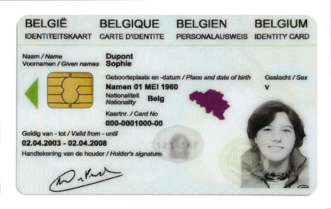
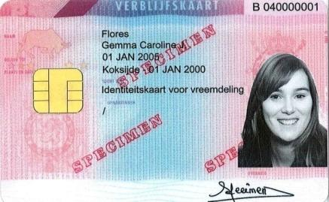
Integrated user and access management
Electronic identity card (eID): statutory electronic identity card for Belgians over the age of twelve
Kids-ID: on demand for children below the age of twelve
Foreigners card: for both EU and non-EU citizens with residence in Belgium

Slide 45

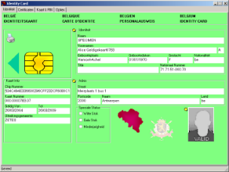
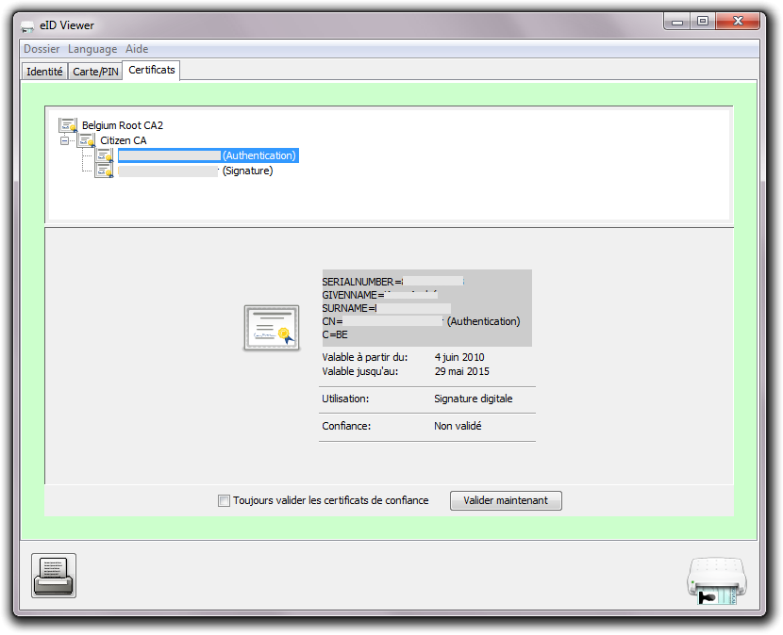
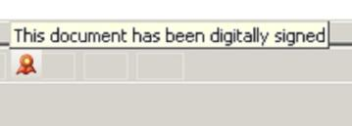
Electronic identity card (eID)
read data
authenticate identity
digital signatures

Slide 46

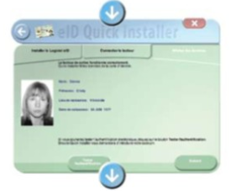
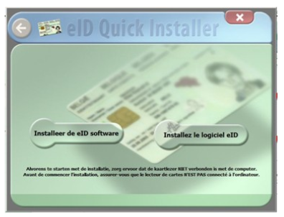
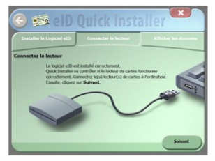
Electronic identity card (eID)
install eID software
connect the card reader with the computer
consult your data

Slide 47
Information security
structural and institutional measures
organizational and technical measures based on ISO 27XXX
legal measures

Slide 48
Structural and institutional measures
no central data storage
independent Sectoral Committee of the Privacy Commission
within social sector, a preventive control of the legitimacy of personal data exchange by CBSS according to the authorizations of the independent Sectoral Committee of the Privacy Commission
information security department with each actor in the social sector
specialized information security service providers
information security working group

Slide 49
Independent Sectoral Committee of the Privacy Commission
designated by the Belgian Parliament
mandate
  information security supervision
  authorizing information exchange
  complaint handling
  information security recommendations
  extensive investigating powers
  annual activity report

Slide 50
Information security department
with each social sector institution
composition
  information security officer
  one or more assistants
Sectoral Committee carries out control on independence and enables the permanent education of the information security officers
Sectoral Committee can allow that a task of the information security department is outsourced to a recognized specialized information security service provider

Slide 51
Information security department
information security department
  recommends
  promotes
  documents
  controls
  reports directly to the executive management
  formulates the blueprint of the security plan
  elaborates the annual information security report
executive management
  takes decisions
  has the final responsibility
  gives motivated feedback
  approves the information security plan
  supplies the necessary resources

Slide 52
Annual information security report
general overview of the information security situation
overview of the activities
  recommendations and their effects
  control activities
  campaigns in order to promote information security
overview of the external recommendations and their effects
overview of the trainings received

Slide 53
Specialized information security service providers
to be recognized by the Government
recognition conditions
  non-profit association
  having information security in the social sector as the one and only activity
  respecting the tariff principles determined by the Government
control on independence is performed by the Sectoral Committee
tasks
  keeping information security specialists at the disposal of the associated actors
  recommending
  organizing information security trainings
  supporting campaigns promoting information security
  external auditing on request of the actor or the Sectoral Committee
each actor can only associate with one specialized information security service provider

Slide 54
Information security working group
composition
  information security officers of all branches in the social sector
  sub-working groups
    branches
    themes (policy, audit, …)
tasks
  coordination
  creation of information security awareness
  communication
  formulating recommendations to the Sectoral Committee
deliverables
  ISMS and information security policies
  minimum information security standards
  information security guidelines
  codes of good practice
  protecting the network
  organizing internal information security audits
  disaster recovery methods

Slide 55
Organizational & technical measures
risk assessment
security policies
governance and organization of information security
inventory and classification of information
human resources security
physical and environmental security
management of communication and service processes
processing of personal data
access control
acquisition, development and maintenance of information systems
information security incident management
business continuity management
compliance: internal and external control
communication to the public of the policies concerning security and the protection of privacy

Slide 56
Legal measures
obligations of the controller of the processing
  criteria for making data processing legitimate
  respect of basic privacy protection principles, such as the purpose limitation principle and the proportionality principle
  specific rules for processing of sensitive data
  information to be given to the data subject
  processing confidentiality, integrity and availability
  notification of the processing of personal data
rights of the data subject
  right to information
  right to access
  right to rectify, erase or block his/her data
  right to a judicial remedy
sanctions and penalties

Slide 57
Useful legislative changes
legal translation of
  the common vision on information management
  the common vision on information security and privacy protection
  the obligation to use unique identification keys
creation of a public institution (CBSS) that acts as a driving force
  mission and tasks
  governance
  financing principles
creation of a control committee on information security and privacy protection
probative value of electronic information storage and exchange
punishment of abuse of the system
gradually, coordination or harmonisation of basic legal concepts
gradually, adaptation of business processes set out in the law

Slide 58
Towards a network of service integrators
Service integrator
(Corve,
eWBS, CIRB, …)
RPS
RPS
Extranet
region of
community
Services
repository
Service
integrator
(CBSS)
Services
repository
ASS
Extranet
social
sector
ASS
Service
integrator
(eHealth)
Internet
Physicians
FPS
ASS
VPN
Fedman
FPS
Services
repository
Service
integrator
(Fedict)
Pharmacists
Hospitals
FPS
Services
repository

Slide 59








Awards

Slide 60

G-Cloud

Slide 61
What is G-Cloud?
shared public ICT platform
  current target: federal state (FPS, PPS, Public Institutions of Social Security, Institutions of Public Benefit)
  can be extended to other interested authorities
hybrid community cloud model
  use of public cloud if possible
  private community cloud cloud hosted in data centers, managed by the government
  operational implementation with strong involvement of the private sector

Slide 62
Basic principles
maximum synergy when possible and when generating efficiency gains and/or savings while maintaining or improving the quality of the services provided to the customer
in line with the synergy program: assignment to the one who is the most capable of proposing a form of shared services
synergy based on result orientation, sense of responsibility and trust

Slide 63







Types of cloud implementations
Public Cloud
Shared
Hybrid
Access/Control
Outsourced Community Cloud (= off-premise)
Community Cloud on-premise
Private Cloud on-premise
Outsourced Private Cloud (= off-premise)
Dedicated
Location
Customer
Service Provider

Slide 64





What is G-Cloud ?
A program including synergy projects
Synergy for existing as well as new services
For public services
Managed by public services
In cooperation with the private sector

Slide 65




G-Cloud ‘products’
Procurement
Cooperationá
Efficiencyá
Projects
Synergy
Services
Costsâ
Qualityá
Know-how & Expertise

Slide 66
Not only technology, also strategy
a multi-layered, suitable ICT architecture (infrastructure, data, basic software, business applications)
  why?
    cost management: bad design and a large number of modifications increase costs exponentially
    time to market
    maintainability
    flexibility
    mobility
    security
    availability of resources
  features
    services oriented
    modular
    interoperable (based on open standards and open specifications)
    expandable
    based on reuse of components and data

Slide 67
Not only technology, also strategy
suitable sourcing choices
  based upon
    Infrastructure as a Service (IaaS)
    Platform as a Service (PaaS)
    Software as a Service (SaaS)
  what will we be doing ourselves?
  big impact on ICT department
    decrease of
      technical infrastructure and platform management
      own development => replaced by standard packages and SaaS solutions (no customization; good is good enough – relevant modules only)
    development of
      architecture function
      information security and compliance function
      process and information analysis
      business knowledge
      knowledge of the ICT market and its development

Slide 68



Why G-Cloud?
Creation of economies of scale: efficiency and high quality/availability
Respect of confidentiality and data protection
Bigger focus on business applications and flexibility in order to realize them

Slide 69

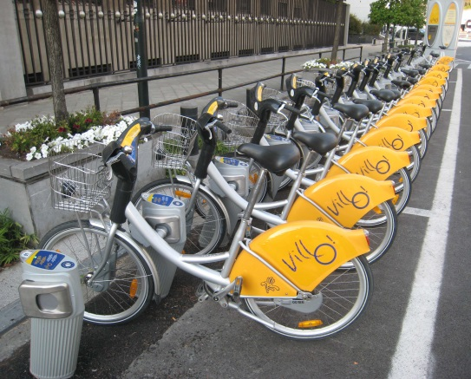

Why G-Cloud?
Greater weight
during negotiations with suppliers
Pooling of knowledge and resources
Technological evolution faster available for everyone

Slide 70
Opportunities and challenges
Challenges
security
confidentiality
continuity
strategic management
Opportunities
cost management
cooperation
self-service
economies of scale
flexibility
quality
know-how

Slide 71

G-Cloud success factors
efficiency
adequate security measures (risk↘)
optimal cooperation and trust between the institutions
differentiation of the offer: neither ‘one size fits all’ nor tailor-made work
capacity management
a phased approach, no ‘big bang’
quality service: service / SLA

Slide 72
G-Cloud projects
Business applications
Standard components and applications
BabelFed
Translation
ITSM
Service desk
WCM
Websites
Platform
Database
Middleware
Communication
BIDA
Green
Open Source
Yellow
Microsoft
Blue
IBM
Red
Oracle
SAS
Architecture
Soft infrastructure
Backup
UCC
VoiP, Mail...
IAP
Firewalls proxy...
Archiving
ShaD
Directory
Hard infrastructure
Compute
Network
LAN/WAN
Consolidation data center
Storage
Being prepared
Ongoing
Available

Slide 73
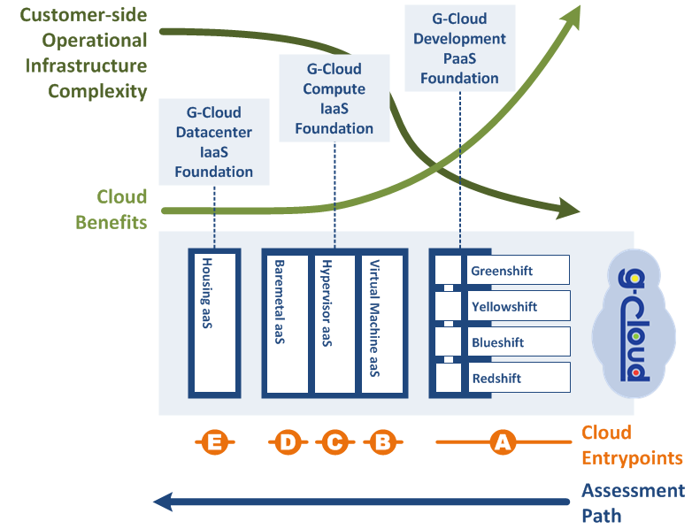
Possible entrypoints

Slide 74
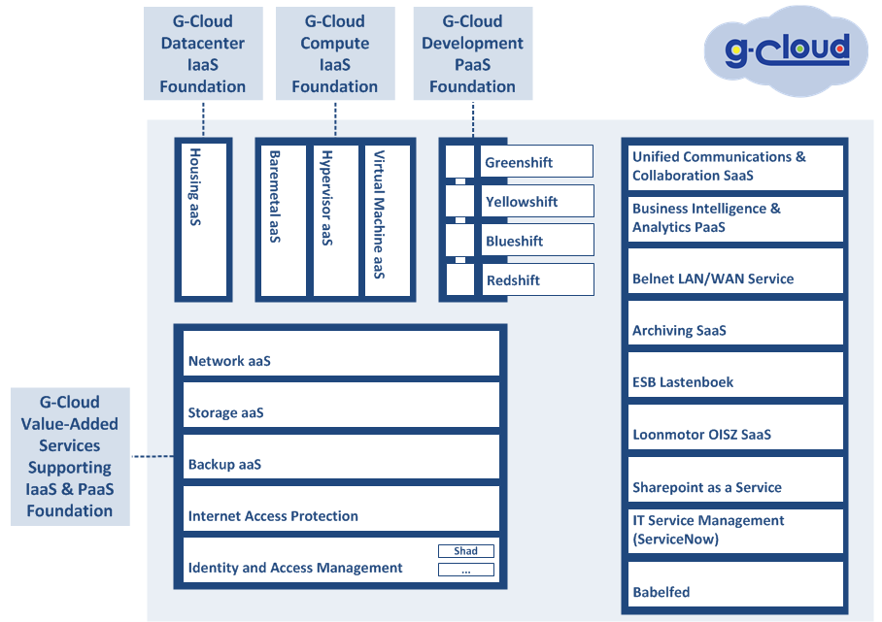
Notes:
Basisschema dienstenaanbod G-Cloud.
Basic scheme G-Cloud service offerings

Slide 75
G-Cloud and the private sector
G-Cloud ≠ IT insourcing
public procurement
translation tool, Converged Infrastructure, Unified Communications, network security, storage, back-up...
in consultation with the sector for several specific platforms
IBM, Microsoft, Oracle, SAS...

Slide 76
G-Cloud organization
Government
G-Cloud Operations & Programme Board
G-Cloud Strategic Board
FPS/PPS
(Horizontal FPS, SPF FIN, Belnet, …)
PIOSS/IPB
(CBSS, ...)
Association of FPS/PPS/IPB
Private ICT companies directed by FPS/PIOSS/...
3 Colleges
Federal Public Services (FPS)
Public Institutions of Social Security (PIOSS)
Institutions of Public Benefit (IPB)
SIT: ICT managers from
FPS
Public Institutions of Social Security
Institutions of Public Benefit
Service
owners

Slide 77


G-Cloud organization
G-Cloud Strategic Board: strategic direction by senior officials
G-Cloud Operations & Program Board:
CIOs for operational direction

Slide 78


G-Cloud organization
Concrete technical projects
Interinstitutional cooperation for specific projects
  Depending on the interest and commitment of federal services

Slide 79
Role of the G-Cloud Strategic Board
set out the G-Cloud vision
determine the priorities
ensure that each G-Cloud service is provided by a Service Owner having the necessary competences
follow the services (availability, performance, capacity) (SLA)
ensure an adequate cost allocation method
follow the program management (‘projects’)
ensure the general policy for the way operations should be proposed
provide an input for the ICT policy of the government
implement the ICT policy and report to the government
the members report to the College which they participate in

Slide 80
Role of the G-Cloud Operational
& Program Board
deliver the necessary input to the G-Cloud Strategic Board
realize the priorities set by the Board in respect of the SLAs
suggest to which ‘service owner’ a G-Cloud service should be assigned to
determine the features, the architecture and the security of the delivered services
manage the services catalogue
determine the specifications calendar
carry out the program management
ensure HR support of the employees who work for the different G-Cloud services
report to the colleagues of the SIT (IT directors)

Slide 81
G-Cloud - Financial aspects
the cost of a service is
  either borne by the responsible institution
  or divided between the customers of the service
G-Cloud services are cheaper than internal implementation (TCO - Total Cost of Ownership)
  calculation of total TCO is difficult
‘pay-for-use’ as much as possible

Slide 82
G-Cloud - Human resources
3500 collaborators with an IT profile working for the federal state
war-for-talent and inverted age pyramid
cost-sharing organization
impact on ICT employees: shift from routine work to the creation of innovative solutions
realization of the projects with ‘Tiger Teams’, i.e. virtual teams containing experts from the different institutions

Slide 83
G-Cloud - Security and policies
crucial elements of the G-Cloud
  Pooling of services
  Risk coverage
not oriented towards highly specific use cases
(e.g. state security...)
security framework compliant with the standards
G-Cloud project <-> security needs

Slide 84
Cloud security evaluation model
What ?
evaluation of safety of the Cloud provider / service
How ?
very detailed questionnaire with scores
4 main criteria: IAM, IT security, operational security, governance
Excel application forms
free & publicly available
in function of the nature and sensitivity of the processed data
visual mapping of both for a convenient overview

Slide 85
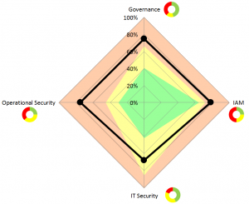
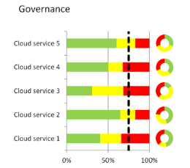
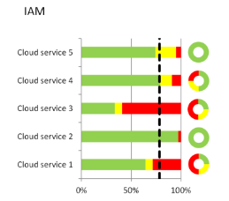
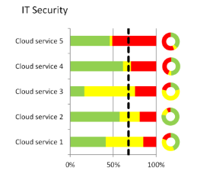
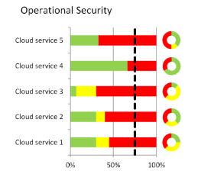
Cloud security evaluation model
Available on
www.SmalsResearch.be
Rubriek Tools

Slide 86

Project realization
identification of a concrete need of an institution → is pooling possible?
are the CIOs interested?
composition of an interinstitutional project group
  scope definition
  methodology
  costs / benefits
realization of the project
  tender
  in-house development
  or a combination of the two
! transition project mode -> service

Slide 87
Shared procurement
cooperation regarding the public procurements
  juridical: central procurement agency clause
  know-how: specialized in ICT purchases
  simplicity: less administrative work for the private sector and the state
  possibility to accelerate the purchases and to avoid double specifications procedures
  price reductions thanks to the volume
software licences
  negotiations with the providers
  exchange of unused licences

Slide 88
Data center consolidation
Cooperation: Belgian Buildings Agency/ FPS Finances / Smals
FROM
40 data centers
≠ scale
legacy, complexity
high-cost connectivity per data center
≠ service levels
power & cooling limits
separate supervision
TO
4 data centers
large scale
standardised
high-speed fibre interconnection
24x7 services
future-proof power & cooling
shared supervision

Slide 89





Data center consolidation
high-performance interconnections (DWDM, Extranet, Belnet, commercial operators…)
24x7 surveillance & management
SLA (end-to-end): >99,9%
future-proof
Fibre connections
Belnet

Slide 90



Ecological and economical
cooling with outside air
cooling with water (canal)
significant cost reduction

Slide 91





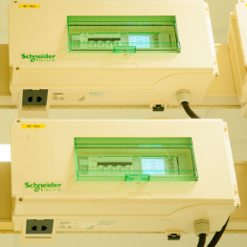

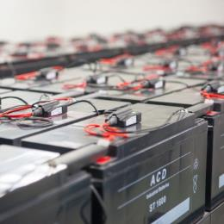

Security environment Tier 3+
power supply*
UPS (batteries)*
diesel generators*
cooling*
network access*
access control
surveillance 24x7
fire detection
fire extinguishing
installations
*Redundant (2N of 2N+1)
At critical points Tier-4 equivalent

Slide 92

Coordinated supervision
24x7 monitoring
multi-data center
end-to-end
  hardware
  basic components
  applications
  company processes
SLA management
permanent on-site
+ on-call services

