Slide 1
eHealth: state of affairs and perspectives
frank.robben@ehealth.fgov.be
@FrRobben
https://www.ehealth.fgov.be
http://www.ksz.fgov.be
http://www.frankrobben.be

Slide 2
Some evolutions in health care
More chronic care instead of merely acute care
Remote care (monitoring, assistance, consultation, diagnosis, operation...), and mobile care
Multidisciplinary, transmural and integrated care
Patient-centric care and patient empowerment
Rapidly evolving knowledge => need for reliable and coordinated management and access to knowledge
Threat of excessively time-consuming administrative processes
Thorough support of health care policy and research requires thorough, integrated and anonymised information
Cross-border mobility
Need for cost control

Slide 3
The reported evolutions require...
Cooperation between all actors in health care
Efficient and secure electronic communication amongst all actors in health care
High-quality, multidisciplinary electronic health records
Care pathways
Optimised administrative processes
Technical and semantic interoperability
Guarantees with regard to
information security
privacy protection
respect for the professional secrecy of health care providers

Slide 4
Electronic communication also stimulates…
Quality of care and patient safety
avoidance of wrong care and medication
incompatibility between medicines
contra-indications against certain medicines or treatments for a specific patient (eg allergies, diseases…)
avoidance of errors in concrete care provision and administration of medicines
availability of reliable databases on good treatment practices and decision support scripts
more opportunity for multidisciplinary consultations and second opinions
Avoidance of unnecessary multiple examinations => less stress for the patient and avoidance of unnecessary additional costs

Slide 5
The patient consults his/her physician
Administrative advantages
Via eID of the patient (at least at the first consultation)
Authentication of identity of the patient
Verification of insurance status
GMF?
Possibility of registering informed consent and therapeutic relationships

Slide 6
History via the SumEHR and hubs/metahub
Online advice and guidelines
Medical
Electronic prescriptions
Medication schedule
Lab results and results of medical imaging
Electronic referrals

Slide 7
Rate setting
& invoicing
SumEHR,
medication schedule,
... updates
Adminis-trative
Create and send certificates
Registrations
Send report to GMF holder

Slide 8
eHealth Roadmap 2015-2019
End of 2012: organisation of a Round table conference on the priorities for computerising the health sector
Participation of about 300 people involved in the sector
Result: eHealth Roadmap providing concrete targets for the next 5 years
2015: update of the eHealth Roadmap 2.0

Slide 9
eHealth Roadmap 2015-2019
Principles
cooperation: coalition of the willing
involvement of all stakeholders
empowerment of all stakeholders
reliable basic services and business continuity actions
simplification where possible
emphasis on concrete results rather than on everlasting discussions
steady progress because of SMART goals and action points
multidisciplinary approach, including training and financial aspects
basis for synergies necessary for high-quality and affordable health care

Slide 10
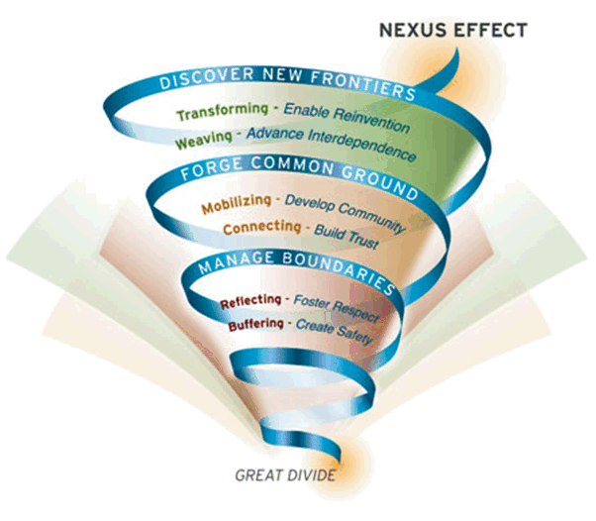
Nexus effect
Bron: MIT Sloan

Slide 11
Roadmap 2.0
eHealth landscape for health care providers in 2019
all GPs will have digitised medical records for all their patients and will publish and keep updated a SumEHR in a secure 'health vault’ (Vitalink, Intermed or BruSafe)
for all other health care professionals, a digitised patient file (DPF) will be set up and they will also be able to publish and keep (certain) information from their DPF up to date in secure ‘vaults'

Slide 12
Roadmap 2.0
hospitals, psychiatric institutions and laboratories will publish their documents via hubs with which they are affiliated and will consult data in secure vaults (Vitalink, Intermed, BruSafe) using this method
pharmacists will publish a shared pharmaceutical file (SPF), which will feed into the medication schedule
the medication schedule will also be available in secure vaults and will be shared between doctors, pharmacists, home nurses and hospitals
GPs, through the EHR (electronic health record for GP’s), will have access to all the medical information published about their patients

Slide 13
Roadmap 2.0
all health care providers will have access to all health data published about their patients, insofar as they are relevant to them
filters will be set up for this purpose
the information may also be added to on a multidisciplinary basis
thus, maximum support will also be given to multidisciplinary care
health information and documents collected and published will be structured and coded to the greatest extent possible
! this will not be fully in place until 2019

Slide 14
Roadmap 2.0
all health care providers will be able to communicate through the eHealthBox
certain standard forms will be provided for this purpose
health care providers will be able to make use of remote health care through 'mobile health' applications which must be officially registered
registration will be subject to controls as regards respect for private life, interoperability, the CE label for medical devices and evidence-based medicine (EBM)
the registers will be optimised and standardised and registration will be automated insofar as possible
the traceability of implants and medicines must comply with international standards

Slide 15
Roadmap 2.0
health care providers will receive incentives for adequate use and usage of eHealth
financial incentives may include a federal element, as well as an element in relation to the various communities and regions
they will be trained on eHealth, both as part of their basic training and continuing professional education
a single point of contact will be in place for all information for the INAMI, SPF Santé Publique, AFMPS and the federal authorities (the "only once" principle)

Slide 16
Roadmap 2.0
eHealth landscape for patients in 2019
patients will have access to all ‘objective’ health information concerning them that is available via the secure vaults and the hubs
the possibility of setting up a consolidated platform is being looked into > this platform would allow patients to consult all their information in an integrated way and to use analysis tools as well as 'translation' tools for a better understanding of the information
contribution to 'health literacy' among patients (preventive health care)

Slide 17
Roadmap 2.0
patients can themselves add information, either via the consolidated platform, or in the secure vaults or the hubs
all the information present on the hubs and the secure vaults on the consolidated platform or in the cloud makes up the patient's PHR (Personal Health Record)
via the consolidated platform, other information may also be added by sickness funds, the Crossroads Bank for Social Security and other relevant sources such as the patient's declarations of their wishes as regards organ donation and euthanasia

Slide 18
Roadmap 2.0
the patient will have access to his/her PHR through various channels
e.g. a preinstalled application on their smartphone
strengthening the role of the patient in their treatment
in principle, the patient should no longer receive papers from their doctor (unless by special request)
the statement of health care provided will be sent to the sickness funds electronically
the medication prescription will be available in the medication schedule
proof of unfitness for work will be sent in electronic format to the employer/schhol
the patient will receive the acknowledgement of receipt (transparency act) in their inbox
condition precedent to the above: the patient must have given his informed consent

Slide 19
www.plan-egezondheid.be

Slide 20
Focus: GMF* = EMF => SumEHR
In order to assure the quality of care and to provide patients with correct information, the GP has to register the medical data in an EMF (Electronic Medical File)
The EMF is the authentic source for data sharing by the GP
The SumEHR (SUMmarized Electronic Health Record) is a brief summary of the EMF in a structured and encrypted form
Each patient is, if desired, entitled to a SumEHR
Subject to consent of the patient, the information provided in the SumEHR is accessible for each doctor having a therapeutic relationship with the patient and for the patient himself
Priority for the use of SumEHR for out-of-hours GP services and emergency services
* Global Medical File

Slide 21
Focus: GMF = EMF => Sumehr
Situation GMF 2015
More than half of all Belgians have a GMF
1 429 doctors manage the GMF holding through MyCareNet
3 926 doctors use the service for consulting the GMF holding
4,332,354 consultations of the GMF holding
1 107 doctors have sent 199,123 notifications GMF holding

Slide 22
Focus: GMF = EMF => Sumehr
Targets 2019
For 100 % of the GPs
an EMF for each patient
publication and update of the SumEHR in a secured “health vault”
For all the other health care providers
definition of the EMF
publication and update of certain information in the secured “health vaults”
Responsible organisation: RIZIV (the Belgian National institute for Health and Disability Insurance) and eHealth platform

Slide 23
Focus: Hubs & Metahub
Hubs-Metahub system = system for the provision of health data between health care providers
consultation reports
surgery reports
discharge letters
protocols of medical imaging
...
Target
linking of regional and local exchange systems of medical data (hubs);
possibility for the health care provider to find and consult the available electronic medical documents on a certain patient regardless of
the place where the documents are stored
the place where the health care provider logs in to the system

Slide 24
Focus: Hubs & Metahub
Situation 2015
system for sharing data and documents for the general and psychiatric hospitals via 5 hubs
Collaboratief Zorgplatform (Cozo)
Antwerpse Regionale Hub (ARH)
Vlaams Ziekenhuisnetwerk KU Leuven (VZN)
Réseau Santé Wallon (RSW)
Réseau Santé Bruxellois (RSB)
reference to the first-line documents (SumEHR, medication schedule...)
via the 3 secure vaults/hubs-metahub
Vitalink
InterMed
BruSafe
February 2016: 11.894.513 Hubs patients relationships registered in the Metahub (total volume)

Slide 25
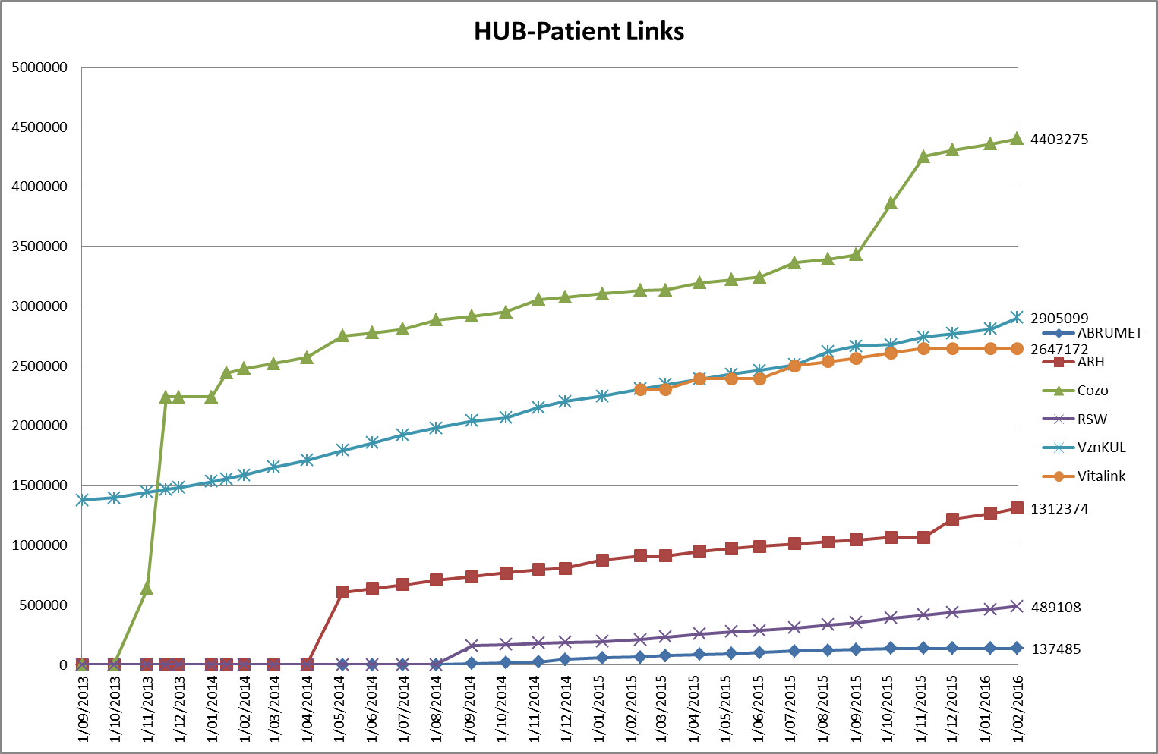
Hubs & Metahub

Slide 26
Hubs & Metahub system
5 hubs
3 technical implementations
Almost all Belgian hospitals connected

Slide 27
Hubs & Metahub system before

Slide 28
Hubs & Metahub system today
3. Retrieve data from hub A
A
1: Where can we find data?
2: In hub A and C
4: All data available
3: Retrieve data from hub C
C
B

Slide 29
Extramural data
A
InterMed
BruSafe
C
B

Slide 30
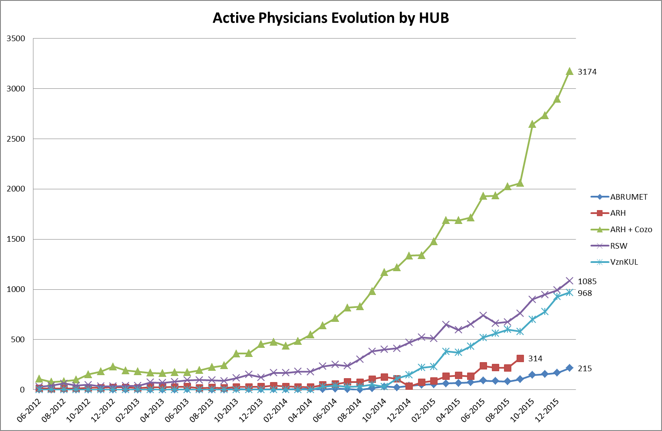
Hubs & Metahub

Slide 31
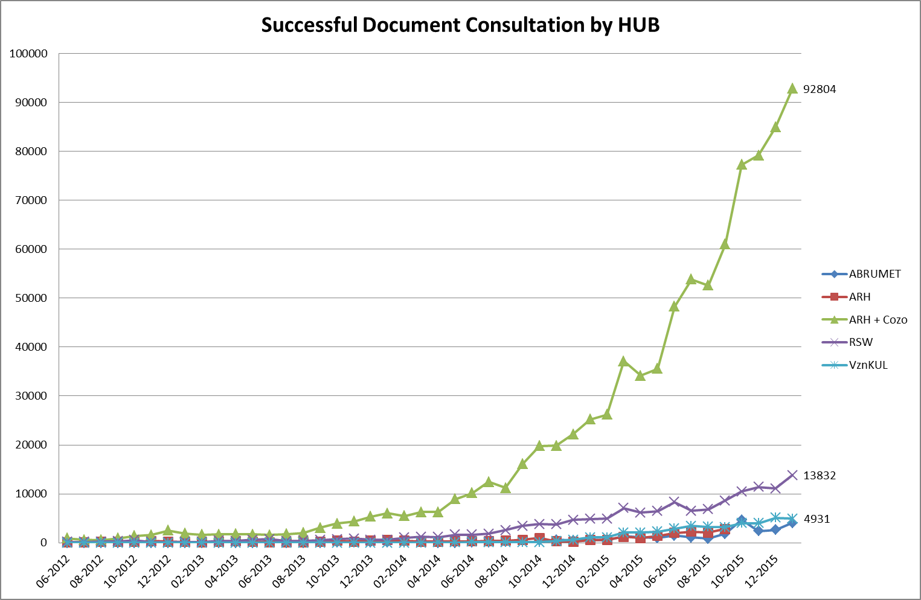
Hubs & Metahub

Slide 32
Focus: Informed consent
Necessary condition for the exchange of health information: consent of the patient for the electronic sharing of his health information
regulations approved by the different management and advisory bodies of the eHealth platform (Conciliation Committee with the users, Management Committee and Health Sector Committee)
only between health care providers/institutions having a therapeutic/health care relationship with the patient (ex. no access for the labour doctor)
registration of the consent by the patient himself or via his doctor, pharmacist, mutual insurance company or hospital

Slide 33
Focus: Informed consent
Possibility to exclude a health care provider
Possibility to withdraw the consent
Possibility to modify the consent profile at any time, without any restriction regarding the modifications
Possibility to see who has entered/modified the informed consent

Slide 34
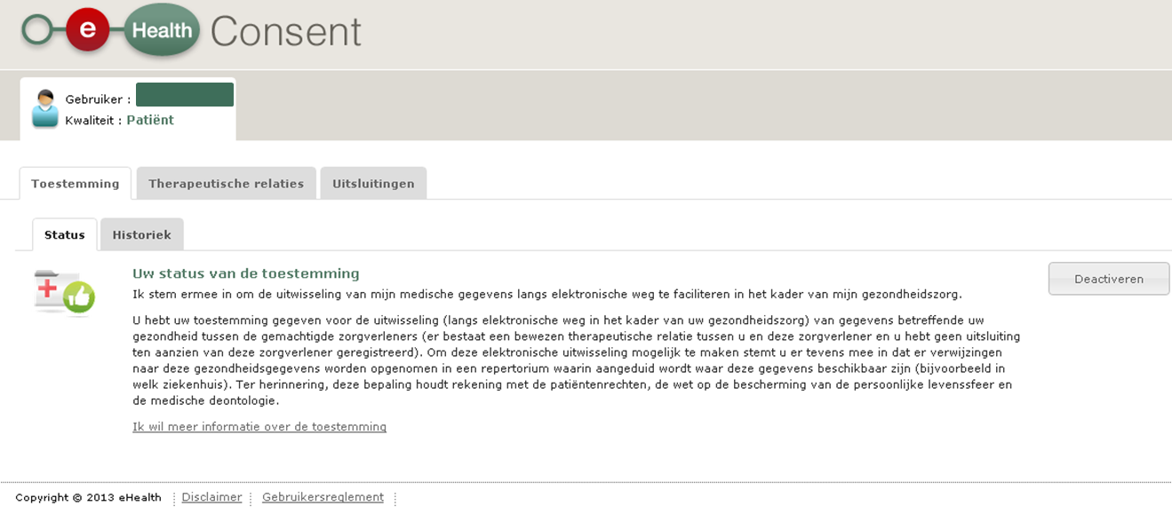
eHealthConsent

Slide 35
Focus: Informed consent
Target 31/12/2015: 2.75 million registered consents
09/03/2016: 2,878,477 registered consents
www.patientconsent.be
information folders
advertising spot spread in hospitals, mutual insurance companies, pharmacies
call centre

Slide 36
www.patientconsent.be

Slide 37
www.patientconsent.be/folder

Slide 38
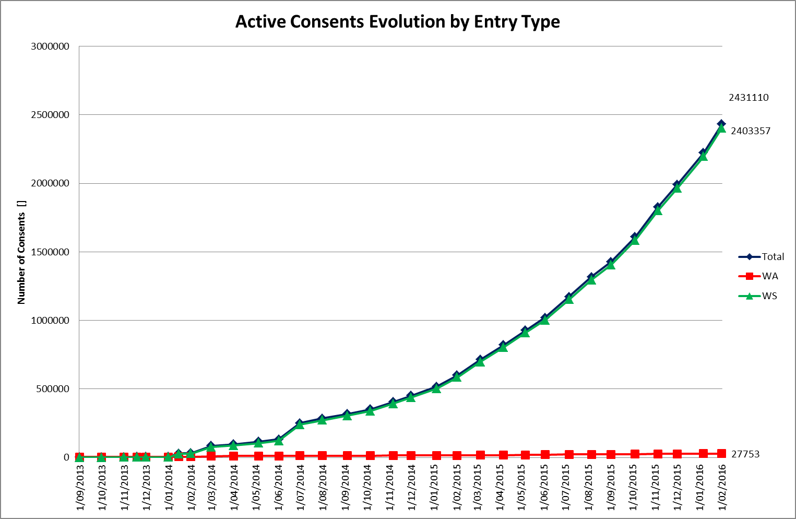
Focus: Informed consent

Slide 39
Focus: eHealthBox
eHealthBox - Status 2015
standard functionalities of an electronic mailbox system with a high-level security for the exchange of medical information
each message is fully encrypted > the health information can be securely exchanged between the different health care actors
2015: 44,753,486 messages sent
2015: +/- 4 million messages sent per month
January 2016: 3.985.854 messages sent
January 2016: 38.910 active health care providers including 18.663 GPs

Slide 40
Focus: eHealthBox
Targets 2019
generalized use of the eHealthBox and of the health care providers’ information available in CoBRHA
allowing a safe electronic communication of health and confidential information between the health care actors
developing and maintaining a common database with information of the health care actors and institutions
allowing the health care actors to consult and modify/complete specific information themselves
address book (database CoBRHA)
unique desk of the care provider
Responsible organisation: eHealth platform and FPS Health, Food Chain Safety & Environment

Slide 41
Role and responsibility of the eHealth platform

Slide 42
10 Tasks
Development of a vision and of a strategy for eHealth
Organization of the cooperation between all governmental institutions which are charged with the coordination of the electronic service provision
The motor of the necessary changes for the implementation of the vision and the strategy with regard to eHealth
Determination of functional and technical norms, standards, specifications and basic architecture with regard to ICT
Registration of software for the management of electronic patient files

Slide 43
10 Tasks
Conceptualization, design and management of a cooperation platform for secure electronic data exchange with the relevant basic services
Reaching an agreement about division of tasks and about the quality standards and checking that the quality standards are being fulfilled
Acting as an independent trusted third party (TTP) for the encoding and anonymisation of personal information regarding health for certain institutions summarized in the law for the support of scientific research and the policymaking
Promoting and coordinating programmes and projects
Managing and coordinating the ICT aspects of data exchange within the framework of the electronic patient files and of the electronic medical prescriptions

Slide 44
Basic Architecture
Patients, health care providers
and health care institutions
Health portal
Health care provider software
Health care institution software
VAS
Site RIZIV
VAS
portal of the eHealth-platform
MyCareNet
VAS
VAS
VAS
Users
Basic Services
eHealth-platform
Network
AS
AS
AS
AS
AS
AS
Suppliers
Notes:
44
44

Slide 45
10 Basic services
Coordination of electronic sub-processes
Portal
Integrated user and access management
Logging management
System for end-to-end encryption
eHealthBox
Timestamping
Encoding and anonymization
Consultation of the National Identification Registers
Reference directory (metahub)

Slide 46
www.ehealth.fgov.be

Slide 48
THANK YOU! ANY Questions?
frank.robben@ehealth.fgov.be
@FrRobben
https://www.ehealth.fgov.be
http://www.ksz.fgov.be
http://www.frankrobben.be

