Slide 1
Big data: some experiences in the social sector
Frank Robben

Slide 2
« Big data » are
Massive
Distri-buted
Fast moving
Diverse data types
Analyzed & used

Slide 3
Use analytics on all levels
Operational
Tactical
Strategic
System

Slide 4
Operational
Embedded in tools (monitoring of computer infrastructure, traffic management)
Electric grid management
Automated monitoring of all the flights in and out of a major airport

Slide 5
Tactical
Using predictive analytics, determine the likelihood that a non-custodial parent will make child support payments
Violent crime prediction, hot spot identification
Where will the next (meth) drug lab pop up ?

Slide 6
Strategic
Strategic forecasting
Telco’s churn management
Get more customers to revisit the website

Slide 7
Strategic in healthcare (US data)
Top 1 % of healthcare consumers cause 20,2% of expenditures
Solution: reduce the care to these extreme patients ?
Data shows that more care leads to lower costs: over 200.000 $ per year, per patient

Slide 8
System
« Data mining is to the healthcare system today, as the microscope was to the germ theory in the 19th century »
If you want to change the system, you have to understand it
Analytics won’t help you climb the mountain, but it will find the mountain

Slide 10
« Little big data » the case of statistical policy support
Problem
Data
With the implementation of LATG (salary and worktime database) in 1990 more complete, more frequent and better quality data became available at 2 gigabyte per quarter (« little big data »)
Innovation
With statistical tools, analysis and simulation was provided within 24 hrs of a formulated request
Impact
Since 1990, no budget round, no government negotiation has taken place without (intensive) use of this support - 70 simulations in 2012 alone
Before the 1990’s policymakers in Belgian Social Security only had a calculator and too little too low quality data to develop new policies

Slide 11
« Little big data » - why did it work ?
Vision
Flexible: no restrictions provided data are present in LATG
Technology
New software
New type of (faster) servers
People
Dedicated team, no part time players
No distribution of work: team knew systems, data, algorithms and did it all
Business
Review and meaningful interpretation of results
Return to sender when needed
Purpose clear: support policy makers when this support is urgently needed, hence deliver within 24 hrs

Slide 12
How does this apply to big data?
Technology is mandatory, but not from day 1. You can start with some servers and an open source such as « R », « Weka » or « Rapidminer »
People are in general the hardest challenge for big data deployment - even harder in government
You can’t do it without business experts: analytics output is worthless unless you can see WHY, useless if business doesn’t ACT upon it
You really, really need to know what you want to achieve - 24 hrs is good, just « faster » is not good enough
Vision
Technology
People
Business
Notes:
»

Slide 13
Applying to fraud management for several social security agencies
Start low cost with available servers , « R » en « touchgraph » software. Prepare for hardware acceleration. Alternatively: commercial software with ease of use
PHD’s working with technical software supported by university
Frequent and intensive contacts
Provide actionable models to specialized anti-fraud teams without noise
Business experts working with easy to use software, supported by PHD’s
Business experts learn to do the analysis themselves
Vision
Technology
People
Business

Slide 14
Analytics & fraudulent networks
Problem
Action
Analytics identifies suspect parties and their network
Innovation
What used to take 2 days for a limited network is now automatic with a substantially larger span
Impact
Decision by business: (1) legal action (2) on site audit (3) monitor (4) false positive
Types of fraud that only can exist through the use of multiple parties
Data on suspects (e.g. 30 parties) and their network (e.g. 1000 parties) are transferred to an interactive visualisation tool

Slide 15
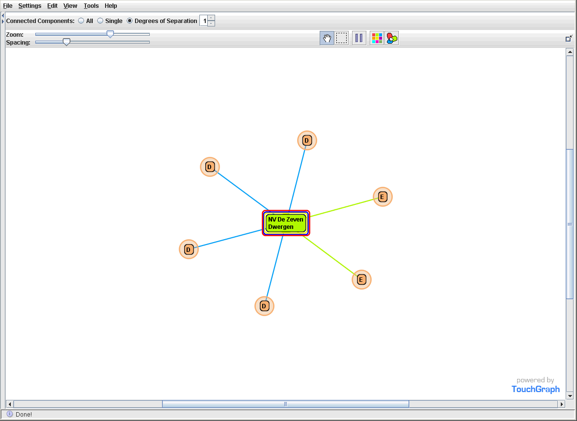

Slide 17
Fraud type 2: analysis
Databank X
Databank Y
Databank Z
Data-preprocessing
Sudden Change in Behaviour
(type 1 fraud) network
t
Fraud type 2 symptoms
& profit
Start of
Lifecycle
Parameter
Change
Consecutive or Complex Events
Network
Info
Predictive model

Slide 19
Start tomorrow, it is feasable for all of you
Use it on all levels, be ready for system change
Pick your first battles well, assign some of your best business- and technical people
Start low cost, learn and invest

Slide 20
QUESTIONS ?
frank.robben@ksz-bcss.fgov.be
@FrRobben
http://www.ksz.fgov.be – https://www.ehealth.fgov.be
http://www.smals.be
http://www.frankrobben.be
frank.robben@ksz.fgov.be

