Slide 1
eHealth Platform: Progress and Prospects
frank.robben@ehealth.fgov.be
@FrRobben
https://www.ehealth.fgov.be
http://www.ksz.fgov.be
http://www.frankrobben.be

Slide 2
Some evolutions in health care
more chronic care instead of merely acute care
remote care (monitoring, assistance, consultation, diagnosis, operation, ...), and home care
multidisciplinary, transmural and integrated care
patient-oriented care and patient empowerment
rapidly evolving knowledge => need for reliable and coordinated management and access to knowledge
threat of excessively time-consuming administrative processes
thorough support of health care policy and research requires thorough, integrated and anonymised information
cross-border mobility
need for cost control

Slide 3
These evolutions require...
collaboration between all actors in health care
efficient and safe electronic communication between all actors in health care
high-quality electronic patient files, across specialties
care pathways
optimised administrative processes
technical and semantic interoperability
guarantees concerning
information security
privacy protection
respect for the professional secrecy of health care providers

Slide 4
Mission of the eHealth platform
how?
through a well-organised, mutual electronic service and information exchange between all actors in health care
by providing the necessary guarantees with regard to information security, privacy protection and professional secrecy
what?
optimisation of health care quality and continuity
optimisation of patient safety
reduction of administrative burden for all actors in health care
thorough support of health care policy and research

Slide 5
10 missions
development of a vision and a strategy with regard to eHealth
organisation of collaboration between other government agencies charged with coordinating electronic services
acting as a key driver for the necessary changes in order to carry out the vision and strategy with regard to eHealth
establishing the functional and technical norms, standards and specifications and the basic ICT architecture
registration of software for management of electronic patient files

Slide 6
10 missions
creation, development and management of a cooperative platform for safe electronic data exchange with the corresponding basic services
to agree on task division and quality standards with regard to information storage, and to verify whether these standards are complied with
as an independent trusted third party (TTP), being in charge of the coding and anonymisation of personal health data for the benefit of specific agencies, as established by law, in order to support scientific research and policy
promoting and coordinating the development of programs and projects
managing and coordinating the ICT aspects of data exchange within the framework of electronic patient files and electronic medical prescriptions

Slide 7
eHealth platform In practice
The patient consults health care provider
Administrative advantages
Patient's eID
Authentication of the patient’s identity
Verification of insurability
GMF ?
Possibility to register therapeutic relationships and informed consent

Slide 8
eHealth platform In practice
Look up medical history through the SumEHR
Online advice and guidelines
Medical advantages
Electronic prescriptions
Medication schedule
Laboratory & medical imaging results
Electronic medical referral form

Slide 9
eHealth platform In practice
Tarification,
billing
Update SumEHR, medication
schedule, ...
Adminis-trative advantages
Create and send certificates
Registrations
Send a report to the GMF owner

Slide 10
10 basic services
Coordination of partially electronic processes
Portal
Integrated management of users and access
Log management
End-to-end encryption system
eHealthBox
Timestamping
Coding and anonymisation
Consultation of the National Registry and the Banque Carrefour registries
Reference directory (Metahub)

Slide 11
10 basic services
Ensures flexible and harmonious integration of various processes for the implementation of various basic services in a single application
Coordination of electronic sub-processes

Slide 12
10 basic services
A window to the web providing
healthcare providers with
a number of online services to
support their medical practice
Offers all relevant information for the services offered via the eHealth platform, to their missions, standards, etc…
The portal environment contains all the documents users need in order to implement precise configurations and access the available online services
Portal

Slide 14
10 basic services
Only authorised care providers/institutions can access personal data
The access rules are required by law or authorisations from the Sectoral Health Committee (set up in the Privacy Protection Committee)
Each application is subject to specific access rules
When the user authenticates their identity (using an electronic identity card or token), the tool's generic verification model launches: the model consults the rules set for the application, checks that the user is in compliance with the rules, and decides whether or not to grant access to the application
Integrated management of users and access

Slide 15
Integrated management of users and access rights How it works

Slide 16
10 basic services
Management of an access registry
for the data management system >
all access rights to read and write
and all withdrawals are registered
and can be used as proof in the event of
the submission of a complaint
Log management

Slide 17
10 basic services
Communication of complete data, unchanged from one point to another by making them unreadable using a key (encyption) until decrypted using a key
2 methods:
Known recipient: use of an asymmetric encryption (2 keys)
Unknown recipient: use of symmetric encryption (the information are encrypted and kept outside the eHealth platform. The decryption key can be obtained via the eHealth platform)
End-of-end encryption system

Slide 18
Encryption for a known recipient
Health care actor
person or entity
eHealth platform
1
Internet
3
Connector or
other software to
generate key pair
Authenticates sender
2
Identification
certificate
4
Sends
public key
Identification
certificate
Stores
public key
Web service
Register key
2
Public keys
repository
Stores private key
in a secure way

Slide 19
Encryption for a known recipient
Message originator
Internet
eHealth platform
1
Identification
certificate
Web service
Ask public key
Identification
certificate
2.
Asks for public key
Authenticates sender
Send message
Any protocol
3
4
Sends
public key
Encrypts
message
Identification
certificate
Message recipient
Public keys
repository
5
Stored
private
key
Decrypts message

Slide 20
Encryption for an unknown recipient
Key
Management
/ Depot
Encrypted with public key of user 1
Encrypted with public key of user 2
Symmetric key
Symmetric key
2 sends key
User 1
Originator
1 asks for key
5 receives key
User 2
Recipient
4 justifies right to
obtain key
4 justifies right to
obtain message
3 sends encrypted message
Encrypted with public key of Message depot
5 receives message
Encrypted with public key of User 2
Message encrypted with
symmetric key
Messages
Depot
Message encrypted with
symmetric key
Message encrypted with
symmetric key

Slide 21
10 basic services
Possibility to date any document created in the healthcare sector, accurate to 1 second, and ensure the validity of content across time through a signature from eHealth
Timestamping

Slide 22
Application of timestamping: electronic prescriptions in hospitals
1
Prescription A
Prescription B
Electronic
signature
5
2
Hashcode A
Hashcode B
3
6
Timestamp bag
4
Archive
Electronic
timestamping
6
Archive

Slide 23
10 basic services
Coded hidden identity so that appropriate personal information can be used without violating privacy and an option to anonymize data by replacing the information indicated with generic information. Once the data have been coded or anonymized, the data remain usable, but it is no longer possible to deduce the identity of the person, either directly or indirectly.
Coding & Anonymization

Slide 24
10 basic services
Access to the national register an the Banque Carrefour registers by authorised health care professionals, under strict conditions
Consultation of the National Consultation of the National Registry and the BCSS registries

Slide 25
10 basic services
Secure electronic letterbox for the exchange of medical data
eHealthBox

Slide 26
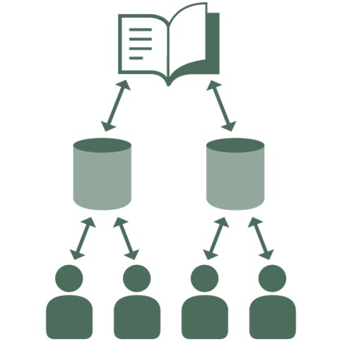
10 basic services
Indicate, with the agreement of patients, the type of data stored with particular health service providers and on which patients
Reference directory

Slide 27
Value-added services
67 value-added services in production
> 40 value-added services under study
Examples of value-added services:
registration in and consultation of
cancer registry
registry of hip and knee prostheses (Orthopride)
registries of care provided for heart implants (Qermid)
shared electronic arthritis file, including electronic processes for the reimbursement of anti-TNF medication (Safe)

Slide 28
Value-added services
PROCARE RX allows radiologists to upload and send anonymous X-rays and information to experts for review or a second opinion
management of on-call GP and dentist shifts (Medega)
reports on MUG interventions
electronic communication to the owner of a global medical file (GMF) of the reports drawn up by on-call GPs
Resident Assessment Instrument (BelRAI)
electronic consultation of patients' health insurance coverage by nurses

Slide 29
Value-added services
SARAI care portal of the Antwerp Hospital Network ('Ziekenhuisnetwerk Antwerpen'-ZNA) in support of
collaboration between GPs, specialists and health care teams within the NIHDI health care programs (diabetes and renal insufficiency)
the contribution of GPs to the multidisciplinary oncology consultation
electronic forwarding of third party invoices by nurses (nurse groups) to health insurance funds
quality indicator for hospitals (QI dataserver)
registration of the emergency services data of 2 participating hospitals
electronic medical card for people without documents (eCarmed)

Slide 30
Value-added services
platform for data exchange between the Flemish Agency for Care and Health and the services recognised by the Agency (VESTA)
support of the electronic care prescription in 108 hospitals (77 % of hospitals)
consultation of living wills regarding euthanasia
electronic registration and consultation of the medical evaluation of disabled people in the FPS Social Security information system (Medic-e)
online registration system for private facilities within the sector of special youth care in Flanders
electronic birth registration – eBirth

Slide 31
Cornerstone: Multidisciplinary data sharing
data transmission
snapshot of the data
sender chooses recipient
sender is responsible for sending the data only to recipients who are entitled to have access to these data
data sharing
evolutive data
the source does not know in advance who will consult the data (e.g. on-call GP)
necessity of clarifying which people are entitled to have access to the data

Slide 32
Data transfer: eHealthBox
sending of messages to "actors in health care“
standard functionalities of a premium high security electronic messenger system > access to the system via eID (web application) or eHealth certificate
applicable to all service providers (not limited to doctors)
designed to allow service providers to send messages to colleagues + other health service providers (other care providers, care institutions, authorities, etc.)
full encryption of all messages, secure exchange of medical data
customised configuration of metadata, transmission with the message for routing within an institution, ex. a hospital
eHealthBox is used by approximately forty labs and hospitals, and almost 4,700 GPs
ROI Agoria Award 2014
October 2014:
2,931,269 messages sent
4,636,258 messages read

Slide 33
Multidisciplinary data sharing
data from hospitals
sharing of documents between hospitals and doctors
“hubs and metahub system”
extramural data
sharing of structured data between first-line health care providers and other extramural health care providers
“extramural vaults”
coupled and interoperable
standards
informed consent
therapeutic relationship/ health care relationship

Slide 34
Hubs & Metahub system: Creation of the "hubs"
5 hubs
3 technical implementations
98 % of Belgian hospitals (have signed the 2012 protocol)

Slide 35
Hub-metahub: past situation

Slide 36
Hub-metahub: actual situation
3. Retrieve data from hub A
A
1: Where can we find data?
2: In hub A and C
4: All data available
3: Retrieve data from hub C
C
B

Slide 37
Extramural data 1/2
supporting the development of data exchange platforms for all sorts of extramural health care providers (GPs, dentists, pharmacists, physiotherapists, home nurses, dietitians, psychologists, ...)
in cooperation with Communities (first-line health care conference in Flanders, the Intermed initiative in Wallonia)
for the disclosure of data via the hub/metahub system between local information systems of extramural health care providers and between these systems and the information systems of health care/welfare organizations
for the interaction with extramural vaults awaiting development
by reusing the basic services of the eHealth platform and by making use of several achievements of the developed data sharing platform between hospitals and GPs/doctors

Slide 38
Extramural data 2/2
A
Inter-Med
C
B

Slide 39
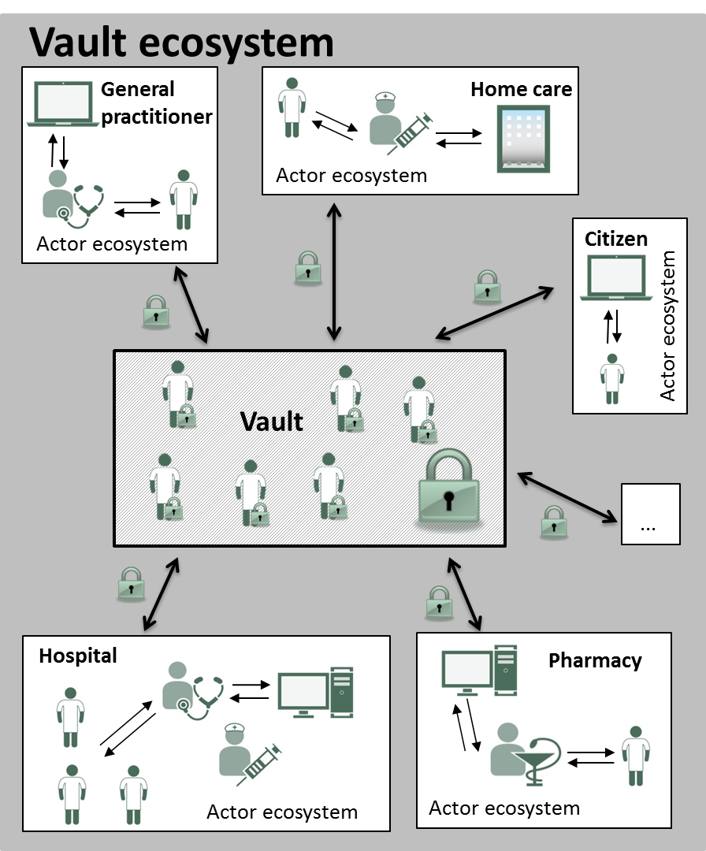
Data sharing
Each actor keeps their own file up to date
However, they can decide to share parts of the file with other actors
Examples:
medication schedule
SUMEHR
parameters
journal
…

Slide 40
Vault
Access for health care providers
having a "health care relationship"
depending on their role
No access for
IT administrators, hoster,..
eHealth platform
authorities
without the active cooperation of the owner of the 2nd key
Governance
Archiving
Management
Vault core
Vault data
Authentication
...
Authorisation
Treshold decryptie
Trusted
3rd party
2
1.
Vault connector
Data
quality
Encryption
Decryption
Authentication

Slide 41
Informed consent & therapeutic relationship
content of informed consent
for registration in the reference directory (as required by the eHealth law)
for the electronic exchange of health data between health care providers within the framework of patient health care, as long as the following conditions are met:
approval by the Sectoral Committee
therapeutic relationship required
only relevant data
the patient decides, in consultation with the health care provider, which data will be shared
health care providers may be excluded by name
possibility of a posteriori verification of the granted access
consent may be revoked at any given time

Slide 42
Informed consent & therapeutic relationship
registration of informed consent
patient is informed about the system
specific procedure approved by the Board of Directors and the Sectoral Committee
consent can be registered through eHealth consent
either by the concerned person themselves
or by a doctor, a pharmacist, a hospital or a health insurance fund
https://www.ehealth.fgov.be/fr/prestataires-de-soins/services-en-ligne/ehealthconsent
therapeutic relationship
only health care providers who have a therapeutic relationship with the patient (1) can access the information they need to perform their task (2)
(1) proof of therapeutic relationship determines which patient the health care provider has access to
(2) role determines which type of data the health care provider has access to

Slide 43
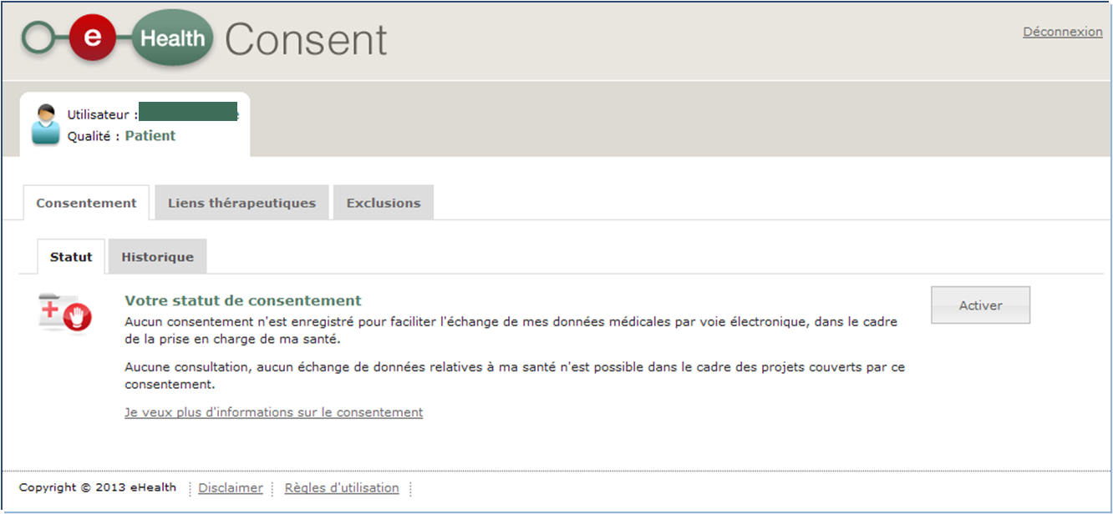
eHealthConsent

Slide 44
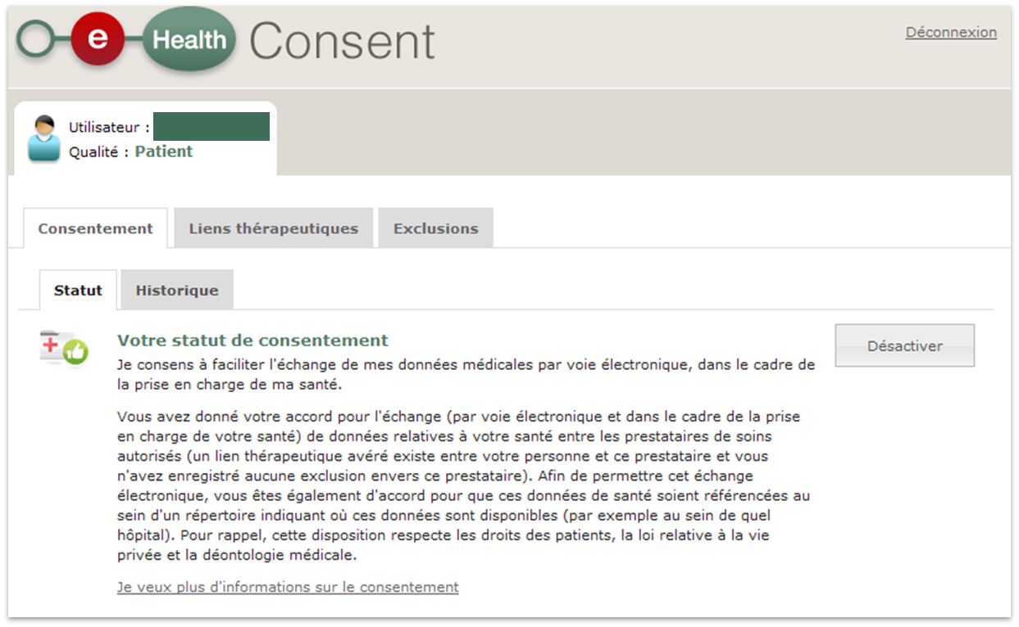
eHealthConsent

Slide 45
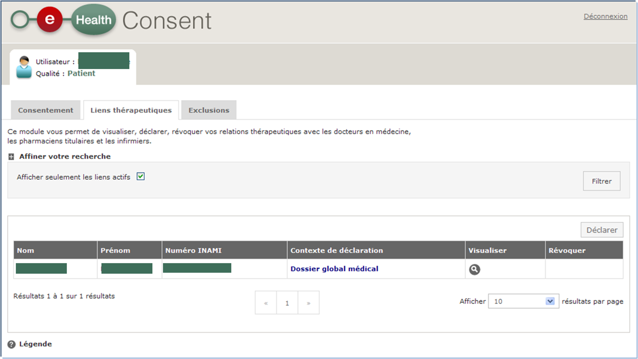
eHealthConsent

Slide 46
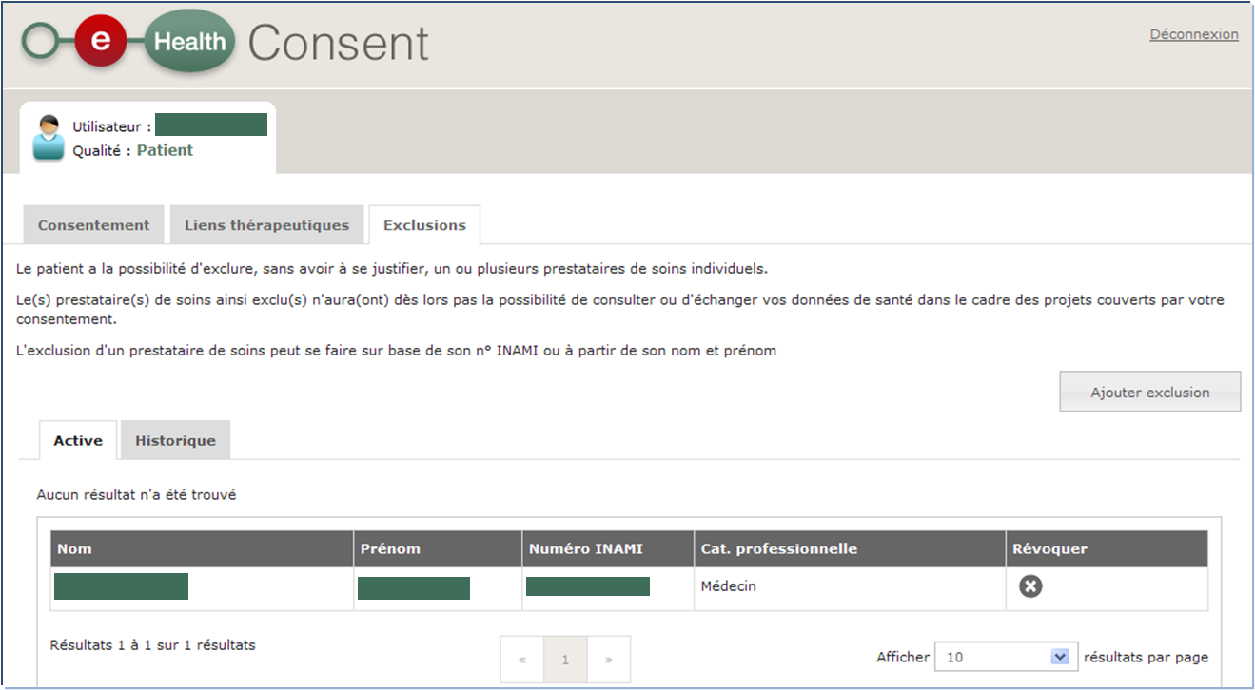
eHealthConsent

Slide 47
Critical success factors
ICT architecture
Governance by stakeholders
Agile delivery
End-to-end process optimisation

Slide 48
Critical success factors
common vision on electronic service delivery, information management and information security amongst all stakeholders
support of and access to policymakers at the highest level
trust of all stakeholders, based on
mutual respect
real mutual agreement
transparency
respect for legal allocation of competences between actors
co-operation between all actors concerned based on distribution of tasks rather than centralization of tasks
focus on more effective and efficient service delivery and on cost control

Slide 49
Critical success factors
reasoning in terms of added value for patients and health care providers rather than in terms of legal competences
quick wins combined with long term vision
lateral thinking when needed
adaptability to an ever changing societal and legal environment
electronic service delivery as a structural reform process
process re-engineering within and across actors
back-office integration for unique information collection, re-use of information and automatic granting of benefits
integrated and personalized front-office service delivery

Slide 50
Critical success factors
multidisciplinary approach
process optimization
legal coordination
ICT coordination
information security and privacy protection
change management
communication
coaching and training

Slide 51
Critical success factors
appropriate balance between efficiency on the one hand and information security and privacy protection on the other
technical and semantic interoperability
legal framework
creation of an institution that stimulates, co-ordinates and assures a sound program and project management
availability of skills and knowledge => creation of an association that hires ICT-specialists at normal market conditions and puts them at the disposal of the actors in the health sector
sufficient financial means for innovation: agreed possibility to re-invest efficiency gains in innovation

Slide 52
Critical success factors
service oriented architecture (SOA)
need for radical cultural change within government, e.g.
from hierarchy to participation and team work
meeting the needs of the customer, not the government
empowering rather than serving
rewarding entrepreneurship within government
ex post evaluation on output, not ex ante control of every input

Slide 53
Nexus effect

Slide 54
Critical success factors
challenge:
mobile devices increasing
multidisciplinary medical practices increasing
find a trusted way to consult data, anytime, anywhere, with any device

Slide 55
Thank you! Questions?
frank.robben@ehealth.fgov.be
@FrRobben
https://www.ehealth.fgov.be
http://www.ksz.fgov.be
http://www.frankrobben.be

